Slide 1
Describing me and others
rot
Follow ups 1-5
Term 1 Week 6
Notes:
Artwork by Steve Clarke. Pronoun pictures from NCELP (www.ncelp.org). All additional pictures selected from Pixabay and are available under a Creative Commons license, no attribution required.
Phonics:
long [i] Familie [329] Linie [926] ihn [92]
short [i] bitte [471] mit [13] Hilfe [481]
Vocabulary (new): Ding [370] Farbe [1079] Ort [341] klar [239]
Revisit 1: es [12] wo [94] England [1762] Deutschland [140] toll [972] und [2]
Jones, R.L & Tschirner, E. (2019). A frequency dictionary of German: Core vocabulary for learners. London: Routledge.
The frequency rankings for words that occur in this PowerPoint which have been previously introduced in these resources are given in the SOW and in the resources that first
introduced and formally re-visited those words.
For any other words that occur incidentally in this PowerPoint, frequency rankings will be provided in the notes field wherever possible.

Slide 2
aussprechen
Follow up 1
…
long [i]
Familie
Linie
ihn
Notes:
Timing: 1 minute
Aim: to revisit long [i].
Procedure:
Re-present the SSC and the source word ‘Familie’ (with gesture, if using).
Click to bring on the picture and get pupils to repeat the word ‘Familie’ (with gesture, if using).
Present the cluster words in the same way, bringing on the picture and getting pupils to pronounce the words.
ihn [52] Linie [451]
2

Slide 3
aussprechen
Follow up 1
…
short [i]
bitte
with
🙏
Hilfe!
mit
Notes:
Timing: 1 minute
Aim: to revise the SSC short [i].
Procedure:
Re-present the SSC and the source word ‘bitte’ (with gesture, if using).
Click to bring on the picture and get pupils to repeat the word ‘bitte’ (with gesture, if using).
Present the cluster words in the same way, bringing on the picture and getting pupils to pronounce the words.
Note: a gesture for ‘bitte’ might be to put your hands together as though asking for something.
Hilfe [481] mit [13]

Slide 4
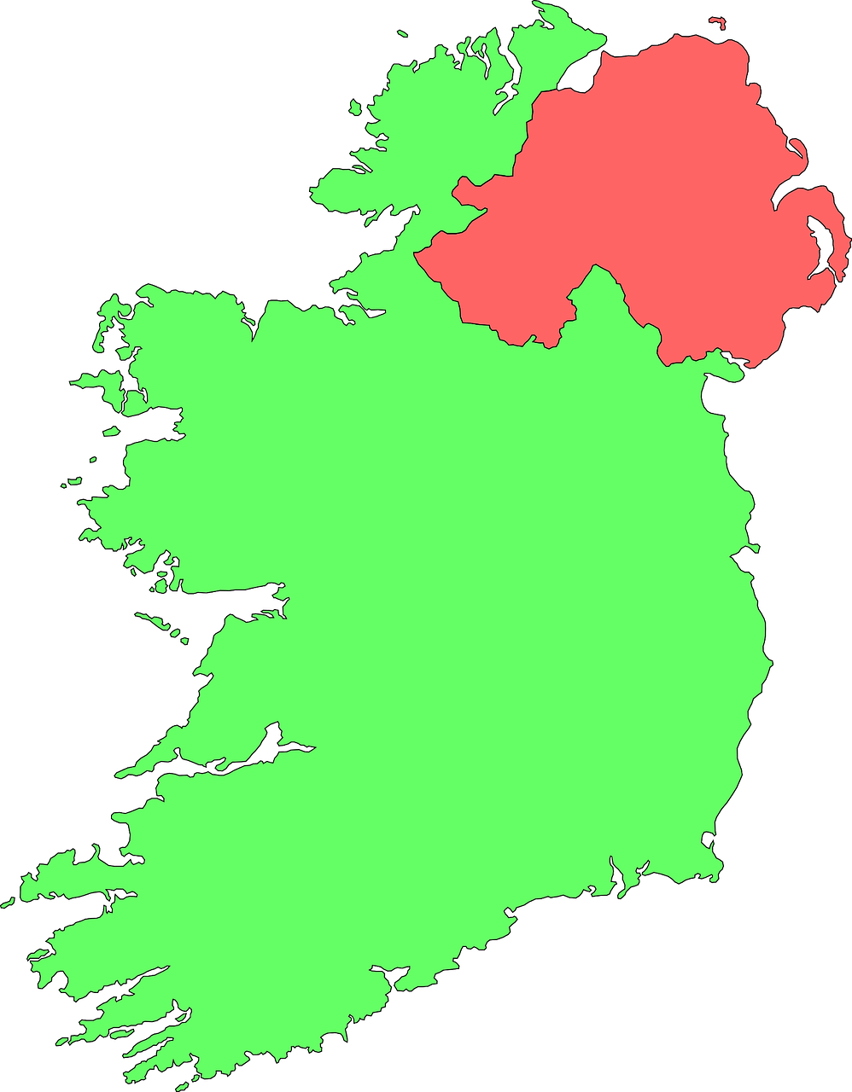
Follow up 1
Hör zu.
Is the [i] in the German word the same sound as in English?
hören
1
2
3
Film
Tourist
ideal
4
5
6
Info
Tipp
Irisch
7
8
9
Alternative
Minister
Idee
Notes:
Timing: 5 minutes
Aim: to practise aural distinction between English and German SSC [i], by listening to cognates.
Procedure:
Do number 1 with pupils to model the task.
Click to hear the German word.
Ask them to tick if they think it is the same [i] sound as in the English word.
Click to reveal the written word and the answer tick or cross.
Repeat steps 2-4 with the remaining eight words.
Transcript: Film
Tourist
ideal
Info
Tipp
Irisch
Alternative
Minister
Idee
Frequency of unknown words and cognates:
April [1004] Alternative [1688] Film [505] ideal [1234] Info(rmation) [465] Irisch [>5009] Minister [1720] Tipp [3088] Tourist [1318]
Jones, R.L & Tschirner, E. (2019). A frequency dictionary of German: Core vocabulary for learners. London: Routledge.

Slide 5
Follow up 2
Ist das ein Ort, eine Person oder ein Ding?
Was ist das? Schreib auf Englisch.
hören
auf Englisch – in English
1
Germany
2
pencil
3
board
4
Johanna
5
Berlin
6
colour
Notes:
Timing: 5 minutes
Aim: to practise aural comprehension of a range of the new language learnt so far in the course.
Procedure: 1. Read the teacher instruction for the activity in German. Elicit the meaning from pupils.
2. Click to listen to the first word.
3. Pupils write down the meaning in English in the correct column.
4. Click to reveal the English meanings in the correct category.
5. Complete items 2-6 and click to correct.
6. Extension: teachers can elicit the German from the English answers on the slide, including the articles (the/a) for the nouns. It does not matter if pupils can only offer some of the words from memory in German. They should be encouraged to say what they do know. Teachers can re-play the audio for an additional listen and check step.
Transcript: Deutschland Bleistift Tafel Johanna Berlin die Farbe

Slide 6
Follow up 3
Yes/no questions
Remember! In German, change a statement into a question by swapping the verb and subject round:
Statement
Das ist eine Farbe.
That is a colour.
Question
Ist das eine Farbe?
Is that a colour?
Notes:
Timing: 2 minutes
Aim: to recap yes / no questions = swapping verb and subject to form questions.
Procedure:
Read the grammar explanation.
Elicit English translation for the German examples provided.

Slide 7
Follow up 3
Person, place, colour or thing?
…
Person B: Write 5 words in German from the table below. Person A: Ask yes/no questions in German to work out the words.
sprechen
Ist es ein Ort?
Nein!
Ist es eine Person?
Ja!
Person A
Person B
Ist es Maike?
Nein!
Then swap roles and play again!
Ist es Steffen?
Ja!
England | die Flasche | blau | Moritz | Berlin
das Fenster | Olsdorf | Johanna | der Bleistift | Maike
das Heft | London | die Tafel | Deutschland | der Tisch
gelb | Frau Bahlsen | rot | Steffen | Bonn
Notes:
Timing: 5 minutes
Aim: to practise asking and answering yes/no questions to identify previously taught vocabulary and the new vocabulary from this week. Procedure:
Pupil B chooses 5 words and writes them down secretly.
Pupil A asks yes/no questions using the categories Person, Ort, Farbe and Ding and then asks ‘Ist es…’ until they work out the 5 words on B’s list.
Then pupils swap roles and play again.

Slide 8
Follow up 4

A Schreib ‘a’ auf Deutsch.
B Ist es A, B oder C?
ein
a
b
c
schreiben
_________ Fenster
_________ Tafel
_________ Ding
_________ Tisch
_________ Person
_________ Flasche
_________ Ort
_________ Bleistift
_________ Heft
_________ Farbe
d
eine
a
ein
i
lesen
ein
h
d
e
f
g
eine
b
eine
g
ein
f
h
ein
c
i
j
ein
e
eine
j
Notes:
Timing: 5 minutes
Aim: to practise written production of the correct indefinite articles and their association with some previously taught nouns.
Procedure:
1. Read the instruction in German.
2. Pupils to identify the gender of the nouns and write the correct indefinite article.
3. Pupils match the pictures to the words to reinforce their understanding.
Transcript:
ein Fenster
eine Tafel
ein Ding
ein Tisch
eine Person
eine Flasche
ein Ort
ein Bleistift
ein Heft
eine Farbe

Slide 9
Follow up 5:

Schreib auf Englisch.
Can you get at least 15 points?
Wörter
 | sein | ja | sie ist
 | er ist | nein | ich bin
 | es | toll | England
 | wo | Deutschland | und
 | der Ort | oder | die Person
 | die Farbe | oder | das Ding
to be, being
yes
she is
Vokabeln
x3
he is
no
I am
it
great
England
x2
where
Germany
and
place
or
person
x1
colour
or
thing
Notes:
Timing: 5 minutes
Aim: to practise written comprehension of vocabulary from this and revisited weeks.
Procedure: 1. Give pupils a blank grid. They fill in the English meanings of any of the words they know, trying to reach 15 points in total. 2. Remind pupils that adjectives can refer to male or female persons and they should note this in their translations. E.g. pleased (f), short (m).
Note: The most recently learnt and practised words are pink, words from the previous week are green and those from week 1 are blue, thus more points are awarded for them, to recognise that memories fade and more effort (heavy lifting!) is needed to retrieve them.

Slide 10
Follow up 5:

Schreib auf Deutsch.
Can you get at least 15 points?
Wörter
 | she is | no | yes
 | to be, being | I am | he is
 | England | where | it
 | and | great | Germany
 | place | clear | or
 | thing | person | colour
sie ist
nein
ja
Vokabeln
x3
sein
ich bin
er ist
England
wo
es
x2
und
toll
Deutschland
der Ort
klar
oder
x1
das Ding
die Person
die Farbe
Notes:
Timing: 5 minutes
Aim: to practise written comprehension of vocabulary from this and revisited weeks.
Procedure: 1. Give pupils a blank grid. They fill in the English meanings of any of the words they know, trying to reach 15 points in total. 2. Remind pupils that adjectives can refer to male or female persons and they should note this in their translations. E.g. pleased (f), short (m).
Note: The most recently learnt and practised words are pink, words from the previous week are green and those from week 1 are blue, thus more points are awarded for them, to recognise that memories fade and more effort (heavy lifting!) is needed to retrieve them.

Slide 11
Follow up 5:

Schreib auf Englisch.
Can you get at least 15 points?
Wörter
 | sein | ja | sie ist
 | er ist | nein | ich bin
 | es | toll | England
 | wo | Deutschland | und
 | der Ort | oder | die Person
 | die Farbe | oder | das Ding
Vokabeln
x3
x2
x1
Notes:
Timing: 5 minutes
Aim: to practise written comprehension of vocabulary from this and revisited weeks.
Procedure: 1. Give pupils a blank grid. They fill in the English meanings of any of the words they know, trying to reach 15 points in total. 2. Remind pupils that adjectives can refer to male or female persons and they should note this in their translations. E.g. pleased (f), short (m).
Note: The most recently learnt and practised words are pink, words from the previous week are green and those from week 1 are blue, thus more points are awarded for them, to recognise that memories fade and more effort (heavy lifting!) is needed to retrieve them.

Slide 12
Follow up 5:

Schreib auf Deutsch.
Can you get at least 15 points?
Wörter
 | she is | no | yes
 | to be, being | I am | he is
 | England | where | it
 | and | great | Germany
 | place | clear | or
 | thing | person | colour
Vokabeln
x3
x2
x1
Notes:
Timing: 5 minutes
Aim: to practise written comprehension of vocabulary from this and revisited weeks.
Procedure: 1. Give pupils a blank grid. They fill in the English meanings of any of the words they know, trying to reach 15 points in total. 2. Remind pupils that adjectives can refer to male or female persons and they should note this in their translations. E.g. pleased (f), short (m).
Note: The most recently learnt and practised words are pink, words from the previous week are green and those from week 1 are blue, thus more points are awarded for them, to recognise that memories fade and more effort (heavy lifting!) is needed to retrieve them.

Slide 13
Tschüss!
rot
Notes:
13

