Slide 1
Describing me and others
rot
Categorising things
Words for ‘a’: ein, eine, ein
SSC long and short [i]
Term 1 Week 6
Notes:
Artwork by Steve Clarke. Pronoun pictures from NCELP (www.ncelp.org). All additional pictures selected from Pixabay and are available under a Creative Commons license, no
attribution required.
Phonics:
long [i] Familie [329] Linie [926] ihn [92]
short [i] bitte [471] mit [13] Hilfe [481]
Vocabulary (new): Ding [370] Farbe [1079] Ort [341] Person [357] klar [239] oder [35]
Revisit 1: es [12] wo [94] England [1762] Deutschland [140] toll [972] und [2]
Jones, R.L & Tschirner, E. (2019). A frequency dictionary of German: Core vocabulary for learners. London: Routledge.
The frequency rankings for words that occur in this PowerPoint which have been previously introduced in these resources are given in the SOW and in the resources that first introduced and formally re-visited those words.
For any other words that occur incidentally in this PowerPoint, frequency rankings will be provided in the notes field wherever possible.
Note that the first three lessons of the year teach language that can be continuously recycled as lesson routine every lesson in Y3/4.
The idea would be that the class teacher (whether or not s/he teaches the class German can re-use the language as part of the daily routine with the class.
1

Slide 2
aussprechen
long [i]
…
The 2nd ‘i’ is short.
Here’s the ‘e’ that sounds like the ‘a’ in ‘ago’, again!
Familie
Notes:
Timing: 1 minute
Aim: to introduce the SSC long [i].
Procedure:
Introduce the SSC and present the source word ‘Familie’ (with gesture, if using).
Click to bring on the picture and get pupils to repeat the word ‘Familie’ (with gesture, if using).
Note:
A gesture for ‘Familie’ might be to mime a roof overhead followed by a ‘heart’ shape with both hands.
Familie [49]
2

Slide 3
aussprechen
long [i]
…
Familie
Linie
ihn
Notes:
Timing: 1 minute
Aim: to introduce the SSC long [i].
Procedure:
Re-present the SSC and the source word ‘Familie’ (with gesture, if using).
Click to bring on the picture and get pupils to repeat the word ‘Familie’ (with gesture, if using).
Present the cluster words in the same way, bringing on the picture and getting pupils to pronounce the words.
ihn [52] Linie [451]
3

Slide 4
aussprechen
short [i]
…
🙏
bitte
Notes:
Timing: 1 minute
Aim: to consolidate the SSC short [i].
Procedure:
Procedure:
Introduce the SSC and present the source word ‘bitte’ (with gesture, if using).
Click to bring on the picture and get pupils to repeat the word ‘bitte’ (with gesture, if using).
Note: a gesture for ‘bitte’ might be to put your hands together as though asking for something.
bitte [471]
Image attribution: please emoji from https://emojipedia.org/folded-hands/

Slide 5
aussprechen
short [i]
…
bitte
with
🙏
Hilfe!
mit
Notes:
Timing: 1 minute
Aim: to consolidate the SSC short [i].
Procedure:
Re-present the SSC and the source word ‘bitte’ (with gesture, if using).
Click to bring on the picture and get pupils to repeat the word ‘bitte’ (with gesture, if using).
Present the cluster words in the same way, bringing on the picture and getting pupils to pronounce the words.
Note: a gesture for ‘bitte’ might be to put your hands together as though asking for something.
Hilfe [481] mit [13]

Slide 6
hören
long and short [i]
Hör zu.
Some German words look very similar to English words. They are called cognates.
However, they may sound different. Listen. Is the [i] long or short?
hören
 | long [i] | short [i] | word
1 |  |  | Finger
2 |  |  | Instrument
3 |  |  | privat
4 |  |  | Maschine
5 |  |  | Ticket
6 |  |  | Kilo
7 |  |  | britisch
8 |  |  | Musik
Can you work out the meaning?
Notes:
Timing: 5 minutes
Aim: to consolidate the SSC long [i] and short [i] by listening to cognates and identifying long and short [i] sounds.
Procedure:
1. Click audio button 1 to play the recording for item 1. Pupils need to decide is it long [i] or short [i] and write list of S for short and L for long.
2. Elicit the answer.
3. Click to bring up the answer tick for item 1.
4. Elicit the whole word; if necessary click the audio button again to play recording again.
5. Click to bring up the written version of the German word.
6. Ensure pupils are clear what it means.
7. Ask if the [i] is pronounced the same way in the English word ‘finger’ (answer: yes). Pupils may volunteer that the ‘g’ is pronounced differently.
6. Continue for items 2-8.
Note: some of these cognates have [i] pronounced in the same way in both languages, others have a different pronunciation. Focus pupils’ attention on this during feedback.
Transcript: Finger Instrument
privat Maschine Ticket Kilo
britisch Musik Word frequency (1 is the most frequent word in German): britisch [1419] Finger [1019] Instrument [1572] Kilo(gramm) [1280] Maschine [] Musik [509] privat [746] Ticket [4769] Source: Jones, R.L. & Tschirner, E. (2019). A frequency dictionary of German: core vocabulary for learners. Routledge

Slide 7
Vokabeln
Vokabeln lernen
Wörter
das Ding
die Farbe
der Ort
die Person
klar
oder
Notes:
Timing: 5 minutes
Aim: to present and practise written comprehension and read aloud of the new vocabulary for this week.
Procedure: 1. Click for a German word. Elicit pronunciation from pupils.
2. Click for the English meaning and picture prompt. Elicit the German word again.
3. Present all six words like this, in order.
4. Click for one English meaning to disappear. Elicit the English meaning from pupils. Continue with the remaining items.
5. Click for the German word to disappear. Elicit the German from pupils. Continue with the remaining items.
7

Slide 8
lesen
Klar!
Read the text.
Ist das klar, Moritz?
Ja!
Ist das klar, Hamza?
Nein!
Notes:
Timing: 2 minutes
Aim: to introduce some German that can be used in the classroom.
Procedure:
Pupils read the short dialogue.
Ensure they understand what Frau Tahler is asking. Pupils should already know ‘ist das…’ and they have just learned ‘klar’.
In future, the teacher can check pupils understand a task by asking ‘ist das klar?’. Pupils should be able to respond with ‘ja’ or ‘nein’.
8

Slide 9
ein, eine, ein = ‘a’
/a
As you know, German has three words for the:
Keep the idea of three genders, even though two of them share the same word for ‘ein’.
masculine
feminine
neuter
der
Tisch
die
Flasche
das
Fenster
It also has different words for a:
masculine
feminine
neuter
ein
Tisch
eine
Flasche
ein
Fenster
‘ein’ and ‘eine’ can also mean ‘one’ so ‘ein Tisch’ means ‘a table’ or ‘one table’
Notes:
Timing: 3 minutes Aim: To introduce the three Row 1 (nominative) forms of the indefinite article. Procedure: 1. Click on the mouse to animate the explanation.
2. Check students’ understanding at each stage; elicit English translations for the German examples provided.
9

Slide 10
sprechen
Was ist das?
…
das Ding
sprechen
die Person
das Heft
der Bleistift
der Ort
die Farbe
das Fenster
die Tafel
die Flasche
der Tisch
ein
eine
ein
Notes:
Timing: 6 minutes (two slides) Aim: To connect the definite and indefinite articles with previously taught nouns.
Procedure: 1. Ask ‘Was ist das?’ 2. Elicit ‘Das ist ein…’ Words are triggered so that students can respond in any order and volunteer those they are most confident with first. 3. Click on the words to make them ‘fly’ into the appropriate gender ‘bin’ at the bottom.
10

Slide 11
sprechen
Was ist das?
…
sprechen
das Ding
die Person
der Ort
die Farbe
ein
eine
ein
Notes:
Timing: 3 minutes Aim: To practise use of the indefinite article with new nouns from this week. Note that the definite articles are still included at this stage. Procedure: 1. Ask ‘Was ist das?’ 2. Elicit ‘Das ist ein…’ Words are triggered so that students can respond in any order and volunteer those they are most confident with first. 3. Click on the words to make them ‘fly’ into the appropriate gender ‘bin’ at the bottom.
Note: the words are supported with pictures as they have only just been introduced. The final slide develops the practice further by only using the images.
11

Slide 12
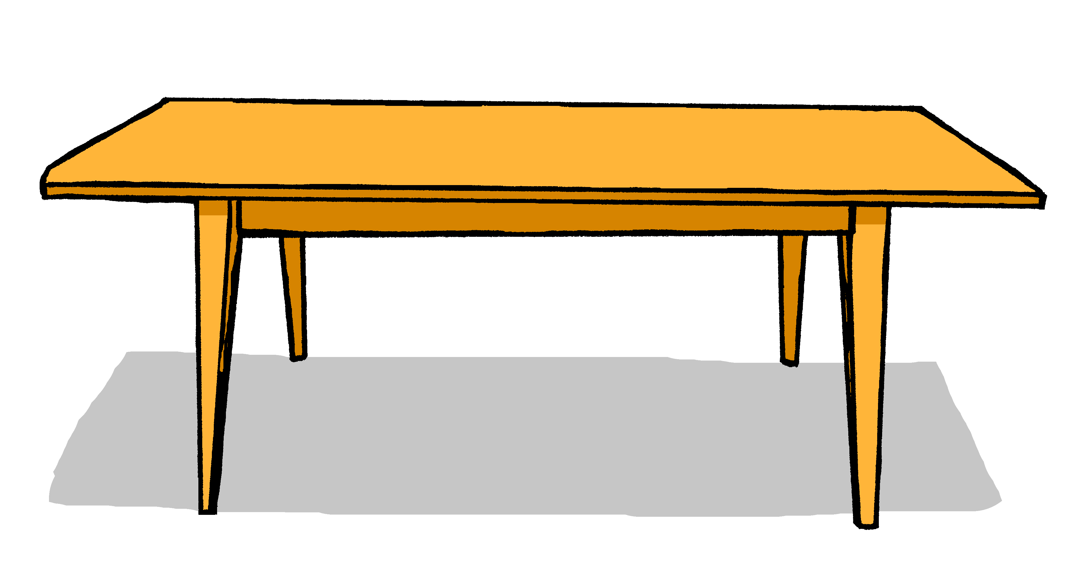
lesen
Was ist total falsch?
1
ein
der
eine
4
der
die
eine
2
ein
eine
die
5
ein
eine
das
3
das
der
ein
6
der
ein
die
Notes:
Timing: 5 minutes Aim: To practise matching nouns with possible articles.
Note: This activity requires students to identify which one of the three options is NOT possible, or ‘total falsch’.
It allows them to see clearly that, for one noun, two determiners are possible from the three provided, but one is not because, whether it is definite or indefinite, it denotes a different gender.
Procedure: 1. Bring up the pictures one at a time, with their set of three articles.
2. Students consider which article is not a possible option for the noun depicted.
3. Click on the mouse to reveal the answer.
Note: this is very early days in pupils’ learning so each item set is introduced one by one to avoid overload and allow pupils to re-focus each time.
12

Slide 13
sprechen
Was ist das?
…
sprechen
ein
eine
ein
Notes:
Timing: 3 minutes Aim: To practise use of the indefinite article with new nouns from this week, without gender or word support. Procedure: 1. Ask ‘Was ist das?’ 2. Elicit ‘Das ist ein…’ Words are triggered so that students can respond in any order and volunteer those they are most confident with first. 3. Click on the words to make them ‘fly’ into the appropriate gender ‘bin’ at the bottom.
13

Slide 14
Tschüss!
rot
Notes:
14

