Slide 1
Describing me and others
rot
Follow ups 1-5
Term 1 Week 7
Notes:
Artwork by Steve Clarke. Pronoun pictures from NCELP (www.ncelp.org). All additional pictures selected from Pixabay and are available under a Creative Commons license, no attribution required.
Phonics:
[ie] Liebe [844] sie [7] Brief [838]
Vocabulary (new): Beispiel [94] Form [307] Mensch [90] groß [67] klein [110] Auf Wiedersehen [n/a] tschüss [3766]
Revisit 1: Fenster [674] Flasche [1602] Heft [3862] Bleistift [>5009] Tafel [3855] Tisch [529] der, die, das [1]
Jones, R.L & Tschirner, E. (2019). A frequency dictionary of German: Core vocabulary for learners. London: Routledge.
The frequency rankings for words that occur in this PowerPoint which have been previously introduced in these resources are given in the SOW and in the resources that first introduced and formally re-visited those words.
For any other words that occur incidentally in this PowerPoint, frequency rankings will be provided in the notes field wherever possible.
Note that the first three lessons of the year teach language that can be continuously recycled as lesson routine every lesson in Y3/4.
The idea would be that the class teacher (whether or not s/he teaches the class German can re-use the language as part of the daily routine with the class.

Slide 2
aussprechen
Follow up 1
…
[ie]
Liebe
Notes:
Timing: 1 minute
Aim: to revisit the SSC [ie].
Procedure:
Introduce the SSC and present the source word ‘Liebe’ (with gesture, if using).
Click to bring on the picture and get pupils to repeat the word ‘Liebe’ (with gesture, if using).
Note:
A gesture for ‘Liebe’ might be to make a ‘heart’ shape with both hands approximately where your heart is in your body.
Liebe [844]
2

Slide 3
aussprechen
Follow up 1
…
[ie]
sie
Liebe
Brief
Notes:
Timing: 1 minute
Aim: to revisit SSC [ie].
Aim: to introduce the SSC [ie].
Procedure:
Re-present the SSC and present the source word ‘Liebe’ (with gesture, if using).
Click to bring on the picture and get pupils to repeat the word ‘Liebe’ (with gesture, if using).
Present the cluster words in the same way, bringing on the picture and getting pupils to pronounce the words.
sie [7] Brief [838]
3

Slide 4
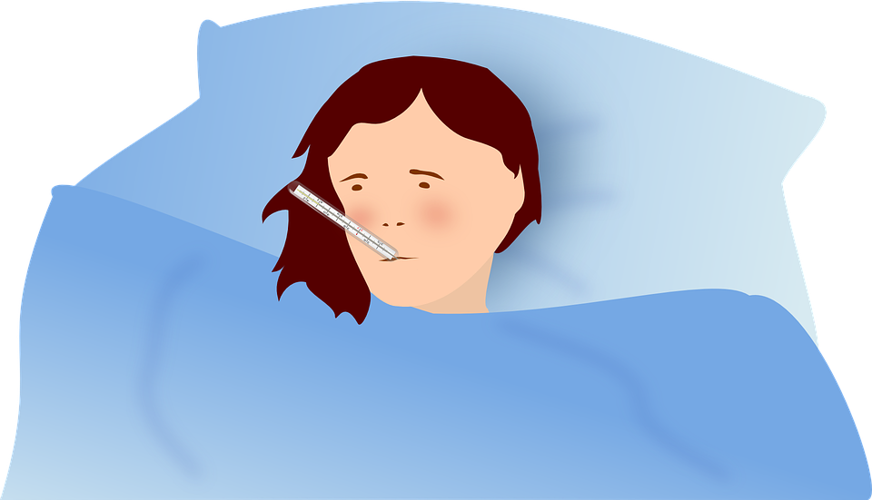
Follow up 1
Say all the words.
…
aussprechen
Lied [song]
hier [here]
fliegen [to fly]
Fieber [fever]
60
wiederholen [to repeat]
nie [never]
Brief [letter]
Biene [bee]
Dienstag [Tuesday]
Papier [paper]
sie [she]
tief [deep]
Sekunden
dies [this]
sieben [seven]
Liebe [love]
Auf Wiedersehen [goodbye]
German ‘w’ is pronounced like English ‘v’!
0
LOS!
Notes:
Timing: 4 minutes (1 minute for practice + 1 minute for saying them out loud x 2 rounds) Aim: to practise SSC knowledge with unfamiliar words. The time limit helps automatization. Procedure: 1. Students take 60 seconds to practise saying the words out loud to themselves. Click LOS! to start the timer.
2. Then teacher clicks and each word flashes a couple of times before disappearing. Students have to pronounce the word (in chorus).
Frequency of unknown words and cognates:
Biene [>5009] Brief [838] Dienstag [1356] dies [24] Fieber [4774] fliegen [824] Liebe [844] Lied [1733] nie [186] Paper [1163] sieben [611] tief [442] wiederholen [988] Auf Wiedersehen [N/A]
Jones, R.L & Tschirner, E. (2019). A frequency dictionary of German: Core vocabulary for learners. London: Routledge.

Slide 5
Follow up 2
auf Englisch – in English
Hör zu. Was ist das auf Englisch?
Robbie has learnt a lot of German this week. Frau Bahlsen decides to see just how much. Join in and see how much you know.
hören
 | A | B | C
 | Hello! | Bye! | Hello (formal)
 | You are here. | I am here. | You are there.
 | Is she there? | She is there. | Is he there?
 | That is great! | Is that great? | Is that right?
 | Is that clear? | Is that wrong? | That is clear!
 | Goodbye! | An example, please! | Bye!
1
2
3
4
5
6
Notes:
Timing: 5 minutes
Aim: to practise aural comprehension of a range of the new language learnt so far in the course. Procedure: 1. Read the teacher instruction for the activity.
2. Click to listen to the first item
3. Pupils write down the correct letter (A. B or C) of the English translation.
4. Click to reveal the correct column A, B or C.
5. Complete items 2-6 and click to correct.
Transcript: Tschüss!
Du bist hier.
Ist er da? Ist das toll?
Das ist klar!
Auf Wiedersehen!

Slide 6
Follow up 3
Robbie can read German and English now, too. Can you?
lesen
Ist es der, die oder das?
Ist das richtig oder falsch?
Guten Tag, Klasse 3!
Was ist das?
Schreib auf Deutsch.
Ist das Beispiel richtig?
Ist das klar?
Auf Wiedersehen!
Is it the (m), the (f) or the(n)?
Is the example right?
Write in German.
Is that right or wrong?
What is that?
Hello, class 3!
Is that clear?
Goodbye!
Notes:
Timing: 5 minutes
Aim: to practise translation of written phrases of classroom instructions.
Procedure:
1. Click to bring up the first item.
2. Pupils to translate.
3. Click to bring up English translation (by Robbie).
4. Continue for items 2-8.

Slide 7
Follow up 4
Partnerarbeit*
*Partnerarbeit – pair work
…
Work in tandem with a partner. A and B have different information (half German, half English).
sprechen
That’s great
Das ist toll!
Tschüss!
Bye!
Tschüss! _____________
_________ That is great!
Bye
Das ist toll!
Das ist toll! __________
______________ Bye!
That is great
Tschüss!
Notes:
Timing: 5 minutes
Aim: to complete an oral jigsaw translation at short sentence level.
Procedure:
This slide models the task.
Click through the animations to show how the task works.
Pupils sit back to back and use the handout provided.
Each student reads what they have in German, the listening student confirms the English translation. Both students fill in the missing language from their sheets.
See next slide for a completed version with all the answers.

Slide 8
Follow up 4 Handout
Person A
Person B
Hallo!
Hilfe!
_____________________ Hello! | _____________________Help!
_____________________ I am here. | _____________________ Is that clear?
_____________________ What is that? | _____________________ Is she here?
_____________________ Hello! [formal] | _____________________ An example, please!
_____________________Are you here? | _____________________ Is he there?
Bist du hier? _____________________ | Ist sie hier? _____________________
Ist das klar? _____________________ | Hilfe! _____________________
Ein Beispiel, bitte! _____________________ | Hallo! _____________________
Ich bin hier. _____________________ | Was ist das? _____________________
Ist er da? _____________________ | Guten Tag! _____________________
Are you here?
Is she here?
Ich bin hier.
Ist das klar?
Is that clear?
Help!
Was ist das?
Ist sie hier?
An example, please!
Hello!
Guten Tag!
Ein Beispiel, bitte!
I am here.
What is that?
Bist du hier?
Ist er da?
Is he there?
Hello! [formal]
Notes:
DO NOT DISPLAY DURING THE TASK
ANSWERS [1]
Procedure:
Click through the animations to reveal the answers.

Slide 9
Follow up 4 Handout
Person A
Person B
Ja, ich bin hier. _____________________ | Ist er hier? _____________________
Tschüss! _____________________ | Ist das ein oder eine? _____________
Ist das die Tafel? ____________________ | Wo bist du? _____________________
Das ist ein Fenster. _____________________ | Ist das falsch? _____________________
Ja, er ist da. _____________________ | Auf Wiedersehen! ________________
Auf Wiedersehen!
Ist er hier?
_____________________ Goodbye! | _____________________Is he here?
_____________________Where are you? | _____________________ Is that a(m) or a(f)?
_____________________ Is that the board? | _____________________ That is a window.
_____________________ Yes, I am here. | _____________________ Bye!
_____________________Is that wrong? | _____________________ Yes, he is there.
Yes, I am here.
Is he here?
Wo bist du?
Ist das ‘ein’ oder ‘eine?
Bye!
Is that a(m) or a(f)?
Ist das die Tafel?
Das ist ein Fenster.
Is that the board?
Where are you?
Ja, ich bin hier.
Tschüss!
That is a window.
Is that wrong?
Ist das falsch?
Ja, er ist da.
Yes, he is there.
Goodbye!
Notes:
DO NOT DISPLAY DURING THE TASK
ANSWERS [2]
Procedure:
Click through the animations to reveal the answers.

Slide 10
Follow up 5:

Schreib auf Englisch.
Can you get at least 15 points?
Wörter
 | Deutschland | wo | es ist
 | du bist | toll | und
 | die Tafel | das Fenster | der Tisch
 | das Heft | die Flasche | der Bleistift
 | das Beispiel | der Mensch | die Form
 | aber | groß | klein
Germany
where
it is
Vokabeln
x3
you are
great
and
(the) board
(the) window
(the) table
x2
(the) exercise book
(the) bottle
(the) pencil
(the) example
(the) human being
(the) shape
x1
but
big
small
Notes:
Timing: 5 minutes
Aim: to practise written comprehension of vocabulary from this and revisited weeks.
Procedure: 1. Give pupils a blank grid. They fill in the English meanings of any of the words they know, trying to reach 15 points in total. 2. Remind pupils that adjectives can refer to male or female persons and they should note this in their translations. E.g. pleased (f), short (m).
Note: The most recently learnt and practised words are pink, words from the previous week are green and those from week 1 are blue, thus more points are awarded for them, to recognise that memories fade and more effort (heavy lifting!) is needed to retrieve them.

Slide 11
Follow up 5:

Schreib auf Deutsch.
Can you get at least 15 points?
Wörter
 | and | it is | you are
 | where | Germany | great
 | (the) bottle | (the) table | (the) window
 | (the) pencil | (the) board | (the) exercise book
 | big | small | but
 | (the) example | (the) shape | (the) human being
und
es ist
du bist
Vokabeln
x3
wo
Deutschland
toll
die Flasche
der Tisch
das Fenster
x2
der Bleistift
die Tafel
das Heft
groß
klein
aber
x1
das Beispiel
die Form
der Mensch
Notes:
Timing: 5 minutes
Aim: to practise written comprehension of vocabulary from this and revisited weeks.
Procedure: 1. Give pupils a blank grid. They fill in the English meanings of any of the words they know, trying to reach 15 points in total. 2. Remind pupils that adjectives can refer to male or female persons and they should note this in their translations. E.g. pleased (f), short (m).
Note: The most recently learnt and practised words are pink, words from the previous week are green and those from week 1 are blue, thus more points are awarded for them, to recognise that memories fade and more effort (heavy lifting!) is needed to retrieve them.

Slide 12
Tschüss!
rot
Notes:
12

Slide 13
Follow up 4 Handout
Person A
__________________________ Hello! | __________________________ Help!
__________________________ I am here. | __________________________ Is that clear?
__________________________ What is that? | __________________________ Is she here?
__________________________ Hello! [formal] | __________________________ An example, please!
__________________________Are you here? | __________________________ Is he there?
Ja, ich bin hier. __________________________ | Ist er hier? __________________________
Tschüss! __________________________ | Ist das ‘ein’ oder ‘eine’? __________________________
Ist das die Tafel? __________________________ | Wo bist du? __________________________
Das ist ein Fenster. __________________________ | Ist das falsch? __________________________
Ja, er ist da. __________________________ | Auf Wiedersehen! _________________________
Person B
Bist du hier? __________________________ | Ist sie hier? __________________________
Ist das klar? __________________________ | Hilfe! __________________________
Ein Beispiel, bitte! __________________________ | Hallo! _________________________
Ich bin hier. __________________________ | Was ist das? __________________________
Ist er da? __________________________ | Guten Tag! __________________________
__________________________ Goodbye! | __________________________ Is he here?
__________________________ Where are you? | __________________________ Is that ‘a (m)’ or ‘a (f)’?
__________________________ Is that the board? | __________________________That is a window.
__________________________ Yes, I am here. | __________________________ Bye!
__________________________ Is that wrong? | __________________________ Yes, he is there.
Notes:
HANDOUT Cut in half lengthways.

Slide 14
Follow up 5:

Schreib auf Englisch.
Can you get at least 15 points?
Wörter
 | Deutschland | wo | es ist
 | du bist | toll | und
 | die Tafel | das Fenster | der Tisch
 | das Heft | die Flasche | der Bleistift
 | das Beispiel | der Mensch | die Form
 | aber | groß | klein
Vokabeln
x3
x2
x1
Notes:
Template

Slide 15
Follow up 5:

Schreib auf Deutsch.
Can you get at least 15 points?
Wörter
 | and | it is | you are
 | where | Germany | great
 | (the) bottle | (the) table | (the) window
 | (the) pencil | (the) board | (the) exercise book
 | big | small | but
 | (the) example | (the) shape | (the) human being
Vokabeln
x3
x2
x1
Notes:
Template

