Slide 1
Describing me and others
rot
Identifying things
Words for ‘a’: ein, eine, ein
SSC [ie]
Term 1 Week 7
Notes:
Artwork by Steve Clarke. Pronoun pictures from NCELP (www.ncelp.org). All additional pictures selected from Pixabay and are available under a Creative Commons license, no
attribution required.
Phonics:
[ie] Liebe [844] sie [7] Brief [838]
Vocabulary (new): Beispiel [94] Form [307] Mensch [90] groß [67] klein [110] Auf Wiedersehen [n/a] tschüss [3766]
Revisit 1: Fenster [674] Flasche [1602] Heft [3862] Bleistift [>5009] Tafel [3855] Tisch [529] der, die, das [1]
Jones, R.L & Tschirner, E. (2019). A frequency dictionary of German: Core vocabulary for learners. London: Routledge.
The frequency rankings for words that occur in this PowerPoint which have been previously introduced in these resources are given in the SOW and in the resources that first introduced and formally re-visited those words.
For any other words that occur incidentally in this PowerPoint, frequency rankings will be provided in the notes field wherever possible.
Note that the first three lessons of the year teach language that can be continuously recycled as lesson routine every lesson in Y3/4.
The idea would be that the class teacher (whether or not s/he teaches the class German can re-use the language as part of the daily routine with the class.
1

Slide 2
aussprechen
[ie]
…
Liebe
Notes:
Timing: 1 minute
Aim: to introduce the SSC [ie].
Procedure:
Introduce the SSC and present the source word ‘Liebe’ (with gesture, if using).
Click to bring on the picture and get pupils to repeat the word ‘Liebe’ (with gesture, if using).
Note:
A gesture for ‘Liebe’ might be to make a ‘heart’ shape with both hands approximately where your heart is in your body.
Liebe [844]
Jones, R.L & Tschirner, E. (2019). A frequency dictionary of German: Core vocabulary for learners. London: Routledge.
2

Slide 3
aussprechen
[ie]
…
sie
Liebe
Brief
Notes:
Timing: 1 minute
Aim: to introduce the SSC [ie].
Procedure:
Re-present the SSC and present the source word ‘Liebe’ (with gesture, if using).
Click to bring on the picture and get pupils to repeat the word ‘Liebe’ (with gesture, if using).
Present the cluster words in the same way, bringing on the picture and getting pupils to pronounce the words.
sie [7] Brief [838]
Jones, R.L & Tschirner, E. (2019). A frequency dictionary of German: Core vocabulary for learners. London: Routledge.
3

Slide 4
hören
Hör zu. Ist es [ee] oder [ie]?
Can you work out the meanings ?
Schreib 1-8 und [ee] oder [ie].
hören
1 | G a l e r i e
2 | K n i e
3 | B i o l o g i e
4 | T e e
5 | S e e
6 | F o t o g r a f i e
7 | K a f f e e
8 | D i e b
_ _
_ _
_ _
_ _
_ _
_ _
_ _
_ _
Notes:
Timing: 5 minutes
Aim: to distinguish between the SSCs [ee] and [ie] by listening to cognates (apart from Dieb) and identifying the sounds.
Procedure:
Click for instructions to come up.
Click audio button 1 to play the recording for item 1. Pupils need to decide is it [ee] or [ie] and write down ee or ie.
Elicit the answer.
Click to reveal the spelling of word 1.
Elicit the meaning, based on the image and the words being cognates or near-cognates.
Continue for items 2-8.
Transcript: Galerie
Knie
Biologie
Tee
See Fotografie
Kaffee
Dieb
Word frequency (1 is the most frequent word in German): Biologie [3617] Dieb [>5009] Fotografie [4327] Galerie [4328] Kaffee [1299] Knie [1679] See [1317] Tee [2617] Source: Jones, R.L. & Tschirner, E. (2019). A frequency dictionary of German: core vocabulary for learners. Routledge

Slide 5
Vokabeln
Was ist das auf Englisch?
Wörter
der Tisch
der Mensch
die Flasche
die Tafel
das Beispiel
das Heft
der Bleistift
das Fenster
die Form
table
human being
window
shape
exercise book
pencil
bottle
board
example
Notes:
Timing: 6 minutes (two slides)
Aim: to present and practise written comprehension and read aloud of the new nouns for this week and revisited vocabulary from Week 3.
Procedure: 1. Click for a German word. Elicit pronunciation from pupils.
2. Elicit the English meaning from pupils and click to confirm.
3. Continue with the remaining words.
4. Then move on to the next slide.
Note: the three new nouns for this week are presented at the end. All the previous answers are left in place to reduce cognitive load.
Teachers could encourage pupils to consider strategies for how to remember these meanings. E.g., Form is also an English word and has a similar meaning to ‘shape’. Mensch has the English word ‘men’ in it and men are human beings. Beispiel – starts with the word ‘by’ and it’s always helpful to have an example ‘by’ your side.
5

Slide 6
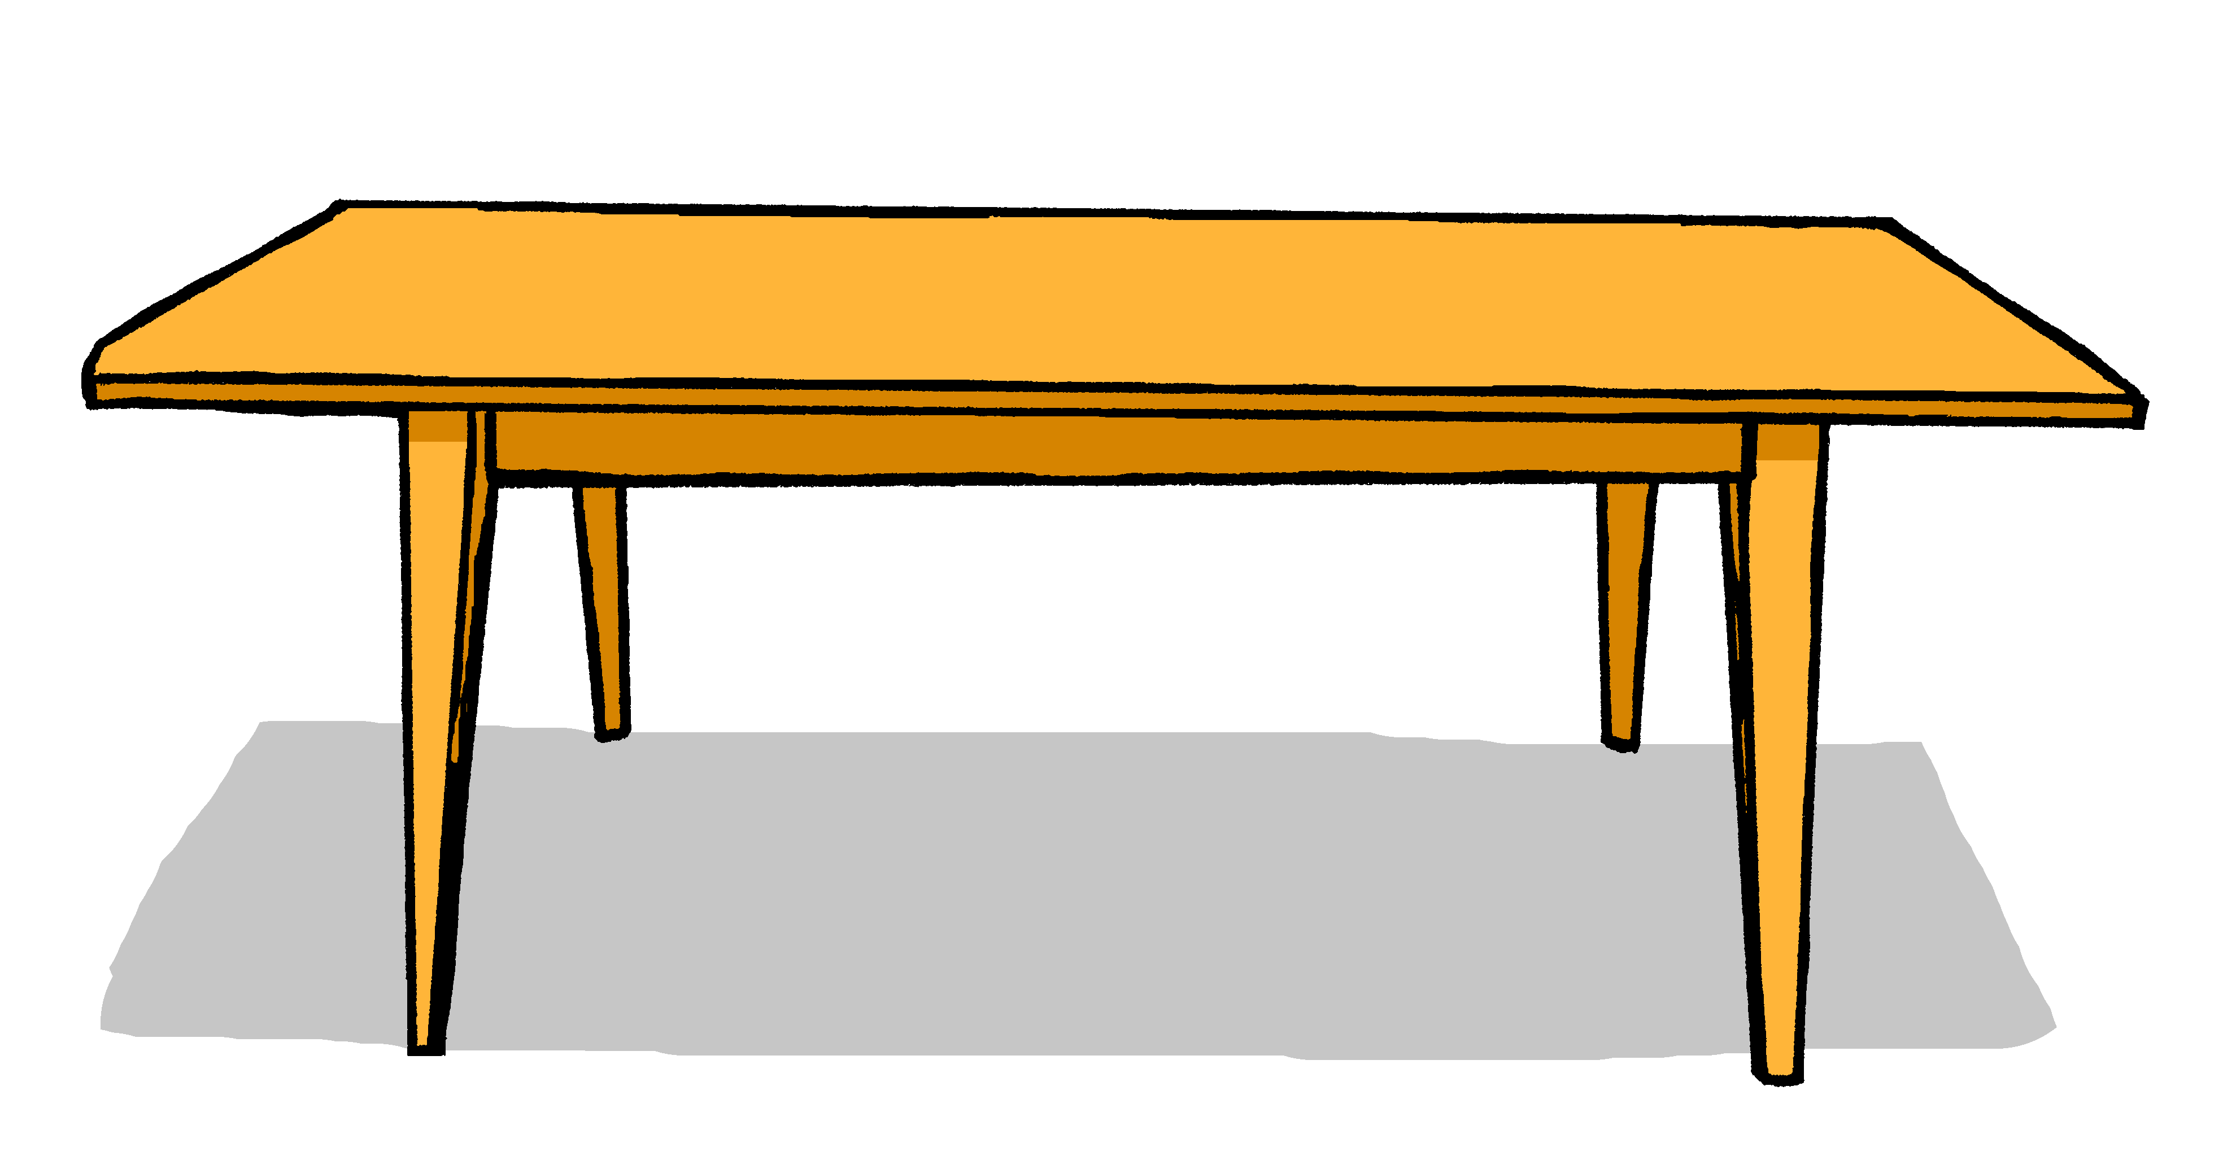
Vokabeln
Was ist das auf Deutsch?
Wörter
bottle
board
shape
window
example
human being
table
exercise book
pencil
das Heft
die Flasche
der Tisch
der Bleistift
das Fenster
das Beispiel
die Tafel
der Mensch
die Form
Notes:
Aim: to elicit oral production of revisited nouns and accurate read aloud of new nouns for this week.
Procedure: 1. Click for an English word.
2. Elicit the German word from all pupils, chorally.
3. Click to provide the written answer.
4. If needed, click on the picture to hear the word pronounced.
6

Slide 7
‘a’ (ein, eine, ein) oder ‘the’ (der, die, das)
‘a’ (ein, eine, ein) often introduces new information and identifies something to the listener:
Das ist eine Tafel.
Was ist das?
Ach! Die Tafel ist groß!
Robbie
‘the’ (der, die, das) refers to something already mentioned or known.
Notes:
Timing: 2 minutes Aim: to contrast use of definitive and indefinite articles Procedure: 1. Click on the mouse to animate the explanation.
2. Check students’ understanding at each stage.
7

Slide 8
schreiben
Robbie is new to Earth. They have a translator but it is stuck between English and German. Help them fill in the gaps.

Schreib auf Englisch und Deutsch.
Robbie
Ist ____ Mensch _____ ?
Ist ____ _______ groß?
Ist ____ Beispiel _______ ?
Ist _____ Farbe ____ ?
Ist ___ _______ ___?
_____ ist ___ ________?
Is a _______ _______blue?
Is a shape ____ ?
Is an _________ correct?
Is a ________ great?
___ a window there?
What ___ a pencil?
1
ein
blau
human being
2
eine Form
big
3
ein
richtig
example
4
eine
toll
colour
5
ein Fenster da
Is
6
Was
ein Bleistift
is
Notes:
Timing: 10 minutes
Aim: to practise written production of the correct indefinite articles and their association with some previously taught nouns.
Procedure:
1. Read the instruction in German.
2. Pupils to identify the gender of the nouns and write the correct indefinite article.
3. Pupils match the pictures to the words to reinforce their understanding.

Slide 9
singen
Hör zu. Dann sing mit!
We are singing the Hallo Song to Robbie to welcome him to our school.
Hallo Robbie!
Hallo! Hallo! Guten Tag! Hallo! Hallo! Guten Tag!
Hallo! Ich bin hier,
Hallo! Du bist da, Hallo! Hallo! Guten Tag!
Robbie
Guten Tag!
But sadly, Robbie can’t stay. Now we are teaching Robbie the goodbye song:
Notes:
Timing: 2 minutes Aim: to revise and practise the Hallo song in preparation for learning the goodbye song on the next slide.
Procedure: 1. Click through the animations of the explanations.
2. Click to bring up speech bubble of teacher saying hello Robbie.
3. Click to bring up speech bubble of Robbie saying hello.
4. Click to play the audio of the sung version of the song.
2. Depending on how much revision is needed, repeat the words of each line to practise saying them clearly (borrow the rhythm of the song so that this is a rehearsal stage before singing).
3. Click to play the audio again and this time, pupils join in.
Note: Teachers might like to re-use this song as part of their lesson starting routine in future lessons. Soon pupils will not need to see the words to recall it.
9

Slide 10
Hör zu. Dann sing mit!
Tschüss, Tschüss, Tschüss, Tschüss,
Tschüss, Tschüss, Auf Wiedersehen!
Bis bald, bis bald, bis bald, bis bald.
Tschüss, Tschüss, Tschüss, Tschüss, Auf Wiedersehen!
Tschüss Robbie!
Auf Wiedersehen!
Notes:
Timing: 5 minutes
Aim: to practise some previously learnt vocabulary in a simple song (to the tune of ‘Hi ho Hi ho it’s off to work we go’).
Procedure: 1. Click to play the audio of the song.
2. Repeat the words of each line to practise saying them clearly (borrow the rhythm of the song so that this is a rehearsal stage before singing).
3. Click to play the audio again and this time, pupils join in.
4. Click to bring speech bubble of the teacher saying bye Robbie!
5. Click again for speech bubble of Robbie saying goodbye.
7. Click on spaceship to send it flying back into space/ home.
Note: Teachers might like to re-use this song as part of their lesson finishing routine in future lessons. Soon pupils will not need to see the words to recall it.

Slide 11
Tschüss!
rot
Notes:
11

