Slide 1
Describing me and others
rot
Words for ‘a’
Words for ‘the’
SSC [ei] & [ie]
Term 1 Week 8
Notes:
Artwork by Steve Clarke. Pronoun pictures from NCELP (www.ncelp.org). All additional pictures selected from Pixabay and are available under a Creative Commons license, no
attribution required.
Phonics:
Same [ie] and [ie] phonics as from week 4 and week 7.
Vocabulary (new): auch [18] aber [31] Punkt [248] wie [25] gut [76] nicht [11] wie geht's? [n/a]
Revisit: was [38] blau [948] falsch [524] gelb [1446] rot [477] richtig [177] das² [1]
Jones, R.L & Tschirner, E. (2019). A frequency dictionary of German: Core vocabulary for learners. London: Routledge.
The frequency rankings for words that occur in this PowerPoint which have been previously introduced in these resources are given in the SOW and in the resources that first
introduced and formally re-visited those words.
For any other words that occur incidentally in this PowerPoint, frequency rankings will be provided in the notes field wherever possible.
Note that the first three lessons of the year teach language that can be continuously recycled as lesson routine every lesson in Y3/4.
The idea would be that the class teacher (whether or not s/he teaches the class German can re-use the language as part of the daily routine with the class.
1

Slide 2
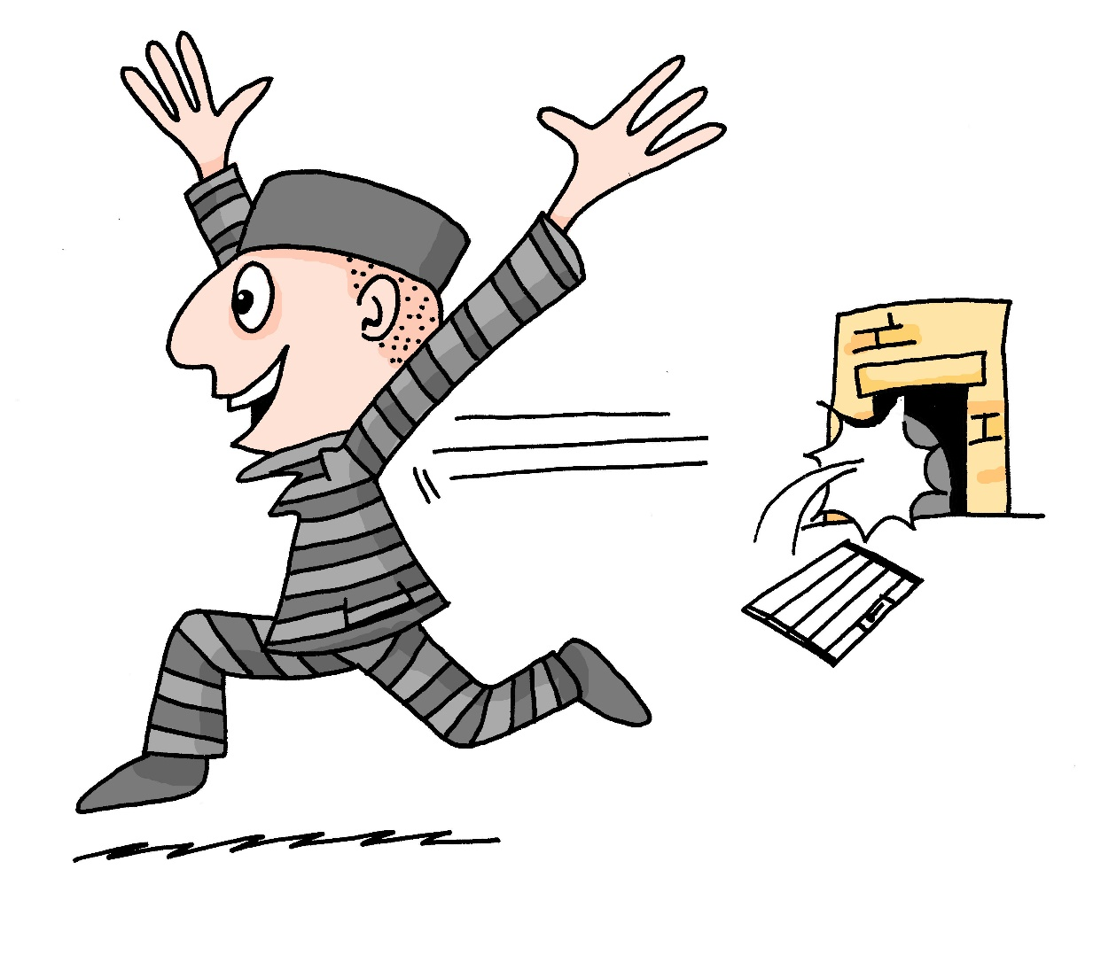
aussprechen
[ei]
…
free
frei
Notes:
Timing: 1 minute
Aim: to revisit the SSC [ei].
Procedure:
Re-present the SSC [ei] and present the source word ‘frei’ (with gesture, if using).
Click to bring on the picture and get pupils to repeat the word ‘frei’ (with gesture, if using).
Note:
a gesture for frei’ might be to throw you hands up in the air and pretend to run away.
Vocabulary: frei [318
Jones, R.L & Tschirner, E. (2019). A frequency dictionary of German: Core vocabulary for learners. London: Routledge.
2

Slide 3
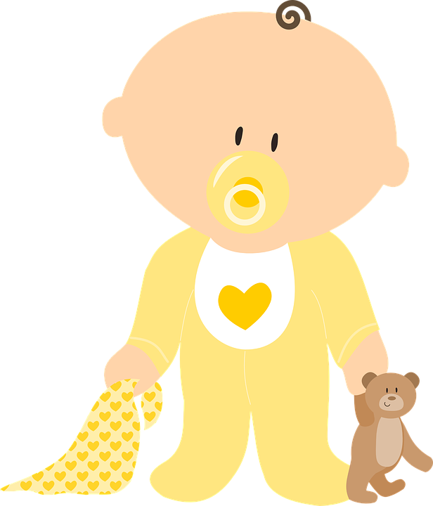
aussprechen
[ei]
…
frei
/a
sein
ein
alone
klein
allein
Notes:
Timing: 1 minute
Aim: to revisit the SSC [ei].
Procedure:
Re-present the SSC and the source word ‘frei’ (with gesture, if using).
Click to bring on the picture and get pupils to repeat the word ‘frei’ (with gesture, if using).
Present the cluster words in the same way, bringing on the picture and getting pupils to pronounce the words.
Vocabulary: frei [318] ein [5] klein [114] sein [3] allein [258]
Jones, R.L & Tschirner, E. (2019). A frequency dictionary of German: Core vocabulary for learners. London: Routledge.

Slide 4
aussprechen
[ie]
…
Liebe
Notes:
Timing: 1 minute
Aim: to revisit the SSC [ie].
Procedure:
Re-present the SSC [ie] and present the source word ‘Liebe’ (with gesture, if using).
Click to bring on the picture and get pupils to repeat the word ‘Liebe’ (with gesture, if using).
Note:
A gesture for ‘Liebe’ might be to make a ‘heart’ shape with both hands approximately where your heart is in your body.
Liebe [844]
Jones, R.L & Tschirner, E. (2019). A frequency dictionary of German: Core vocabulary for learners. London: Routledge.
4

Slide 5
aussprechen
[ie]
…
sie
Liebe
Brief
Notes:
Timing: 1 minute
Aim: to revisit the SSC [ie].
Procedure:
Re-present the SSC and present the source word ‘Liebe’ (with gesture, if using).
Click to bring on the picture and get pupils to repeat the word ‘Liebe’ (with gesture, if using).
Present the cluster words in the same way, bringing on the picture and getting pupils to pronounce the words.
sie [7] Brief [838]
Jones, R.L & Tschirner, E. (2019). A frequency dictionary of German: Core vocabulary for learners. London: Routledge.
5

Slide 6
aussprechen
Hör zu.
1
Ist es [ei] oder [ie]?
c
w
Riese
leider
Riese
One of the chests contains buried treasure. All the others contain poison!
Listen carefully to the secret code and follow the arrows to find the treasure.
Reise
Lieder
Reise
h
z
Wien
Biene
Feile
v
Wein
Beine
viele
Riese
k
Riese
Biene
Feile
leider
i
Reise
Beine
viele
Lieder
Reise
Riese
leider
Feile
leider
Riese
r
Reise
Lieder
viele
Lieder
Reise
Riese
y
j
q
Reise
Notes:
Slide 1 of 3
Timing: 5 minutes (three slides)
This slide and the two that follow are three versions of the activity with different solutions.
The game makes use of minimal pairs of unknown words (unknown words are used so that pupils focus on the sound. Definitions are given on a later slide).
Starting on the red square, pupils listen to the words and decide whether they hear /ei/ or /ei/. They follow the arrows indicated by their choice to finish at one of the chests. There is only one correct route per slide, so pupils must correctly identify all words to find the treasure. The order or /ei/ and /ie/ changes (i.e. sometimes /ei/ is on the white square and sometimes on the blue) so the pupils must read the spellings.
Pupils can follow the slide on the projector, or the slide can be printed so they can trace the route with a pen/finger.
Teacher clicks on the chests they say to reveal treasure (or not!)
Audio plays on clicking the green play button. Pupils will probably need to hear the audio at least three times.
Note: Each treasure chest is triggered to reveal what is underneath. You see a hand icon appear when you mouse over it – click and the chest disappears. Each slide only has one treasure chest – the rest reveal skulls.
Transcript:
Wien, Biene, Feile, Lieder, Reise
Treasure is located in chest W.

Slide 7
aussprechen
Hör zu.
2
Ist es [ei] oder [ie]?
c
One of the chests contains buried treasure. All the others contain poison!
Listen carefully to the secret code and follow the arrows to find the treasure.
w
Riese
leider
Riese
Reise
Lieder
Reise
z
Wien
Biene
Feile
Wein
Beine
viele
Riese
Biene
Feile
leider
Riese
i
Reise
Beine
viele
Lieder
Reise
Riese
leider
Feile
leider
Riese
Reise
Lieder
viele
Lieder
Reise
y
Riese
q
j
Reise
Notes:
2 /3
Alternative: Give pupils a copy of the transcript below on a slip of paper and ask them to read to a partner.
Transcript:
Wein, Beine, viele, Lieder, Reise
Treasure is located in chest Y.

Slide 8
aussprechen
Hör zu.
3
Ist es [ei] oder [ie]?
c
One of the chests contains buried treasure. All the others contain poison!
Listen carefully to the secret code and follow the arrows to find the treasure.
w
Riese
leider
Riese
Reise
Lieder
Reise
h
z
Wien
Biene
Feile
v
Wein
Beine
viele
Riese
k
Riese
Biene
Feile
leider
i
Reise
Beine
viele
Lieder
Reise
Riese
leider
Feile
leider
Riese
r
Reise
Lieder
viele
Lieder
Reise
Riese
y
j
q
Reise
Notes:
3 /3
Alternative: Give pupils a copy of the transcript below on a slip of paper and ask them to read to a partner.
Transcript:
Wein, Beine, viele, Lieder, Reise
Treasure is located in chest Y.

Slide 9
Vokabeln
Wörter
wie?
how?
Wie geht’s?
[How goes it?]
Notes:
1 of 2
Timing: 5 minutes
Aim: to present and practise ‘Wie’ and ‘wie geht’s’.
Procedure:
Click to bring up Wie and illustration.
Click again to bring up translation: wie = how.
Click again to bring up phrase ‘Wie geht’s.
Click again to bring up literal translation: How goes it? Explain that a better translation in English is: How’s it going? OR How are you?
9

Slide 10
Vokabeln
Wie geht’s?
Wörter
wie?
how?
____ geht’s?
Wie
[How’s it going?]
Notes:
2/2
Timing: 5 minutes
Aim: to present and practise ‘Wie’ and ‘wie geht’s’.
Procedure:
Click to bring up Wie and illustration.
Click for question mark to appear – what does wie mean?
Click again to bring up translation: wie = how.
Click again to bring up gapped phrase ‘____ geht’s.
Click for question mark to appear: what goes in the gap? Elicit which word goes in the gap (Wie).
Click again to bring up the missing Wie.
Last, elicit translation. Explain the common phrase ‘Wie geht’s’ is better translated as ‘how’s it going’.
10

Slide 11
Vokabeln
Wie geht’s?
Wörter
gut
Ja, es geht.
nicht so gut
Notes:
Timing: 5 minutes
Aim: to present and practise possible answers to the question ‘wie geht’s’.
Procedure:
1. Ask ‘Wie geht’s’, click to bring up thumbs up icon.
2. Click to bring up answer: gut.
Click to bring up thumbs down image.
Click to bring up possible answer: nicht so gut.
Continue with the thumbs wavering between up and down (pupils can do all of these three gestures as they practise the words): Ja, es geht. (yes, it’s going (ok)).
11

Slide 12
Vokabeln
Vokabeln lernen
Punkt means dot and also point, spot, and full stop!
Wörter
auch
aber
der Punkt
wie
gut
nicht
Notes:
Timing: 5 minutes
Aim: to present and practise written comprehension and read aloud of the new vocabulary for this week.
Procedure: 1. Click for a German word. Elicit pronunciation from pupils.
2. Click for the English meaning and picture prompt. Elicit the German word again.
3. Present all six words like this, in order top left to bottom right.
4. Click for one English meaning to disappear in random order. Elicit the English meaning from pupils. Continue with the remaining items.
5. Click for the German word to disappear in random order. Elicit the German from pupils. Continue with the remaining items.
Vocabulary:
auch [18] aber [31] Punkt [248] wie [25] gut [76] nicht [11] Jones, R.L & Tschirner, E. (2019). A frequency dictionary of German: Core vocabulary for learners. London: Routledge.
12

Slide 13
Wie?
Wie? means ‘how’, as in ‘Wie geht’s?’
How’s it going?
Wie? also means ‘how’, as in ‘Wie ist die Person?’
How is the person? – description
or What is the person like?
Was ist das?
Das ist eine Person.
Wie ist die Person?
Die Person ist klein und rot.
Notes:
Timing: 2 minutes
Aim: To introduce the 2nd meaning of ‘wie’ → What … like?
Procedure: 1. Use the slide animation to present the second meaning of wie.
2. Model the dialogue, one line at a time.
3. Check students’ understanding at each stage.
13

Slide 14
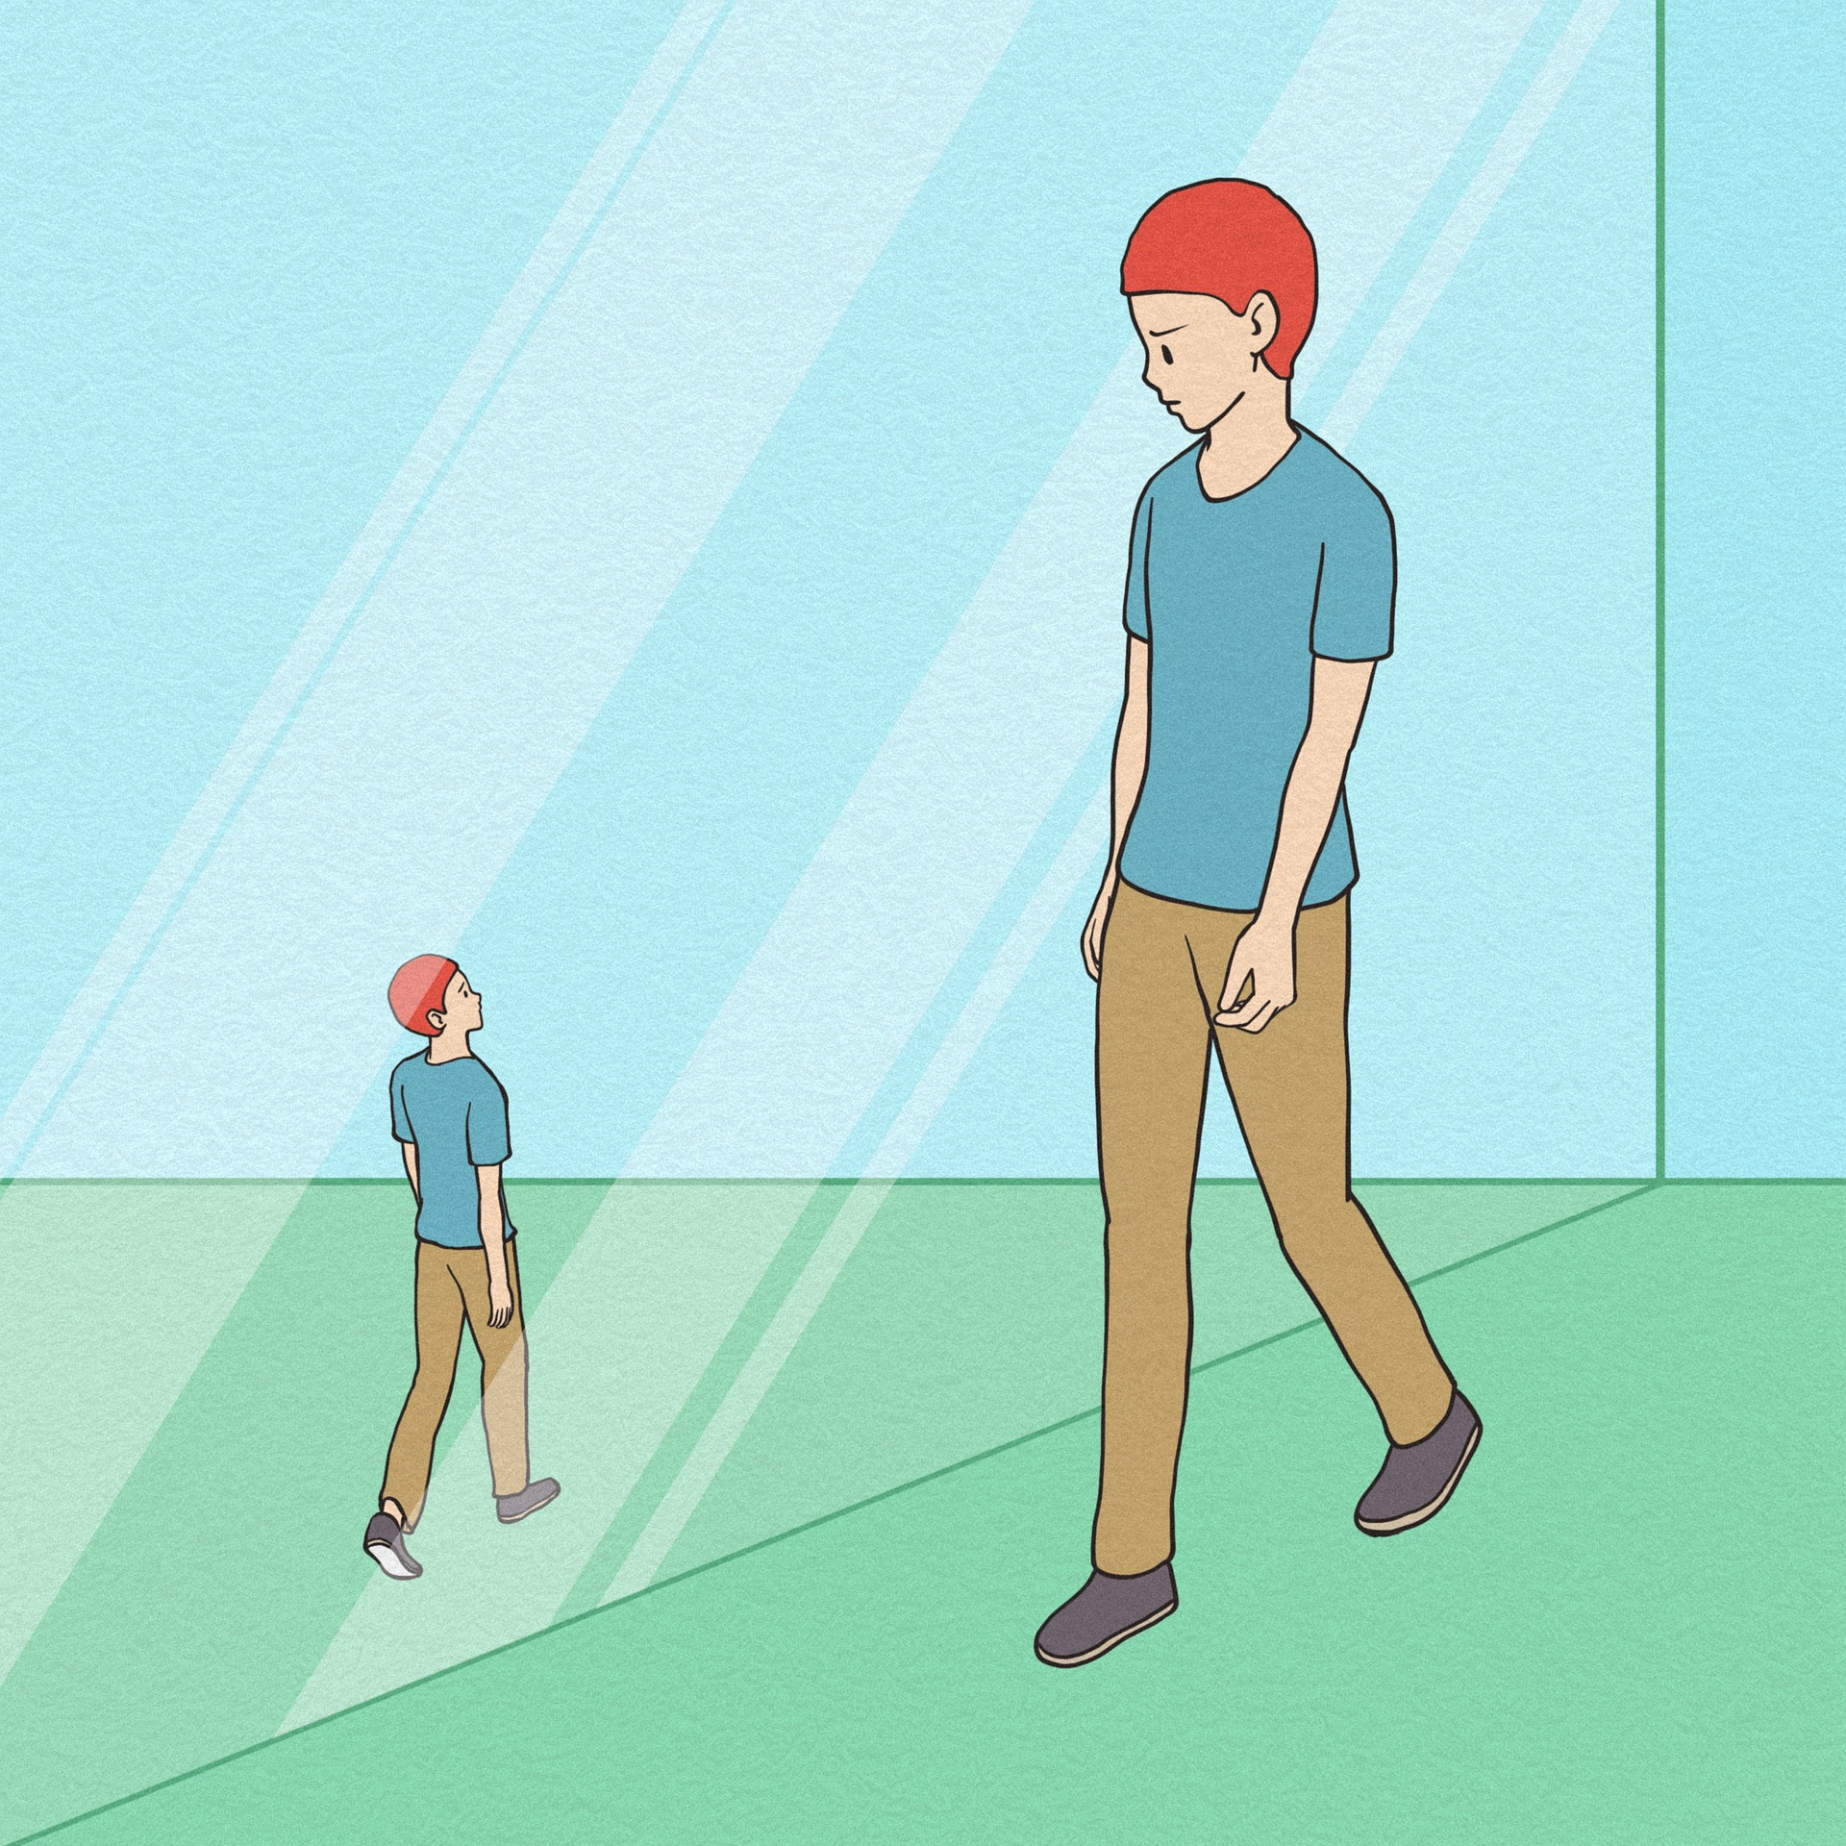
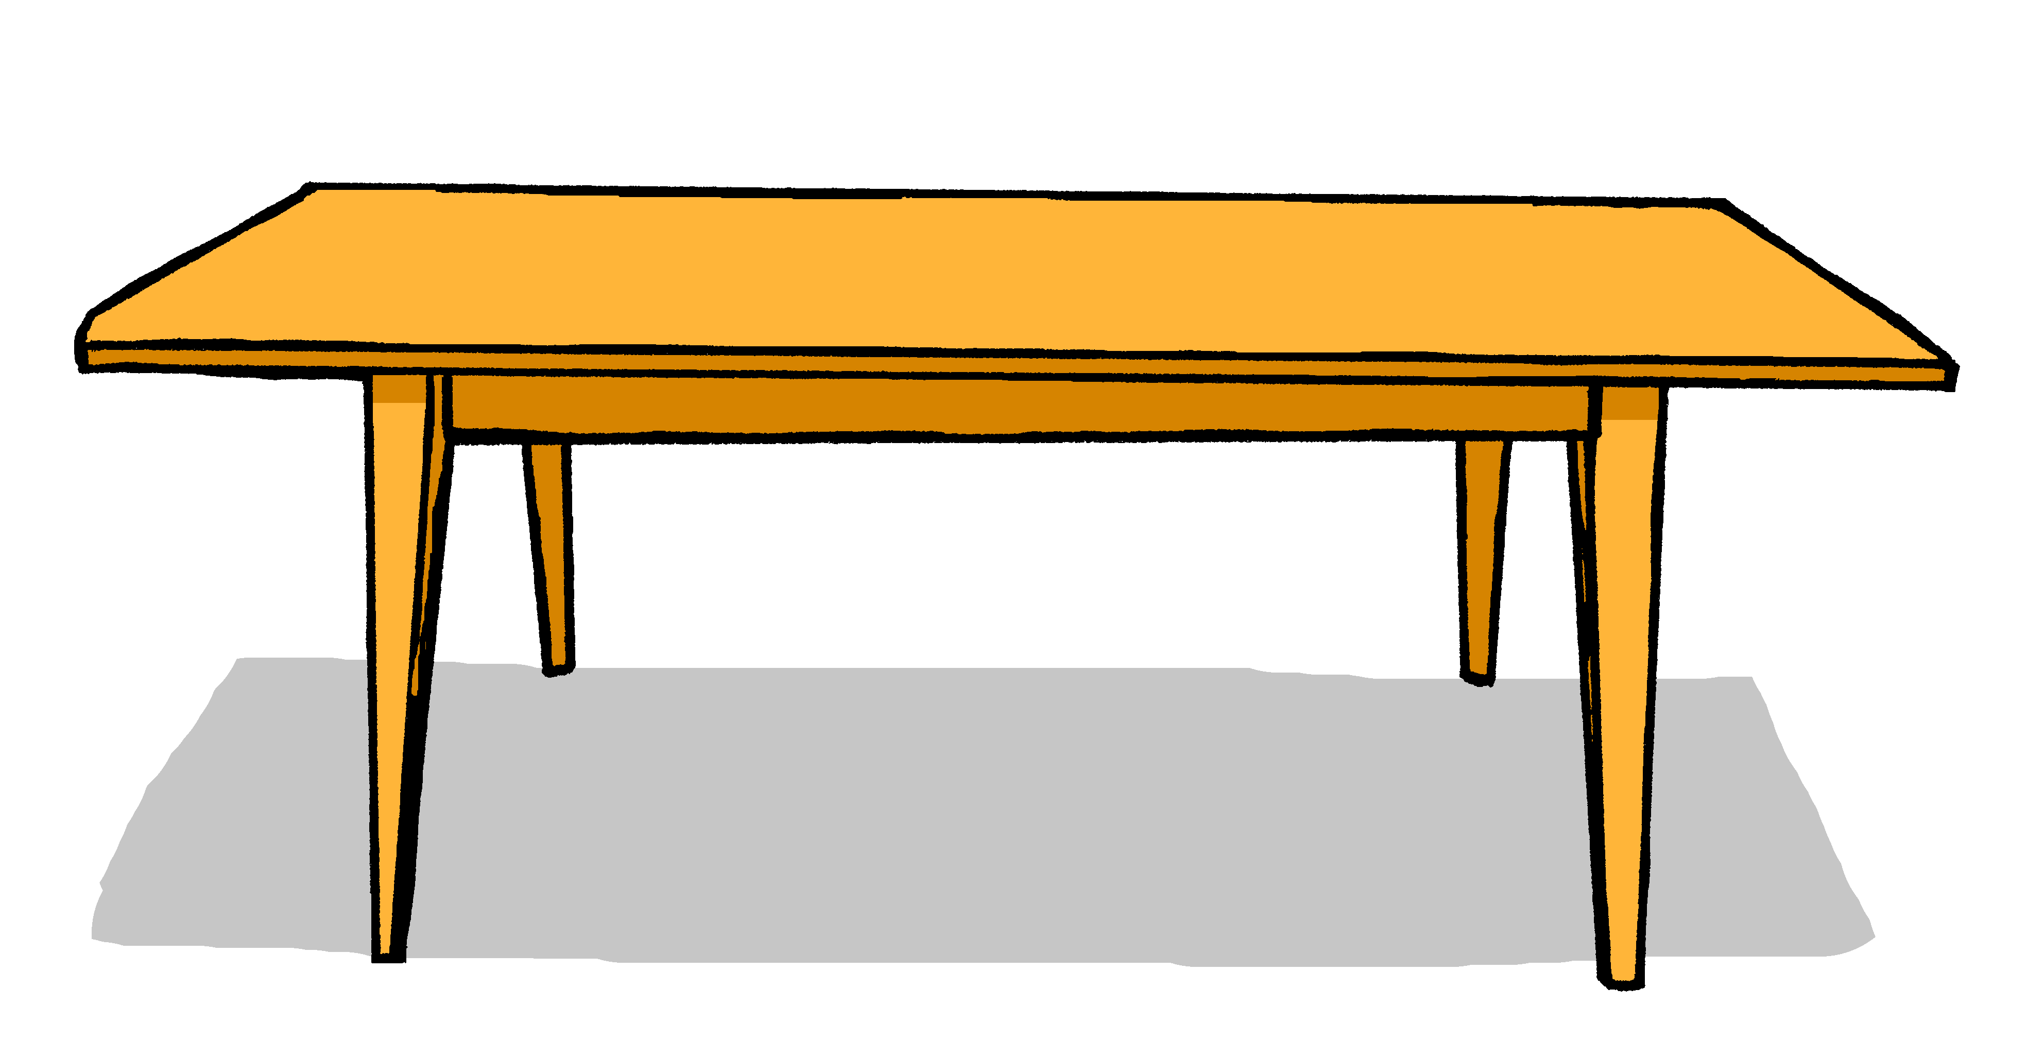
schreiben

Wie ist das?
Schreib auf Deutsch.
Wie ist das?
4
eine
Das ist _______ Person. _______ Person ist klein und rot.
1
Die
Das ist ein Fenster. Das Fenster ist klein und gelb.
2
5
Das ist ein Ort. Der Ort ist klein und blau.
Das ist eine Flasche. Die Flasche ist klein und blau.
3
6
Das ist ein Tisch. Der Tisch ist groß und rot.
Das ist ein Heft. Das Heft ist groß und gelb.
Notes:
Timing: 6 minutes Aim: To practise describing things (writing modality).
Procedure: 1. Model number 1 carefully, eliciting the correct words for ‘a’ and ‘the’ and the translation.
2. Bring up the picture prompts for 2-6. 3. Give students time to write their sentences and correct, whole class, paying particular attention to the articles.
4. ‘Klein’ is illustrated by the arrow pointing to the small or the large figure. Do ensure that the prompt is clear.
5. For checking, click to bring up correct written versions of items 2-6.

Slide 15
Tschüss!
rot
Notes:
15

