Slide 1
Describing me and others
rot
Follow ups 1-5
Term 1 Week 9
Notes:
Artwork by Steve Clarke. Pronoun pictures from NCELP (www.ncelp.org). All additional pictures selected from Pixabay and are available under a Creative Commons license, no attribution required.
Phonics:
[w] Antwort [522] gewinnen [372] ja [45] wahr [737] Wasser [254] Welt [164]
Vocabulary:
New words in bold: links [893] oben [417] rechts [829] unten [710]
Revisit 1: Ding [370] Farbe [1079] Ort [341] Person [357] klar [239] oder [35]
Revisit 2: ich [10] er [15] sie [7] sein, bin, ist [4] da [239] hier [68] Guten Tag [n/a] Hallo [1077] ja [45] nein [148]
Jones, R.L & Tschirner, E. (2019). A frequency dictionary of German: Core vocabulary for learners. London: Routledge.
The frequency rankings for words that occur in this PowerPoint which have been previously introduced in these resources are given in the SOW and in the resources that first
introduced and formally re-visited those words.
For any other words that occur incidentally in this PowerPoint, frequency rankings will be provided in the notes field wherever possible.

Slide 2
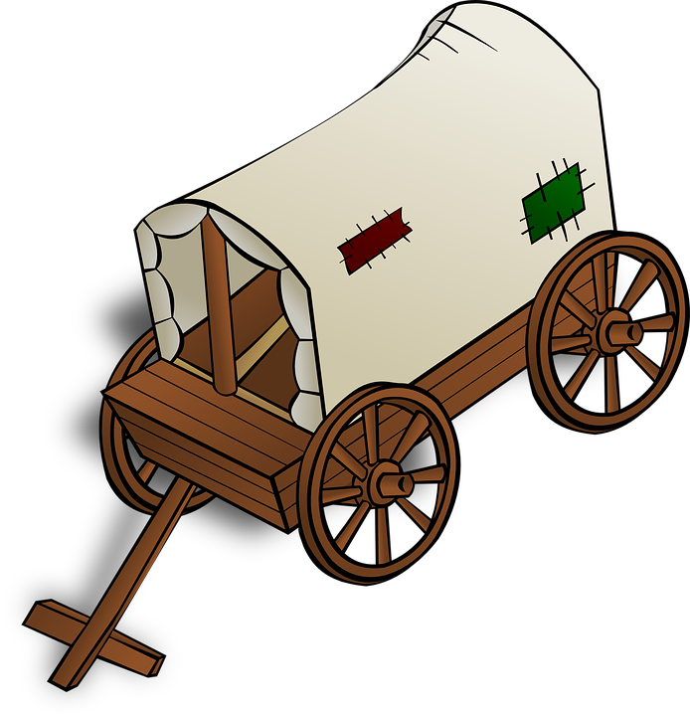
Follow up 1: Sag die Wörter.
aussprechen
Auf Wieder-sehen [goodbye]
wann?
[when]
der Wind
[wind]
Welt |  | wann? | Wind | Wagen |  | Auf Wieder-sehen!
wo? |  | West |  | wie? |  | warum?
Schwester | Wald | was? |  | Winter | warm | Gewitter
die Welt
[world]
der Wagen
[cart, car]
60
wo?
[where]
West
[West]
wie?
[how?]
warum? [why?]
S
die
Schw-ester
[sister]
der Wald
[woods]
was?
[what?]
der Winter
[winter]
warm [warm]
das Gewitter [thunder storm]
0
START
Notes:
Timing: 5 minutes
Aim: to practise applying knowledge of [w] to known and unknown words.
Procedure: 1. Start the timer. Pupil A tries to read aloud all of the words within the 60 seconds allowed.
2. Pupil B listens. If Pupil A says mistake, Pupil B can direct him/her to start again from the beginning. 3. They swap roles and repeat the task.
4. Click to reveal the worlds and pictures.
Vocabulary:
Gewitter [>5009] Schwester [974] Wagen [1175] Wald [1028] wann [657] warm [1281] warum [192] Welt [164] west [1010] Wind [1124] Winter [1206]
Jones, R.L & Tschirner, E. (2019). A frequency dictionary of German: Core vocabulary for learners. London: Routledge.

Slide 3
Follow up 2

Schreib auf Deutsch. [1/5]
hören
Das ist _______ ___ ________.
1
nicht
die
Person
3
2
1
Schreib!
Notes:
Timing: 5 minutes (5 slides)
Aim: to practise dictation of previously-taught words in short, simple sentences.
Procedure:
Complete this first slide with pupils to model the activity.
Tell students this is a delayed dictation activity. They will hear a sentence out loud twice and they will have to retain the three missing words in their working memory (picturing it in their heads!) for 3 seconds.
Note: they can choose to use the help on the board or turn away to do the full sentence without looking – encourage students to choose their own level of challenge.
Click the audio button to hear the audio. Click to start timer once you’ve played the sentence twice.
Once the time is up, the instruction ‘Schreib’ will come up and they need to write the whole sentence or the missing three words.
Click to reveal the words.
Elicit the English meaning from pupils.
Repeat steps 4-7 with the remaining 4 slides.
Transcript: Das ist nicht die Person.

Slide 4
Follow up 2

Schreib auf Deutsch. [2/5]
hören
Der Ort ___ _____ _______.
2
ist
nicht
rechts
​ | ​
​ | ​
3
2
1
Schreib!
Notes:
[2/5]
Transcript: Der Ort ist nicht rechts.

Slide 5
Follow up 2

Schreib auf Deutsch. [3/5]
hören
Das Ding ___ _____ _______.
3
ist
nicht
unten
​ | ​
​ | ​
3
2
1
Schreib!
Notes:
[3/5]
Transcript: Das Ding ist nicht unten.

Slide 6
Follow up 2

Schreib auf Deutsch. [4/5]
hören
Ich ___ _____ _______.
4
bin
oben
rechts
​ | ​
​ | ​
3
2
1
Schreib!
Notes:
[4/5]
Transcript:
Ich bin oben rechts

Slide 7
Follow up 2

Schreib auf Deutsch. [5/5]
hören
Das ___ _____ _______.
5
ist
nicht
klar
3
2
1
Schreib!
Notes:
[5/5]
Transcript: Das ist nicht klar.

Slide 8
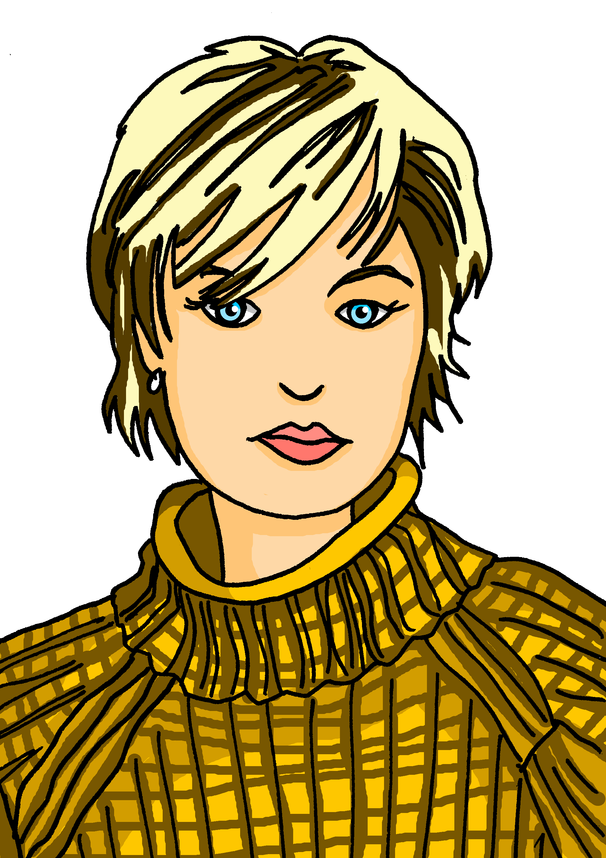
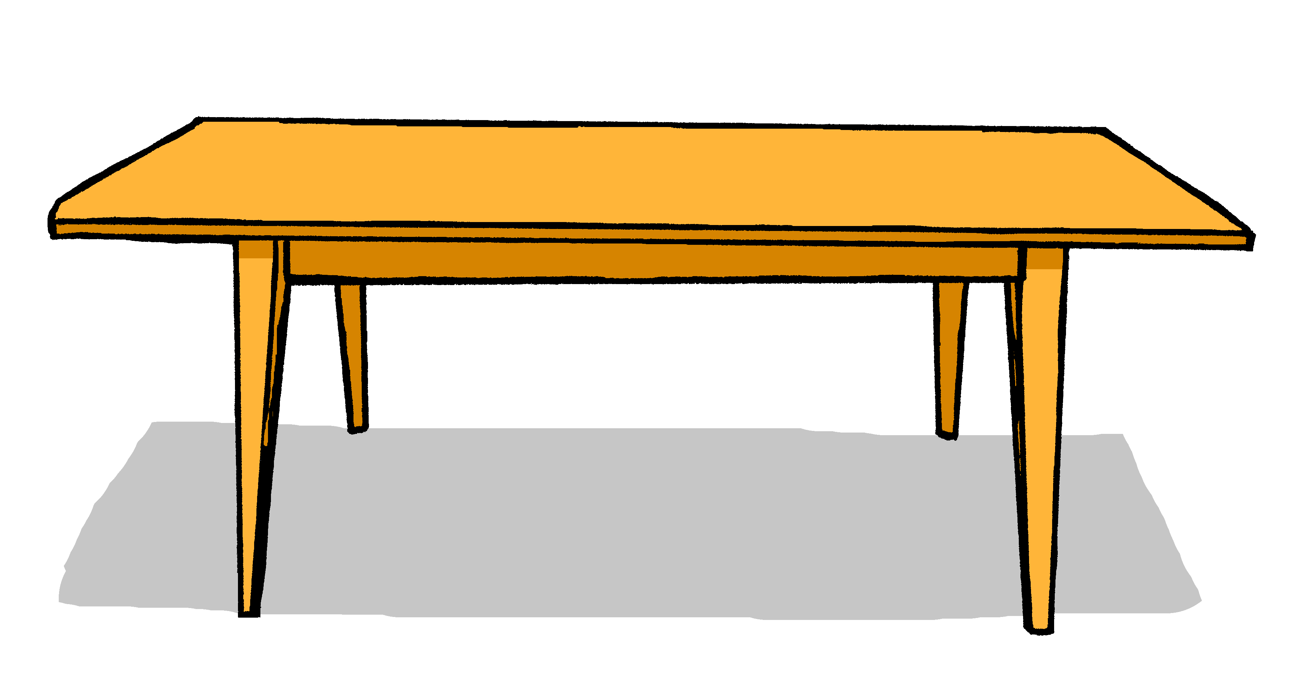
Follow up 3
Hör zu. Was ist das? Was ist das nicht?
Schreib A oder B.
hören
 | A | B
 | A | B
1
4
2
5
3
6
Notes:
Timing: 5 minutes
Aim: to practise aural comprehension of nicht and previously taught nouns in short sentences of three types: nicht + adverb/adjective, nicht + definite article, nicht + proper noun.
Procedure:
1. Das ist nicht Steffen.
2. Der Bleistift ist unten.
3. Das ist nicht das Fenster.
4. Die Flasche ist nicht rechts.
5. Das ist nicht Deutschland.
6. Das ist nicht die Person.

Slide 9
Follow up 4
*Schnell! Schnell! [1/2]
schnell - quick
or
Partnerarbeit: Auf Deutsch sprechen.
sprechen
down, below
30
d_ _ D_ _ _
to be
das Ding
ich bin ja
richtig die Farbe
Guten Tag! klar sein unten oder
clear
colour
i_ _ b_ _
j_
right
r_ _ _ _ _ _
S
d_ _ F_ _ _ _
G_ _ _ _ T_ _!
yes
k _ _ _
s_ _ _
I am
hello! (formal)
u_ _ _ _
0
o_ _ _
thing
START
Notes:
Timing: 5 minutes (two slides)
Aim: revisit vocabulary from 3 weeks ago and 9 weeks ago. Pupils translate the words orally to find their way out of the maze.
Procedure:
Explain that pupils work in pairs to say all the words in German to move through the maze and get out at the top.
There are some hints (first letters of the German words) to help them.
Click ‘Start’ to start the timer.
They can have a go several times.
Click for the animated answers to appear.
Pupils can then move on to the next slide for a 2nd round with different words.

Slide 10
Follow up 4
*Schnell! Schnell! [1/2]
schnell - quick
no
Partnerarbeit: Auf Deutsch sprechen.
sprechen
here
30
links
nicht oder
die Person der Ort
da sie ist er ist hier nein
he is
she is
l_ _ _ _
place
n_ _ _ _
o_ _ _
person
d_ _ P_ _ _ _ _
S
d_ _ O_ _
d_
oder
s_ _ i_ _
e_ i _ _
not
there
h_ _ _
0
n_ _ _
left
START
Notes:
Timing: 5 minutes (two slides)
Aim: revisit vocabulary from 3 weeks ago and 9 weeks ago. Pupils translate the words orally to find their way out of the maze.
Procedure:
Explain that pupils work in pairs to say all the words in German to move through the maze and get out at the top.
There are some hints (first letters of the German words) to help them.
Click ‘Start’ to start the timer.
They can have a go several times.
Click for the animated answers to appear.
Pupils can then move on to the next slide for a 2nd round with different words.

Slide 11
Follow up 5:

Schreib auf Englisch.
Can you get at least 15 points?
Wörter
 | nein | sie ist | ich bin
 | ja | sein | er ist
 | Guten Tag! | oder | der Ort
 | das Ding | die Farbe | die Person
 | unten | oben | links
 | rechts | klar | nicht
Vokabeln
no
she is
I am
x3
yes
to be, being
he is
Hello! (formal)
or
(the) place
x2
(the) thing
(the) colour
(the) person
down, below
up, above
left
x1
right
clear
not
Notes:
Timing: 5 minutes
Aim: to practise written comprehension of vocabulary from this and revisited weeks.
Procedure: 1. Give pupils a blank grid. They fill in the English meanings of any of the words they know, trying to reach 15 points in total. 2. Remind pupils that adjectives can refer to male or female persons and they should note this in their translations. E.g. pleased (f), short (m).
Note: The most recently learnt and practised words are pink, words from the previous week are green and those from week 1 are blue, thus more points are awarded for them, to recognise that memories fade and more effort (heavy lifting!) is needed to retrieve them.

Slide 12
Follow up 5:

Schreib auf Deutsch.
Can you get at least 15 points?
Wörter
 | he is | no | yes
 | to be, being | I am | she is
 | (the) place | (the) thing | Hello! (formal)
 | or | (the) person | (the) colour
 | down, below | not | clear
 | left | up, above | right
Vokabeln
er ist
nein
ja
x3
sein
ich bin
sie ist
der Ort
das Ding
Guten Tag!
x2
oder
die Person
die Farbe
unten
nicht
klar
x1
links
oben
rechts
Notes:
Timing: 5 minutes
Aim: to practise written production of vocabulary from this and revisited weeks.
Procedure: 1. Give pupils a blank grid. They fill in the German meanings of any of the words they know, trying to reach 15 points in total. 2. Remind pupils that adjectives can refer to male or female persons and they should note this in their translations. E.g. pleased (f), short (m).
Note: The most recently learnt and practised words are pink, words from the previous week are green and those from week 1 are blue, thus more points are awarded for them, to recognise that memories fade and more effort (heavy lifting!) is needed to retrieve them.

Slide 13
Tschüss!
rot
Notes:
13

Slide 14
Follow up 5:

Schreib auf Englisch.
Can you get at least 15 points?
Wörter
 | nein | sie ist | ich bin
 | ja | sein | er ist
 | Guten Tag! | oder | der Ort
 | das Ding | die Farbe | die Person
 | unten | oben | links
 | rechts | klar | nicht
Vokabeln
x3
x2
x1
Notes:
Template for photocopying

Slide 15
Follow up 5:

Schreib auf Deutsch.
Can you get at least 15 points?
Wörter
 | he is | no | yes
 | to be, being | I am | she is
 | (the) place | (the) thing | Hello! (formal)
 | or | (the) person | (the) colour
 | down, below | not | clear
 | left | up, above | right
Vokabeln
Notes:
Template for photocopying

