Slide 1
Describing me and others
rot
Negation with nicht
SSC [w]
Term 1 Week 9
Notes:
Artwork by Steve Clarke. Pronoun pictures from NCELP (www.ncelp.org). All additional pictures selected from Pixabay and are available under a Creative Commons
license, no attribution required.
Phonics:
[w] Antwort [522] gewinnen [372] ja [45] wahr [737] Wasser [254] Welt [164]
Vocabulary:
New words in bold: links [893] oben [417] rechts [829] unten [710]
Revisit 1: Ding [370] Farbe [1079] Ort [341] Person [357] klar [239] oder [35]
Revisit 2: ich [10] er [15] sie [7] sein, bin, ist [4] da [239] hier [68] Guten Tag [n/a] Hallo [1077] ja [45] nein [148]
Jones, R.L & Tschirner, E. (2019). A frequency dictionary of German: Core vocabulary for learners. London: Routledge.
The frequency rankings for words that occur in this PowerPoint which have been previously introduced in these resources are given in the SOW and in the resources
that first introduced and formally re-visited those words.
For any other words that occur incidentally in this PowerPoint, frequency rankings will be provided in the notes field wherever possible.
Note that the first three lessons of the year teach language that can be continuously recycled as lesson routine every lesson in Y3/4.
The idea would be that the class teacher (whether or not s/he teaches the class German can re-use the language as part of the daily routine with the class.
1

Slide 2
singen
Hör zu. Dann sing mit!
Hallo! Hallo! Guten Tag! Hallo! Hallo! Guten Tag!
Hallo! Ich bin hier,
Hallo! Du bist da, Hallo! Hallo! Guten Tag!
Notes:
Timing: 2 minutes
Aim: to practise some previously learnt vocabulary in a simple song (to the tune of ‘If you’re happy and you know it’).
Procedure: 1. Click the callout to play the audio of the song.
2. Repeat the words of each line to practise saying them clearly (borrow the rhythm of the song so that this is a rehearsal stage before singing).
3. Click to play the audio again and this time, pupils join in.
Note: Teachers might like to re-use this song as part of their lesson starting routine in future lessons. Soon pupils will not need to see the words to recall it.

Slide 3
aussprechen
[w]
…
Welt
Notes:
Timing: 1 minute
Aim: to introduce the SSC [W].
Procedure:
Introduce the SSC and present the source word ‘Welt’ (with gesture, if using).
Click to bring on the picture and get pupils to repeat the word Welt’ (with gesture, if using).
Note:
a gesture for ‘Welt’ might be to mime a big sphere with your hands.
Vocabulary: Welt [164]
Jones, R.L & Tschirner, E. (2019). A frequency dictionary of German: Core vocabulary for learners. London: Routledge.
3

Slide 4
aussprechen
[w]
…
Wasser
Antwort
Welt
wahr
gewinnen
Notes:
Timing: 1 minute
Aim: to consolidate the SSC [W].
Procedure:
Re-present the SSC and the source word ‘Welt’ (with gesture, if using).
Click to bring on the picture and get pupils to repeat the word ‘Welt’ (with gesture, if using).
Present the cluster words in the same way, bringing on the picture and getting pupils to pronounce the words.
Vocabulary: Antwort [522] gewinnen [372] wahr [737] Wasser [245] Welt [164]
Jones, R.L & Tschirner, E. (2019). A frequency dictionary of German: Core vocabulary for learners. London: Routledge.

Slide 5
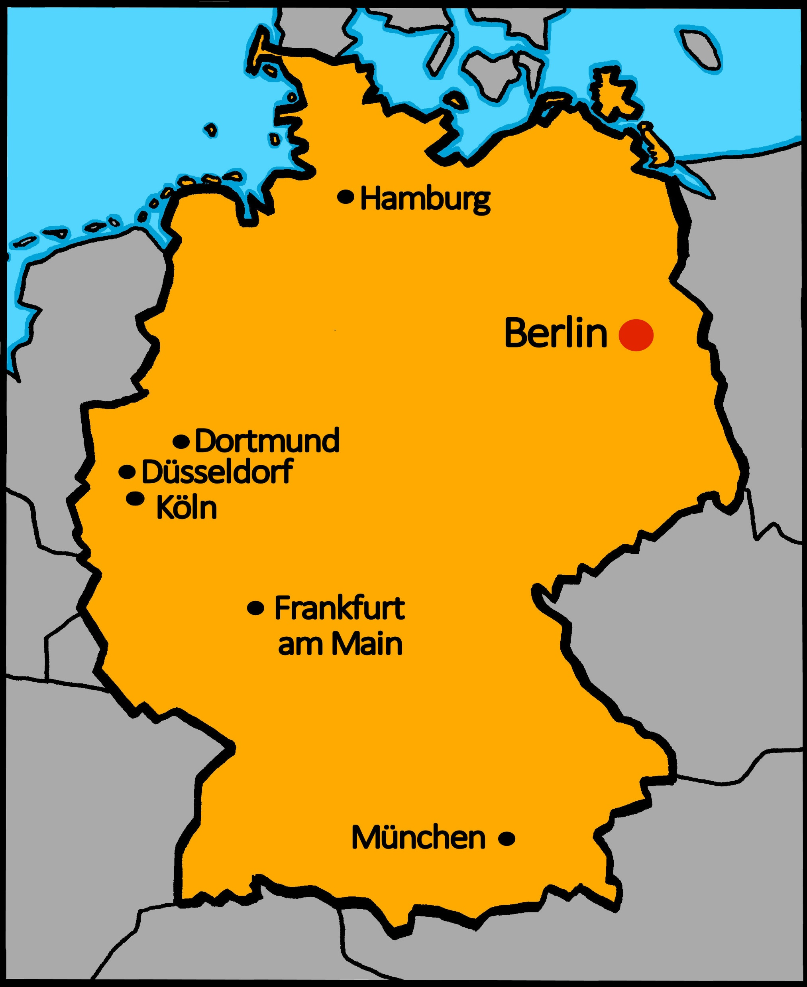
aussprechen
[w]
Read the dialogue with a partner.
Map of Germany with the two cities marked on there.
Maike and Steffen are travelling in Germany and are talking on the phone.
Alles klar means all clear and can be used as a question and an answer:
Teacher: Alles klar? (Everything clear?)
Pupil: Alles klar! (all clear!)
Hallo! Wie geht’s?
Gut! Wo bist du?
Ich bin in Wuppertal! Und du?
Ich bin in Wiesbaden.
Alles klar.
Auf Wiedersehen.
Tschüss!
Notes:
Timing: 1 minute
Aim: to consolidate the SSC [w] by ‘read aloud’ conversation containing known words with [w].
Procedure:
1. Model the dialogue or click audio to play.
2. Click to bring up speech bubble explaining about ‘alles klar’ – they already know ‘klar’. Explain that teachers can say this as a question to ask if everything is clear/understood and that they can reply using ‘alles klar’ as a statement.

Slide 6
Vokabeln
Vokabeln lernen
Wörter
up
above
oben
left
right
links
rechts
unten
down,
below
Notes:
Timing: 5 minutes
Aim: to present and practise new vocabulary for this week.
Procedure:
1. Click for a German word. Elicit pronunciation from pupils.
2. Click for the English meaning and picture prompt. Elicit the German word again.
3. Present all six words like this, in order top left to bottom right.
4. Click for one English meaning to disappear in random order. Elicit the English meaning from pupils. Continue with the remaining items.
5. Click for the German word to disappear in random order. Elicit the German from pupils. Continue with the remaining items.
Vocabulary: links [893] oben [417] rechts [829] unten [710]
6

Slide 7
Nicht (not) [1/2]
Use nicht before an adjective or adverb to mean not:
Ich bin hier.
Ich bin nicht hier.
I am here.
I am not here.
Der Tisch ist blau.
Der Tisch ist nicht blau.
The table is blue.
The table is not blue.
Notes:
Timing: 2 minutes
Aim: to introduce the use of nicht for negation with adjectives, adverbs and definite articles.
Procedure:
Click through the animations to present the new information.
Elicit English translation for the German examples provided.
7

Slide 8
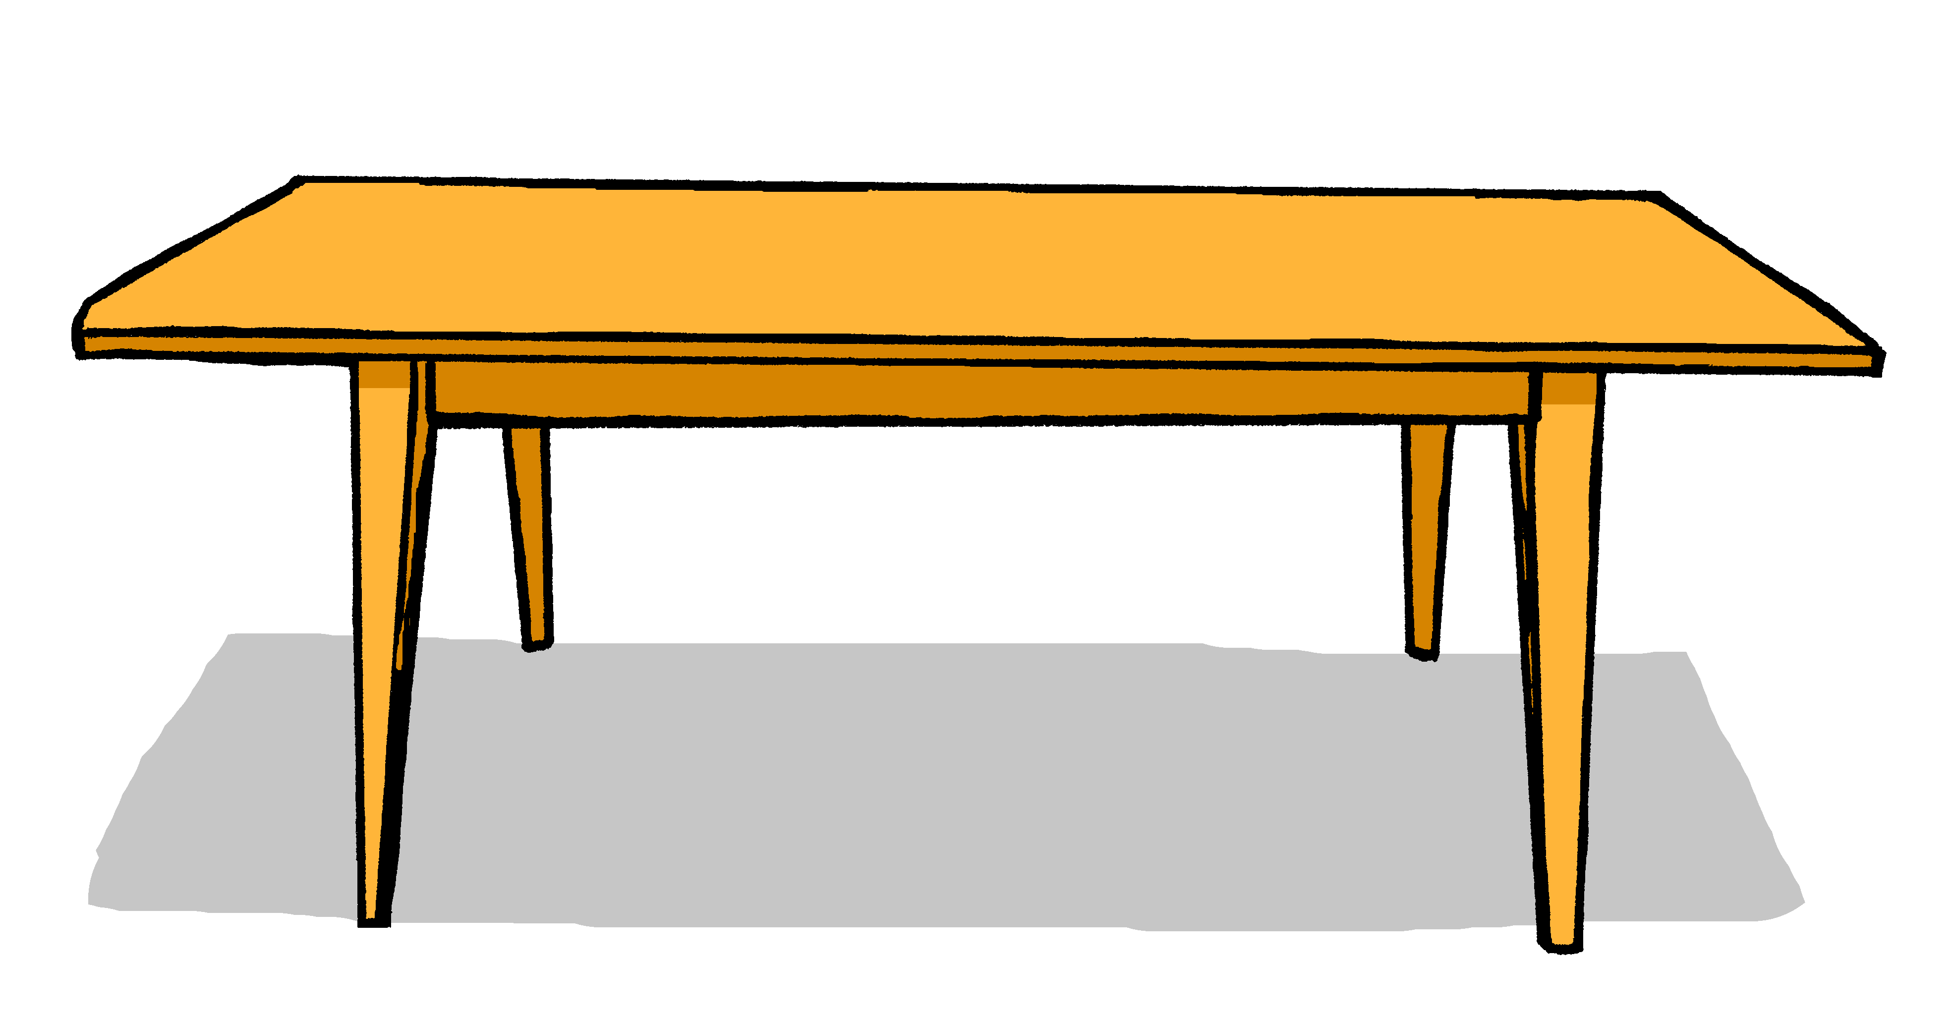
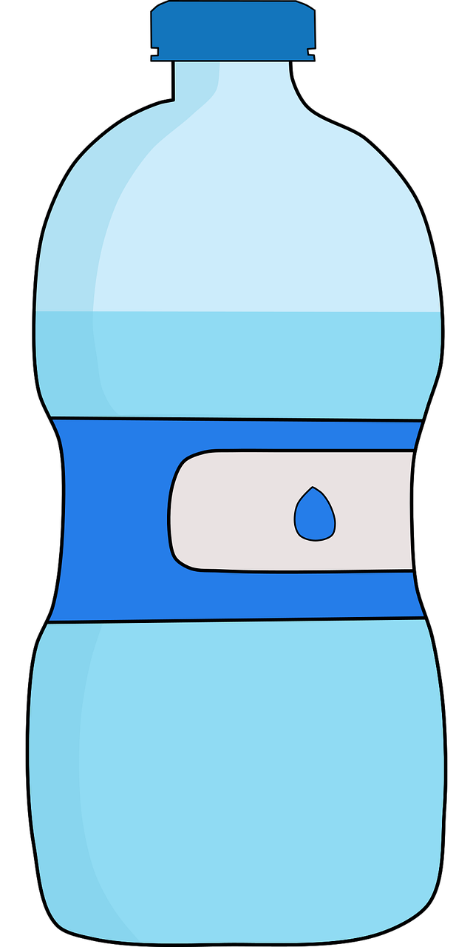
lesen
Richtig oder falsch? [1/6]
Lies den Satz*. Ist das richtig oder falsch?
falsch
1
Das Heft ist oben rechts.
der Satz - sentence
Notes:
[Slide 1 of 6]
Timing: 8 minutes (6 slides)
Aim: to practise written comprehension of nicht, the four new adverbs for this lesson and a range of previously taught vocabulary.
Procedure:
Talk pupils through the first one to model the task.
Identify ‘das Heft’ and then elicit the meaning of ‘oben’ (up, above) and ‘rechts’ (right) and ask pupils: Ist das Heft oben rechts?
If needed, put to the position ‘oben rechts’ and ask ‘Ist das das Heft?’
When pupils are happy that the answer is ‘falsch’ move on to the remaining five slides.
Answer:
falsch
8

Slide 9
lesen
Richtig oder falsch? [2/6]
Lies den Satz*. Ist das richtig oder falsch?
richtig
2
Der Ort ist nicht oben rechts.
der Satz - sentence
Notes:
[2/6]
Answer:
richtig
9

Slide 10
lesen
Richtig oder falsch? [3/6]
Lies den Satz*. Ist das richtig oder falsch?
falsch
3
Der Bleistift ist nicht oben links.
der Satz - sentence
Notes:
[3/6]
Answer:
falsch
10

Slide 11
lesen
Richtig oder falsch? [4/6]
Lies den Satz*. Ist das richtig oder falsch?
richtig
4
Die Tafel ist nicht unten rechts.
der Satz - sentence
Notes:
[4/6]
Answer:
richtig
11

Slide 12
lesen
Richtig oder falsch? [5/6]
Lies den Satz*. Ist das richtig oder falsch?
5
richtig
Das Ding ist nicht oben rechts.
der Satz - sentence
Notes:
[5/6]
Answer:
richtig
12

Slide 13
lesen
Richtig oder falsch? [6/6]
Lies den Satz*. Ist das richtig oder falsch?
falsch
6
Der Punkt is nicht unten links.
der Satz - sentence
Notes:
[6/6]
Answer:
falsch
13

Slide 14
Nicht (not) [2/2]
Use nicht before ‘der, die, das’ and a noun to mean not the:
Das ist der Tisch.
Das ist nicht der Tisch.
That is the table.
That is not the table.
This works in the same way with questions:
Ist das der Tisch?
Nein, das ist nicht der Tisch.
Is that the table?
No, that is not the table.
Notes:
Timing: 2 minutes
Aim: to introduce the use of nicht for negation with adjectives, adverbs and definite articles.
Procedure:
Click through the animations to present the new information.
Elicit English translation for the German examples provided.
14

Slide 15
hören
A oder B?
Hör zu. Ist das A oder B?
 | A | B
Das ist nicht England!
1
2
zum Beispiel:
A | B
3
Ex
4
5
6
Notes:
Timing: 5 minutes
Aim: to practise aural comprehension of nicht and previously taught nouns in short sentences.
Procedure:
Click to bring up the example. Pupils will hear a ‘nicht’ negative sentence or an affirmative sentence and decide whether it refers to A or B.
Continue for items 1-6. Click to bring up answer ticks.
Transcript:
Ex. Das ist nicht England!
1. Das ist nicht das Ding.
2. Das ist die Farbe rot.
3. Das ist nicht der Tisch.
4. Das ist die Person.
5. Das ist nicht der Ort.
6. Das ist nicht die Farbe gelb.
15

Slide 16
Hör zu. Dann sing mit!
Tschüss, Tschüss, Tschüss, Tschüss,
Tschüss, Tschüss, Auf Wiedersehen!
Bis bald, bis bald, bis bald, bis bald.
Tschüss, Tschüss, Tschüss, Tschüss, Auf Wiedersehen!
Bis bald! – See you soon!
Notes:
Timing: 3 minutes
Aim: to practise the language for bye and goodbye in a simple song (to the tune of ‘Hi ho Hi ho it’s off to work we go’).
Procedure: 1. Click on the mp3 player to play the audio of the song.
2. Repeat the words of each line to practise saying them clearly (borrow the rhythm of the song so that this is a rehearsal stage before singing).
3. Click to play the audio again and this time, pupils join in.
Note: Teachers might like to re-use this song as part of their lesson finishing routine in future lessons. Soon pupils will not need to see the words to recall it.

Slide 17
Tschüss!
rot
Notes:
17

