Slide 1
Talking about things and things to do
rot
Follow ups 1-5
Term 2 Week 1
Notes:
Artwork by Steve Clarke. Pronoun pictures from NCELP (www.ncelp.org). All additional pictures selected from Pixabay and are available under a Creative Commons license, no attribution required.
Phonics:
[ä] spät [171] zählen [680] wählen [64]
Vocabulary (new): kein, keine, kein [46] Handy [1693] Hund [825] Wasser [245] Wort [194]
Revisit 1: Bild [253] Foto [633] Freund, Freundin [273] Fußball [1277] Tasche [1804] mein, meine [51] dein, deine [233]
Jones, R.L & Tschirner, E. (2019). A frequency dictionary of German: Core vocabulary for learners. London: Routledge.
The frequency rankings for words that occur in this PowerPoint which have been previously introduced in these resources are given in the SOW and in the resources that first introduced and formally re-visited those words.
For any other words that occur incidentally in this PowerPoint, frequency rankings will be provided in the notes field wherever possible.

Slide 2
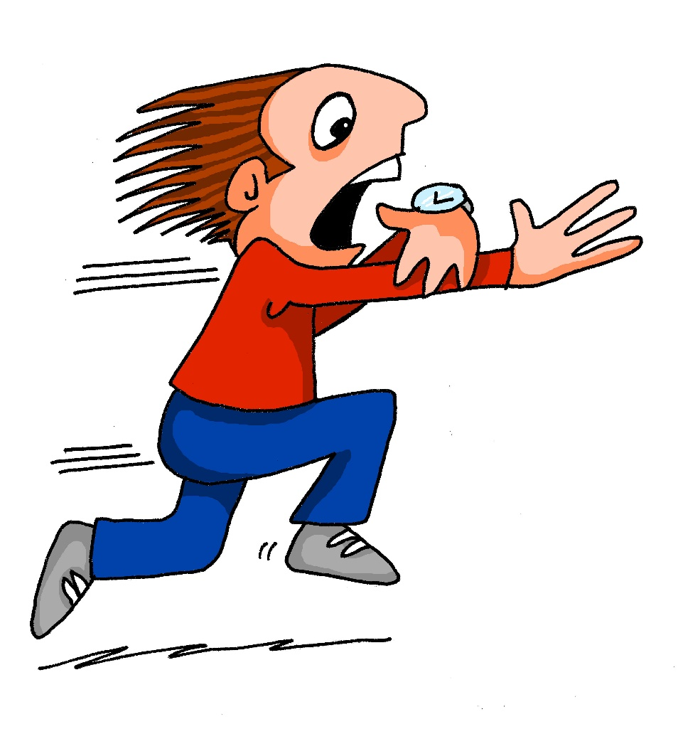
aussprechen
Follow up 1
…
[ä]
spät
[late]
Notes:
Timing: 1 minute
Aim: To introduce SSC [ä]
Procedure:
Introduce the SSC and say the [ä] sound first, on its own. Pupils repeat it with you.
Present the source word ‘spät’ (with gesture, if using).
Click to bring on the picture and get pupils to repeat the word ‘spät’ (with gesture, if using).
Note:
A gesture for this could be to bring your left arm up to mime suddenly looking at your watch.
spät [171]
Jones, R.L & Tschirner, E. (2019). A frequency dictionary of German: Core vocabulary for learners. London: Routledge.
2

Slide 3
aussprechen
Follow up 1
…
[ä]
1, 2, 3, …100
spät
wählen
zählen
[to count]
[to choose]
Notes:
Timing: 1 minute
Aim: to introduce the SSC [ä].
Procedure:
Re-present the SSC and the source word ‘spät’ (with gesture, if using).
Click to bring on the picture and get pupils to repeat the word ‘spät’ (with gesture, if using).
Present the cluster words in the same way, bringing on the picture and getting pupils to pronounce the words.
spät [171] zählen [680] wählen [64]
Jones, R.L & Tschirner, E. (2019). A frequency dictionary of German: Core vocabulary for learners. London: Routledge.
3

Slide 4
Follow up 1
…
Sag die Wörter.
aussprechen
Bär
Präsident
Universität
Fußbälle
60
März
Realität
Atmosphäre
Identität
Sekunden
Hände
Aktivität
Nationalität
Käse
0
LOS!
Notes:
Timing: 4 minutes (1 minute for practice + 1 minute for saying them out loud x 2 rounds) Aim: to practise SSC [ä] knowledge with unfamiliar words. Procedure: 1. Pupils take 60 seconds to practise saying the words out loud to themselves. Click LOS! to start the timer.
2. Then teacher clicks and each word flashes a couple of times before disappearing. Pupils have to pronounce the word (in chorus).
Frequency of unknown words and cognates:
Bär [3494] Hand [180] Präsident [546] Universität [415] März [987] Realität [1684] Atmosphäre [2423] Identität [2272] Qualität [1202] Aktivität [1422]
Nationalität [n/a] Käse [4094]
Jones, R.L & Tschirner, E. (2019). A frequency dictionary of German: Core vocabulary for learners. London: Routledge.

Slide 5
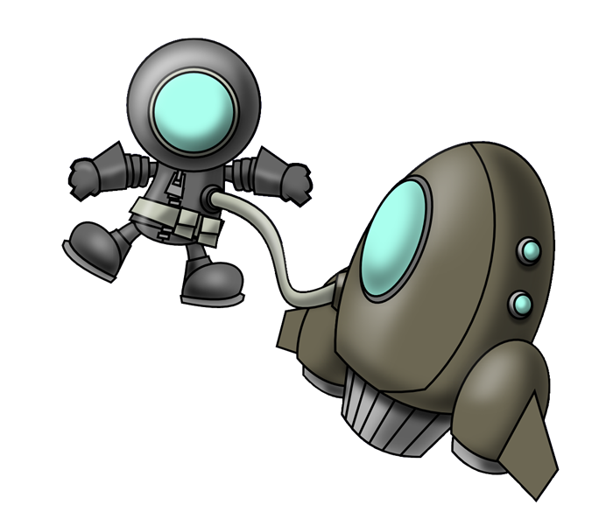
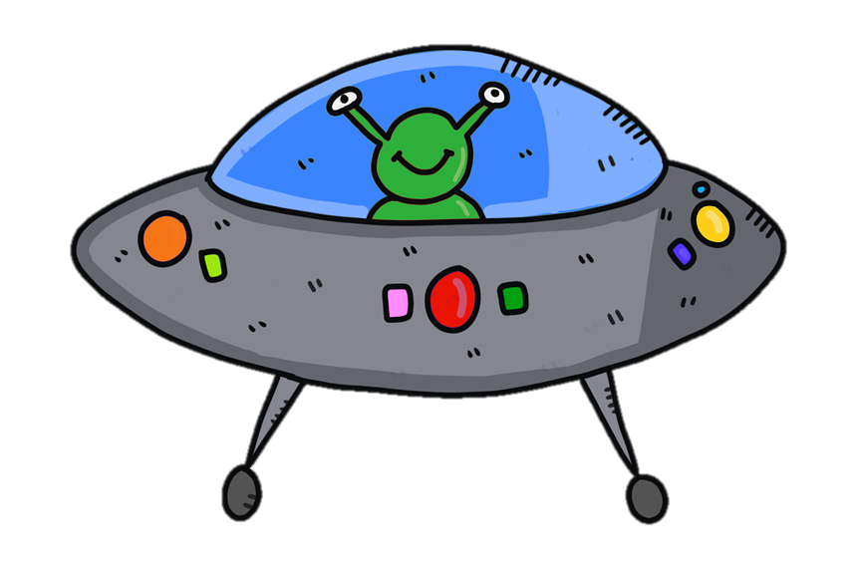
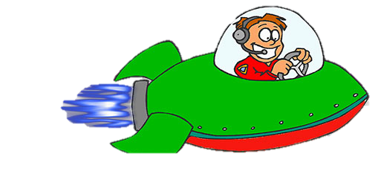
Follow up 2: Schreib auf Englisch.
der Fußball
die Freundin
Achtung! – Watch out!
Achtung*! They disappear fast! Then try to say the German for all the words on your list.
das Handy
dein (e)
der Hund
mein (e)
kein(e)
der Freund
das Wasser
das Bild
das Wort
die Tasche
Notes:
With thanks to Amanda Izquierdo for the task design.
Timing: 5 minutes
Aim: to practise written recall of meanings of 12 items of vocabulary from this week’s new and revisited list.
Procedure:
Click to animate. A word will pass across the screen.
Pupils write down the English meaning.
Repeat for items 2-12.
In pairs, pupils try to say the German for all the items on their list. Note: they may not manage to do them all but should not worry at this stage. Follow up 5 offers another opportunity to revisit much of the same vocabulary.
The next slide presents the answers, in order, with audio.
Answers: der Hund
das Bild
die Freundin
das Handy
der Freund
das Wasser
das Wort
mein(e)
dein (e)
die Tasche
kein (e)
der Fußball

Slide 6
Follow up 2: Antworten
Achtung! – Watch out!
die Freundin
der Hund
das Handy
das Bild
das Wasser
der Freund
das Wort
mein (e)
der Fußball
kein(e)
die Tasche
dein (e)
Notes:
Aim: to practise written recall of meanings of 12 items of vocabulary from this week’s new and revisited list.
Procedure:
Click to animate. Words appear in answer order, with audio to check, if required.
Answers: der Hund
das Bild
die Freundin
das Handy
der Freund
das Wasser
das Wort
mein(e)
dein (e)
die Tasche
kein (e)
der Fußball

Slide 7
Follow up 3
Robbie can read German and English now, too. Can you?
lesen
Das ist ein Hund!
Das ist kein Hund!
Das ist ein Handy.
Guten Tag, Klasse 3!
Du bist eine Person.
Auf Wiedersehen!
Bist du meine Freundin?
Das ist kein Wort!
Ist das ein Foto?
Ich bin keine Person!
Ich bin dein Freund!
I am not a person!
I am your friend! (m)
Are you my friend? (f)
That is a mobile phone.
You are a person.
Is that a photo?
That is not a dog!
That isn’t a word!
That is a dog!
Goodbye!
Hello, class 3!
Notes:
Timing: 5 minutes
Aim: to practise comprehension and translation of written phrases using ich bin/du bist/ das ist + ein/eine/ein and kein/keine/kein + a range of new and revisited nouns.
Procedure:
1. Click to bring up the first item.
2. Pupils to translate e.g. on mini whiteboards.
3. Click to bring up English translation (by Robbie).
4. Continue for items 2-11.

Slide 8
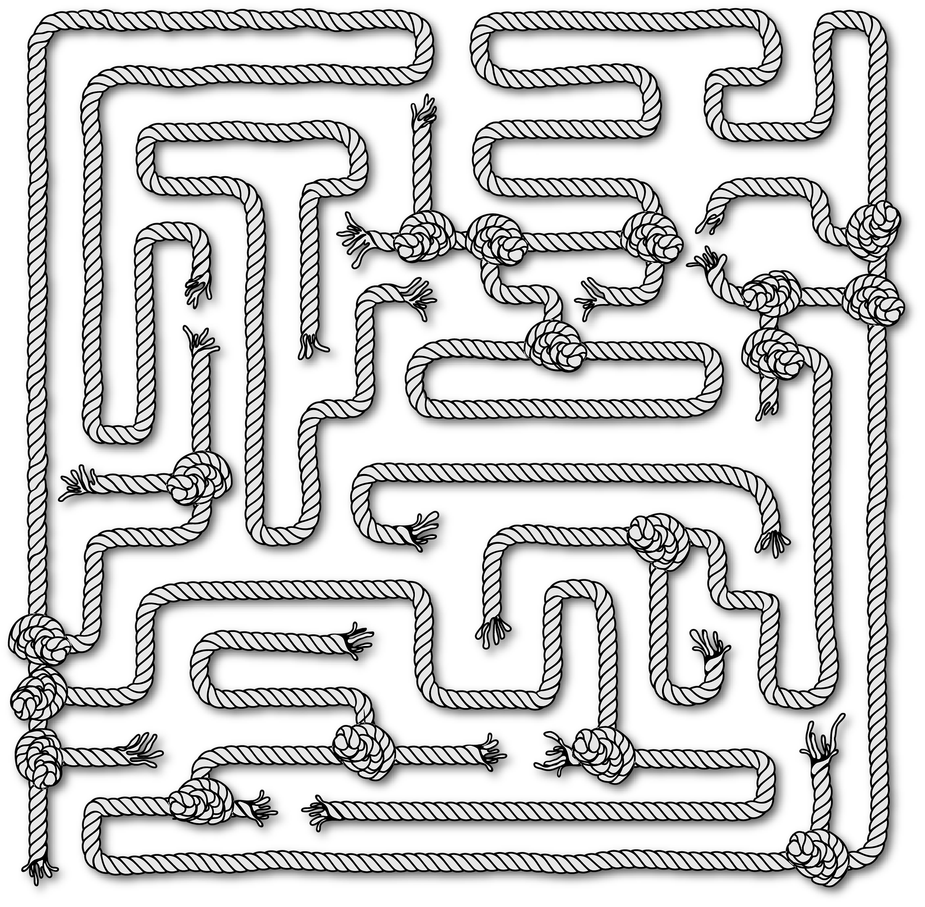
Follow up 4
Sag die Sätze*!
…
Robbie has learnt a lot of German this week but is feeling a bit muddled. Can you help them find their way through the maze?
sprechen
Das ist ein Hund!
Das ist kein Hund?
Das ist kein Handy
Das ist keine Handy?
Sätze – sentences
Notes:
Timing: 5 minutes
Aim: to practise oral production of sentences with ein/eine/ein and kein/keine/kein and a range of new and revisited nouns.
Procedure: 1. Read the scenario: pupils are going to help Robbie find their way through the maze by producing correct German sentences using ein/eine/ein or kein/keine/kein. If there is a cross on the object, pupils must make a sentence with kein(e). If they only see the object, they use ein(e). They need to think about the gender of each noun to make accurate sentences e.g das ist kein Foto but das ist keine Flasche.
2. Click through the first two together- Robbie gets them wrong, can the class correct? In the first example they use kein instead of ein. In the second they use keine instead of kein.
3. In pairs, pupil take it in turns to say sentences to make their way from the bottom to the top of the maze. If they make a mistake, they go back to the start.
4. They then need to find their way back through the maze (top to bottom) using a different route.
5. If time, play a whole class version, with pupils listening out carefully for correct use of ein and kein words.
Correct sentences (bottom to top):
Das ist ein Hund.
Das ist ein Wort.
Das ist kein Handy.
Das ist kein Fußball.
Das ist eine Freundin.
Das ist eine Flasche.
Das ist ein Fußball.
Das ist kein Wort.
Das ist kein Hund.
Das ist kein Foto.
Das ist keine Flasche.
Das ist ein Handy.
Das ist kein Wasser.

Slide 9
Follow up 5:

Schreib auf Englisch.
Can you get at least 15 points?
Wörter
 | was? | falsch | richtig
 | blau | das | gelb
 | die Freundin | mein | deine
 | das Bild | die Tasche | der Freund
 | kein | keine | das Handy
 | das Wort | der Hund | das Wasser
what?
wrong, false
right, true
Vokabeln
x3
blue
the (nt), that
yellow
(the) female friend
my (m,nt)
your (f)
x2
(the) picture
(the) bag
(the) male friend
not a/no (m, nt)
not a/no (f)
(the) mobile phone
x1
(the) word
(the) dog
(the) water
Notes:
Timing: 5 minutes
Aim: to practise written comprehension of vocabulary from this and revisited weeks.
Procedure: 1. Give pupils a blank grid. They fill in the English meanings of any of the words they know, trying to reach 15 points in total. 2. Remind pupils to think about genders (masculine/feminine/neuter) for nouns and kein/mein/dein.
Note: The most recently learnt and practised words are pink, words from the previous week are green and those from week 1 are blue, thus more points are awarded for them, to recognise that memories fade and more effort (heavy lifting!) is needed to retrieve them.

Slide 10
Follow up 5:

Schreib auf Deutsch.
Can you get at least 15 points?
Wörter
 | the (nt), that | yellow | blue
 | what? | right, true | wrong, false
 | (the) female friend | (the) bag | (the) male friend
 | my (m,nt) | your (f) | (the) picture
 | (the) dog | (the) water | (the) word
 | not a/no (m,nt) | not a/no (f) | (the) mobile phone
das
gelb
blau
Vokabeln
x3
was?
richtig
falsch
die Freundin
die Tasche
der Freund
x2
mein
deine
das Bild
der Hund
das Wasser
das Wort
x1
kein
keine
das Handy
Notes:
Timing: 5 minutes
Aim: to practise written production of vocabulary from this and revisited weeks.
Procedure: 1. Give pupils a blank grid. They fill in the German translations of any of the words they know, trying to reach 15 points in total. 2. Remind pupils to think about genders (masculine/feminine/neuter) for nouns and kein/mein/dein.
Note: The most recently learnt and practised words are pink, words from the previous week are green and those from week 1 are blue, thus more points are awarded for them, to recognise that memories fade and more effort (heavy lifting!) is needed to retrieve them.

Slide 11
Tschüss!
rot
Notes:
11

Slide 12
Follow up 5:

Schreib auf Englisch.
Can you get at least 15 points?
Wörter
 | was? | falsch | richtig
 | blau | das | gelb
 | die Freundin | mein | deine
 | das Bild | die Tasche | der Freund
 | kein | keine | das Handy
 | das Wort | der Hund | das Wasser
Vokabeln
x3
x2
x1
Notes:
HANDOUT

Slide 13
Follow up 5:

Schreib auf Deutsch.
Can you get at least 15 points?
Wörter
 | the (nt), that | yellow | blue
 | what? | right, true | wrong, false
 | (the) female friend | (the) bag | (the) male friend
 | my (m, nt) | your (f) | (the) picture
 | (the) dog | (the) water | (the) word
 | not a/no (m,nt) | not a/no (f) | (the) mobile phone
Vokabeln
x3
x2
x1
Notes:
HANDOUT

