Slide 1
Talking about things and things to do
rot
Follow ups 1-5
Term 2 Week 2
Notes:
Artwork by Steve Clarke. Pronoun pictures from NCELP (www.ncelp.org). All additional pictures selected from Pixabay and are available under a Creative Commons license, no attribution required.
Phonics:
[ö] König [1087] Österreich [n/a] Wörter [194]
Vocabulary (new): Frau [99] Lehrer, Lehrerin [695] sehr [81], Mann [121], Herr [154]
Revisit 1: Buch [300] Haustier [n/a] Schule [359] Tier [614] nicht wahr? [n/a]
Revisit 2: Ding [370] Farbe [1079] Ort [341] Person [357] klar [239] oder [35] ein, eine [5]
Jones, R.L & Tschirner, E. (2019). A frequency dictionary of German: Core vocabulary for learners. London: Routledge.
The frequency rankings for words that occur in this PowerPoint which have been previously introduced in these resources are given in the SOW and in the resources that first
introduced and formally re-visited those words.
For any other words that occur incidentally in this PowerPoint, frequency rankings will be provided in the notes field wherever possible.

Slide 2
aussprechen
long [o]
…
wo
wohnen
Million
Notes:
Timing: 1 minute
Aim: to consolidate the SSC long [o].
Procedure:
Re-present the SSC and the source word ‘wo’ (with gesture, if using).
Click to bring on the picture and get pupils to repeat the word ‘wo’ (with gesture, if using).
Present the cluster words in the same way, bringing on the picture and getting pupils to pronounce the words.
Word frequency (1 is the most frequent word in German): Million [206]] wo? [94] wohnen [380]
Jones, R.L & Tschirner, E. (2019). A frequency dictionary of German: Core vocabulary for learners. London: Routledge.

Slide 3
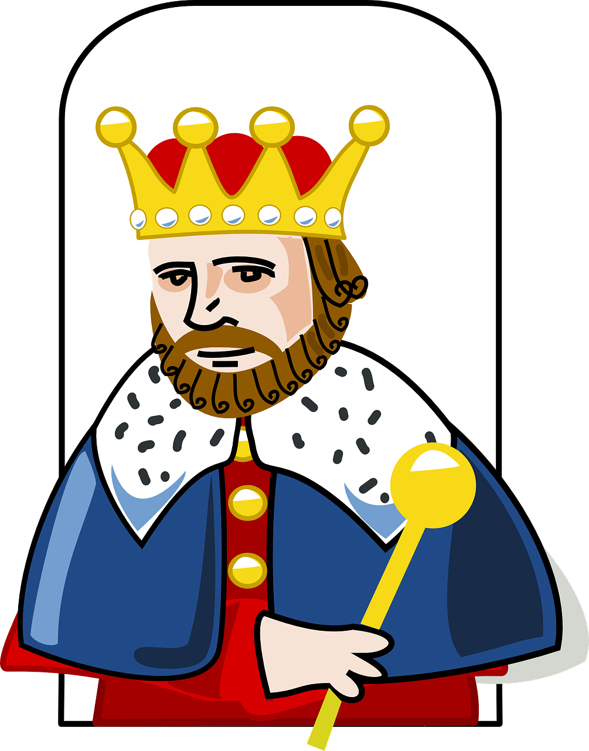
aussprechen
[ö]
…
To make the ö sound, say the letter ‘e’ and then round your lips as tightly as possible. Check your partner’s lips. Are they rounded?
König
[king]
Notes:
Timing: 1 minute
Aim: To introduce SSC [ö]
Procedure:
Introduce the SSC and and say the [ö] sound first, on its own. Pupils repeat it with you.
Present the source word ‘König’ (with gesture, if using).
Click to bring on the picture and get pupils to repeat the word ‘König’ (with gesture, if using).
Note:
A gesture for this could be to mime placing a crown on your head.
König [1087]
Jones, R.L & Tschirner, E. (2019). A frequency dictionary of German: Core vocabulary for learners. London: Routledge.
3

Slide 4
aussprechen
[ö]
…
Österreich
König
Wörter
[Austria]
[king]
[words]
Notes:
Timing: 1 minute
Aim: to introduce the SSC [ö].
Procedure:
Re-present the SSC and the source word ‘König’ (with gesture, if using).
Click to bring on the picture and get pupils to repeat the word ‘König’ (with gesture, if using).
Present the cluster words in the same way, bringing on the picture and getting pupils to pronounce the words.
König [1087] Österreich [707] Wörter [194]
Jones, R.L & Tschirner, E. (2019). A frequency dictionary of German: Core vocabulary for learners. London: Routledge.
4

Slide 5
Follow up 1a
. Écoute les noms des animaux. C’est [ien] ou [(a)in]?
Hör zu. Ist es [ä] oder [ö] ?
[ä]
[ö]
hören
Bär
Körper
Hälfte
Löwe
Nähe
Käse
Löffel
zwölf
Nächte
Neukölln
Can you help Robbie to score lots of goals?
???????
???????
???????
???????
???????
???????
???????
???????
???????
???????
Notes:
Timing: 5 minutes
Aim: Aural recognition and production of SSCs [ö] and [ä]
Procedure:
Click on the [ö] and [ä] to hear and revise these two sounds.
Pupils write down 1-10. For each word they hear, they are going to write down either ä or ö. Alternatively they could signal left goal and right goal with their arms based on the sound they identify.
Click to bring up a football and hear an unseen word. Ask pupils which goal the word should go into.
Click to shoot the ball into the correct goal and to bring up a picture to show the meaning of the word.
Repeat for the following 9 words. How many goals can they help Robbie to score?
Once all 10 words are in the goals, pupils should try to pronounce them all. Click on each word to check pronunciation.
Word frequency of unknown words and cognates (1 is the most frequent word in German):
Bär [3494] Körper [488] Löwe [4160] Hälfte [929] Nähe [918] Käse [4094] Löffel [N/A] [1080] Neukölln [N/A] Nächte [325]
Note: most of the words in this task will be taught later in the scheme of work.
Transcript & meanings: Bär (bear)
Körper (body)
Löwe (lion)
Hälfte (half)
Nähe (vicinity; proximity)
Käse (cheese)
Löffel (spoon)
Zwölf (12)
Neukölln (a district of Berlin)
Nächte (nights)
5

Slide 6
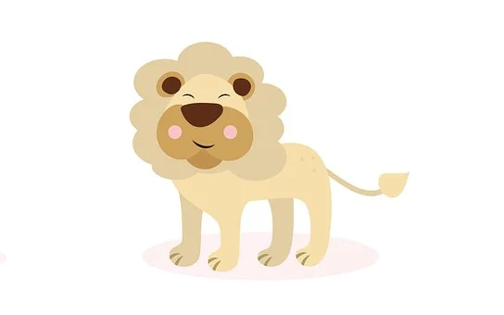
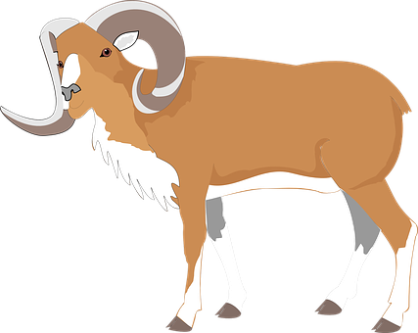
Follow up 1b
. Écoute les noms des animaux. C’est [ien] ou [(a)in]?
Sag die Wörter.
Robbie has been on a trip around the earth and has encountered some interesting
animals. Can you help to pronounce them all?
aussprechen
Leon der Löwe
Waldi und Wilhelm die Walrösser
Moritz die Möwe
Sofie die Seelöwin
Simon der Stör
Erich das Eichhörnchen
Sebastian und Stefan die Schafböcke
Sandra die Schildkröte
Notes:
Timing: 2 minutes
Aim: to practise pronouncing unknown words with the SSC [ö]
Procedure:
Explain the scenario: Robbie has been travelling around the earth. They have never seen these animals before. Pupils will help them to pronounce the types of animals, which all contain the ö sound.
Click on each text box to hear the correct pronunciation.
Note:
Can pupils spot the female ending on Seelöwin? They have seen this pattern this week with Lehrerin and Freundin.

Slide 7
Follow up 2
Hör zu und schreib die richtigen Buchstaben*.
hören
A I | E am | H not | K here
B you | F are | I not the | L there
C he | G is | J not a/no | M yellow
D that |  |  | N correct
 |  |  | O [female] friend
 |  |  | P [male] friend
 |  |  | Q [female] teacher
 |  |  | R [male] teacher]
1
D
G
H
N
5
B
F
J
R
2
A
E
J
Q
6
D
G
H
M
3
C
G
I
P
7
B
F
H
K
4
C
G
H
L
8
A
E
I
O
Buchstaben=letters (A-Z)
Notes:
Timing: 5 minutes Aim: to practise aural comprehension of this week’s new language.
Procedure:
Click the numbered buttons to listen to each German sentence.
Pupils select 4 letters from the table above (A-R) for each sentence to translate what they hear into English. Encourage them to listen out for male/female person nouns and to think carefully about whether they heard nicht/kein/keine and to choose carefully between H/I/J.
Click to correct after each one, to give pupils instant feedback.
If time allows, elicit the German sentences from pupils chorally and click again for the audio, to listen and check.
Transcript:
Das ist nicht richtig!
Ich bin keine Lehrerin.
Er ist nicht der Freund.
Er ist nicht da!
Du bist kein Lehrer.
Das ist nicht gelb!
Du bist nicht hier.
Ich bin nicht die Freundin!

Slide 8
Follow up 3
Rot is an adjective so we use nicht to make it negative.
…
Robbie is muddled yet again. Can you help to make German sentences?
Person A translates Robbie’s sentences into German.
Person B corrects the sentences by making them negative.
sprechen
 |  | Person A | Person B
1
2
3
4
5
6
7
I am red!
Ich bin rot!
Ich bin nicht rot!
Remember to use ‘nicht’ with proper nouns
He is there!
Er ist da!
Er ist nicht da!
Remember to use ‘nicht’ before der/die/das.
She is a friend.
Sie ist eine Freundin.
Sie ist keine Freundin.
That is a book.
Das ist ein Buch.
Das ist kein Buch.
That is England.
Das ist England.
Das ist nicht England.
That is wrong!
Das ist falsch!
Das ist nicht falsch!
He is the teacher.
Er ist der Lehrer.
Er ist nicht der Lehrer.
Notes:
Timing: 5 minutes
Aim: to practise sentence-building using language from this week, with a particular focus on use of nicht and kein.
Note:
There is an optional handout grid at the end of this presentation to offer pupils support with the translation. This grid is also on the next slide.
There is an alternative whole class version of this activity on the next slide.
Procedure:
Explain the scenario: Robbie is muddled and is making nonsense sentences. Person A translates the sentence as it is into German, and Person B then makes it negative (to make it true for the picture).
Click to bring up the English prompt and picture for number 1. Elicit the translation of the sentence and click to reveal. Discuss with pupils whether you need nicht or kein to make this sentence negative, then click to reveal answer.
Pupils continue to work through 2-7 in pairs.
Use the call-outs to highlight the trickier rules in 5 and 7.
Additional task suggestions:
Pupils could also correct the sentences e.g. Er ist nicht da. Er ist hier! This would provide further practice of vocab.
Pupils could make their own incorrect sentences, which their partner must then correct using a negative e.g. Das ist eine Person (pointing at a book). Das ist keine Person. Das ist ein Buch!

Slide 9
Follow up 3
Rot is an adjective so we use nicht to make it negative.
…
Robbie is muddled yet again. Can you help to make German sentences?
Translate Robbie’s English sentence into German.
Make the sentence negative to make it true!
sprechen
Remember to use ‘nicht’ with proper nouns
Ich bin Du bist Er ist Sie ist Das ist | nicht ein eine kein keine nicht der nicht die nicht das | rot/gelb/falsch/richtig/da/hier/wahr
 |  | England/Deutschland
 |  | Freund/Freundin/Lehrer/Lehrerin Buch/Ort/Tier/Ding
She is the [female] friend.
Ich bin rot!
Er ist nicht der Lehrer.
Das ist ein Buch.
Er ist der Lehrer.
Das ist nicht England.
Ich bin nicht rot!
Das ist nicht falsch.
Das ist nicht das Buch.
He is there!
Das ist kein Buch.
She is a friend.
I am red!
Sie ist nicht die Freundin.
That is wrong!
That is the book.
Das ist das Buch.
Das ist England.
That is a book.
Das ist falsch.
Er ist nicht da!
That is England.
Sie ist eine Freundin.
Sie ist keine Freundin.
He is the teacher.
Er ist da!
Sie ist die Freundin.
Notes:
This is the alternative whole class version of the activity.
Timing: 5 minutes
Aim: to practise sentence-building using language from this week, with a particular focus on use of nicht and kein. .
Procedure:
Explain the scenario: Robbie is muddled and is making nonsense sentences. Pupils first translate the sentence as it is into German, using the grid, and then they make it negative ( to make it true for the picture) by adding in a word from the middle column of the grid.
Click to bring up the English prompt and picture for the first sentence. Elicit the translation of the sentence (pointing at the options in the table) and click to reveal. Discuss with pupils whether you need nicht or kein to make this sentence negative, then click to reveal answer.
Continue to work through 2-7 in pairs. Pupils could answer orally, discuss in pairs, or on mini whiteboards.
Use the call-outs to highlight the trickier rules.
Note: There is an alternative paired speaking version of this activity on the previous slide. Additional task suggestions: 1. Pupils could also correct the sentences e.g. Er ist nicht da. Er ist hier! This would provide further practice of vocab.
2. Pupils could make their own incorrect sentences, which their partner must then correct using a negative e.g. A: Das ist eine Person (pointing at a book). B: Das ist keine Person. Das ist ein Buch!

Slide 10
Follow up 4:

Schreib auf Englisch.
Can you get at least 15 points?
Wörter
 | die Person | ein, eine | die Farbe
 | der Ort | klar | oder
 | das Haustier | das Buch | die Schule
 | das Ding | nicht wahr? | das Tier
 | die Frau | sehr | die Freundin
 | der Freund | der Lehrer | die Lehrerin
Vokabeln
x3
(the) person
a/an (m), a/an (f)
(the) colour
(the) place
clear
or
x2
(the) pet
(the) book
(the) school
(the) thing
Isn’t it? Isn’t that right?
(the) animal
(the) woman, Mrs,Ms
very
(the) [female] friend
x1
(the) [male] friend
(the) [male] teacher
(the) [female] teacher
Notes:
Timing: 5 minutes
Aim: to practise written comprehension of vocabulary from this and revisited weeks.
Procedure: 1. Give pupils a blank grid. They fill in the English meanings of any of the words they know, trying to reach 15 points in total. 2. Remind pupils to think about the male and female person nouns (-in added for feminine) when translating.
Note: The most recently learnt and practised words are pink, words from the previous week are green and those from week 1 are blue, thus more points are awarded for them, to recognise that memories fade and more effort (heavy lifting!) is needed to retrieve them.

Slide 11
Follow up 4:

Schreib auf Deutsch.
Can you get at least 15 points?
Wörter
 | clear | or | a/an (m), a/an (f)
 | (the) colour | (the) place | (the) person
 | (the) pet | Isn’t it? Isn’t that right? | (the) thing
 | (the) book | (the) animal | (the) school
 | very | (the) [male] friend | (the) [female] friend
 | (the) woman, Mrs, Ms | (the) [male] teacher | (the) [female] teacher
klar
oder
ein, eine
Vokabeln
x3
die Farbe
der Ort
die Person
das Haustier
nicht wahr?
das Ding
x2
das Buch
das Tier
die Schule
sehr
der Freund
die Freundin
x1
der Lehrer
die Frau
die Lehrerin
Notes:
Timing: 5 minutes
Aim: to practise written production of vocabulary from this and revisited weeks.
Procedure: 1. Give pupils a blank grid. They fill in the German meanings of any of the words they know, trying to reach 15 points in total. 2. Remind pupils to think about the gender of the nouns (and in particular here how the female person nouns change).
Note: The most recently learnt and practised words are pink, words from the previous week are green and those from week 1 are blue, thus more points are awarded for them, to recognise that memories fade and more effort (heavy lifting!) is needed to retrieve them.

Slide 12
Follow up 5
 Bingo
Schreib 9 Wörter auf Deutsch.
schreiben
a /an (feminine) | (the) [female] teacher
(the) woman | (the) book
(the) [male] friend | Isn’t it? Isn’t that right?
very | clear
(the) animal | or
Notes:
Timing: 5 minutes
Aim: to practise written production of this week’s new language and revisited words for this week.
Procedure: 1. Pupils choose any 9 of the words from the English table and write them into their grid in German.
2. Teacher then calls out the German for any of the 9 words in the table in whichever order.
3. Pupils call Bingo when they have any three in a row (vertical, horizontal, or diagonal) and then again for the first full house.
4. Click on the blue buttons to hear the German translations if needed to support the activity.
Translation:
a/an (feminine)= eine
(the) woman= die Frau
(the) [male] friend= der Freund
very=sehr
(the) animal= das Tier
(the) [female] teacher= die Lehrerin
(the) book= das Buch
Isn’t it? Isn’t that right?= nicht wahr?
clear= klar
or= oder

Slide 13
Tschüss!
rot
Notes:
13

Slide 14
Follow up 4:

Schreib auf Englisch.
Can you get at least 15 points?
Wörter
 | die Person | ein, eine | die Farbe
 | der Ort | klar | oder
 | das Haustier | das Buch | die Schule
 | das Ding | nicht wahr? | das Tier
 | die Frau | sehr | die Freundin
 | der Freund | der Lehrer | die Lehrerin
Vokabeln
x3
x2
x1
Notes:
HANDOUT

Slide 15
Follow up 4:

Schreib auf Deutsch.
Can you get at least 15 points?
Wörter
 | clear | or | a/an (m), a/an (f)
 | (the) colour | (the) place | (the) person
 | (the) pet | Isn’t it? Isn’t that right? | (the) thing
 | (the) book | (the) animal | (the) school
 | very | (the) [male] friend | (the) [female] friend
 | (the) woman, Mrs, Ms | (the) [male] teacher | (the) [female] teacher
Vokabeln
x3
x2
x1
Notes:
HANDOUT

Slide 16
Notes:
HANDOUT
Optional handout for Follow up 3. There are 5 copies of the grid on the page.

