Slide 1
Talking about things and things to do
rot
Identifying things
nicht & kein, keine, kein
SSC [ö] and [o]
Term 2 Week 2
Notes:
Artwork by Steve Clarke. Pronoun pictures from NCELP (www.ncelp.org). All additional pictures selected from Pixabay and are available under a Creative Commons license, no attribution required.
Phonics:
[ö] König [1087] Österreich [707] Wörter [194]
Vocabulary (new): Frau [99] Lehrer, Lehrerin [695] sehr [81], Mann [121], Herr [154]
Revisit 1: Buch [300] Haustier [n/a] Schule [359] Tier [614] nicht wahr? [n/a]
Revisit 2: Ding [370] Farbe [1079] Ort [341] Person [357] klar [239] oder [35] ein, eine [5]
Jones, R.L & Tschirner, E. (2019). A frequency dictionary of German: Core vocabulary for learners. London: Routledge.
The frequency rankings for words that occur in this PowerPoint which have been previously introduced in these resources are given in the SOW and
in the resources that first introduced and formally re-visited those words.
For any other words that occur incidentally in this PowerPoint, frequency rankings will be provided in the notes field wherever possible.
1

Slide 2
aussprechen
long [o]
…
wo
wohnen
Million
Notes:
Timing: 1 minute
Aim: to consolidate the SSC long [o].
Procedure:
Re-present the SSC and the source word ‘wo’ (with gesture, if using).
Click to bring on the picture and get pupils to repeat the word ‘wo’ (with gesture, if using).
Present the cluster words in the same way, bringing on the picture and getting pupils to pronounce the words.
Word frequency (1 is the most frequent word in German): Million [206]] wo? [94] wohnen [380]
Jones, R.L & Tschirner, E. (2019). A frequency dictionary of German: Core vocabulary for learners. London: Routledge.

Slide 3
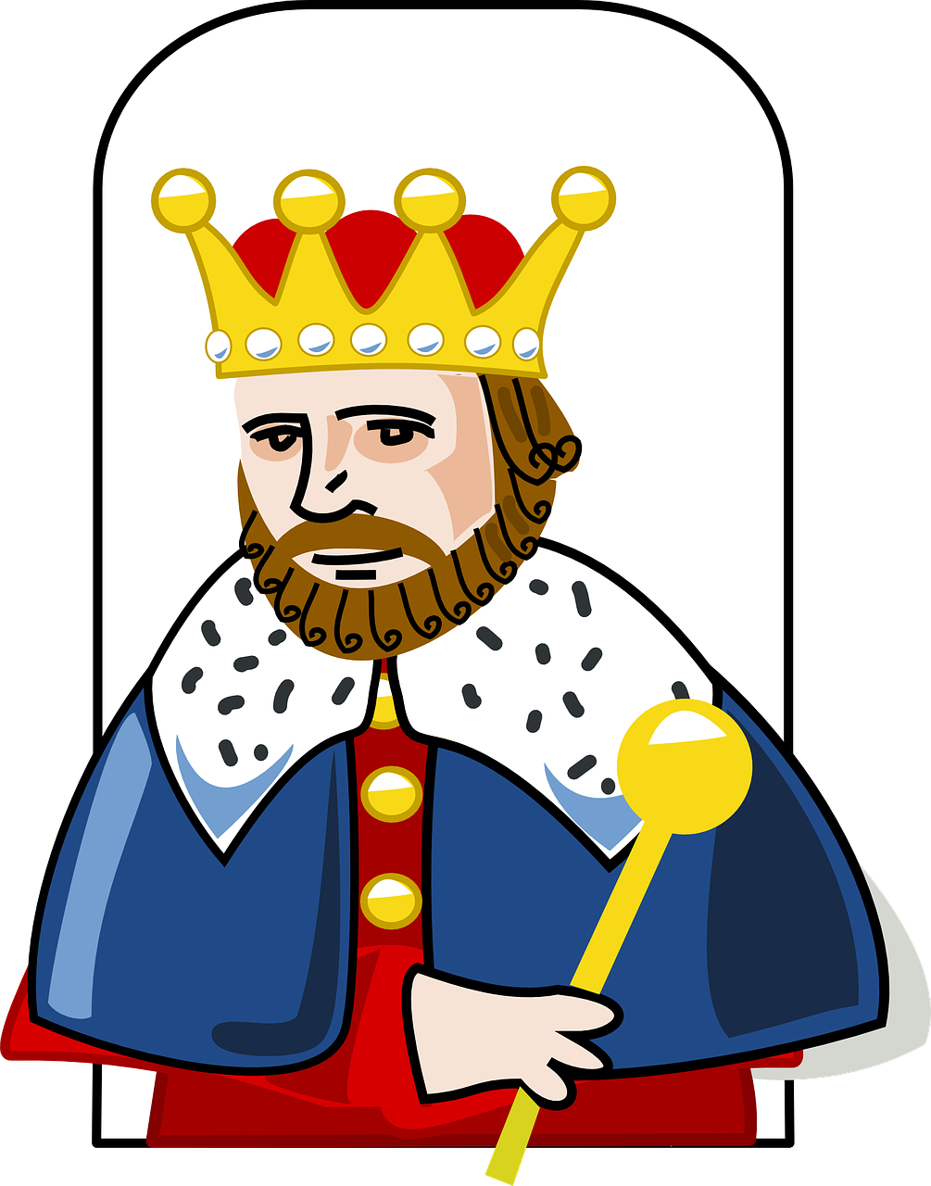
aussprechen
[ö]
…
To make the ö sound, say the letter ‘e’ and then round your lips as tightly as possible. Check your partner’s lips. Are they rounded?
König
[king]
Notes:
Timing: 1 minute
Aim: To introduce SSC [ö]
Procedure:
Introduce the SSC and and say the [ö] sound first, on its own. Pupils repeat it with you.
Present the source word ‘König’ (with gesture, if using).
Click to bring on the picture and get pupils to repeat the word ‘König’ (with gesture, if using).
Note:
A gesture for this could be to mime placing a crown on your head.
König [1087]
Jones, R.L & Tschirner, E. (2019). A frequency dictionary of German: Core vocabulary for learners. London: Routledge.
3

Slide 4
aussprechen
[ö]
…
Österreich
König
Wörter
[Austria]
[king]
[words]
Notes:
Timing: 1 minute
Aim: to introduce the SSC [ö].
Procedure:
Re-present the SSC and the source word ‘König’ (with gesture, if using).
Click to bring on the picture and get pupils to repeat the word ‘König’ (with gesture, if using).
Present the cluster words in the same way, bringing on the picture and getting pupils to pronounce the words.
König [1087] Österreich [707] Wörter [194]
Jones, R.L & Tschirner, E. (2019). A frequency dictionary of German: Core vocabulary for learners. London: Routledge.
4

Slide 5
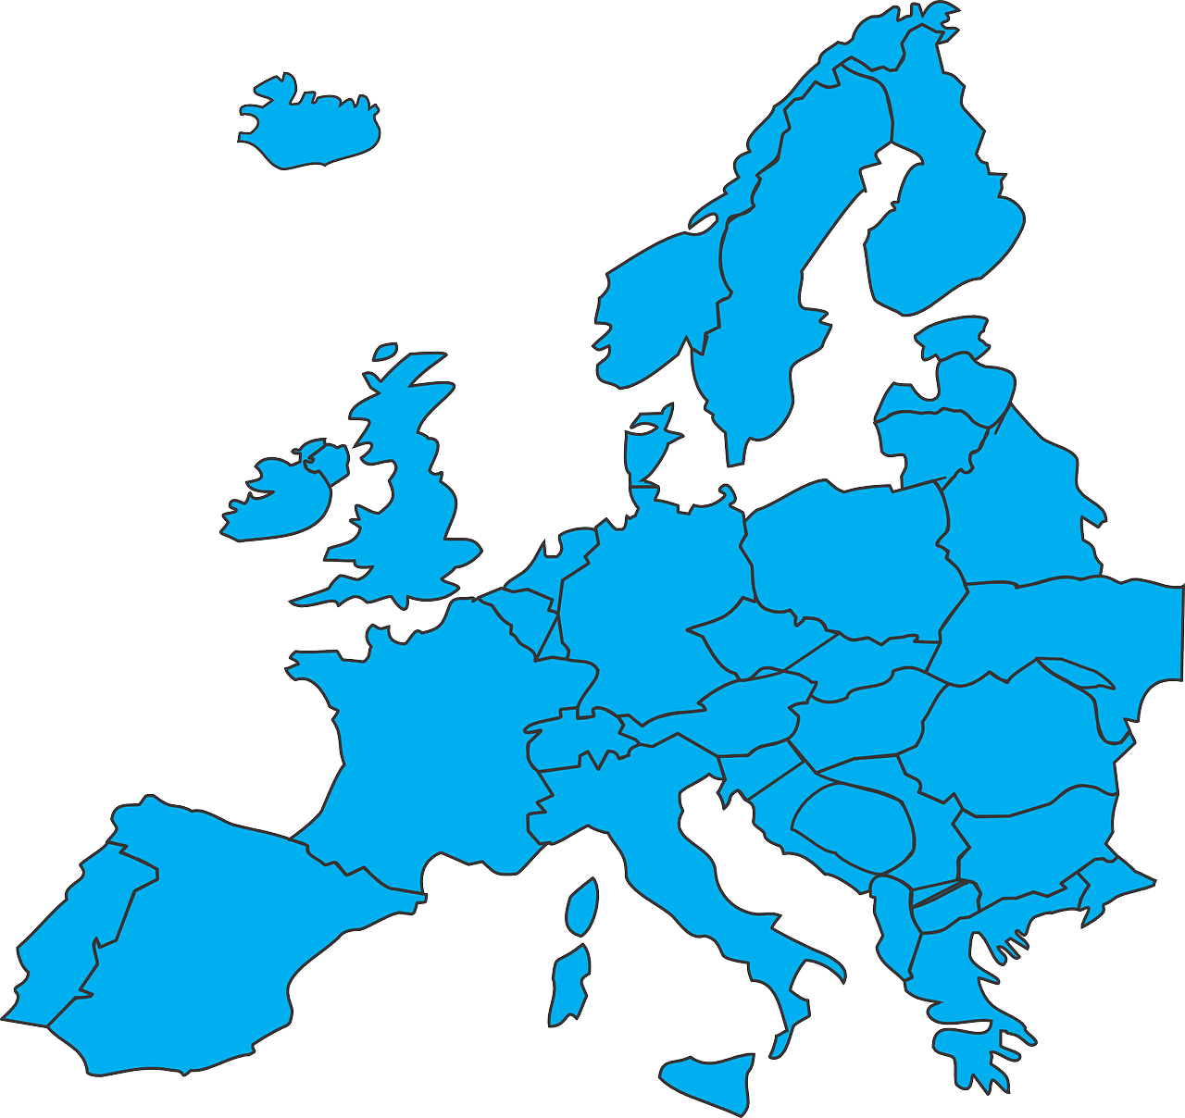
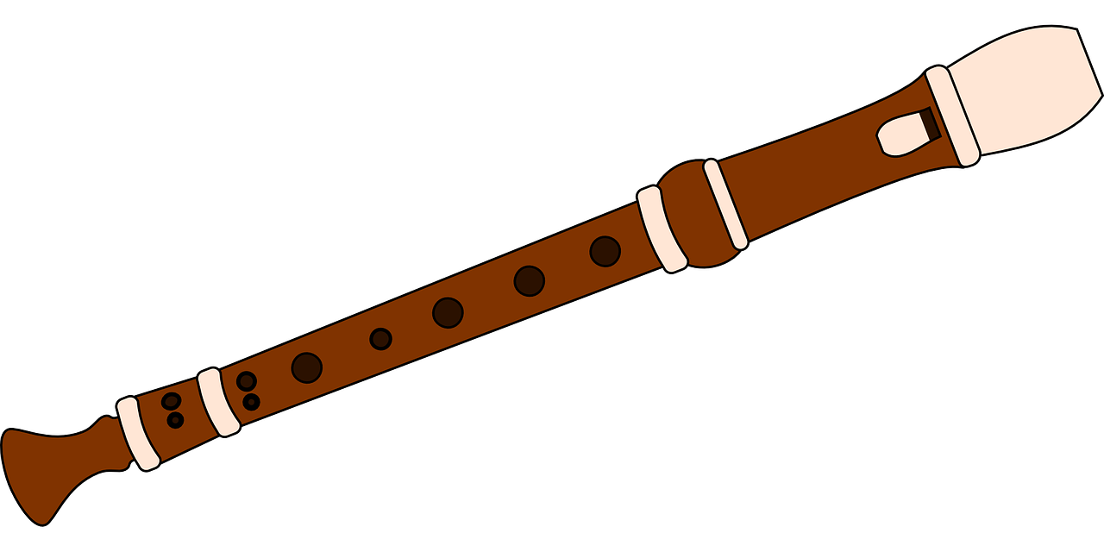
hören
Hör zu. Ist es [ö] oder [o]?
Schreib die Wörter.
hören
W ö r t e r
_
E u r o p a
_
S o m m e r
L ö f f e l
_
_
[o]
[ö]
[o]
&
[ö]
L ö w e
_
P r o j e k t
_
K ö l n
_
U n i f o r m
B l o c k f l ö t e
_
_
_
Notes:
Timing: 5 minutes
Aim: to distinguish between the SSCs [ö] and [o] by listening to unknown words and identifying the sounds.
Procedure:
Click for instructions to come up.
Pupils sketch the Venn-diagram in their books.
Click on the images one by one to hear the pronunciation of these (mostly) unknown words.
Pupils assign the word to the appropriate part of the diagram. Note: pupils could face away from the board if they want to challenge themselves. Elicit the answer.
Click to reveal answers (clockwise, starting from the top RHS with Europa).
Meanings: Europa= Europe
Sommer= Summer Löwe= lion
Blockflöte= recorder
Köln= Cologne Uniform= uniform Projekt= project Löffel= spoon
Wörter= words
Note: these are all words that will be taught later as part of this SOW. Word frequency (1 is the most frequent word in German): Europa [294], Sommer [771 ], Löwe [4160 ], Köln [N/A ], Blockflöte [N/A], Uniform [3857 ], Projekt [720 ], Löffel [N/A], Wörter [ 194] Source: Jones, R.L. & Tschirner, E. (2019). A frequency dictionary of German: core vocabulary for learners. Routledge

Slide 6
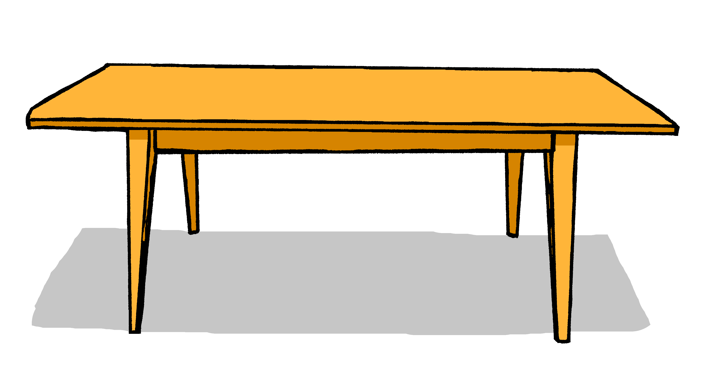
Nicht (not) | kein, keine, kein (not a/an)
You know that nicht is used before an adjective or adverb to mean not:
Der Tisch ist nicht blau.
The table is not blue.
You also know that nicht is also used before proper nouns to mean not:
Das ist nicht England.
That is not England.
However, remember that to say not a with nouns, we use kein:
Das ist kein Tisch.
Das ist keine Flasche.
Das ist kein Buch.
That is not a table.
That is not a bottle.
That is not a book.
Notes:
Timing: 3 minutes
Aim: to revise the use of nicht for negation with adjectives, adverbs, and proper nouns and the use of kein with nouns (not a).
Procedure:
Click through the animations to present the information.
Elicit English translations for the German examples provided.
6

Slide 7
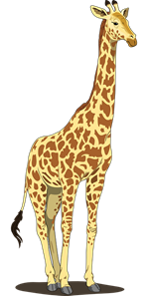
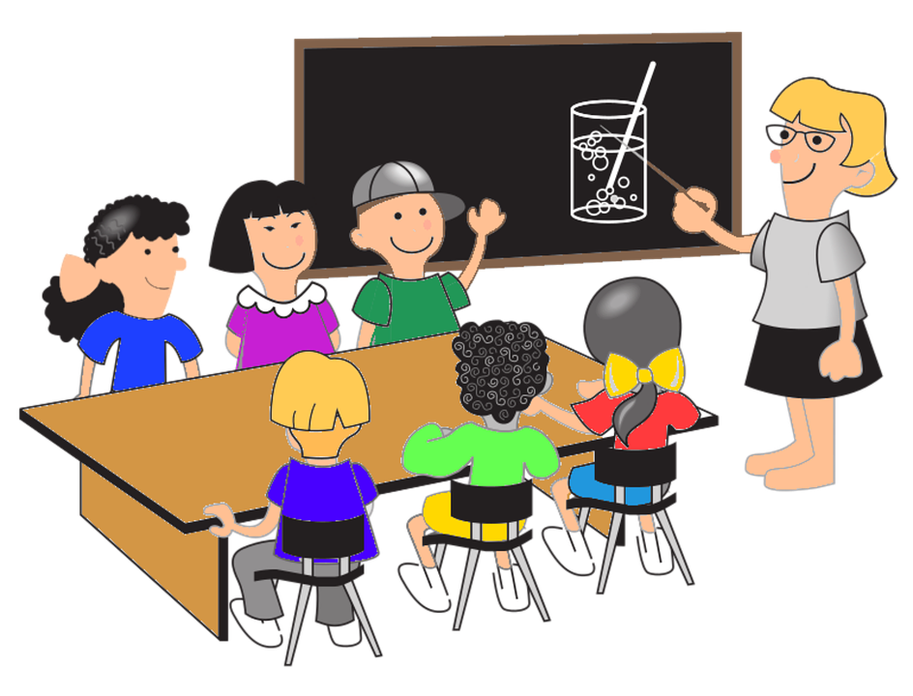
hören
Nicht oder kein? Adjective or noun?
Hör zu. Ist das A oder B?
 | A | B
 |  | small
Das ist nicht… [rot].
1
1
2
2
A | B
3
3
B
B
4
4
B. is short for Beispiel.
5
5
big
6
6
Which of these words are nouns? Which are adjectives or adverbs?
Notes:
Timing: 5 minutes
Aim: to practise aural comprehension of nicht+ adjective/adverb and kein + noun in short sentences.
Procedure:
Click to bring up the example. Pupils will hear a ‘nicht’ sentence or a ‘kein’ sentence with the ending bleeped out and must decide whether it refers to picture A or B, based on whether they hear nicht or kein. If they hear nicht, they should select the adjective, if they hear kein, they should select the noun.
Give pupils 30 seconds to discuss in pairs which pictures represent nouns and which represent adjectives.
Listen to items 1-6 (click on blue audio boxes) and pupils select A or B. Click to bring up answers.
Click to bring up yellow audio boxes and click on each one to hear full sentences with nouns/adjectives.
Transcript:
Beispiel: Das ist nicht [rot].
1. Das ist kein [Tier].
2. Das ist nicht [richtig].
3. Das ist nicht [klein].
4. Das ist keine [Schule].
5. Das ist keine [Farbe].
6. Das ist nicht [falsch].
7

Slide 8
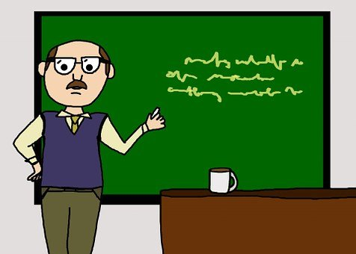
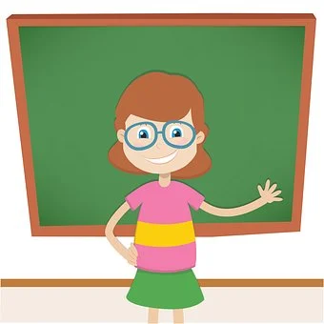
Vokabeln lernen
What is your class teacher called?
Herr..?
Frau..?
Wörter
To say (the) man we use der Mann. But to say Mr XXX we need a different word: Herr
Ich bin Herr Klein.
very
sehr
Die Frau means (the) woman. Frau XXX means Mrs or Ms XXX.
der Mann
der Lehrer
Ich bin Frau Tahler.
die Frau
die Lehrerin
Notes:
[1/2]
Timing: 3 minutes
Aim: to introduce the new items of vocabulary for this week.
Procedure 1. Click to introduce the new words and their pictures.
2. Ask pupils what the words mean in English.
3. Draw attention to the der/die/das- what gender is each noun? What do they notice about the word for a female teacher?
4. Ask pupils if they have seen the word Frau before? Use the call-outs to highlight the use of the same word but difference in meaning for die Frau (woman) and Frau XXX (Mrs, Ms), whereas for men there are different words: der Mann (man) and Herr (Mr).
4. Practise pronouncing the new words as a class and individually. 2. Then, on the next slide, pupils try to match the German and the pictures, then try to recall the German words.

Slide 9
Vokabeln lernen
der Mann
die Frau
der Lehrer
Herr
die Lehrerin
sehr
1
2
5
6
3
4
Mr
very
Notes:
2/2
Timing: 3 minutes (including previous slide) Aim: To provide production (speaking) practice with the new vocabulary.
Procedure: 1. Pupils match the German nouns to the pictures in their heads.
2. The teacher gives the pupils a number and the pupils must say the correct word in German. The number prompts are the trigger (i.e. click on the number) for the lines to connect the correct word to the picture.
3. Click to make each German word disappear in turn. Can pupils recall the German words? Double check understanding of Mann/Herr and Frau x2.

Slide 10
Remember that ‘kein’ works like ‘ein’ and matches the gender of the noun.
Nicht der, die, das (not the) | kein, keine, kein (not a/an)
So, remember that to say not a with nouns, we use kein:
Das ist kein Tisch.
Das ist keine Flasche.
Das ist kein Buch.
That is not a table.
That is not a bottle.
That is not a book.
However, remember that we use nicht before ‘der, die, das’ and a noun to mean not the:
Das ist nicht der Tisch.
Das ist nicht die Flasche.
Das ist nicht das Buch.
That is not the table.
That is not the bottle.
That is not the book.
Notes:
Timing: 2 minutes
Aim: to revise the use of nicht for negation with definite articles (not the) and the use of kein with nouns (not a).
Procedure:
Click through the animations to recap the information.
This time, elicit German translations for the English examples provided.

Slide 11
Female person nouns
We often miss out the words ‘male’ and ‘female’ in English.
To make many German person nouns feminine, we add -in to the masculine noun and change the article to ‘die’.
der Lehrer
die Lehrerin
der Freund
die Freundin
(the) [male]
teacher
(the) [female]
teacher
(the) [male] friend
(the) [female] friend
Robbie is trying to understand all this. Help him translate each sentence.
1. Das ist nicht der Lehrer!
1. That is not the (male) teacher!
2. Das ist kein Freund!
2. That’s not a (male) friend!
3. Sie ist keine Lehrerin!
3. She is not a (female) teacher!
Notes:
Timing: 2 minutes Aim: to introduce the pattern of adding –in to female person nouns and to consolidate use of nicht and kein. Procedure: 1. Click through the animations to present the explanation.
2. Check pupils’ understanding at each stage.
3. Pupils could work in pairs to orally translate the 3 sentences.
11

Slide 12
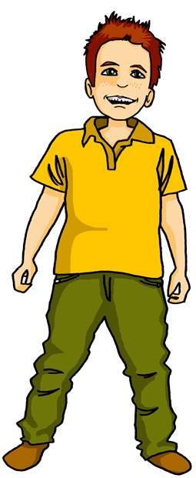
Moritz makes another quiz for Robbie to help him practise German.
Should Robbie choose the male or female noun? Why? What does the sentence mean?
Das ist nicht die Lehrer / Lehrerin.
That is not the [female] teacher.
The ‘die’ here tells Robbie they need a female noun.
Notes:
Timing: 6 minutes (6 slides)
Aim: to recognise in written form the correct use of male and female person nouns and use of kein/nicht.
Procedure:
Explain the scenario and that pupils are going to make decisions about which noun is needed to complete each sentence, and then translate each sentence.
Work through the first slide together as a class. Prompt pupils using the call-outs-and click to cover up the incorrect word. Elicit the translation: click to reveal the answer in green call-out. .
For the following 5 slides, pupils note down A or B for the noun they think is correct and discuss the translation of the whole sentence in pairs. Negatives kein and nicht appear here too.
Click to reveal answers slide by slide.

Slide 13
Moritz makes another quiz for Robbie to help him practise German.
Should Robbie choose the male or female noun? Why? What does the sentence mean?
Das ist kein Freund / Freundin.
.
Remember that kein is used for ‘not a’ before a noun
There is no ‘e’ here this time which tells us the friend is masculine.
That is not a [male] friend.

Slide 14
Moritz makes another quiz for Robbie to help him practise German.
Should Robbie choose the male or female noun? Why? What does the sentence mean?
Das ist nicht die Freund / Freundin.
That is not the [female] friend.
The ‘die’ here tells Robbie they need a female noun.

Slide 15
Moritz makes another quiz for Robbie to help him practise German.
Should Robbie choose the male or female noun? Why? What does the sentence mean?
Ich bin kein Pilot/ Pilotin.
.
This is a cognate; the English word is the same.
Remember that kein is used for ‘not a’ before a noun
I am not a pilot.
There is no ‘e’ here

Slide 16
Moritz makes another quiz for Robbie to help him practise German.
Should Robbie choose the male or female noun? Why? What does the sentence mean?
Das ist keine Lehrerin / Lehrer .
.
That is not a [female] teacher.
What does the ‘e’ here tell you?

Slide 17
Moritz makes another quiz for Robbie to help him practise German.
Should Robbie choose the male or female noun? Why? What does the sentence mean?
Du bist [nicht die Partnerin]/
[kein Partner]
You are not the [female] partner.
Both sentences are correct here, but they mean different things…
You are not a [male] partner

Slide 18
Tschüss!
rot
Notes:
18

