Slide 1
Talking about things and things to do
Konrad Duden Schule
rot
Follow ups 1-5
Term 2 Week 4
Notes:
Artwork by Steve Clarke. Pronoun pictures from NCELP (www.ncelp.org). All additional pictures selected from Pixabay and are available under a Creative Commons license, no
attribution required.
Phonics: SSC [au] Haus [147] blau [948] laufen [252]; SSC [eu] Deutschland [140] Freund [273] heute [116]
Vocabulary: du hast [7]
Revisit 1: kein, keine, kein [46] Handy [1693] Hund [825] Wasser [245] Wort [194]
Revisit 2: Punkt [248] gut [76] aber [31] auch [18] nicht [11] wie [25] wie geht's? [n/a]
Jones, R.L & Tschirner, E. (2019). A frequency dictionary of German: Core vocabulary for learners. London: Routledge.
The frequency rankings for words that occur in this PowerPoint which have been previously introduced in these resources are given in the SOW and in the resources that first
introduced and formally re-visited those words.
For any other words that occur incidentally in this PowerPoint, frequency rankings will be provided in the notes field wherever possible.

Slide 2
aussprechen
[au]
…
Haus
Notes:
Timing: 1 minute
Aim: to introduce the SSC [au].
Procedure:
Introduce the SSC and present the source word ‘Haus’ (with gesture, if using).
Click to bring on the picture and get pupils to repeat the word ‘Haus’ (with gesture, if using).
Note:
a gesture for ‘Haus’ might be to make a roof above your head with two hands.
2

Slide 3
aussprechen
[au]
…
Haus
[to run, running]
blau
laufen
Notes:
Timing: 1 minute
Aim: to consolidate the SSC [au].
Procedure:
Re-present the SSC and the source word ‘Haus’ (with gesture, if using).
Click to bring on the picture and get pupils to repeat the word ‘Haus’ (with gesture, if using).
Present the cluster words in the same way, bringing on the picture and getting pupils to pronounce the words.
3

Slide 4
aussprechen
[eu]
…
Deutschland
Notes:
Timing: 1 minute
Aim: to introduce the SSC [eu].
Procedure:
Re-present the SSC and the source word ‘Deutschland’
Click to bring on the picture and get pupils to repeat the word ’Deutschland’

Slide 5
aussprechen
[eu]
…
[today]
[friend]
Freund
heute
Deutschland
Notes:
Timing: 1 minute
Aim: to consolidate the SSC [eu].
Procedure:
Re-present the SSC and the source word ‘Deutschland’
Click to bring on the picture and get pupils to repeat the word ’Deutschland’
Present the cluster words in the same way, bringing on the picture and getting pupils to pronounce the words.

Slide 6
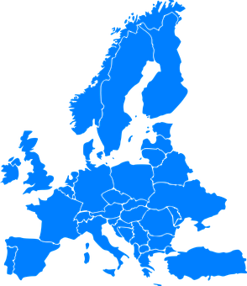
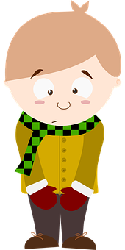
Follow up 1
[au]
[eu]
C Lies die Wörter.
A Hör zu.
teuer
Baum
[expensive]
aussprechen
aussprechen
is number ________.
Freundin
30
is number _______.
Leute
braun
1
2
3
Traum
[dream]
Euro
glauben
4
5
[believe]
Flugzeug
Maus
B Draw it!
Deutschland
laut
Haus
Europa
0
bauen
scheu
Freund
[shy]
START
Notes:
Timing: 5 minutes
Aim: to practise SSC word recognition and spoken production of the SSC [au] and [eu].
Procedure:
Click to bring up the prompts.
Click on each audio symbol to listen to the words.
Click for the number answers.
Click to bring up task B. Give a time limit for the drawing (e.g., 30 seconds for each).
Click to bring up task C.
In pairs, pupil A silently chooses 5 of the au/eu words on the board. Pupil B must read aloud all of the words on the board in any order within the time limit in order to ‘find’ pupil A’s words. Repeat with roles reversed.
Click again for pictures to appear and to discuss meaning of words.
Transcript Part A:
blau Freund laufen Deutschland heute
Part C
Meanings
der Baum- tree
teuer- expensive
die Freundin-[female] friend
die Leute- people
der Traum-dream
braun-brown
der Euro- Euro
glauben-to believe
das Flugzeug-aeroplane
laut- loud
die Maus- mouse
Europa- Europe
scheu-shy
bauen- to build
Word frequency (1 is the most frequent word in German): Baum [1013] teuer [950] Maus [3463] braun [2320] Traum [992]Euro [207] glauben [156] Leute [224] Flugzeug [1776] laut [572] Europa [294] bauen [667] Scheu [N/A] Source: Jones, R.L. & Tschirner, E. (2019). A frequency dictionary of German: core vocabulary for learners. Routledge

Slide 7
Follow up 2a
Hör zu. Was sagt Moritz?
A Write the words that are mentioned.
B.
I am | That is | She is
hören
1
You have | I have | Do you have?
2
not a | is | not
3
no/not a | has | not
Do you have? | How are you? | Are you?
4
a pencil | a point, dot, full stop | a word
5
6
but | also | good
Notes:
Timing: 5 minutes
Aim: to practise aural comprehension of this week’s new and revisited vocabulary
Procedure:
Click the sound buttons to listen to each sentence. Pupils need to identify and write down the English words they hear from the 3 options given.
Click to reveal answers.
Transcript:
B: Das ist ein Wort.
Hast du auch einen Hund?
Er ist nicht gut in Englisch.
Du hast kein Handy.
Wie geht’s? Gut?
Da ist kein Punkt!
Ich habe eine Wasserflasche aber du hast kein Wasser.

Slide 8
Follow up 2b
Which word is the odd one out?
This is the only masculine word here. The others are neuter.
This word has the negative ‘not a/no’ instead of ‘a’
A | blau | gut | gelb
B | ein Hund | ein Handy | kein Wasser
C | ich habe | du hast | ich bin
D | ein Wort | auch | aber
This is part of the verb ‘to be’ and not ‘to have’
This word is not a colour!
This verb is in the ‘you’ form, not the ‘I’ form.
Did you have other good ideas?
This word is the only noun.
Notes:
Timing: 5 minutes
Aim: to practise written comprehension of this week’s new and revisited vocabulary.
Procedure:
Ask pupils to look at the 3 words in row A. Which one is the odd one out? Click to circle ‘gut’ (the other two are colours). Click again for a justification of this choice.
Click to display the rest of the Odd One Out words. Pupils could discuss in pairs or as a class which word/phrase is the odd one out in each of groups B, C and D. There are several correct answers to some of these e.g. C- du hast could be the OOO as the other verbs are in the ‘I’ form OR ich bin could be the OOO as the other two are both parts of the verb haben.
Click to show example answers with reasons. Pupils might have other valid answers. The important thing here is the discussion and justification for the word they choose.

Slide 9
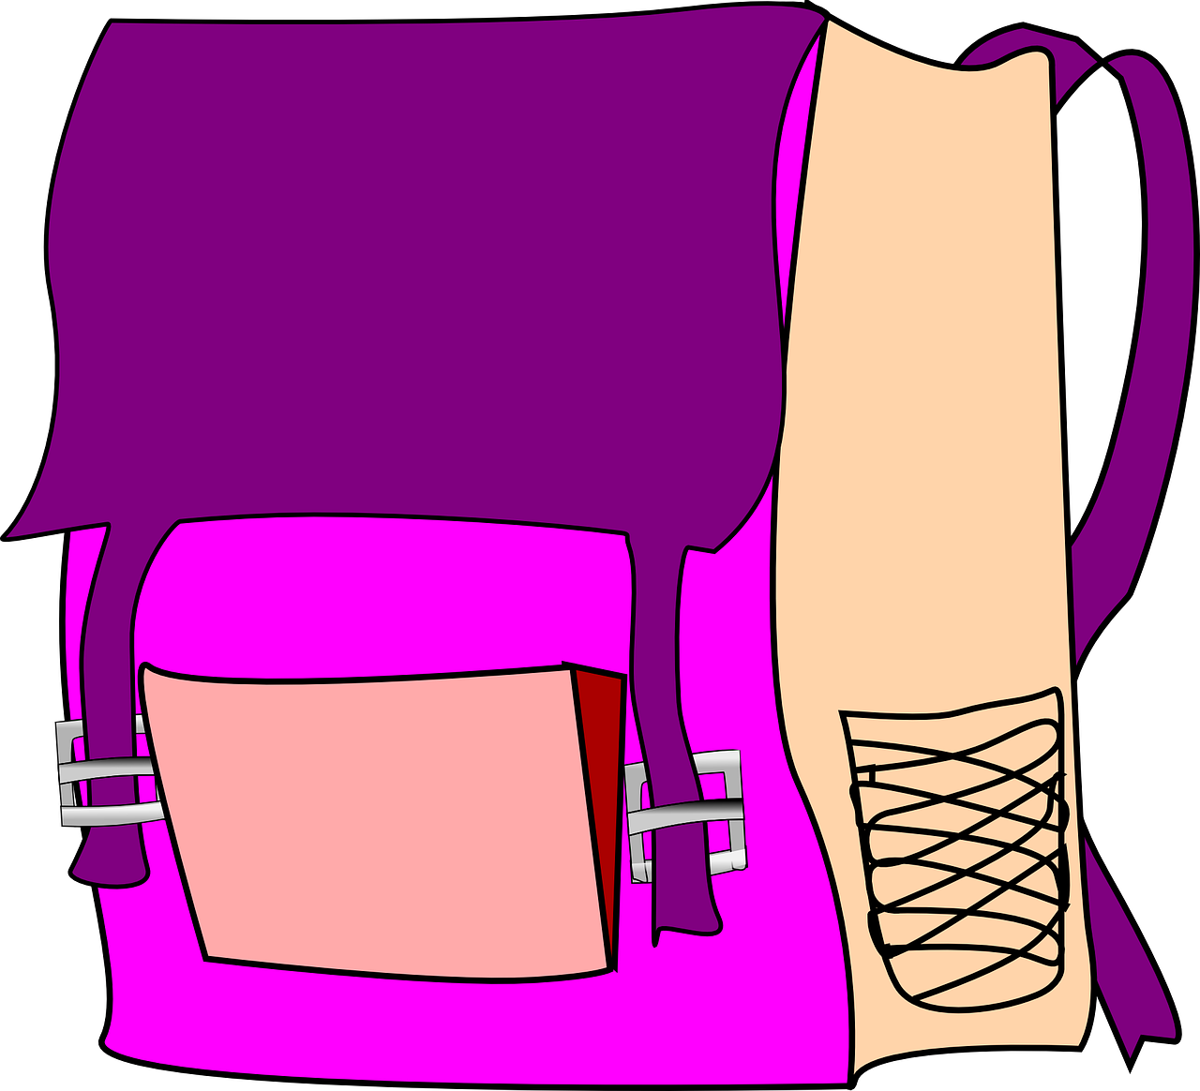
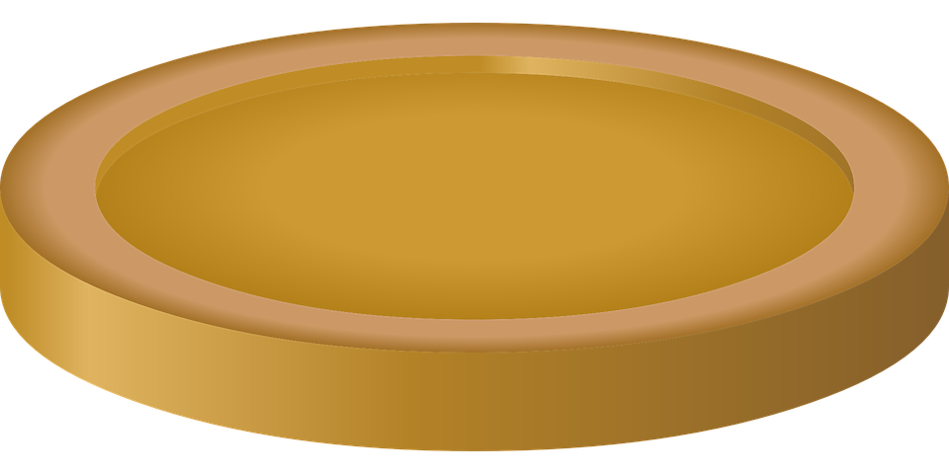
Follow up 3
Wo ist das Gold?
Make sentences to find gold and jewels!
sprechen
m
f
nt
m
f
nt
Das ist
Ich habe
Du hast
Notes:
Timing: 5 minutes
Slide 1/2
Aim: to practise oral production of sentences with haben/sein plus ein/kein words and revisited vocabulary.
Procedure:
Explain that as a class pupils need to find all the treasure by saying correct sentences to reveal the squares. In total there are 15 gold coins and 5 jewels to collect. Allocate 1 pupil to keep track of the gold/jewels as they collect them.
A pupil selects a sentence starter from the vertical axis and a noun from the horizontal axis and makes a sentence e.g. das ist ein Hund; Ich habe einen Hund, du hast einen Hund. If there is a cross, they need to use kein instead of ein. The genders of the nouns are given next to the pictures.
Hover over the chosen square and click to reveal what is beneath.
Repeat with different pupils selecting different squares until they have found all the gold coins and jewels.
Note: The next slide is the same game but with treasure hidden in different places, to be used if pupils find all the treasure on this one quickly! Transcript: Das ist ein Hund. Das ist eine Freundin. Das ist ein Handy. Das ist kein Fußball.
Das ist keine Tasche.
Das ist kein Wasser. Ich habe einen Hund. Ich habe eine Freundin. Ich habe ein Handy. Ich habe keinen Fußball.
Ich habe keine Tasche.
Ich habe kein Wasser.
Du hast einen Hund. Du hast eine Freundin. Du hast ein Handy. Du hast keinen Fußball.
Du hast keine Tasche.
Du hast kein Wasser.

Slide 10
Follow up 3
Wo ist das Gold?
sprechen
m
f
nt
m
f
nt
Das ist
Ich habe
Du hast
Notes:
Slide 2/2

Slide 11
Follow up 4:

Schreib auf Englisch.
Can you get at least 15 points?
Wörter
 | der Punkt | Wie geht’s? | auch
 | gut | nicht | aber
 | das Wasser | kein | keine
 | der Hund | das Wort | das Handy
 | sie hat | es hat | ich habe
 | haben | er hat | du hast
Vokabeln
(the) dot, point, full stop
How are you?
also
x3
good
not
but
(the) water
not a/no (m, nt)
not a/no (f)
x2
(the) dog
(the) word
(the) mobile
she has
it has
I have
x1
to have, having
he has
you have
Notes:
Timing: 5 minutes
Aim: to practise written comprehension of vocabulary from this and revisited weeks.
Procedure: 1. Give pupils a blank grid. They fill in the English meanings of any of the words they know, trying to reach 15 points in total.
Note: The most recently learnt and practised words are pink, words from the previous week are green and those from week 1 are blue, thus more points are awarded for them, to recognise that memories fade and more effort (heavy lifting!) is needed to retrieve them.

Slide 12
Follow up 4:

Schreib auf Deutsch.
Can you get at least 15 points?
Wörter
Vokabeln
 | also | not | How are you?
 | (the) dot, point, full stop | good | but
 | (the) dog | (the) water | (the) word
 | not a/no (m, nt) | not a/no (f) | (the) mobile phone
 | He has | She has | It has
 | You have | to have, having | I have
x3
auch
nicht
Wie geht’s?
der Punkt
gut
aber
x2
der Hund
das Wasser
das Wort
kein
keine
das Handy
er hat
sie hat
es hat
x1
du hast
haben
ich habe
Notes:
Timing: 5 minutes
Aim: to practise written production of vocabulary from this and revisited weeks.
Procedure: 1. Give pupils a blank grid. They fill in the German meanings of any of the words they know, trying to reach 15 points in total. 2. Remind pupils to think about genders (der/die/das) for nouns and forms of kein.
Note: The most recently learnt and practised words are pink, words from the previous week are green and those from week 1 are blue, thus more points are awarded for them, to recognise that memories fade and more effort (heavy lifting!) is needed to retrieve them.

Slide 13
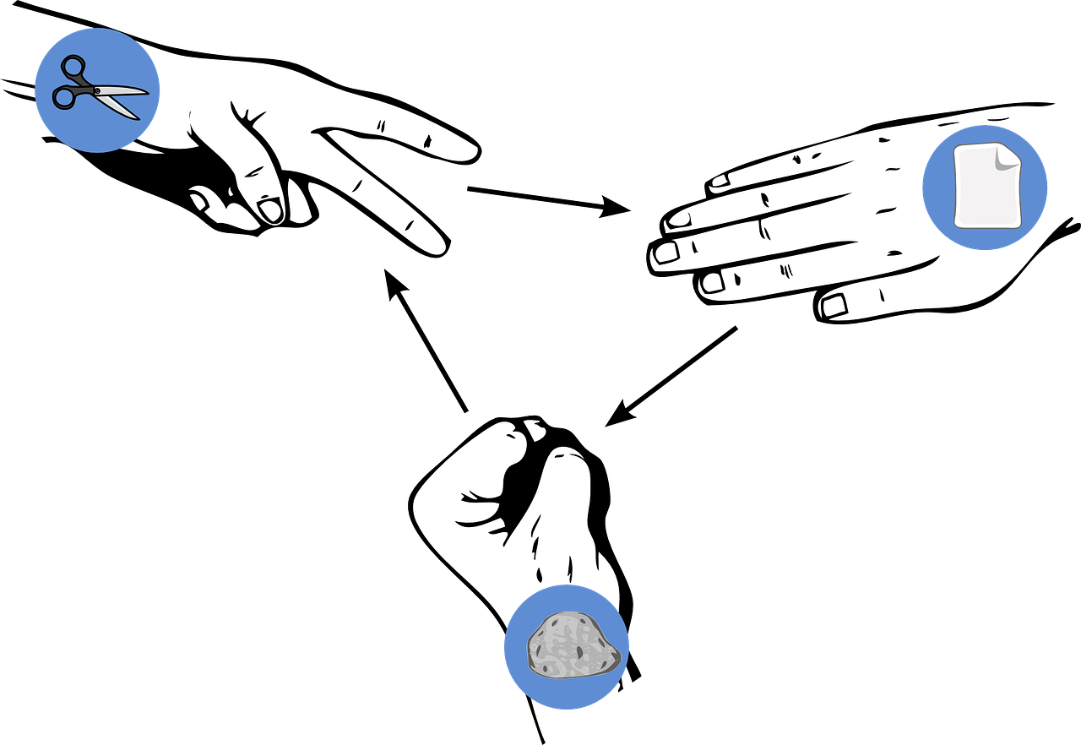
Follow up 5:

Schere-Stein-Papier*
Schreib auf Deutsch.
Choose three objects and write three sentences in German saying what you have: ‘I have a…’.
schreiben
Choose three more objects and write three sentences saying what your partner has: ‘You have a…’
Remember to change ein to einen for masculine nouns.
sprechen
Read your sentences aloud. If your partner has the same sentence as you, play rock-paper-scissors. The loser must make their sentence negative with ‘kein’ and say a new sentence. Play until you have successfully said all your sentences.
Beispiel:
Ich habe einen Hund.
Ich habe auch einen Hund!
Ich habe keinen Hund. Ich habe ein Handy!
Person A
Person B
*Rock-paper-scissors
Notes:
Timing: 5-10 minutes
Aim: to practise oral production of nouns with indefinite articles and kein, and two parts of the verb haben.
Note:
1. The stages are animated to support the teacher in modelling the task.
2. An easier version of this task would be to remove the ‘kein’ element. Pupils could just make a new sentence when they ‘lose’.
Procedure:
After modelling this example, display the next slide with 15 item choices. The items are grouped according to gender to help pupils select the correct ein/kein word.
Pupils write down 3 sentences about themselves: ‘Ich habe ein(e)(n)….’ and 3 sentences about their partner: ‘Du hast ein(e)(n)…’
Pupils then take it in turns in their pairs to read aloud their sentences. As modelled in the example, if their partner has the same sentence, they play rock-paper-scissors to decide who ‘keeps’ that sentence. The loser uses ‘kein’ to make that sentence negative and then makes a new sentence.

Slide 14
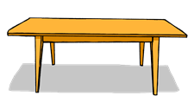
Follow up 5
Schere-Stein-Papier*
m
f
n
Ich habe keinen Hund. Ich habe ein Handy.
Ich habe einen Hund.
Ich habe auch einen Hund!
Person A
Person B
*rock-paper-scissors
Notes:
DISPLAY THIS SLIDE FOR PUPILS DURING THE TASK.

Slide 15
Tschüss!
rot
Notes:
15

Slide 16
Follow up 4:

Schreib auf Englisch.
Can you get at least 15 points?
Wörter
 | der Punkt | Wie geht’s? | auch
 | gut | nicht | aber
 | das Wasser | kein | keine
 | der Hund | das Wort | das Handy
 | sie hat | es hat | ich habe
 | haben | er hat | du hast
x3
x2
x1
Notes:
HANDOUT

Slide 17
Follow up 4:

Schreib auf Deutsch.
Can you get at least 15 points?
Wörter
 | also | not | How are you?
 | (the) dot, point, full stop | good | but
 | (the) dog | (the) water | (the) word
 | not a/no (m, nt) | not a/no (f) | (the) mobile phone
 | He has | She has | It has
 | You have | to have, having | I have
x3
x2
x1
Notes:
HANDOUT

