Slide 1
Talking about things and things you do
Konrad Duden Schule
rot
haben, du hast
‘a’- einen, eine, ein
SSC [au] + [eu]
Term 2 Week 4
Notes:
Artwork by Steve Clarke. Pronoun pictures from NCELP (www.ncelp.org). All additional pictures selected from Pixabay and are available under a Creative Commons license, no
attribution required.
Phonics: SSC [au] Haus [147] blau [948] laufen [252]; SSC [eu] Deutschland [140] Freund [273] heute [116]
Vocabulary: du hast [7]
Revisit 1: kein, keine, kein [46] Handy [1693] Hund [825] Wasser [245] Wort [194]
Revisit 2: Punkt [248] gut [76] aber [31] auch [18] nicht [11] wie [25] wie geht's? [n/a]
Jones, R.L & Tschirner, E. (2019). A frequency dictionary of German: Core vocabulary for learners. London: Routledge.
The frequency rankings for words that occur in this PowerPoint which have been previously introduced in these resources are given in the SOW and in the resources that first
introduced and formally re-visited those words.
For any other words that occur incidentally in this PowerPoint, frequency rankings will be provided in the notes field wherever possible.
1

Slide 2
aussprechen
[au]
…
Haus
Notes:
Timing: 1 minute
Aim: to introduce the SSC [au].
Procedure:
Introduce the SSC and present the source word ‘Haus’ (with gesture, if using).
Click to bring on the picture and get pupils to repeat the word ‘Haus’ (with gesture, if using).
Note:
a gesture for ‘Haus’ might be to make a roof above your head with two hands.
2

Slide 3
aussprechen
[au]
…
Haus
[to run, running]
blau
laufen
Notes:
Timing: 1 minute
Aim: to consolidate the SSC [au].
Procedure:
Re-present the SSC and the source word ‘Haus’ (with gesture, if using).
Click to bring on the picture and get pupils to repeat the word ‘Haus’ (with gesture, if using).
Present the cluster words in the same way, bringing on the picture and getting pupils to pronounce the words.
3

Slide 4
aussprechen
[eu]
…
Deutschland
Notes:
Timing: 1 minute
Aim: to introduce the SSC [eu].
Procedure:
Re-present the SSC and the source word ‘Deutschland’
Click to bring on the picture and get pupils to repeat the word ’Deutschland’

Slide 5
aussprechen
[eu]
…
[today]
[friend]
Freund
heute
Deutschland
Notes:
Timing: 1 minute
Aim: to consolidate the SSC [eu].
Procedure:
Re-present the SSC and the source word ‘Deutschland’
Click to bring on the picture and get pupils to repeat the word ’Deutschland’
Present the cluster words in the same way, bringing on the picture and getting pupils to pronounce the words.

Slide 6
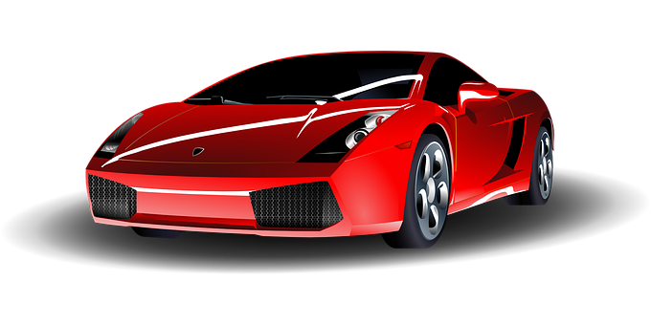
Hör zu. Ist es [au] oder [eu]?
Can you work out the meanings ?
Schreib 1-10 und [au] oder [eu].
eu
au
6. L ___ te
7. ___ to
8. Fr _____
9. Fr ____ndschaft
10. ____ gust
1. B ___m
2. n ___
3. M ___s
4. Sch __!
5. ___ ro
[people]
eu
Au
[new]
au
eu
au
au
au
eu
[Look!]
Eu
Au
Notes:
Timing: 5 minutes
Aim: to practise recognising aurally the SSCs [au] and [eu].
Procedure:
Click to bring up instructions. Pupils write down 1-10 and will write either ‘eu’ or ‘au’ based on what they hear.
Click the audio button to hear the first word, elicit the answer from pupils and click to display answer.
Repeat for items 2-10.
Transcript: 1. der Baum 2. neu 3. die Maus 4. Schau! 5. der Euro
6. die Leute
7. das Auto 8. die Frau 9. die Freundschaft
10. der August
Meanings: 1. der Baum- tree 2. neu- new 3. die Maus- mouse 4. Schau!- Look! 5. der Euro- Euro
6. die Leute= people
7. das Auto-car 8. die Frau- woman, Mrs, Ms, Miss 9. die Freundschaft- friendship
10. der August- august
Word frequency (1 is the most frequent word in German): Baum [1013] neu [84] Maus [3463] Schau![510] Euro [207] Leute [224] Auto [361] Frau [99] Freundschaft [2981] August [1929] Source: Jones, R.L. & Tschirner, E. (2019). A frequency dictionary of German: core vocabulary for learners. Routledge

Slide 7
Vokabeln
Es regnet!
es regnet = it’s raining
Wörter
Schreib auf Englisch.
eine Farbe ein Spiel ein Lehrer ein Punkt
5
eine Flasche ein Wort eine Minitafel ein Bleistift ein Tisch
4
eine Freundin ein Heft eine Lehrerin ein Beispiel
3
2
ein Kuchen eine Tasche ein Buch ein Freund ein Handy
1
Notes:
Timing: 5 minutes (two slides)
Aim: to practise written comprehension of previously taught nouns that we will be using this lesson.
Procedure:
Tell pupils to be ready to write the English meanings of words they have learnt before. There will be 18 altogether and they should prepare to work from the bottom of the slide, left to right.
Explain the scenario – it’s raining and the raindrops will splash down and cover the words. They need to write the meanings before the words get covered. Tell them they will have 5 seconds to get a headstart on the rain.
Click to start number animation.
Click once more to start raindrops. The timing has been carefully set! Don’t click again or all the raindrops will appear at once.
When finished move to the next slide to check answers.
7

Slide 8
Vokabeln
Sag die Wörter auf Deutsch.
Which words are masculine, which are feminine, and which are neuter?
Wörter
eine Farbe
ein Spiel
ein Lehrer
ein Punkt
a colour |a game | a [male] teacher |a point/dot
eine Flasche
ein Wort
eine Minitafel
ein Bleistift
ein Tisch
a bottle |a word | a mini whiteboard | a pencil | a table
eine Freundin
ein Heft
eine Lehrerin
ein Beispiel
a [female] friend|an exercise book|a [female] teacher |an example
ein Kuchen
eine Tasche
ein Buch
ein Freund
ein Handy
a cake | a bag | a book |a friend | a mobile phone
Notes:
Timing: 5 minutes (slide 2/2)
Aim: to practise written comprehension of previously taught vocab and then oral production of the same vocab.
Procedure:
Elicit English translations of the words seen on previous slide row by row. Click to display English answers for pupils to check.
Ask pupils why 3 different colours have been used (masculine, feminine, neuter).
Then give pupils time in pairs to see how many of the words they can translate orally back into German. The colours on the English words can help them decide whether to say ein or eine before the noun.
Click to display the German words again and give pupils time to recognise any they missed.
8

Slide 9
haben
After most verbs the masculine word for ‘a’, ein, changes its spelling to einen. It still means ‘a’.
to have | having
As you know, the verb haben means ‘to have’.
You have already seen I have, he has and she has.
I have
ich habe
he has
er hat
she has
sie hat
To say you have, we say du hast.
Ich habe ein Heft.
Du hast eine Tasche.
Sie hat einen Bleistift.
I have an exercise book.
You have a bag.
She has a pencil.
Notes:
Timing: 3 minutes
Procedure:
Read the grammar explanation about haben. Make sure pupils are clear about the ‘I’, ‘you’, ‘he’ and ‘she’ pictures.
Elicit English translation for the German examples provided. This is another opportunity to hear and see three of our new words.
Draw attention to the einen used here after haben for masculine nouns.
9

Slide 10
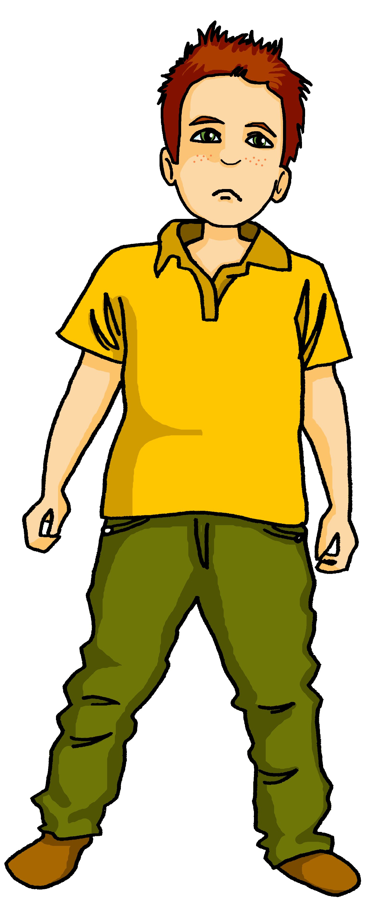
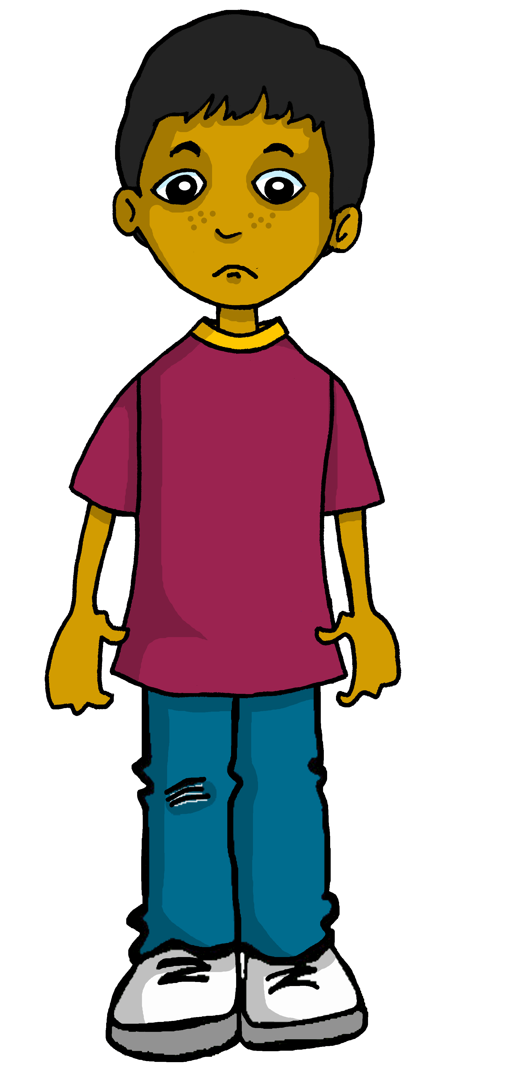
hören
Moritz and Hamza have got their school things muddled up. Who has what?
Hör zu? Wer hat was?
Moritz (I) | Hamza (you)
What?
B.
mobile phone
1
water bottle
2
pencil
3
exercise book
4
book
5
mini whiteboard
6
game
Notes:
Timing: 5 minutes
Aim: to practise aural comprehension of the first and second parts of the verb haben.
Procedure:
1. Explain the scenario and tell pupils they will listen to Moritz speaking and they must decide who has what. They should write down numbers 1-6.
2. Play the example (B). From the verb they hear (habe or hast) they decide whether ‘I’ have it or ‘you’ have it. ‘I have’ is Moritz as he is speaking and ‘you have’ is Hamza.
3. Play items 1-6 and pupils choose ‘I’ or ‘you’ for each one.
4. Play the items again. This time pupils write down in English what the object is that they hear.
Transcript
B: [Ich] habe ein Handy. 1. [du] hast eine Wasserflasche. 2. [du] hast einen Bleistift. 3. [Ich] habe ein Heft. 4. [ich] habe ein Buch.
5. Hast [du] eine Minitafel? Ja? OK.
6. [Ich] habe ein Spiel.
10

Slide 11
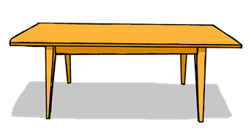
einen and keinen
As you know, there are 3 words for ‘a’ in German: ein, eine, ein.
You also know that kein, meaning ‘not a’,changes in the same way:
Das ist ein Tisch.
Das ist eine Flasche.
Das ist ein Heft.
You have already seen that der changes to den after haben & most other verbs. This is a similar change.
Das ist kein Heft.
Das ist kein Tisch.
Das ist keine Flasche.
After the verb haben and most other verbs, the masculine ein changes to einen and the masculine kein changes to keinen.
Ich habe einen Tisch.
Ich habe eine Flasche.
Ich habe ein Heft.
I have a table.
I have a bottle.
I have an exercise book.
Ich habe keinen Tisch.
Ich habe keine Flasche.
Ich habe kein Heft.
I don’t have a bottle.
I don’t have an exercise book.
I don’t have a table.
Notes:
Timing: 2 minutes
Procedure:
Click through the animations to recap ‘ein’ and kein’ and to present the new information.
Elicit English translation for the German examples provided.
Using the call-out, remind pupils that they have seen something similar with der→den after haben & most verbs.
11

Slide 12
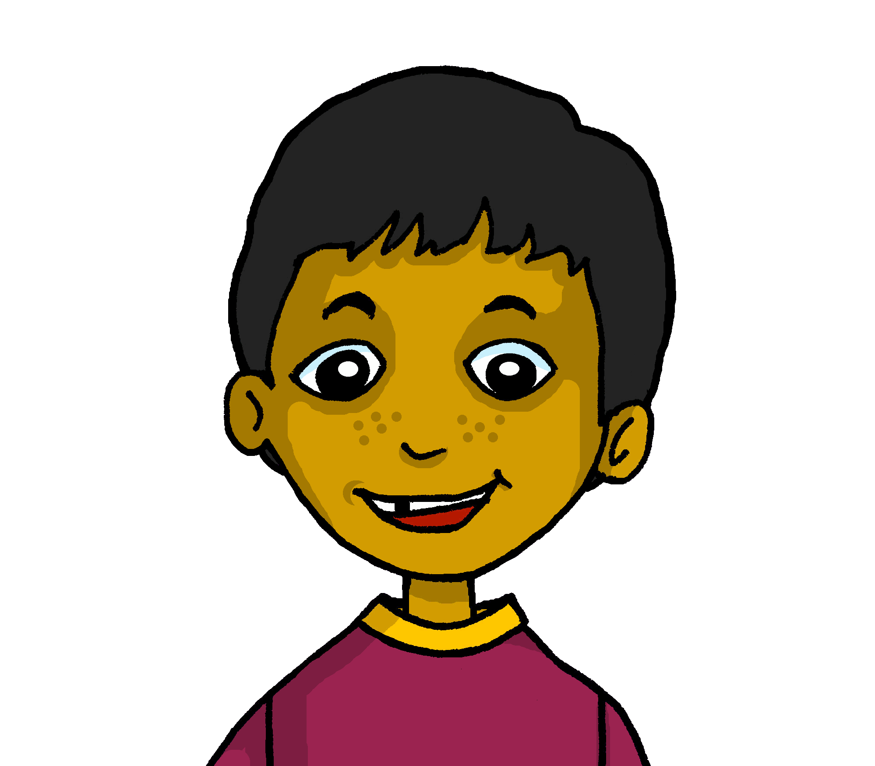
hören
Moritz and Hamza have a new pupil in their class, Lukas. He is not very prepared for school. Help Hamza make a list of what he has and doesn’t have.
Hör zu. Was hat Lukas? Was hat er nicht?
B
1
bottle
pencil
2
game
exercise book
3
cake
mobile phone
4
football
mini whiteboard
5
6
book
7
8
für dich= for you
Notes:
Timing: 5 minutes
Aim: to practise aural comprehension of einen/eine/ein and keinen/keine/kein and this week’s revisited vocabulary
Procedure:
Explain the scenario. The new classmate Lukas doesn’t have everything he needs for school. Moritz is helping him go through what he has and doesn’t have. Hamza and the pupils are going to write two lists.
Click the B speech bubble to play the audio for the example. Ask pupils which item is mentioned, and whether Lukas has it or doesn’t have it. Click for the answer to appear under the tick, and for the bottle to fly into Lukas’ bag.
3. Repeat for items 1-8. Elicit answers and click for each word to appear on the √ list and click again for the object to fly into the bag, then click for the items to appear on the X list
The final item has Moritz saying he has a book for Lukas, so the book moves from the X to the √ list, and into the bag.
Transcript:
B. Du hast eine Flasche
Du hast keinen Bleistift
Du hast kein Heft
Du hast ein Spiel
Du hast kein Handy
Du hast einen Kuchen
Du hast keine Minitafel
Du hast einen Fußball
Du hast kein Buch. Kein Problem. Ich habe ein Buch für dich!
12

Slide 13
Vokabeln
Freundschaft*
die Freundschaft - friendship
As you know, learning languages is about making friends.
You show kindness when you learn even a few words in another language.
Let’s remember some of the friendship sentences we have learnt already!
Hallo!
_ _ _ _ _ _ _’_?
_ _ _ _ _!
Wie geht’s?
Danke!
Guten Tag!
D_ _ _ _!
_ _ _ _ _ _ _ _!
Can you say other kind things to welcome Lukas to the class?
Du bist toll!
You are great!
Deine Tasche ist super!
Dein Beispiel ist gut!
Kein Problem! Du hast einen Freund/eine Freundin. ☺
Your bag is super!
Your example is good!
You have a friend ☺
Notes:
Timing: 3 minutes
Aim: to continue the idea that learning other languages opens the door to new friendships, and that a few kind words go a long way; to revisit some previously-taught language from this term that fits our category of ‘friendship sentences’.
Procedure:
Click to present the information on the slide.
Elicit the German from pupils for the English greetings and friendly statements.
Allow pupils a few moments to turn to those around them and greet them and say something kind about their work or about themselves.
13

Slide 14
Tschüss!
rot
Notes:
14

