Slide 1
Talking about things and things you do
rot
Follow ups 1-5
Term 2 Week 6
Notes:
Artwork by Steve Clarke. Pronoun pictures from NCELP (www.ncelp.org). All additional pictures selected from Pixabay and are available under a Creative Commons license, no attribution required.
Phonics:
Introduce [sch] schreiben [245] falsch [638] schnell [233] Mensch [104] schwarz [451]
[sp] spielen [197] Sprache [367] sprechen [157] Sport [845] Spiel [500]
[st] stark [207] Straße [355] stehen [87] verstehen [222] Stadt [186]
Vocabulary: denken [128] lernen [288] singen [1063] spielen [205] verstehen [211] viel [56] oft [223] ich weiß (es) nicht [n/a] wie sagt man…? [n/a]
Revisit 1: Wer? [149] haben, ich habe, er, sie, es hat [6] Blume [2463] Geschenk [2595] Spiel [328] Kuchen [4381]
Revisit 2: Bild [253] Foto [633] Freund, Freundin [273] Fußball [1277] Tasche [1804] mein, meine [51] dein, deine [233]
Jones, R.L & Tschirner, E. (2019). A frequency dictionary of German: Core vocabulary for learners. London: Routledge.
The frequency rankings for words that occur in this PowerPoint which have been previously introduced in these resources are given in the SOW and in the resources that first
introduced and formally re-visited those words.
For any other words that occur incidentally in this PowerPoint, frequency rankings will be provided in the notes field wherever possible.

Slide 2
aussprechen
[sch]
…
schreiben
Notes:
Timing: 1 minute
Aim: To introduce/consolidate SSC [sch]
Procedure: 1. Present the letter(s) and say the [sch] sound first, on its own. Pupils repeat it with you. 2. Bring up the word ”schreiben” on its own, say it, pupils repeat it, so that they have the opportunity to focus all of their attention on the connection between the written word and its sound.
3. A possible gesture for this would be to mime writing.
4. Roll back the animations and work through 1-3 again, but this time, dropping your voice completely to listen carefully to the pupils saying the [sch] sound, pronouncing ”schreiben” and, if using, doing the gesture. Word frequency (1 is the most frequent word in German):
schreiben [245] Source: Jones, R.L. & Tschirner, E. (2006). A frequency dictionary of German: core vocabulary for learners. Routledge
2

Slide 3
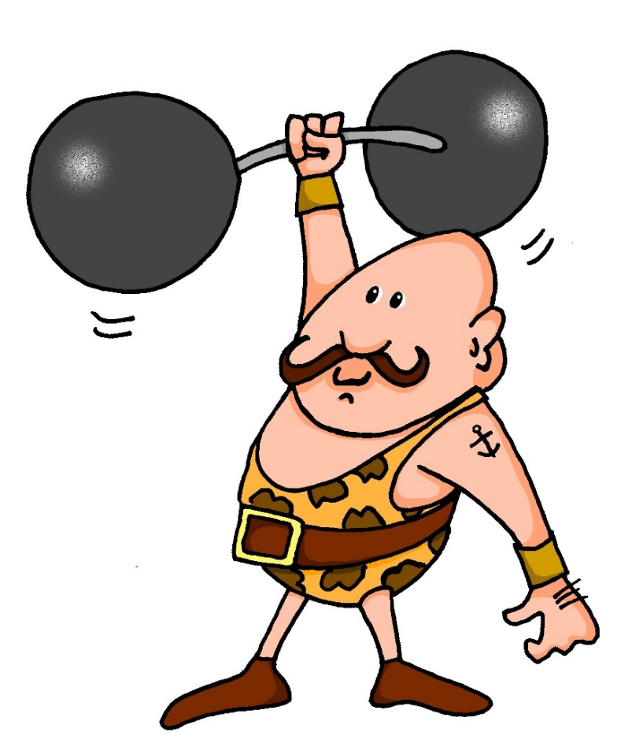
aussprechen
[st]
…
stark
Notes:
Timing: 1 minute
Aim: To introduce/consolidate SSC [st-]
Procedure: 1. Present the letter(s) and say the [st-] sound first, on its own. Pupils repeat it with you. 2. Bring up the word ”stark” on its own, say it, pupils repeat it, so that they have the opportunity to focus all of their attention on the connection between the written word and its sound.
3. A possible gesture for this would be to mime lifting dumbells by clenching your fists and raising them above your head.
4. Roll back the animations and work through 1-3 again, but this time, dropping your voice completely to listen carefully to the pupils saying the [st-] sound, pronouncing ”stark” and, if using, doing the gesture. Word frequency (1 is the most frequent word in German): stark [207] Source: Jones, R.L. & Tschirner, E. (2006). A frequency dictionary of German: core vocabulary for learners. Routledge
3

Slide 4
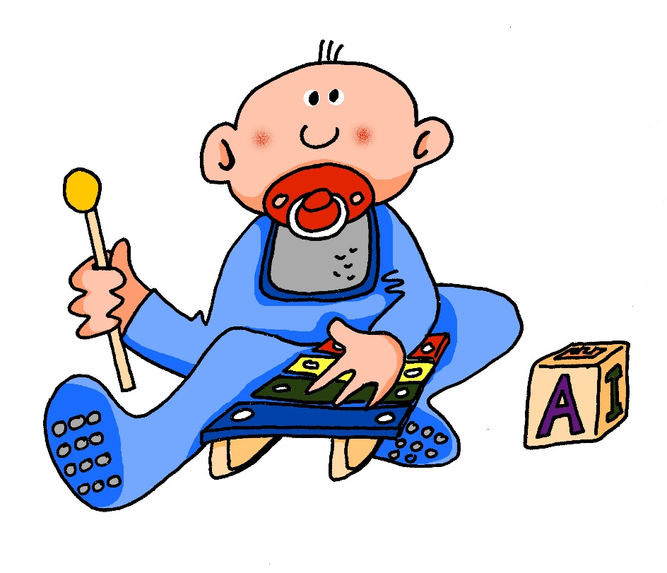
[sp]
…
aussprechen
spielen
Notes:
Timing: 1 minute
Aim: To introduce/consolidate SSC [sp-]
Procedure: 1. Present the letter(s) and say the [sp-] sound first, on its own. Pupils repeat it with you. 2. Bring up the word ”spielen” on its own, say it, pupils repeat it, so that they have the opportunity to focus all of their attention on the connection between the written word and its sound.
3. A possible gesture for this would be to mime playing an instrument or sport.
4. Roll back the animations and work through 1-3 again, but this time, dropping your voice completely to listen carefully to the pupils saying the [sp-] sound, pronouncing ”spielen” and, if using, doing the gesture. Word frequency (1 is the most frequent word in German): spielen [197] Source: Jones, R.L. & Tschirner, E. (2006). A frequency dictionary of German: core vocabulary for learners. Routledge

Slide 5
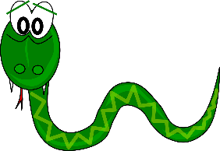
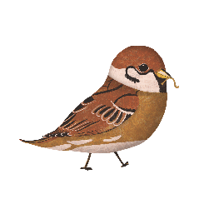
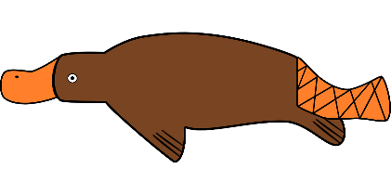
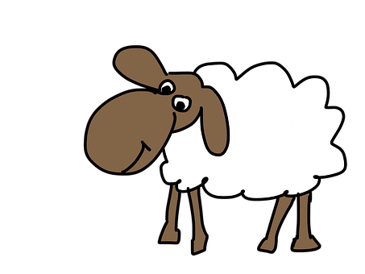
Follow up 1
Lies die Wörter. Ist das [sp],[st] oder [sch]?
aussprechen
Schnecke
Schlange
Stier
20
Spinne
Schildkröte
Spatz
Stinktier
Stachelschwein
Specht
Schnabeltier
Schaf
0
Schmetterling
START
Notes:
Timing: 5 minutes
Aim: To provide practice in recognising and producing this week’s SSCs [sp], [st] and [sch] Procedure: 1. This is a paired read aloud task. Pupil A chooses a word and writes it down secretly. Pupil B must ‘find’ their partner’s word by pronouncing the animal words and guessing it within 20 seconds.
2. Repeat so that each partner has several turns at writing a word and guessing the word.
Word frequency (1 is the most frequent word in German):
Schnecke [>5009] , Stier [>5009], Schlange [3601], Specht [4900], Stinktier [>5009], Spatz [>5009], Schildkröte [>5009], Schnabeltier [>5009], Stachelschwein [>5009], Spinne [>5009], Schmetterling [>5009]. Schaf [3673]
Source: Jones, R.L. & Tschirner, E. (2006). A frequency dictionary of German: core vocabulary for learners. Routledge

Slide 6
Follow up 2
Hör zu. Was macht Moritz und was macht Lukas?
 | I | he | Activity?
 |  |  | to play | to think
 |  |  | to understand | to learn
 |  |  | to play | to sing
 |  |  | to learn | to think
 |  |  | often | a lot
 |  |  | good | a lot
 |  |  | to play | to sing
hören
B.
1
2
3
4
5
6
mit Freunden-with friends
Notes:
Timing: 5 minutes
Aim: to practise recognition of the ‘I’ and ‘he/she’ parts of weak verbs and of the new vocabulary.
Procedure:
1. Explain the scenario: Moritz is talking about what he does (I) and what Lukas does (he).
2. Click the B to play the example. Pupils write ‘I’ or ‘he’. Play it again and pupils decide which of the two new items of vocabulary is mentioned, writing the English word.
3. Repeat for items 2-6.
4. Click to display answers.
Additional task suggestions: 1. Pupils could try to rewrite the sentences in German from their answers. See transcript below for answers.
Trancript:
Ich spiele ein Handyspiel
Er versteht mein Buch
Er singt ein Lied
Ich lerne ein Beispiel
Ich denke oft
Er lernt viel
Ich spiele Fußball mit Freunden

Slide 7
Follow up 3
Hör zu. Schreib ein Wort!
Listen to the sentences 1-9. Choose a word to fill in the gap to complete each sentence and to complete the crossword.
1
 |  |  | D | E | I | N | E
 | S | P | I | E | L | T
 |  | L | E | R | N | E
 |  |  | S | A | G | T
 | K | U | C | H | E | N
 |  |  | H | A | T
 |  | H | U | N | D
V | I | E | L
 |  | W | E | R
1
lerne
2
2
Kuchen
3
3
hören
viel
deine
4
4
sagt
5
5
hat
6
6
Hund
7
7
wer
8
8
spielt
9
9
Notes:
Timing: 8 minutes Aim: To practise written production of some of this week’s new and revisited vocabulary, in response to aural cues. Procedure: 1. Click to listen to each sentence clue.
2. Pupils write the answers to fill the bleeped gaps, choosing from the options shown. Higher proficiency pupils could face away from board to make the task more challenging if they wish. 3. The letters top to bottom in the red column indicated spell the noun die Schule.
4. Click the lighter blue audio button to hear the full sentence audio (listen and check). Click for each word answer. 5. Ensure all meanings all clear.
Transcript: 1. Moritz, ich habe [deine] Tasche!
2. Johanna [spielt] oft Fußball.
3. Ich [lerne] oft Englisch.
4. Wie [sagt] man to play auf Deutsch?
5. Ich habe Hunger! Wo ist mein [Kuchen]?
6. Lukas [hat] ein Geschenk.
7. Mein Lieblingstier ist ein [Hund]
8. Er lernt [viel] in der Schule.
9. [Wer] ist das? Hamza oder Lukas?

Slide 8
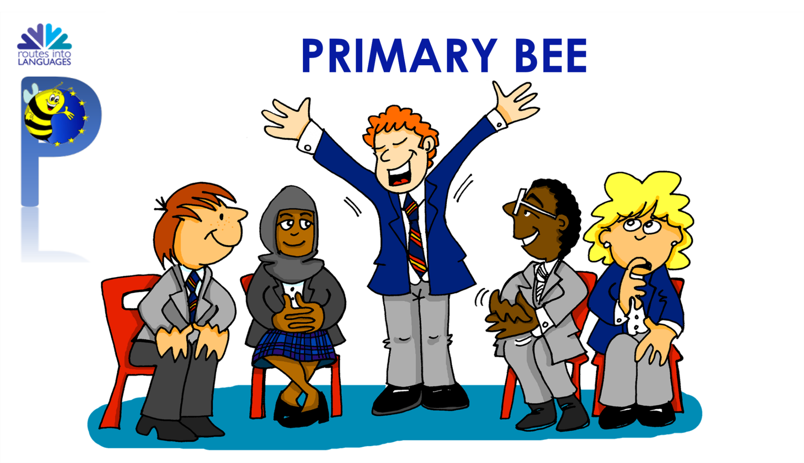
Follow up 4a
Primary Bee
Wie sagt man…auf Deutsch?
sprechen
Lukas is preparing for the German Primary Bee in his school.
Moritz is helping him.
Wie sagt man ‘to sing’ auf Deutsch?
singen?
Richtig!
If you don’t know, say ‘Ich weiß es nicht!’
Notes:
Timing: 2 mins
Aim: To introduce the concept of the Primary Bee & to practise oral translation of new vocabulary (English into German).
Procedure:
Click through the information on the slide and the example with Moritz and Lukas.
2. Share the key messages as follows: Open to pupils in Years 5 and 6; tests word knowledge; there are three stages: school, regional, national and pupils are given 40 words to learn and practise at each stage.
Note:
The aim of the Primary Bee is for pupils in Years 5 & 6 who have started learning a foreign language ab initio in KS2 to practise and improve their vocabulary, pronunciation and memory skills in the target language (French, Spanish and German). Native or bilingual students, as well as those who communicate in or are exposed to the language on a regular basis at home (speaking and/or listening), are not eligible to compete. It is the classroom teacher’s responsibility, with careful consideration of the ethos of the competition, to decide whether or not a student falls into this category.
Words and phrases have been selected according to the work of NCELP (National Centre for Excellence in Language Pedagogy) which highlights the importance of word frequency in informing vocabulary learning, particularly during the early stages of language development. The list includes many high-frequency words (e.g., some numbers, some colours, some verbs, days of the week, question words and a number of common verbs to help early learners to acquire a robust knowledge of verb vocabulary. These most common verbs are included in the infinitive and 3rd person singular forms; these two verb forms have been shown to provide a very useful linguistic core that can subsequently be further developed. For information we publish the word lists, indicating the word frequency.

Slide 9
Follow up 4b
Wie sagt man … auf Deutsch?
Partnerbarbeit!
sprechen
Wie sagt man ‘to play’ auf Deutsch?
B
1. to play
2. he learns
3. I think
4. to sing
5. often
6. (the) flower
7. He has
8. Who?
9. my
10. I don’t know
1. to think
2. she plays
3. I understand
4. to learn
5. a lot
6. (the) cake
7. It has
8. (the) present
9. your
10. (the) picture
Spielen?
Richtig!
If you don’t know, say ‘Ich weiß es nicht!’
Notes:
Timing: 5 minutes
Aim: to provide oral practice of this week’s vocabulary and to familiarise pupils with the concept of the Primary Bee.
Procedure:
Demonstrate the conversations pupils will have using Moritz’ and Lukas’ speech bubbles.
Ask pupils to decide who is Person A and who is Person B. Person A will be asked to translate items 1-10 on the left hand list and Partner B will translate items 1-10 on the right hand list. It is important that pupils use ‘Wie sagt man…auf Deutsch’ and ‘Ich weiß es nicht’ if unsure, as these two key phrases are part of this week’s vocabulary to practise too.
Give pupils time in pairs to ask and answer the 10 items of vocabulary each.
If time allows, pupils could choose a new partner or swap lists.
Note:
Some of the verbs are given in the infinitive, some in the ‘I’ form and some in the ‘he/she’ form. Discuss what pupils will need to think about for these before they start.
Additional task suggestions:
1. Pupils could continue using any other vocabulary covered this term. Follow Up 5 sheets from previous week could support this.

Slide 10
Follow up 5:

Schreib auf Englisch.
Can you get at least 15 points?
Wörter
 | die Tasche | dein, deine | das Bild
 | das Foto | die Freundin | mein, meine
 | er hat | es hat | das Geschenk
 | die Blume | wer? | der Kuchen
 | singen | oft | sie
 | viel | denken | lernen
 | verstehen | Wie sagt man..? | ich weiß es nicht
(the) bag
your
(the) picture
Vokabeln
x3
(the) photo
(the) [female] friend
my
he has
it has
(the) present
x2
(the) flower
who?
(the) cake
to sing, singing
often
sie
a lot, much
to think, thinking
to learn, learning
x1
to understand, understanding
How do you say?
I don’t know
Notes:
Timing: 5 minutes
Aim: to practise written comprehension of vocabulary from this and revisited weeks.
Procedure: 1. Give pupils a blank grid. They fill in the English meanings of any of the words they know, trying to reach 15 points in total.
Note: The most recently learnt and practised words are pink, words from the previous week are green and those from week 1 are blue, thus more points are awarded for them, to recognise that memories fade and more effort (heavy lifting!) is needed to retrieve them.

Slide 11
Follow up 5:

Schreib auf Deutsch.
Can you get at least 15 points?
 | my | your | (the) [female] friend
 | (the) picture | (the) photo | (the) bag
 | (the) present | (the) cake | It has
 | Who? | he has | (the) flower
 | I don’t know | How do you say? | she
 | to understand, understanding | a lot, much | often
 | to think, thinking | to learn, leaning | to sing, singing
Wörter
mein, meine
dein, deine
die Freundin
Vokabeln
x3
das Bild
das Foto
die Tasche
das Geschenk
der Kuchen
es hat
x2
wer?
er hat
die Blume
Ich weiß es nicht
Wie sagt man..?
sie
verstehen
viel
oft
x1
denken
lernen
singen
Notes:
Timing: 5 minutes
Aim: to practise written production of vocabulary from this and revisited weeks.
Procedure: 1. Give pupils a blank grid. They fill in the German meanings of any of the words they know, trying to reach 15 points in total.
Note: The most recently learnt and practised words are pink, words from the previous week are green and those from week 1 are blue, thus more points are awarded for them, to recognise that memories fade and more effort (heavy lifting!) is needed to retrieve them.

Slide 12
Tschüss!
rot
Notes:
12

Slide 13
Follow up 5:

Schreib auf Englisch.
Can you get at least 15 points?
Wörter
 | die Tasche | dein, deine | das Bild
 | das Foto | die Freundin | mein, meine
 | er hat | es hat | das Geschenk
 | die Blume | wer? | der Kuchen
 | singen | oft | sie
 | viel | denken | lernen
 | verstehen | Wie sagt man..? | ich weiß es nicht
Vokabeln
x3
x2
x1
Notes:
Timing: 5 minutes
Aim: to practise written comprehension of vocabulary from this and revisited weeks.
Procedure: 1. Give pupils a blank grid. They fill in the English meanings of any of the words they know, trying to reach 15 points in total.
Note: The most recently learnt and practised words are pink, words from the previous week are green and those from week 1 are blue, thus more points are awarded for them, to recognise that memories fade and more effort (heavy lifting!) is needed to retrieve them.

Slide 14
Follow up 5:

Schreib auf Deutsch.
Can you get at least 15 points?
 | my | your | (the) [female] friend
 | (the) picture | (the) photo | (the) bag
 | (the) present | (the) cake | It has
 | Who? | he has | (the) flower
 | I don’t know | How do you say? | she
 | to understand, understanding | a lot, much | often
 | to think, thinking | to learn, leaning | to sing, singing
Wörter
Vokabeln
x3
x2
x1
Notes:
Timing: 5 minutes
Aim: to practise written production of vocabulary from this and revisited weeks.
Procedure: 1. Give pupils a blank grid. They fill in the German meanings of any of the words they know, trying to reach 15 points in total.
Note: The most recently learnt and practised words are pink, words from the previous week are green and those from week 1 are blue, thus more points are awarded for them, to recognise that memories fade and more effort (heavy lifting!) is needed to retrieve them.

