Slide 1
Talking about things and things to do
Konrad Duden Schule
rot
Infinitive verbs
Present tense (I, s/he, it)
SSC [sch] [sp] [st]
Term 2 Week 6
Notes:
Artwork by Steve Clarke. Pronoun pictures from NCELP (www.ncelp.org). All additional pictures selected from Pixabay and are available under a Creative Commons license, no
attribution required.
Phonics:
Introduce [sch] schreiben [245] falsch [638] schnell [233] Mensch [104] schwarz [451]
[sp] spielen [197] Sprache [367] sprechen [157] Sport [845] Spiel [500]
[st] stark [207] Straße [355] stehen [87] verstehen [222] Stadt [186]
Vocabulary: denken [128] lernen [288] singen [1063] spielen [205] verstehen [211] viel [56] oft [223] ich weiß (es) nicht [n/a] wie sagt man…? [n/a]
Revisit 1: Wer? [149] haben, ich habe, er, sie, es hat [6] Blume [2463] Geschenk [2595] Spiel [328] Kuchen [4381]
Revisit 2: Bild [253] Foto [633] Freund, Freundin [273] Fußball [1277] Tasche [1804] mein, meine [51] dein, deine [233]
Jones, R.L & Tschirner, E. (2019). A frequency dictionary of German: Core vocabulary for learners. London: Routledge.
The frequency rankings for words that occur in this PowerPoint which have been previously introduced in these resources are given in the SOW and in the resources that first
introduced and formally re-visited those words.
For any other words that occur incidentally in this PowerPoint, frequency rankings will be provided in the notes field wherever possible.
Note that the first three lessons of the year teach language that can be continuously recycled as lesson routine every lesson in Y3/4.
The idea would be that the class teacher (whether or not s/he teaches the class German can re-use the language as part of the daily routine with the class.
1

Slide 2
aussprechen
[sch]
…
schreiben
Notes:
Timing: 1 minute
Aim: To introduce/consolidate SSC [sch]
Procedure: 1. Present the letter(s) and say the [sch] sound first, on its own. Pupils repeat it with you. 2. Bring up the word ”schreiben” on its own, say it, pupils repeat it, so that they have the opportunity to focus all of their attention on the connection between the written word and its sound.
3. A possible gesture for this would be to mime writing.
4. Roll back the animations and work through 1-3 again, but this time, dropping your voice completely to listen carefully to the pupils saying the [sch] sound, pronouncing ”schreiben” and, if using, doing the gesture. Word frequency (1 is the most frequent word in German):
schreiben [245] Source: Jones, R.L. & Tschirner, E. (2006). A frequency dictionary of German: core vocabulary for learners. Routledge
2

Slide 3
aussprechen
[sch]
…
[fast]
falsch
schnell
schreiben
Mensch
schwarz
Notes:
Timing: 2 minutes
Aim: To introduce/consolidate SSC [sch]
Procedure:
Introduce and elicit the pronunciation of the individual SSC [sch] and then the source word again ‘schreiben’ (with gesture, if using).
Then present and elicit the pronunciation of the four cluster words.
Word frequency (1 is the most frequent word in German): schreiben [245] falsch [638] schnell [233] Mensch [104] schwarz [451] Source: Jones, R.L. & Tschirner, E. (2006). A frequency dictionary of German: core vocabulary for learners. Routledge
3

Slide 4
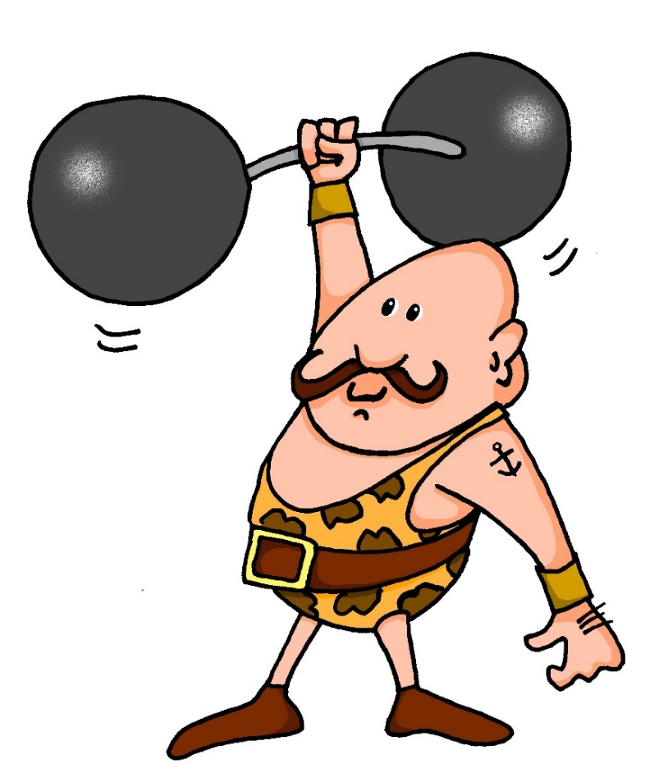
aussprechen
[st]
…
stark
Notes:
Timing: 1 minute
Aim: To introduce/consolidate SSC [st-]
Procedure: 1. Present the letter(s) and say the [st-] sound first, on its own. Pupils repeat it with you. 2. Bring up the word ”stark” on its own, say it, pupils repeat it, so that they have the opportunity to focus all of their attention on the connection between the written word and its sound.
3. A possible gesture for this would be to mime lifting dumbells by clenching your fists and raising them above your head.
4. Roll back the animations and work through 1-3 again, but this time, dropping your voice completely to listen carefully to the pupils saying the [st-] sound, pronouncing ”stark” and, if using, doing the gesture. Word frequency (1 is the most frequent word in German): stark [207] Source: Jones, R.L. & Tschirner, E. (2006). A frequency dictionary of German: core vocabulary for learners. Routledge
4

Slide 5
[st]
…
aussprechen
[to stand]
stehen
Straße
stark
[to understand]
verstehen
Stadt
Notes:
Timing: 2 minutes
Aim: To introduce/consolidate SSC [st-]
Procedure:
Introduce and elicit the pronunciation of the individual SSC [st-] and then the source word again ‘stark’ (with gesture, if using).
Then present and elicit the pronunciation of the five cluster words.
Word frequency (1 is the most frequent word in German): stark [207] Straße [355] stehen [87] verstehen [222] Stadt [186] Source: Jones, R.L. & Tschirner, E. (2006). A frequency dictionary of German: core vocabulary for learners. Routledge

Slide 6
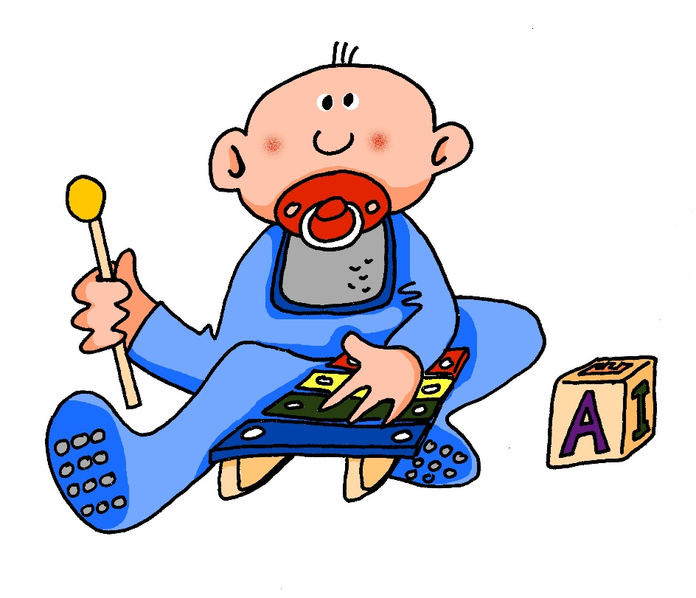
[sp]
…
aussprechen
spielen
Notes:
Timing: 1 minute
Aim: To introduce/consolidate SSC [sp-]
Procedure: 1. Present the letter(s) and say the [sp-] sound first, on its own. Pupils repeat it with you. 2. Bring up the word ”spielen” on its own, say it, pupils repeat it, so that they have the opportunity to focus all of their attention on the connection between the written word and its sound.
3. A possible gesture for this would be to mime playing an instrument or sport.
4. Roll back the animations and work through 1-3 again, but this time, dropping your voice completely to listen carefully to the pupils saying the [sp-] sound, pronouncing ”spielen” and, if using, doing the gesture. Word frequency (1 is the most frequent word in German): spielen [197] Source: Jones, R.L. & Tschirner, E. (2006). A frequency dictionary of German: core vocabulary for learners. Routledge

Slide 7
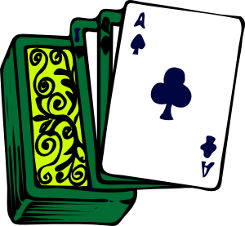
[sp]
…
aussprechen
Sprache
sprechen
spielen
Sport
Spiel
Notes:
Timing: 2 minutes
Aim: To introduce/consolidate SSC [sp]
Procedure:
Introduce and elicit the pronunciation of the individual SSC [sp] and then the source word again ‘spielen’ (with gesture, if using).
Then present and elicit the pronunciation of the five cluster words.
Word frequency (1 is the most frequent word in German): spielen [197] Sprache [367] sprechen [157] Sport [845] Spiel [500] Source: Jones, R.L. & Tschirner, E. (2006). A frequency dictionary of German: core vocabulary for learners. Routledge

Slide 8
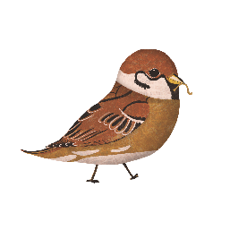
[sp-] [st-] oder [sch-]?
At the start of words, German [sp-] and [st-] are pronounced ‘schp-’ and ‘scht-’.
Hör zu. Schreib [sp], [st]
oder [sch].
1 | 2 | 3
4 | 5 | 6
7 | 8 | 9
B.
1
2
__
__
__
Schnecke
Stier
Schlange
3
4
5
__
__
__
Specht
Stinktier
Spatz
6
7
8
__
__
__
__
Schildkröte
Schnabeltier
Stachel schwein
Notes:
Timing: 5 minutes Aim: To practise aural recognition of the three sounds [sch], [sp], and [st]. Procedure: 1. Click the sound button to play B (the example). Pupils must write down sch, sp, or st based on what they hear and which sound they think fills the gap.
2. Click to reveal and check answer.
3. Repeat for items 1-8.
Transcript: Schnecke
Stier
Schlange
Specht
Stinktier
Spatz
Schildkröte
Schnabeltier
Stachelschwein Word frequency (1 is the most frequent word in German): Schnecke [>5009] , Stier [>5009], Schlange [3601], Specht [4900], Stinktier [>5009], Spatz [>5009], Schildkröte [>5009], Schnabeltier [>5009], Stachelschwein [>5009]
Source: Jones, R.L. & Tschirner, E. (2019). A frequency dictionary of German: core vocabulary for learners. Routledge

Slide 9
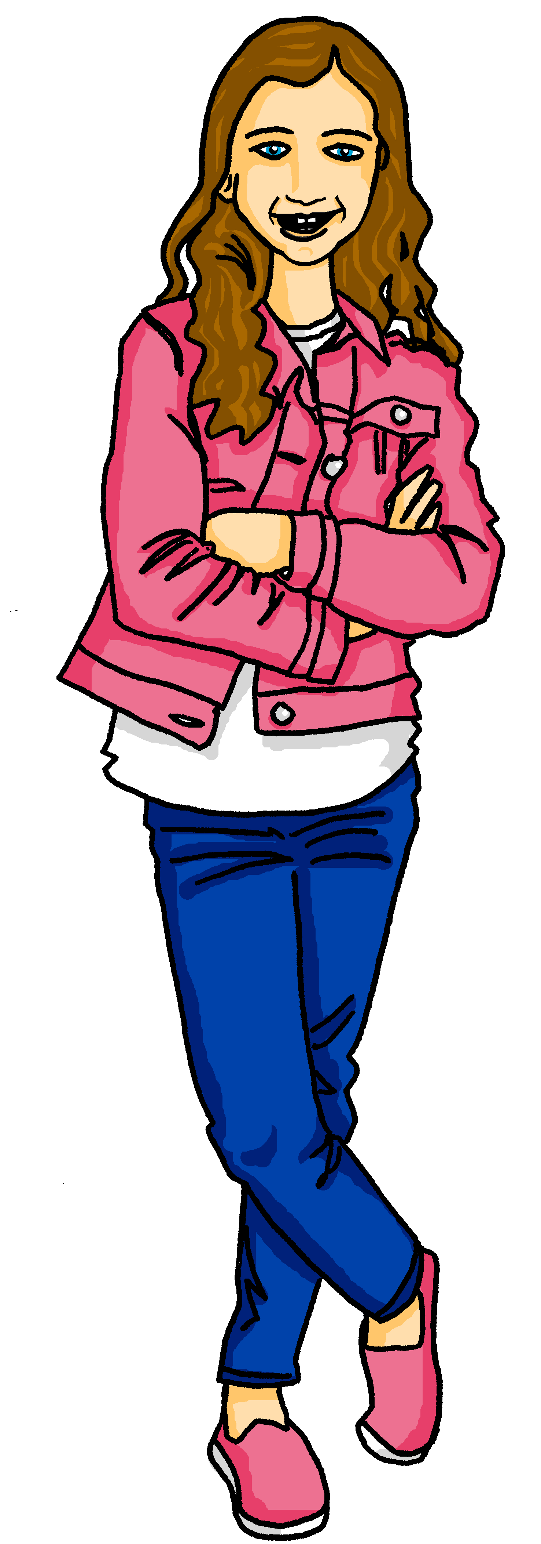
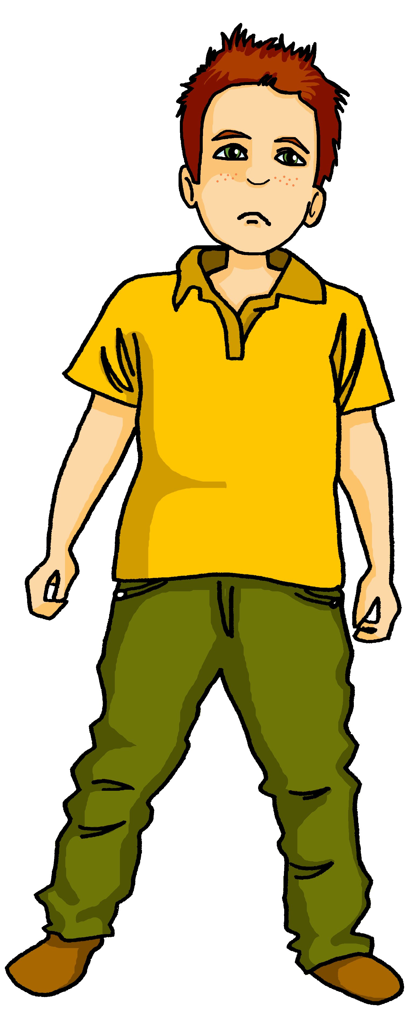
Vokabeln
Vokabeln lernen
Johanna is helping Moritz to practise for the English Word Bee. In the Word Bee he has to translate words from German into English.
Wörter
Ok. Spielen. Wie sagt man das auf Englisch?
????
Ich weiß es nicht.
Wie sagt man das (auf Englisch)?= How do you say that (in English)?
Ich weiß es nicht. = I don’t know.
Notes:
Timing: 2 minutes
Aim: to present and practise two new phrases for this week.
Procedure:
1. Explain the scenario and click to present Johanna and Moritz practising the Word Bee.
2. Ask pupils what they think the two phrases could mean in English from the context.
3. Use the callouts to give the translations.
4. Practise saying the two new phrases as a class.
9

Slide 10
Vokabeln
Vokabeln lernen
Sag die Wörter auf Deutsch. Wie sagt man das auf Englisch?
Wörter
singen
lernen
spielen
denken
[much, a lot]
[often]
viel
oft
verstehen
Wie sagt man denken auf Englisch?
To think, thinking!
Wie sagt man to sing auf Deutsch?
singen!
Notes:
Timing: 3 minutes
Aim: to present and practise more new vocabulary for this week
Procedure:
1. Click to introduce the new words and their pictures. Practise pronouncing the words as a class and individually.
2. Ask pupils what they think the words mean in English. They have already seen ‘verstehen’ in the phonics part of the lesson.
3. Click for individual words to disappear and to elicit them from the class. Click again for them to reappear.
4. Click on the images to listen and check pronunciation, if required.
5. Ask pupils to imagine they are doing a Word Bee. Click to bring up the callout ‘Wie sagt man…auf Englisch’ to elicit the English meanings, then swap to ‘Wie sagt man…auf Deutsch’ to elicit the German words instead. Pupils will have further practice of this in pairs in the follow-ups.
Word frequency (1 is the most frequent word in German):
denken [128] lernen [288] singen [1063] spielen [205] verstehen [211] viel [56] oft [223]
ich weiß (es) nicht [n/a] wie sagt man…? [n/a]
Source: Jones, R.L. & Tschirner, E. (2019). A frequency dictionary of German: core vocabulary for learners. Routledge
10

Slide 11
Infinitive (dictionary verb) and he, she, it forms
Only the infinitive form of a verb appears in the dictionary.
e.g. lernen (to learn / learning), spielen (to play / playing)
To say what he/she does or is doing, use er (he), sie (she) and change the ending from -en to -t:
lernen → Er lernt Gitarre.
(He learns guitar. / He is learning guitar.)
There is only one present tense in German!
spielen → Sie spielt Fußball.
(She plays football. / She is playing football.)
How many are there in English?
Er singt
Sie denkt
Er versteht Englisch.
He sings/
He is singing
She thinks/She is thinking
He understands / He is understanding English.
Notes:
Timing: 2 minutes
Aim: To explain how the dictionary form of the verb (infinitive) relates to the third person singular form.
Procedure:
Click through the animations to introduce infinitive and 3rd person forms of verbs.
Discuss present tense forms in English: he lives, he is living. In German both are Er wohnt.
Elicit 2x English translations for the German examples provided.
11

Slide 12
hören
Infinitive (dictionary verb) or he/she?
Hör zu. Ist das ein Infinitiv [A] oder sie/er [B]?
A
B
infinitive | she/he (sie/er)
to learn | learns
to play | plays
to understand | understands
to sing | sings
to think | thinks
to write | writes
to have | has
B.
1
2
3
4
5
6
Notes:
Timing: 5 minutes
Aim: to practise aural distinction between infinitive and 3rd person singular verbs from this week’s vocab.
Procedure:
Clarify the activity.
Click to play the example (Beispiel). Pupils decide if they hear ‘to learn’ or ‘learns’ and write A or B.
Click to correct. Remind pupils that the infinitive in German usually ends in –en and the s/he form of the verb in –t.
Continue with items 1-6.
Elicit answers and click to reveal.
Transcript:
B. lernt
1. spielen
2. verstehen
3. singt
4. denkt
5. schreiben
6. haben
12

Slide 13
Who does what: weak verbs ‘I’ and ‘he/she’
In German, the verb ending often tells us who is doing the action.
Compare:
Infinitive
singen
= to sing
Remember: the infinitive is the dictionary form. It tells you ‘what’ but not ‘who’.
s/he
Sie / er singt
= She/he sings
I
Ich singe
= I sing
‘Weak’ is another word for ‘regular’.
So, for weak German verbs:
For ‘she/he’, remove –en and add –t.
lernen →
lern- →
sie/er lernt →
she/he learns
spielen →
spiel- →
ich spiele →
I play
For ‘I’, remove –en and add –e.
Notes:
Timing: 2 minutes
Aim: To recap verb knowledge about infinitives and he/she forms, and to introduce the first person singular form.
Procedure:
Click through the animations to recap infinitive and 3rd person forms of verbs and to introduce 1st person form.
Use call-outs to remind pupils of meaning of infinitive and to teach the idea of ‘weak’ verbs (verbs that follow a regular pattern).
Work through the 2 examples as a class, using mini whiteboards if helpful.
13

Slide 14
Wer macht was in der Schule?
Moritz is messaging about what he does (ich-I) and what Johanna does (sie-she).
lesen
1
She
2
She
She plays football.
She sings a song in English.
… singt ein Lied auf Englisch.
Sie
Sie
… spielt Fußball.
I
I
3
I
4
She
… lerne Englisch.
I learn English.
Ich
I often think: why?
… denke oft: warum?
Ich
She
I
5
I
6
I
I don’t understand a word!
She learns music.
… verstehe kein Wort!
Sie
Ich
…lernt Musik.
She
She
Notes:
Timing: 5 minutes
Aim: to practise written comprehension of first and third person weak (regular) verbs.
Procedure:
Pupils write 1-6 and the correct English meaning from the two options given (She=Johanna, I=Moritz).
Click to reveal answers and the German pronouns.
Elicit meanings of 6 sentences in English orally and click to reveal.
Additional task suggestions:
Ask pupils to change the ‘I’ sentences to ‘she/he’ sentences, remembering to change the pronoun AND the verb ending. E.g. sie spielt Fußball→ ich spiele Fußball
Ask pupils to write down the infinitive forms of each verb. E.g. spielen; lernen…
Ask pupils to write one sentence that is true for them (I form) and one that is true for a friend (he/she form).

Slide 15
Tschüss!
rot
Notes:
15

