Slide 1
Talking about things and things you do
zu Hause
rot
Follow ups 1-5
Term 2 Week 7
Notes:
Artwork by Steve Clarke. Pronoun pictures from NCELP (www.ncelp.org). All additional pictures selected from Pixabay and are available under a Creative Commons license, no attribution required.
Phonics:
[s-] [-s-] singen [1063] Person [357] langsam [526] sehr [81] besuchen [820]
vs. [z] Zug [675] sitzen [231] Platz [326] Zimmer [665] zehn [333]
Vocabulary: gewinnen [372] hören [146] machen [58] zu Hause [n/a]
Revisit 1: du hast [7]
Revisit 2: Buch [300] Haustier [n/a] Schule [359] Tier [614] nicht wahr? [n/a]
Jones, R.L & Tschirner, E. (2019). A frequency dictionary of German: Core vocabulary for learners. London: Routledge.
The frequency rankings for words that occur in this PowerPoint which have been previously introduced in these resources are given in the SOW and in the resources that first introduced and formally re-visited those words.
For any other words that occur incidentally in this PowerPoint, frequency rankings will be provided in the notes field wherever possible.

Slide 2
aussprechen
[s]
Before a vowel, German 's' sounds like English ‘z’.
…
singen
Notes:
Timing: 1 minute
Aim: to present the SSC [s] before a vowel.
Procedure:
Present the SSC and the source word ‘singen’ (with gesture, if using).
Click to bring on the picture and get pupils to repeat the word ‘singen’ (with gesture (a gesture might be to sing ‘lalala’) if using).
Frequency:
singen [1063]

Slide 3
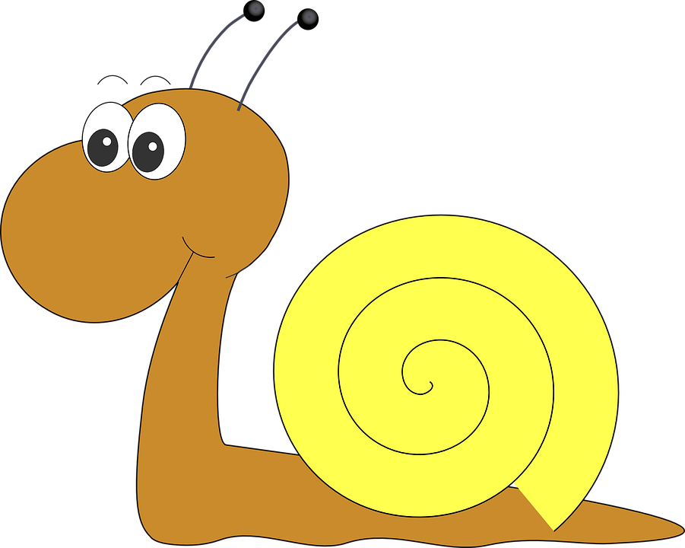
aussprechen
[s]
Before a vowel, German 's' sounds like English ‘z’.
…
singen
langsam
besuchen
sehr
Person
other words: Person langsam sehr
besuchen
(we then have all the vowels represented)
Notes:
Timing: 1 minute
Aim: to consolidate the SSC [s] before a vowel.
Procedure:
Re-present the SSC and the source word ‘singen’ (with gesture, if using).
Click to bring on the picture and get pupils to repeat the word ‘singen’ (with gesture, if using).
Present the cluster words in the same way, bringing on the picture and getting pupils to pronounce the words.
Frequency:
singen [1063] Person [357] langsam [526] sehr [81] besuchen [820]

Slide 4
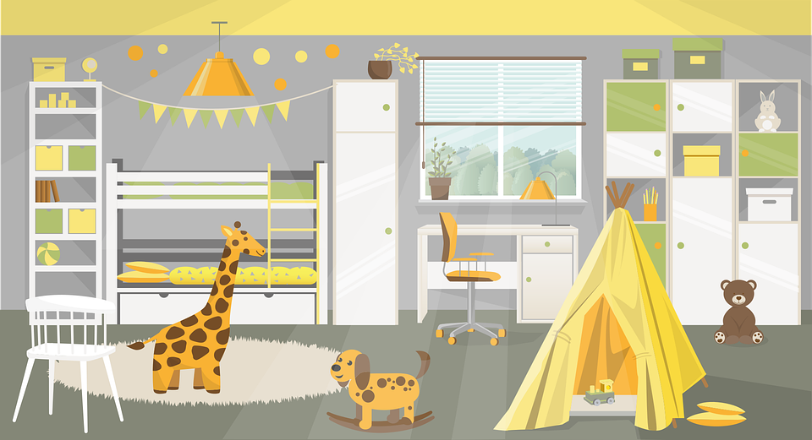
aussprechen
[z]
Remember: German ‘z’ sounds like English ‘ts’, like at the end of boots.
…
Zug
sitzen
Platz
Zimmer
zehn
Notes:
Timing: 1 minute
Aim: to consolidate the SSC [z].
Procedure:
Re-present the SSC and the source word ‘Zug’ (with gesture, if using).
Click to bring on the picture and get pupils to repeat the word ‘Zug’ (with gesture, if using).
Present the cluster words in the same way, bringing on the picture and getting pupils to pronounce the words.
Click to bring up call-out explaining the pronounciation of ‘z’.
Click to bring up the prompt to identify the nouns (the ones with capital letters). This is still very new knowledge for pupils, so it’s good to revisit this as often as we can. Plus, it gives an additional opportunity to pronounce the words.
Click to highlight the 3 x nouns.
Vocabulary:
sitzen [231] Platz [326] Zimmer [665] zehn [333] Zug [675]
Jones, R.L & Tschirner, E. (2019). A frequency dictionary of German: Core vocabulary for learners. London: Routledge.

Slide 5
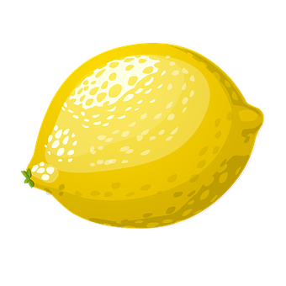
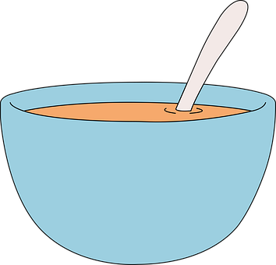
Follow up 1
Was ist das?.
Ich sehe was*…
Was ist das?
rot
blau
gelb
groß [big]
klein [small]
Person?
Das ist rot…
Zebra?
Falsch!
Richtig!
was – what?, something
Zebra
Zitrone
Zwiebel
Platz
Sonne
Suppe
]
Sänger
Zaun
Person
Zug
Notes:
Timing: 5 minutes
Aim: to practise distinguishing between [s], pronounced like an English ‘z’, and [z], pronounced like English ‘ts’
Procedure: 1. Point out that the words are all red, blue, yellow, big or small, and that there is a key to help them with the German for these words. They are going to play a speaking game like eye spy with the words. Explain that Ich sehe means ‘I see’ or here, ‘I spy’. 2. Click to bring up the example conversation between the teacher and Moritz. Explain that the pupils will take on Moritz’ role first of all, and you will be the teacher. 3. Play the game as a class, with you saying the teacher role and the pupils guessing the word, based on whether you say rot/gelb/blau/groß/klein. Check that pupils are applying the pronunciation rules for [s] and [z] in each word. Repeat a few times with different words.
4. Pupils can then play in pairs, with one pupil taking on the teacher role and choosing a word and the other guessing the word.
Word frequency (1 is the most frequent word in German): Sonne [864] Zebra [N/A] Zitrone [N/A] Zwiebel [N/A] Platz [326] Suppe [N/A] Sänger [3029] Zaun [3279] Person [357] Zug [675]
Source: Jones, R.L. & Tschirner, E. (2006). A frequency dictionary of German: core vocabulary for learners. Routledge

Slide 6
Follow up 2
Was ist richtig? Was ist falsch?
lesen
1
Hast du
3
Hörst du
Spielst du
Spielst du
ein Lied?
das Spiel?
Lernst du
Singst du
Machst du
5
Gewinnst du
Verstehst du
Singst du
das Buch?
2
Ich mache
4
Ich höre
Spielst du
Ich denke
ein Geschenk.
Ich mache
ein Foto.
Verstehst du
Ich singe
Ich spiele
Ich habe
Ich habe
Notes:
Timing: 5 minutes
Aim: to practise recognition of verbs and vocabulary from this and previous weeks.
Procedure:
Explain to pupils that they need to decide which verbs could be correct starters to each of the 5 sentences, based on their meaning. Sometimes all verbs might make sense.
Pupils discuss in pairs and write down 1-5 and the verbs they think work for each sentence.
Elicit answers and click for ticks to appear next to correct verbs. Discuss meanings of each question/statement as you correct.
Note: Ensure pupils know the meanings of the 5 words in red boxes, as without this knowledge they will struggle to access the task. Also point out the questions and statements. Additional task suggestions: 1. Pupils make up their own sense and nonsense sentences and questions, and their partner or the class must decide whether or not they make sense.

Slide 7
Follow up 3
Hör zu. Wer ist das? I, you oder he/she?
1
2
3
4
5
6
7
8
9
10
hören
5. denke
6. hörst
4. gewinnt
3. spiele
I
you
he/she
9. verstehe
7. machst
8. lernt
10. habe
1. singst
2. macht
Notes:
Timing: 5 minutes
Aim: to practise understanding of 1st, 2nd and 3rd person singular verb endings.
Procedure:
Explain that pupils will hear 10 verb forms and need to decide if they belong in the I, you or he/she category, based on the endings.
Pupils write down 1-10.
Play the first audio and discuss as a class why the verb belongs in the ‘you’ circle.
Repeat for items 2-10.
Click for answers to appear in the correct circle.
Ensure pupils know what each verb is in the infinitive and how they have been changed for the different persons of the verb.
Note: haben is included here in the ‘ich’ form as it follows the regular pattern, but not in the ‘du’ and ‘er/sie’ forms.
Transcript:
[du] singst
[er] macht
[ich] spiele
[sie] gewinnt
[ich] denke
[du] hörst
[du] machst
[er] lernt
[ich] verstehe
[ich] habe Additional task suggestions: 1. Pupils rewrite each verb, with the ich/du/er/sie added back in, and their English translations e.g. du singst= you sing/are singing.

Slide 8
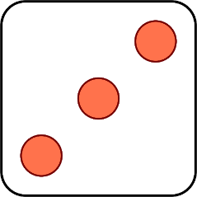
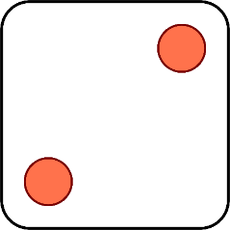
Follow up 4:
Wer macht was?
Versteht er ..?
Gewinnt er ..?
Machst du ..?
Er singt…
Spiele ich ..?
sprechen
Du hörst…
💡
ein Lied
Fußball
Musik
kein Wort
ein Geschenk
ein Spiel
ein Bild
ein Buch
Deutsch
1 | I
2 | You
3 | He
4 | Do I?
5 | Do you?
6 | Does he?
1 | play
2 | sing
3 | understand
4 | do / make
5 | win
6 | listen
Notes:
Timing: 5 minutes
Aim: to practise oral production of singular person forms of a regular verb in statements and questions.
Procedure: 1. Remind pupils how verbs change their ending depending who is ‘doing’ the verb and how the syntax changes for a question.
2. Click to ‘roll’ the 2 dice.
3. Pupils translate the pronouns and verbs into German according to the numbers on the 2 dice.
4. Click to reveal the correct verb phrase/question.
5. Pupils then choose any word from the orange list which would make sense to complete the sentence. Hear various options e.g. 1) Spiele ich Fußball? Spiele ich ein Spiel? Spiele ich Musik?
6. Repeat until all six dice combinations have been used.
Additional task suggestions:
If pupils have their own dice, they could continue in pairs, rolling the dice and making sentences. If they don’t have dice, their partner could give them two numbers and they have to make a sentence.
Pupils could write sentences using the combinations on the board and their partner must a) check the verb ending is correct and b) decide if the sentence is sense or nonsense. E.g. Du hörst ein Lied= sense; Du hörst ein Bild= nonsense

Slide 9
Follow up 5:

Schreib auf Englisch.
Can you get at least 15 points?
Wörter
Vokabeln
 | das Buch | das Haustier | nicht wahr?
 | die Schule | das Tier | nicht
 | zu Hause | gewinnen | hören
 | du | du hast | machen
Isn’t it? Isn’t that right?
(the) book
(the) pet
x2
(the) school
(the) animal
not
at home
to win, winning
to listen, listening
x1
you
you have
to do, make
Notes:
Timing: 5 minutes
Aim: to practise written comprehension of vocabulary from this and revisited weeks.
Procedure: 1. Give pupils a blank grid. They fill in the English meanings of any of the words they know, trying to reach 15 points in total.
Note: The most recently learnt and practised words are pink and revisited words are green.

Slide 10
Follow up 5:

Schreib auf Deutsch.
Can you get at least 15 points?
Wörter
 | (the) animal | Isn’t it? Isn’t that right? | not
 | (the) book | (the) pet | (the) school
 | at home | you | you have
 | to win, winning | to listen, listening | to do, make
Vokabeln
x2
das Tier
nicht wahr?
nicht
das Buch
das Haustier
die Schule
zu Hause
du
du hast
x1
gewinnen
hören
machen
Notes:
Timing: 5 minutes
Aim: to practise written production of vocabulary from this and revisited weeks.
Procedure: 1. Give pupils a blank grid. They fill in the German meanings of any of the words they know, trying to reach 15 points in total.
Note: The most recently learnt and practised words are pink and revisited words are green.

Slide 11
Tschüss!
rot
Notes:
11

Slide 12
Follow up 5:

Schreib auf Englisch.
Can you get at least 15 points?
Wörter
Vokabeln
 | das Buch | das Haustier | nicht wahr?
 | die Schule | das Tier | nicht
 | zu Hause | gewinnen | hören
 | du | du hast | machen
x2
x1
Notes:
HANDOUT

Slide 13
Follow up 5:

Schreib auf Deutsch.
Can you get at least 15 points?
Wörter
 | (the) animal | Isn’t it? Isn’t that right? | not
 | (the) book | (the) pet | (the) school
 | at home | you | you have
 | to win, winning | to listen, listening | to do, make
Vokabeln
x2
x1
Notes:
HANDOUT

