Slide 1
Talking about things and things you do
zu Hause
rot
Present tense (I, you)
Yes/no questions
SSC [s-] [-s-] vs. [z]
Term 2 Week 7
Notes:
Artwork by Steve Clarke. Pronoun pictures from NCELP (www.ncelp.org). All additional pictures selected from Pixabay and are available under a Creative Commons license, no attribution required.
Phonics:
[s-] [-s-] singen [1063] Person [357] langsam [526] sehr [81] besuchen [820]
vs. [z] Zug [675] sitzen [231] Platz [326] Zimmer [665] zehn [333]
Vocabulary: gewinnen [372] hören [146] machen [58] zu Hause [n/a]
Revisit 1: du hast [7]
Revisit 2: Buch [300] Haustier [n/a] Schule [359] Tier [614] nicht wahr? [n/a]
Jones, R.L & Tschirner, E. (2019). A frequency dictionary of German: Core vocabulary for learners. London: Routledge.
The frequency rankings for words that occur in this PowerPoint which have been previously introduced in these resources are given in the SOW and in the resources that first
introduced and formally re-visited those words.
For any other words that occur incidentally in this PowerPoint, frequency rankings will be provided in the notes field wherever possible.
Note that the first three lessons of the year teach language that can be continuously recycled as lesson routine every lesson in Y3/4.
The idea would be that the class teacher (whether or not s/he teaches the class German can re-use the language as part of the daily routine with the class.
1

Slide 2
aussprechen
[s]
Before a vowel, German 's' sounds like English ‘z’.
…
singen
Notes:
Timing: 1 minute
Aim: to present the SSC [s] before a vowel.
Procedure:
Present the SSC and the source word ‘singen’ (with gesture, if using).
Click to bring on the picture and get pupils to repeat the word ‘singen’ (with gesture (a gesture might be to sing ‘lalala’) if using).
Frequency:
singen [1063]

Slide 3
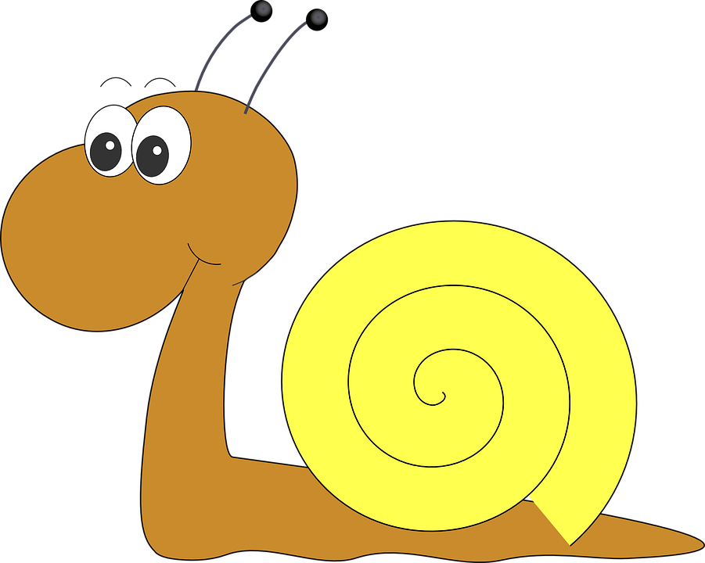
aussprechen
[s]
Before a vowel, German 's' sounds like English ‘z’.
…
singen
langsam
besuchen
sehr
Person
other words: Person langsam sehr
besuchen
(we then have all the vowels represented)
Notes:
Timing: 1 minute
Aim: to consolidate the SSC [s] before a vowel.
Procedure:
Re-present the SSC and the source word ‘singen’ (with gesture, if using).
Click to bring on the picture and get pupils to repeat the word ‘singen’ (with gesture, if using).
Present the cluster words in the same way, bringing on the picture and getting pupils to pronounce the words.
Frequency:
singen [1063] Person [357] langsam [526] sehr [81] besuchen [820]

Slide 4
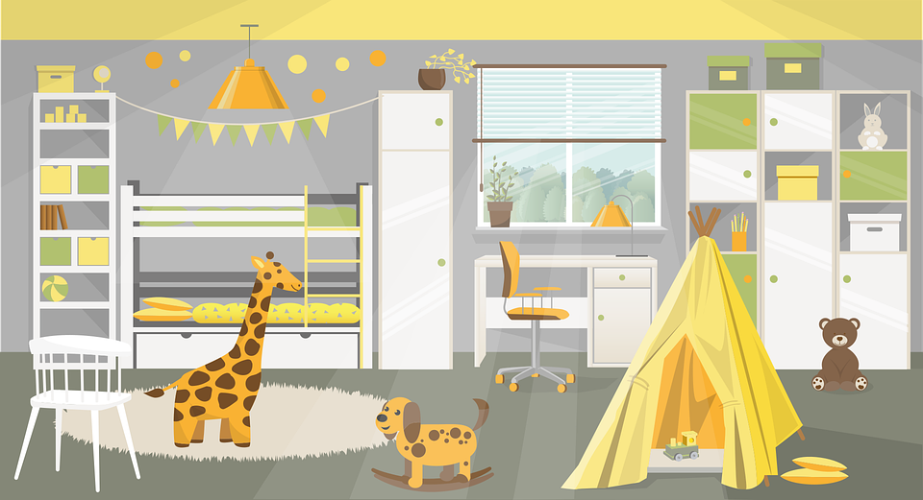
aussprechen
[z]
Remember: German ‘z’ sounds like English ‘ts’, like at the end of boots.
…
Zug
sitzen
Platz
Zimmer
zehn
Notes:
Timing: 1 minute
Aim: to consolidate the SSC [z].
Procedure:
Re-present the SSC and the source word ‘Zug’ (with gesture, if using).
Click to bring on the picture and get pupils to repeat the word ‘Zug’ (with gesture, if using).
Present the cluster words in the same way, bringing on the picture and getting pupils to pronounce the words.
Click to bring up call-out explaining the pronounciation of ‘z’.
Click to bring up the prompt to identify the nouns (the ones with capital letters). This is still very new knowledge for pupils, so it’s good to revisit this as often as we can. Plus, it gives an additional opportunity to pronounce the words.
Click to highlight the 3 x nouns.
Vocabulary:
sitzen [231] Platz [326] Zimmer [665] zehn [333] Zug [675]
Jones, R.L & Tschirner, E. (2019). A frequency dictionary of German: Core vocabulary for learners. London: Routledge.

Slide 5
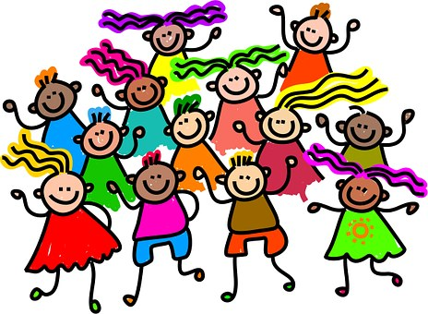
Ist das [s] oder [z]?
Hör zu. Schreib 1-9 und [z] oder [s].
Remember! German ‘s’ before a vowel sounds like English ‘z’. German ‘z’ sounds like ‘ts’ in English ‘boots’.
hören
10
_
_
_
E sel
zehn
4
7
1
Zelt
_
_
_
Tanz
Zahn
8
2
Sonne
5
_
_
_
Z oo
3
Sonntag
6
Seife
9
Notes:
Timing: 5 minutes
Aim: to practise recognising aurally the SSCs [z] and [s].
Procedure:
Click to bring up a reminder about distinguishing [s] and [z].
Pupils write down 1-9 and will write the full word with [s] or [z], based on what they hear.
3. Click the audio button to hear the first word, elicit the answer from pupils and click to display answer.
Repeat for items 2-9.
Transcript:
Zehn
Sonne
Sonntag
Zelt
Zahn
Seife
Esel
Tanz
Zoo
Word frequency (1 is the most frequent word in German): zehn [333], Sonne [864], Sonntag [804], Zelt [2880], Zahn [1871], Seife [N/A], Esel [N/A], Tanz [3946], Zoo [N/A]
Source: Jones, R.L. & Tschirner, E. (2019). A frequency dictionary of German: core vocabulary for learners. Routledge

Slide 6
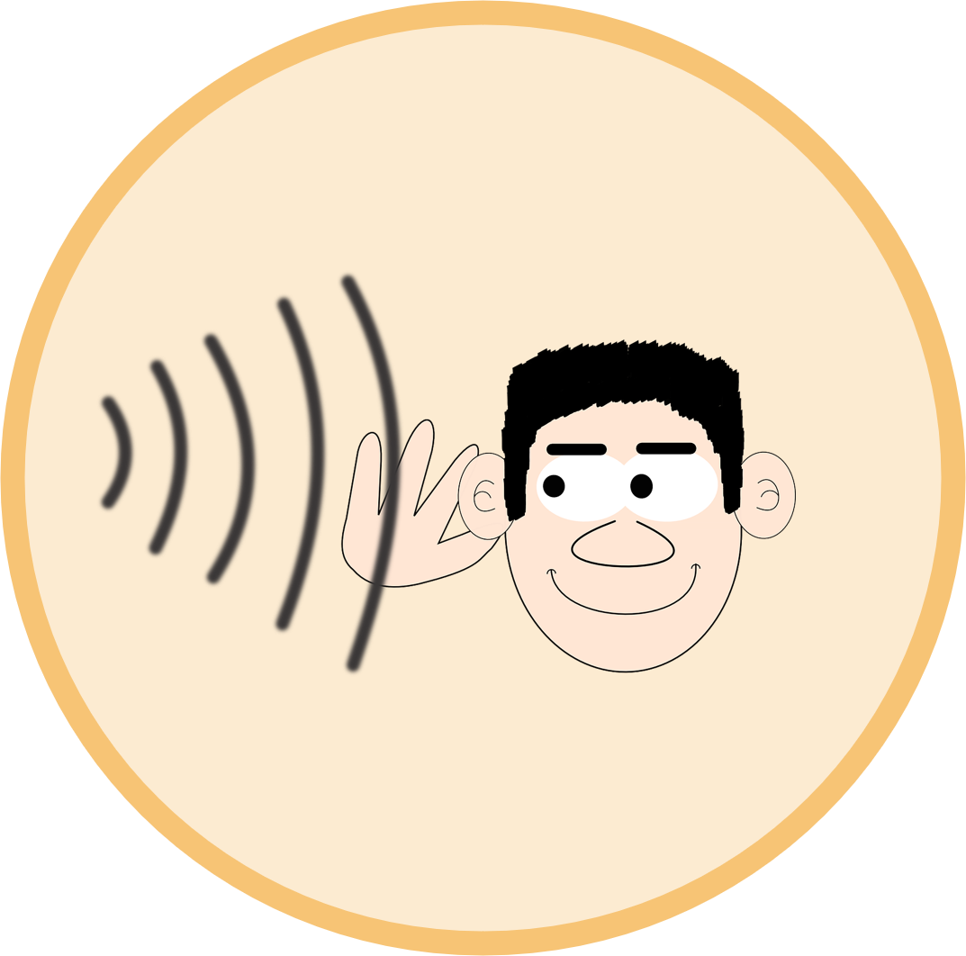
Vokabeln
Hör zu. Sag das Wort.
Wörter
Three of these new words are verbs.
gewinnen
hören
Which one is not a verb?
to do, make
What do the infinitive verbs all have in common?
machen
zu Hause
Notes:
Timing: 5 minutes
Aim: to present and practise 4 new items of vocabulary for this week
Procedure:
Click for each new word to appear, and again for the picture. Practise repeating the 4 words as a class and ensure pupils understand the meanings.
Click to bring up the call-out to discuss which items are verbs, and how we can tell. Pupils will be using verbs this lesson, and need to recognise them in their infinitive form here.
6

Slide 7
Was ist das?
Wörter
gewinnen
to do,
make
Notes:
Slide 1 of 7
Timing: 2 minutes (7 slides) Aim: To elicit understanding of verbs met so far, including new verbs this week Procedure: 1. Click to bring up the infinitive.
2. Ask pupils to decide which picture represents the correct meaning, pointing to the left or right hand side of the classroom/board. 3. Click again to bring up answer.
4. Repeat for slides 2-7.
7

Slide 8
Was ist das?
Wörter
machen
to do,
make
Notes:
2/7
8

Slide 9
Was ist das?
Wörter
spielen
Notes:
3/7
9

Slide 10
Was ist das?
Wörter
lernen
Notes:
4/7
10

Slide 11
Was ist das?
Wörter
haben
Notes:
5/7
11

Slide 12
Was ist das?
Wörter
denken
Notes:
6/7
12

Slide 13
Was ist das?
Wörter
verstehen
Notes:
7/7
13

Slide 14
Who does what: weak verbs ‘you’
You know that German verb endings often tell us who a statement is about:
I
she/he
Ich singe das Lied.
Sie/Er singt oft.
= I sing the song.
= She/He sings often.
Remember: ‘Weak’ is another word for ‘regular’.
To say ‘you’ with weak German verbs:
you
Du singst gut.
= You sing well.
Remove –en and add –st.
lernen →
lern- →
du lernst →
you learn
Notes:
Timing: 2 minutes
Aim: To recap verb knowledge about the 1st and 3rd persons singular of weak verbs, and to introduce the 2nd person singular.
Procedure:
Click through the animations to recap 1st and 3rd person forms of verbs and to introduce 2nd person form.
Elicit the English meanings from pupils.
14

Slide 15
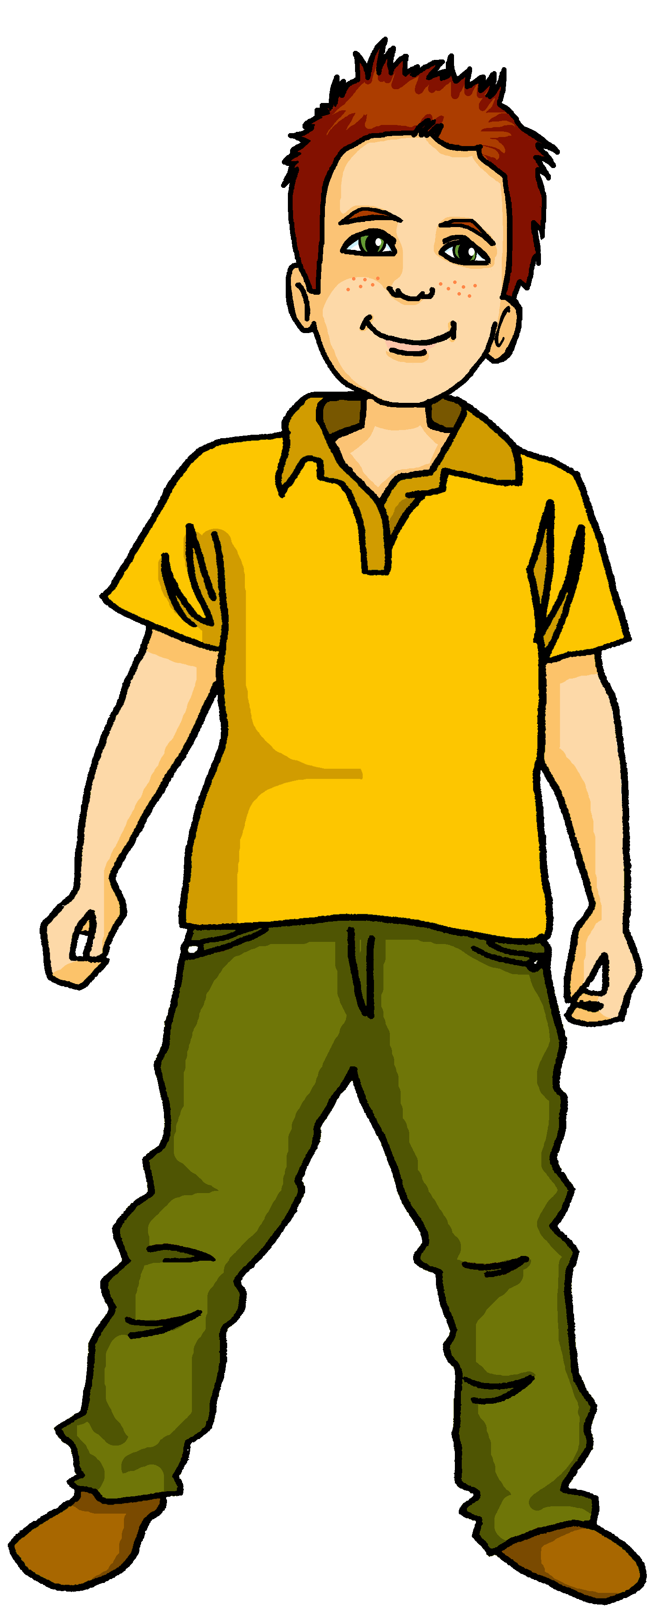
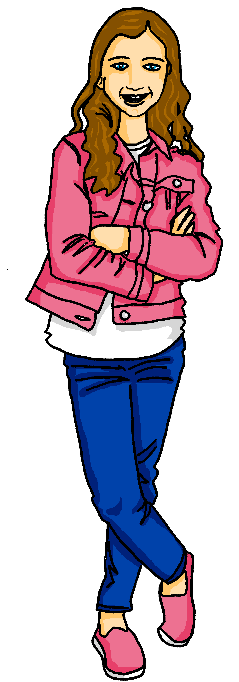
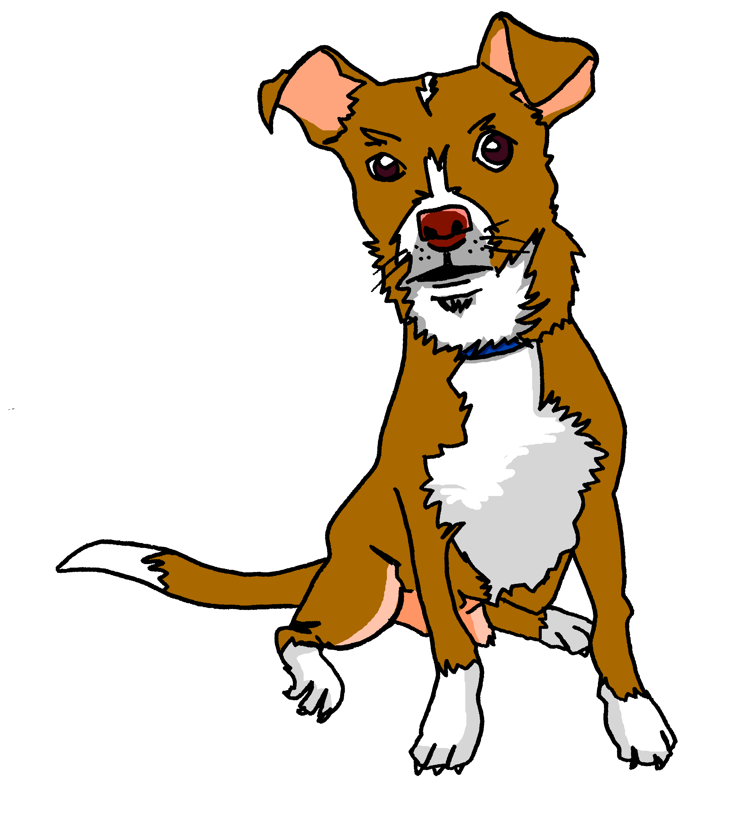
lesen
Moritz has made a list of things that he is doing today and things that Johanna is doing. Tasso, their dog, has chewed the list and some bits are missing.
Wer macht was? Moritz (I) oder Johanna (you)?
1
… singe ein Lied.
Ich
5
… mache ein Bild.
Ich
 | ich (I) | du (you)
1
2
3
4
5
6
7
8
2
… spielst Fußball.
6
Du
Du
… hörst Musik.
3
… gewinnst ein Spiel.
Du
4
7
Ich
… mache ein Buch.
… verstehe die Liste.
Ich
8
… machst ein Geschenk für* Aisha.
Du
*für- for
Notes:
Timing: 8 minutes
Slide 1/2
Aim: to practise written comprehension of verb endings in the first and second person singular (ich and du).
Procedure:
Explain the scenario and that pupils need to identify which verbs are in the ‘I’ form (written by Moritz about himself) and which verbs are in the ‘you’ form (written by Moritz for Johanna).
Pupils write down numbers 1-8 and either ‘I’ or ‘you’ for each sentence, depending on the verb ending.
Click for ticks to appear and again for the ‘ich’ or ‘du’ to appear to complete each sentence.
Pupils now need to make a list in English of what Moritz and Johanna are each doing. See next slide for answers.
15

Slide 16
Schreib zwei Listen auf Englisch.
lesen
I’m singing a song.
You’re playing football.
I’m making a book.
You’re winning a game.
I’m making a picture.
You’re listening to music.
I’m understanding the list.
You’re making a present for Aisha.
Ich singe ein Lied.
Du spielst Fußball.
Ich mache ein Buch.
Du gewinnst ein Spiel.
Du hörst Musik.
Ich mache ein Bild.
Ich verstehe die Liste.
Du machst ein Geschenk für Aisha.
Notes:
Slide 2/2

Slide 17
Yes / no questions
You know to swap verb and subject to make a yes/no question:
Statement
Du singst das Lied.
= You sing the song.
= You are singing the song.
Question
Singst du das Lied?
= Do you sing the song?
= Are you singing the song?
Remember! German has no word for ‘do’ or ‘are’ in questions.
Note that when you hear questions, you get an extra clue from the intonation, and when you read, you see the question mark.
Notes:
Timing: 3 minutes Aim: to revisit knowledge that pupils were taught in 1.1.7 on the formation of closed questions.
Procedure: 1. Click to animate the explanation.
2. Highlight that German does not have a word for do/does, or the continuous equivalent are/is, and that inversion must be used to translate these.
3. Ensure pupils’ understanding at each stage.
17

Slide 18
Question or statement?
Hör zu. Schreib 1-10 und [?] oder [.]
When you are listening to a question, you have two clues: the intonation of the speaker and the word order.
hören
For numbers 1-5, I’ll give you both clues!
For numbers 6-10, I’m afraid I’ve forgotten my intonation…
 | ? oder .
 |  | Spielst du Tennis?
 |  | Du machst ein Foto.
 |  | Verstehst du das Wort?
 |  | Hörst du die Musik?
 |  | Du gewinnst einen Punkt.
 | ? oder .
 |  | Du spielst Fußball.
 |  | Denkst du oft?
 |  | Du singst ein Lied.
 |  | Lernst du Deutsch?
 |  | Machst du einen Film?
?
6
.
1
.
2
7
?
3
?
.
8
4
?
9
?
.
?
5
10
Notes:
Timing: 5 minutes
Aim: to practise recognising aurally questions and statements.
Procedure:
Click to bring up reminders about how to recognise a question in German. Pupils are going to identify questions and statements, first by listening to natural intonation and word order to decide, then relying solely on recognising the word order.
Pupils write down 1-10 and will write down either ? or . for each item.
Click the audio button to hear the first sentence, elicit the answer from pupils and click to display answer and then the German sentence. Translate into English to check comprehension and remind pupils that English questions start with ‘Do you’ and there is no word for ‘do’ in German.
Repeat for items 2-5.
Explain that they now have to rely solely on the grammar i.e. verb before pronoun and repeat for items 6-10.
Transcript:
Spielst du Tennis?
Du machst ein Foto
Verstehst du das Wort?
Hörst du die Musik?
Du gewinnst einen Punkt
Du spielst Fußball
Denkst du oft?
Du singst ein Lied
Lernst du Deutsch?
Machst du einen Film?
Additonal Task Suggestions:
Pupils turn the questions into statements and statements into questions.

Slide 19
Tschüss!
rot
Notes:
19

