Slide 1
Talking about things and things you do
rot
Follow ups 1-5
Term 2 Week 8
Notes:
Artwork by Steve Clarke. Pronoun pictures from NCELP (www.ncelp.org). All additional pictures selected from Pixabay and are available under a Creative Commons license, no attribution required.
Phonics: SSC [ß-] [-ss-] [-s]
Vocabulary: Nummer [806] null [1680] eins [774] zwei [70] drei [106] vier [200] fünf [274] sechs [428] sieben [611] acht [645] neun [1053] zehn [333] elf [1507] zwölf [1080] es gibt [n/a]
Revisit 1: Film [505] Lieblings- [n/a] Lied [1733] Musik [509]
Revisit 2: revisit all language learnt in Term 1
Jones, R.L & Tschirner, E. (2019). A frequency dictionary of German: Core vocabulary for learners. London: Routledge.
The frequency rankings for words that occur in this PowerPoint which have been previously introduced in these resources are given in the SOW and in the resources that first
introduced and formally re-visited those words.
For any other words that occur incidentally in this PowerPoint, frequency rankings will be provided in the notes field wherever possible.
Note that the first three lessons of the year teach language that can be continuously recycled as lesson routine every lesson in Y3/4.
The idea would be that the class teacher (whether or not s/he teaches the class German can re-use the language as part of the daily routine with the class.

Slide 2
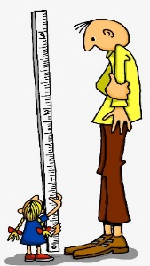
aussprechen
[s][ss][ß]
…
You know that ‘s’ in front of a vowel sounds like the English ‘z’.
ß is just a special way of writing ‘ss’ after a long vowel.
At all other times German ‘s’, ‘ss’ and ‘ß’ sound like English ‘s’.
groß
[big, tall]
Notes:
Timing: 1 minute
Aim: To introduce SSC [s/ss/ß] when not in front of a vowel.
Procedure:
Introduce the SSC and and say the [s/ss/ß] sound first, on its own. Pupils repeat it with you.
Present the source word ‘groß’ (with gesture, if using).
Click to bring on the picture and get pupils to repeat the word ‘groß’ (with gesture, if using).
Use the callouts to emphasise the difference between ‘s’ in front of a vowel and ‘s’ at all other times and to explain about the new letter ß.
Note:
A gesture for this could be to reach high above your head.
groß [67]
Jones, R.L & Tschirner, E. (2019). A frequency dictionary of German: Core vocabulary for learners. London: Routledge.
2

Slide 3
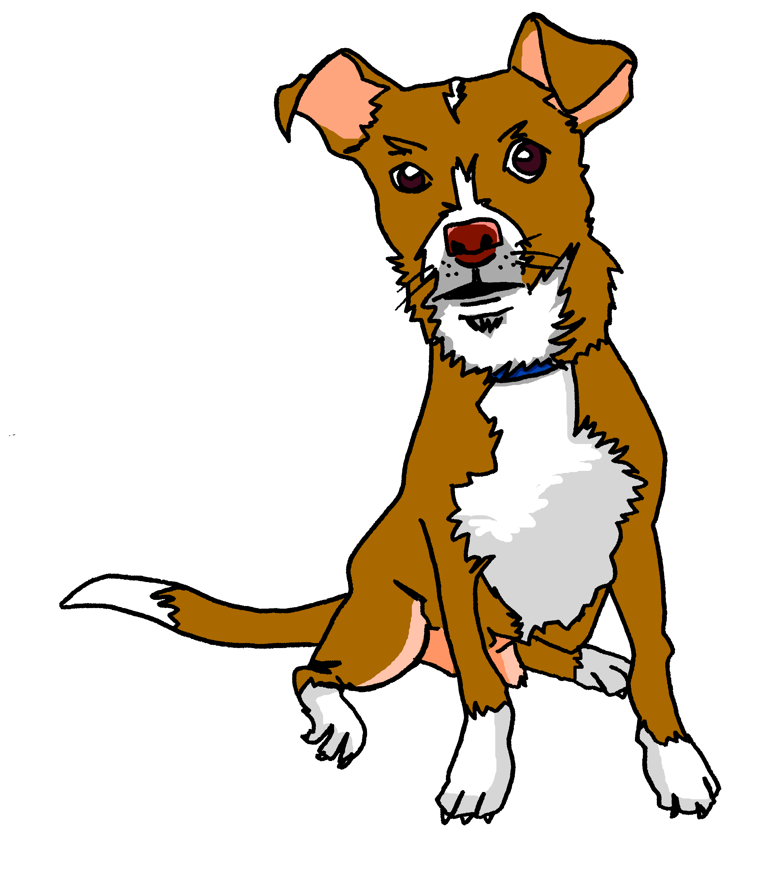
aussprechen
[s][ss][ß]
…
Tasso
Fußball
heißen
groß
essen
tschüss
This can be written with ‘s’ or ‘ss’ at the end.
[to eat, eating]
Notes:
Timing: 1 minute
Aim: to introduce the SSC [s/ss/ß].
Procedure:
Re-present the SSC and the source word ‘groß’ (with gesture, if using).
Click to bring on the picture and get pupils to repeat the word ‘groß’ (with gesture, if using).
Present the cluster words in the same way, bringing on the pictures and getting pupils to pronounce the words.
Note: It’s very important that pupils start to recognise ß as an ‘s’ sound, and don’t confuse it with a B.
essen [323] Fußball [1277] tschüss [3766] heißen [126]
Jones, R.L & Tschirner, E. (2019). A frequency dictionary of German: Core vocabulary for learners. London: Routledge.
3

Slide 4
Follow up 1a
Lies die Wörter..
Musik
weiß
sie
zu Hause
Fußball
sehr
super
interessant
Liste
Notes:
Timing: 5 minutes (two slides)
Aim: to practise distinguishing between [s] or [ss] pronounced as English ‘s’, or [s] pronounced as English ‘z’.
Note: Words for this task are taken from previously taught words and cognates.
Procedure: 1. Pupils must decide whether the sounds in the words match to the bee (buzz) or the snake (hiss). 2. Teachers can elicit the sound [zzzz] or [ssss] first from the pupils, then the full word. 3. Answers are animated one by one to move to the correct image.
Word frequency (1 is the most frequent word in German): interessant [810] super [1772] Liste [1792]
Source: Jones, R.L. & Tschirner, E. (2006). A frequency dictionary of German: core vocabulary for learners. Routledge

Slide 5
Follow up 1b
Snap?
links
Fußball
sein
Person
es
heißen
tschüss
sie
Wasser
super
sehr
Musik
interessant
rechts
das
zu Hause
singen
Notes:
Procedure: 1. Pupils identify if the sounds circled are a match, ‘snap’ (like the card game) by pronouncing the words aloud and comparing them. 2. Play FOUR times with class and give pupils a few seconds to pronounce in pairs and decide, before taking the class answer each time. The answers are animated with a tick or cross. 3. Then pairs can play against each other – one pupil choosing and pronouncing two words from any on the slide, and the other pupil deciding whether they make a matching snap pair or not.
Note: Words chosen are from previously taught language or they are cognates.

Slide 6
Follow up 2
Hör zu. Was gibt es in der Schule?
There is a/one table.
Es gibt einen Tisch.
hören
1
2
There are two boards.
Es gibt zwei Tafeln.
3
There are twelve books.
Es gibt zwölf Hefte.
4
There is a/one [female] teacher.
Es gibt eine Lehrerin.
5
There is a/one game.
Es gibt ein Spiel.
6
There are ten friends.
Es gibt zehn Freunde.
7
There are eleven pencils.
Es gibt elf Bleistifte.
8
There are two animals.
Es gibt zwei Tiere.
Notes:
Timing: 5 minutes
Aim: to practise aural comprehension of numbers and previously taught vocabulary.
Procedure:
Explain the scenario: Moritz is telling his parents about what there is in school. Pupils need to translate his sentences into English, focusing on whether the noun is singular or plural.
Click the sound button to listen to number 1. Pupils write the English translation.
Click again for the answer in English and again for the original sentence in German.
Complete items 2-8 and click to correct with the class.
Additional task suggestion:
Pupils could adapt the sentences to be about their ideal school e.g. Es gibt zwölf Spiele; Es gibt keine Lehrerin; Es gibt einen Hund.
Transcript:
Es gibt einen Tisch.
Es gibt zwei Tafeln.
Es gibt zwölf Hefte.
Es gibt eine Lehrerin.
Es gibt ein Spiel.
Es gibt zehn Freunde.
Es gibt elf Bleistifte.
Es gibt zwei Tiere.

Slide 7
Follow up 3a
Partnerarbeit. Sag die Nummern.
sprechen
2
3
4
1
1
5
5
2
7
8
9
6
8
6
10
2
4
10
3
5
4
3
12
11
10
9
8
7
6
6
4
1
3
5
7
9
2
3
1
6
1
1
1
1
5
4
Notes:
Timing: 5 minutes (two slides, two activities)
Aim: to practise oral production of numbers 1-12.
Procedure:
Model number 1 with pupils chanting the numbers 1-5 as a class.
Pupils work in pairs to follow the different patterns of numbers 2-6.
Click on the audio buttons to hear the full sequences. Encourage pupils to join in to increase fluency in production.
Additional task suggestions:
Pupils could do each sequence backwards.
Pupils could make up their own sequence for their partner (using only numbers 1-12).

Slide 8
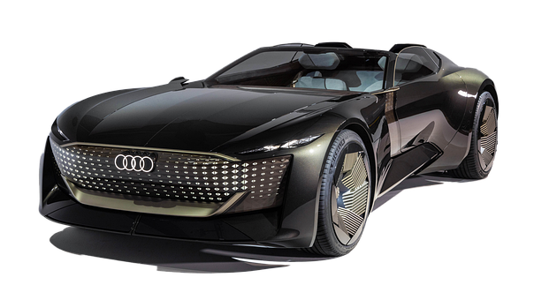
Follow up 3b
Schreib die Nummern auf Deutsch.
schreiben
f
+
f _ n _
=
ü
Schreib die Nummern auf Deutsch
1
n
s_ e _ e _
+
=
i
b
2
e
n
+
=
z _ h _
3
n
n _ u _
=
e
4
+
w
l
=
z _ ö _ f
5
Notes:
Timing: 5 minutes
Aim: to practise written production of numbers.
Procedure:
Pupils work out the Maths sums and write the answers as German numbers from memory.
Click to reveal the written answers.
Additional Task suggestions: 1. More confident pupils could write out the whole sums in German words e.g. zwei + drei= fünf.
2. Pupils could write their own word sums for others to complete.

Slide 9
schreiben
Follow up 4
Schreib auf Englisch und Deutsch
Es gibt ein Tier.
Es gibt ________ Tische.
Es gibt zehn _______.
Es gibt ______ __________.
___ ______ drei ____________.
____ ________ _____ _____________.
There ____ an __________.
There _____ five ________ .
There are ________ films.
_______ _______ two schools.
There are ________ presents.
There are nine bottles.
1
is
animal
2
fünf
are
tables
3
Filme
ten
4
zwei
Schulen
There
are
5
Es
gibt
Geschenke
three
6
Es
gibt
neun
Flaschen
You know two plural patterns: -e for masculine and some neuter nouns, -(e)n for feminine. Take care to choose the correct ending!
Notes:
Timing: 5 minutes
Aim: to practise written production of plural masculine and feminine nouns, es gibt and numbers.
Procedure:
Pupils to write out the sentences, filling in the gaps by translating German to English and English to German. Remind pupils of the different rules learnt about forming plurals so far.
Click to display missing words.
Additional task suggestions:
1. Give pupils a list of other nouns learnt and ask them to adapt the sentences, carefully selecting the plural forms. Possible nouns are: Bleistift; Heft; Tisch; Ding; Ort; Beispiel; Freund;Hund; Spiel; Fußball; Punkt; Form; Blume; Tafel; Tasche; Farbe, Person, Frau.

Slide 10
Follow up 5:

Schreib auf Englisch.
Can you get at least 15 points?
Wörter
 | Lieblings- | der Film | das Lied
 | die Musik | das Lieblingslied | zwei Filme
 | acht | eins | elf
 | zwei | neun | zwölf
 | vier | zehn | die Nummer
 | fünf | sechs | null
 | sieben | drei | es gibt
favourite
(the) film
(the) song
Vokabeln
x2
(the) music
(the) favourite song
two films
eight
one
eleven
two
nine
twelve
four
ten
(the) number
x1
five
six
zero
seven
three
there is, there are
Notes:
Timing: 5 minutes
Aim: to practise written comprehension of vocabulary from this and revisited weeks.
Procedure: 1. Give pupils a blank grid. They fill in the English meanings of any of the words they know, trying to reach 15 points in total.
Note: The most recently learnt and practised words are pink and revisited words are green.

Slide 11
Follow up 5:

Schreib auf Deutsch.
Can you get at least 15 points?
Wörter
 | (the) music | (the) favourite song | two films
 | (the) film | favourite | (the) song
 | eleven | twelve | There is, there are
 | eight | nine | ten
 | five | six | seven
 | two | three | four
 | (the) number | zero | one
die Musik
das Lieblingslied
zwei Filme
Vokabeln
x2
der Film
Lieblings-
das Lied
elf
zwölf
es gibt
acht
neun
zehn
fünf
sechs
sieben
zwei
drei
vier
x1
die Nummer
null
eins
Notes:
Timing: 5 minutes
Aim: to practise written production of vocabulary from this and revisited weeks.
Procedure: 1. Give pupils a blank grid. They fill in the German meanings of any of the words they know, trying to reach 15 points in total.
Note: The most recently learnt and practised words are pink and revisited words are green.

Slide 12
Tschüss!
rot
Notes:
12

Slide 13
Follow up 5:

Schreib auf Englisch.
Can you get at least 15 points?
Wörter
 | Lieblings- | der Film | das Lied
 | die Musik | das Lieblingslied | zwei Filme
 | acht | eins | elf
 | zwei | neun | zwölf
 | vier | zehn | die Nummer
 | fünf | sechs | null
 | sieben | drei | es gibt
Vokabeln
x2
x1
Notes:
HANDOUT

Slide 14
Follow up 5:

Schreib auf Deutsch.
Can you get at least 15 points?
Wörter
 | (the) music | (the) favourite song | two films
 | (the) film | favourite | (the) song
 | eleven | twelve | There is, there are
 | eight | nine | ten
 | five | six | seven
 | two | three | four
 | (the) number | zero | one
Vokabeln
x2
x1
Notes:
HANDOUT

