Slide 1
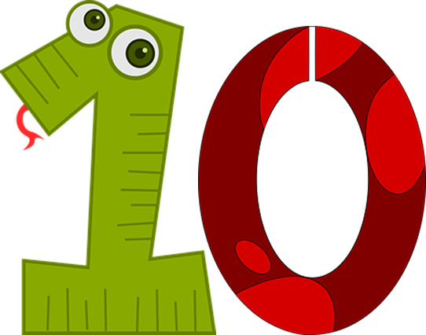
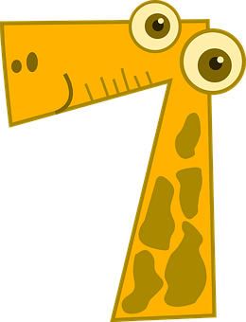
Talking about things and things you do
rot
Numbers 1-12
Es gibt
Plural nouns
SSC [ß-] [-ss-] [-s]
Term 2 Week 8
Notes:
Artwork by Steve Clarke. Pronoun pictures from NCELP (www.ncelp.org). All additional pictures selected from Pixabay and are available under a Creative Commons license, no
attribution required.
Phonics: SSC [ß-] [-ss-] [-s]
Vocabulary: Nummer [806] null [1680] eins [774] zwei [70] drei [106] vier [200] fünf [274] sechs [428] sieben [611] acht [645] neun [1053] zehn [333] elf [1507] zwölf [1080] es gibt [n/a]
Revisit 1: Film [505] Lieblings- [n/a] Lied [1733] Musik [509]
Revisit 2: revisit all language learnt in Term 1
Jones, R.L & Tschirner, E. (2019). A frequency dictionary of German: Core vocabulary for learners. London: Routledge.
The frequency rankings for words that occur in this PowerPoint which have been previously introduced in these resources are given in the SOW and in the resources that first
introduced and formally re-visited those words.
For any other words that occur incidentally in this PowerPoint, frequency rankings will be provided in the notes field wherever possible.
Note that the first three lessons of the year teach language that can be continuously recycled as lesson routine every lesson in Y3/4.
The idea would be that the class teacher (whether or not s/he teaches the class German can re-use the language as part of the daily routine with the class.
1

Slide 2
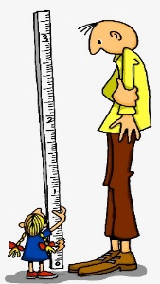
aussprechen
[s][ss][ß]
…
You know that ‘s’ in front of a vowel sounds like the English ‘z’.
ß is just a special way of writing ‘ss’ after a long vowel.
At all other times German ‘s’, ‘ss’ and ‘ß’ sound like English ‘s’.
groß
[big, tall]
Notes:
Timing: 1 minute
Aim: To introduce SSC [s/ss/ß] when not in front of a vowel.
Procedure:
Introduce the SSC and and say the [s/ss/ß] sound first, on its own. Pupils repeat it with you.
Present the source word ‘groß’ (with gesture, if using).
Click to bring on the picture and get pupils to repeat the word ‘groß’ (with gesture, if using).
Use the callouts to emphasise the difference between ‘s’ in front of a vowel and ‘s’ at all other times and to explain about the new letter ß.
Note:
A gesture for this could be to reach high above your head.
groß [67]
Jones, R.L & Tschirner, E. (2019). A frequency dictionary of German: Core vocabulary for learners. London: Routledge.
2

Slide 3
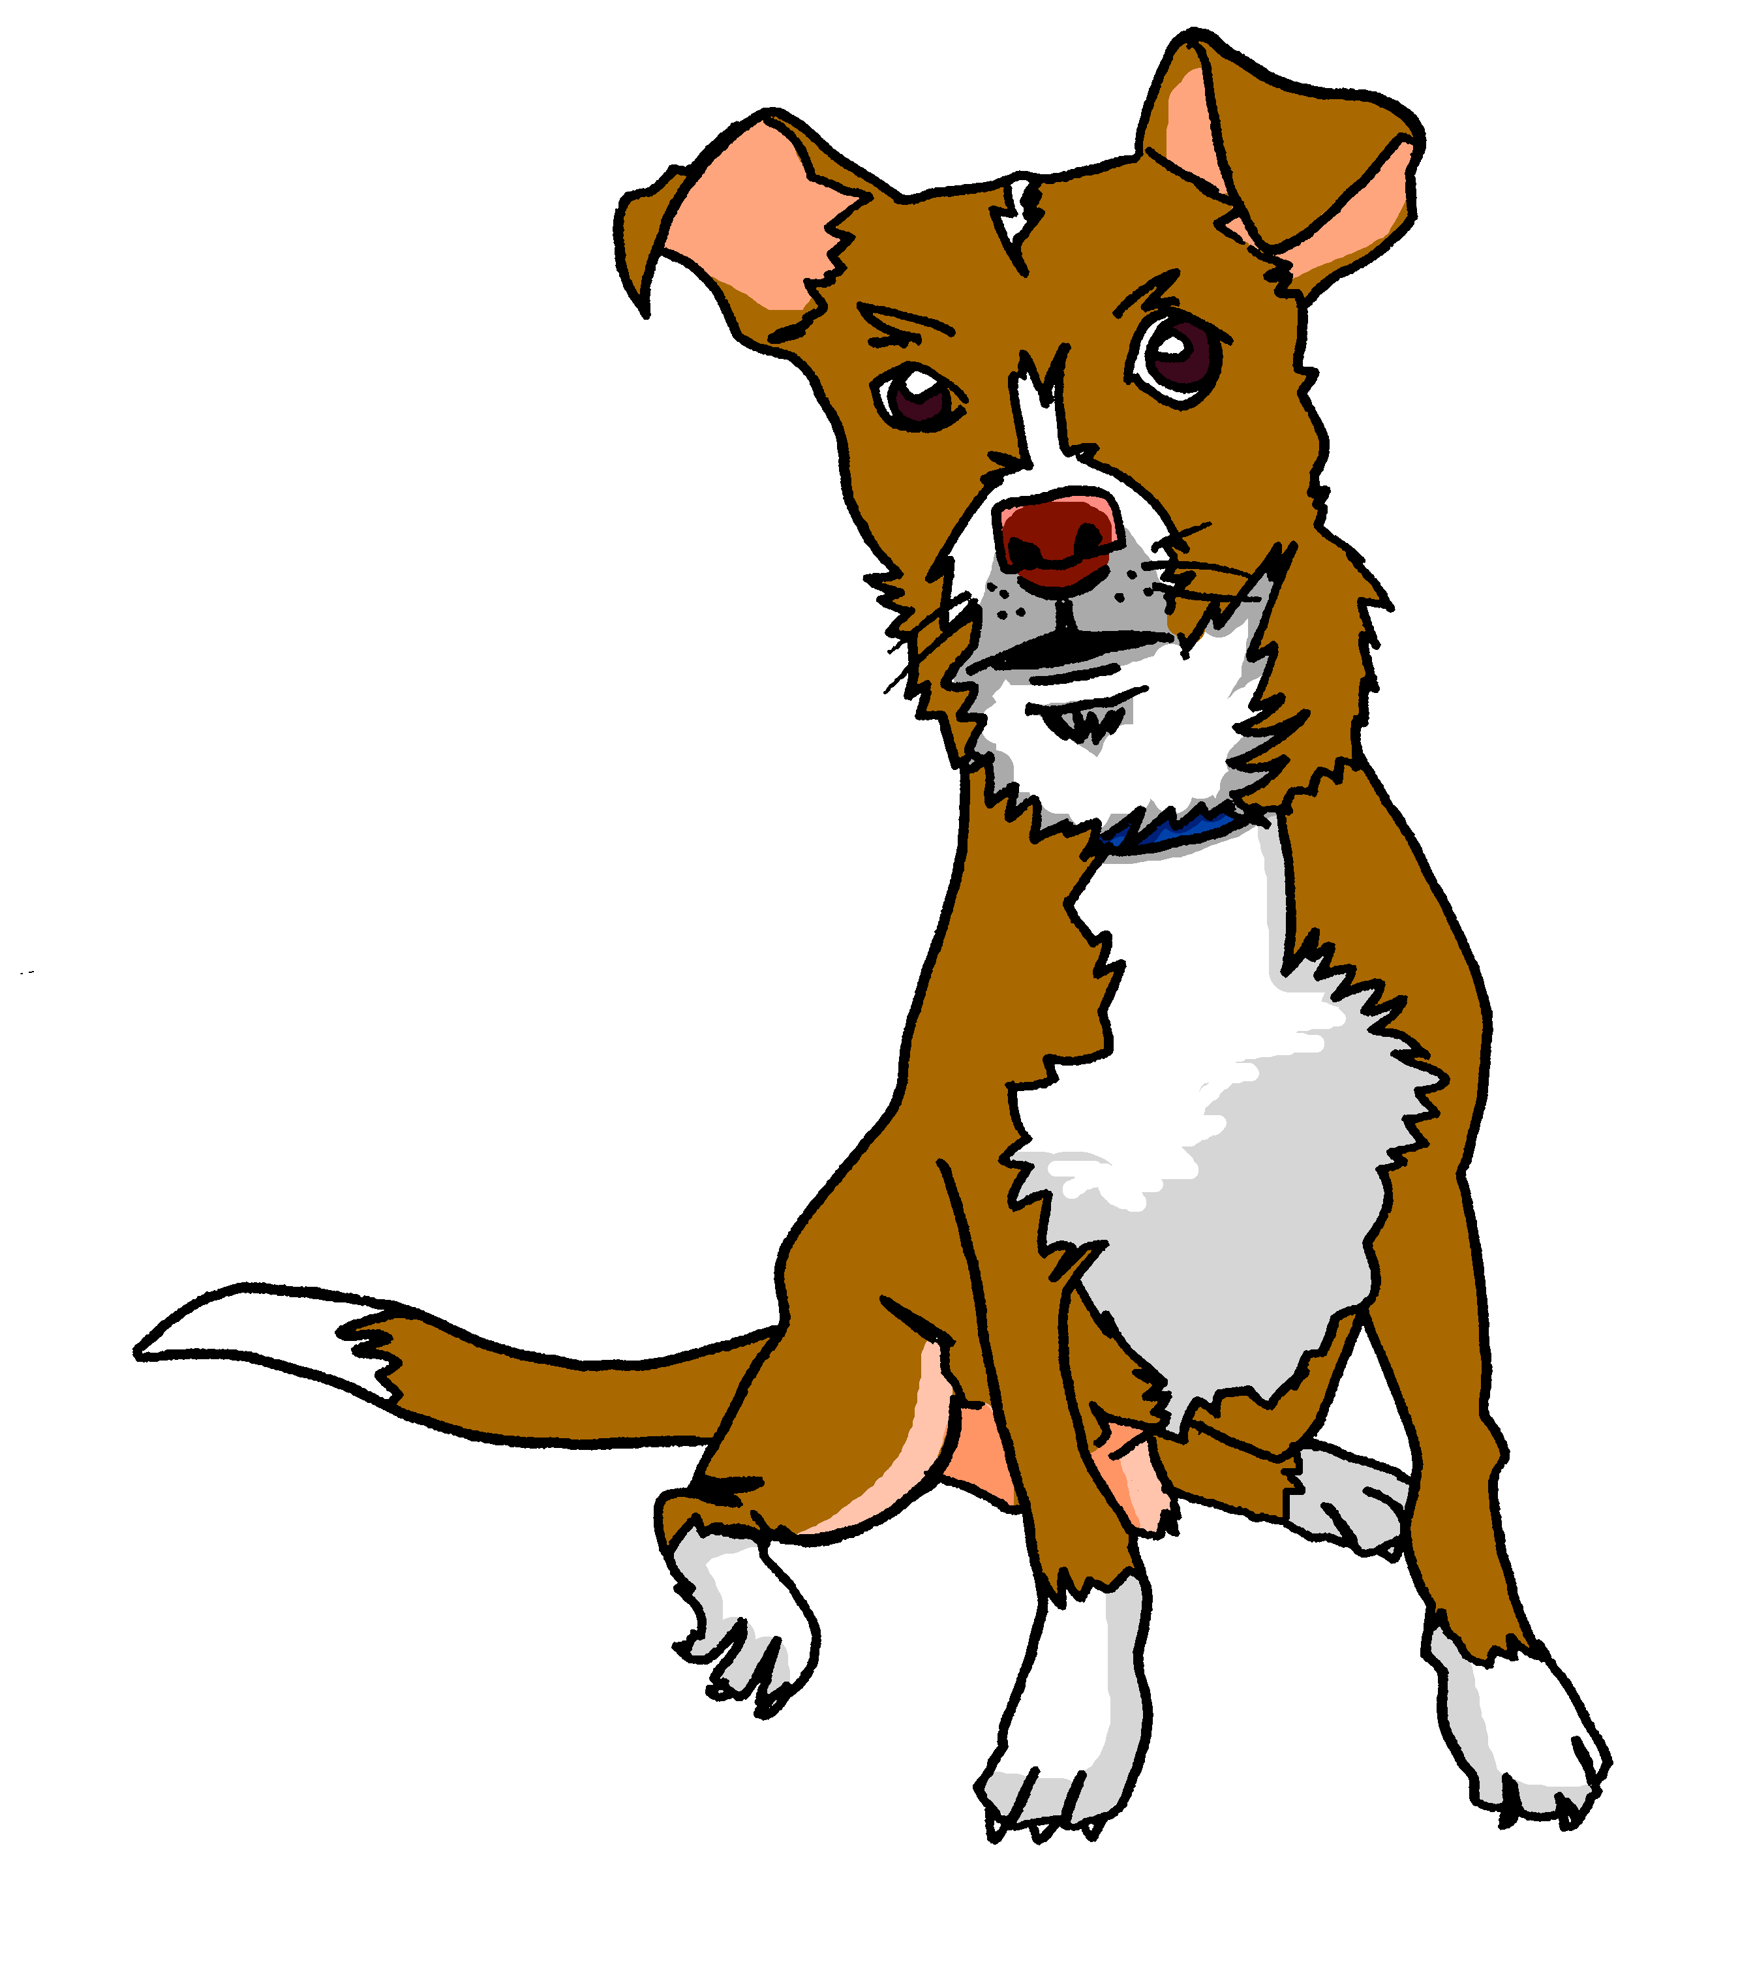
aussprechen
[s][ss][ß]
…
Tasso
Fußball
heißen
groß
essen
tschüss
This can be written with ‘s’ or ‘ss’ at the end.
[to eat, eating]
Notes:
Timing: 1 minute
Aim: to introduce the SSC [s/ss/ß].
Procedure:
Re-present the SSC and the source word ‘groß’ (with gesture, if using).
Click to bring on the picture and get pupils to repeat the word ‘groß’ (with gesture, if using).
Present the cluster words in the same way, bringing on the pictures and getting pupils to pronounce the words.
Note: It’s very important that pupils start to recognise ß as an ‘s’ sound, and don’t confuse it with a B.
essen [323] Fußball [1277] tschüss [3766] heißen [126]
Jones, R.L & Tschirner, E. (2019). A frequency dictionary of German: Core vocabulary for learners. London: Routledge.
3

Slide 4
Listen to the words which all contain an ‘s’, ‘ss’, or ‘ß’. Can you hear a buzzing bee sound or a hissing snake sound?
sssss
Hör zu.
zzzzz
hören
1
2
3
4
5
6
[s]
[s|ss|ß]
Remember that ‘s’ in front of a vowel sounds like the English ‘z’.
At all other times German ‘s’, ‘ss’ and ‘ß’ sound like English ‘s’.
Notes:
Timing: 4 minutes
Aim: To practise distinguishing between [s] [ß] or [ss] pronounced as English ‘s’, and [s] pronounced as English ‘z’.
Procedure:
1. Encourage pupils to make the sounds of a buzzing bee and a hissing snake to identify the two sounds they are listening for.
2. Play number 1. Pupils must decide if the sound is pronounced like an English ‘z’ (bee) or an English ‘s’ (snake). They could draw a quick bee or snake or just write letter A or B for the two columns.
3. Click to elicit answer and play the word again if necessary.
4. Repeat for items 2-6.
Transcript:
Person
Wasser
Haustier
Singen
Wie sagt man…?
Ich weiß es nicht

Slide 5
Vokabeln
Sag die Nummern.
Wörter
eins
zwei
drei
Notes:
Timing: 5 minutes (8 slides) Aim: to introduce numbers 1-12
Procedure: 1. Click to present and say the numbers. 2. Pupils repeat.
5

Slide 6
Vokabeln
Sag die Nummern.
Wörter
e_ _ _
z_ _ _
d_ _ _
Notes:
[2/8]
Procedure: 1. Click to present the gapped numbers.
2. Elicit the numbers orally from pupils.
6

Slide 7
Vokabeln
Sag die Nummern.
Wörter
vier
fünf
sechs
Notes:
[3/8]
Procedure: 1. Click to present and say the numbers. 2. Pupils repeat.
7

Slide 8
Vokabeln
Sag die Nummern.
Wörter
v_ _ _
f_ _ _
s_ _ _ _
Notes:
[4/8]
Procedure: 1. Click to present the gapped numbers.
2. Elicit the numbers orally from pupils.
8

Slide 9
Vokabeln
Sag die Nummern.
Wörter
sieben
acht
neun
Notes:
[5/8]
Procedure: 1. Click to present and say the numbers. 2. Pupils repeat.
9

Slide 10
Vokabeln
Sag die Nummern.
Wörter
s_ _ _ _ _
a_ _ _
n_ _ _
Notes:
[6/8]
Procedure: 1. Click to present the gapped numbers.
2. Elicit the numbers orally from pupils.
10

Slide 11
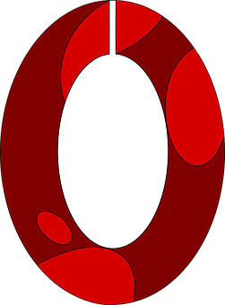
Vokabeln
Sag die Nummern.
Wörter
zehn
elf
zwölf
Notes:
[7/8]
Procedure: 1. Click to present and say the numbers. 2. Pupils repeat.
11

Slide 12
Vokabeln
Sag die Nummern.
Wörter
z_ _ _
e_ _
z_ _ _ _
Notes:
[8/8]
Procedure: 1. Click to present the gapped numbers.
2. Elicit the numbers orally from pupils.
12

Slide 13
sprechen
Lies die Nummern.
vier
sieben
lesen
elf
fünf
60
zehn
zwei
zwölf
sechs
acht
drei
neun
eins
S
- - - - - - - - - - - - - - - - - - - - - - - - - - - - - - -
eins
zwei
drei
vier
fünf
sechs
sieben
neun
zehn
zwölf
0
acht
elf
START
Notes:
Timing: 3 minutes
Aim: to practise written comprehension and pronunciation/read aloud of numbers.
Procedure:
Teacher reads the instruction in German.
Pupils work in pairs to say the numbers in order (1-12). They have one minute.
Click to trigger the timer.
To bring up the answers, each number disappears on click, and the correct answer appears.
Additional Task suggestions:
1. Pupils could say the numbers in reverse order, only even numbers, only odd numbers etc.
13

Slide 14
Plural nouns
To make most masculine nouns plural add –e at the end:
Some plural nouns also add umlaut to the a, o, u:
Some neuter nouns work like this, too: ein Spiel → zwei Spiele
Singular
Plural
masculine
ein Bleistift
zwei Bleistifte
a/one pencil
two pencils
ein Fußball
drei Fußbälle
a/one football
three footballs
Most feminine nouns add –n or –en at the end to make the plural:
eine Flasche
vier Flaschen
feminine
a/one bottle
four bottles
eine Person
fünf Personen
a/one person
five persons/people
Notes:
Timing: 2 minutes
Procedure:
Click through the animations to present the new information.
Elicit English translation for the German examples provided.
14

Slide 15
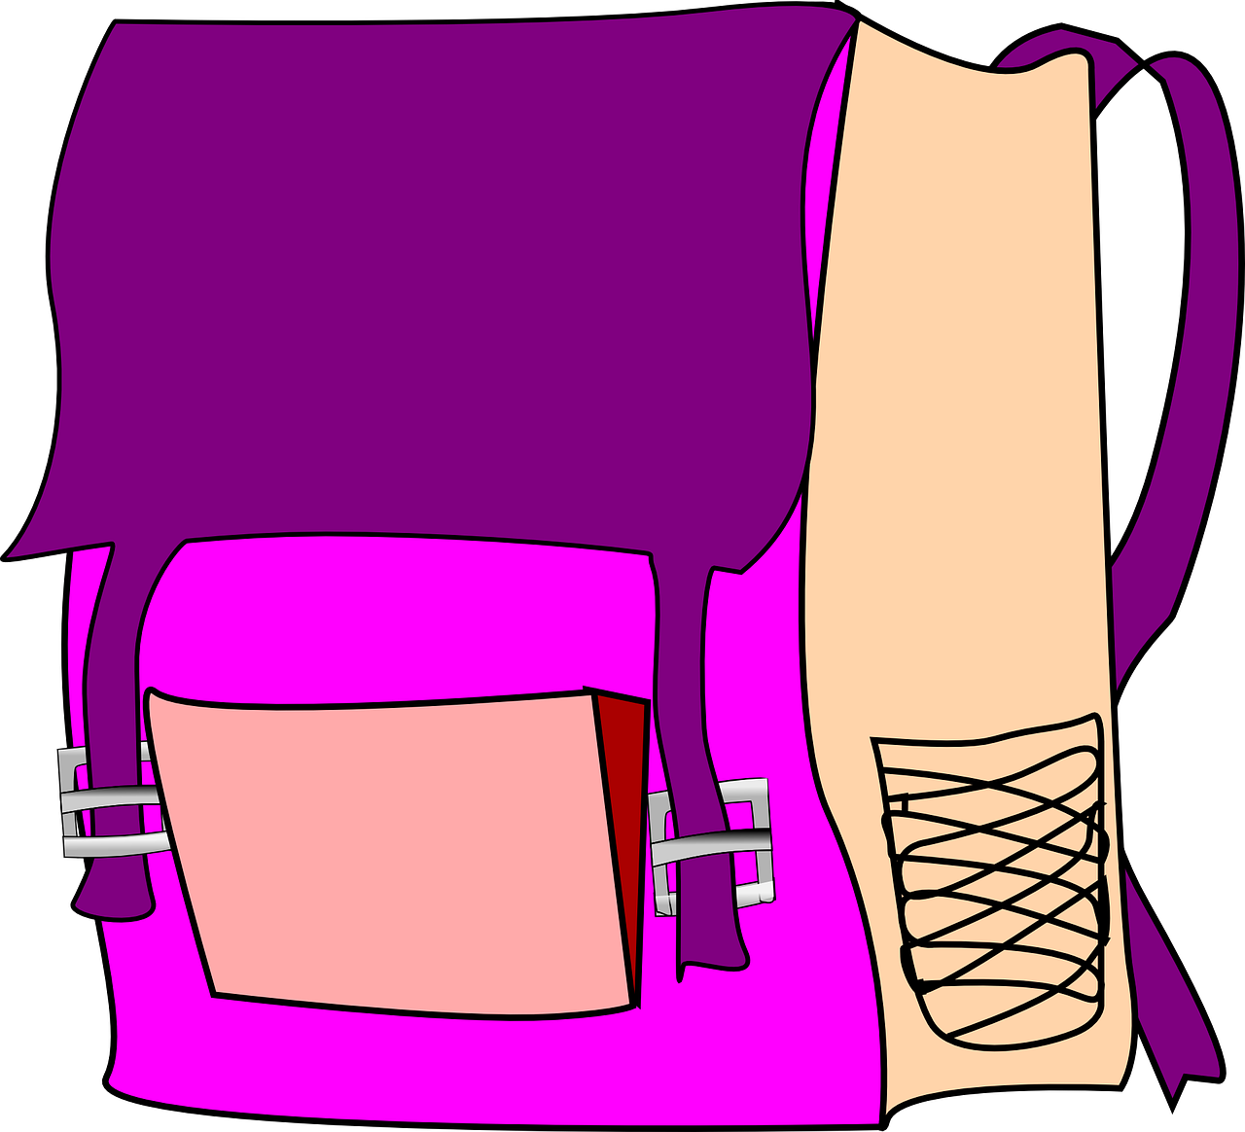
hören
Singular or plural?
Hör zu. Ein Freund oder drei Freunde?
A-Singular | B-Plural
B.
drei Freunde
Remember:
To make most masculine nouns plural, add –e at the end. Some plural nouns also add an umlaut to the a, o, u.
Most feminine nouns add –n or –en at the end.
1
eine Blume
2
zwei Fußbälle
3
vier Filme
4
ein Ding
5
ein Geschenk
6
fünf Taschen
Notes:
Timing: 5 minutes
Aim: to practise aural comprehension of singular and plural nouns and numbers up to 5.
Procedure:
Encourage pupils to discuss the picture nouns on the slide and think about their gender and plural forms before listening.
Play the example. Pupils must decide if the word ‘Freunde’ is singular or plural and write down A or B.
Elicit the answer and click to reveal answer tick. Ask pupils to say how many friends there are in the plural picture: drei Freunde. You could count up together to 3 as a class. Click to show written form.
Repeat for items 1-6, first eliciting singular or plural and then giving pupils time in pairs/as a class to come up with the number + plural or ein/eine + singular noun.
Transcript:
Freunde
Blume
Fußbälle
Filme
Ding
Geschenk
Taschen
15

Slide 16
Es gibt
To say how many of something there are, use es gibt + number:
Remember: ein, eine means a/an and one.
Es gibt eine Schule.
There is a/one school.
Es gibt zwei Schulen.
There are two schools.
Es gibt means there is AND there are.
Notes:
Timing: 2 minutes
Procedure:
Click through the animations to present the new information.
Elicit English translation for the German examples provided.
16

Slide 17
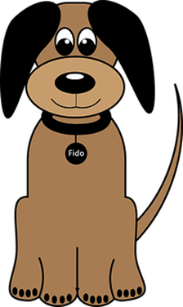
lesen
There is or there are?
Lies die Sätze.
There
is …
There
are…
1
Es gibt vier Hunde.
5
Es gibt drei Farben.
2
Es gibt eine Blume.
6
Es gibt zwei Hefte.
3
Es gibt zwei Bleistifte.
7
Es gibt ein Spiel.
4
Es gibt ein Geschenk.
8
Es gibt eine Form.
Notes:
Timing: 5 minutes
Aim: to practise written comprehension of es gibt, numbers and plural nouns.
Note: There is an optional handout at the end of the presentation for pupils to draw the objects into the correct sack. Alternatively they could quickly draw two sacks, or write translations.
Procedure:
Remind pupils that ‘es gibt’ can mean ‘there is’ or ‘there are’. They are going to translate the sentences and decide whether the nouns belong in the ‘there is’ or ‘there are’ sack.
Pupils work individually or in pairs to translate the sentences into English and/or to draw the pictures into the correct sacks.
Elicit answers and click for pictures to appear in the correct sacks.
Additional Task Suggestion:
1. Pupils convert the singular sentences 2,4,7& 8 into plural sentences using any numbers 2-12. E.g. Es gibt fünf Schulen; Es gibt zehn Spiele. Their partner could draw or translate the sentences.
17

Slide 18
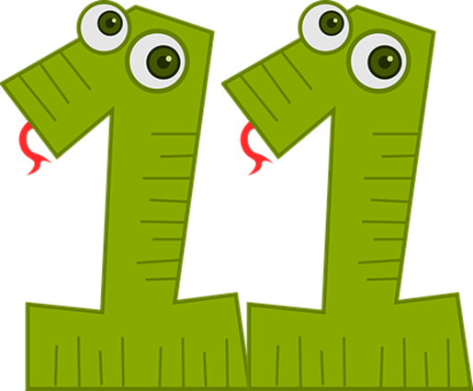
sprechen
Sag die Nummern 1-12.
lesen
60
S
- - - - - - - - - - - - - - - - - - - - - - - - - - - - - - -
eins
zwei
drei
vier
fünf
sechs
sieben
neun
zehn
elf
zwölf
0
acht
START
Notes:
Timing: 3 minutes
Aim: to consolidate numbers in oral production.
Procedure:
Teacher reads the instruction in German.
Pupils work in pairs to say the numbers in order (1-12). They have one minute.
Click to trigger the timer.
To bring up the answers, each number disappears on click, and the correct answer appears.
18

Slide 19
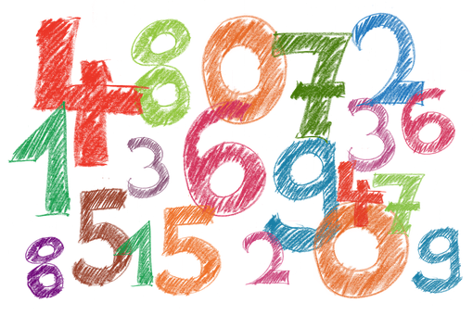
hören
Bingo
Schreib sechs Nummern.
Notes:
Suggested additional activity - Bingo
Aim: to practise aural comprehension of numbers.
Procedure:
Pupils write down 6 digits.
The teacher calls out numbers 1-12, in any order.
Pupils call ‘Bingo!’ if they have a horizontal row of 3 numbers checked off, and then play resumes for a full house.
Note: A great alternative is to play ‘strip bingo’; this is where pupils have a strip of paper and write down 6 numbers in any order from left to right. As the teacher calls out numbers, pupils can only rip off matching numbers from either end of their strip, if they hear them called. It is the pupil whose final remaining number is called, who wins.
19

Slide 20
Tschüss!
rot
Notes:
20

Slide 21
lesen
There is or there are?
There is a…
There are…
1. Es gibt vier Hunde.
5. Es gibt drei Farben.
2. Es gibt eine Blume.
6. Es gibt zwei Hefte.
3. Es gibt zwei Bleistifte.
7. Es gibt ein Spiel.
4. Es gibt ein Geschenk.
8. Es gibt eine Form.
Notes:
HANDOUT
21

