Slide 1
What I can do
Ich kann* das!
gelb
Follow ups 1-5
Term 1 Week 12
kann – can
Notes:
Artwork by Steve Clarke. All additional pictures selected from Pixabay and are available under a Creative Commons license, no attribution required.
Phonics: revisit SSC long and short [a] [e] [i] [o] [u] (for these also write long or short); [ei] [ie] [w] [z] hard and soft [ch]
Vocabulary: revisit words from lessons 1 - 11
Jones, R.L & Tschirner, E. (2019). A frequency dictionary of German: Core vocabulary for learners. London: Routledge.
The frequency rankings for words that occur in this PowerPoint which have been previously introduced in these resources are given in the SOW and in the resources that first introduced and formally re-visited those words.
For any other words that occur incidentally in this PowerPoint, frequency rankings will be provided in the notes field wherever possible.

Slide 2
aussprechen
Follow up 1
long
[u]
short
[u]
aussprechen
rufen
Luft
[to call]
[air]
Notes:
Timing: 5 minutes (8 slides)
Aim: to practise read aloud of SSC learnt so far with unknown words.
Procedure:
Tell pupils that they are going to practise the sounds of German that they have learnt this year.
Click to bring up the first ‘flashcard’.
Elicit the SSC first. (To bring all pupils in together, teachers could use a silent 3-2-1 countdown gesture with their fingers).
Elicit the word, using the same countdown procedure.
Click to bring up the 2nd flashcard and repeat steps 1-4.
Word frequency (1 is the most frequent word in German):
rufen [530] Luft [487]
Jones, R.L & Tschirner, E. (2019). A frequency dictionary of German: Core vocabulary for learners. London: Routledge.
2

Slide 3
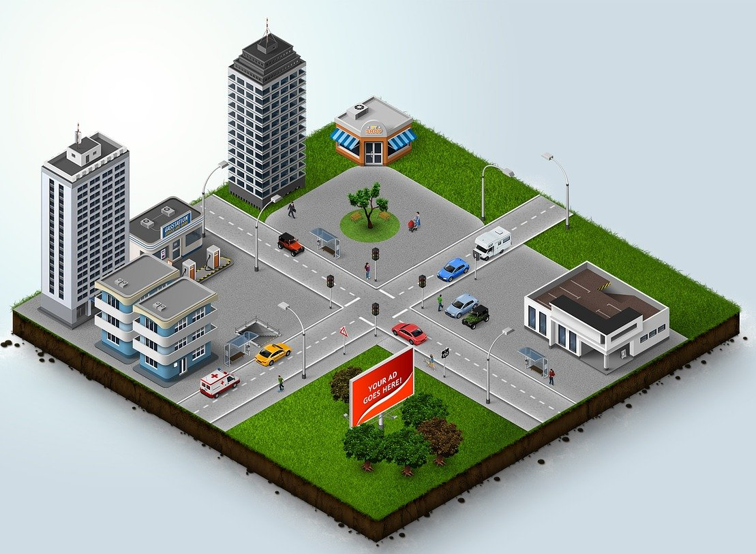
aussprechen
Follow up 1
long
[a]
short
[a]
aussprechen
nah
Kraft
[close]
[strength, power]
Notes:
[2/8]
Word frequency (1 is the most frequent word in German):
nah [480] Kraft [458]
3

Slide 4
aussprechen
Follow up 1
long
[o]
short
[o]
aussprechen
Boden
hoffen
[ground]
[to hope]
Notes:
3/8
Word frequency (1 is the most frequent word in German):
Boden [536] hoffen [689]
4

Slide 5
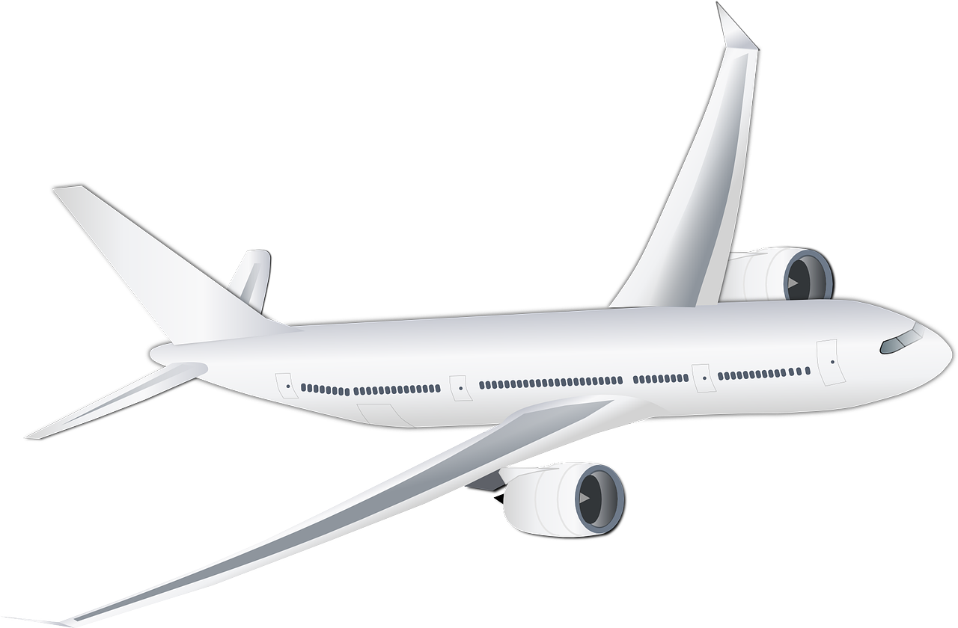
aussprechen
Follow up 1
[ei]
[ie]
aussprechen
meist
fliegen
[mostly]
[to fly]
Notes:
4/8
Word frequency (1 is the most frequent word in German):
meist [705] fliegen [824]
5

Slide 6
aussprechen
Follow up 1
long
[e]
short [e]
aussprechen
Meer
melden
[sea]
[to report, register]
Notes:
5/8
Word frequency (1 is the most frequent word in German):
Meer [852] melden [1005]
6

Slide 7
aussprechen
Follow up 1
long
[i]
short
[i]
aussprechen
Figur
hinten
[figure]
[at the back]
Notes:
6/8
Word frequency (1 is the most frequent word in German):
Figur [1285] hinten [1159]
7

Slide 8
aussprechen
Follow up 1
[w]
[z]
aussprechen
Umwelt
Zahn
[environment]
[tooth]
Notes:
7/8
Word frequency (1 is the most frequent word in German):
Umwelt [1164] Zahn [1871]
8

Slide 9
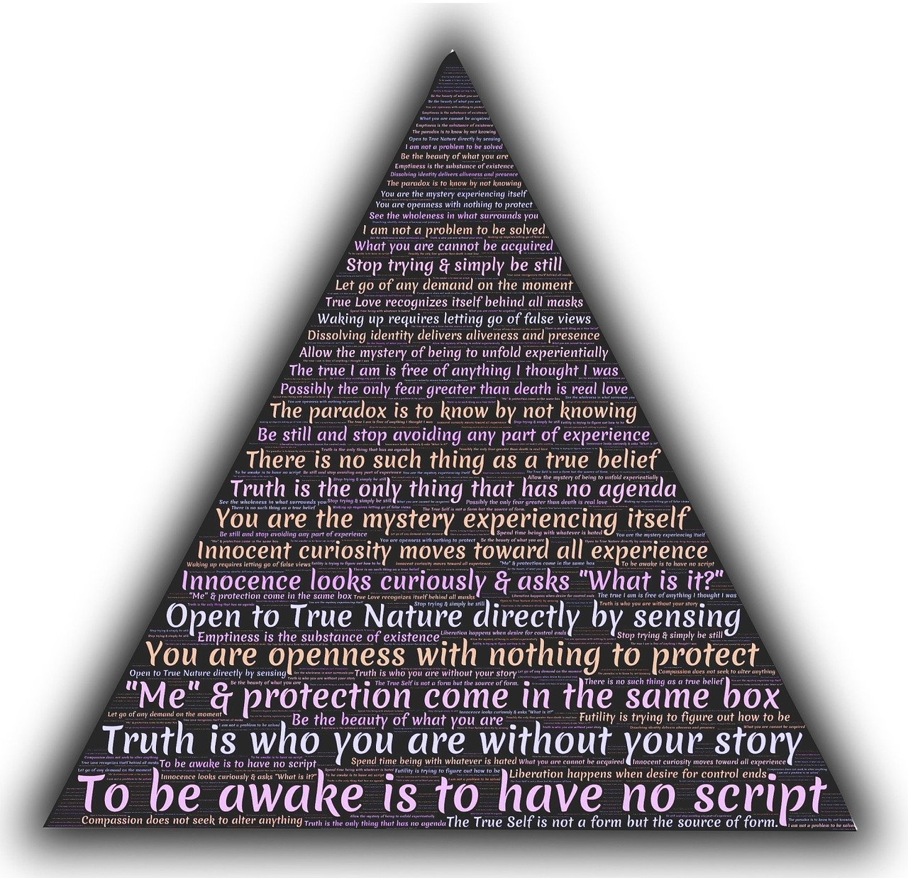
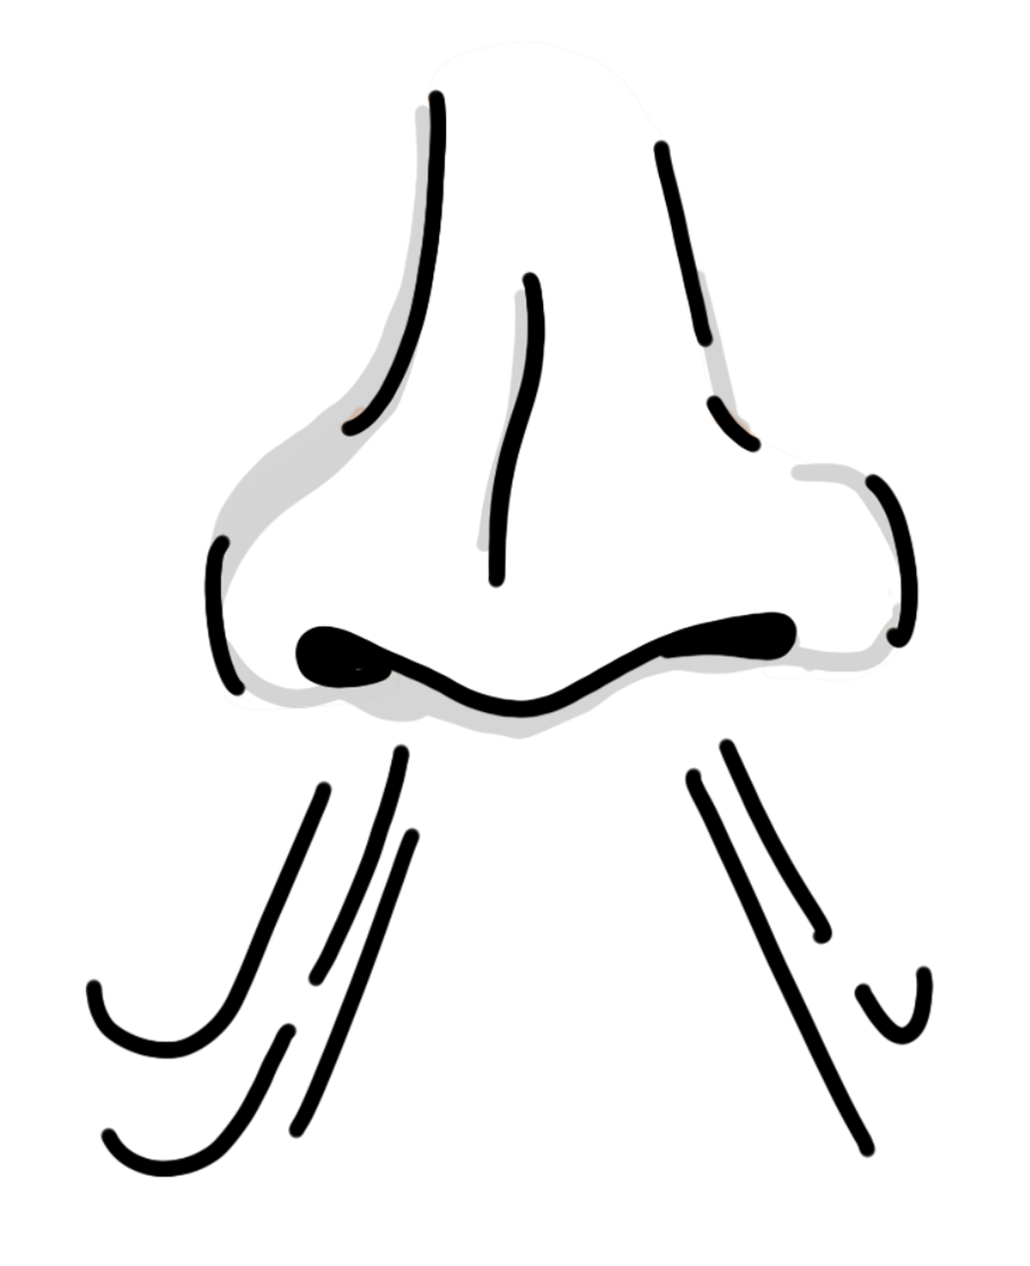
aussprechen
Follow up 1
soft [ch]
hard [ch]
aussprechen
Gedicht
Geruch
[poem]
[smell]
Notes:
8/8
Word frequency (1 is the most frequent word in German):
Gedicht [1897] Geruch [2335]
9

Slide 10
Follow up 2
Sag die Wörter.
sprechen
sprechen
der
das
die
Notes:
Timing: 5 minutes
Aim: to practise spoken production of a range of vocabulary and practise applying gendered articles
Procedure:
Click to bring up the image. Pupils say the word and say them aloud with the appropriate article.
Click again for the words to disappear into the appropriate ‘pacman’.
Continue for the rest of the items.
Items in order:
die Idee
der Partner
die Liste
das Blatt
der Ball
das Butterbrot

Slide 11
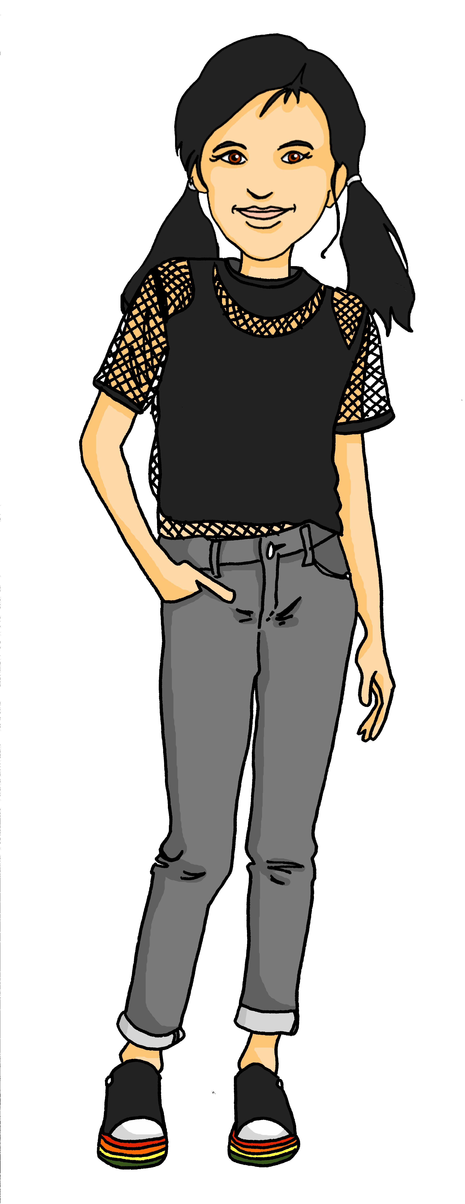
hören
Follow up 3
Was ist das?
Ronja and Lias are playing a word game.
Which word is Ronja referring to?
oder
A
aber
B
die Kleidung
C
schwarz
D
Notes:
Timing: 5 minutes (6 slides)
Aim: to revisit some of this term’s vocabulary. Procedure: 1. Explain the task. Ronja and Lias are playing a word association game.
2. Click on the audio button to hear the word that Ronja says. Pupils look at the words on the right next to Lias and decide which word she is referring to, noting down either the word or A,B,C or D.
3. Click to reveal the answers.
Transcript:
eine Farbe
11

Slide 12
hören
Follow up 3
Was ist das?
Ronja and Lias are playing a word game.
Which word is Ronja referring to?
tschüss
A
ja
B
nicht wahr?
C
auch
D
Notes:
[2/6]
Transcript:
Auf Wiedersehen
12

Slide 13
hören
Follow up 3
Was ist das?
Ronja and Lias are playing a word game.
Which word is Ronja referring to?
eine
A
die Jacke
B
es
C
sein
D
Notes:
[3/6]
Transcript:
die Kleidung
13

Slide 14
hören
Follow up 3
Was ist das?
Ronja and Lias are playing a word game.
Which word is Ronja referring to?
wie
A
und
B
C
Hallo
D
er
Notes:
[4/6]
Transcript:
Guten Morgen
14

Slide 15
hören
Follow up 3
Was ist das?
Ronja and Lias are playing a word game.
Which word is Ronja referring to?
er
A
England
B
nein
C
die Person
D
Notes:
[5/6]
Transcript:
der Ort
15

Slide 16
hören
Follow up 3
Was ist das?
Ronja and Lias are playing a word game.
Which word is Ronja referring to?
die Schweiz
A
klar
B
ein
C
das Problem
D
Notes:
[6/6]
Transcript:
schlecht
16

Slide 17
Follow up 4
Wo, was, wie, nicht wahr?
Ist das richtig?
sprechen
Person A
Wo…?
Person B
bin ich
ist die Schweiz
er ist
mein Partner
bist du
Guten Morgen
England ist
schlecht
ist das Butterbrot
Notes:
Timing: 5 minutes (4 slides)
Aim: to practise forming questions and contrasting word order using question words and nicht wahr.
Procedure:
1. Pupils work in pairs. Partner A reads out the question starter.
2. Partner B reads the boxes below and forms questions by saying all the possible options that could fill in the ellipsis in the question starter. They will need to pay close attention to the word order of the options in boxes.
3. Click to reveal answers.
4. Click to reveal the following slides. Partners swap roles for each new slide.

Slide 18
Follow up 4
Wo, was, wie, nicht wahr?
Ist das richtig?
sprechen
Person B
Was…?
Person A
ein Ding ist
ist eine Farbe
einfach
ist das
klar ist
ist grün
ist der Preis
Hallo
ist ein Blatt
Notes:
[2/4]

Slide 19
Follow up 4
Wo, was, wie, nicht wahr?
Ist das richtig?
sprechen
Person A
Wie…?
Person B
die Karte ist
ist die Uhr
sie ist
mein Ball
geht’s
ist der Apfel
ist die Jacke
rund
ist die Person
Notes:
[3/4]

Slide 20
Follow up 4
Wo, was, wie, nicht wahr?
Ist das richtig?
sprechen
Person B
…, nicht wahr?
Person A
der Ort ist hier
wie
wo
das ist lang
sie ist da
ist das gut
nicht wahr
ist der Preis
was
ist die Kleidung
Notes:
[4/4]

Slide 21
Follow up 5:

Schreib auf Deutsch.

schreiben
1 _____________________________
Du bist nicht mein Partner.
You are not my (male) partner.

Ich bin deine Partnerin.
2 ___________________________
I am your (female) partner.

Das ist nicht dein Apfel.
3 ___________________________
That is not your apple.
Notes:
Timing: 5 minutes
Aim: to revise forms of the verb sein, nicht with possessive adjectives, and gender agreement of possessive adjectives and nouns in R1 (nominative).
Procedure:
Pupils translate the sentences from English into German.
Click for answers.

Slide 22
Tschüss!
gelb
Notes:
22

