Slide 1
What I can do
Ich kann* das!
gelb
Phonics, Vocabulary, and Grammar Revision
kann – can
Term 1 Week 12
Notes:
Artwork by Steve Clarke. All additional pictures selected from Pixabay and are available under a Creative Commons license, no attribution required.
Phonics: revisit SSC long and short [a] [e] [i] [o] [u] (for these also write long or short); [ei] [ie] [w] [z] hard and soft [ch]
Vocabulary: revisit words from lessons 1 - 11
Jones, R.L & Tschirner, E. (2019). A frequency dictionary of German: Core vocabulary for learners. London: Routledge.
The frequency rankings for words that occur in this PowerPoint which have been previously introduced in these resources are given in the SOW and in the resources that first
introduced and formally re-visited those words.
For any other words that occur incidentally in this PowerPoint, frequency rankings will be provided in the notes field wherever possible.
1

Slide 2
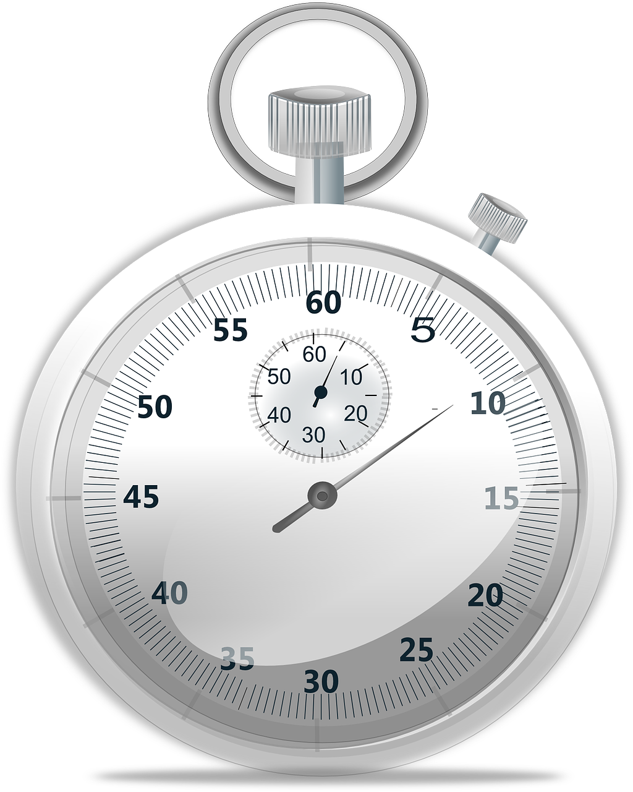
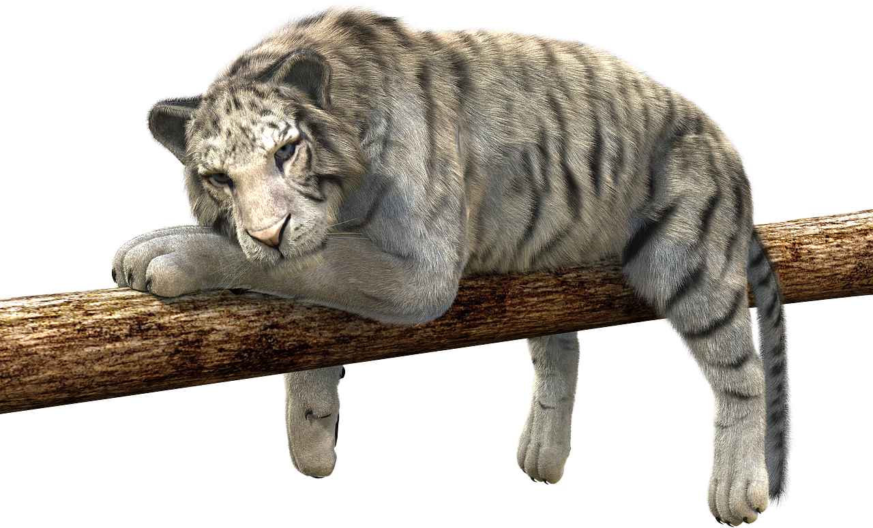
hören
Hör zu.
Write 1-8 und the sound: [a], [e], [i] ,[o], [u] (for these also write long or short); [ei], [ie], [w], [z], [ch] (for [ch] also write hard or soft).
hören
1 | g l e i c h
2 | k o m m e n
3 | w i s s e n
4 | P r o z e n t
5 | s a g e n
6 | Z e i t
7 | l i e g e n
8 | d i r e k t
?
?
soft
long
?
?
short
?
?
short
?
?
long
Notes:
1/2
Timing: 5 minutes
Aim: to practise aural recognition and transcription of previously taught SSCs.
Procedure:
Click audio button 1 to play the recording for item 1. Pupils need to write down the SSC.
Elicit the answer.
Click to reveal the spelling of word 1.
Elicit the meaning, based on the image.
Continue for items 2-8.
NB: Flag this when giving feedback. Items 7 and 8, liegen and direkt: pupils are not expected to know whether it is long [i] or [ie], as they sound the same and these are unknown words. It is useful to point out to students that long ‘i’ and ‘ie’ sound the same so when they don’t know the word, it is fine to put either.
Transcript: 1. gleich [141] (soft [ch])
2. kommen [62] (short [o])
3. wissen [78] (short [i])
4. Prozent [172] [z]
5. sagen [40] (long [a])
6. Zeit [96] [ei]
7. liegen [107] [ie]
8. direkt [353] (long [i])
Word frequency of unknown words (1 is the most frequent word in German): direkt [353] gleich [141] kommen [62] liegen [107] Prozent [172] sagen [40] wissen [78] Zeit [96] Source: Jones, R.L. & Tschirner, E. (2019). A frequency dictionary of German: core vocabulary for learners. Routledge

Slide 3
hören
Hör zu.
Write 1-8 und the sound: [a], [e], [i] ,[o], [u] (for these also write long or short); [ei], [ie], [w], [z], [ch] (for [ch] also write hard or soft).
hören
1 | w e n n
2 | g a n z
3 | n u n
4 | S t u n d e
5 | w o h l
6 | w a r t e n
7 | n o ch
8 | l e b e n
?
?
short
long
?
?
short
?
?
long
?
?
short
long
Notes:
2/2
Timing: 5 minutes
Aim: to identify the SSCs by listening and identifying the sounds.
Procedure:
Click audio button 1 to play the recording for item 1. Pupils need to write down the SSC.
Elicit the answer.
Click to reveal the spelling of word 1.
Elicit the meaning, based on the image.
Continue for items 2-8.
Transcript: 1. wenn [42] (short [e])
2. ganz [69] (short [a]
3. nun [114] (long [u])
4. Stunde [276] (short [u])
5. wohl [281] (long [o])
6. warten [364] [w]
7. noch [33] (hard [ch])
8. leben [98] (long [e])
Word frequency of unknown words (1 is the most frequent word in German): ganz [69] leben [98] noch [33] nun [114] Stunde [276] warten [364] wenn [42] wohl [281] Source: Jones, R.L. & Tschirner, E. (2019). A frequency dictionary of German: core vocabulary for learners. Routledge

Slide 4
Vokabeln
What’s the connection?
Wörter
Vokabeln
1
2
3
4
5
6
schwarz
grün
grau
gut
einfach
wunderbar
schwer
schlecht
falsch
die Hausaufgabe
der Text
das Blatt
wo?
was?
wie geht’s?
das Ding
die Farbe
der Ort
Notes:
Timing: 5 minutes
Aim: to revisit some of this term’s vocabulary by associating words with a broader theme.
Procedure: 1. Explain the task. Pupils write 1-6 and the category for each line.
2. To volunteer a connection, pupils say the three German words followed by the English category word they suggest.
3. Teacher clicks to reveal answers.
4

Slide 5
lesen
Ich, du, oder sie?
Is Ronja talking about herself (ich), Lias (du) or Mariem (sie)?
hören
hören
A
B
1
Ich | du | sie
here | there
2
Ich | du | sie
here | there
3
Ich | du | sie
in England | in Switzerland
4
Ich | du | sie
in England | in Switzerland
5
Ich | du | sie
old | new
6
Ich | du | sie
wonderful | good
Notes:
Timing: 8 minutes
Aim: to revise the person/verb agreement with singular persons of sein (to be, being), to recap some of this term’s vocabulary.
Procedure:
Click the audio buttons to hear the sentences.
Pupils write out 1-6, and write down ich, du or sie for each item based on the form of sein that they hear.
Click to reveal answers.
Click to reveal the second table and click on the audio buttons again.
Pupils write down whether they hear option A or B at the end of the sentence.
Click to reveal answers.
Transcript:
[Ich] bin hier.
[Du] bist da.
[Ich] bin in der Schweiz.
[Sie] ist in England.
[Sie] ist neu.
[Du] bist wunderbar.
5

Slide 6
lesen
Robbie has forgotten to use capital letters and punctuation! Ronja helps them.
 |  | ? | .
1 | der ball ist rund
2 | ist das problem schlecht
3 | ist die jacke weiß
4 | dein butterbrot ist neu
5 | die karte ist lang
6 | ist meine partnerin ronja
1
Der Ball ist rund
Alles klar, Robbie?
2
Ist das Problem schlecht
3
Ist die Jacke weiß
4
Dein Butterbrot ist neu
5
Die Karte ist lang
Ja, alles klar, Ronja!
6
Ist meine Partnerin Ronja
Notes:
Timing: 5 minutes
Aim: to practise understanding of capitalisation of German nouns; to practise word order in subject-verb inversion questions.
Procedure:
First, pupils read each sentence and decide which words need capital letters.
Click to reveal answers.
Pupils read the sentences again and based on the word order, they decide whether Robbie has written a statement or a question.
Click to reveal answers.
6

Slide 7
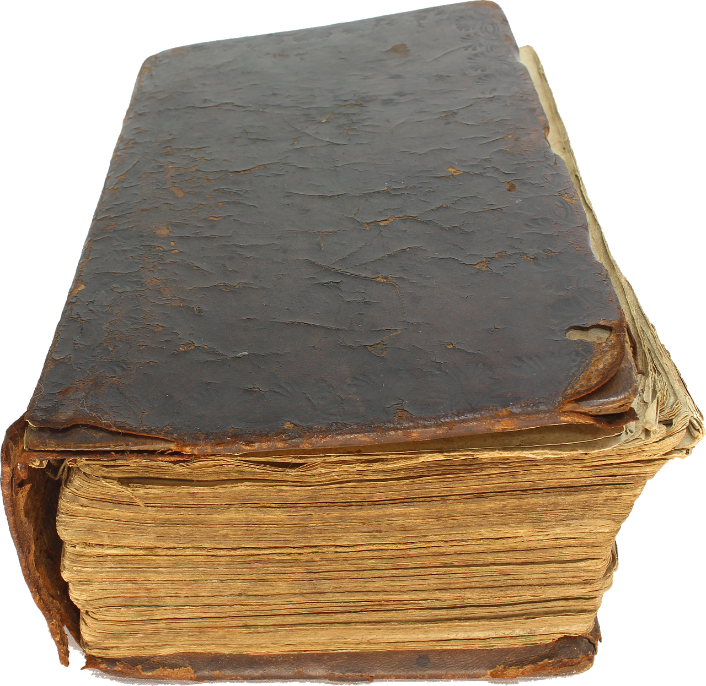
lesen
Richtig (R) oder falsch (F)?
Help Robbie tell what is right and what is wrong.
 |  |  | R | F
 |  | Das ist nicht alt.
 |  | Das ist grün.
 |  | Das ist die Liste.
 |  | Das ist nicht die Person.
 |  | Das ist nicht der Preis.
 |  | Das ist nicht rund.
1
2
3
4
5
6
Notes:
Timing: 5 minutes
Aim: to practise nicht and previously taught words in short sentences.
Procedure:
Pupils read either a ‘nicht’ negative sentence or an affirmative sentence and decide whether the sentence is true or false.
Click to bring up answer ticks.
If time, elicit translations.
7

Slide 8
sprechen
Partnerarbeit
Ronja and Robbie take it in turns to say as many sentences as they can in one minute. You do the same with a partner!
mein meine dein deine der die das | Apfel (m) Uhr (f) Aufgabe (f) Preis (m) Blatt (nt) Ding (nt) Liste (f) | ist | klar grau grün alt neu rund einfach schlecht
START
Notes:
1/2
Timing: 2 minutes (two slides)
Aim: to consolidate the gender agreement between possessive adjectives and nouns and articles and nouns.
Procedure:
Explain that pupils have to make as many sentences as they can and say them out loud in under one minute (use the timer).
First, the gender is indicated in brackets so that pupils can practise to get this right.
On the second slide, pupils do the task without the gender of the nouns being indicated in brackets.
If their partner notices a gender mistake, they swap over.

Slide 9
sprechen
Partnerarbeit
Ronja and Robbie take it in turns to say as many sentences as they can in one minute. You do the same with a partner!
mein meine dein deine der die das | Apfel Uhr Aufgabe Preis Blatt Ding Liste | ist | klar grau grün alt neu rund einfach schlecht
START
Notes:
2/2
Slide 2 without the gender of the nouns being indicated in brackets.
Procedure:
Click the timer to repeat the activity.
If the partner notices a gender mistake, the pupils swap over.

Slide 10
Tschüss!
gelb
Notes:
10

