Slide 1
Describing me and others
gelb
Follow ups 1-5
Term 1 Week 8
Notes:
Artwork by Steve Clarke. Pronoun pictures from NCELP (www.ncelp.org). All additional pictures selected from Pixabay and are available under a Creative Commons license, no attribution required.
Phonics:
Same [ie] and [ie] phonics as from week 4 and week 7.
Vocabulary (new): schlecht [327] aber [31] auch [18] nicht [11] wie [25] wie geht's? [n/a]
Revisit: was [38] falsch [524] grau [1560] grün [682] richtig [177]schwarz [471] weiß [474] das² [1]
Jones, R.L & Tschirner, E. (2019). A frequency dictionary of German: Core vocabulary for learners. London: Routledge.
The frequency rankings for words that occur in this PowerPoint which have been previously introduced in these resources are given in the SOW and in the resources that first
introduced and formally re-visited those words.
For any other words that occur incidentally in this PowerPoint, frequency rankings will be provided in the notes field wherever possible.
Note that the first three lessons of the year teach language that can be continuously recycled as lesson routine every lesson in Y3/4.
The idea would be that the class teacher (whether or not s/he teaches the class German can re-use the language as part of the daily routine with the class.

Slide 2
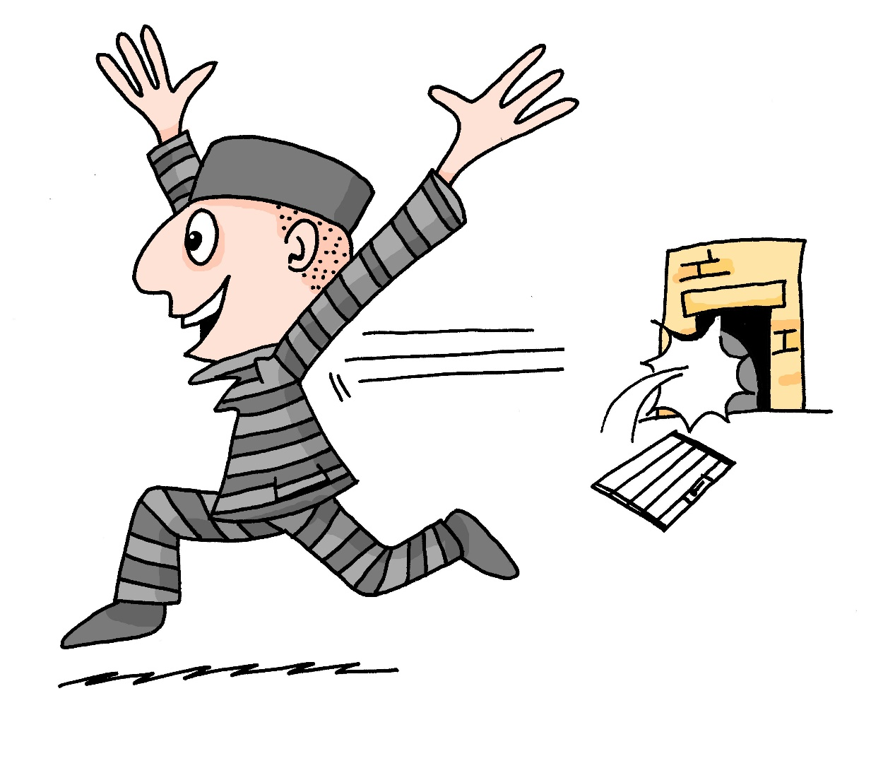
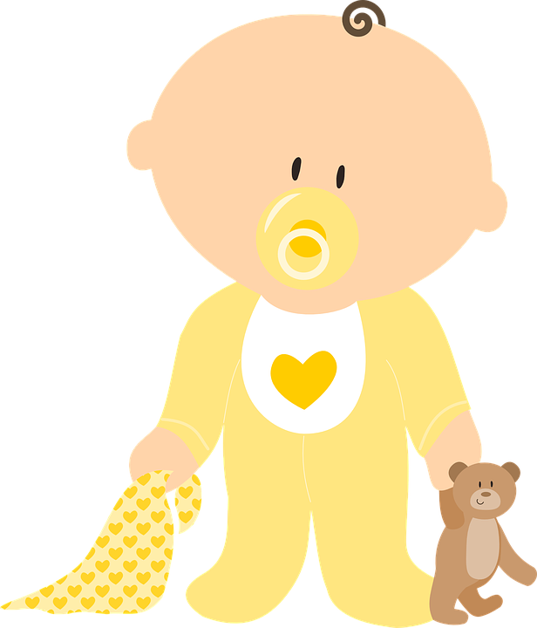
aussprechen
[ei]
…
frei
/a
sein
ein
alone
klein
allein
Notes:
Timing: 1 minute
Aim: to revisit the SSC [ei].
Procedure:
Re-present the SSC and the source word ‘frei’ (with gesture, if using).
Click to bring on the picture and get pupils to repeat the word ‘frei’ (with gesture, if using).
Present the cluster words in the same way, bringing on the picture and getting pupils to pronounce the words.
Vocabulary: frei [318] ein [5] klein [114] sein [3] allein [258]
Jones, R.L & Tschirner, E. (2019). A frequency dictionary of German: Core vocabulary for learners. London: Routledge.

Slide 3
aussprechen
[ie]
…
sie
Liebe
Brief
Notes:
Timing: 1 minute
Aim: to revisit the SSC [ie].
Procedure:
Re-present the SSC and present the source word ‘Liebe’ (with gesture, if using).
Click to bring on the picture and get pupils to repeat the word ‘Liebe’ (with gesture, if using).
Present the cluster words in the same way, bringing on the picture and getting pupils to pronounce the words.
sie [7] Brief [838]
Jones, R.L & Tschirner, E. (2019). A frequency dictionary of German: Core vocabulary for learners. London: Routledge.
3

Slide 4
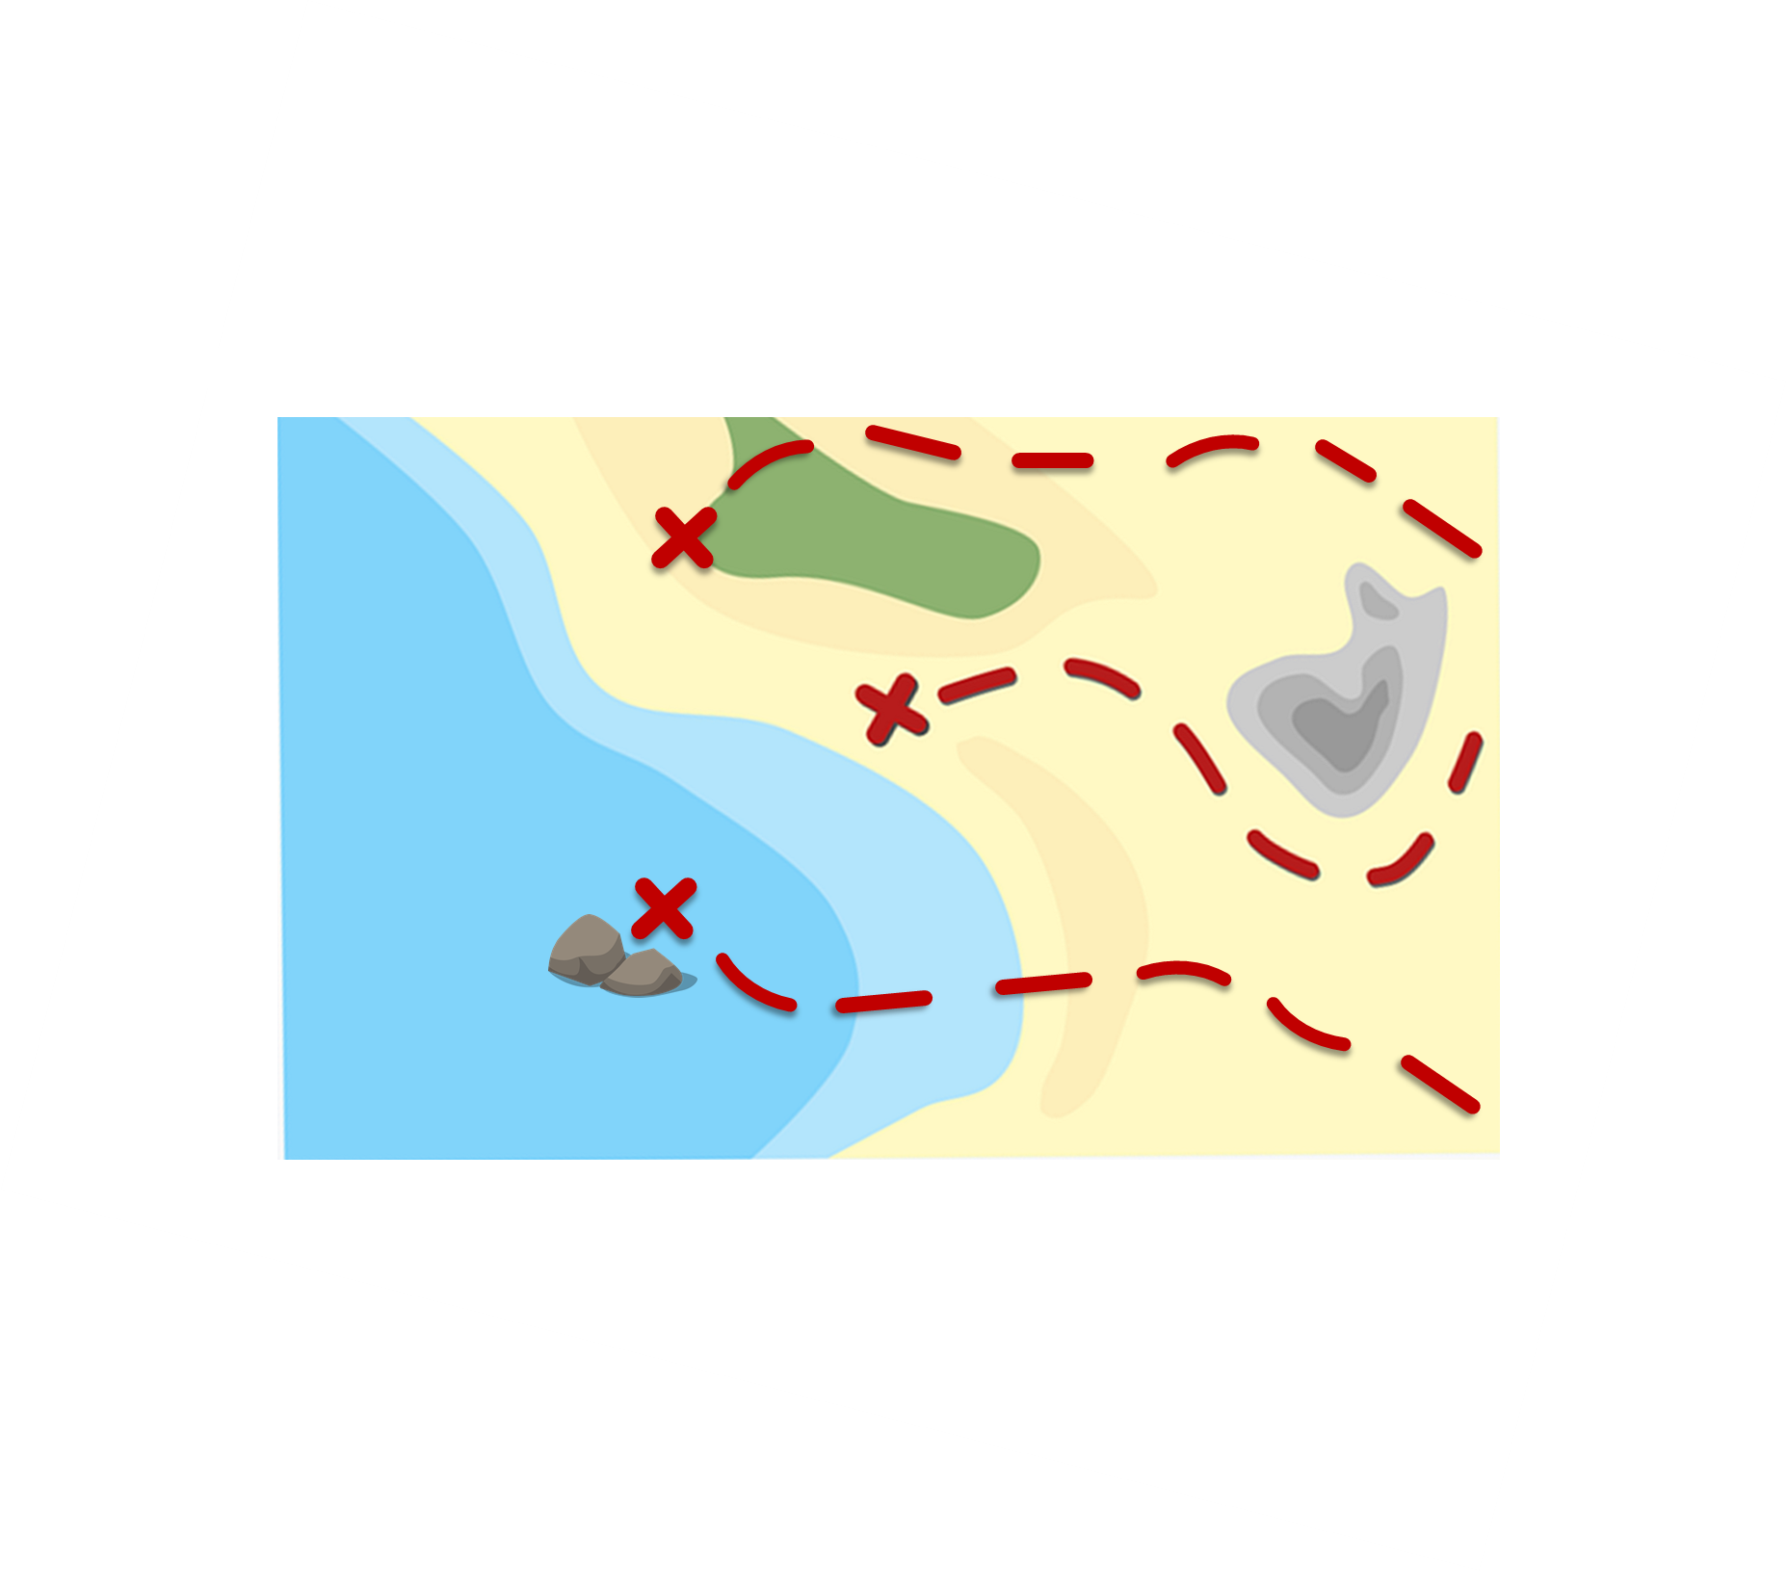
Follow up 1:
Pronounce the words and collect coins.
Reise
aussprechen
60
hier
Brief
wie
leider
Tier
frei
sie
Bein
allein
0
Liebe
klein
START
Notes:
Timing: 5 minutes [2 rounds]
Aim: To practise the pronunciation of words with the SSCs [ei] and [ie].
Procedure:
Pupils work in pairs to practise pronunciation. They can choose where to start and have one minute to collect as many coins as possible.
Pupil A starts from either ‘wie’ ‘frei’ or ‘klein’, and follows the path to pronounce the words and collect the corresponding coins. They need to be careful! Each path contains a mixture of [ie] and [ei] and it is very easy to mix them up! Pupil B listens and notes down the number of coins for his/her partner.
Pupils swap roles.
Click on each word to hear it pronounced, as required.
Frequency of unknown words and cognates: allein [258] Bein [884] Brief [838] frei [318] hier [68] klein [114] leider [643] Liebe [844] Reise [734] sie [7] Tier [614] wie [25]
4

Slide 5
Follow up 2
Lias has lost his things. Help him find them!
Wörter
Vokabeln
Wie geht’s, Lias?
Schlecht!
Notes:
Timing: 5 minutes (6 slides) Aim: To recall vocabulary from this week and previous weeks. To practise identifying objects based on descriptions. Procedure: 1. On the first slide, click to reveal the conversation between Lias and Lothar. Ask pupils to translate what they say. Explain that Lias is sad because he has lost his things!
2. For the remaining five slides, pupils read Lias’s description of what he has lost and decide which of the three pictures he is describing. Click to reveal answer and move on to the next slide.

Slide 6
Follow up 2
Lias has lost his things. Help him find them!
Wörter
Vokabeln
Der Apfel ist nicht grün und nicht schlecht.
Notes:
[2/6]

Slide 7
Follow up 2
Lias has lost his things. Help him find them!
Wörter
Vokabeln
Das Blatt is weiß aber schlecht.
Notes:
[3/6]

Slide 8
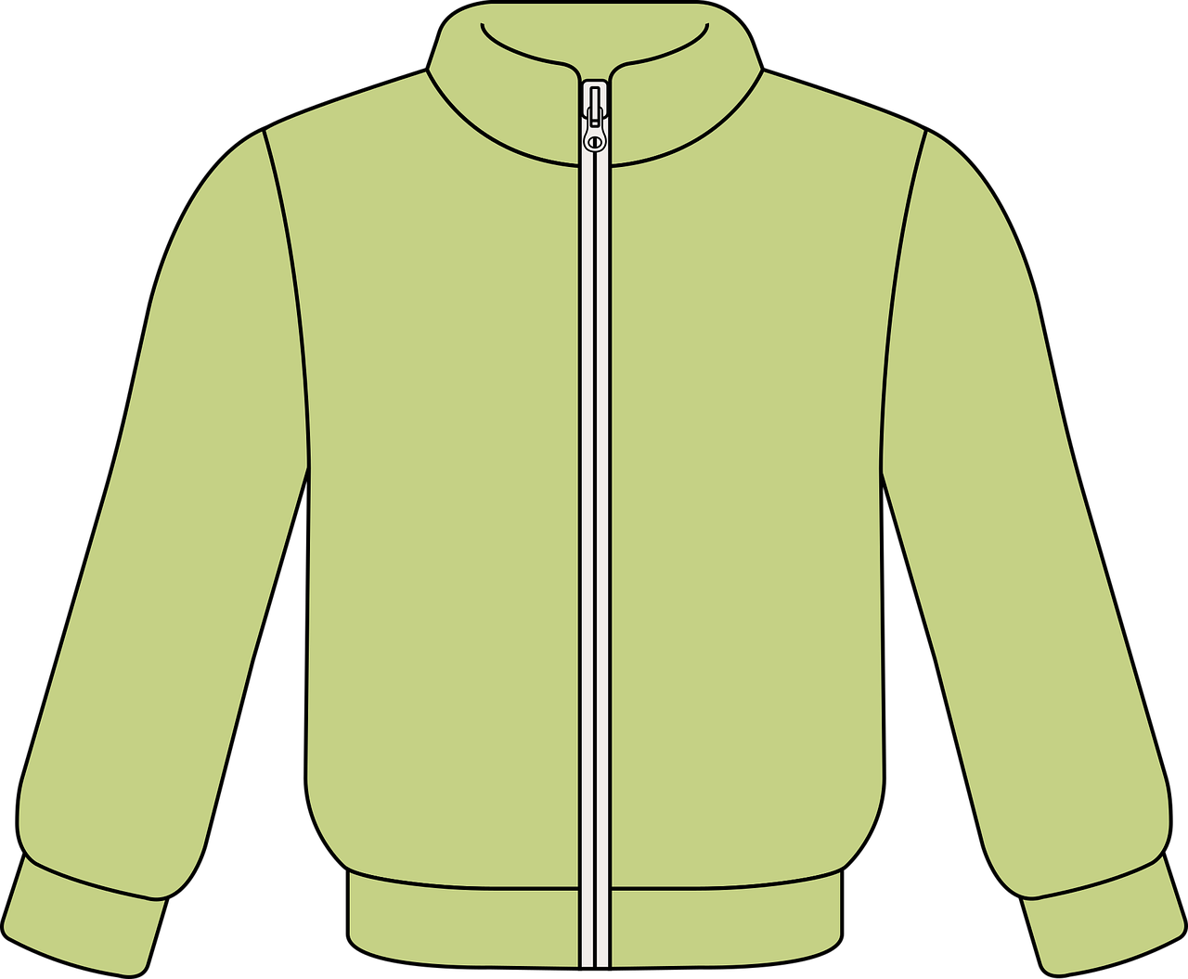
Follow up 2
Lias has lost his things. Help him find them!
Wörter
Vokabeln
Die Jacke ist auch weiß.
Notes:
[4/6]

Slide 9
Follow up 2
Lias has lost his things. Help him find them!
Wörter
Vokabeln
Der Preis ist weiß aber auch schwarz.
Notes:
[5/6]

Slide 10
Follow up 2
Lias has lost his things. Help him find them!
Wörter
Vokabeln
Der Ball ist schwarz und weiß aber nicht grün.
Notes:
[6/6]

Slide 11
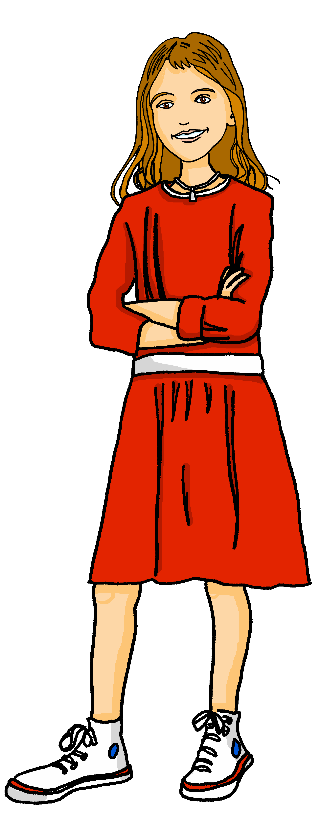
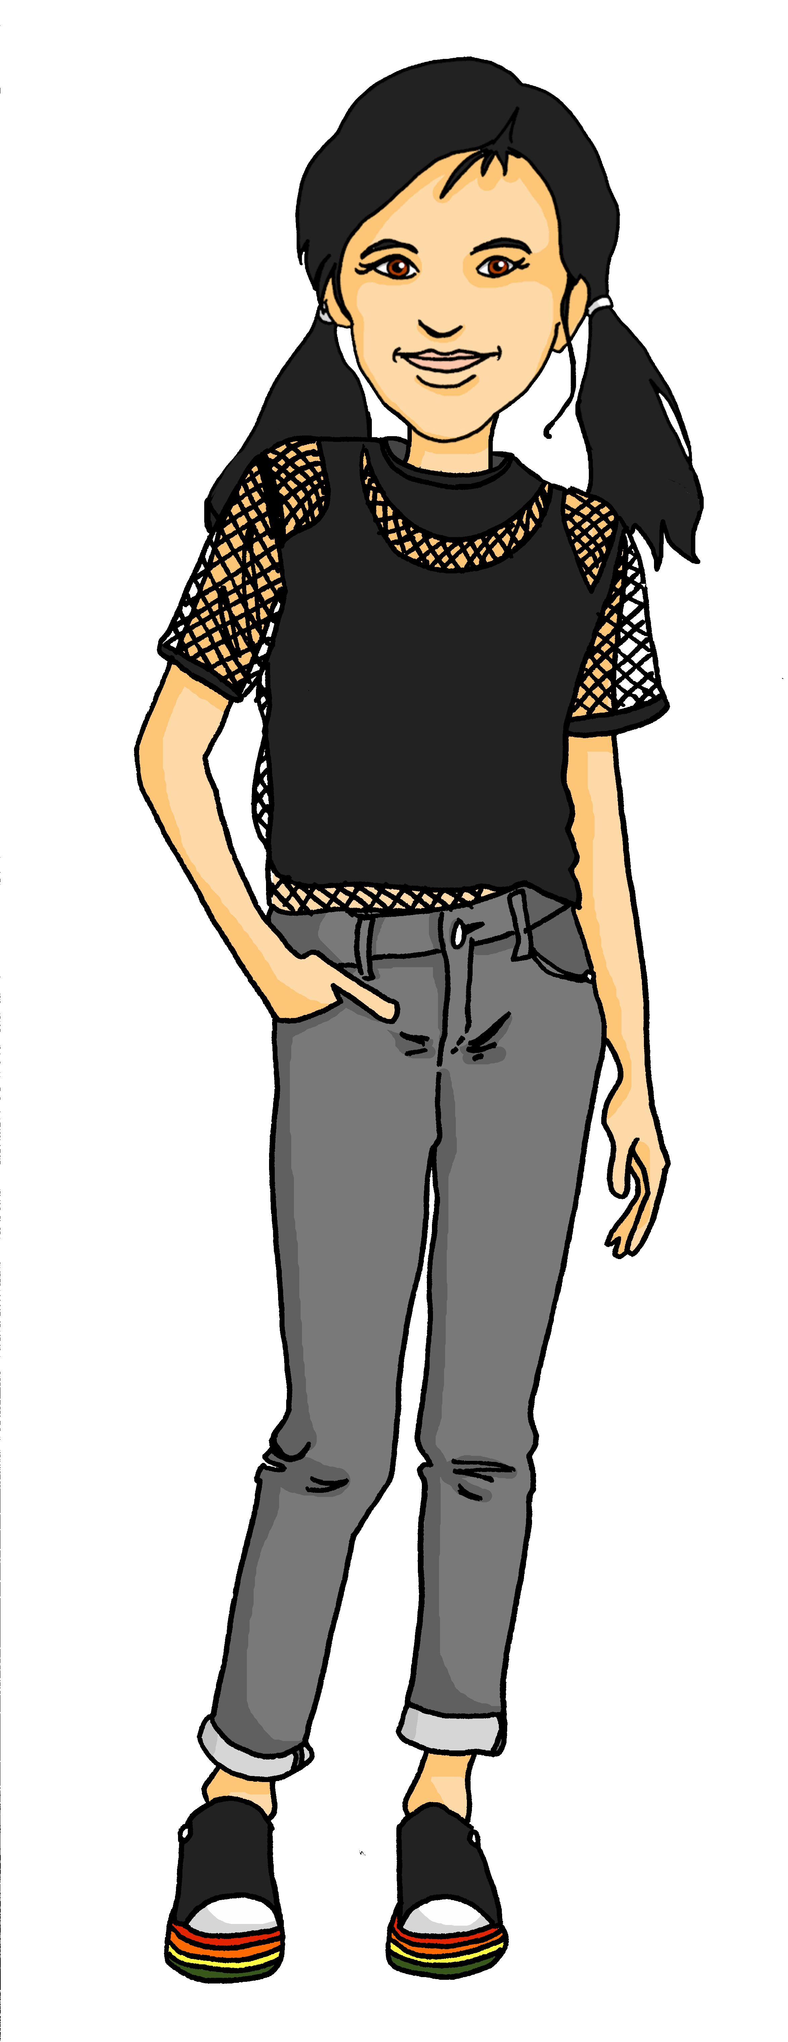
Follow up 3
Wie ist das Ding?
…
Bist du eine Idee?
Ja
sprechen
Wie ist die Idee?
Die Idee ist gut aber schwer.
Bist du ein Preis?
Nein.
The idea is bad and difficult.
The idea is good but difficult.
LOOK FOR: The idea is easy and good.
LOOK FOR: The prize is green and bad.
Notes:
Timing: 5 minutes Aim: To practise describing (speaking modality) things using vocabulary and grammar from this week and previous weeks. Procedure: 1. Model the activity using this slide. Ronja is looking for someone whose card says ‘The idea is easy and good’. She first asks Jana if she is an idea, and when Jana says yes, she then asks her to describe the idea.
2. Each pupil is given a square from the handouts at the end of this presentation.
3. Pupils walk around the classroom trying to find their matching partner, asking each other questions in German about what is on their cards.

Slide 12
schreiben

Wie ist das?
Follow up 4
Schreib auf Deutsch.
4
eine
Das ist _______ Person. _______ Person ist gut.
1
Die
Das ist eine Farbe. Die Farbe ist grau.
2
5
Das ist ein Problem. Das Problem ist schlecht.
Das ist eine Idee. Die Idee ist gut aber einfach.
3
6
Das ist eine Jacke. Die Jacke ist grün. Die Jacke ist auch weiß.
Das ist ein Preis. Der Preis ist nicht grün.
Notes:
Timing: 6 minutes Aim: To practise describing things (writing modality).
Procedure: 1. Model number 1 carefully, eliciting the correct words for ‘a’ and ‘the’ and the translation.
2. Bring up the picture prompts for 2-6. 3. Give pupils time to write their sentences and correct, whole class, paying particular attention to the articles.
4. For checking, click to bring up correct written versions of items 2-6.

Slide 13
Follow up 5:

Schreib auf English.
Can you get at least 15 points?
Wörter
 | er | ist | sie
 | das | weiß | du bist
 | schwarz | falsch | was
 | grau | grün | richtig
 | auch | aber | wie geht’s?
 | schlecht | nicht | wie
Vokabeln
he
is
she
x3
that
white
you are
black
wrong
what
x2
grey
green
right
also
but
how’s it going?
x1
bad, badly
not
how
Notes:
Timing: 5 minutes
Aim: to practise written production of vocabulary from this and revisited weeks.
Procedure: 1. Give pupils a blank grid. They fill in the English meanings of any of the words they know, trying to reach 15 points in total. 2. Remind pupils that adjectives can refer to male or female persons and they should note this in their translations. E.g. pleased (f), short (m).
Note: The most recently learnt and practised words are pink, words from the previous week are green and those from week 1 are blue, thus more points are awarded for them, to recognise that memories fade and more effort (heavy lifting!) is needed to retrieve them.

Slide 14
Follow up 5:

Schreib auf Deutsch.
Can you get at least 15 points?
Wörter
 | she | I am | is
 | green | what | to be
 | right | grey | wrong
 | white | black | that
 | how’s it going? | bad, badly | not
 | also | how | but
Vokabeln
sie
ich bin
ist
x3
grün
was
sein
richtig
grau
falsch
x2
weiß
schwarz
das
wie geht’s?
schlecht
nicht
x1
auch
wie
aber
Notes:
Timing: 5 minutes
Aim: to practise written production of vocabulary from this and revisited weeks.
Procedure: 1. Give pupils a blank grid. They fill in the German meanings of any of the words they know, trying to reach 15 points in total. 2. Remind pupils that adjectives can refer to male or female persons and they should note this in their translations. E.g. pleased (f), short (m).
Note: The most recently learnt and practised words are pink, words from the previous week are green and those from week 1 are blue, thus more points are awarded for them, to recognise that memories fade and more effort (heavy lifting!) is needed to retrieve them.

Slide 15
Tschüss!
gelb
Notes:
15

Slide 16
The idea is good. The idea is also easy.
The idea is not good.
LOOK FOR: The prize is white. The prize is also black.
LOOK FOR: The prize is good but grey.
The idea is easy but bad.
The idea is difficult. The idea is also bad.
LOOK FOR: The prize is not clear.
LOOK FOR: The prize is bad and green.
Notes:
HANDOUT
Cut along dotted lines, one square per pupil

Slide 17
The prize is bad and green.
The prize is not clear.
LOOK FOR: The idea is difficult. The idea is also bad.
LOOK FOR: The idea is easy but bad.
The prize is good but grey.
The prize is white. The prize is also black.
LOOK FOR: The idea is not good.
LOOK FOR: The idea is good. The idea is also easy.
Notes:
HANDOUT
Cut along dotted lines, one square per pupil

Slide 18
Follow up 5:

Schreib auf English.
Can you get at least 15 points?
Wörter
 | er | ist | sie
 | das | weiß | du bist
 | schwarz | falsch | was
 | grau | grün | richtig
 | auch | aber | wie geht’s?
 | schlecht | nicht | wie
Vokabeln
x3
x2
x1
Notes:
HANDOUT

Slide 19
Follow up 5:

Schreib auf Deutsch.
Can you get at least 15 points?
Wörter
 | she | I am | is
 | green | what | to be
 | right | grey | wrong
 | white | black | that
 | how’s it going? | bad, badly | not
 | also | how | but
Vokabeln
x3
x2
x1
Notes:
HANDOUT

