Slide 1
Describing me and others
gelb
Words for ‘a’
Words for ‘the’
SSC [ei] & [ie]
Term 1 Week 8
Notes:
Artwork by Steve Clarke. Pronoun pictures from NCELP (www.ncelp.org). All additional pictures selected from Pixabay and are available under a Creative Commons license, no attribution required.
Phonics:
Same [ie] and [ie] phonics as from week 4 and week 7.
Vocabulary (new): schlecht [327] aber [31] auch [18] nicht [11] wie [25] wie geht's? [n/a]
Revisit: was [38] falsch [524] grau [1560] grün [682] richtig [177]schwarz [471] weiß [474] das² [1]
Jones, R.L & Tschirner, E. (2019). A frequency dictionary of German: Core vocabulary for learners. London: Routledge.
The frequency rankings for words that occur in this PowerPoint which have been previously introduced in these resources are given in the SOW and in the resources that first
introduced and formally re-visited those words.
For any other words that occur incidentally in this PowerPoint, frequency rankings will be provided in the notes field wherever possible.
Note that the first three lessons of the year teach language that can be continuously recycled as lesson routine every lesson in Y3/4.
The idea would be that the class teacher (whether or not s/he teaches the class German can re-use the language as part of the daily routine with the class.
1

Slide 2
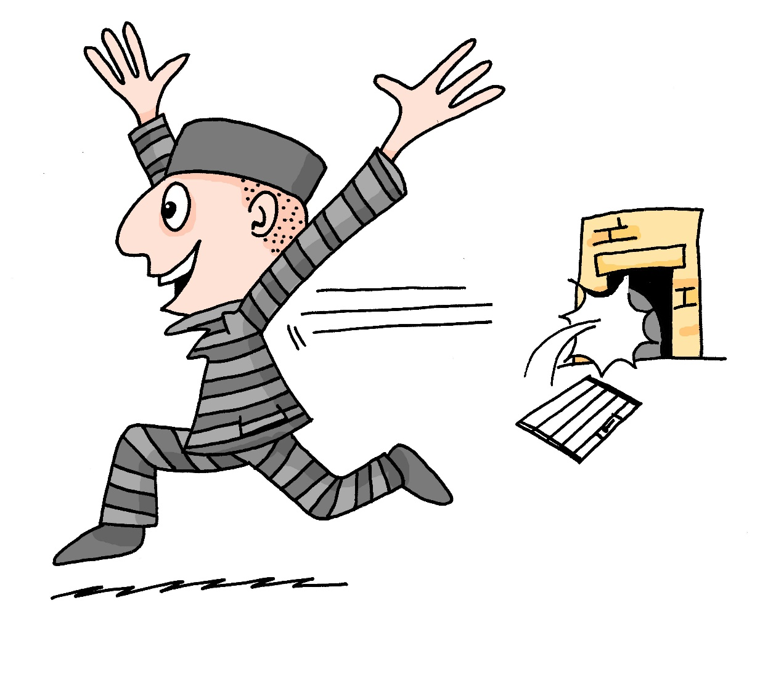
aussprechen
[ei]
…
free
frei
Notes:
Timing: 1 minute
Aim: to revisit the SSC [ei].
Procedure:
Re-present the SSC [ei] and present the source word ‘frei’ (with gesture, if using).
Click to bring on the picture and get pupils to repeat the word ‘frei’ (with gesture, if using).
Note:
a gesture for ‘frei’ might be to throw you hands up in the air and pretend to run away.
Vocabulary: frei [318
Jones, R.L & Tschirner, E. (2019). A frequency dictionary of German: Core vocabulary for learners. London: Routledge.
2

Slide 3
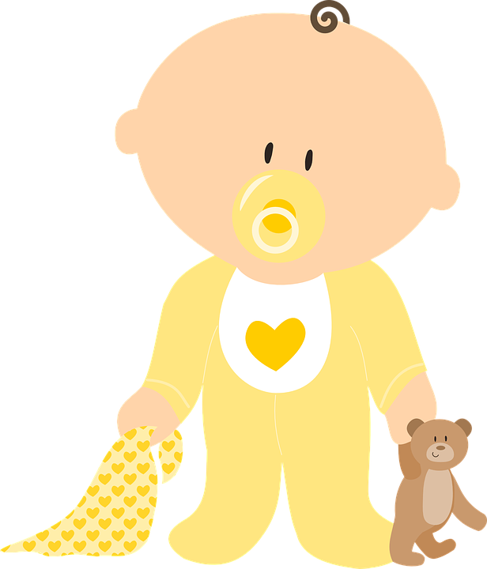
aussprechen
[ei]
…
frei
/a
sein
ein
alone
klein
allein
Notes:
Timing: 1 minute
Aim: to revisit the SSC [ei].
Procedure:
Re-present the SSC and the source word ‘frei’ (with gesture, if using).
Click to bring on the picture and get pupils to repeat the word ‘frei’ (with gesture, if using).
Present the cluster words in the same way, bringing on the picture and getting pupils to pronounce the words.
Vocabulary: frei [318] ein [5] klein [114] sein [3] allein [258]
Jones, R.L & Tschirner, E. (2019). A frequency dictionary of German: Core vocabulary for learners. London: Routledge.

Slide 4
aussprechen
[ie]
…
Liebe
Notes:
Timing: 1 minute
Aim: to revisit the SSC [ie].
Procedure:
Re-present the SSC [ie] and present the source word ‘Liebe’ (with gesture, if using).
Click to bring on the picture and get pupils to repeat the word ‘Liebe’ (with gesture, if using).
Note:
A gesture for ‘Liebe’ might be to make a ‘heart’ shape with both hands approximately where your heart is in your body.
Liebe [844]
Jones, R.L & Tschirner, E. (2019). A frequency dictionary of German: Core vocabulary for learners. London: Routledge.
4

Slide 5
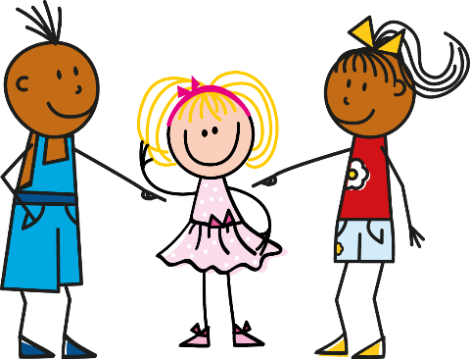
aussprechen
[ie]
…
sie
Liebe
Brief
Notes:
Timing: 1 minute
Aim: to revisit the SSC [ie].
Procedure:
Re-present the SSC and present the source word ‘Liebe’ (with gesture, if using).
Click to bring on the picture and get pupils to repeat the word ‘Liebe’ (with gesture, if using).
Present the cluster words in the same way, bringing on the picture and getting pupils to pronounce the words.
sie [7] Brief [838]
Jones, R.L & Tschirner, E. (2019). A frequency dictionary of German: Core vocabulary for learners. London: Routledge.
5

Slide 6
hören
Was ist die Idee?
Lias is wondering what to draw. Which idea does he choose?
Hör zu
a) Biene
b) Beine
1
Notes:
Timing: 5 minutes (5 slides)
Aim: to practise aural distinction between [ie] and [ei] using minimal pairs. This SSC pair is particularly difficult for learners of German.
Procedure:
1. Click on the audio button to hear a native speaker say one of the two words on screen.
2. Pupils listen carefully to determine whether they have heard [ie] or [ei] and note down either option a) or b).
3. Click to reveal answer.
4. Repeat for slides 2-5.
Transcript:
Biene
lieb
Reise
Weise
Ziele
Word frequency (1 is the most frequent word in German): Bein [884] Biene [>5000] Leib [3274] lieb [897] Reise [734] Riese [4585] Weise [468] Wiese [2963] Zeile [2318] Ziel [320] Source: Jones, R.L. & Tschirner, E. (2019). A frequency dictionary of German: core vocabulary for learners. Routledge
6

Slide 7
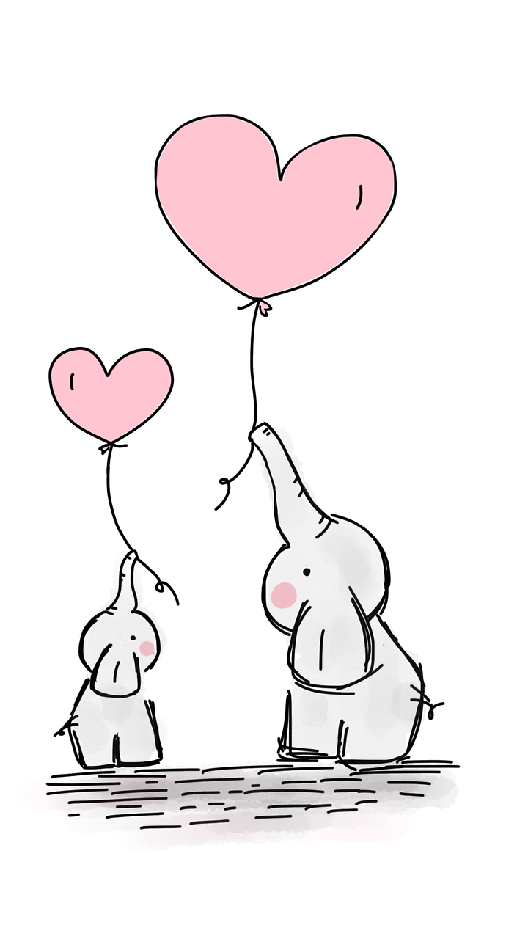
hören
Was ist die Idee?
Lias is wondering what to draw. Which idea does he choose?
Hör zu
a) Leib
b) lieb
2
Notes:
[2/5]
7

Slide 8
hören
Was ist die Idee?
Lias is wondering what to draw. Which idea does he choose?
Hör zu
a) Reise
b) Riese
3
Notes:
[3/5]
8

Slide 9
hören
Was ist die Idee?
Lias is wondering what to draw. Which idea does he choose?
Hör zu
a) Wiese
b) Weise
4
Notes:
[4/5]
9

Slide 10
hören
Was ist die Idee?
Lias is wondering what to draw. Which idea does he choose?
Hör zu
a) Zeile
b) Ziele
5
Notes:
[5/5]
10

Slide 11
Vokabeln
Wörter
wie?
how?
Wie geht’s?
[How goes it?]
Notes:
1 of 2
Timing: 5 minutes
Aim: to present and practise ‘Wie’ and ‘wie geht’s’.
Procedure:
Click to bring up Wie and illustration.
Click again to bring up translation: wie = how.
Click again to bring up phrase ‘Wie geht’s’.
Click again to bring up literal translation: How goes it? Explain that a better translation in English is: How’s it going? OR How are you?
11

Slide 12
Vokabeln
Wie geht’s?
Wörter
wie?
how?
____ geht’s?
Wie
[How’s it going?]
Notes:
2/2
Timing: 5 minutes
Aim: to present and practise ‘Wie’ and ‘wie geht’s’.
Procedure:
Click to bring up Wie and illustration.
Click for question mark to appear – what does wie mean?
Click again to bring up translation: wie = how.
Click again to bring up gapped phrase ‘____ geht’s’.
Click for question mark to appear: what goes in the gap? Elicit which word goes in the gap (Wie).
Click again to bring up the missing Wie.
Last, elicit translation. Explain the common phrase ‘Wie geht’s’ is better translated as ‘how’s it going’.
12

Slide 13
Vokabeln
Wie geht’s?
Wörter
gut
Ja, es geht.
schlecht
Notes:
Timing: 5 minutes
Aim: to present and practise possible answers to the question ‘wie geht’s’.
Procedure:
1. Ask ‘Wie geht’s’, click to bring up thumbs up icon.
2. Click to bring up answer: gut.
Click to bring up thumbs down image.
Click to bring up possible answer: schlecht.
Continue with the thumbs wavering between up and down (pupils can do all of these three gestures as they practise the words): Ja, es geht. (yes, it’s going (ok)).
13

Slide 14
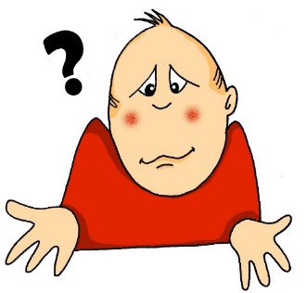
Vokabeln
Vokabeln lernen
Wörter
auch
aber
schlecht
not
wie
nicht
Notes:
Timing: 5 minutes (3 slides)
Aim: to present and practise written comprehension and read aloud of the new vocabulary for this week.
Procedure: 1. Click for a German word. Elicit pronunciation from pupils.
2. Click for the English meaning and picture prompt. Elicit the German word again.
3. Present all six words like this, in order top left to bottom right.
4. Click for the next slide. Click for one English meaning to disappear in random order. Elicit the English meaning from pupils. Continue with the remaining items.
5. Click for the next slide. Click for the German word to disappear in random order. Elicit the German from pupils. Continue with the remaining items.
Vocabulary:
schlecht [327] aber [31] auch [18] nicht [11] wie [25] Jones, R.L & Tschirner, E. (2019). A frequency dictionary of German: Core vocabulary for learners. London: Routledge.
14

Slide 15
Vokabeln
Vokabeln lernen
Wörter
auch
aber
schlecht
not
wie
nicht
Notes:
[2/3]
15

Slide 16
Vokabeln
Vokabeln lernen
Wörter
auch
aber
schlecht
not
wie
nicht
Notes:
[3/3]
16

Slide 17
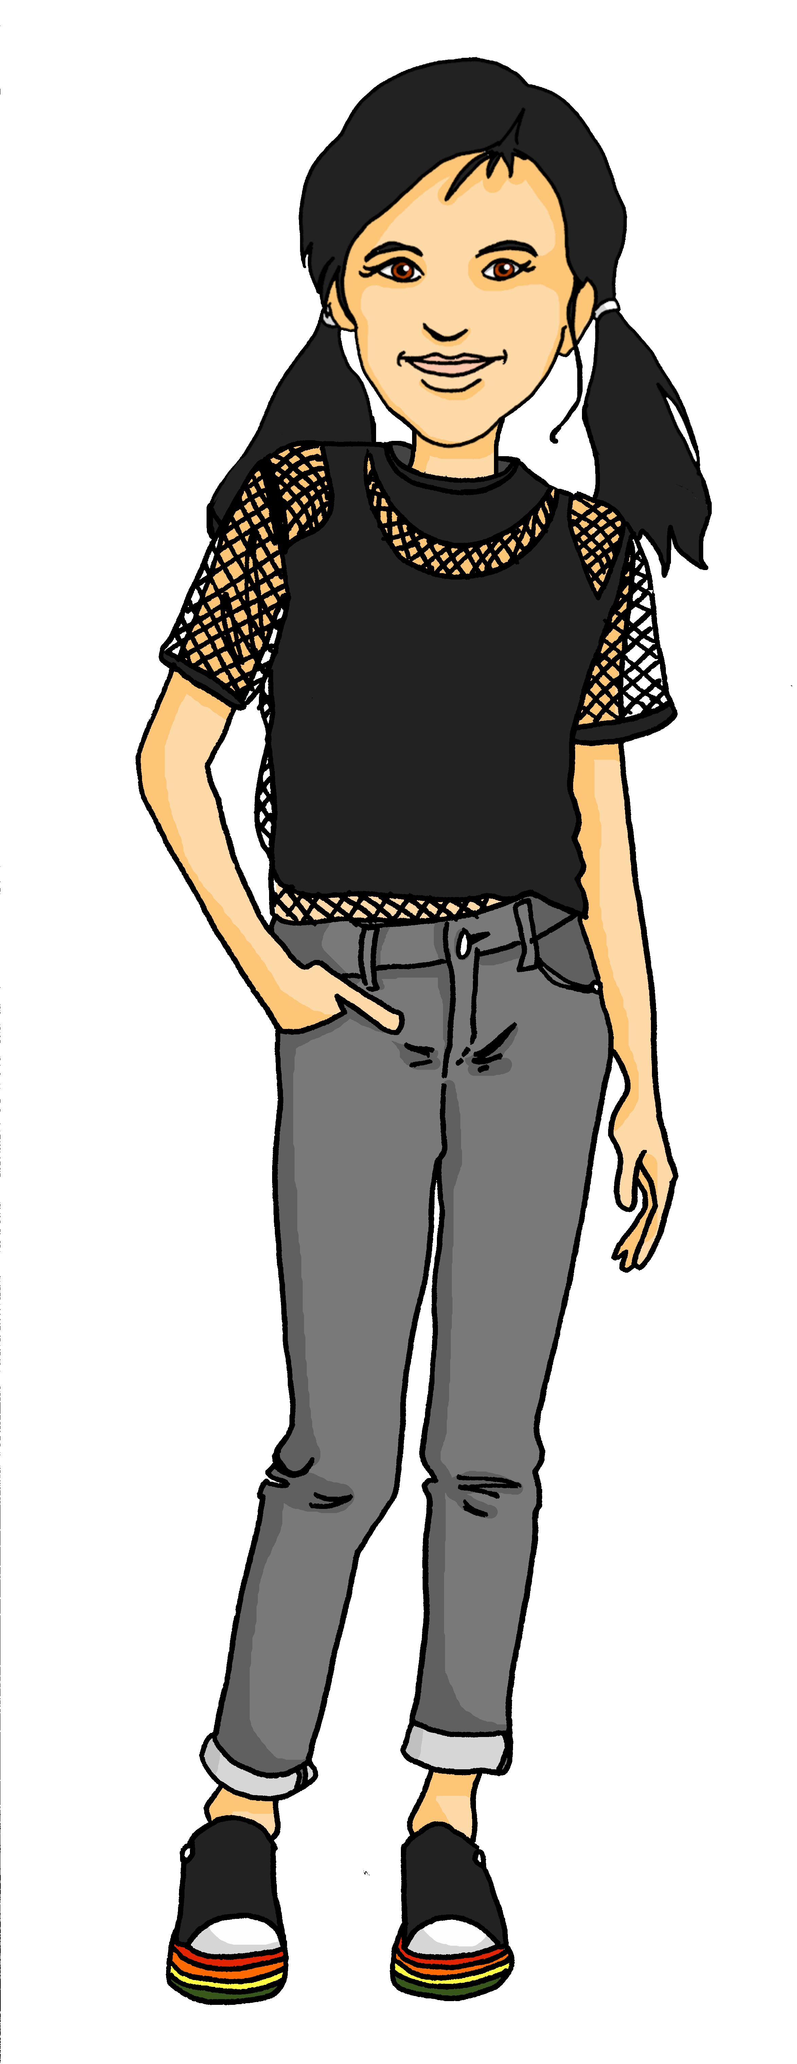
Wie?
Wie? means ‘how’, as in ‘Wie geht’s?’
How’s it going?
Wie? also means ‘how’, as in ‘Wie ist die Person?’
How is the person? – description
or What is the person like?
Was ist das?
Das ist ein Apfel.
Wie ist der Apfel?
Der Apfel ist grün, aber schlecht.
Notes:
Timing: 2 minutes
Aim: To introduce the 2nd meaning of ‘wie’ → What … like?
Procedure: 1. Use the slide animation to present the second meaning of wie.
2. Model the dialogue, one line at a time.
3. Check students’ understanding at each stage.
17

Slide 18
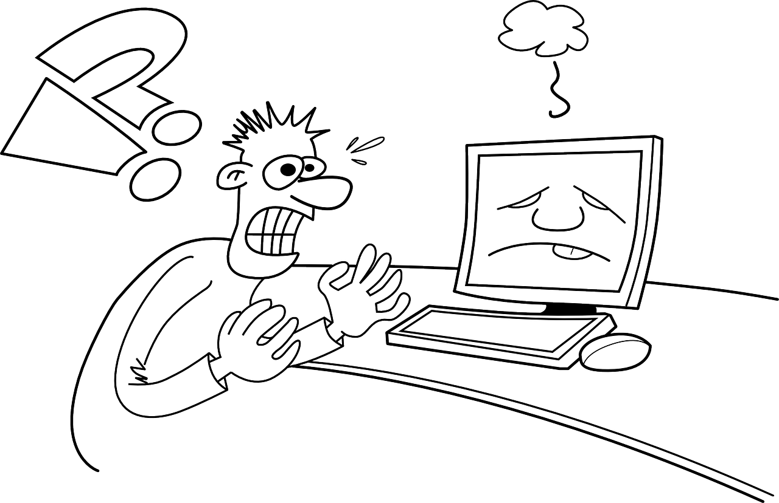
lesen
“Wie ist der/ die/ das…?” oder “Was ist das?”
Robbie has asked Ronja about lots of things. Read her answers. Did Robbie ask her “Wie ist der/ die/ das…?” or “Was ist das?”
Was ist das?
Wie ist das Problem?
Das ist ein Ort.
Das Problem ist schlecht.
Wie ist die Idee?
Wie ist die Person?
Die Idee ist nicht klar.
Die Person ist wunderbar.
Was ist das?
Was ist das?
Das ist ein Preis.
Das ist eine Farbe.
Notes:
Timing: 5 minutes
Aim: to consolidate the idea that ‘wie’ is used to ask for descriptions, and that ‘was’ is used to ask to identify things.
Procedure:
Pupils read Ronja’s answers. If the answer is a description, then Robbie must have asked as ‘wie’ question. If the answer identifies an object, then Robbie must have asked a ‘was’ question.
Pupils note down their answers. Pupils could have a greater challenge by writing full sentences (either ‘was ist das’ or ‘wie ist der/die/das…), or less of a challenge by simply writing ‘was’ or ‘wie’.
Click to reveal answers.
18

Slide 19
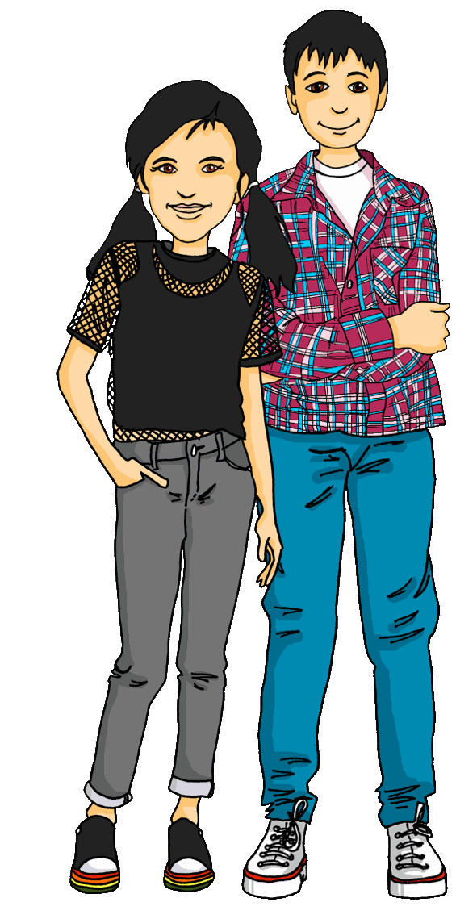
Kultur
Wie ist die Schule* in Biel in der Schweiz?
*die Schule
- school
Richtig oder falsch?
We start primary school when we are 7 years old.
Richtig!
Notes:
Timing: 4 minutes (4 slides)
Aim: to learn about school in Switzerland. To practise richtig and falsch, two words in this week’s revisited vocabulary set.
Procedure:
Pupils read the speech bubble on each slide and decide whether it is true or false.
Click to reveal answer. If the answer is false, click to reveal a callout giving the true answer.
19

Slide 20
Kultur
Wie ist die Schule* in Biel in der Schweiz?
*die Schule
- school
Richtig oder falsch?
But we start Kindergarten when we are 3 years old.
In Switzerland, children start Kindergarten when they are four years old. Here, they begin to learn how to read and write.
Falsch!
Notes:
[2/4]
20

Slide 21
Kultur
Wie ist die Schule* in Biel in der Schweiz?
*die Schule
- school
Richtig oder falsch?
There is no school Wednesday afternoons!
Richtig!
Notes:
[3/4]
21

Slide 22
Kultur
Wie ist die Schule* in Biel in der Schweiz?
*die Schule
- school
Richtig oder falsch?
School finishes at 5 pm.
In Switzerland, school finishes at 4 pm.
Falsch!
Notes:
[4/4]
22

Slide 23
Tschüss!
gelb
Notes:
23

