Slide 1
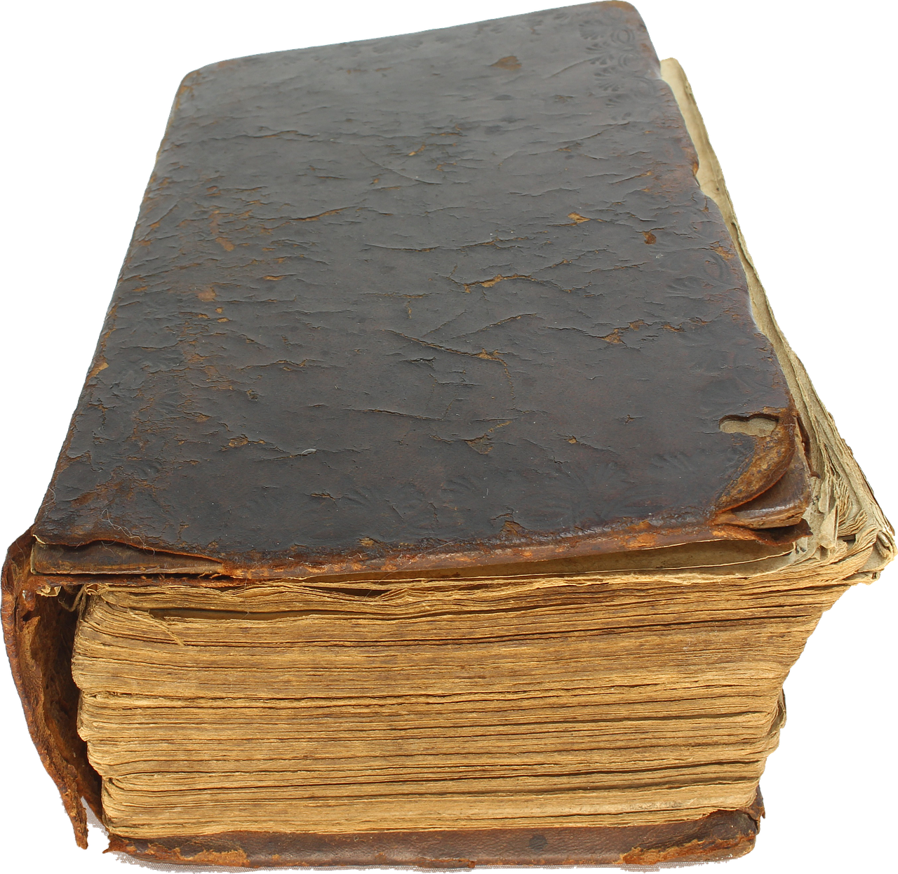
Describing me and others
gelb
Follow ups 1-5
Term 1 Week 9
Notes:
Artwork by Steve Clarke. Pronoun pictures from NCELP (www.ncelp.org). All additional pictures selected from Pixabay and are available under a Creative Commons license, no attribution required.
Phonics:
[w] Antwort [522] gewinnen [372] ja [45] wahr [737] Wasser [254] Welt [164]
Vocabulary:
New words in bold: alt [138] neu [84] lang [97] rund [296]
Revisit 1: Ding [370] Farbe [1079] Ort [341] Person [357] klar [239] oder [35]
Revisit 2: ich [10] er [15] sie [7] sein1, bin, ist [4] da [239] hier [68] Guten Morgen [n/a] Hallo [1077] ja [45] nein [148]
Jones, R.L & Tschirner, E. (2019). A frequency dictionary of German: Core vocabulary for learners. London: Routledge.
The frequency rankings for words that occur in this PowerPoint which have been previously introduced in these resources are given in the SOW and in the resources
that first introduced and formally re-visited those words.
For any other words that occur incidentally in this PowerPoint, frequency rankings will be provided in the notes field wherever possible.
Note that the first three lessons of the year teach language that can be continuously recycled as lesson routine every lesson in Y3/4.
The idea would be that the class teacher (whether or not s/he teaches the class German can re-use the language as part of the daily routine with the class.

Slide 2
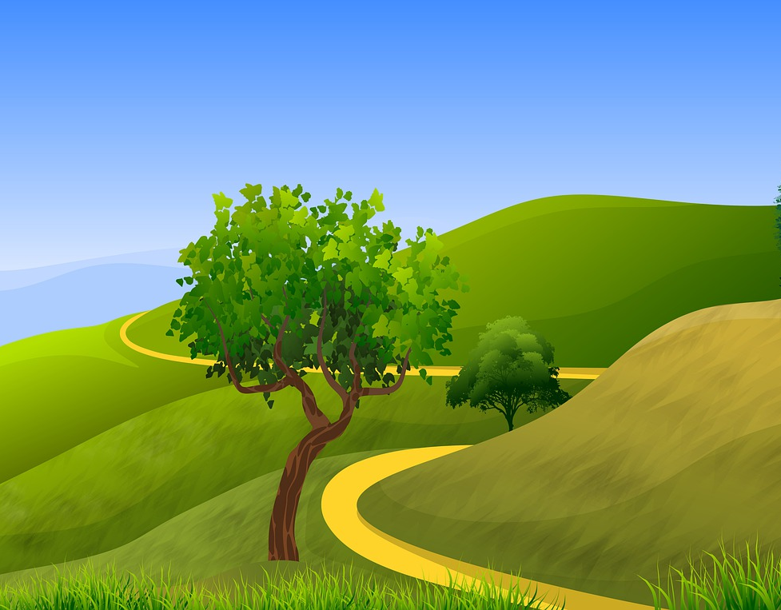
Follow up 1
Say all the words.
…
aussprechen
Winter [winter]
warum? [why?]
wie? [how?]
gewinnen [to win]
60
wiederholen [to repeat]
die Schweiz [Switzerland]
Welt [world]
Wand [wall]
Wald [wood]
Wetter [weather]
warm [warm]
Weg [path]
Sekunden
Westen [west]
Wasser [water]
Antwort [answer]
Auf Wiedersehen [goodbye]
0
LOS!
Notes:
Timing: 4 minutes (1 minute for practice + 1 minute for saying them out loud x 2 rounds) Aim: to practise SSC knowledge with a mixture of known and unknown words. The time limit helps automatization. Procedure: 1. Students take 60 seconds to practise saying the words out loud to themselves. Click LOS! to start the timer.
2. Then teacher clicks and each word flashes a couple of times before disappearing. Students have to pronounce the word (in chorus).
Frequency of unknown words and cognates:
Antwort [522] Auf Wiedersehen [n/a] die Schweiz [763] gewinnen [372] Wald [1028] Wand [828] warm [1281] warum [192] Wasser [245] Weg [220] Welt [164] Westen [1010] wiederholen [988] Winter [1206]
Jones, R.L & Tschirner, E. (2019). A frequency dictionary of German: Core vocabulary for learners. London: Routledge.

Slide 3
Follow up 2 :
Schreib auf Englisch.
lesen
lang
eine
der Ort
neu
5
rund
4
klar
nein
ein
3
2
alt
Guten Morgen
1
Notes:
Timing: 5 minutes (two slides)
Aim: to practise written comprehension of vocabulary.
Procedure:
Tell pupils to be ready to write the English meanings of key vocabulary. There will be 10 altogether and they should prepare to work from the bottom of the slide, left to right.
Explain the scenario – it’s raining and the raindrops will splash down and cover the words. They need to write the Spanish (but also be prepared to translate). Tell them they will have 5 seconds to get a headstart on the rain.
Click to start number animation.
Click once more to start raindrops. The timing has been carefully set! Don’t click again or all the raindrops will appear at once.
When finished move to the next slide to check answers.

Slide 4
Follow up 2 :
Antworten
lesen
lang
eine
long
a/an (f)
der Ort
neu
rund
place
new
round
klar
nein
ein
clear
a/an (m, nt)
no
alt
Guten Morgen
old
Good Morning
Notes:
Procedure:
Elicit responses from the bottom, left to right, from pupils.
Click to bring up a written version of the answer.

Slide 5
Follow up 3:
Wo ist Lias? Wo ist Ronja? Wo ist Leonie? Wo ist Lothar?
sprechen
Das ist Biel. Biel ist in der Schweiz.
round
the idea
long
the place
England
That is
That is not
Is that…?
Notes:
Timing: 5 minutes
Aim: to practise nicht in short sentences of three types: nicht + adjective, nicht + definite article, nicht + proper noun; to practise spoken production of some of this week‘s vocabulary; to practise spoken production of subject-verb inversion yes/no questions.
Procedure:
Click to reveal a callout explaining that the picture shows Biel. Biel is where Lias and Ronja live. Click to hide the callout.
Pupils select a sentence starter on the vertical axis and a sentence end along the horizontal axis at random.
They translate the sentence (e.g. That is – round= Das ist rund) to identify the square where they think Lias, Ronja, Leonie or Lothar is.
Click on the square to reveal what is beneath.
Continue until all four family members have been found.
Image attribution: By Swiss-bienne-city-1.JPG: Marcel.c.derivative work: RotGelb (talk) - Swiss-bienne-city-1.JPG, Copyrighted free use, https://commons.wikimedia.org/w/index.php?curid=9699514

Slide 6
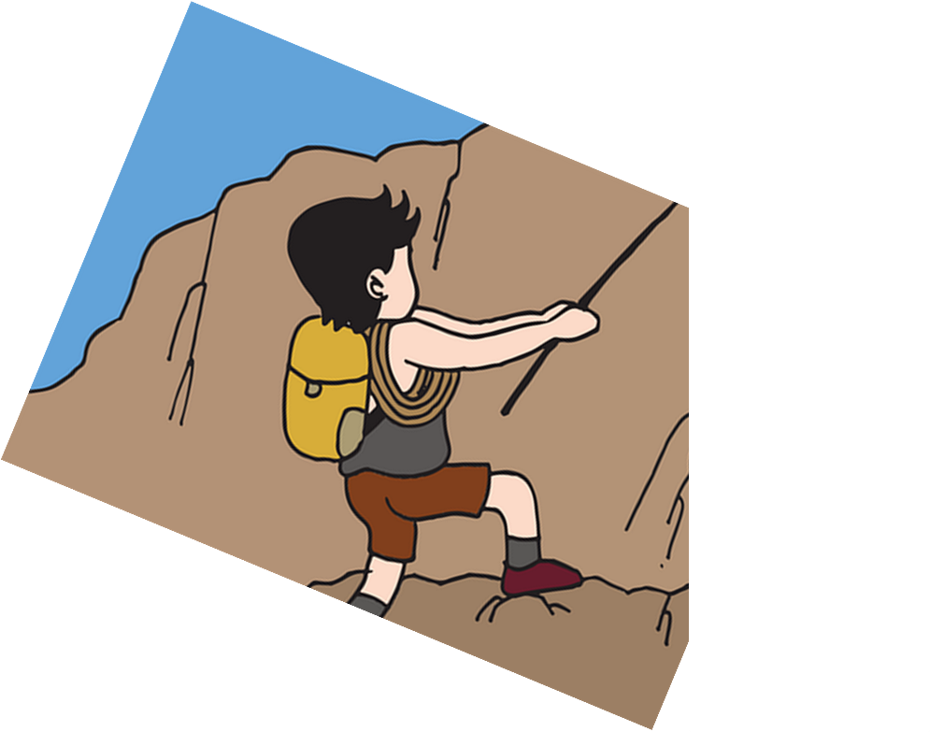
Follow up 4:
Was ist das auf Deutsch?
[1/5]
schreiben
He is not old.
alt
grün
Ding
rund
4
nicht
ein
neu
3
er
rund
ist
das
2
Er
Ist
1
Notes:
Timing: 5 minutes (5 slides)
Aim: to practise writing short sentences in German using nicht and subject-verb inversion questions.
Procedure:
Tell pupils they need to use the words, starting from the bottom, to climb up the mountain (so that they translate the sentence!).
Pupils write down their answer.
Ask a volunteer to say the German translation out loud.
Click to reveal answers.
Repeat with the next 4 sentences (there are 5 in total).

Slide 7
Follow up 4:
Was ist das auf Deutsch?
[2/5]
schreiben
That is not Switzerland.
Schweiz
England
Farbe
5
alt
die
das
eine
4
nicht
ein
neu
3
lang
rund
ist
das
2
Das
Ist
1
Notes:
[2/5]

Slide 8
Follow up 4:
Was ist das auf Deutsch?
[3/5]
schreiben
Is she the person?
Person
Farbe
Ding
Ort
4
die
ein
das
3
das
sie
ist
er
2
Sie
Ist
1
Notes:
[3/5]

Slide 9
Follow up 4:
Was ist das auf Deutsch?
[4/5]
schreiben
That is not the place.
Farbe
Ort
Ding
5
der
die
ein
eine
4
bin
neu
nicht
3
sie
ich
ist
das
2
Das
Ist
1
Notes:
[4/5]

Slide 10
Follow up 4:
Was ist das auf Deutsch?
[5/5]
schreiben
She is not Ronja.
Person
Farbe
Lias
Ronja
4
nicht
eine
das
3
bin
sie
ist
bist
2
Sie
Er
1
Notes:
[5/5]

Slide 11
Follow up 5:

Schreib auf Englisch.
Can you get at least 15 points?
Wörter
 | nein | sie ist | ich bin
 | ja | hier | er ist
 | Guten Morgen! | oder | der Ort
 | das Ding | die Farbe | die Person
 | alt | neu | lang
 | rund | klar | ein
Vokabeln
no
she is
I am
x3
yes
here
he is
Good morning!
or
(the) place
x2
(the) thing
(the) colour
(the) person
old
new
long
x1
round
clear
a/an (m, nt)
Notes:
Timing: 5 minutes
Aim: to practise written comprehension of vocabulary from this and revisited weeks.
Procedure: 1. Give pupils a blank grid. They fill in the English meanings of any of the words they know, trying to reach 15 points in total. 2. Remind pupils that adjectives can refer to male or female persons and they should note this in their translations. E.g. pleased (f), short (m).
Note: The most recently learnt and practised words are pink, words from the previous week are green and those from week 1 are blue, thus more points are awarded for them, to recognise that memories fade and more effort (heavy lifting!) is needed to retrieve them.

Slide 12
Follow up 5:

Schreib auf Deutsch.
Can you get at least 15 points?
Wörter
 | you | hello | yes
 | to be, being | I am | she is
 | (the) place | (the) thing | Good morning!
 | or | (the) person | (the) colour
 | long | a/an (f) | clear
 | old | round | new
Vokabeln
du
hallo
ja
x3
sein
ich bin
sie ist
der Ort
das Ding
Guten Morgen!
x2
oder
die Person
die Farbe
lang
eine
klar
x1
alt
rund
neu
Notes:
Timing: 5 minutes
Aim: to practise written production of vocabulary from this and revisited weeks.
Procedure: 1. Give pupils a blank grid. They fill in the German meanings of any of the words they know, trying to reach 15 points in total. 2. Remind pupils that adjectives can refer to male or female persons and they should note this in their translations. E.g. pleased (f), short (m).
Note: The most recently learnt and practised words are pink, words from the previous week are green and those from week 1 are blue, thus more points are awarded for them, to recognise that memories fade and more effort (heavy lifting!) is needed to retrieve them.

Slide 13
Tschüss!
gelb
Notes:
13

Slide 14
Follow up 5:

Schreib auf Englisch.
Can you get at least 15 points?
Wörter
 | nein | sie ist | ich bin
 | ja | hier | er ist
 | Guten Morgen! | oder | der Ort
 | das Ding | die Farbe | die Person
 | alt | neu | lang
 | rund | klar | ein
Vokabeln
x3
x2
x1
Notes:
HANDOUT

Slide 15
Follow up 5:

Schreib auf Deutsch.
Can you get at least 15 points?
Wörter
 | you | hello | yes
 | to be, being | I am | she is
 | (the) place | (the) thing | Good morning!
 | or | (the) person | (the) colour
 | long | a/an (f) | clear
 | old | round | new
Vokabeln
x3
x2
x1
Notes:
HANDOUT

