Slide 1
Describing me and others
gelb
Negation with nicht
SSC [w]
Term 1 Week 9
Notes:
Artwork by Steve Clarke. Pronoun pictures from NCELP (www.ncelp.org). All additional pictures selected from Pixabay and are available under a Creative Commons
license, no attribution required.
Phonics:
[w] Antwort [522] gewinnen [372] ja [45] wahr [737] Wasser [254] Welt [164]
Vocabulary:
New words in bold: alt [138] neu [84] lang [97] rund [296]
Revisit 1: Ding [370] Farbe [1079] Ort [341] Person [357] klar [239] oder [35]
Revisit 2: ich [10] er [15] sie [7] sein1, bin, ist [4] da [239] hier [68] Guten Morgen [n/a] Hallo [1077] ja [45] nein [148]
Jones, R.L & Tschirner, E. (2019). A frequency dictionary of German: Core vocabulary for learners. London: Routledge.
The frequency rankings for words that occur in this PowerPoint which have been previously introduced in these resources are given in the SOW and in the resources
that first introduced and formally re-visited those words.
For any other words that occur incidentally in this PowerPoint, frequency rankings will be provided in the notes field wherever possible.
Note that the first three lessons of the year teach language that can be continuously recycled as lesson routine every lesson in Y3/4.
The idea would be that the class teacher (whether or not s/he teaches the class German can re-use the language as part of the daily routine with the class.
1

Slide 2
singen
Hör zu. Dann sing mit!
Hallo! Hallo! Guten Tag! Hallo! Hallo! Guten Tag!
Hallo! Ich bin hier,
Hallo! Du bist da, Hallo! Hallo! Guten Tag!
Notes:
Timing: 2 minutes
Aim: to practise some previously learnt vocabulary in a simple song (to the tune of ‘If you’re happy and you know it’).
Procedure: 1. Click the sound player icon to play the audio of the song.
2. Repeat the words of each line to practise saying them clearly (borrow the rhythm of the song so that this is a rehearsal stage before singing).
3. Click to play the audio again and this time, pupils join in.
Note: Teachers might like to re-use this song as part of their lesson starting routine in future lessons. Soon pupils will not need to see the words to recall it.

Slide 3
aussprechen
[w]
…
[world]
Welt
Notes:
Timing: 1 minute
Aim: to introduce the SSC [w].
Procedure:
Introduce the SSC and present the source word ‘Welt’ (with gesture, if using).
Click to bring on the picture and get pupils to repeat the word Welt’ (with gesture, if using).
Note:
a gesture for ‘Welt’ might be to mime a big sphere with your hands.
Vocabulary: Welt [164]
Jones, R.L & Tschirner, E. (2019). A frequency dictionary of German: Core vocabulary for learners. London: Routledge.
3

Slide 4
aussprechen
[w]
…
[answer]
Wasser
Antwort
[world]
Welt
[to win, winning]
[true]
wahr
gewinnen
Notes:
Timing: 1 minute
Aim: to consolidate the SSC [w].
Procedure:
Re-present the SSC and the source word ‘Welt’ (with gesture, if using).
Click to bring on the picture and get pupils to repeat the word ‘Welt’ (with gesture, if using).
Present the cluster words in the same way, bringing on the picture and getting pupils to pronounce the words.
Vocabulary: Antwort [522] gewinnen [372] wahr [737] Wasser [245] Welt [164]
Jones, R.L & Tschirner, E. (2019). A frequency dictionary of German: Core vocabulary for learners. London: Routledge.

Slide 5
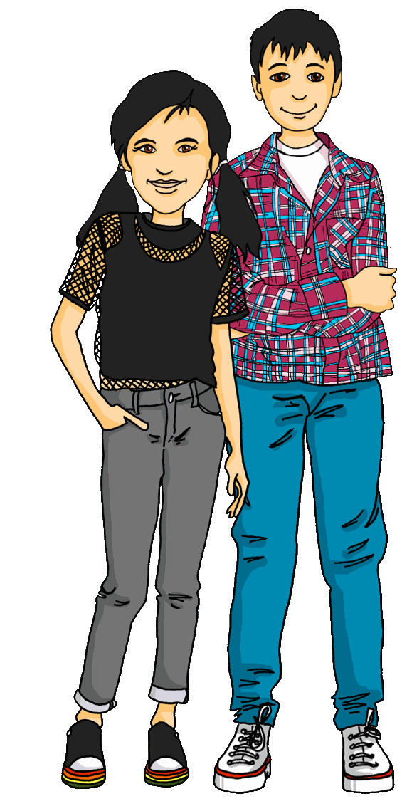
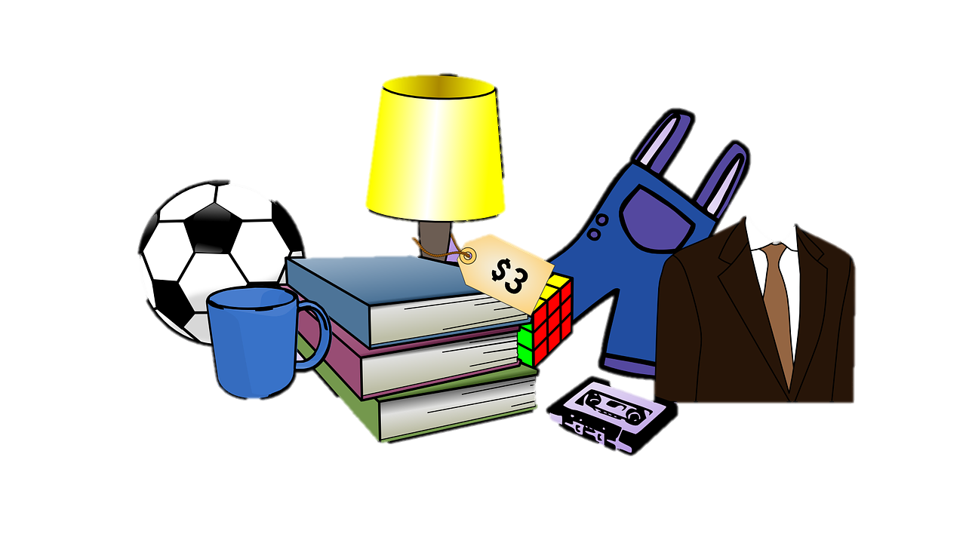
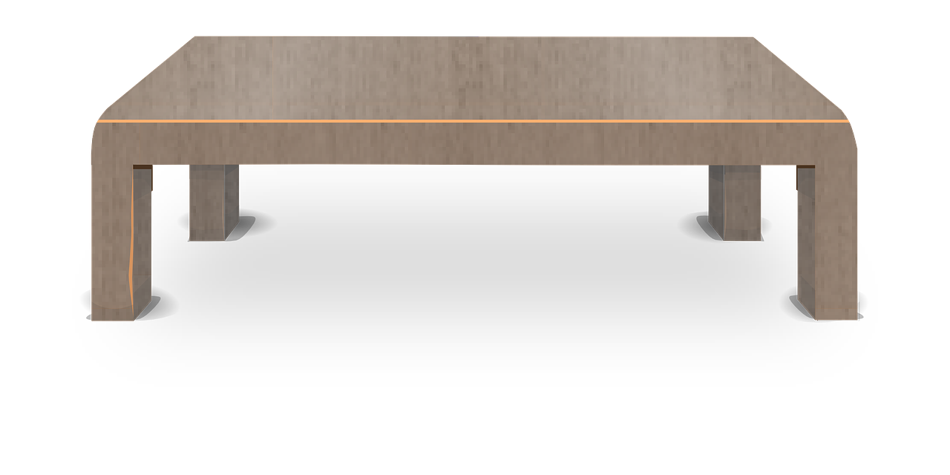
aussprechen
[w]
Read the dialogue with a partner.
Ronja and Lias are helping at a second-hand sale.
Hallo! Wie geht’s?
Gut! Wie ist die Jacke?
Die Jacke ist weiß und schwarz.
Die Farbe weiß ist wunderbar!
Ja, das ist wahr.
Auf Wiedersehen!
Notes:
Timing: 2 minutes
Aim: to consolidate the SSC [w] by ‘read aloud’ conversation containing known words with [w].
Procedure:
Model the dialogue or click audio to play.
Pupils work in pairs and read the conversation to each other, focusing on their pronunciation of [w].

Slide 6
Vokabeln
Vokabeln lernen
Wörter
old
new
alt
neu
long
round
lang
rund
Notes:
Timing: 5 minutes (3 slides)
Aim: to present and practise new vocabulary for this week.
Procedure:
1. Click for a German word. Elicit pronunciation from pupils.
2. Click for the English meaning and picture prompt. Elicit the German word again.
3. Present all four words like this, in order top left to bottom right.
4. Click for the next slide. Click for one English meaning to disappear in random order. Elicit the English meaning from pupils. Continue with the remaining items.
5. Click for the next slide. Click for the German word to disappear in random order. Elicit the German from pupils. Continue with the remaining items.
6

Slide 7
Vokabeln
Vokabeln lernen
Wörter
old
new
alt
neu
long
round
lang
rund
Notes:
[2/3]
7

Slide 8
Vokabeln
Vokabeln lernen
Wörter
old
new
alt
neu
long
round
lang
rund
Notes:
[3/3]
8

Slide 9
Nicht (not) [1/2]
Use nicht before an adjective or adverb to mean not:
Ich bin hier.
Ich bin nicht hier.
I am here.
I am not here.
Die Person ist grün.
Die Person ist nicht grün.
The person is green.
The person is not green.
Notes:
Timing: 2 minutes
Aim: to introduce the use of nicht for negation with adjectives, adverbs and definite articles.
Procedure:
Click through the animations to present the new information.
Elicit English translation for the German examples provided.
9

Slide 10
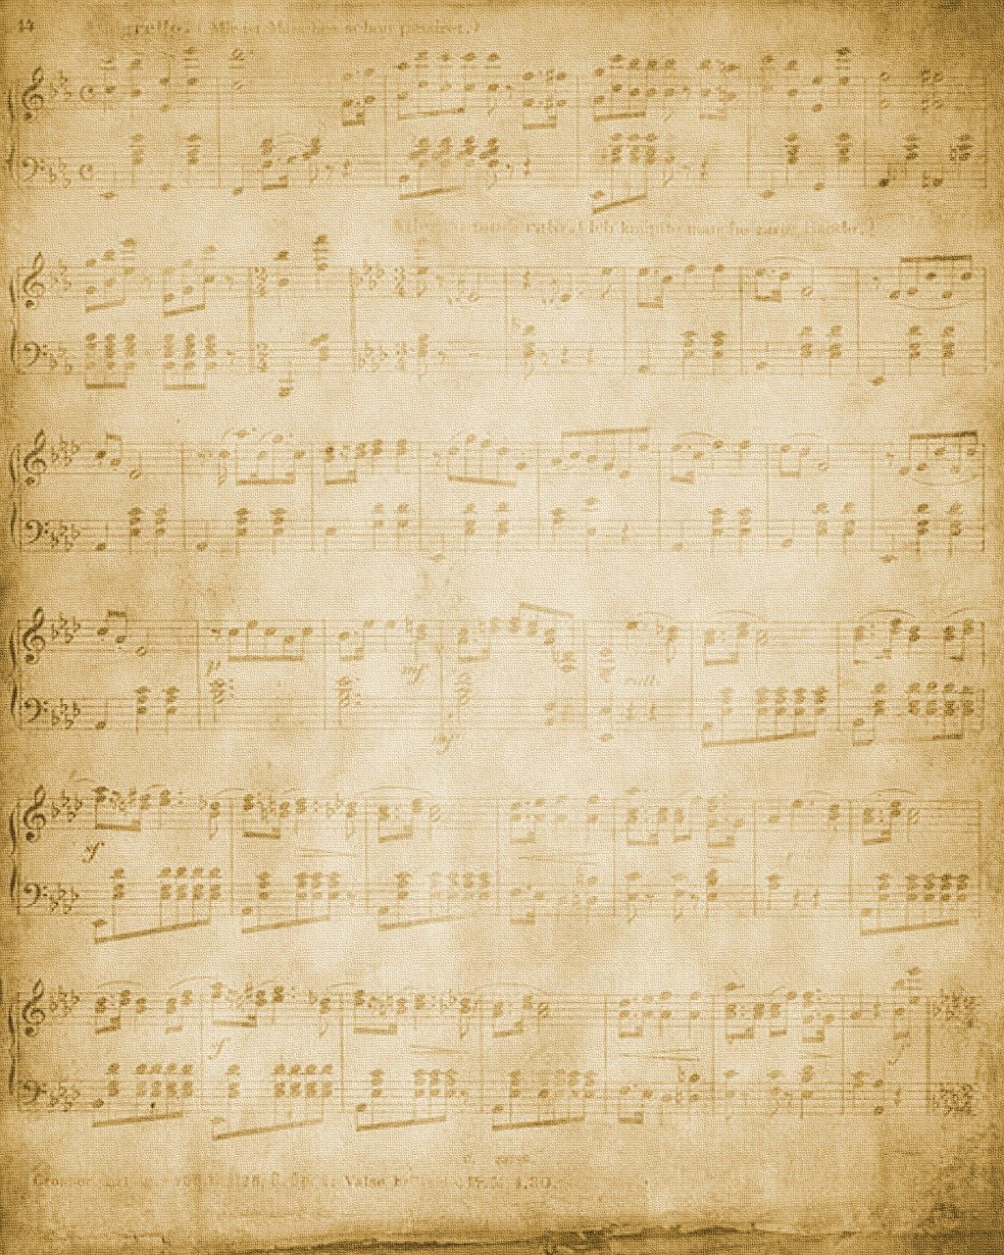
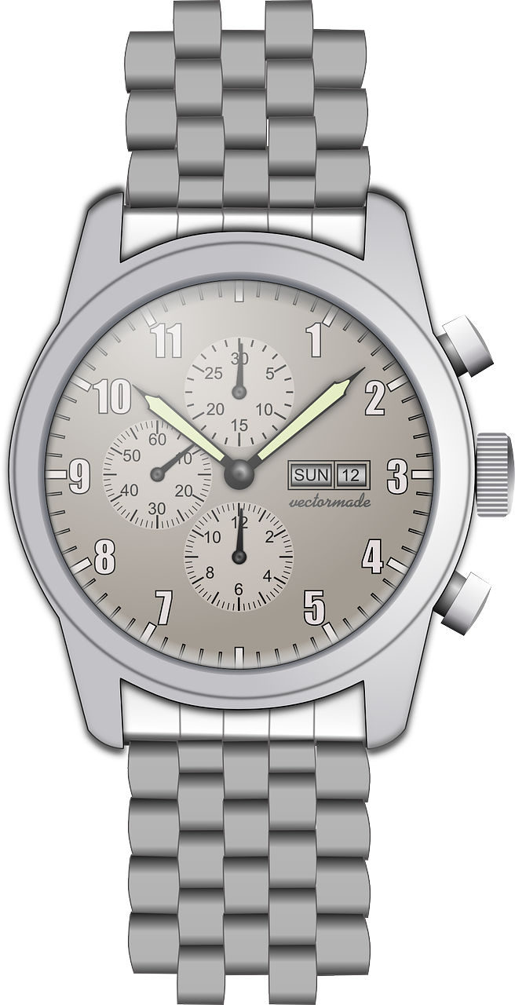
lesen
Was ist das?
Lias has written labels for the sale, but they have got jumbled!
1
Die Jacke ist lang.
A
7
B
2
C
1
2
Die Uhr ist nicht alt.
3
Der Ball ist rund.
4
Das Blatt ist nicht alt.
E
3
D
5
F
4
5
Die Uhr ist nicht neu.
6
Der Ball ist nicht rund.
G
6
7
Das Blatt ist alt.
Notes:
Timing: 8 minutes
Aim: to practise written comprehension of nicht, the four new adjectives for this lesson, and a range of previously taught vocabulary.
Procedure:
Explain the task. Lias has written labels for the sale, but he has jumbled them. Pupils need to match the labels with the items.
Pupils write A-G in their books and note down which number sentence refers to which item.
Click to reveal answers.
10

Slide 11
Nicht (not) [2/2]
Use nicht before ‘der, die, das’ and a noun to mean not the:
Das ist das Ding.
Das ist nicht das Ding.
That is the thing.
That is not the thing.
This works in the same way with questions:
Ist das das Ding?
Nein, das ist nicht das Ding.
Is that the thing?
No, that is not the thing.
Notes:
Timing: 2 minutes
Aim: to introduce the use of nicht for negation with definite articles.
Procedure:
Click through the animations to present the new information.
Elicit English translation for the German examples provided.
11

Slide 12
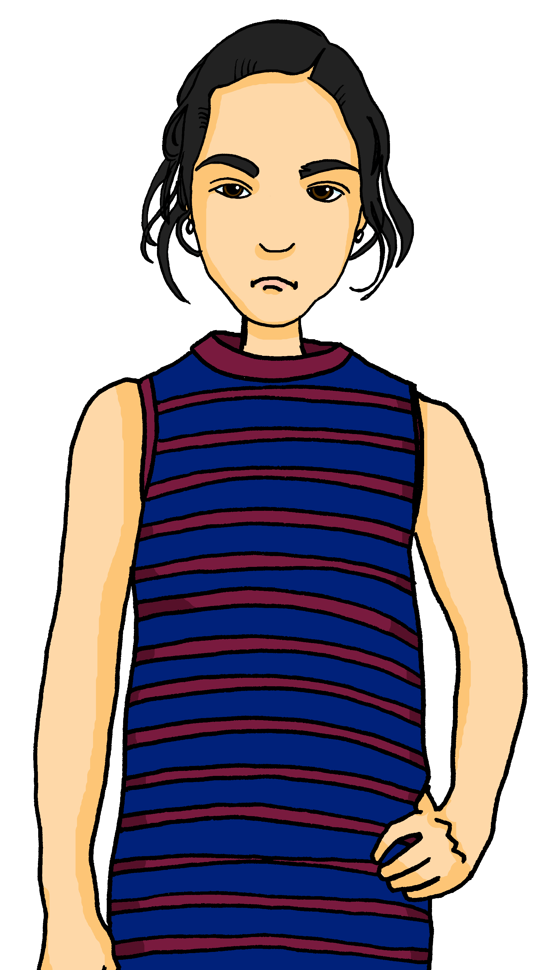
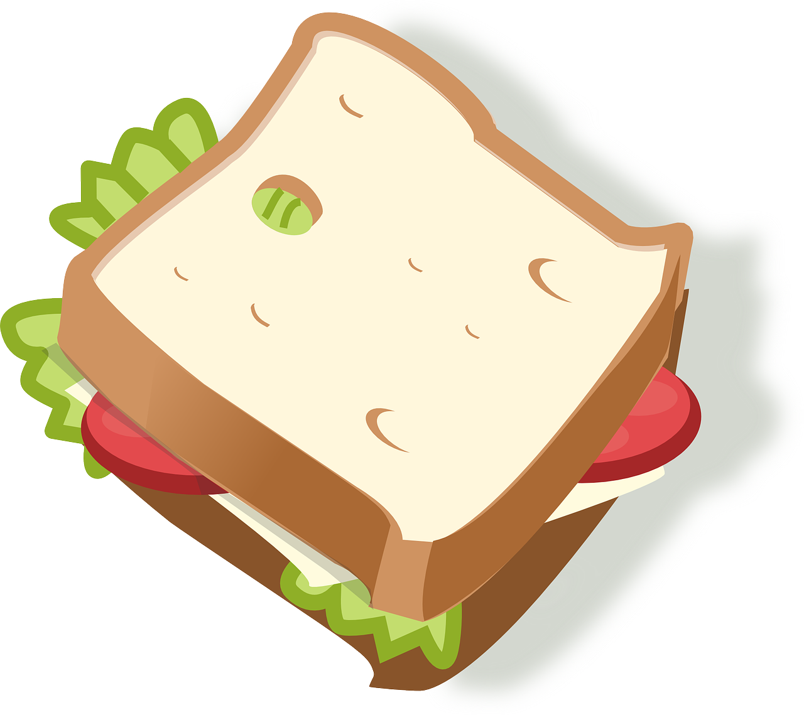
hören
Ist es A oder B?
People have taken things home from the sale. But not everything is right! What have they ended up with?
 | A | B
1
zum Beispiel:
A | B
Ex
2
3
Das ist nicht die Uhr!
4
5
6
Notes:
Timing: 5 minutes
Aim: to practise aural comprehension of nicht and previously taught nouns in short sentences.
Procedure:
Click to bring up the example. Pupils will hear a ‘nicht’ negative sentence or an affirmative sentence and decide whether it refers to A or B.
Continue for items 1-6. Click to bring up answer ticks.
Transcript:
Ex. Das ist nicht die Uhr!
1. Das ist nicht der Preis.
2. Das ist die Farbe grün.
3. Das ist nicht die Jacke.
4. Das ist der Ball.
5. Das ist nicht das Butterbrot.
6. Das ist nicht das Blatt.
12

Slide 13
Hör zu. Dann sing mit!
Tschüss, Tschüss, Tschüss, Tschüss,
Tschüss, Tschüss, Auf Wiedersehen!
Bis bald, bis bald, bis bald, bis bald.
Tschüss, Tschüss, Tschüss, Tschüss, Auf Wiedersehen!
Bis bald! – See you soon!
Notes:
Timing: 3 minutes
Aim: to practise the language for bye and goodbye in a simple song (to the tune of ‘Hi ho Hi ho it’s off to work we go’).
Procedure: 1. Click on the mp3 player to play the audio of the song.
2. Repeat the words of each line to practise saying them clearly (borrow the rhythm of the song so that this is a rehearsal stage before singing).
3. Click to play the audio again and this time, pupils join in.
Note: Teachers might like to re-use this song as part of their lesson finishing routine in future lessons. Soon pupils will not need to see the words to recall it.

Slide 14
Tschüss!
gelb
Notes:
14

