Slide 1
Talking about activities and events
Wie alt bist du ?
Ich bin fünf Jahre alt.
rot
Follow ups 1-5
Term 3 Week 8
Notes:
Artwork by Steve Clarke. Pronoun pictures from NCELP (www.ncelp.org). All additional pictures selected from Pixabay and are available under a Creative Commons license, no
attribution required.
Phonics: [th] Theater [1086] Bibliothek [2366] Mathematik [1636]
Vocabulary: heißen [126] wohnen [560] Jahr [53] alt [138] jung [199]
Revisit 1: können, ich kann, du kannst [23] etwas [100] Instrument [1572]
Revisit 2: revisit language from Term 2
kein, keine, kein [46] Handy [1693] Hund [825] Wasser [245] Wort [194]
Frau [99] Herr [154] Lehrer, Lehrerin [695] Mann [121] sehr [81]
Wer? [149] haben, ich habe, er, sie, es hat [6] Blume [2463] Geschenk [2595] Spiel [328] Kuchen [4381]
du hast [7]
Film [505] Lieblings- [n/a] Lied [1733] Musik [509]
denken [128] lernen [288] singen [1063] spielen [205] verstehen [211] viel [56] oft [223] ich weiß (es) nicht [n/a] wie sagt man…? [n/a]
gewinnen [372] hören [146] machen [58] zu Hause [n/a]
Nummer [806] null [1680] eins [774] zwei [70] drei [106] vier [200] fünf [274] sechs [428] sieben [611] acht [645] neun [1053] zehn [333] elf [1507] zwölf [1080] es gibt [n/a]
Jones, R.L & Tschirner, E. (2019). A frequency dictionary of German: Core vocabulary for learners. London: Routledge.
The frequency rankings for words that occur in this PowerPoint which have been previously introduced in these resources are given in the SOW and in the resources that first
introduced and formally re-visited those words.
For any other words that occur incidentally in this PowerPoint, frequency rankings will be provided in the notes field wherever possible.
Note that the first three lessons of the year teach language that can be continuously recycled as lesson routine every lesson in Y3/4.
The idea would be that the class teacher (whether or not s/he teaches the class German can re-use the language as part of the daily routine with the class.

Slide 2
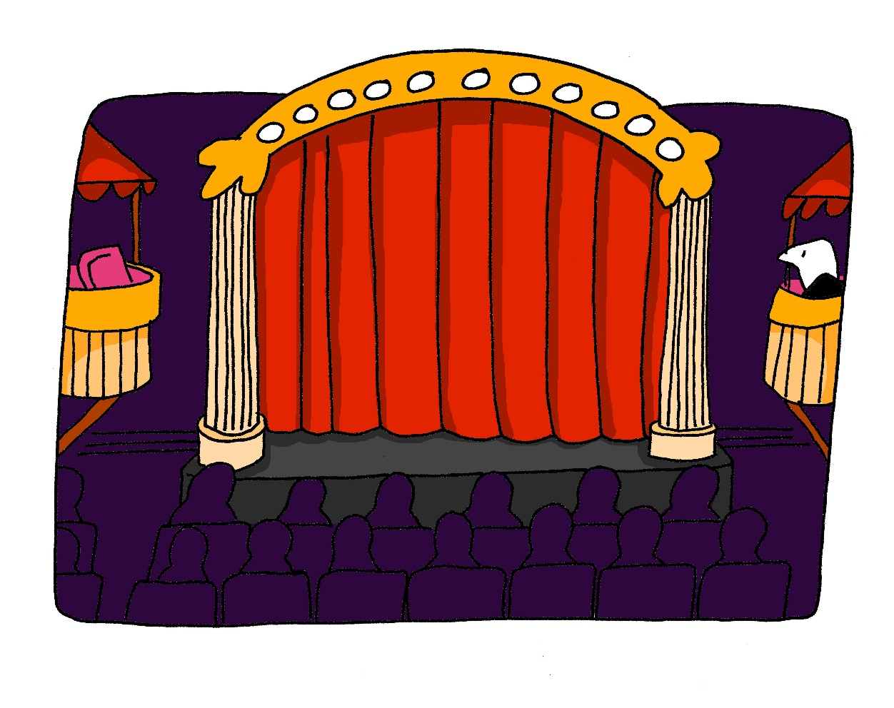
aussprechen
[th]
…
Theater
Notes:
Timing: 1 minute
Aim: to present the SSC [th].
Procedure:
1. Present the letter and say the [th] sound first, on its own. Pupils repeat it with you. 2. Bring up the word ”Theater” on its own, say it, pupils repeat it, so that they have the opportunity to focus all of their attention on the connection between the written word and its sound.
3. Click to bring up the picture and introduce the gesture, if using. Pupils repeat the word again.
4. Roll back the animations and work through 1-3 again, but this time, dropping your voice completely to listen carefully to the students saying the [th] sound, pronouncing ”Theater” and, if using, doing the gesture.
Note: A possible gesture for this would be to mime the opening of a theatre’s curtains, by drawing your hands away from each other quickly, in front of your body. This is very much like the gesture for ‘play’ in charades.
Frequency: Theater [1086]
Jones, R.L & Tschirner, E. (2019). A frequency dictionary of German: Core vocabulary for learners. London: Routledge.
2

Slide 3
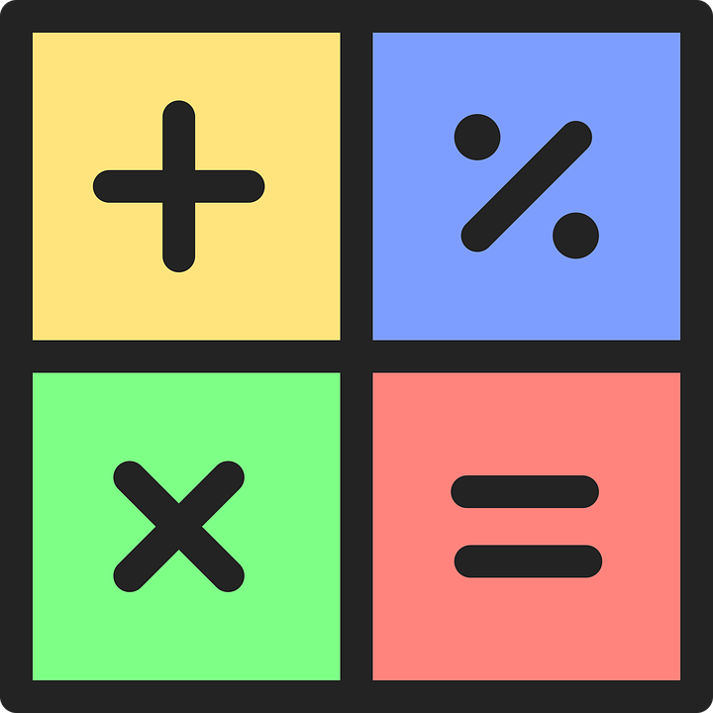
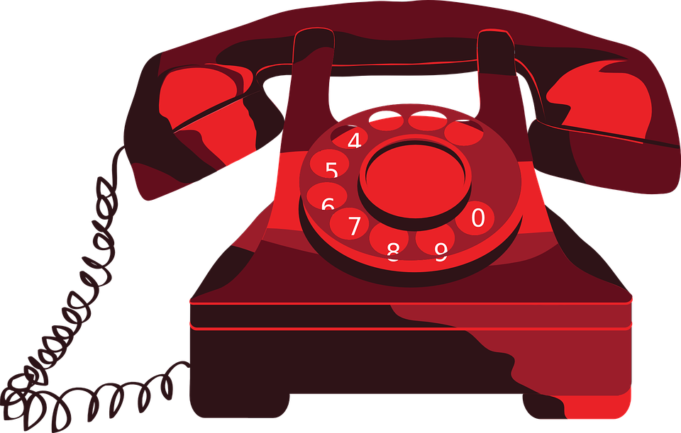
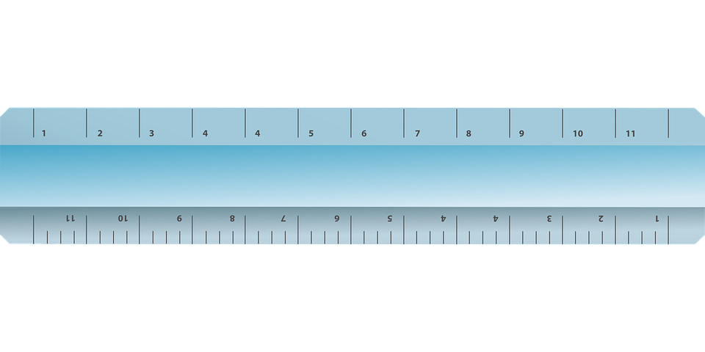
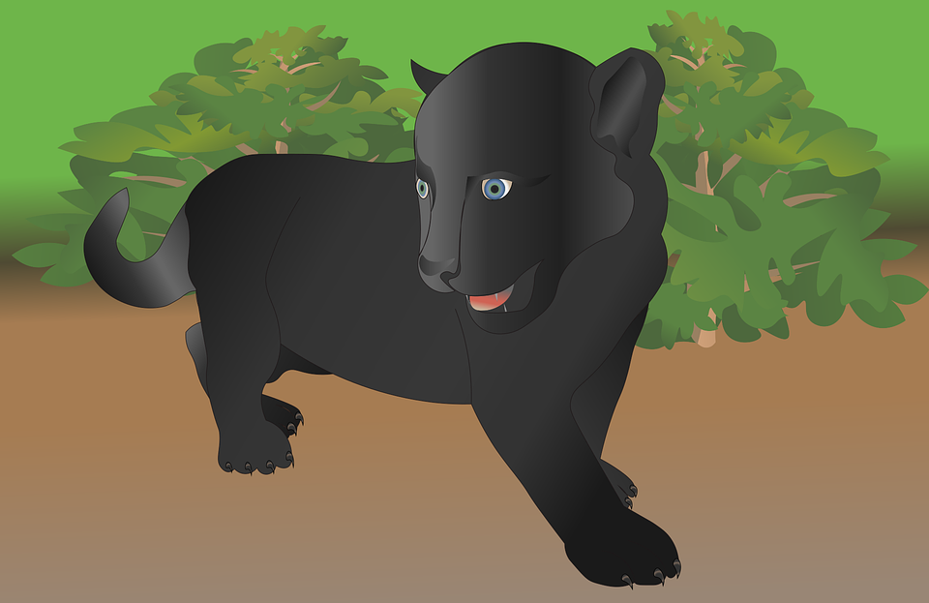
Follow up 1
Hör zu. Ist das ‘th’ oder ‘t’?
hören
 | t | th |  |  | t | th
 | Hotel |  |  |  | katholisch
 |  | Mathe |  |  | Interview
 | Telefon |  |  |  |  | Therapie
 | Meter |  |  |  |  | Panther
1
5
2
6
3
7
4
8
Notes:
Timing: 5 minutes
Aim: to practise applying knowledge of [th] and to cognates and contrasting it with [t].
Note: This exercise only contains cognates, emphasising a cross-linguistic difference between English and German
Procedure: 1. Remind pupils that although ‘th’ and ‘t’ are pronounced differently in English, they sound the same in German – even when the word is borrowed from English (or another language). Pupils will therefore have to draw on English to match what they hear with a known word, relying on knowledge of English spelling to work out the answer.
2. Click on the audio buttons to hear a native speaker say each word. Drawing on their knowledge of English, pupils write down the word either with [th] or [t]. The pictures are there to help them arrive at the English word more easily. Hint for pupils: if they don’t recognise the word they hear, try replacing the ‘t’ sound with an English ‘th’.
3. Click to reveal the answers. Before revealing the answers, play the audio again and ask pupils which English word it sounds like.
1. Hotel 2. Mathe 3. Telefon 4. Meter 5. katholisch 6. Interview 7. Therapie 8. Panther
Word frequency rankings: Telefon [1595]; Therapie [2484]; katholisch [2932]; Meter [479]; Interview [931]; Mathe [1636]; Hotel [772]; Panther [>5000]

Slide 4
Follow up 2
Noughts and Crosses
Wie alt bist du?
Ich bin ein Jahr alt.
Ich bin sechs Jahre alt.
sprechen
Ich bin zwölf Jahre alt.
Notes:
Timing: 5 minutes
Aim: to practise using ‘ich bin xxx Jahre alt’ in a spoken context.
Procedure:
Explain the task by using the model
Pupils draw a 3x3 grid, and randomly write numbers 1-12 in the grid.
They work in pairs. One person takes circles, the other crosses.
Pupils take it in turns to claim a square by saying ‘ich bin xxx Jahre alt’. If their partner also has that number, they must mark it off on their grid using their partner’s symbol.
The aim is to get three in a row. As pupils will not know what is on their partner’s grid, they may inadvertently block their partner!

Slide 5
Follow up 3:

Schreib auf Englisch.
Can you get at least 15 points?
Wörter
 | was? | das Handy | die Frau
 | verstehen | gewinnen | singen
 | ich kann | das Instrument | können
 | du kannst | wo? | etwas
 | das Jahr | heißen | alt
 | wohnen | jung | wie?
what?
(the) mobile phone
(the) woman
Vokabeln
Vokabeln
x3
to understand
to win, winning
to sing, singing
I can
(the) instrument
to be able to, can
x2
you can
where?
something
(the) year
to be called
old
x1
to live, living
young
how?
Notes:
Timing: 5 minutes
Aim: to practise written comprehension of vocabulary from this and revisited weeks.
Procedure: 1. Give pupils a blank grid. They fill in the English meanings of any of the words they know, trying to reach 15 points in total. 2. Remind pupils that adjectives can refer to male or female persons and they should note this in their translations. E.g. pleased (f), short (m).
Note: The most recently learnt and practised words are pink, words from the previous week are green and those from week 1 are blue, thus more points are awarded for them, to recognise that memories fade and more effort (heavy lifting!) is needed to retrieve them.

Slide 6
Follow up 3:

Schreib auf Deutsch.
Can you get at least 15 points?
Wörter
 | to win, winning | to sing, singing | to understand
 | (the) woman | (the) mobile phone | what?
 | (the) instrument | to be able to, can | where?
 | something | you can | I can
 | to live, living | how? | to be called
 | young | (the) year | old
gewinnen
singen
verstehen
Vokabeln
x3
die Frau
das Handy
was?
das Instrument
können
wo?
x2
etwas
du kannst
ich kann
wohnen
wie?
heißen
x1
jung
das Jahr
alt
Notes:
Timing: 5 minutes
Aim: to practise written production of vocabulary from this and revisited weeks.
Procedure: 1. Give pupils a blank grid. They fill in the German meanings of any of the words they know, trying to reach 15 points in total. 2. Remind pupils that adjectives can refer to male or female persons and they should note this in their translations. E.g. pleased (f), short (m).
Note: The most recently learnt and practised words are pink, words from the previous week are green and those from week 1 are blue, thus more points are awarded for them, to recognise that memories fade and more effort (heavy lifting!) is needed to retrieve them.

Slide 7
Follow up 4
Hör zu. Ist die Antwort A, B oder C richtig?
A
B
C
1
Ich bin eine Frau. | Er heißt Lukas. | Ich heiße Moritz.
hören
2
Ich wohne in Dortmund. | Er wohnt zu Hause. | Sie wohnt hier nicht.
3
Du bist acht Jahre alt. | Bin ich jung? | Ich bin sieben Jahre alt.
4
Ich kann etwas gewinnen. | Ich habe ein Handy. | Er hat ein Lieblingslied.
5
Ich habe ein Geschenk. | Ich kann ein Instrument spielen. | Sie kann oft lernen.
6
Ich singe ein Lied. | Ich kann ein Spiel spielen. | Er versteht viel.
Notes:
Timing: 5 minutes
Aim: to practise aural comprehension of questions and written comprehension of answers containing a variety of verbs in the present tense and this week’s new and revisited vocabulary.
Procedure:
Click on the first audio button to hear a question. Pupils listen carefully and decide whether option A, B or C contains the correct answer.
Repeat for questions 2-6.
Click to reveal the answers.
Transcript: 1. Wie heißt du?
2. Wo wohnst du?
3. Wie alt bist du?
4. Was hast du?
5. Was kannst du machen?
6. Was machst du?

Slide 8
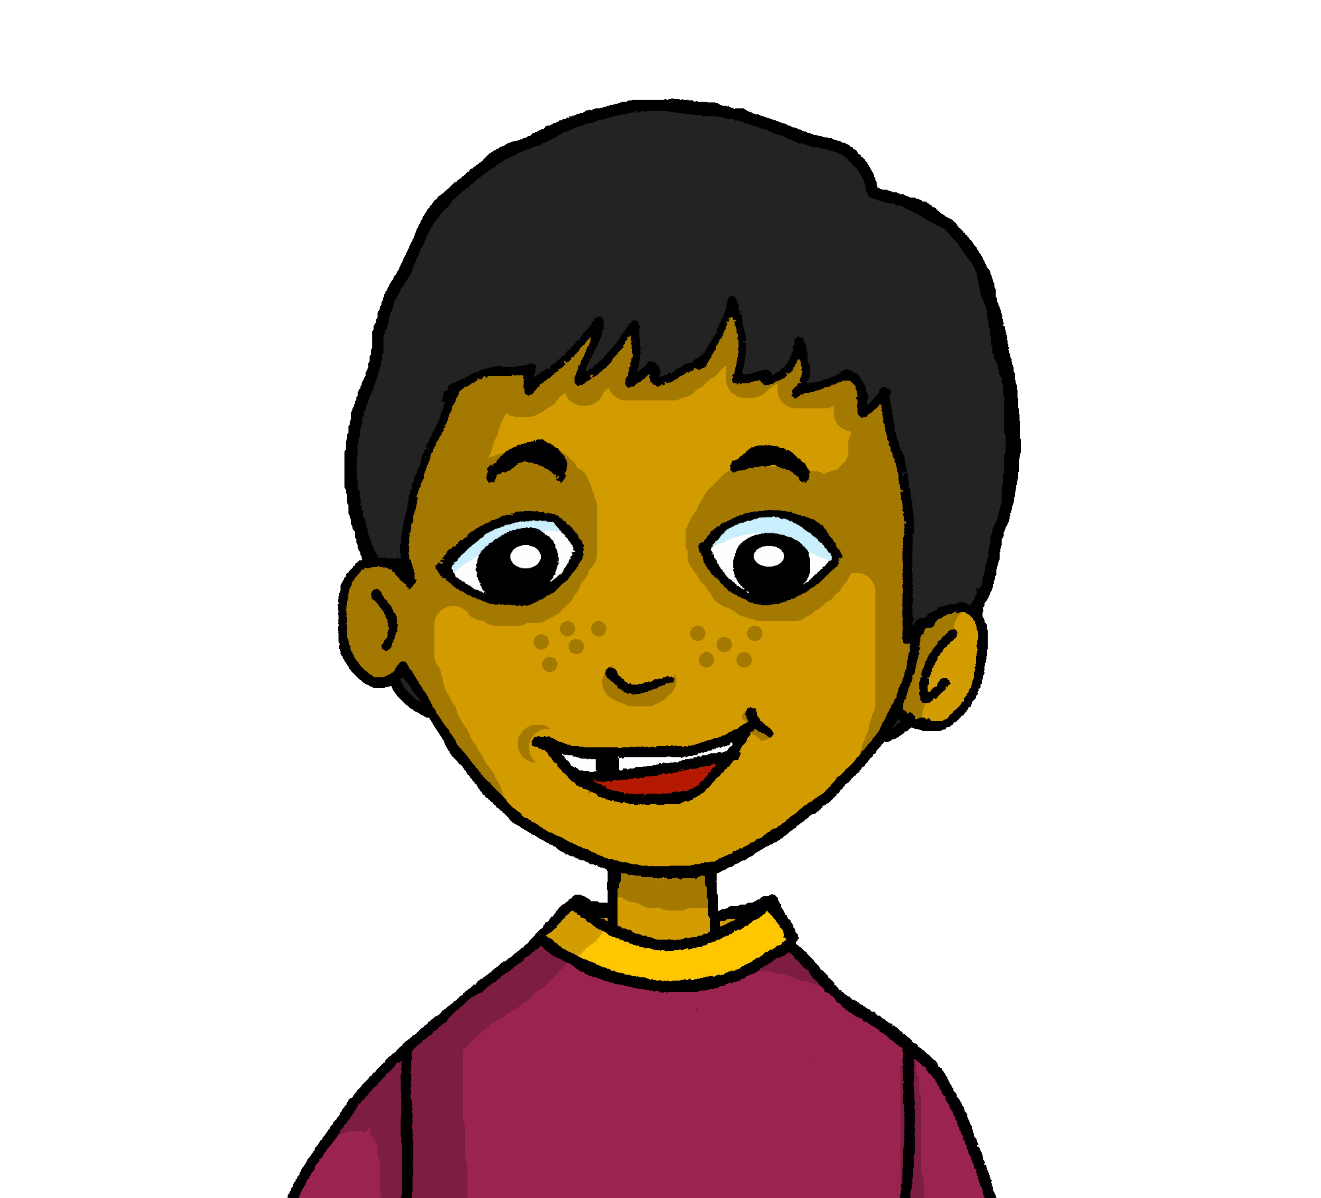
Follow up 5a
Wie heißt du?
* Partner work
Partnerbarbeit*!
Ask your partner the questions below and briefly note down their answers.
sprechen
 | Hamza
1. Wie heißt du?
Wie heißt du?
2. Wo wohnst du?
3. Wie alt bist du?
Ich heiße Hamza.
4. Was hast du?
5. Was kannst du machen?
Some ideas for you:
ein Instrument
etwas
ein Handy
einen Hund
eine Blume
ein Geschenk
ein Spiel
einen Kuchen
einen Film
ein Lied
Some verbs for you:
denken
lernen
singen
spielen
Remember! the 2nd verb in German goes to the end.
gewinnen
hören
machen
verstehen
Notes:
Timing: 5 minutes
Aim: to provide pupils practice (speaking) in asking and answering questions about themselves using a variety of verbs in the first and second persons.
Procedure:
Demonstrate the conversations pupils will have using Moritz’s and Hamza’s speech bubbles.
Give pupils time in pairs to both ask and answer all questions, noting down their partner’s answers as they go.
If time allows, hear some of the conversations as a class.
Note: Pupils may use any nouns or verbs they know to answer questions four and five. The words we have suggested come from term 2 vocabulary, which is being revisited this week.
Additional task suggestions:
1. See next slide for follow up writing task. 2. Alternatively, pupils could report back to the teacher/rest of class using the 3rd person e.g. Sie heißt Lucy.

Slide 9
Follow up 5b
Schreib Sätze!
schreiben
Write full sentences based on your partner’s answers.
1. Wie heißt du? | Hamza
Er heißt Hamza.
2. Wo wohnst du? | Dortmund
Er wohnt in Dortmund.
Notes:
Timing: 3 minutes
Aim: to provide written practice of present tense verbs in the third person.
Procedure:
Remind pupils of the conversation between Moritz and Hamza and click to bring up the first row of the table showing Hamza’s answers.
Click again to reveal an example sentence. Draw attention to the use of the third person.
Repeat steps 1&2 with another example.
Ask pupils to write a few sentences based on their partner’s answers from the previous speaking exercise.
Hear a few sentences written by pupils and use these as an opportunity to identify errors and correct as a class.

Slide 10
Tschüss!
rot
Notes:
10

Slide 11
Follow up 3:

Schreib auf Englisch.
Can you get at least 15 points?
Wörter
 | was? | das Handy | die Frau
 | verstehen | gewinnen | singen
 | ich kann | das Instrument | können
 | du kannst | wo? | etwas
 | das Jahr | heißen | alt
 | wohnen | jung | wie?
Vokabeln
Vokabeln
x3
x2
x1
Notes:
HANDOUT

Slide 12
Follow up 3:

Schreib auf Deutsch.
Can you get at least 15 points?
Wörter
 | to win, winning | to sing, singing | to understand
 | (the) woman | (the) mobile phone | what?
 | (the) instrument | to be able to, can | where?
 | something | you can | I can
 | to live, living | how? | to be called
 | young | (the) year | old
Vokabeln
x3
x2
x1
Notes:
HANDOUT

