Slide 1
Describing me and others
Online-Austausch
blau
Follow ups 1-5
Term 1 Week 2
Notes:
Artwork by Steve Clarke. All additional pictures selected from Pixabay and are available under a Creative Commons license, no attribution required.
Vocabulary: sie sind [4] Aktivität [1422] Aufgabe [256] Beispiel [94] Frau [99] Freund, Freundin [273] Geburtstag [1779] Geschichte [262] Herr [154] Klasse [961] Lied [1733] Mensch [90] Party [2809] Person [357] Problem [210] Satz [432] Song [3373] Spiel [328] Spieler, Spielerin [822] Sport [945] Text [473] Zimmer [665] welcher, welche, welches [122] die2 [1]
Revisit 1: -
Revisit 2: können, ich kann, du kannst [23] Instrument [1572]
Jones, R.L & Tschirner, E. (2019). A frequency dictionary of German: Core vocabulary for learners. London: Routledge.
The frequency rankings for words that occur in this PowerPoint which have been previously introduced in these resources are given in the SOW and in the resources that first
introduced and formally re-visited those words.
For any other words that occur incidentally in this PowerPoint, frequency rankings will be provided in the notes field wherever possible.
Note that the first three lessons of the year teach language that can be continuously recycled as lesson routine every lesson in Y5/6.
The idea would be that the class teacher (whether or not s/he teaches the class German can re-use the language as part of the daily routine with the class.

Slide 2
aussprechen
long[u]
…
gut
du
super
[good]
[you]
Ruth
Lukas
Notes:
Timing: 2 minutes
Aim: to consolidate the SSC long [u].
Procedure:
Re-present the SSC and the source word ‘du’ (with gesture, if using).
Click to bring on the picture and get pupils to repeat the word ‘du’ (with gesture, if using).
Present the cluster words in the same way, bringing on the picture and getting pupils to pronounce the words.
Note:
a gesture for ‘du’ might be to point at someone else.
2

Slide 3
aussprechen
short [u]
…
Nummer
Punkt
dunkel
[number]
[dot, full stop]
[dark]
Notes:
Timing: 2 minutes
Aim: to consolidate the SSC short [u].
Procedure:
Re-present the SSC and the source word ‘Punkt’ (with gesture, if using).
Click to bring on the picture and get pupils to repeat the word ‘Punkt’ (with gesture, if using).
Present the cluster words in the same way, bringing on the picture and getting pupils to pronounce the words.

Slide 4
Follow up 1
Long [u] or short [u]? Which word is the odd one out?
Hör zu.
hören
 | A | B | C
 | Hund | Computer | Instrument
 | Punkt | Buch | Musik
 | gut | super | wunderbar
 | jung | du | Bruder
 | Mutter | Uhr | rund
 | Gruppe | Kunst | Minute
Buch is an exception: it has a long [u] which comes before two consonants!
1
2
3
4
5
6
Notes:
Timing: 8 minutes
Aim: to practise long and short [u] in the listening modality.
Procedure:
Click to play the first recording. Pupils decide which of the three words they hear is the odd one out based on a long or short [u].
Differentiation: pupils write all the words down for a higher challenge and then select the odd one out, or just 1.B etc.
Click to reveal answer tick.
Click to reveal written version of the words.
Continue for items 2-6.
Transcript:
Hund | Computer | Instrument
Punkt | Buch | Musik
Gut | super | wunderbar
jung| du | Bruder
Mutter | Uhr | rund
Gruppe | Kunst | Minute
Vocabulary: Gruppe [369] Uhr [348]
Jones, R.L & Tschirner, E. (2019). A frequency dictionary of German: Core vocabulary for learners. London: Routledge.

Slide 5
Follow up 2
Word snake!
Put capitals on the nouns, then sort into singular and plural.
Wörter
Now read the words aloud with a partner!
Vokabeln
60
S
Singular
Plural
Mensch
Probleme
Mensch
Sport
Person
Geschichten
Probleme
Texte
Satz
Spiele
Person
Freund
Sport
Texte
Satz
Aufgabe
0
Freund
Lieder
Geschichten
Lieder
Aufgabe
Klassen
Spiele
Klasse
START
Notes:
Timing: 5 minutes
Aim: to consolidate this week’s new nouns.
Procedure: 1. Pupils put capitals on the nouns.
2. Click to bring up the individual words. 3. Pupils sort nouns into plural and singular 4. Pupils work with a partner to say the nouns out loud.

Slide 6
Follow up 3
Hör zu. Ist das welcher, welche oder welches? Welches Wort ist das?
hören
 | Klasse | Zimmer
 | Satz | Beispiel
 | Frau | Herr
 | Spieler | Spielerin
 | Aktivität | Spiel
 | Freund | Freundin
1
2
3
4
5
6
Notes:
Timing: 8 minutes
Aim: to practise the different forms of welch- in the listening modality.
Procedure:
Click to play the first recording of a bleeped sentence. Pupils decide which of the two nouns is the correct one, based on the gender of welch-
Click to blank out incorrect choice and hear audio to listen and check the full sentence.
Continue for items 2-6.
Transcript:
Welches [Zimmer] ist das? Fünf!
Welcher [Satz] ist das? Die Flasche ist blau.
Welche [Frau] ist das? Schmidt. Welcher [Spieler] ist das? Alex.
Welches [Spiel] ist das? Uno. Welche [Freundin] ist das? Dani.

Slide 7
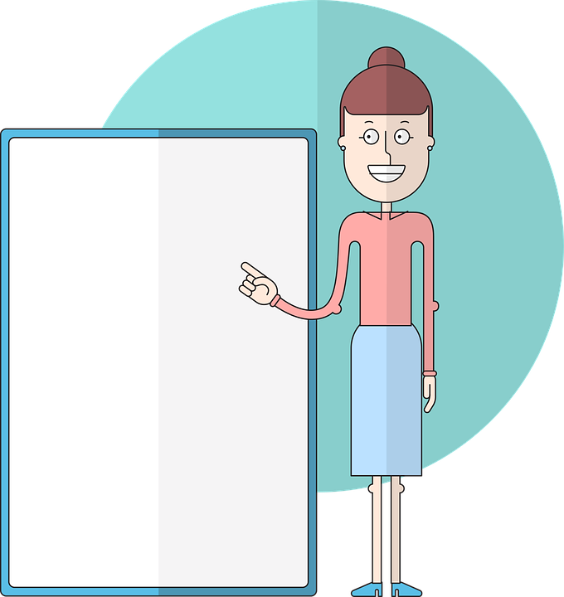
Follow up 4:
Schreib das Verb auf Deutsch.

Ist es ‘is’ oder ‘are’? Dann beschreib das Ding.
Zum Beispiel:
schreiben
Das sind die Geschichten. Sie sind wunderbar!
_____
_____
_____
_________!
sein
1
Das ist die Klasse. Sie ist groß!
____
____
____
____ !
2
Das ist das Beispiel. Es ist gut!
____
____
____
____ !
3
Das sind die Freundinnen. Sie sind toll!
____
____
____
____ !
4
Das sind die Lieder. Sie sind lang!
____
____
____
____ !
Das ist der Mensch. Er ist groß!
5
___
____
____
____ !
Notes:
More challenging version
Note: There are two versions of this slide, this is the more challenging version which has no suggestions for adjectives. The next slide is the same task, but includes a list of suggestions for adjectives which pupils can choose.
Timing: 8 minutes.
Aim: to practise the third person singular and plural of sein in the written modality.
Procedure:
Click through the instructions and the example.
For each pair of sentences: Ask pupils to say / write down the correct verb (is – ist or are – sind) for part 1 and then complete part 2 using the correct subject pronoun and verb. Pupils can choose their own adjectives for each sentence.
Click to reveal answers in turn. The adjective at the end can vary as pupils will have chosen their own.
Click on the number to hear audio to listen and check each completed pair of sentences.

Slide 8
Follow up 4:
Schreib das Verb auf Deutsch.

Ist es ‘is’ oder ‘are’? Dann beschreib das Ding.
Zum Beispiel:
schreiben
Das sind die Geschichten. Sie sind wunderbar!
_____
_____
_____
_________!
sein
1
Das ist die Klasse. Sie ist groß!
____
____
____
____ !
2
Das ist das Beispiel. Es ist gut!
____
____
____
____ !
3
Das sind die Freundinnen. Sie sind toll!
____
____
____
____ !
4
Das sind die Lieder. Sie sind lang!
lang – kurz – wunderbar – toll – klein – groß – gut – richtig – falsch – klar – freundlich - nett
____
____
____
____ !
5
Das ist der Mensch. Er ist klein!
____
____
____
____ !
Notes:
Less challenging version
Note: There are two versions of this slide, this is the less challenging version which has suggestions for adjectives which pupils can choose from.
Timing: 8 minutes.
Aim: to practise the third person singular and plural of sein in the written modality.
Procedure:
Click through the instructions and the example.
For each pair of sentences: Ask pupils to say / write down the correct verb (is – ist or are – sind) for part 1 and then complete part 2 using the correct subject pronoun and verb. Pupils can choose their own adjectives for each sentence.
Click to reveal answers in turn. The adjective at the end can vary as pupils will have chosen their own.
Click on the number to hear audio to listen and check each completed pair of sentences.

Slide 9
Follow up 5:
Ist das der, die oder das?
Text
Aktivität
Klasse
Party
Sport
Song
Problem
Freund
Person
der
das
die
Notes:
Timing: 3 minutes Aim: To revisit the knowledge that there are lots of words that look similar or exactly the same in German and English but it is important to know their gender and how to pronounce them.
Procedure:
1. Pupils sort the cognates into the three gender ‘pacpeople’: der, die , and das.
2. Pupils pronounce the words together with their articles.
3. Click to move each word to the correct ‘pacperson’ (der, die, das). Audio will play as word moves.
9

Slide 10
Extra:

Schreib auf Englisch.
Can you get at least 15 points?
Vokabeln
 | ich kann | können | die Aufgabe
 | du kannst | das Instrument | das Beispiel
 | der Herr | der Mensch | der Satz
 | das Lied | die Geschichte | der Geburtstag
 | welche | sie sind | die Party
 | er | die Aktivität | welcher
 | die | welches | sie
I can
to be able to, can
(the) task
x3
you can
(the) instrument
(the) example
Mr.
(the) human being
(the) sentence
x2
(the) song
(the) story
(the) birthday
which (f)
they are
(the) party
he/it
(the) activity
which (m)
x1
the (f), the (pl)
which (nt)
she/it
Notes:
Timing: 5 minutes
Aim: to practise written production of vocabulary from this and revisited weeks.
Procedure: 1. Give pupils a blank grid. They fill in the English meanings of any of the words they know, trying to reach 15 points in total. Click on each German word to hear audio.
2. Click to reveal the answers (which will appear one by one from the bottom row upwards).
Note: The most recently learnt and practised words are pink, words from the previous week are green and those from week 1 are blue, thus more points are awarded for them, to recognise that memories fade and more effort (heavy lifting!) is needed to retrieve them.

Slide 11
Extra:

Schreib auf Deutsch.
Can you get at least 15 points?
Vokabeln
 | (the) instrument | (the) task | (the) example
 | to be able to, can | I can | you can
 | (the) story | (the) sentence | (the) song
 | (the) human being | (the) birthday | Mr.
 | which (nt) | he/it | she/it
 | the (f), the (pl) | which (m) | which (f)
 | they are | (the) activity | (the) party
das Instrument
die Aufgabe
das Beispiel
x3
können
ich kann
du kannst
die Geschichte
der Satz
das Lied
x2
der Mensch
der Geburtstag
der Herr
welches
er
sie
die
welcher
welche
x1
sie sind
die Aktivität
die Party
Notes:
Timing: 5 minutes
Aim: to practise written production of vocabulary from this and revisited weeks.
Procedure: 1. Give pupils a blank grid. They fill in the German meanings of any of the words they know, trying to reach 15 points in total.
2. Click to reveal the answers (which will appear one by one from the bottom row upwards). Click on each German word to hear audio.
Note: The most recently learnt and practised words are pink, words from the previous week are green and those from week 1 are blue, thus more points are awarded for them, to recognise that memories fade and more effort (heavy lifting!) is needed to retrieve them.

Slide 12
Tschüss!
blau
Notes:
12

Slide 13
Extra:

Schreib auf Englisch.
Can you get at least 15 points?
Vokabeln
 | Ich kann | können | die Aufgabe
 | du kannst | das Instrument | das Beispiel
 | der Herr | der Mensch | der Satz
 | das Lied | die Geschichte | der Geburtstag
 | welcher | sie sind | die Party
 | er | die Aktivität | welcher
 | die | welches | sie
Notes:
Template for photocopying

Slide 14
Extra:

Schreib auf Deutsch.
Can you get at least 15 points?
Vokabeln
 | (the) instrument | (the) task | (the) example
 | to be able to, can | I can | you can
 | (the) story | (the) sentence | (the) song
 | (the) human being | (the) birthday | Mr.
 | which (nt) | he/it | she/it
 | the (f), the (pl) | which (m) | which (f)
 | they are | (the) activity | (the) party
x3
x2
x1
Notes:
Template for photocopying

