Slide 1
Interacting
Online-Austausch
blau
Follow ups 1-5
Term 1 Week 3
Notes:
Artwork by Steve Clarke. Pronoun pictures from NCELP (www.ncelp.org). All additional pictures selected from Pixabay and are available under a Creative Commons license, no attribution required.
Phonics:
long [o] wo? [94] wohnen [380] Million [206]
short [o] Kopf [279] offen [382] kommen [61]
Vocabulary (new words in bold): mögen, ich mag, du magst, er/sie/es mag [168] Bilder [253] Bücher [300] Glas [885] Gläser [885] Lieder
[1733] Morgen [621] Sommer [771] Winter [1206] Wörter [194]
Revisit 1:
Revisit 2: er/sie/es kann [23]
Jones, R.L & Tschirner, E. (2019). A frequency dictionary of German: Core vocabulary for learners. London: Routledge.
The frequency rankings for words that occur in this PowerPoint which have been previously introduced in these resources are given in the SOW and in the resources that first
introduced and formally re-visited those words.
For any other words that occur incidentally in this PowerPoint, frequency rankings will be provided in the notes field wherever possible.

Slide 2
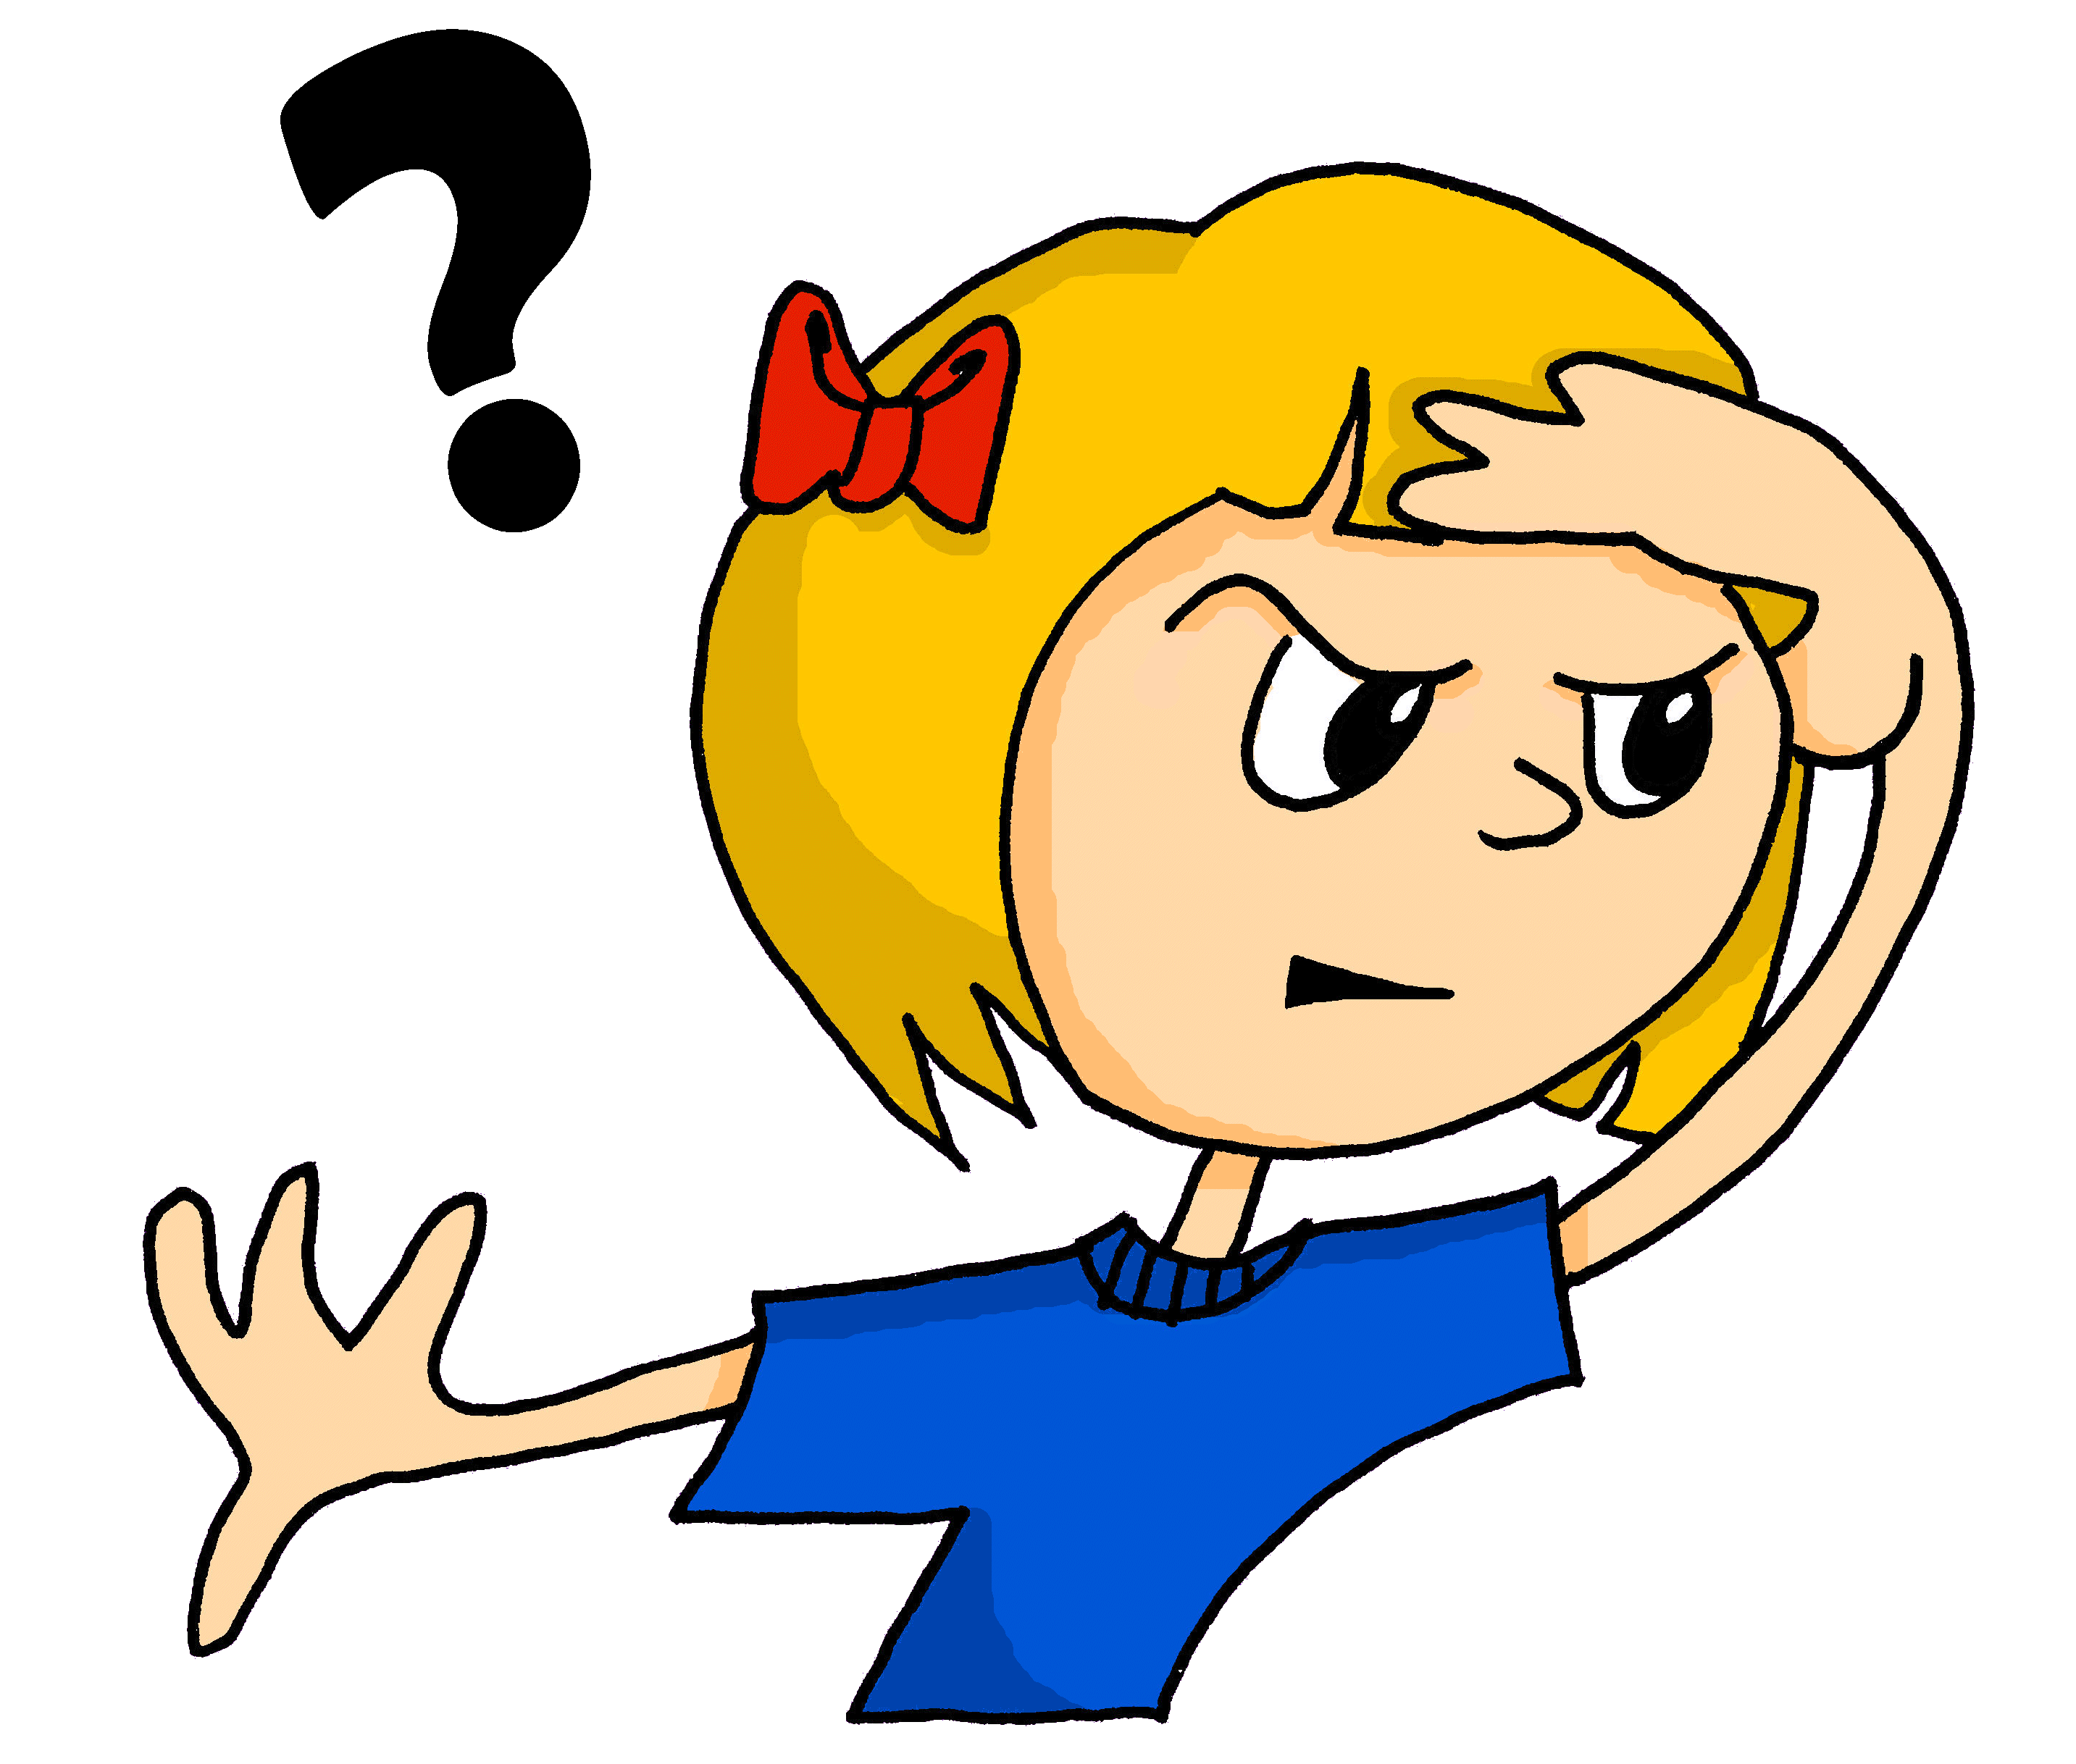
aussprechen
long [o]
…
wohnen
wo
Million
[to live]
Notes:
Timing: 1 minute
Aim: to consolidate the SSC long [o].
Procedure:
Re-present the SSC and the source word ‘wo’ (with gesture, if using).
Click to bring on the picture and get pupils to repeat the word ‘wo’ (with gesture, if using).
Present the cluster words in the same way, bringing on the picture and getting pupils to pronounce the words.
Word frequency (1 is the most frequent word in German): Million [206] ohne [119] wo? [94] wohnen [380]
Jones, R.L & Tschirner, E. (2019). A frequency dictionary of German: Core vocabulary for learners. London: Routledge.

Slide 3
aussprechen
short [o]
…
kommen
Kopf
offen
[to come]
Notes:
Timing: 1 minute
Aim: to consolidate the SSC short [o].
Procedure:
Re-present the SSC and the source word ‘Kopf’ (with gesture, if using).
Click to bring on the picture and get pupils to repeat the word ‘Kopf’ (with gesture, if using).
Present the cluster words in the same way, bringing on the picture and getting pupils to pronounce the words.
Word frequency (1 is the most frequent word in German): kommen [61] Kopf [279] offen [382]
Jones, R.L & Tschirner, E. (2019). A frequency dictionary of German: Core vocabulary for learners. London: Routledge.
3

Slide 4
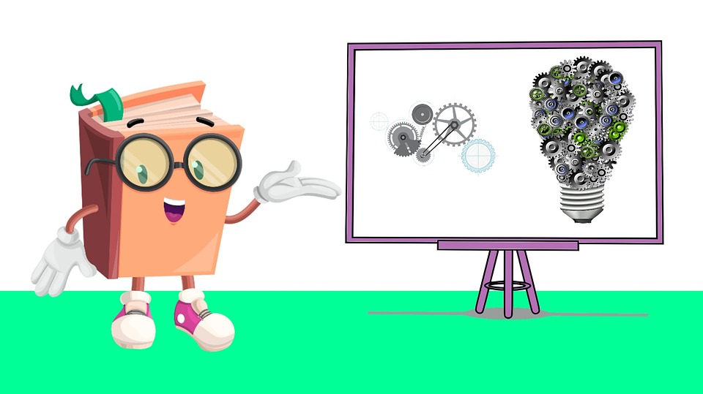
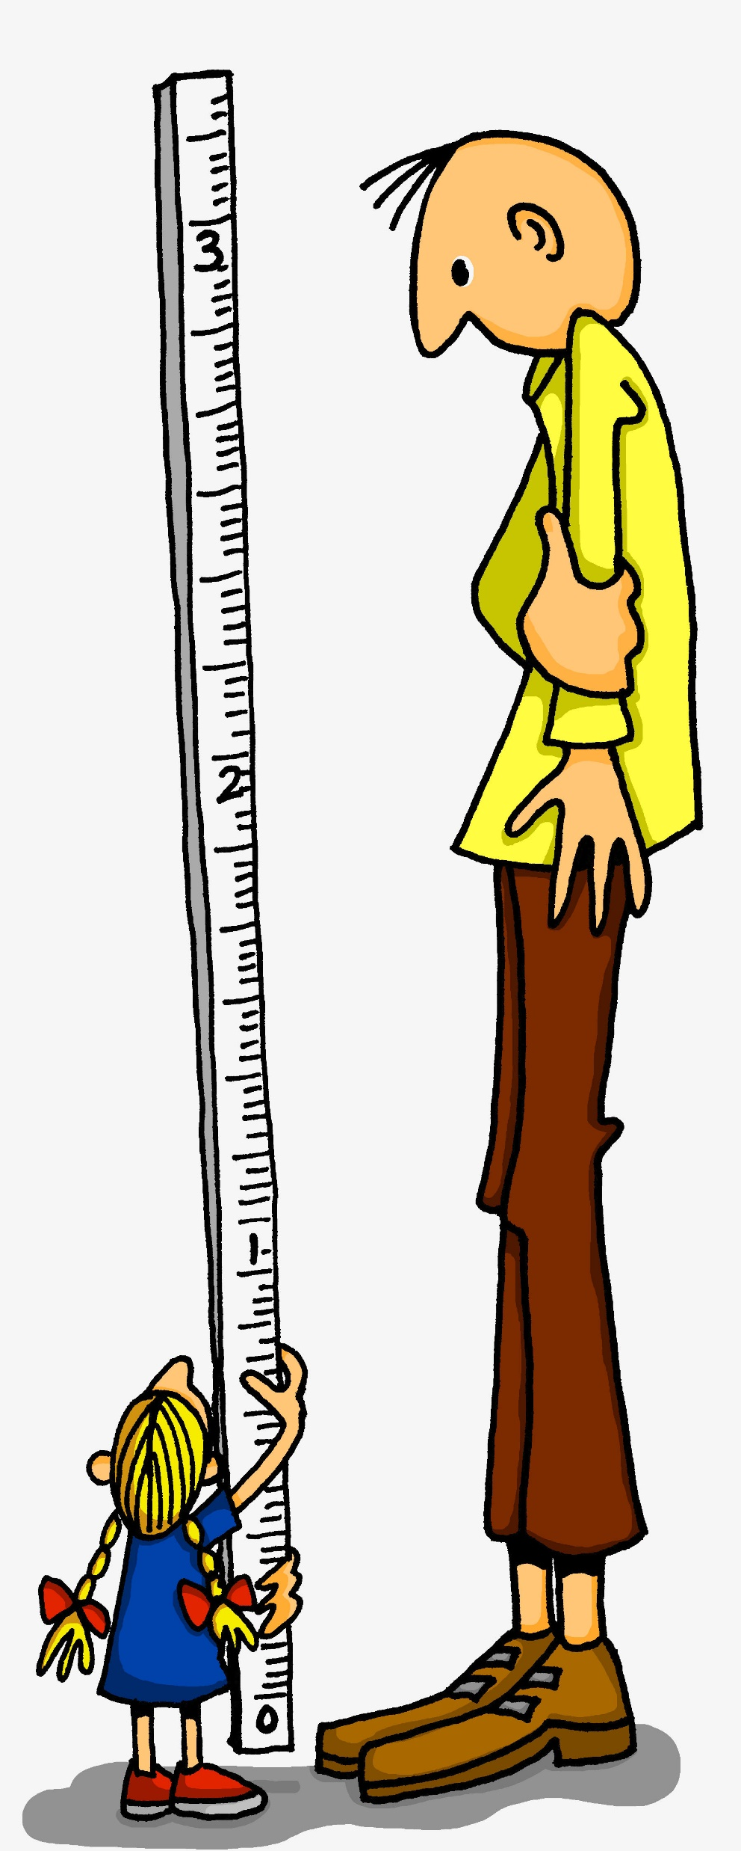
Follow up 1
long and short [o]
Hör zu. Langes oder kurzes [o]?
aussprechen
der Grand Prix
long [o] | short [o]
 | Oskar
Sophie
Mohammed
 | Lottie
Dorothea
Otto | Otto
Say these words one after the other as quickly as you can. Your partner will count and check.
1
2
Foto
oben
Protein
Definition
3
Wed
komplett
Mittwoch
groß
total
4
Sun
5
Konzept
Osten
Diskussion
Sonntag
6
Thu
Mon
At the end of words in German, ‘o’ will always be long!
Donnerstag
Hallo
Montag
Theorie
Notes:
Timing: 5 minutes
Aim: to practise aural recognition of this week’s SSC [o] and differentiate the long and short versions of the vowel.
Procedure:
Click to bring up the prompts.
Click on each audio symbol to listen to name.
Pupils decide if they hear a long or short vowel [o].
Click for the answers.
Click to bring up task B.
Pupils apply their phonics knowledge to read aloud these words, a mixture of known words and unknown cognates. The listening partner can send his/her partner back to the start if s/he hears the [o] pronounced wrongly.
Teacher circulates to listen and support, as needed.
Pupils swap roles.
Transcript Part A: [1] Oskar [2] Sophie
[3] Mohammed
[4] Lotte
[5] Dorothea
[6] Otto
Vocabulary: Definition [1057] Diskussion [1015] komplett [1215] Konzept [1186] Osten [1208] Protein [984] total {1021]
Jones, R.L & Tschirner, E. (2019). A frequency dictionary of German: Core vocabulary for learners. London: Routledge.

Slide 5
Follow up 2
Wie sagt man das ?
(the) glasses
(the) words
I like
(the) summer
she likes
(the) books
(the) pictures
(the) mornings
(the) glass
to like, liking
(the) songs
you like
sprechen
die Lieder
das Glas
d__ L_____
d__ G___
m____
mögen
du magst
d_ m____
d__ W_____
d__ B_____
die Wörter
die Bilder
die Bücher
die Morgen
den Sommer
d__ B_____
d__ M_____
d__ S_____
sie mag
ich mag
s__ m__
d__ G_____
i__ m__
die Gläser
Notes:
Timing: 5 minutes Aim: to practise spoken production of this week’s new vocabulary. Procedure: 1. Click to bring up the English translations one by one.
2. For each English word, students identify the corresponding German from the first-letter clues provided and say the full word aloud.
3. Click on the mouse to reveal the answer and check.

Slide 6
mögen + article ‘the’
You know how to say you like specific things:
Ich mag…
den Winter hier.
I like the winter here.
Ich mag…
die Winter hier.
I like the winters here.
To speak more generally we can leave out the article in English and German:
English and German use of ‘the’ is often the same so just leave out ‘the’ in German when you don’t use it in English.
Ich mag…
Winter.
I like winter.
Bilder.
I like pictures.
Morgen.
I like morning(s).
Partys.
I like parties.
Notes:
Timing: 3 minutes Aim: To introduce the omission of articles before (usually) plural nouns in German and English.
Procedure: 1. Click through the animations to present the new information.
2. Elicit the English meanings of all the German examples.
6

Slide 7
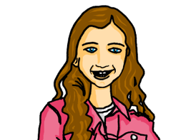
Follow up 3
Johanna und Aisha
Johanna introduces Aisha to her brother, Moritz.
lesen
Welches Wort ist das? Schreib die Wörter auf.
Das ist meine Freundin, Aisha. Sie mag Fußball und Bücher. Du magst Fußball und Filme, nicht wahr? Magst du auch Bücher?
Du magst Computerspiele. Sie mag Computerspiele nicht. Sie mag Kartenspiele, wie ich.
Magst du Musik? Du magst Rammstein, nicht wahr? Sie mag Rockmusik nicht. Sie mag Popmusik.
_1_
_2_
_3_
_4_
_5_
_6_
_7_
_8_
_9_
_10_
Notes:
Timing: 5 minutes
Aim: To practise distinguishing between the second and third person forms of mögen (reading); to practise written comprehension of this week’s new and previously taught language.
Procedure:
1. Pupils decide whether du or sie should go in each gap in the text where the pronoun should be (based upon a consideration of the verb form).
2. Pupils check their answers by listening to the recording of the text, which plays (in three parts, for manageability) when clicking on the player icons (Johanna for part 1, Mortiz for part 2, and Aisha for part 3).
3. Once the audio for one section has finished playing, answers can be revealed individually on clicks. (Note, don’t click to reveal answers as the audio plays, as this will stop the audio.)
4. Pupils to volunteer information about what Moritz and Aisha have in common and any differing likes and dislikes. Do they think that they will get on. Why/Why not?

Slide 8
Follow up 4
Wer ist das?
sprechen
Odelina
Laura
Ali
I like the books.
I like the songs.
I don’t like the summer.
Dorothea
Tim
Ophelia
I like the pictures.
I like the winters in Germany.
I don’t like mornings.
Sarah
Leonardo
Emma
I like mornings.
I like the picture.
I don’t like the books.
Callum
Rafi
Oskar
I like the summer.
I don’t like the winters in Germany.
I like the song.
Notes:
Timing: 5 minutes Aim: to practise spoken production of this week’s new language. Procedure: 1. Pupils work in pairs. Pupil A chooses an identity and says the corresponding opinion in German. E.g., for Odelina ‘Ich mag die Bücher’.
2. Pupil B works out the name and checks with Pupil. E.g. ‘Bist du Odelina?’ 3. They swap roles and repeat the task several times.
4. In the audio version, click on the names to hear the German sentences.
Note: an alternative or extension activity is to ask yes/no questions to work out the partner’s identity. E.g. Magst du die Bücher? Nein. Magst du das Bild? Ja. Ah, du bist Oskar. Ja!

Slide 9
Follow up 5:

Schreib auf Englisch.
Can you get at least 15 points?
Wörter
 | er kann | die Gläser | sie kann
 | es kann | Guten Morgen! | die Morgen
 | die Sommer | die Lieder | die Winter
 | die Wörter | die Bilder | die Bücher
 | du magst | ich mag | sie mag
 | das Glas | mögen | er mag
 | der Sommer | der Morgen | der Winter
he can
(the) glasses
she can
Vokabeln
x3
it can
Good morning!
(the) mornings
(the) summers
(the) songs
(the) winters
x2
(the) words
(the) pictures
(the) books
you like
I like
she likes
(the) glass
to like, liking
he likes
x1
(the) summer
(the) morning
(the) winter
Notes:
Timing: 5 minutes
Aim: to practise written comprehension of vocabulary from this and revisited weeks.
Procedure: 1. Give pupils a blank grid. They fill in the English meanings of any of the words they know, trying to reach 15 points in total.
2. Click to reveal answers (which will appear one by one from the bottom row upwards).
Note: The most recently learnt and practised words are pink, words from the previous week are green and those from week 1 are blue, thus more points are awarded for them, to recognise that memories fade and more effort (heavy lifting!) is needed to retrieve them.

Slide 10
Follow up 5:

Schreib auf Deutsch.
Can you get at least 15 points?
Wörter
 | (the) glasses | (the) mornings | Good morning!
 | it can | she can | he can
 | (the) pictures | (the) books | (the) words
 | (the) songs | (the) summers | (the) winters
 | (the) summer | (the) winter | (the) morning
 | she likes | he likes | (the) glass
 | to like, liking | I like | you like
die Gläser
die Morgen
Guten Morgen!
Vokabeln
x3
es kann
sie kann
er kann
die Bilder
die Bücher
die Wörter
x2
die Lieder
die Sommer
die Winter
der Sommer
der Winter
der Morgen
sie mag
er mag
das Glas
x1
mögen
ich mag
du magst
Notes:
Timing: 5 minutes
Aim: to practise written production of vocabulary from this and revisited weeks.
Procedure: 1. Give pupils a blank grid. They fill in the German meanings of any of the words they know, trying to reach 15 points in total. 2. Click to reveal answers (which will appear one by one from the bottom row upwards).
Note: The most recently learnt and practised words are pink, words from the previous week are green and those from week 1 are blue, thus more points are awarded for them, to recognise that memories fade and more effort (heavy lifting!) is needed to retrieve them.

Slide 11
Tschüss!
rot
Notes:
11

Slide 12
Follow up 5:

Schreib auf Englisch.
Can you get at least 15 points?
Wörter
 | er kann | die Gläser | sie kann
 | es kann | Guten Morgen! | die Morgen
 | die Sommer | die Lieder | die Winter
 | die Wörter | die Bilder | die Bücher
 | du magst | ich mag | sie mag
 | das Glas | mögen | er mag
 | der Sommer | der Morgen | der Winter
Vokabeln
x3
x2
x1
Notes:
HANDOUT

Slide 13
Follow up 5:

Schreib auf Deutsch.
Can you get at least 15 points?
Wörter
 | (the) glasses | (the) mornings | Good morning!
 | it can | she can | he can
 | (the) pictures | (the) books | (the) words
 | (the) songs | (the) summers | (the) winters
 | (the) summer | (the) winter | (the) morning
 | she likes | he likes | (the) glass
 | to like, liking | I like | you like
Vokabeln
x3
x2
x1
Notes:
HANDOUT

