Slide 1
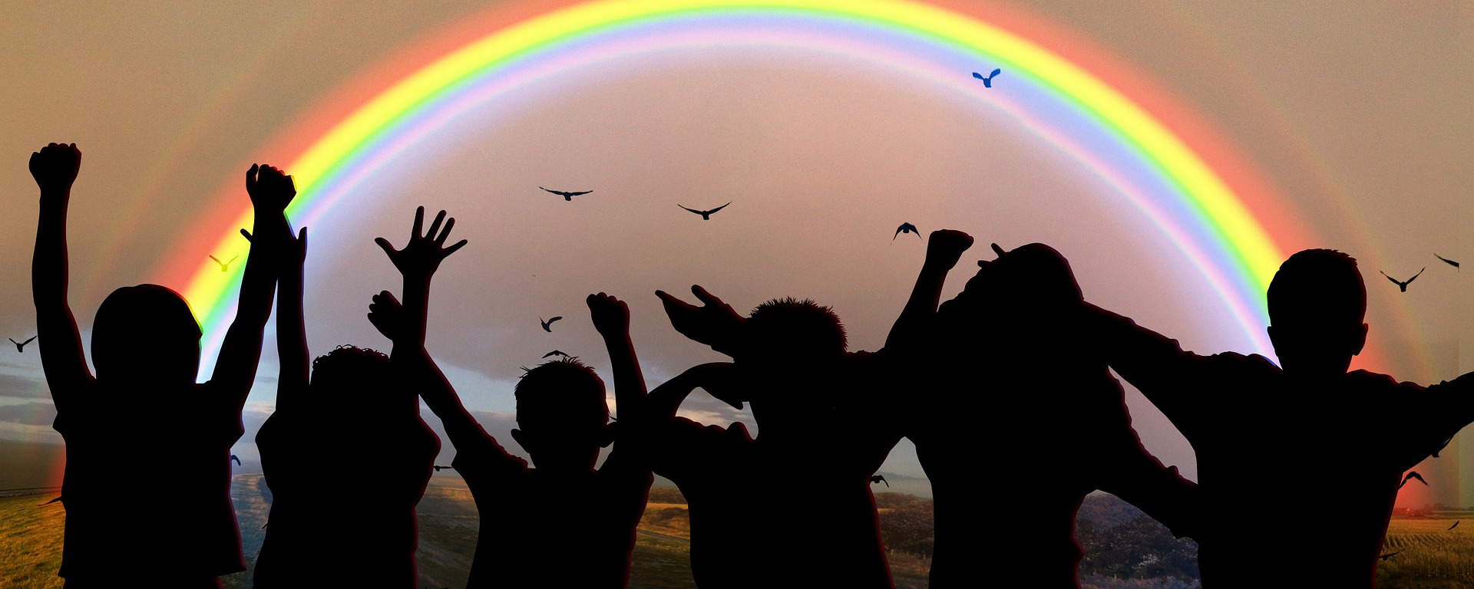
Exploring
Wir helfen!
blau
Follow ups 1-5
Term 2 Week 6
Notes:
Artwork by Steve Clarke. Pronoun pictures from NCELP (www.ncelp.org). All additional pictures selected from Pixabay and are available under
a Creative Commons license, no attribution required.
Phonics:
[sch] schreiben [245] falsch [638] schnell [233] Mensch [104] schwarz [451]
[sp] spielen [197] Sprache [367] sprechen [157] Sport [845] Spiel [500]
[st] stark [207] Straße [355] stehen [87] verstehen [222] Stadt [186]
Introduce: Uhr3 [348] spät [169] um1 [44] zusammen [533] Revisit numbers 1-12
Revisit 1: Term 1 and Term 2 Week 2
Revisit 2: essen [323] lesen [305] sitzen [231] sprechen [161] Antwort [522] Hilfe [481] Moment [358] langsam [526] manchmal [382]
oft [223] nie [196] schnell [203] neben [266]
Jones, R.L & Tschirner, E. (2019). A frequency dictionary of German: Core vocabulary for learners. London: Routledge.
The frequency rankings for words that occur in this PowerPoint which have been previously introduced in these resources are given in the
SOW and in the resources that first introduced and formally re-visited those words.
For any other words that occur incidentally in this PowerPoint, frequency rankings will be provided in the notes field wherever possible.
Note that the first three lessons of the year teach language that can be continuously recycled as lesson routine every lesson in Y3/4.
The idea would be that the class teacher (whether or not s/he teaches the class German can re-use the language as part of the daily routine
with the class.

Slide 2
aussprechen
[sch]
…
[fast]
falsch
schnell
schreiben
Mensch
schwarz
Notes:
Timing: 2 minutes
Aim: To introduce/consolidate SSC [sch]
Procedure:
Introduce and elicit the pronunciation of the individual SSC [sch] and then the source word again ‘schreiben’ (with gesture, if using).
Then present and elicit the pronunciation of the four cluster words.
Word frequency (1 is the most frequent word in German): schreiben [245] falsch [638] schnell [233] Mensch [104] schwarz [451] Source: Jones, R.L. & Tschirner, E. (2006). A frequency dictionary of German: core vocabulary for learners. Routledge
2

Slide 3
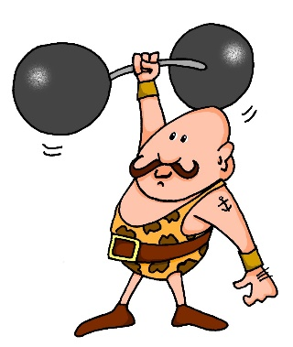
[st]
…
aussprechen
[to stand]
stehen
Straße
stark
[to understand]
verstehen
Stadt
Notes:
Timing: 2 minutes
Aim: To introduce/consolidate SSC [st-]
Procedure:
Introduce and elicit the pronunciation of the individual SSC [st-] and then the source word again ‘stark’ (with gesture, if using).
Then present and elicit the pronunciation of the five cluster words.
Word frequency (1 is the most frequent word in German): stark [207] Straße [355] stehen [87] verstehen [222] Stadt [186] Source: Jones, R.L. & Tschirner, E. (2006). A frequency dictionary of German: core vocabulary for learners. Routledge

Slide 4
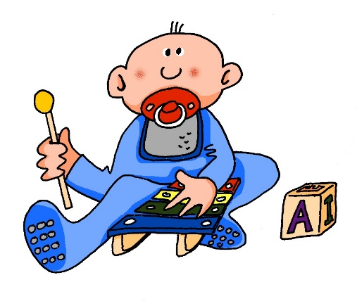
[sp]
…
aussprechen
Sprache
sprechen
spielen
Sport
Spiel
Notes:
Timing: 2 minutes
Aim: To introduce/consolidate SSC [sp]
Procedure:
Introduce and elicit the pronunciation of the individual SSC [sp] and then the source word again ‘spielen’ (with gesture, if using).
Then present and elicit the pronunciation of the five cluster words.
Word frequency (1 is the most frequent word in German): spielen [197] Sprache [367] sprechen [157] Sport [845] Spiel [500] Source: Jones, R.L. & Tschirner, E. (2006). A frequency dictionary of German: core vocabulary for learners. Routledge

Slide 5
Follow up 1:
Sag die Wörter.
verstehen
Straße
aussprechen
Schule
Geschenk
[street]
25
schnell
Schüler
stehen
[to stand, standing]
Sprache
Schwester
Beispiel
S
Schweiz
[Switzerland]
spät
schwer
[late]
Frühstück
spielen
[breakfast]
Sport
Bleistift
0
schwarz
Spaß
Schloss
START
[fun]
Notes:
Timing: 5 minutes
Aim: to practise applying knowledge of [sch] [st-] [sp-] to mostly known (previously taught) words.
Procedure: 1. Pupil A selects 4 words and writes them without showing.
2. Start the timer. Pupil B tries to say all of A’s chosen words within the time limit (25 seconds). 3. They swap roles and repeat the task. They may place multiple rounds.
Frühstück [2600] Schweiz [763] Spaß [1045] spät [169] Straße [391]

Slide 6
Follow up 2
Lies die Sätze. Wer macht was?
The word ‘zusammen*’ (together) indicates the right verb option. Who is doing what?
lesen
A
They wash/are washing cars together.
Sie wäscht|Sie waschen zusammen Autos.
In English, together usually comes at the end. In German, zusammen usually comes after the verb.
B
Wir essen| Sie isst zusammen Pizza.
They eat/are eating pizza together.
C
Schreibst du | Schreibt ihr zusammen ein Quiz?
Do you write/ Are you writing a quiz together?
D
Ich verkaufe | Wir verkaufen zusammen Kuchen.
We sell/ are selling cake together.
E
Sie laufen |Sie läuft zusammen 5KM.
They run/ are running 5 km together.
F
Singt ihr | Singst du zusammen Lieder?
Do you sing/ Are you singing songs together?
Notes:
Timing: 6 minutes
Aim: to practise the syntax and use of ‘zusammen’ with plural verb forms.
Procedure:
Click for the instructions.
Elicit the correct answer for A.
Click to blank out incorrect option.
Elicit English translation.
Click to bring up callout drawing attention to the different syntax around zusammen/ together in German/English.
Continue for items B-F.

Slide 7
Follow up 3a
Hör zu.
A
B
 | A, B, C? | when?
 |  | Monday
 |  | 4.00
 |  | 3.00
 |  | Monday
 |  | 11.00
 |  | 3.00
 |  | 11.00
 |  | 4.00
Time: __________ They are not wearing uniform in school.
Time: __________ Are you selling books?
hören
1
D
2
G
C
D
E
3
B
Time: __________ She is not wearing uniform in school.
Time: __________ I am washing cars.
Time: __________ We are helping in year 2.
4
A
5
C
6
H
F
G
H
Time: __________ Are you helping in year 2?
Time: __________ You are washing cars.
Time: __________ he is selling books.
7
F
8
E
Notes:
Scaffolded version. The ‘stretch version’ of this task is on slide 8.
Timing: 8 minutes
Aim: to practise comprehension of times and activities in this week’s fundraising context.
Procedure:
Pupils listen to the German audio (click on the audio button) and select the letter of the corresponding English translation.
Pupils number the English or fill in the letter in the table on the left.
Click for answers to appear in the table.
Second step: Pupils write in the times in the English sentences, or fill in the table.
Click for answers to appear in the table.
Transcript: 1. Sie trägt keine Uniform in der Schule am Montag. 2. Du wäschst Autos um vier Uhr.
3. Verkauft ihr Bücher um drei Uhr?
4. Sie tragen keine Uniform in der Schule am Montag.
5. Wir helfen in Klasse 2 um 11 Uhr.
6. Er verkauft Bücher um drei Uhr.
7. Helft ihr in Klasse 2 um 11 Uhr?
8. Ich wasche Autos um vier Uhr.

Slide 8
Follow up 3b
Hör zu.
 | Person | Activity | Time
hören
1
she
is not wearing school uniform
Monday
2
you
are washing cars
four o’clock
3
you (all)
are selling books
three o’clock
4
they
are not wearing school uniform
Monday
5
we
are helping in year 2
eleven o’clock
6
he
is selling books
three o’clock
7
you (all)
are helping in year 2
eleven o’clock
8
I
am washing cars
four o’clock
Notes:
‘Stretch’ version. The scaffolded version of this task is on slide 7.
Aim: to practise comprehension of times and activities in this week’s fundraising context.
Procedure:
Pupils listen to the German audio (click on the audio button) fill in the table for grammatical person, activity and time.
Click for answers to appear in table.
Transcript: 1. Sie trägt keine Uniform in der Schule am Montag. 2. Du wäschst Autos um vier Uhr.
3. Verkauft ihr Bücher um drei Uhr?
4. Sie tragen keine Uniform in der Schule am Montag.
5. Wir helfen in Klasse 2 um 11 Uhr.
6. Er verkauft Bücher um drei Uhr.
7. Helft ihr in Klasse 2 um 11 Uhr?
8. Ich wasche Autos um vier Uhr.

Slide 9
Follow up 4
Wie spät ist es? Rede mit deinem Partner/deiner Partnerin.
Partner A
Person B: Wie spät ist es?
Person A: Es ist zwei Uhr.
2 o’clock
Person B: 🖊 …………………..
Notes:
Timing: 5 minutes (two slides)
Model slide.
Aim: to practise asking and giving times, to practise oral recall and production of numbers 1-12.
Procedure:
Click through animations on this slide to model the task.
Move to next slide.
Transcript:
Wie spät ist es?
Es ist zwei Uhr.

Slide 10
Follow up 4
Wie spät ist es? Rede mit deinem Partner/deiner Partnerin.
sprechen
1
2
1
2
3
3
4
4
5
6
5
6
Notes:
Aim: to practise asking and giving times, to practise oral recall and production of numbers 1-12.
Procedure:
Person B turns away.
Click to bring up 6 x clock faces for Person A.
Person B asks ‘Wie spät ist es? (x 6)
Person A responds (x 6)
Person B writes down the times, then turns back to check the board.
Swap roles and repeat for Round 2.
Click on yellow speaker icon for listen and check.
Transcript:
1. Wie spät ist es?
Es ist zwei Uhr.
2. Wie spät ist es?
Es ist neun Uhr.
3. Wie spät ist es?
Es ist zwölf Uhr.
4. Wie spät ist es?
Es ist sieben Uhr.
5. Wie spät ist es?
Es ist acht Uhr.
6. Wie spät ist es?
Es ist ein Uhr.
1. Wie spät ist es?
Es ist sechs Uhr.
2. Wie spät ist es?
Es ist zehn Uhr.
3. Wie spät ist es?
Es ist fünf Uhr.
4. Wie spät ist es?
Es ist elf Uhr.
5. Wie spät ist es?
Es ist vier Uhr.
6. Wie spät ist es?
Es ist drei Uhr.

Slide 11
Follow up 5:

Schreib auf Englisch.
Can you get at least 15 points?
Wörter
 | langsam | manchmal | der Moment
 | oft | schnell | neben
 | die Hilfe | lesen | sprechen
 | die Antwort | sitzen | essen
 | um vier Uhr | um | (die) Uhr
 | spät | zwölf | zusammen
Vokabeln
slow, slowly
sometimes
(the) moment
x3
often
fast, quick, quickly
next to, beside
(the) help
to read, reading
to speak, speaking
x2
(the) answer
to sit, sitting
to eat, eating
at four o’clock
at (o’clock)
watch, clock, o’clock
x1
late
twelve
together
Notes:
Timing: 5 minutes
Aim: to practise written comprehension of vocabulary from this and revisited weeks.
Procedure: 1. Give pupils a blank grid. They fill in the English meanings of any of the words they know, trying to reach 15 points in total.
Note: The most recently learnt and practised words are pink, words from the previous week are green and those from week 1 are blue, thus more points are awarded for them, to recognise that memories fade and more effort (heavy lifting!) is needed to retrieve them.

Slide 12
Follow up 5:

Schreib auf Deutsch.
Can you get at least 15 points?
Wörter
 | never | fast, quick, quickly | next to, beside
 | (the) moment | slow, slowly | often
 | (the) answer | (the) help | to sit, sitting
 | to eat, eating | to read, reading | to speak, speaking
 | together | at four o’clock | twelve
 | watch, clock, o’clock | late | at (o’clock)
Vokabeln
nie
schnell
neben
x3
der Moment
langsam
oft
die Antwort
die Hilfe
sitzen
x2
essen
lesen
sprechen
zusammen
um vier Uhr
zwölf
x1
(die) Uhr
um
spät
Notes:
Timing: 5 minutes
Aim: to practise written production of vocabulary from this and revisited weeks.
Procedure: 1. Give pupils a blank grid. They fill in the German meanings of any of the words they know, trying to reach 15 points in total.
Note: The most recently learnt and practised words are pink, words from the previous week are green and those from week 1 are blue, thus more points are awarded for them, to recognise that memories fade and more effort (heavy lifting!) is needed to retrieve them.

Slide 13
Tschüss!
blau
Notes:
13

Slide 14
Follow up 5:

Schreib auf Englisch.
Can you get at least 15 points?
Wörter
 | langsam | manchmal | der Moment
 | oft | schnell | neben
 | die Hilfe | lesen | sprechen
 | die Antwort | sitzen | essen
 | um vier Uhr | um | (die) Uhr
 | spät | zwölf | zusammen
Vokabeln
x3
x2
x1
Notes:
Template

Slide 15
Follow up 5:

Schreib auf Deutsch.
Can you get at least 15 points?
Wörter
 | never | fast, quick, quickly | next to, beside
 | (the) moment | slow, slowly | often
 | (the) answer | (the) help | to sit, sitting
 | to eat, eating | to read, reading | to speak, speaking
 | together | at four o’clock | twelve
 | watch, clock, o’clock | late | at (o’clock)
Vokabeln
x3
x2
x1
Notes:
Timing: 5 minutes
Aim: to practise written production of vocabulary from this and revisited weeks.
Procedure: 1. Give pupils a blank grid. They fill in the German meanings of any of the words they know, trying to reach 15 points in total.
Note: The most recently learnt and practised words are pink, words from the previous week are green and those from week 1 are blue, thus more points are awarded for them, to recognise that memories fade and more effort (heavy lifting!) is needed to retrieve them.

