Slide 1
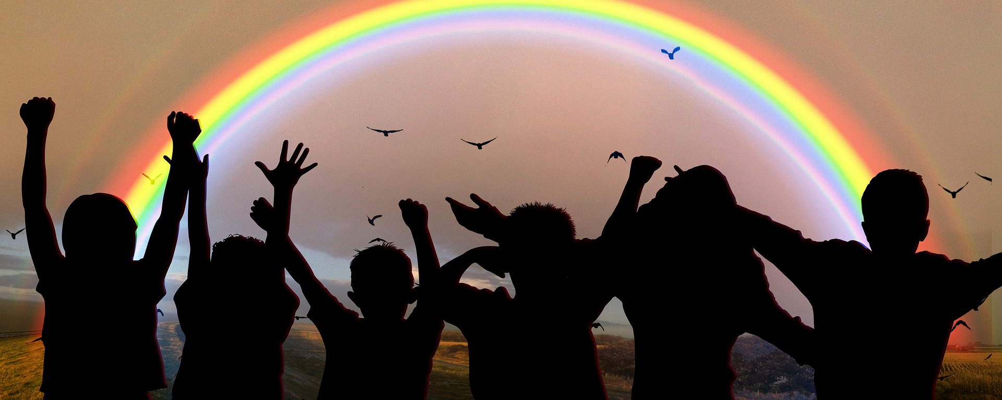
Exploring
Wir helfen!
blau
Present tense weak and strong verbs
Time
SSC [sch] [sp-] [st-]
Term 2 Week 6
Notes:
Artwork by Steve Clarke. Pronoun pictures from NCELP (www.ncelp.org). All additional pictures selected from Pixabay and are available under
a Creative Commons license, no attribution required.
Phonics:
[sch] schreiben [245] falsch [638] schnell [233] Mensch [104] schwarz [451]
[sp] spielen [197] Sprache [367] sprechen [157] Sport [845] Spiel [500]
[st] stark [207] Straße [355] stehen [87] verstehen [222] Stadt [186]
Introduce: Uhr3 [348] spät [169] um1 [44] zusammen [533] Revisit numbers 1-12
Revisit 1: Term 1 and Term 2 Week 2
Revisit 2: essen [323] lesen [305] sitzen [231] sprechen [161] Antwort [522] Hilfe [481] Moment [358] langsam [526] manchmal [382]
oft [223] nie [196] schnell [203] neben [266]
Jones, R.L & Tschirner, E. (2019). A frequency dictionary of German: Core vocabulary for learners. London: Routledge.
The frequency rankings for words that occur in this PowerPoint which have been previously introduced in these resources are given in the
SOW and in the resources that first introduced and formally re-visited those words.
For any other words that occur incidentally in this PowerPoint, frequency rankings will be provided in the notes field wherever possible.
Note that the first three lessons of the year teach language that can be continuously recycled as lesson routine every lesson in Y3/4.
The idea would be that the class teacher (whether or not s/he teaches the class German can re-use the language as part of the daily routine
with the class.
1

Slide 2
aussprechen
[sch]
…
schreiben
Notes:
Timing: 1 minute
Aim: To introduce/consolidate SSC [sch]
Procedure: 1. Present the letter(s) and say the [sch] sound first, on its own. Pupils repeat it with you. 2. Bring up the word ”schreiben” on its own, say it, pupils repeat it, so that they have the opportunity to focus all of their attention on the connection between the written word and its sound.
3. A possible gesture for this would be to mime writing.
4. Roll back the animations and work through 1-3 again, but this time, dropping your voice completely to listen carefully to the pupils saying the [sch] sound, pronouncing ”schreiben” and, if using, doing the gesture. Word frequency (1 is the most frequent word in German):
schreiben [245] Source: Jones, R.L. & Tschirner, E. (2006). A frequency dictionary of German: core vocabulary for learners. Routledge
2

Slide 3
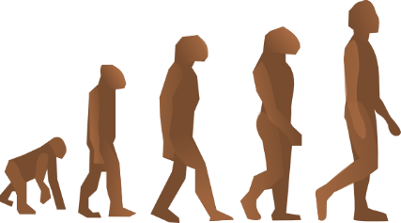
aussprechen
[sch]
…
[fast]
falsch
schnell
schreiben
Mensch
schwarz
Notes:
Timing: 2 minutes
Aim: To introduce/consolidate SSC [sch]
Procedure:
Introduce and elicit the pronunciation of the individual SSC [sch] and then the source word again ‘schreiben’ (with gesture, if using).
Then present and elicit the pronunciation of the four cluster words.
Word frequency (1 is the most frequent word in German): schreiben [245] falsch [638] schnell [233] Mensch [104] schwarz [451] Source: Jones, R.L. & Tschirner, E. (2006). A frequency dictionary of German: core vocabulary for learners. Routledge
3

Slide 4
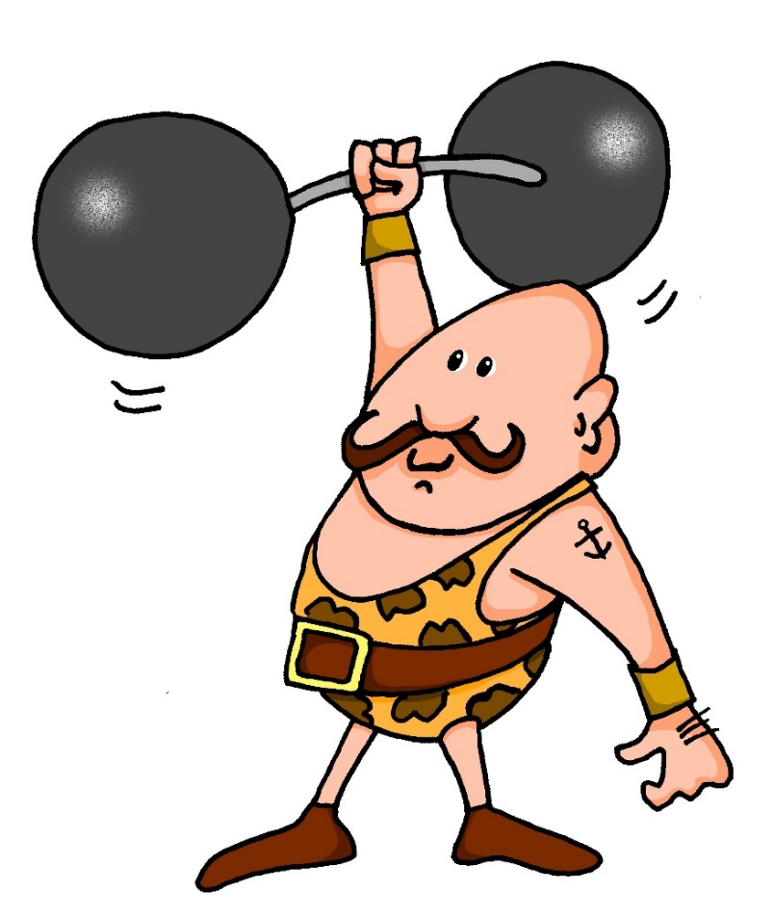
aussprechen
[st]
…
stark
Notes:
Timing: 1 minute
Aim: To introduce/consolidate SSC [st-]
Procedure: 1. Present the letter(s) and say the [st-] sound first, on its own. Pupils repeat it with you. 2. Bring up the word ”stark” on its own, say it, pupils repeat it, so that they have the opportunity to focus all of their attention on the connection between the written word and its sound.
3. A possible gesture for this would be to mime lifting dumbells by clenching your fists and raising them above your head.
4. Roll back the animations and work through 1-3 again, but this time, dropping your voice completely to listen carefully to the pupils saying the [st-] sound, pronouncing ”stark” and, if using, doing the gesture. Word frequency (1 is the most frequent word in German): stark [207] Source: Jones, R.L. & Tschirner, E. (2006). A frequency dictionary of German: core vocabulary for learners. Routledge
4

Slide 5
[st]
…
aussprechen
[to stand]
stehen
Straße
stark
[to understand]
verstehen
Stadt
Notes:
Timing: 2 minutes
Aim: To introduce/consolidate SSC [st-]
Procedure:
Introduce and elicit the pronunciation of the individual SSC [st-] and then the source word again ‘stark’ (with gesture, if using).
Then present and elicit the pronunciation of the five cluster words.
Word frequency (1 is the most frequent word in German): stark [207] Straße [355] stehen [87] verstehen [222] Stadt [186] Source: Jones, R.L. & Tschirner, E. (2006). A frequency dictionary of German: core vocabulary for learners. Routledge

Slide 6
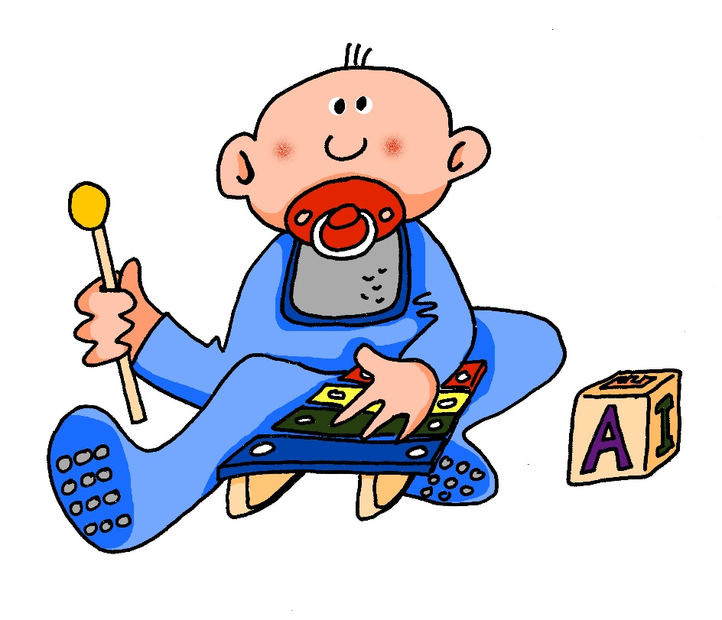
[sp]
…
aussprechen
spielen
Notes:
Timing: 1 minute
Aim: To introduce/consolidate SSC [sp-]
Procedure: 1. Present the letter(s) and say the [sp-] sound first, on its own. Pupils repeat it with you. 2. Bring up the word ”spielen” on its own, say it, pupils repeat it, so that they have the opportunity to focus all of their attention on the connection between the written word and its sound.
3. A possible gesture for this would be to mime playing an instrument or sport.
4. Roll back the animations and work through 1-3 again, but this time, dropping your voice completely to listen carefully to the pupils saying the [sp-] sound, pronouncing ”spielen” and, if using, doing the gesture. Word frequency (1 is the most frequent word in German): spielen [197] Source: Jones, R.L. & Tschirner, E. (2006). A frequency dictionary of German: core vocabulary for learners. Routledge

Slide 7
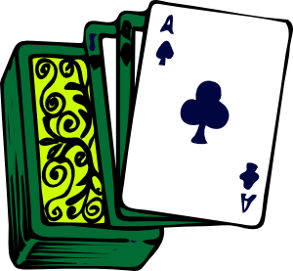
[sp]
…
aussprechen
Sprache
sprechen
spielen
Sport
Spiel
Notes:
Timing: 2 minutes
Aim: To introduce/consolidate SSC [sp]
Procedure:
Introduce and elicit the pronunciation of the individual SSC [sp] and then the source word again ‘spielen’ (with gesture, if using).
Then present and elicit the pronunciation of the five cluster words.
Word frequency (1 is the most frequent word in German): spielen [197] Sprache [367] sprechen [157] Sport [845] Spiel [500] Source: Jones, R.L. & Tschirner, E. (2006). A frequency dictionary of German: core vocabulary for learners. Routledge

Slide 8
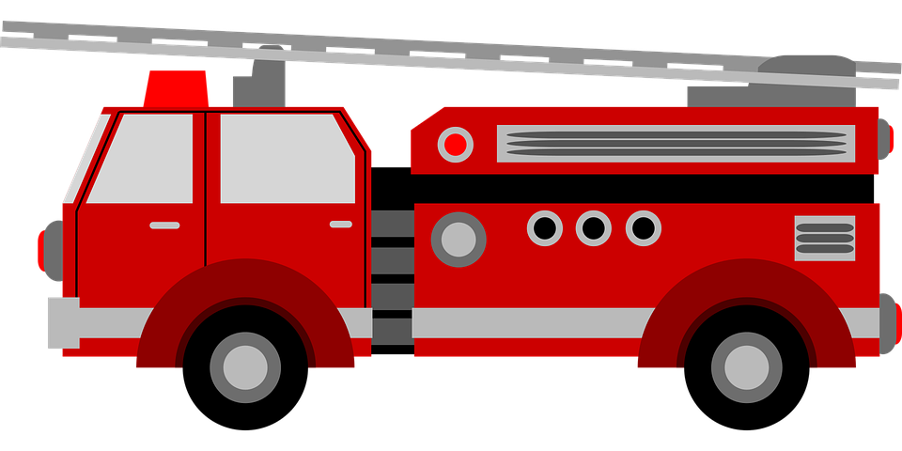
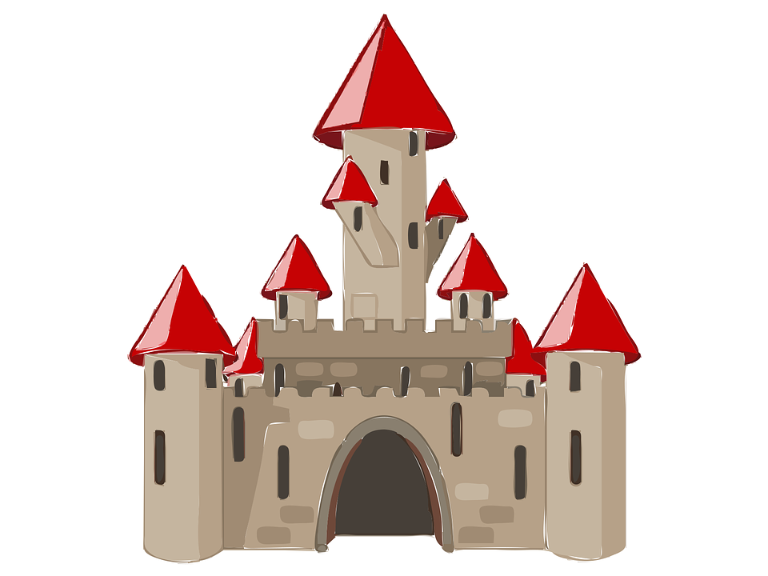
[sp-] [st-] oder [sch-]?
More donations! But what are they? Johanna tells Moritz. Help him complete the list.
Hör zu. Schreib [sp], [st]
oder [sch].
B.
Schnecke
__
__
__
5
Schlafanzug
1
Spielzeug
Schloss
__
__
2
Strauß
6
__
Stiefel
Schuhe
3
7
__
Schüssel
__
__
4
8
Spardose
Notes:
Timing: 5 minutes Aim: To practise aural recognition of the three sounds [sch], [sp], and [st]. Procedure: 1. Click the sound button to play B (the example). Pupils must write down sch, sp, or st based on what they hear and which sound they think fills the gap.
2. Click to reveal and check answer.
3. Repeat for items 1-8. Extension: Pupils can challenge themselves to write the whole word by turning away from the board.
Transcript:
Beispiel: Schnecke
Spielzeug
Schloss
Stiefel
Schüssel
Schlafanzug
Strauß
Schuhe
8. Spardose Word frequency (1 is the most frequent word in German):
Schlafanzug [>5009] Schloss [1907] Schnecke [>5009] Schuhe [>5009] Spardose [>5009] Spielzeug [>5009] Stiefel [>5009] Strauß [4767]
Source: Jones, R.L. & Tschirner, E. (2019). A frequency dictionary of German: core vocabulary for learners. Routledge

Slide 9
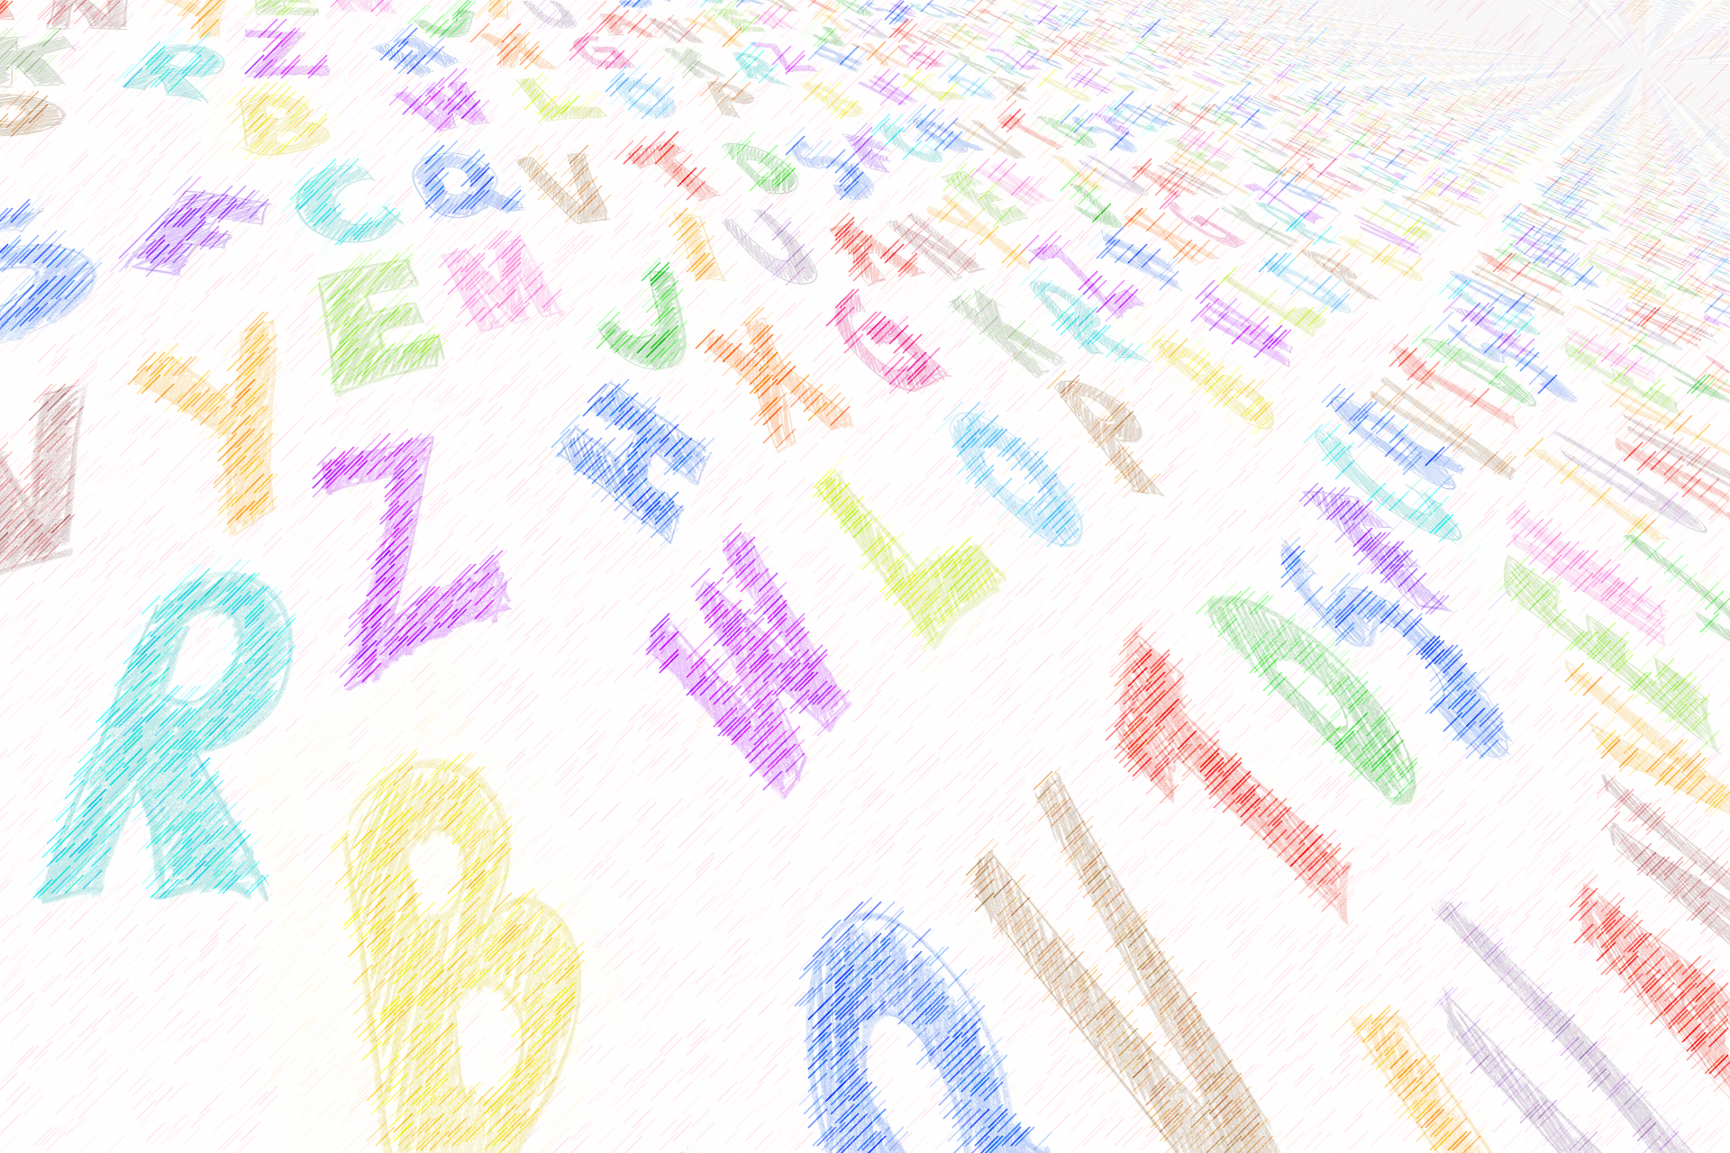
Vokabeln
Wie sagt man das auf Englisch?
Wörter
essen
to eat, eating
(the) car
(the) hour, lesson
das Auto
die Stunde
to wear,
to carry
tragen
to speak, speaking
geben
laufen
sprechen
to give, giving
(the) answer
to run, running
die Antwort
lesen
schlafen
manchmal
fast, quick, quickly
to read, reading
to sleep, sleeping
sometimes
schnell
verkaufen
to write, writing
to sell, selling
die Nacht
schreiben
(the) night
(the) moment
der Moment
Notes:
Aim: to practise oral recall of vocabulary from this and previous weeks.
Procedure:
1. Pupils sketch a 4x4 grid.
2. Working in pairs, they take turns to choose a word to translate orally into English.
3. Pupils should work as quickly as they can without repeating a word the other has already said. If their partner agrees the given translation is correct, the speaking pupil ‘claims’ the relevant square on the grid by putting their initials in it. If they cannot translate a word, or translate it incorrectly, they do not claim a square and the game moves on.
4. Click to reveal translations one by one.
5. Pupils count up the number of squares they have claimed. The pupil with the most squares wins.
Extension: At the end of the activity, see how many words pupils can recall in German, from the English prompts.
9

Slide 10
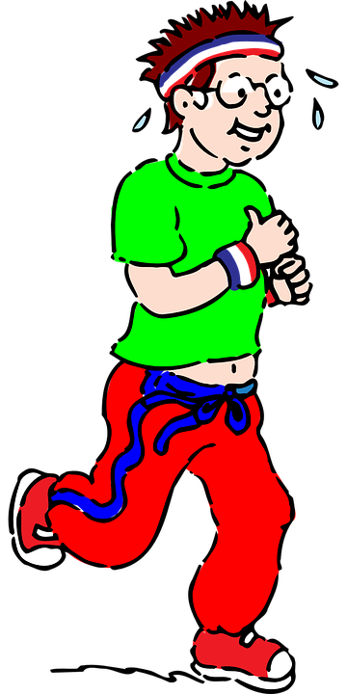
Time
You know Stunde means hour:
60 Minuten
Ich laufe jeden Tag eine Stunde.
I run for an hour every day.
Remember: die Uhr also means watch or clock.
Use Uhr to mean o’clock:
Es ist zwei Uhr.
It is two o’clock.
Um here means ‘at’:
Um drei Uhr – at three o’clock.
Ich laufe um zwei Uhr.
I run at two o’clock.
If you start with the time, swap verb and subject for Word Order 2:
Um zwei Uhr laufe ich.
At two o’clock I run.
Notes:
Timing: 3 minutes
Aim: to introduce 12-hour (on the hour) clock time, remind pupils about the difference between Stunde (hour) and Uhr (o’clock), and about
word order 2 after adverbs of time.
Procedure:
Click through the animations to present the information.
Elicit English translation for the German examples provided.
Note: the translation for the last two sentences in English follows the order of the German. ‘At two o’clock I run’, is correct and possible, though much less common. In English we usually opt to put adverbs of time at the end of the sentence.
10

Slide 11
lesen
Ein Projekt für UNICEF
Johanna und Moritz planen Aktivitäten für den UNICEF-Tag.
Was macht Klasse 4A? Which activities have a time slot and which don’t?
B.
Um neun Uhr
sie wäscht Autos für die Lehrer.
----
Time | Activity
1
----
spricht sie eine Stunde nicht.
washes cars for the teachers.
Um zehn Uhr
?
2
Um elf Uhr
10.00
doesn’t speak for one hour.
sie verkauft Bücher und Spiele.
----
?
sells books and games.
3
Um ein Uhr
1.00
sings songs in the dining room.
singt sie Lieder in der Kantine.
----
3.00
runs five kilometers.
4
----
Um drei Uhr
läuft sie fünf Kilometer.
?
sleeps in the school for one night.
5
Um acht Uhr
sie schläft eine Nacht in der Schule.
----
Notes:
Timing: 8 minutes
Aim: to practise written recognition of Word Order 2 (WO2), and comprehension of times and this week’s and previous vocabulary.
Procedure:
Explain the scenario.
Pupils identify the correct choice for the example, based on the syntax of the second part of the sentence.
Click for the incorrect choice to disappear and to leave only the correct choice visible. EXPLAIN (for the example) that there is no time because if there is a time at the start of the sentence then the verbs comes 2nd, but in the example we have Word Order 1, so this activity hasn’t yet got a time slot.
Elicit oral translation of the item. Click to reveal the written translation with a time OR with a ?.
Pupils complete items 1-6, writing their English translations into the table, including either the time OR a ? where the syntax (i.e., Word Order 1 indicates that there is no time given).
Click to correct with pupils.
Vocabulary: beschreiben [435]
Jones, R.L & Tschirner, E. (2019). A frequency dictionary of German: Core vocabulary for learners. London: Routledge.
11

Slide 12
hören
Johanna und Aisha sprechen zusammen* über Pläne für Klasse 6.
zusammen – together
Hör zu. Was sagt Aisha zu Johanna?
A | B | Gibt es eine Zeit? Dann übersetze auf Englisch!
Um vier Uhr | _
_ | Um zwölf Uhr
-- | Um neun Uhr
Um elf Uhr | _
Um sieben Uhr | --
-- | Um zehn Uhr
1
At 4 o’clock Ali plays music.
2
3
At 9 o’clock you sell flowers.
4
At 11 o’clock you run three kilometers.
5
6
Notes:
Timing: 5 minutes
Aim: to practise aural distinction between WO1 and WO2 and comprehension of this week’s and previous weeks’ vocabulary.
Procedure:
Click to listen to sentences with the beginnings obscured by ‘interference’.
Pupils select the correct beginning – A or B.
Click to elicit and confirm answers.
As a second step, pupils translate the sentence with a time in into English. Click for answers.
Transcript:
[Um vier Uhr] spielen Ali und Lina zusammen Musik.
Laura spricht eine Stunde nicht.
[Um neun Uhr] verkaufst du Blumen.
[Um elf Uhr] lauft ihr zusammen drei Kilometer.
Ich wasche das Auto für die Direktorin.
Du liest ein Buch für Klasse 2.
12

Slide 13
Tschüss!
Don’t forget this more formal way to say Goodbye!
Auf Wiedersehen!
blau
Notes:
13

