Slide 1
Exploring
Klassenfahrt nach Köln
blau
in (R3) location and in (R2) movement
present tense
SSC [s-|-s- | z]
Term 2 Week 7
Notes:
Artwork by Steve Clarke. Pronoun pictures from NCELP (www.ncelp.org). All additional pictures selected from Pixabay and are available under a Creative Commons license, no
attribution required.
Phonics:
[s-] [-s-] singen [1063] Person [357] langsam [526] sehr [81] besuchen [820]
[z] Zug [675] sitzen [231] Platz [326] Zimmer [665] zehn [333]
Vocabulary: gehen [66] sein [3] Bibliothek [2366] Dom [4916] Garten [1158] Haus [147] Kino [2020] Stadt [204] Wohin? [1811]
Revisit 1: finden [103] Sie [7] Arbeit [208] Essen [323] Pause [1441] Uniform [3857] Unterricht [1823]
Revisit 2: sehen [79] vergessen [584] nichts [109] Sprache [421] Wochenende [1243] immer [64] jetzt [72]
Jones, R.L & Tschirner, E. (2019). A frequency dictionary of German: Core vocabulary for learners. London: Routledge.
The frequency rankings for words that occur in this PowerPoint which have been previously introduced in these resources are given in the SOW and in the resources that first
introduced and formally re-visited those words.
For any other words that occur incidentally in this PowerPoint, frequency rankings will be provided in the notes field wherever possible.
Remember that at the start of the course (first three lessons of Rot/Gelb) pupils learnt language (for greetings and register taking) that can still be part of the lesson routines in upper KS2 (Blau/Grün). They are not re-taught, as we anticipate that teachers have built these in from early in lower KS2.
1

Slide 2
aussprechen
[s]
Before a vowel, German 's' sounds like English ‘z’.
…
singen
Notes:
Timing: 1 minute
Aim: to present the SSC [s] before a vowel.
Procedure:
Present the SSC and the source word ‘singen’ (with gesture, if using).
Click to bring on the picture and get pupils to repeat the word ‘singen’ (with gesture (a gesture might be to sing ‘lalala’) if using).

Slide 3
aussprechen
[s]
Before a vowel, German 's' sounds like English ‘z’.
…
singen
langsam
besuchen
sehr
Person
other words: Person langsam sehr
besuchen
(we then have all the vowels represented)
Notes:
Timing: 1 minute
Aim: to consolidate the SSC [s] before a vowel.
Procedure:
Re-present the SSC and the source word ‘singen’ (with gesture, if using).
Click to bring on the picture and get pupils to repeat the word ‘singen’ (with gesture, if using).
Present the cluster words in the same way, bringing on the picture and getting pupils to pronounce the words.

Slide 4
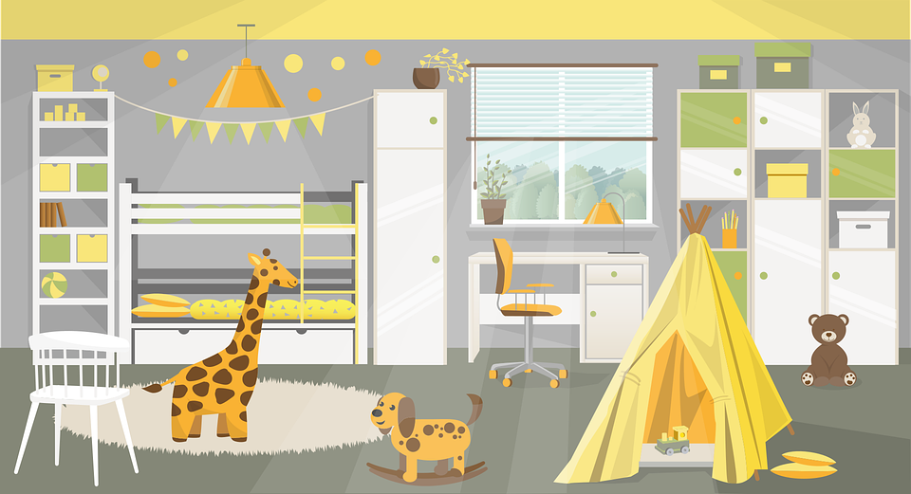
aussprechen
[z]
Which words are nouns? How do you know?
…
Zug
sitzen
Platz
zehn
Zimmer
Notes:
Timing: 1 minute
Aim: to consolidate the SSC [z].
Procedure:
Re-present the SSC and the source word ‘Zug’ (with gesture, if using).
Click to bring on the picture and get pupils to repeat the word ‘Zug’ (with gesture, if using).
Present the cluster words in the same way, bringing on the picture and getting pupils to pronounce the words.
Click to bring up call-out explaining the pronounciation of ‘z’.
Click to bring up the prompt to identify the nouns (the ones with capital letters). This is still very new knowledge for pupils, so it’s good to revisit this as often as we can. Plus, it gives an additional opportunity to pronounce the words.
Click to highlight the 3 x nouns.
Vocabulary:
sitzen [231] Platz [326] Zimmer [665] zehn [333]
Jones, R.L & Tschirner, E. (2019). A frequency dictionary of German: Core vocabulary for learners. London: Routledge.

Slide 5
aussprechen
Sag die Wörter.
Runde 1: Person A spricht. 🗣
Person B macht Notizen📝✅
Sonntag
sehen
Insel
Gläser
Konzert
Rucksack
sechzehn
sitzen
Dezember
Notes:
1/3
Timing: 5-6 minutes [3 slides]
Aim: To practise the pronunciation of German words with the SSC [s] and [z].
Procedure:
Pupils work in pairs to practise and recognise correct pronunciation.
Divide the class in A & B before explaining the task.
Click to bring up the instruction in German. Click again to start the fish going across the screen (it will come across the screen three times, revealing three words at a time)
Pupil A reads the words aloud and pupil B checks their pronunciation. There are 9 words in total.

Slide 6
aussprechen
Sag die Wörter.
Runde 2: Person B spricht. 🗣
Person A macht Notizen📝✅
Satz
besuchen
langsam
Zimmer
nach Hause
zusammen
zwanzig
tanzen
Museum
Notes:
2/3
Procedure:
Pupils swap roles and repeat the activity.

Slide 7
aussprechen
How much are your words worth?
Runde 1
Runde 2
Sonntag 💰
Gläser 💰💰
Konzert 💰
sehen 💰
sechzehn💰💰
sitzen 💰💰
Insel 💰
Rucksack💰💰
Dezember 💰
Satz 💰
Zimmer💰
zwanzig💰
besuchen 💰💰
nach Hause💰💰
tanzen💰
langsam💰💰
zusammen💰
Museum 💰💰
Notes:
3/3
Procedure:
Pupils can view their results and another round can be played with the same words or swapping A/B.
All words are previously taught words so for an extra point pupils can translate the words.

Slide 8
Vokabeln
Sag die Wörter. Was heißt das auf Deutsch?
Wörter
to go, walk
(the) library
(the) cathedral
(the) cinema
Where to?
Wohin?
(the) town
gehen
der Dom
die Stadt
das Kino
die Bibliothek
Notes:
Timing: 5 minutes
Aim: to present and practise written comprehension and read aloud of previously taught words and the new vocabulary for this week.
Procedure: 1. Click for a German word and icon. Elicit English translation from pupils.
2. Continue until the final word (wohin?) has been introduced. 3. Elicit translation of all words again, clicking to provide an emphasis animation.
8

Slide 9
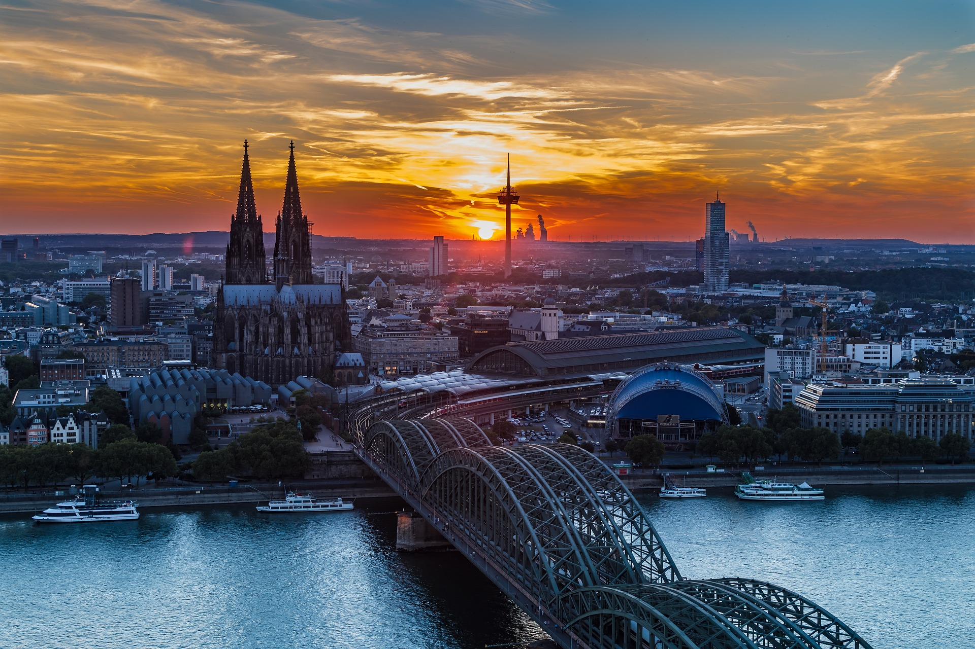
Kultur
Köln
Lies den Text.
In English, we call Köln Cologne!
Johannas Klasse ist in Köln.
Köln ist eine Stadt im Westen von Deutschland.
Die Stadt ist bekannt für den Dom.
Im Winter ist sie auch bekannt für den Weihnachtsmarkt*!
der Weihnachtsmarkt – Christmas market
Notes:
Timing: 5 minutes
Aim: to present and practise new vocabulary for this week
Procedure:
Click to bring up short reading text about Köln/ Cologne.
Click to bring up callout to say that Köln is called Cologne in English.
Discuss the text and ensure that the meaning is clear.
9

Slide 10
The preposition ‘in’ for location
Remember that ‘in’ is the same word in English and German:
Wir sind in Köln.
We are in Cologne.
We shorten ‘in dem‘ to ‘im’.
You know that to say ‘in the’, the words for ‘the’ (der, die, das) change.
der Dom:
in the cathedral
in dem Dom
im Dom
die Stadt:
in the town/city
in der Stadt
‘Stadt’ still has feminine gender. Just the article spelling has changed.
das Kino:
in the cinema
in dem Kino
im Kino
Notes:
Timing: 2 minutes
Aim: to recap the preposition ‘in’ for location.
Procedure:
Click through the animations to present the grammar of ‘in’.
10

Slide 11
The preposition ‘in’ for movement.
We shorten ‘in das‘ to ‘ins’.
Also use‘in’ in German to mean moving into.
In this case, the words for ‘the’ (der, die, das) are:
masculine
feminine
neuter
Ich gehe…
in den Dom
in die Stadt
in das Kino
I go…
into the cathedral
into the town
into the cinema
For ‘in’ a place (location), compare:
‘in dem’ → im
‘in dem’ → im
Ich bin…
in dem Dom
in der Stadt
in dem Kino
I am…
in the cathedral
in the town
in the cinema
Notes:
Timing: 2 minutes
Aim: to introduce the preposition ‘in’.
Procedure:
Click through the animations to present the grammar of ‘in’.
11

Slide 12
lesen
Johanna sendet Fotos, aber es gibt ein Problem: keine Fotos!
Was schreibt Johanna? Ist es ‘ich gehe’ oder ‘ich bin’?
An: Familie Brandt
Ich gehe | bin jetzt im Schloss.
An: Familie Brandt
Ich gehe | bin in der Stadt.
4
1
2
An: Familie Brandt
Ich gehe | bin im Garten.
An: Familie Brandt
Ich gehe | bin in den Dom.
5
An: Familie Brandt
Ich gehe | bin in die Bibliothek.
An: Familie Brandt
Ich gehe | bin ins Kino.
6
3
Notes:
Timing: 8 minutes
Aim: to practise identifying movement /no-movement with ‘in’ based on the article case(R2 or R3).
Procedure:
Explain the scenario.
Pupils identify the correct choice of verb for item one.
Click to block out the incorrect choice and only the correct choice visible.
Elicit oral translations of each message.
12

Slide 13
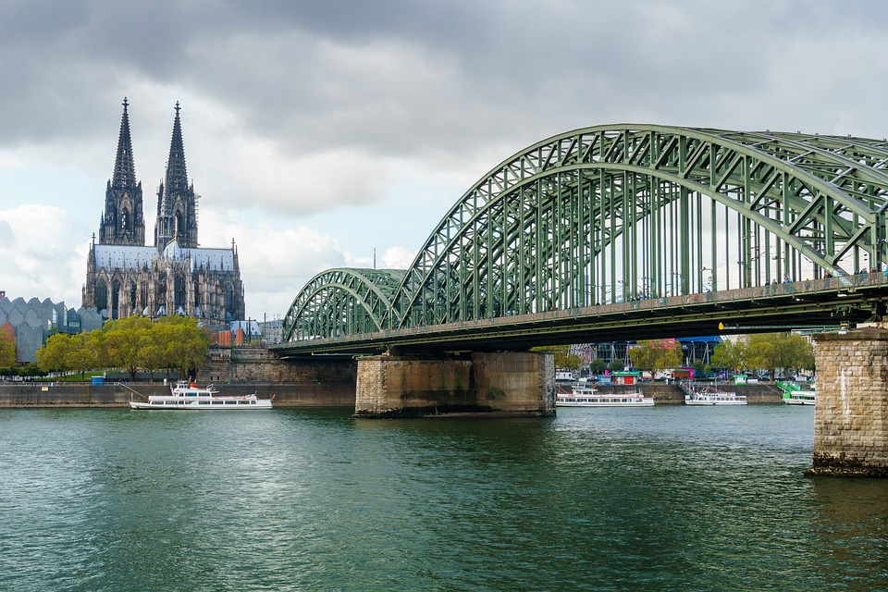
hören
Johannas Klasse hat zwei Stunden Freizeit* in Köln.
Johannas Freunde senden Sprachnachrichten*.
 |  | bin
 |  | bin
 | gehe
 |  | bin
 | gehe
 | gehe
 | gehe
 |  | bin
Ich gehe…
Ich bin…
die Freizeit – free time
die Sprachnachricht – voice mail
Wo sind sie, oder wohin gehen sie?
1
2
3
4
5
6
7
8
Notes:
Timing: 5 minutes
Aim: to practise aural comprehension of R2 and R3 articles, which in turn helps them to identify the correct verb – location (I am) or movement towards (I’m going).
Procedure:
Pupils need only write 1-8 and either gehe or bin.
They listen and decide if her classmates say where they are now or where they are going to.
The answers are animated and appear upon successive clicks of the mouse.
Transcript
Ich [bin] jetzt im Kino.
Ich [bin] um zwei Uhr in der Bibliothek.
Ich [gehe] in den Wald.
Ich [bin] im Dom.
Ich [gehe] in die Stadtmitte.
Ich [gehe] auch in den Garten.
Ich [gehe] dort ins Wasser.
Ich [bin] jetzt im Haus.
13

Slide 14
Tschüss!
blau
Notes:
14

