Slide 1
What I can do
Ich kann das!
blau
Phonics, Vocabulary
and Grammar revision
Follow ups 1-5
Term 2 Week 9
Notes:
Artwork by Steve Clarke. Pronoun pictures from NCELP (www.ncelp.org). All additional pictures selected from Pixabay and are available under a Creative Commons license, no attribution required.
Phonics: revisit SSC [ä] [ö] [ü] [au] [eu | äu] [sch] [sp] [st] [s-] [-s-] [ß] [ss] [-s]
Vocabulary: revisit words from term 2
Jones, R.L & Tschirner, E. (2019). A frequency dictionary of German: Core vocabulary for learners. London: Routledge.
The frequency rankings for words that occur in this PowerPoint which have been previously introduced in these resources are given in the SOW and in the resources that first introduced and formally re-visited those words.
For any other words that occur incidentally in this PowerPoint, frequency rankings will be provided in the notes field wherever possible.
1

Slide 2
aussprechen
Follow up 1
[ä]
[ö]
Höhle
Bär
[cave]
Notes:
1/6
Timing: 5 minutes (six slides)
Aim: to practise read aloud of SSC learnt so far with unknown words.
Procedure:
Tell pupils that they are going to practise the sounds of German that they have learnt this year.
Click to bring up the first ‘flashcard’.
Elicit the SSC first. (To bring all pupils in together, teachers could use a silent 3-2-1 countdown gesture with their fingers).
Elicit the word, using the same countdown procedure.
Click to bring up the 2nd flashcard and repeat steps 3-4.
Word frequency (1 is the most frequent word in German):
Bär [3494] Höhle [2866]
Jones, R.L & Tschirner, E. (2019). A frequency dictionary of German: Core vocabulary for learners. London: Routledge.
2

Slide 3
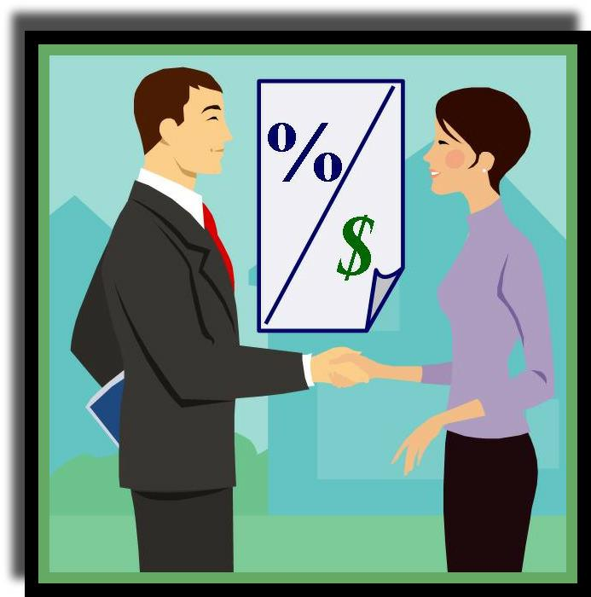
aussprechen
[au]
[äu|eu]
schlau
Käufer
[clever]
[buyer]
Notes:
[2/6]
Word frequency (1 is the most frequent word in German):
Käufer [2051] schlau [N/A]
3

Slide 4
aussprechen
[sch]
[sp]
Sprung
wischen
[to wipe, mop]
[leap, jump]
Notes:
3/6
Word frequency (1 is the most frequent word in German):
Sprung [2727] wischen [3666]
4

Slide 5
aussprechen
[st]
[-s-]
Stiefel
Wespen
[wasps]
Notes:
4/6
Word frequency (1 is the most frequent word in German):
Stiefel [N/A] Wespe [N/A]
5

Slide 6
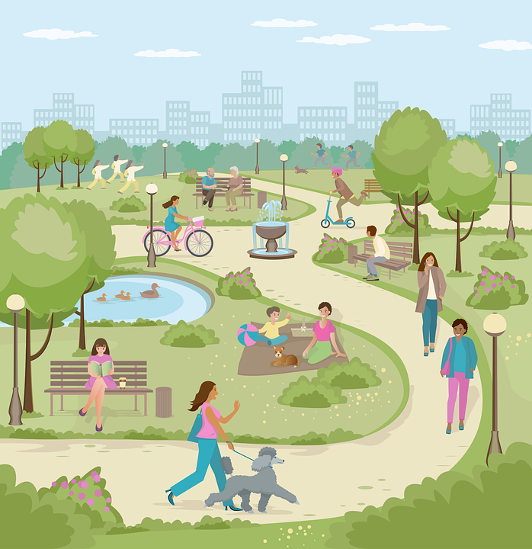
aussprechen
[ss]
[-s]
Gasse
Mais
[lane]
[sweetcorn]
Notes:
5/6
Word frequency (1 is the most frequent word in German):
Gasse [N/A] Mais [N/A]
6

Slide 7
aussprechen
[ß]
Ruß
[soot]
Notes:
6/6
Word frequency (1 is the most frequent word in German):
Ruß [N/A]
7

Slide 8
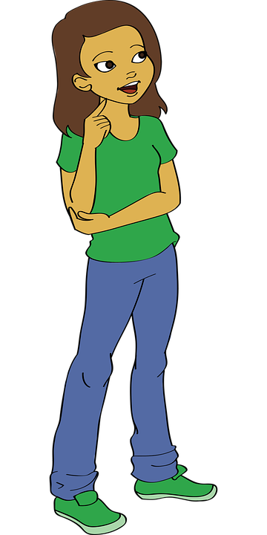
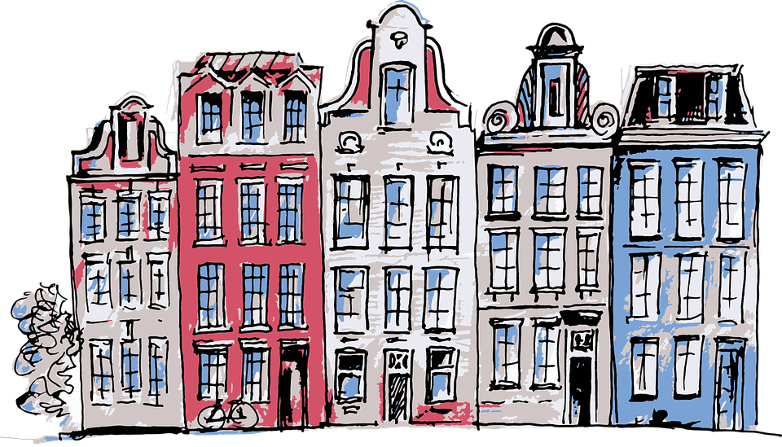
Follow up 2: Sag die Wörter.
aussprechen
Straße
Sprache
Hör zu!
lassen
60
[to let, letting]
Muße
Mädchen
Stelle
Söhne
S
[(quiet) time]
[girl]
[place]
zusammen
waschen
Häuser
Pause
0
[houses]
START
Notes:
Timing: 5 minutes
Aim: to practise applying knowledge of previously learnt SSCs to known and unknown words.
Procedure: 1. Start the timer. Pupil A tries to read aloud all of the words taking care with their pronounciation of the highlighted SSC’s, within the 60 seconds allowed.
2. Pupil B listens. If Pupil A makes a slip, Pupil B can direct him/her to start again from the beginning. 3. They swap roles and repeat the task.
Word frequency for unknown words: (1 is the most frequent word in German):
Häuser [(Haus) 147] lassen [83] Mädchen [602] [Muße [>5009] Sohn [596] Stelle [344]

Slide 9
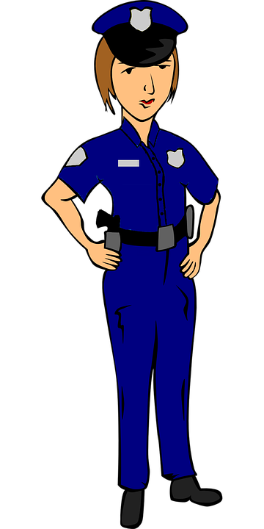
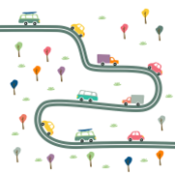
Follow up 3
Sag die Wörter.
sprechen
sprechen
der
das
die
Notes:
Timing: 5 minutes
Aim: to practise spoken production of a range of vocabulary and practise applying gendered articles
Procedure:
Click to bring up the image. Pupils say the word and say them aloud with the appropriate article.
Click again for the words to disappear into the appropriate ‘pacperson’.
Continue for the rest of the items.
Items in order:
das Schloss
die Bibliothek
das Auto
die Arbeit
die Uhr
der Wald
die Straße
die Uniform
der Fluss
die Insel
der Abend
das Fest

Slide 10
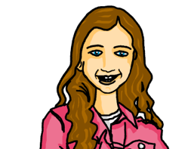
Follow up 4
Das ist ein Quiz für dich, Robbie!
Can you help Robbie with their German?
lesen
Put an (X) next to the noun that completes each sentence.
1. | Am Abend | ☐ spiele ich Tennis. ☐ ich spiele Tennis.
2. |  | ☐ ich sehe einen Film. ☐ sehe ich einen Film.
3. | Im Wald | ☐ ich laufe am Nachmittag. ☐ laufe ich am Nachmittag.
4. | Auf dem Markt | ☐ ich kaufe einen Apfel. ☐ kaufe ich einen Apfel.
5. |  | ☐ ich trage eine Uniform ☐ trage ich eine Uniform.
1
2
3
4
5
Notes:
Timing: 4-5 minutes
Aim: to practise written understanding of WO 2 after adverbs of time and place.
Note: the audio version of this resource has the audio attached the answer cross (click on the green cross for each item, once it has appeared.
Procedure:
Pupils select the correct choice out of two for items 1-5.
Elicit answers.
Click for answers.

Slide 11
Follow up 5
Robbie has forgotten some of their German. Can you help them?
Sometimes you have to tick more than one box!
 |  | A: sind | B: schwimmst | C: vergisst | D: mögen | E: gebe | F: schlaft
1 | ich
2 | du
 | er/sie
 | wir
 | ihr
 | sie (pl.)
 | Sie
lesen
1
2
3
4
5
6
Danke!
7
Notes:
Timing: 6 minutes
Aim: to revise the person/verb agreement with all persons for weak and strong verbs.
Procedure:
Pupils write out 1-9, and write down all possible combinations (between one and three per item/grammatical person).
Click to bring up answer ticks in turn.
If time, elicit English translations for the verb forms.

Slide 12
Tschüss!
blau
Notes:
12

