Slide 1
What I can do
Ich kann das!
blau
Phonics, Vocabulary
and Grammar revision
Term 2 Week 9
Notes:
Artwork by Steve Clarke. Pronoun pictures from NCELP (www.ncelp.org). All additional pictures selected from Pixabay and are available under a Creative Commons license, no attribution required.
Phonics: revisit SSC [ä] [ö] [ü] [au] [eu | äu] [sch] [sp] [st] [s-] [-s-] [ß] [ss] [-s]
Vocabulary: revisit words from term 2
Jones, R.L & Tschirner, E. (2019). A frequency dictionary of German: Core vocabulary for learners. London: Routledge.
The frequency rankings for words that occur in this PowerPoint which have been previously introduced in these resources are given in the SOW and in the resources that first
introduced and formally re-visited those words.
For any other words that occur incidentally in this PowerPoint, frequency rankings will be provided in the notes field wherever possible.
Remember that at the start of the course (first three lessons of Rot/Gelb) pupils learnt language (for greetings and register taking) that can still be part of the lesson routines in upper KS2 (Blau/Grün). They are not re-taught, as we anticipate that teachers have built these in from early in lower KS2.
1

Slide 2
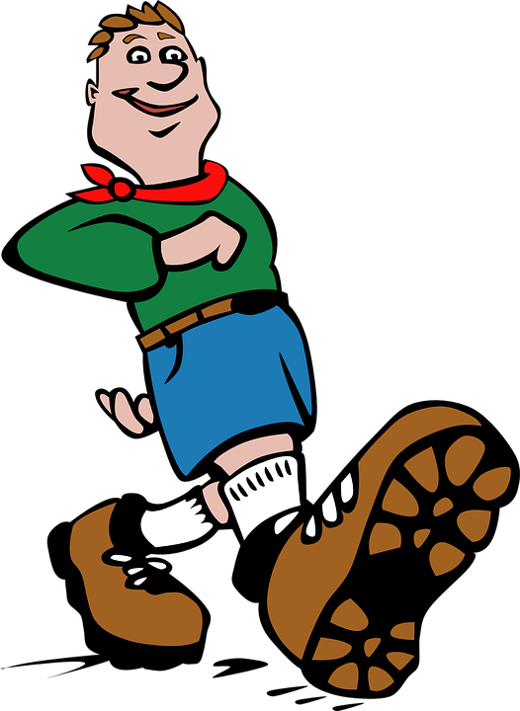
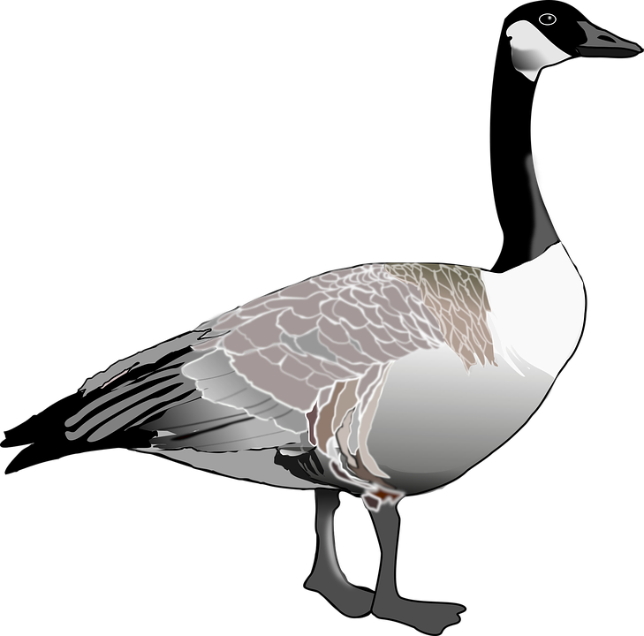
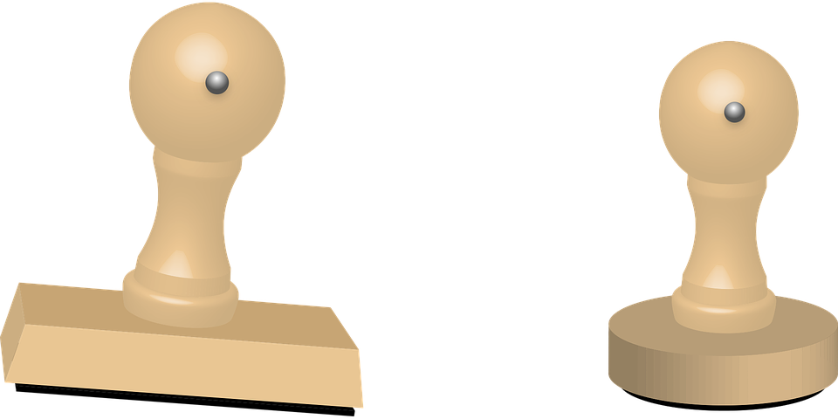
hören
Hör zu.
Write 1-8 und the sound: [ä], [ö], [au],[eu]/[äu], [sch], [sp], [st], [-s-], [ß/s], [ss/s].
hören
1 | Mu sch el
2 | Eu le
3 | H ö lle
4 | Va s e
5 | sp azieren
6 | St empel
?
7 | Flo ss e
8 | F ä den
9 | br au sen
10 | Fu ß
11 | Gan s
?
?
?
?
?
?
?
?
?
?
Notes:
Timing: 5 minutes
Aim: to practise aural recognition and transcription of previously taught SSCs using unknown words.
Procedure:
Click for instructions to come up.
Click audio button 1 to play the recording for item 1. Pupils need to write down the SSC.
Elicit the answer.
Click to reveal the spelling of word 1.
Elicit the meaning, based on the image.
Continue for items 2-11.
Transcript and word frequency: 1. Muschel [N/A] [sch]
2. Eule [N/A] [eu] (also accept äu as it sounds the same)
3. Hölle [4313] [ö]
4. Vase [N/A] [-s-]
5. spazieren [3312] [sp]
6. Stempel [N/A] [st]
7. Flosse [N/A] [ss]
8. Fäden [Faden, 4197] [ä]
9. Brausen [N/A] [au]
10. Fuß [573] [ß]
11. Gans [N/A] [-s]
Source: Jones, R.L. & Tschirner, E. (2019). A frequency dictionary of German: core vocabulary for learners. Routledge

Slide 3
schreiben
Write one different German word into each square.
Wörter
Vokabeln
(( (the) evening | east
every day | to sleep, sleeping
(the) teaching, lessons | (the) work
to sell / selling | there
late | (the) town
to come, coming | where (to)?
(to) home | (the) afternoon
Notes:
Timing: 5 minutes
Aim: to practise written production of this term’s new language.
Procedure: 1. Pupils choose any 9 of the words from the English table and write them into their grid in German.
2. Teacher then calls out the German for any of the 9 words in the table in whichever order.
3. Pupils call Bingo when they have any three in a row (vertical, horizontal, or diagonal) and then again for the first full house.
4. Click on the blue buttons to hear the German translations if needed to support the activity.
Transcript (top to bottom, left to right):
der Abend
jeden Tag
der Unterricht
verkaufen
spät
kommen
nach Hause
Osten, Ost-
schlafen
die Arbeit
dort
die Stadt
wohin?
der Nachmittag
3

Slide 4
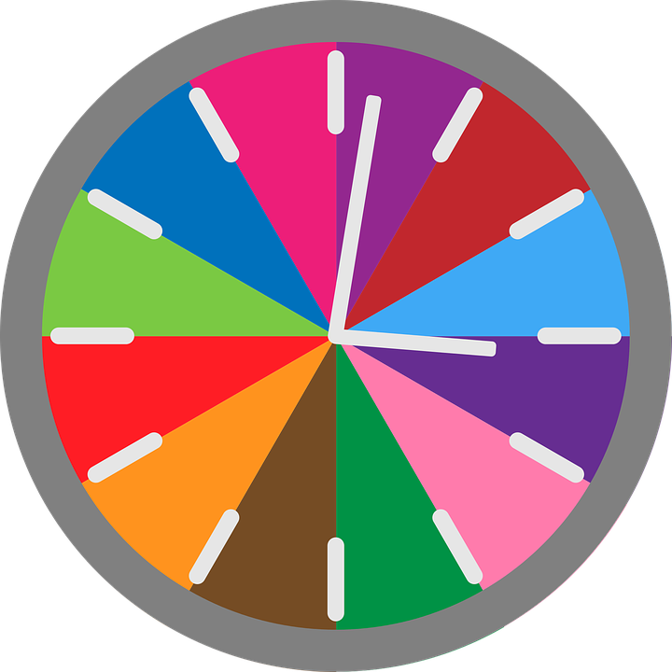
hören
Wie spät ist es?
Hör zu.
Schreib auf Englisch.
 | 3 o’clock
 | 7 o’clock
 | 6 o’clock
 | 2 o’clock
 | 9 o’clock
 | 12 o’clock
 | 5 o’clock
 | 11 o’clock
 | 4 o’clock
 | 8 o’clock
 | 1 o’clock
 | 10 o’clock
 | 3 o’clock
B.
1
7
2
8
3
9
4
10
5
11
6
12
Notes:
Timing: 5 minutes
Aim: to practise aural comprehension of numbers 1-12 in sentences telling the time.
Procedure:
Click on the ‘B.’ sound button to play the example. Students write down the time.
Elicit the answer.
Click to reveal the answer.
Continue for items 1-12.
Transcript:
Beispiel: Wie spät ist es? Es ist drei Uhr.
Wie spät ist es? Es ist sieben Uhr.
Wie spät ist es? Es ist sechs Uhr.
Wie spät ist es? Es ist zwei Uhr.
Wie spät ist es? Es ist neun Uhr.
Wie spät ist es? Es ist zwölf Uhr.
Wie spät ist es? Es ist fünf Uhr.
Wie spät ist es? Es ist elfUhr.
Wie spät ist es? Es ist vier Uhr.
Wie spät ist es? Es ist 8 Uhr.
Wie spät ist es? Es ist 1 Uhr.
Wie spät ist es? Es ist 10 Uhr.
Wie spät ist es? Es ist drei Uhr.
4

Slide 5
lesen
Johanna und Aisha machen Aktivitäten. Sie schreiben eine Liste.
Wann machen sie das? Wissen* wir es oder nicht?
1
Am Nachmittag
laufe ich im Wald.
-
2
Jeden Tag
ich schreibe Geschichten.
-
3
In der Stadt
ich kaufe Geschenke.
-
Am Donnerstag
4
wasche ich den Hund.
-
5
Am Freitag
komme ich spät nach Hause.
-
6
In der Schule
ich mache keine Hausaufgaben.
wissen – to know
-
Notes:
Timing: 8 minutes
Aim: to practise identification of Word Order 2 after adverbs of placer and time.
Procedure:
Explain the scenario. Johanna and Aisha write a list of their activities but the list gets torn up.
Pupils identify the correct choice for item one, based on the syntax of the second part of the sentence.
Click for the incorrect choice to disappear and only the correct choice visible.
Elicit oral translations of each message.
Vocabulary: wissen [78]
Jones, R.L & Tschirner, E. (2019). A frequency dictionary of German: Core vocabulary for learners. London: Routledge.
5

Slide 6
hören
Hör zu. Spricht Aisha mit Johanna (du, informal) oder mit Frau Schmitz (Sie, formal)?
Johanna - du | Frau Schmitz - Sie
Du oder Sie?
B.
1
2
3
4
5
6
Notes:
Timing: 5 minutes
Aim: to practise aural comprehension of du (informal) vs Sie (formal) based on respective second person verb forms.
Procedure:
1. Click to play the audio for the example. Pupils choose their answer, based on the verb.
2. Click for answer tick.
3. Continue for items 1-6.
Transcript:
Beispiel: Hast [du] meine Tasche?
Haben [Sie] meine Hausaufgaben?
Hilfst [du] in der Klasse?
Magst [du] Kuchen?
Sind [Sie] aus Deutschland?
Wohnst [du] in Dortmund?
Gehen [Sie nach Hause?
6

Slide 7
sprechen
Partnerarbeit
Aisha und Robbie take it in turns to say as many sentences as they can in one minute. You do the same with a partner!
60
 | sitzt | kein Deutsch
 | machst | einen Film
ich | sehen | ein Buch
du | helft | in der Klasse
er | haben | die Hausaufgaben
wir | spreche | in der Schule
ihr | vergesst | eine Geschichte
sie | bin | auf dem Stuhl
 | lest | einen Hund
S
0
START
Notes:
Timing: 5 minutes
Aim: to practise spoken production of all weak and strong verbs – all grammatical persons
Procedure:
Explain that pupils have to make as many meaningful sentences as they can and say them out loud in under one minute (use the timer).
If their partner notices a mistake, they swap over. The mistakes could be grammatical (e.g. the pronoun doesn’t match the verb form) or semantic (i.e., the sentence is grammatically correct but doesn’t make logical sense). Note that the latter is a matter of judgement and pupils may want to debate this – as long as it is brief, this interaction is not a bad thing as both pupils will be focused on the meaning of the sentences they are producing).
7

Slide 8
Tschüss!
blau
Notes:
8

