Slide 1
Experiences home and away
blau
Follow ups 1-5
Term 3 Week 7
Notes:
Artwork by Steve Clarke. Pronoun pictures from NCELP (www.ncelp.org). All additional pictures selected from Pixabay and are available under a Creative Commons license, no attribution required.
Phonics: revisit [ie] and [ei]
Vocabulary: putzen [3586] waschen [2315] wollen, ich will, du willst, er/sie/es will [57] Auto [361] Frühstück [2600] Skateboard [n/a] Zimmer [665] sauber
[2026] warum? [192]
Revisit 1: laufen [252] lesen [288] schlafen [679] sehen [79] sprechen [161]
Revisit 2: gehen [66] kommen [62] sein [3] tanzen [1497] Fest [2089] Platz [326] Straße [391] auf [16] nach Hause [n/a]
Jones, R.L & Tschirner, E. (2019). A frequency dictionary of German: Core vocabulary for learners. London: Routledge.
The frequency rankings for words that occur in this PowerPoint which have been previously introduced in these resources are given in the SOW and in the resources that first
introduced and formally re-visited those words.
For any other words that occur incidentally in this PowerPoint, frequency rankings will be provided in the notes field wherever possible.

Slide 2
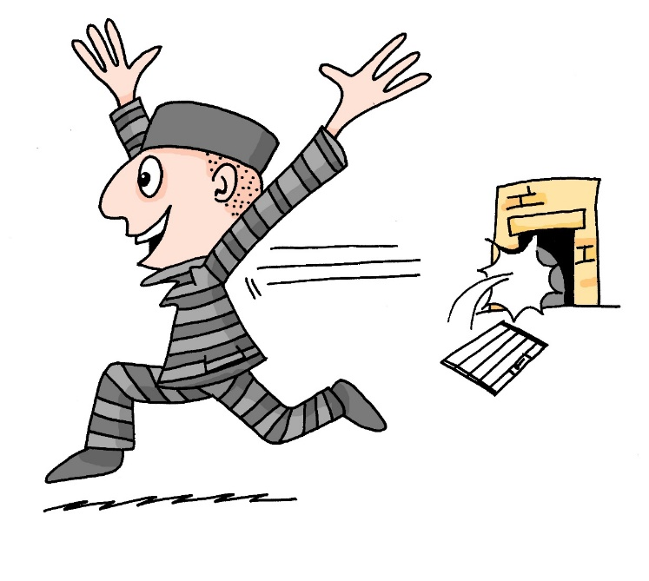
aussprechen
[ei]
[ie]
…
free
frei
Liebe
Notes:
Timing: 1 minute
Aim: to revisit the SSC [ei] and [ie].
Procedure:
Re-present the SSC [ei] and present the source word ‘frei’ (with gesture, if using).
Click to bring on the picture and get pupils to repeat the word ‘frei’ (with gesture, if using).
Note:
a gesture for frei’ might be to throw you hands up in the air and pretend to run away.
Re-present the SSC [ie] and present the source word ‘Liebe’ (with gesture, if using).
Click to bring on the picture and get pupils to repeat the word ‘Liebe’ (with gesture, if using).
Note:
A gesture for ‘Liebe’ might be to make a ‘heart’ shape with both hands approximately where your heart is in your body.
Vocabulary:
frei [318] Liebe [844]
Jones, R.L & Tschirner, E. (2019). A frequency dictionary of German: Core vocabulary for learners. London: Routledge.
2

Slide 3
Follow up 1
Lies, hör zu, und schreib.
Person B
Person A

1. Liebe heißt frei und nicht allein sein.
1. ___________________________
aussprechen

2. __________________________________
2. Deine beiden Haustiere beißen* nie!

3. Die meisten* Spieler lieben Papier und Bleistift.
3. __________________________________

4. Ich wiederhole: keine Briefe für die Feier bei Meier*!
4. __________________________________

5. Zwei Riesen* liegen auf der weißen Wiese.
5. __________________________________

6. __________________________________
6. Die sieben reisen mit drei Klavieren*!
beißen – to bite, meistens – mostly, Meier – common surname, Riese – giant, Klavier - piano
Notes:
Timing: 8 minutes
Aim: to practise aural production, comprehension and written production of the SSCs [ei] and [ie].
Procedure:
Split the class into Person A and Person B pairs.
Person B turns away from the board.
Click to bring up the first item for Person A to read out.
Person B writes down what they have heard, taking care with the [ei] and [ie] SSCs.
Person B turns around and compares what they have written with the version on the board.
Now Person A turns away from the board.
Click to bring up item 2 for Person B to read.
Person B reads out loud and Person A transcribes.
The Person A turns around and compares their version with what is on the board.
Continue for items 2-6.
Note: in the audio version of the lesson, click on the writing hand to hear the sentence pronounced.
Vocabulary:
beide [117 ] beißen [3317] Klavier [4340] Meier [N/A] meinen [213] meistens [1262] Riese [4585]
Jones, R.L & Tschirner, E. (2019). A frequency dictionary of German: Core vocabulary for learners. London: Routledge.

Slide 4
Follow up 2

Schreib auf Englisch.
Can you get at least 15 points?
Wörter
 | das Fest | kommen | der Platz
 | die Straße | auf | nach Hause
 | waschen | lesen | schlafen
 | sprechen | sehen | laufen
 | wollen | ich will | putzen
 | er will | sie will | das Skateboard
 | warum? | sauber | ich will
(the) festival,
celebration
to come, coming
(the) square, place, room
x3
(the) street
on, to, at
(to)home
to wash,washing
to read, reading
to sleep, sleeping
x2
to speak, speaking
to see, seeing
to run, running
to want (to)
I want (to)
to clean, cleaning
he wants (to)
she wants (to)
(the) skateboard
x1
why?
clean
I want (to)
Notes:
Timing: 5 minutes
Aim: to practise written production of vocabulary from this and revisited weeks.
Procedure: 1. Give pupils a blank grid. They fill in the English meanings of any of the words they know, trying to reach 15 points in total.
Note: The most recently learnt and practised words are pink, words from the previous week are green and those from week 1 are blue, thus more points are awarded for them, to recognise that memories fade and more effort (heavy lifting!) is needed to retrieve them.

Slide 5
Follow up 2

Schreib auf Deutsch.
Can you get at least 15 points?
Wörter
 | (the) street | on, to, at | (to) home
 | to come, coming | (the) festival, celebration | (the) square, place, room
 | to see, seeing | to speak, speaking | to wash, washing
 | to run, running | to read, reading | to sleep, sleeping
 | clean | why? | she wants (to)
 | I want (to) | you want (to) | he wants (to)
 | to clean, cleaning | (the) skateboard | to want (to), wanting (to)
die Straße
auf
nach Hause
x3
kommen
das Fest
der Platz
sehen
sprechen
waschen
x2
laufen
lesen
schlafen
sauber
warum?
sie will
ich will
du willst
er will
x1
putzen
das Skateboard
wollen
Notes:
Timing: 5 minutes
Aim: to practise written production of vocabulary from this and revisited weeks.
Procedure: 1. Give pupils a blank grid. They fill in the German meanings of any of the words they know, trying to reach 15 points in total.
Note: The most recently learnt and practised words are pink, words from the previous week are green and those from week 1 are blue, thus more points are awarded for them, to recognise that memories fade and more effort (heavy lifting!) is needed to retrieve them.

Slide 6
Follow up 3
Was ist richtig? Was ist falsch?
lesen
1
singen
3
putzen
Ich will ein Lied
Ich will etwas
verstehen
sehen
wiederholen
lernen
waschen
spielen
5
schlafen
Er will nach Hause
laufen
2
denken
4
verstehen
Du willst dein Skateboard
Was willst du
putzen
fahren
laufen
kommen
waschen
schlafen
spielen
sehen
Notes:
Timing: 5 minutes
Aim: to practise recognition of verbs and vocabulary from this and previous weeks.
Procedure:
Explain to pupils that they need to decide which verbs could be correct enders to each of the 5 sentence starters, based on their meaning. Sometimes all verbs might make sense.
Pupils discuss in pairs and write down 1-5 and the verbs they think work for each sentence.
Elicit answers and click for ticks to appear next to correct verbs. Discuss meanings of each sentence as you correct.
In the audio version, click on the numbered buttons to hear all the possible sentences. Pupils can be encouraged to join in with the audio.
Note: Ensure pupils know the meanings of the sentence starters in red boxes, as without this knowledge they will struggle to access the task. Additional task suggestions: 1. Pupils make up their own sense and nonsense sentences, and their partner or the class must decide whether or not they make sense.

Slide 7
Follow up 4:

Schreib auf Deutsch.


schreiben
Ich will etwas putzen.
Ich will etwas putzen und auf dem Fest tanzen.

1 __________________________
2 ____________________________________________
Ich will etwas putzen, auf dem Fest tanzen und mit Johanna sprechen.
3 ________________________________________________________
am Nachmittag
auf dem Fest
mit Johanna
jetzt im Bett
Skateboard
nach Hause
etwas
einen Film
das Auto
Notes:
Timing: 10 minutes
Aim: writing activity to practise using ‘ich will’, focusing on correct word order with the infinitive verb at the end of each clause.
Procedure:
Explain that pupils are going to play a memory game.
Model how this will work by clicking through the example. After the first sentence click to bring up a callout explaining that pupils can choose to use a verb compliment, or not (inbuilt differentiation).
Pupils work individually. They choose a phrase from the 9 options at random. They start with ‘ich will’ and write a sentence.
They exchange papers with their partner, who writes a sentence with two of the pictures, starting with the same one as their partner.
They keep swapping papers and adding sentences until all options are used up.
If there is any time remaining, they take their own original list back and read it to their partner, who acts out the list, doing an action to show comprehension of each sentence.
Note: in the audio version only, click on the verb icons to hear the verb phrase. Transcript: auf dem Fest tanzen mit Johanna sprechen am Nachmittag laufen jetzt im Bett schlafen Skateboard fahren nach Hause gehen etwas putzen einen Film sehen das Auto waschen

Slide 8
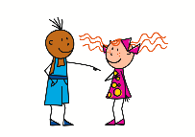
Questions
Remember how to ask yes/no questions with wollen:
Willst du lesen?
?
Du willst lesen.
Note that the verb wollen swaps with the subject du.
Do the same swap with information questions, too:
Wo willst du lesen?
Where do you want to read?
Was willst du lesen?
What do you want to read?
Wann willst du lesen?
When do you want to read?
Warum willst du lesen?
Why do you want to read?
Notes:
Timing: 2 minutes
Aim: to recap the formation of yes/no questions by swapping the subject and verb and to teach the formation of information questions by swapping the subject and verb.
Procedure:
Click through the animations to recap the formation of yes/no questions and to teach the formation of information questions.
Elicit English translation for the German examples provided line by line.
8

Slide 9
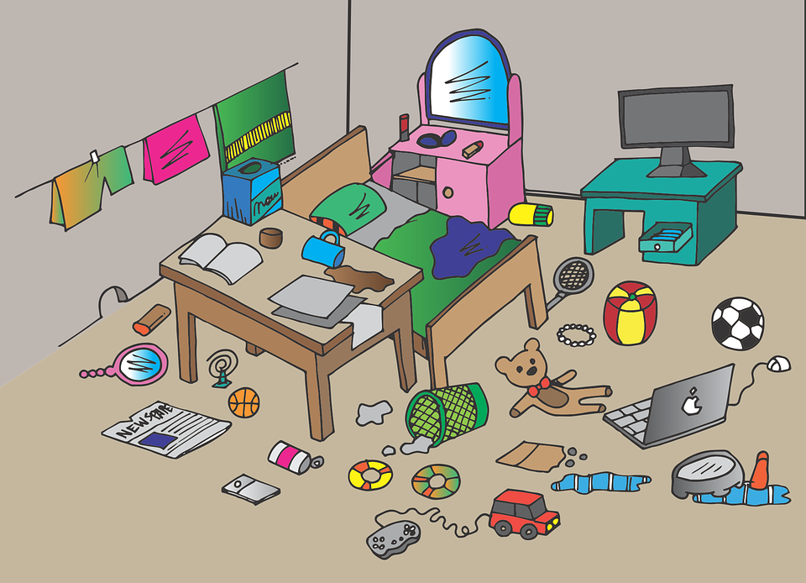
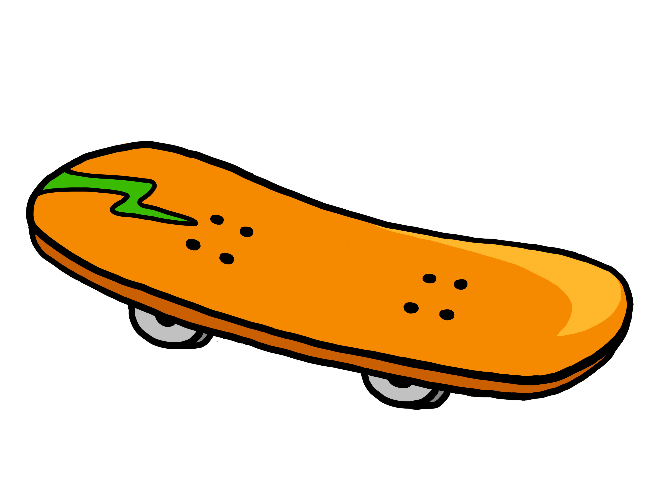
Follow up 5a
Warum willst du…?
Partnerarbeit*!
* Partner work
sprechen
Warum willst du tanzen?
Ask your partner why they want to do each of the things below.
Say why you want to do the things your partner asks you about.
Es macht Spaß.
Person A
Person B
etwas
mein Zimmer
Remember! the 2nd verb in German goes to the end. Willst is the 1st verb.
You can use a reason more than once!
Notes:
Slide 1/2
Timing: 8 minutes
Aim: to provide practice (speaking) in asking and answering questions using wollen.
Procedure:
Demonstrate the conversations pupils will have using Moritz’ and Lukas’ speech bubbles.
Give pupils time in pairs to both ask and answer all questions, noting down their partner’s answers as they go.
If time allows, hear some of the conversations as a class.
After all questions have been asked, partners swap roles – click for next slide.
Possible question/answer pairs:
Warum willst du tanzen?
Es macht Spaß.
Warum willst du etwas essen?
Ich habe Hunger.
Warum willst du nach Hause gehen?
Ich bin müde.
Warum willst du Skateboard fahren?
Es macht Spaß.
Warum willst du putzen?
Mein Zimmer ist nicht sauber.

Slide 10
Follow up 5b
Warum willst du…?
Tauscht die Rollen*!
* Swap roles!
Warum willst du das Auto waschen?
sprechen
Ask your partner why they want to do each of the things below.
Say why you want to do the things your partner asks you about.
Es ist nicht sauber.
Person B
Person A
Remember! the 2nd verb in German goes to the end. Willst is the 1st verb.
You can use a reason more than once!
Notes:
slide 2/2
Partners swap roles.
Click on each verb icon to hear the questions. Click on each answer image to hear reasons.
Possible question/answer pairs:
Warum willst du laufen?
Es macht Spaß.
Warum willst du das Auto waschen?
Es ist nicht sauber.
Warum willst du einen Film sehen?
Es macht Spaß.
Warum willst du Wasser trinken?
Ich habe Durst.
Warum willst du schlafen?
Ich bin müde.

Slide 11
Tschüss!
blau
Notes:
11

Slide 12
Follow up 2

Schreib auf Englisch.
Can you get at least 15 points?
Wörter
 | das Fest | kommen | der Platz
 | die Straße | auf | nach Hause
 | waschen | lesen | schlafen
 | sprechen | sehen | laufen
 | wollen | ich will | putzen
 | er will | sie will | das Skateboard
 | warum? | sauber | ich will
Vokabeln
x3
x2
x1
Notes:
HANDOUT

Slide 13
Follow up 2

Schreib auf Deutsch.
Can you get at least 15 points?
Wörter
 | (the) street | on, to, at | (to) home
 | to come, coming | (the) festival, celebration | (the) square, place, room
 | to see, seeing | to speak, speaking | to wash, washing
 | to run, running | to read, reading | to sleep, sleeping
 | clean | why? | she wants (to)
 | I want (to) | you want (to) | he wants (to)
 | to clean, cleaning | (the) skateboard | to want (to), wanting (to)
Vokabeln
x3
x2
x1
Notes:
HANDOUT

