Slide 1
Experiences at home and away
blau
2-verb structures with wollen
SSC [ei] [ie]
Term 3 Week 7
Notes:
Artwork by Steve Clarke. Pronoun pictures from NCELP (www.ncelp.org). All additional pictures selected from Pixabay and are available under a Creative Commons license, no
attribution required.
Phonics: revisit [ie] and [ei]
Vocabulary: putzen [3586] waschen [2315] wollen, ich will, du willst, er/sie/es will [57] Auto [361] Frühstück [2600] Skateboard [n/a] Zimmer [665] sauber [2026] warum? [192]
Revisit 1: laufen [252] lesen [288] schlafen [679] sehen [79] sprechen [161]
Revisit 2: gehen [66] kommen [62] sein [3] tanzen [1497] Fest [2089] Platz [326] Straße [391] auf [16] nach Hause [n/a]
Jones, R.L & Tschirner, E. (2019). A frequency dictionary of German: Core vocabulary for learners. London: Routledge.
The frequency rankings for words that occur in this PowerPoint which have been previously introduced in these resources are given in the SOW and in the resources that first
introduced and formally re-visited those words.
For any other words that occur incidentally in this PowerPoint, frequency rankings will be provided in the notes field wherever possible.
Remember that at the start of the course (first three lessons of Rot/Gelb) pupils learnt language (for greetings and register taking) that can still be part of the lesson routines in upper KS2 (Blau/Grün). They are not re-taught, as we anticipate that teachers have built these in from early in lower KS2.
1

Slide 2
aussprechen
[ei]
…
free
frei
Notes:
Timing: 1 minute
Aim: to revisit the SSC [ei].
Procedure:
Re-present the SSC [ei] and present the source word ‘frei’ (with gesture, if using).
Click to bring on the picture and get pupils to repeat the word ‘frei’ (with gesture, if using).
Note:
a gesture for frei’ might be to throw you hands up in the air and pretend to run away.
Vocabulary: frei [318
Jones, R.L & Tschirner, E. (2019). A frequency dictionary of German: Core vocabulary for learners. London: Routledge.
2

Slide 3
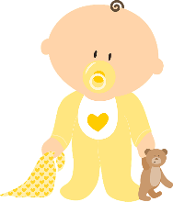
aussprechen
[ei]
…
frei
/a
sein
ein
alone
klein
allein
Notes:
Timing: 1 minute
Aim: to revisit the SSC [ei].
Procedure:
Re-present the SSC and the source word ‘frei’ (with gesture, if using).
Click to bring on the picture and get pupils to repeat the word ‘frei’ (with gesture, if using).
Present the cluster words in the same way, bringing on the picture and getting pupils to pronounce the words.
Vocabulary: frei [318] ein [5] klein [114] sein [3] allein [258]
Jones, R.L & Tschirner, E. (2019). A frequency dictionary of German: Core vocabulary for learners. London: Routledge.

Slide 4
aussprechen
[ie]
…
Liebe
Notes:
Timing: 1 minute
Aim: to revisit the SSC [ie].
Procedure:
Re-present the SSC [ie] and present the source word ‘Liebe’ (with gesture, if using).
Click to bring on the picture and get pupils to repeat the word ‘Liebe’ (with gesture, if using).
Note:
A gesture for ‘Liebe’ might be to make a ‘heart’ shape with both hands approximately where your heart is in your body.
Liebe [844]
Jones, R.L & Tschirner, E. (2019). A frequency dictionary of German: Core vocabulary for learners. London: Routledge.
4

Slide 5
aussprechen
[ie]
…
sie
Liebe
Brief
Notes:
Timing: 1 minute
Aim: to revisit the SSC [ie].
Procedure:
Re-present the SSC and present the source word ‘Liebe’ (with gesture, if using).
Click to bring on the picture and get pupils to repeat the word ‘Liebe’ (with gesture, if using).
Present the cluster words in the same way, bringing on the picture and getting pupils to pronounce the words.
sie [7] Brief [838]
Jones, R.L & Tschirner, E. (2019). A frequency dictionary of German: Core vocabulary for learners. London: Routledge.
5

Slide 6
[ie] [ei]
Hör zu. Wie viele [ei] und [ie] hörst du?
hören
 |  | ei | ie
1 | Die zwei Kinder lieben klein sein. | I I I | I I
2 | Wie heißen deine Lieblingstiere? | I I | I I I
3 | Nein, für meine drei Spiele kriege* ich keinen Preis. | I I I I I | I I
4 | Dieses Eis ist weiß und nie heiß*! | I I I | I I
5 | Frieda, Heike und Addie reisen* in die Schweiz. | I I I | I I I
6 | Wie viele Beispiele sind auf dem Papier hier? Drei! | I I | I I I I I
*kriegen – to get, receive (informal)
*heiß (adjective) – hot
*reisen – to travel
Notes:
Timing: 5 minutes
Aim: to consolidate the SSC [ei] and [ie] in a listening activity.
Procedure:
Explain the task. Pupils are going to hear six sentences which contain a mixture of [ei] and [ie] sounds.
For each sentence they hear, pupils count the number of times they hear each SSC, noting down their answers.
Click to reveal answers.
To aid comprehension, click to reveal a gloss box each for the unknown word in items 3, 4 and 5 respectively.
Transcript:
Die zwei Kinder lieben klein sein.
Wie heißen deine Lieblingstiere?
Nein, für meine drei Spiele kriege ich keinen Preis.
Dieses Eis ist weiß und nie heiß!
Frieda, Heike und Addie reisen in die Schweiz.
Wie viele Beispiele sind auf dem Papier hier? Drei!
Vocabulary:
heiß [1195] kriegen [724] reisen [933]
Jones, R.L & Tschirner, E. (2019). A frequency dictionary of German: Core vocabulary for learners. London: Routledge.

Slide 7
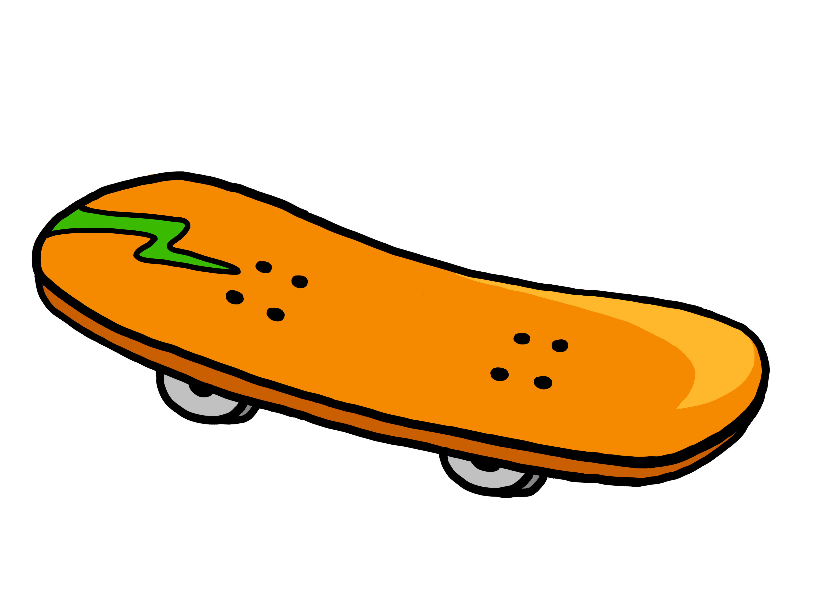
Vokabeln
Vokabeln lernen [1/3]
Wörter
Hör zu und wiederhole.
putzen
wollen
das Skateboard
warum?
sauber
du willst
er will
sie will
ich will
Notes:
Timing: 5 minutes (3 slides)
Aim: to present and practise new vocabulary for this week
Procedure:
Click to bring up each German word. In audio versions, the audio is attached to the appear animation. Pupils repeat.
Click to bring up the English meaning and image and pupils say the German again. (This challenges them to retain the pronunciation in their working memory, but they are also supported by the written German version on the slide).
Move to the next slide.
7

Slide 8
Vokabeln
Vokabeln lernen [2/3]
Wörter
Was ist das auf Englisch?
putzen
wollen
das Skateboard
warum?
sauber
ich will
du willst
er will
sie will
Notes:
[2/3]
Procedure:
Click to hide the English translation of each word in turn. Pupils chorally suggest the English answers.
Move to the next slide.
8

Slide 9
Vokabeln
Vokabeln lernen [3/3]
Wörter
Was ist das auf Deutsch?
putzen
wollen
das Skateboard
warum?
sauber
du willst
er will
sie will
ich will
Notes:
[3/3]
Procedure:
Click to hide the German word by word in random order. Pupils chorally suggest the German.
Click to reveal answers (with audio attached, in the audio version).
9

Slide 10
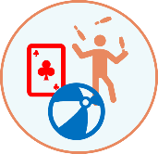
wollen – to want to
To say what you want to do use the verb wollen and a 2nd verb in the infinitive form.
Wollen is irregular. The spelling changes.
Ich will tanzen.
I want to dance.
Du willst spielen.
You want to play.
The 2nd verb always goes to the end of the sentence:
Ich will Skateboard fahren.
I want to go skateboarding.
Du willst Fußball spielen.
You want to play football.
The word order is different from English!
Notes:
Timing: 2 minutes
Aim: to present the 1st and 2nd persons singular of the verb wollen.
Procedure:
Click through the animations to present the new information.
Elicit English translation for the German examples provided.
10

Slide 11
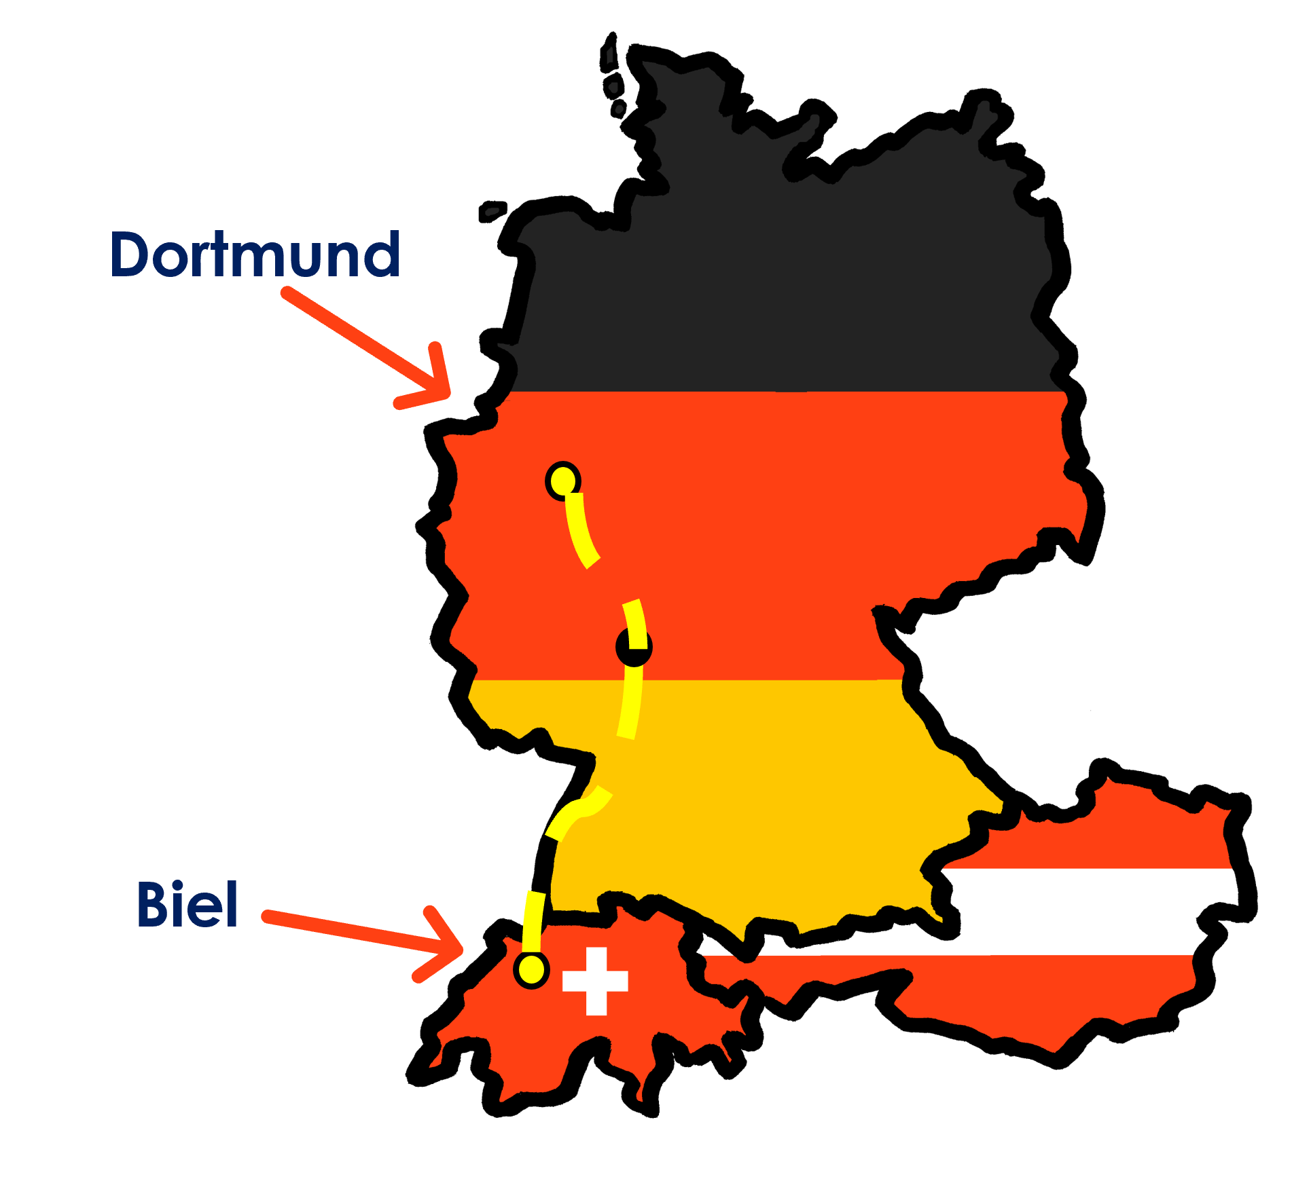
hören
Ist es Johanna oder Moritz? Was will Johanna machen? → Ich will
Was will Moritz machen? → Du willst
Hör zu.
Johanna und Moritz planen* für Lias und Ronja.
 |  | Johanna (ich) | Moritz (du)
 | Du willst das Haus putzen.
 | Ich will einen Film sehen.
 | Ich will den Hund sauber waschen.
 | Du willst mit Lias sprechen.
 | Du willst Skateboard fahren.
 | Ich will ein Frühstück für Ronja und Lias machen.
Ich oder
du?
Johanna
1
2
Moritz
3
4
5
6
Ronja
Lias
Notes:
Timing: 5 minutes
Aim: to practise aural identification and comprehension of wollen in first and second persons singular.
Procedure:
Explain the task. Johanna and Moritz are planning for their cousins, the twins Lias and Ronja’s, visit. Johanna is summarising what they each want to do.
Students listen carefully. If they hear ‘will’ it is something Johanna wants to do and they tick Johanna. If they hear ‘willst’ then it is something Moritz wants to do.
Click to play number 1 as an example. Ask pupils to write either Johanna or Moritz.
Click to reveal the answer.
Repeat with items 2-6.
Transcript:
1. [Du] willst das Haus putzen.
2. [Ich] will einen Film sehen.
3. [Ich] will den Hund sauber waschen.
4. [Du] willst mit Lias sprechen.
5. [Du] willst Skateboard fahren.
6. [Ich] will ein Frühstück für Ronja und Lias machen.
Vocabulary: planen [579]
Jones, R.L & Tschirner, E. (2019). A frequency dictionary of German: Core vocabulary for learners. London: Routledge.
11

Slide 12
wollen – to want to
Note that will does NOT mean will in English. This is called a falscher Freund (false friend)!
Remember how to say what you want to do with the verb wollen:
Ich will laufen.
I want to run.
Du willst laufen.
You want to run.
Note! will = want to for ich, er, sie and es. This is different from most German verbs you know.
To say he/she/it can, use:
Er will laufen.
He wants to run.
Sie will laufen.
She wants to run.
Es will laufen.
It wants to run.
Notes:
Timing: 2 minutes
Aim: to present the 3rd person singular of wollen.
Procedure:
Click through the animations to present the new information.
Elicit English translations for the German examples provided.
Click to bring up the callouts about the third person and person version of ‘wollen’ being the same: ‘will’ and that wollen is a false friend as it does not mean ‘will’ in English.
12

Slide 13
lesen
Johanna schreibt SMS mit Ronja.
Ist das Johanna (ich), Vati/Steffen (er), oder Ronja (du)?
[Vati] will das Haus putzen. Es ist nicht sehr sauber.
you
Vati will ein großes Frühstück machen. Wir haben Hunger.
1
you
4
he
he
Du willst deine Kleidung waschen. Wir gehen auf eine Party!
Du willst in meinem Zimmer schlafen. Es ist sauber, nicht wahr?
he
I
2
you
5
you
Warum will ich das Auto waschen?
Es ist sauber, nicht wahr?
Ich will nach Hause gehen und schlafen. Ich bin müde.
I
you
3
6
you
I
Notes:
1/2
Timing: 5 minutes
Aim: to practise written comprehension of this week’s verbs and vocabulary in the present tense.
Procedure:
Read and ensure pupils understand the context and the instruction. Johanna is writing messages with Ronja, talking about what Vati/Steffen (er), herself (ich) and Ronja( du)want to do.
Pupils write 1-6 and the correct English pronoun from the two options given. They use their knowledge of wollen in the present tense to determine which pronoun is missing.
Click to reveal answers. To consolidate understanding, pupils can be asked to help Johanna put her sentences into English. Rather than writing the translations, teachers can simply elicit the meanings orally.
13

Slide 14
lesen
Warum will Johanna, Vati oder Ronja das machen?
Schreib auf Englisch.
Warum will Vati das Haus putzen?
Vati will das Haus putzen. Es ist nicht sehr sauber.
Warum will Vati ein Frühstück machen?
Vati will ein großes Frühstück machen. Wir haben Hunger.
1
It is not clean.
4
Warum will Ronja ihre Kleidung waschen?
We are hungry.
Du willst deine Kleidung waschen. Wir gehen auf eine Party!
Du willst in meinem Zimmer schlafen. Es ist sauber, nicht wahr?
Warum will Ronja in Johannas Zimmer schlafen?
2
5
They’re going to a party!
It is clean, isn’t it?
Warum will ich das Auto waschen?
Es ist sauber, nicht wahr?
Warum will Johanna das Auto nicht waschen?
Ich will nach Hause gehen und schlafen. Ich bin müde.
Warum will Johanna nach Hause gehen?
3
6
It is clean, isn’t it?
She is tired.
Notes:
2/2
Timing: 5 minutes
Aim: to practise written comprehension of the singular forms of wollen and vocabulary in the present tense.
Procedure:
Read the items, which are the same as on the previous slide.
Pupils write 1-6 and answer to the question in English, as this is a comprehension task.
14

Slide 15
Tschüss!
blau
Notes:
15

