Slide 1
Mann ohne Kopf
rot
Follow ups 1-5
Text translated and adapted from an original poem, Hombre sin cabeza, by Armando José Sequera.
Term 3 Week 12
Notes:
Artwork by Steve Clarke. Pronoun pictures from NCELP (www.ncelp.org). All additional pictures selected from Pixabay and are available under a Creative Commons license, no attribution required.
Phonics:
[pf] Kopf [279] Pflanze [1667] Apfel [3490]
[kn] Knie [1679] Knochen [1930] knüpfen [4564]
Vocabulary: besuchen [820] lieben [701] Kopf [279] (essen [323] lesen [305] sehen [79] introduced as infinitives only)
Revisit 1: Bruder [730] Mutter [218] Schwester [974] Vater [232] freundlich [1566] ihr¹ [27] nett [1565] sein² [30]
Revisit 2: sitzen [231] wiederholen [988] Antwort [522] Frage [157] Satz [432] neben [266]
Jones, R.L & Tschirner, E. (2019). A frequency dictionary of German: Core vocabulary for learners. London: Routledge.
The frequency rankings for words that occur in this PowerPoint which have been previously introduced in these resources are given in the SOW and in the resources that first
introduced and formally re-visited those words.
For any other words that occur incidentally in this PowerPoint, frequency rankings will be provided in the notes field wherever possible.

Slide 2
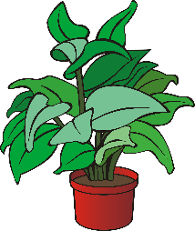
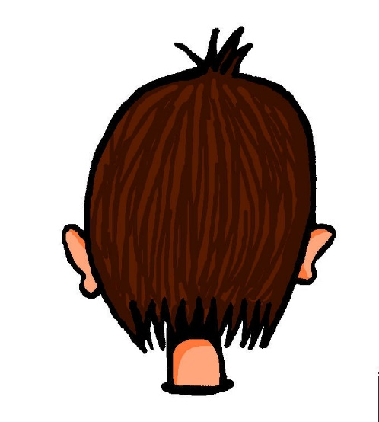
aussprechen
[pf]
…
Kopf
Pflanze
Apfel
Notes:
Timing: 1 minute
Aim: to consolidate the SSC [pf].
Procedure:
Re-present the SSC and the source word ‘Kopf’ (with gesture, if using).
Click to bring on the picture and get pupils to repeat the word ‘Kopf’ (with gesture, if using).
Present the cluster words in the same way, bringing on the picture and getting pupils to pronounce the words.
Frequency: Kopf [250] Pflanze [1667] Apfel [3490]
Jones, R.L & Tschirner, E. (2019). A frequency dictionary of German: Core vocabulary for learners. London: Routledge.

Slide 3
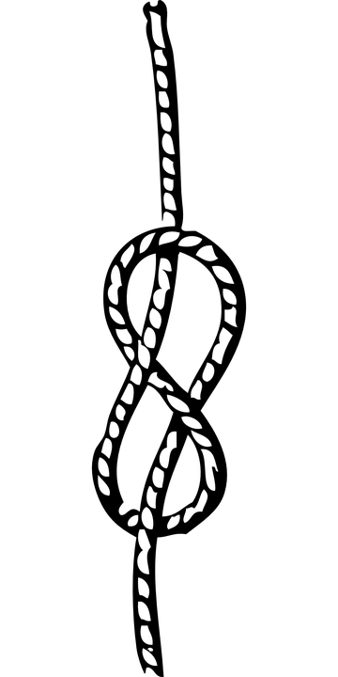
aussprechen
[kn]
…
Knie
Knochen
knüpfen
Notes:
Timing: 1 minute
Aim: to consolidate the SSC [kn].
Procedure:
Re-present the SSC and the source word ‘Knie’ (with gesture, if using).
Click to bring on the picture and get pupils to repeat the word ‘Knie’ (with gesture, if using).
Present the cluster words in the same way, bringing on the picture and getting pupils to pronounce the words.
Frequency: Knie [1679] Knochen [1930] knüpfen [4564]
Jones, R.L & Tschirner, E. (2019). A frequency dictionary of German: Core vocabulary for learners. London: Routledge.

Slide 4
Follow up 1
Hör zu. Was kann Klaus Knopf nicht machen?
aussprechen
1
Klaus Knopf ohne Kopf kann keine Pfeife pfeifen.
Klaus Knopf without a head can’t whistle a whistle.
2
3
Notes:
Timing: 5 minutes (4 slides)
Aim: to practise applying knowledge of [pf] and [kn] to unknown words.
Procedure: 1. Pupils read the sentence and the English translation.
2. Click on the 3 audio buttons to hear the sentence read at increasing speeds.
3. Click to reveal the following slide. Teacher clicks on the 30 second timer, and pupils try to say the sentence before the timer runs out. Repeat for the 20 second and 15 second timers.
4. Repeat steps 1-3 for the next two slides.
Frequency: Kopf [250] ohne [120] Pfeife [>5000] pfeifen [4545] knacken [4657] knistern [>5000]
Jones, R.L & Tschirner, E. (2019). A frequency dictionary of German: Core vocabulary for learners. London: Routledge.

Slide 5
Follow up 1
Sag den Satz.
aussprechen
How quickly can you say the sentence?
Klaus Knopf ohne Kopf kann keine Pfeife pfeifen.
30
S
20
15
S
S
0
0
0
START
START
START
Notes:
[2/4]

Slide 6
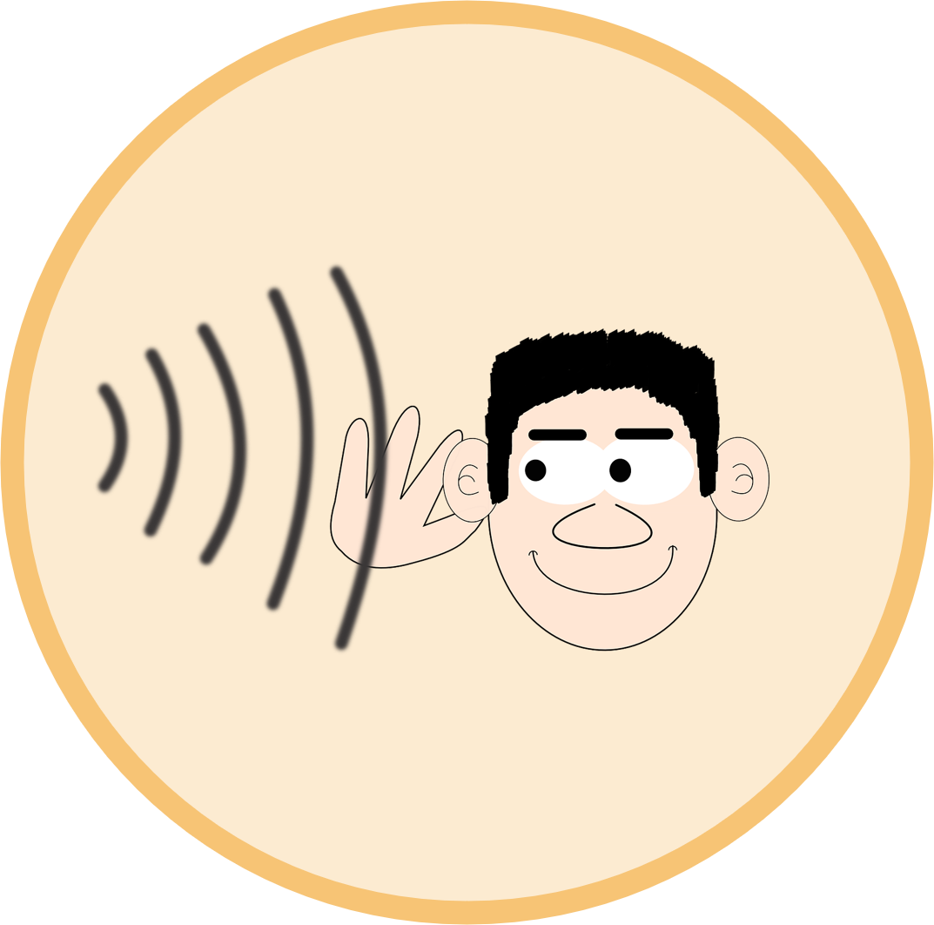
Follow up 1
Hör zu. Was kann Klaus Knopf nicht machen?
aussprechen
1
Klaus Knopf ohne Kopf kann kein Knacken und Knistern hören.
Klaus Knopf without a head can’t hear any crackles or rustling.
2
3
Notes:
[3/4]

Slide 7
Follow up 1
Sag den Satz.
aussprechen
How quickly can you say the sentence?
Klaus Knopf ohne Kopf kann kein Knacken und Knistern hören.
30
S
20
15
S
S
0
0
0
START
START
START
Notes:
[4/4]

Slide 8
Können
How is the word order different from English?
To say can’t with nouns and können, put the noun before the infinitive verb:
Er kann keinen Satz verstehen.
He can’t understand a sentence
Er kann keine Antwort wiederholen.
He can’t repeat an answer
Er kann kein Buch lesen.
He can’t read a book
Notes:
Timing: 3 minutes
Procedure:
Click through the animations to present the information.
Elicit English translation for the German examples provided.
8

Slide 9
Follow up 2
Can oder can’t?
lesen
 | Ich kann eine Frage wiederholen. | I can|can’t repeat a question.
 | Du kannst kein Spiel gewinnen. | You can|can’t win a game.
 | Sie kann einen Kuchen essen | She can|can’t eat a cake.
 | Er kann einen Ort besuchen. | He can|can’t visit a place.
 | Du kannst kein Foto sehen. | You can|can’t see a photo.
 | Ich kann kein Buch lesen. | I can|can’t read a book.
1
2
3
4
5
6
Notes:
Timing: 5 minutes
Aim: To focus on the difference in meaning between ‘ein/eine/ein’ and ‘kein/keine/kein’ within two-verb sentences with können.
Note: Three persons of können are used, for variety, but the English translations are provided to allow pupils focus solely on the difference in form and meaning ‘ein/kein’ and the equivalent structure in English, which is very different. Pupils have already been taught ‘nicht’ with verbs and ‘kein’ with nouns and practised differentiating between them. However, this is a point of significant cross-linguistic difficulty, and is therefore being revisited here, with different lexis and a different sentence structure.
Procedure:
Pupils should write 1-6 in their books and record ‘can’ or ‘can’t for each.
Answers are revealed on separate mouse clicks.
In the audio version, click on the blue buttons to hear a native speaker.

Slide 10
Follow up 3

Remember! If you say ‘can’t’ with a verb only, use ‘nicht’. If your sentence has a noun, use ‘kein’.
Schreib die Wörter auf Deutsch und auf Englisch.
schreiben
‘can’t’ is the short version of cannot or can not.
__ _____ nicht sitzen.
___ _____ kein Lied hören.
Ich kann ____ _____ _______.
Du kannst ____ __________ _______.
Ich kann _____ ______
He can ____ ___.
She can __ ____ _ ______.
_ ____ ‘t take (make) a photo.
___ ____ ‘t play an instrument.
_ ____ ‘t help.
Er kann
‘t sit
1
Sie kann
‘t hear a song
2
kein Foto machen
I can
3
kein Instrument spielen
You can
4
nicht helfen.
I can
5
Notes:
Timing: 5 minutes
Aim: to contrast ‘can’t’ sentences with verbs only and those with noun verb phrases.
This is a jigsaw translation task.
Procedure:
Students write the missing words in both German and English to complete the sentences.
Teacher clicks to provide the written answers and/or clicks the audio buttons to hear the full German sentences.

Slide 11
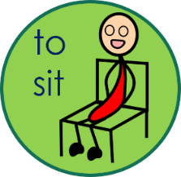
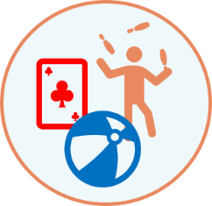
Follow up 4
Ich kann nicht/ kein…
sprechen
Was kannst du nicht machen?
Ich kann nicht schwimmen.
Ich kann nicht schwimmen. Ich kann keinen Kuchen essen.
Ich kann nicht schwimmen. Ich kann keinen Kuchen essen. Ich kann kein Foto machen.
Notes:
Timing: 5 minutes
Aim: to practise using ‘ich kann nicht/ kein’.
Procedure:
Explain that pupils are going to play a memory game.
Model how this will work by clicking through the example.
Pupils work in pairs. Pupil A chooses one of the 9 options on the slide at random. If they have chosen just a verb, they will say ‘ich kann nicht…’. If they have chosen a verb with a noun, they will say ‘ich kann kein…’. Pupil B then repeats what pupil A has said and then adds a second option. Pupils continue adding sentences until they have used all 9 options.

Slide 12
Follow up 5:

Schreib auf Englisch.
Can you get at least 15 points?
Wörter
 | die Antwort | wiederholen | der Satz
 | neben | sitzen | die Frage
 | der Vater | freundlich | sein
 | ihr | der Bruder | nett
 | die Schwester | haben | die Mutter
 | der Bleistift | gewinnen | das Lied
 | hören | das Bild | spielen
(the) answer
to repeat, repeating
(the) sentence
Vokabeln
x3
next to, beside
to sit, sitting
(the) question
(the) father
friendly
his
x2
her
(the) brother
nice
(the) sister
to have, having
(the) mother
(the) pencil
to win, winning
(the) song
x1
to listen, listening
(the) picture
to play, playing
Notes:
Timing: 5 minutes
Aim: to practise written comprehension of vocabulary from this and revisited weeks.
Procedure: 1. Give pupils a blank grid. They fill in the English meanings of any of the words they know, trying to reach 15 points in total. 2. Remind pupils that adjectives can refer to male or female persons and they should note this in their translations. E.g. pleased (f), short (m).
Note: The most recently learnt and practised words are pink, words from the previous week are green and those from week 1 are blue, thus more points are awarded for them, to recognise that memories fade and more effort (heavy lifting!) is needed to retrieve them.

Slide 13
Follow up 5:

Schreib auf Deutsch.
Can you get at least 15 points?
Wörter
 | (the) sentence | (the) answer | next to, beside
 | (the) question | to sit, sitting | to repeat, repeating
 | (the) brother | (the) sister | nice
 | friendly | (the) mother | to have, having
 | (the) father | her | his
 | (the) song | to listen, listening | (the) picture
 | (the) pencil | to play, playing | to win, winning
der Satz
die Antwort
neben
Vokabeln
x3
die Frage
sitzen
wiederholen
der Bruder
die Schwester
nett
x2
freundlich
die Mutter
haben
der Vater
ihr
sein
das Lied
hören
das Bild
x1
der Bleistift
spielen
gewinnen
Notes:
Timing: 5 minutes
Aim: to practise written production of vocabulary from this and revisited weeks.
Procedure: 1. Give pupils a blank grid. They fill in the German meanings of any of the words they know, trying to reach 15 points in total. 2. Remind pupils that adjectives can refer to male or female persons and they should note this in their translations. E.g. pleased (f), short (m).
Note: The most recently learnt and practised words are pink, words from the previous week are green and those from week 1 are blue, thus more points are awarded for them, to recognise that memories fade and more effort (heavy lifting!) is needed to retrieve them.

Slide 14
Tschüss!
rot
Notes:
14

Slide 15
Follow up 5:

Schreib auf Englisch.
Can you get at least 15 points?
Wörter
 | die Antwort | wiederholen | der Satz
 | neben | sitzen | die Frage
 | der Vater | freundlich | sein
 | ihr | der Bruder | nett
 | die Schwester | haben | die Mutter
 | der Bleistift | gewinnen | das Lied
 | hören | das Bild | spielen
Vokabeln
x3
x2
x1
Notes:
Handout

Slide 16
Follow up 5:

Schreib auf Deutsch.
Can you get at least 15 points?
Wörter
 | (the) sentence | (the) answer | next to, beside
 | (the) question | to sit, sitting | to repeat, repeating
 | (the) brother | (the) sister | nice
 | friendly | (the) mother | to have, having
 | (the) father | her | his
 | (the) song | to listen, listening | (the) picture
 | (the) pencil | to play, playing | to win, winning
Vokabeln
x3
x2
x1
Notes:
Handout

