Slide 1
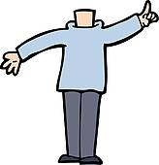
Mann ohne Kopf
rot
können
SSC [pf] [kn]
Text translated and adapted from an original poem, Hombre sin cabeza, by Armando José Sequera.
Term 3 Week 12
Notes:
Artwork by Steve Clarke. Pronoun pictures from NCELP (www.ncelp.org). All additional pictures selected from Pixabay and are available under a Creative Commons license, no
attribution required.
Text source: the text is translated and adapted from an original Spanish source: Hombre sin cabeza, by Armando José Sequera.
Phonics:
[pf] Kopf [279] Pflanze [1667] Apfel [3490]
[kn] Knie [1679] Knochen [1930] knüpfen [4564]
Vocabulary: besuchen [820] lieben [701] Kopf [279] (essen [323] lesen [305] sehen [79] introduced as infinitives only)
Revisit 1: Bruder [730] Mutter [218] Schwester [974] Vater [232] freundlich [1566] ihr¹ [27] nett [1565] sein² [30]
Revisit 2: sitzen [231] wiederholen [988] Antwort [522] Frage [157] Satz [432] neben [266]
Jones, R.L & Tschirner, E. (2019). A frequency dictionary of German: Core vocabulary for learners. London: Routledge.
The frequency rankings for words that occur in this PowerPoint which have been previously introduced in these resources are given in the SOW and in the resources that first
introduced and formally re-visited those words.
For any other words that occur incidentally in this PowerPoint, frequency rankings will be provided in the notes field wherever possible.
Note that the first three lessons of the year teach language that can be continuously recycled as lesson routine every lesson in Y3/4.
The idea would be that the class teacher (whether or not s/he teaches the class German can re-use the language as part of the daily routine with the class.
1

Slide 2
aussprechen
[pf]
…
Kopf
Notes:
Timing: 1 minute
Aim: to introduce the SSC [pf].
Procedure:
1. Present the letter and say the [pf] sound first, on its own. Pupils repeat it with you. 2. Bring up the word ”Kopf” on its own, say it, pupils repeat it, so that they have the opportunity to focus all of their attention on the connection between the written word and its sound.
3. Click to bring up the picture and introduce the gesture, if using. Pupils repeat the word again.
4. Roll back the animations and work through 1-3 again, but this time, dropping your voice completely to listen carefully to the students saying the [pf] sound, pronouncing ”Kopf” and, if using, doing the gesture.
Note: A possible gesture for this would be to use the British Sign Language (BSL) sign for head, as here: https://www.signbsl.com/sign/head
Frequency: Kopf [250]
Jones, R.L & Tschirner, E. (2019). A frequency dictionary of German: Core vocabulary for learners. London: Routledge.
2

Slide 3
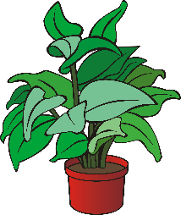
aussprechen
[pf]
…
Kopf
Pflanze
Apfel
Notes:
Timing: 1 minute
Aim: to consolidate the SSC [pf].
Procedure:
Re-present the SSC and the source word ‘Kopf’ (with gesture, if using).
Click to bring on the picture and get pupils to repeat the word ‘Kopf’ (with gesture, if using).
Present the cluster words in the same way, bringing on the picture and getting pupils to pronounce the words.
Frequency: Kopf [250] Pflanze [1667] Apfel [3490]
Jones, R.L & Tschirner, E. (2019). A frequency dictionary of German: Core vocabulary for learners. London: Routledge.

Slide 4
aussprechen
[kn]
In English the k in words starting with kn (e.g. knee, knot) is silent.
In German the k is pronounced, → K-nie.
…
Knie
Notes:
Timing: 1 minute
Aim: to introduce the SSC [kn].
Procedure:
1. Present the letter and say the [kn] sound first, on its own. Pupils repeat it with you. 2. Bring up the word ”Knie” on its own, say it, pupils repeat it, so that they have the opportunity to focus all of their attention on the connection between the written word and its sound.
3. Click to bring up the picture and introduce the gesture, if using. Pupils repeat the word again.
4. Roll back the animations and work through 1-3 again, but this time, dropping your voice completely to listen carefully to the students saying the [kn] sound, pronouncing ”Knie” and, if using, doing the gesture.
Note: A possible gesture for this would be to point to your knee.
Frequency: Kopf [1679]
Jones, R.L & Tschirner, E. (2019). A frequency dictionary of German: Core vocabulary for learners. London: Routledge.
4

Slide 5
aussprechen
[kn]
…
Knie
Knochen
knüpfen
Notes:
Timing: 1 minute
Aim: to consolidate the SSC [kn].
Procedure:
Re-present the SSC and the source word ‘Knie’ (with gesture, if using).
Click to bring on the picture and get pupils to repeat the word ‘Knie’ (with gesture, if using).
Present the cluster words in the same way, bringing on the picture and getting pupils to pronounce the words.
Frequency: Knie [1679] Knochen [1930] knüpfen [4564]
Jones, R.L & Tschirner, E. (2019). A frequency dictionary of German: Core vocabulary for learners. London: Routledge.

Slide 6
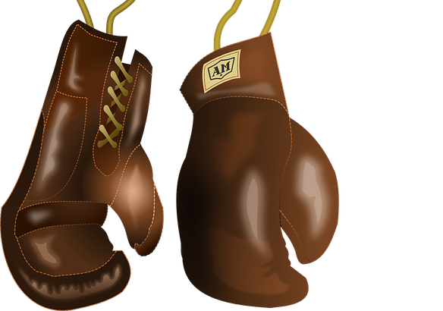
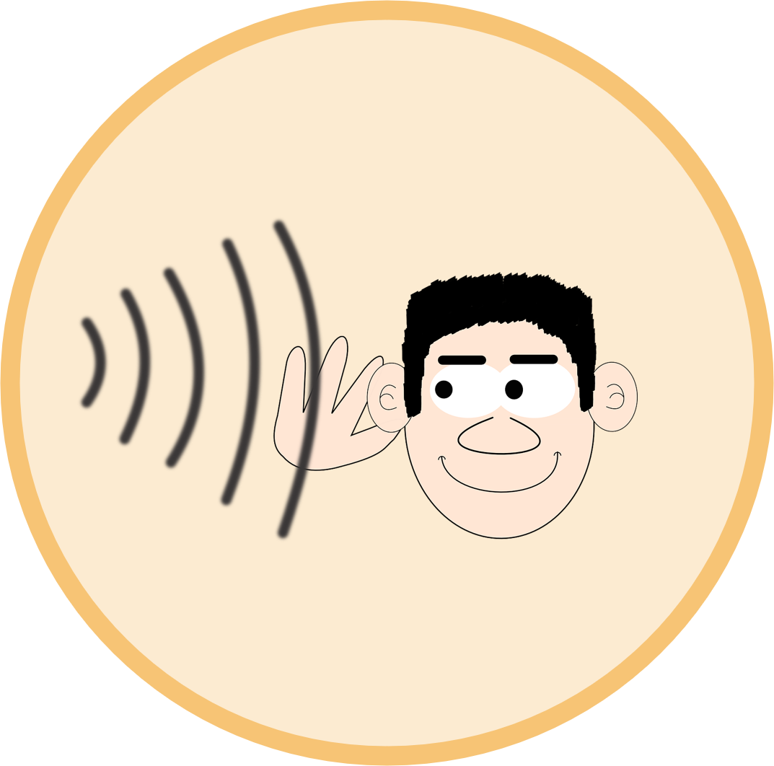
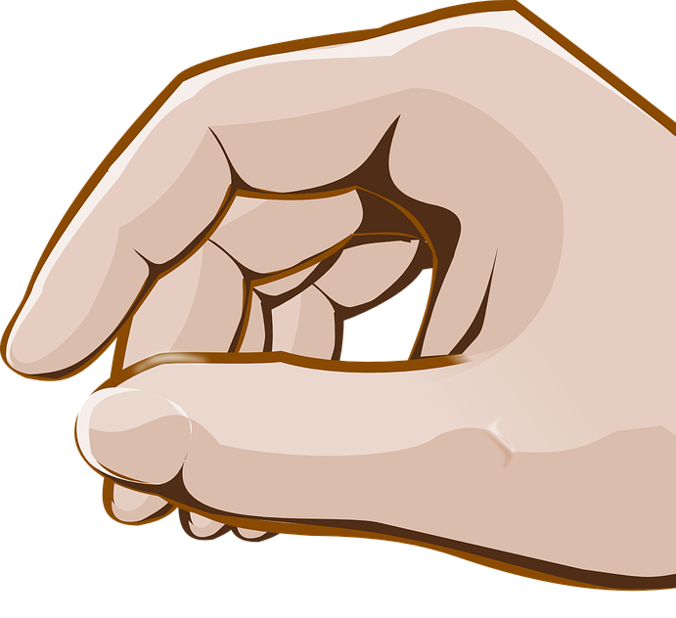
aussprechen
[pf] [kn]
Hör zu. Wie viele [pf] und [kn] hörst du?
 |  | kn | pf
1 | Ein Mann ohne Kopf kann keine Pflanzen pflegen. |  | I I I
2 | Ein Mann ohne Kopf kann keinen Kampf gewinnen. |  | I I
3 | Ein Mann ohne Kopf kann keinen Pfefferminztee trinken. |  | I I
4 | Ein Mann ohne Kopf kann keinen Knall hören | I | I
5 | Ein Mann ohne Kopf kann keine Knöchel knacken | I I | I
6 | Ein Mann ohne Kopf kann keine Knoten knüpfen. | I I | I I
crack
Notes:
Timing: 5 minutes
Aim: to consolidate the SSCs [pf] and [kn] in a listening activity.
Procedure:
Explain the task. Pupils are going to hear six sentences which contain a mixture of [pf] and [kn] sounds.
For each sentence they hear, pupils count the number of times they hear each SSC, noting down their answers.
Click to reveal answers.
To aid comprehension, pictures are revealed with the answers.
Transcript:
1. Ein Mann ohne Kopf kann keine Pflanzen pflegen.
2. Ein Mann ohne Kopf kann keinen Kampf gewinnen.
3. Ein Mann ohne Kopf kann keinen Pfefferminztee trinken.
4. Ein Mann ohne Kopf kann keinen Knall hören.
5. Ein Mann ohne Kopf kann keine Knöchel knacken.
6. Ein Mann ohne Kopf kann keine Knoten knüpfen.
Frequency: ohne [120] Kopf [250] Pflanze [1667] pflegen [1842] Kampf [867] Pfefferminz [>5000] Tee [2617] Knall [4658] Knöchel [>5000] knacken [4657] Knoten [>5000] knüpfen [4564]
Jones, R.L & Tschirner, E. (2019). A frequency dictionary of German: Core vocabulary for learners. London: Routledge.

Slide 7
Vokabeln
Vokabeln lernen
Wörter
Hör zu und wiederhole
1 | 2 | 3 | 4
5 | 6 | 7 | 8
to dance, dancing
to eat, eating
to read, reading
to love, loving
tanzen
essen
lesen
lieben
to see, seeing
to visit, visiting
to sing, singing
to think, thinking
sehen
besuchen
singen
denken
Notes:
Timing: 5 minutes
Aim: to practise infinitive verbs in preparation for the following activities. To recap three verbs and to learn five new verbs.
Procedure:
Click on each infinitive verb to hear a native speaker. Pupils repeat.
Click to reveal the English translation for each verb.
Click to hide the German, pupils try to remember the German translation for each English verb. Pupils have already come across tanzen, singen, denken and some pupils may be familiar with lesen from reading activities. The other verbs are likely to be new. Click to reveal the answers.
Click again to hide the English.
Pupils have one piece of A4 paper. They fold it (no need for numbers or drawing of lines) horizontally in half, then vertically in half and half again to create 8 rectangular box shapes. If this is the first time pupils have done this, teacher models carefully from the front.
Pupils write the verb in German within each box 1-8.
Above each verb they draw a very quick picture (5 seconds only allowed for drawing, count down 5-1) to indicate the meaning. Alternatively, they can write the English word.
The next slide shows example pictures (for pupils to check their understanding).
7

Slide 8
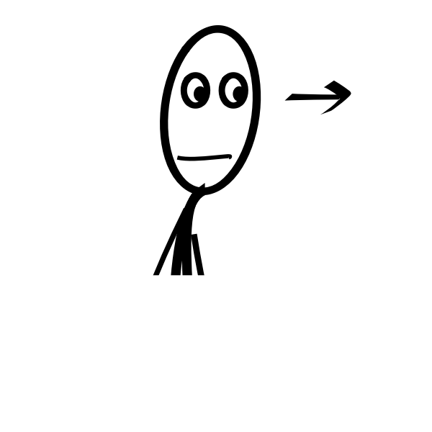
Vokabeln
Vokabeln lernen
Wörter
Ist dein Bild richtig?
1 | 2 | 3 | 4
5 | 6 | 7 | 8
tanzen
essen
lesen
lieben
sehen
besuchen
singen
denken
Notes:
Timing: 1 minute
Aim: To provide the answers to the activity on the previous slide.
Procedure:
1. Pupils compare their drawings/ English answers with the drawings on slide.
8

Slide 9
Können
As you know, to say ‘can’ with another verb, use können plus an infinitive verb. The second verb is at the end of the sentence:
Sie kann sehen.
She can see.
And to say cannot/can’t with verbs, use nicht before the infinitive verb:
Sie kann nicht sehen.
She can’t see.
Notes:
Timing: 2 minutes
Procedure:
Click through the animations to present the information.
Elicit English translation for the German examples provided.
9

Slide 10
lesen
*ohne – without
gar – at all
Ein Mann ohne* Kopf
Ein Mann ohne Kopf
hat viele Probleme:
Er kann nicht denken
Er kann nicht lesen
Er kann nicht singen
Er kann nicht essen
Er kann nicht hören
Und auch nicht verstehen,
dass man ohne Kopf gar* nicht lieben kann.
Hallo! Ich heiße Klaus Knopf!
Notes:
Timing: 12 minutes
Aim: to provide a reading and writing task based on a semi-authentic text.
Note: The context of this poem allows us to focus on ‘can’ as physically and situationally able to do something.
Procedure:
1. Click to show picture and elicit the meaning of the poem’s title from students. Mann and Kopf have been explicitly taught as vocabulary, ohne is glossed. Ensure the meaning of the title is clear to all students. 2. Click to reveal the first line of the poem. Teacher reads. Proceed with the remaining lines, pausing for the gap where there is a missing verb, each time. 3. Ask students in pairs, (or groups with a big piece of A1 sugar paper), to brainstorm the possible infinitives that could be at the end of each line of the poem. [If desired, add an element of competition with a points system - e.g., students could receive two points for a correct infinitive.]
After 8 minutes to work on their list, ask the class to listen to the audio and write down the seven missing infinitives.
Then reveal each infinitive, one by one, telling students to mark off any that they have in common with the poem, awarding themselves two points for any that they already had.
Frequency: ohne [120] gar [165]
Jones, R.L & Tschirner, E. (2019). A frequency dictionary of German: Core vocabulary for learners. London: Routledge.
10

Slide 11
lesen
*ohne – without
gar – at all
Ein Mann ohne* Kopf
Ein Mann ohne Kopf
hat viele Probleme:
Er kann nicht denken
Er kann nicht lesen
Er kann nicht singen
Er kann nicht essen
Er kann nicht hören
Und auch nicht verstehen,
dass man ohne Kopf gar* nicht lieben kann.
Hallo! Ich heiße Klaus Knopf!
Notes:
Timing: 3 minutes
Aim: To provide a reading and writing task based on an authentic text.
Procedure:
Give students one minute in pairs to translate the poem orally together into English. Take feedback and clarify meanings, as necessary.
Frequency: ohne [120] gar [165]
Jones, R.L & Tschirner, E. (2019). A frequency dictionary of German: Core vocabulary for learners. London: Routledge.
11

Slide 12
Tschüss!
rot
Notes:
12

