Slide 1
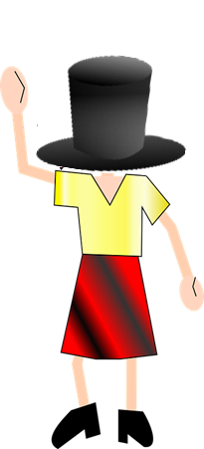
Mann und Frau ohne Kopf
rot
Follow ups 1-5
Text translated and adapted from an original poem, Hombre sin cabeza, by Armando José Sequera.
Term 3 Week 13
Notes:
Artwork by Steve Clarke. Pronoun pictures from NCELP (www.ncelp.org). All additional pictures selected from Pixabay and are available under a Creative Commons license, no attribution required.
Phonics:
[y] typisch [1109] Rhythmus [3823] Physik [1917]
[qu] Quatsch [1650] bequem [1657] Aquarium [>5000]
Vocabulary: Revisit vocabulary
Revisit 1: heißen [126] wohnen [560] Jahr [53] alt [138] jung [199]
Revisit 2: schwimmen [1863] tanzen [1497]
Jones, R.L & Tschirner, E. (2019). A frequency dictionary of German: Core vocabulary for learners. London: Routledge.
The frequency rankings for words that occur in this PowerPoint which have been previously introduced in these resources are given in
the SOW and in the resources that first introduced and formally re-visited those words.
For any other words that occur incidentally in this PowerPoint, frequency rankings will be provided in the notes field wherever
possible.
Note that the first three lessons of the year teach language that can be continuously recycled as lesson routine every lesson in Y3/4.
The idea would be that the class teacher (whether or not s/he teaches the class German can re-use the language as part of the daily routine with the class.

Slide 2
aussprechen
[y]
…
typisch
1 2& 3& 4
Rhythmus
Physik
Notes:
Timing: 1 minute
Aim: to consolidate the SSC [y].
Procedure:
Re-present the SSC and the source word ‘typisch’ (with gesture, if using).
Click to bring on the picture and get pupils to repeat the word ‘typisch’ (with gesture, if using).
Present the cluster words in the same way, bringing on the picture and getting pupils to pronounce the words.
Frequency: typisch [1109] Rhythmus [3823] Physik [1917]
Jones, R.L & Tschirner, E. (2019). A frequency dictionary of German: Core vocabulary for learners. London: Routledge.

Slide 3
aussprechen
[qu]
…
Quatsch!
[comfortable]
bequem
Aquarium
Notes:
Timing: 1 minute
Aim: to consolidate the SSC [qu].
Procedure:
Re-present the SSC and the source word ‘quatsch’ (with gesture, if using).
Click to bring on the picture and get pupils to repeat the word ‘quatsch’ (with gesture, if using).
Present the cluster words in the same way, bringing on the picture and getting pupils to pronounce the words.
Frequency: Quatsch [1650] bequem [1657] Aquarium [>5000]
Jones, R.L & Tschirner, E. (2019). A frequency dictionary of German: Core vocabulary for learners. London: Routledge.

Slide 4
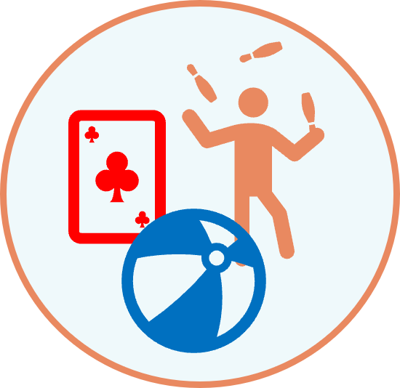
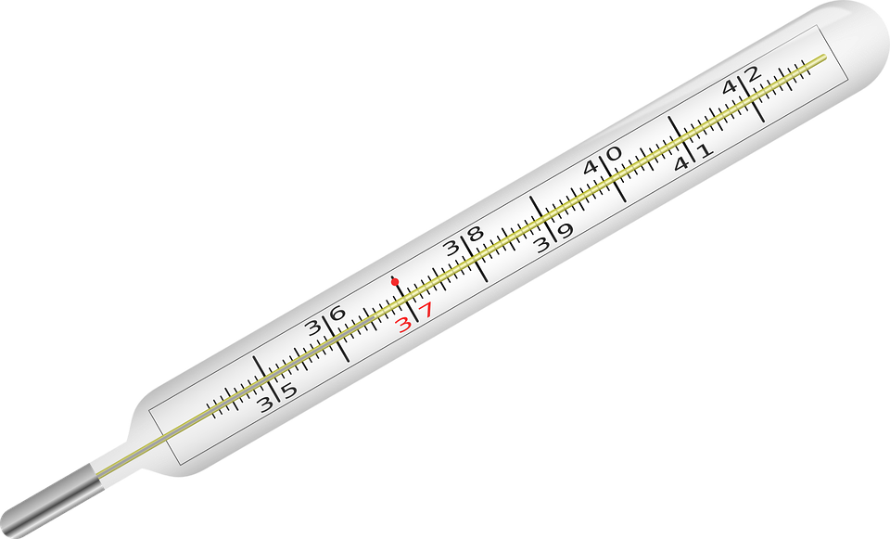
Follow up 1
Wie sagt man das richtig?
aussprechen
Klaus Knopf kann kein Aquarium besuchen.
Klaus Knopf kann keinen Rhythums spielen.
Klaus Knopf kann kein Symptom verstehen.
Klaus Knopf kann keine Qualle sehen.
1 2& 3& 4
Notes:
Timing: 5 minutes (2 slides)
Aim: to practise applying knowledge of [qu] and [y] to unknown words. To provide inspiration for kein sentences for posters or performances.
Procedure:
Pupils work in pairs. Partner A reads the four sentences on this slide aloud to their partner. Partner B listens closely to Partner A pronounce the letters in bold ([qu] and [y]), and corrects if necessary. Note: some of the words containing these SSCs are cognates with English: pupils will need to be careful to pronounce the words the German way.
Click to reveal the following slide. Partners swap roles.
Frequency: Aquarium [>5000] Rhythmus [3823] Symptom [3030] Qualle [>5000] Physik [1917] Quatsch [1650] System [384] Qualifikation [3600]
Jones, R.L & Tschirner, E. (2019). A frequency dictionary of German: Core vocabulary for learners. London: Routledge.

Slide 5
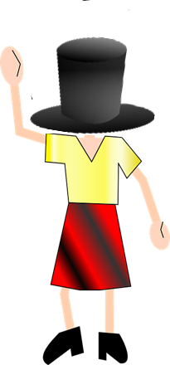
Follow up 1
Wie sagt man das richtig?
aussprechen
Karla Knoll kann kein Physik lernen.
Karla Knoll kann keinen Quatsch verstehen.
Karla Knoll kann kein System lernen.
Karla Knoll kann keine Qualifikation haben.
Notes:
[2/2]

Slide 6
Follow up 2:

Schreib auf Englisch.
Can you get at least 15 points?
Wörter
 | die Flasche | das Heft | tanzen
 | lernen | schwimmen | denken
 | das Jahr | heißen | alt
 | singen | jung | wohnen
 | das Foto | machen | die Freundin
 | das Instrument | verstehen | der Fußball
 | das Handy | das Haustier | der Satz
(the) exercise book, notebook
to dance, dancing
(the) bottle
Vokabeln
x3
to learn, learning
to swim, swimming
to think, thinking
(the) year
to be called
old
x2
to sing, singing
young
to live, living
to do, make, doing, making
(the) photo
(the) (female) friend
(the) instrument
to understand
(the) football
x1
(the) mobile phone
(the) pet
(the) sentence
Notes:
Timing: 5 minutes
Aim: to practise written comprehension of vocabulary from this and revisited weeks.
Procedure: 1. Give pupils a blank grid. They fill in the English meanings of any of the words they know, trying to reach 15 points in total. 2. Remind pupils that adjectives can refer to male or female persons and they should note this in their translations. E.g. pleased (f), short (m).
Note: The most recently learnt and practised words are pink, words from the previous week are green and those from week 1 are blue, thus more points are awarded for them, to recognise that memories fade and more effort (heavy lifting!) is needed to retrieve them.

Slide 7
Follow up 2:

Schreib auf Deutsch.
Can you get at least 15 points?
Wörter
 | to learn, learning | to dance, dancing | to swim, swimming
 | to think, thinking | (the) bottle | (the) exercise book, notebook
 | to be called | to live, living | young
 | old | to sing, singing | (the) year
 | (the) instrument | (the) mobile phone | (the) photo
 | (the) sentence | (the) (female) friend | (the) pet
 | (the) football | to do, make, doing, making | to understand
lernen
tanzen
schwimmen
Vokabeln
x3
denken
die Flasche
das Heft
heißen
wohnen
jung
x2
alt
singen
das Jahr
das Instrument
das Handy
das Foto
der Satz
die Freundin
das Haustier
x1
der Fußball
machen
verstehen
Notes:
Timing: 5 minutes
Aim: to practise written production of vocabulary from this and revisited weeks.
Procedure: 1. Give pupils a blank grid. They fill in the German meanings of any of the words they know, trying to reach 15 points in total. 2. Remind pupils that adjectives can refer to male or female persons and they should note this in their translations. E.g. pleased (f), short (m).
Note: The most recently learnt and practised words are pink, words from the previous week are green and those from week 1 are blue, thus more points are awarded for them, to recognise that memories fade and more effort (heavy lifting!) is needed to retrieve them.

Slide 8
Tschüss!
rot
Notes:
8

Slide 9
Follow up 2:

Schreib auf Englisch.
Can you get at least 15 points?
Wörter
 | die Flasche | das Heft | tanzen
 | lernen | schwimmen | denken
 | das Jahr | heißen | alt
 | singen | jung | wohnen
 | das Foto | machen | die Freundin
 | das Instrument | verstehen | der Fußball
 | das Handy | das Haustier | der Satz
Vokabeln
x3
x2
x1
Notes:
Handout

Slide 10
Follow up 2:

Schreib auf Deutsch.
Can you get at least 15 points?
Wörter
 | to learn, learning | to dance, dancing | to swim, swimming
 | to think, thinking | (the) bottle | (the) exercise book, notebook
 | to be called | to live, living | young
 | old | to sing, singing | (the) year
 | (the) instrument | (the) mobile phone | (the) photo
 | (the) sentence | (the) (female) friend | (the) pet
 | (the) football | to do, make, doing, making | to understand
Vokabeln
x3
x2
x1
Notes:
Handout

