Slide 1
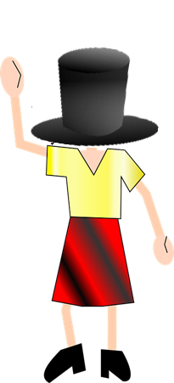
Mann und Frau ohne Kopf
rot
können
SSC [y] [ü] [qu]
Text translated and adapted from an original poem, Hombre sin cabeza, by Armando José Sequera.
Term 3 Week 13
Notes:
Artwork by Steve Clarke. Pronoun pictures from NCELP (www.ncelp.org). All additional pictures selected from Pixabay and are available under a Creative Commons license, no
attribution required.
Phonics:
[y] typisch [1109] Rhythmus [3823] Physik [1917]
[qu] Quatsch [1650] bequem [1657] Aquarium [>5000]
Vocabulary: Revisit vocabulary
Revisit 1: heißen [126] wohnen [560] Jahr [53] alt [138] jung [199]
Revisit 2: schwimmen [1863] tanzen [1497]
Jones, R.L & Tschirner, E. (2019). A frequency dictionary of German: Core vocabulary for learners. London: Routledge.
The frequency rankings for words that occur in this PowerPoint which have been previously introduced in these resources are given in the SOW and in the resources that first
introduced and formally re-visited those words.
For any other words that occur incidentally in this PowerPoint, frequency rankings will be provided in the notes field wherever possible.
Note that the first three lessons of the year teach language that can be continuously recycled as lesson routine every lesson in Y3/4.
The idea would be that the class teacher (whether or not s/he teaches the class German can re-use the language as part of the daily routine with the class.
1

Slide 2
aussprechen
[y]
[y] sounds the same as [ü]
…
typisch
Notes:
Timing: 1 minute
Aim: to introduce the SSC [y].
Procedure:
1. Present the letter and say the [y] sound first, on its own. Pupils repeat it with you. 2. Bring up the word ”Typisch” on its own, say it, pupils repeat it, so that they have the opportunity to focus all of their attention on the connection between the written word and its sound.
3. Click to bring up the picture and introduce the gesture, if using. Pupils repeat the word again.
4. Roll back the animations and work through 1-3 again, but this time, dropping your voice completely to listen carefully to the students saying the [y] sound, pronouncing ”Typisch” and, if using, doing the gesture.
Note: A possible gesture for this would be to mime drinking tea
Frequency: typisch [1109]
Jones, R.L & Tschirner, E. (2019). A frequency dictionary of German: Core vocabulary for learners. London: Routledge.
2

Slide 3
aussprechen
[y]
…
typisch
1 2& 3& 4
Rhythmus
Physik
Notes:
Timing: 1 minute
Aim: to consolidate the SSC [y].
Procedure:
Re-present the SSC and the source word ‘typisch’ (with gesture, if using).
Click to bring on the picture and get pupils to repeat the word ‘typisch’ (with gesture, if using).
Present the cluster words in the same way, bringing on the picture and getting pupils to pronounce the words.
Frequency: typisch [1109] Rhythmus [3823] Physik [1917]
Jones, R.L & Tschirner, E. (2019). A frequency dictionary of German: Core vocabulary for learners. London: Routledge.

Slide 4
aussprechen
[qu]
…
Quatsch!
Notes:
Timing: 1 minute
Aim: to introduce the SSC [qu].
Procedure:
1. Present the letter and say the [qu] sound first, on its own. Pupils repeat it with you. 2. Bring up the word ”Quatsch” on its own, say it, pupils repeat it, so that they have the opportunity to focus all of their attention on the connection between the written word and its sound.
3. Click to bring up the picture and introduce the gesture, if using. Pupils repeat the word again.
4. Roll back the animations and work through 1-3 again, but this time, dropping your voice completely to listen carefully to the students saying the [qu] sound, pronouncing ”Quatsch” and, if using, doing the gesture.
Note: A possible gesture for this would be to shrug your shoulders and hold your arms slightly out, palms of hands facing up.
Frequency: Quatsch [1650]
Jones, R.L & Tschirner, E. (2019). A frequency dictionary of German: Core vocabulary for learners. London: Routledge.
4

Slide 5
aussprechen
[qu]
…
Quatsch!
[comfortable]
bequem
Aquarium
Notes:
Timing: 1 minute
Aim: to consolidate the SSC [qu].
Procedure:
Re-present the SSC and the source word ‘quatsch’ (with gesture, if using).
Click to bring on the picture and get pupils to repeat the word ‘quatsch’ (with gesture, if using).
Present the cluster words in the same way, bringing on the picture and getting pupils to pronounce the words.
Frequency: Quatsch [1650] bequem [1657] Aquarium [>5000]
Jones, R.L & Tschirner, E. (2019). A frequency dictionary of German: Core vocabulary for learners. London: Routledge.

Slide 6
[y]
Hör zu. Ist das Deutsch oder Englisch?
hören
German [y] is usually pronounced the same as [ü]. However, for words that come from English, initial or final [y] is often pronounced as in English, e.g., das Baby.
1 | okay
2 | symmetrisch
3 | System
4 | hey
5 | Party
6 | olympisch
Notes:
Timing: 5 minutes Aim: To distinguish between German and English [y]. Procedure: 1. Click sound button, students transcribe word and tick whether they hear German or English [y].
2. Click to reveal transcribed word and tick.
Transcript:
okay
symmetrisch
System
hey
Party
olympisch
Word frequency (1 is the most frequent word in German): Baby [2297] okay [629] symmetrisch [3226] System [384] hey [1142] Party [2809] olympisch [2469] Source: Jones, R.L. & Tschirner, E. (2019). A frequency dictionary of German: core vocabulary for learners. Routledge

Slide 7
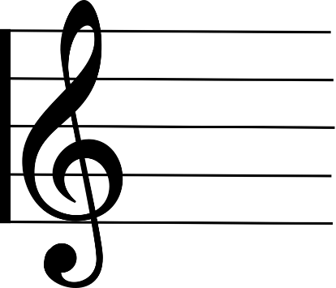
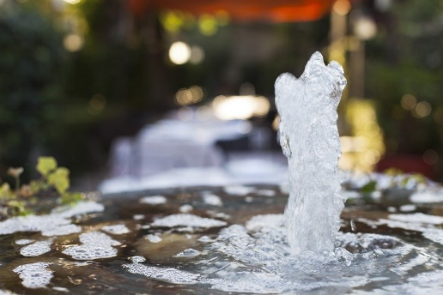
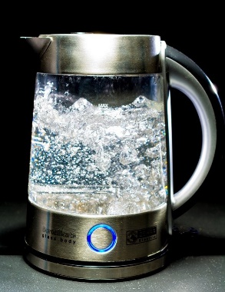
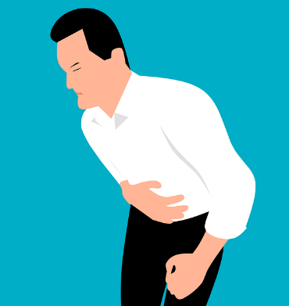
[qu]
Hör zu. Ist das [qu] oder [w]?
hören
Quarte Warte | Quelle Welle
Wal Qual | Wallen Quallen
__
__
__
__
__
__
__
__
Notes:
Timing: 5 minutes Aim: to differentiate between minimal pairs with [qu] and [w]. Procedure: 1. Click on the audio buttons to hear the two words.
2. Students note down whether they hear [qu] or [w] for each gap.
3. Click to reveal answers.
Transcript:
1. Quarte / Warte 2. Quelle / Welle 3. Wal / Qual 4. wallen / Quallen
Word frequency (1 is the most frequent word in German): Wal [>5000] Qual [>5000] Quelle [1108] Welle [1263] Quarte [>5000] Warte [>5000] wallen [>5000] Quallen [>5000] Source: Jones, R.L. & Tschirner, E. (2019). A frequency dictionary of German: core vocabulary for learners. Routledge

Slide 8
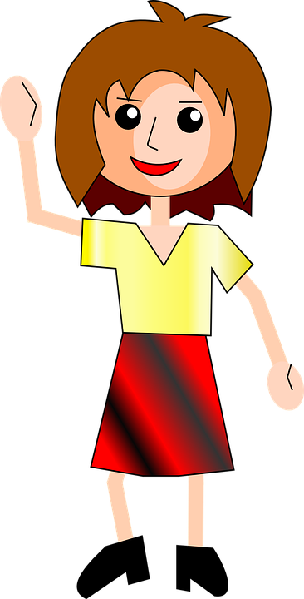
Eine Frau ohne Kopf
lesen
Was kann Karla Knoll nicht machen?
Remember, after most verbs, masculine kein becomes keinen.
For feminine nouns use keine.
For neuter nouns use kein.
Eine Frau ohne Kopf
hat viele Probleme:
Sie kann keine Ort|Schule besuchen
Sie kann kein Musik|Instrument hören
Sie kann keinen Satz|Frage verstehen
Sie kann keine Tasche|Buch haben
Sie kann kein Bleistift|Spiel gewinnen
Hallo! Ich heiße Karla Knoll!
Notes:
Timing: 5 minutes Aim: to practise negative sentences using kein in preparation for pupils designing their own performance/ poster. To recap using keinen, keine, and kein after verbs. To recap various nouns that pupils could use in their own creations. Procedure: 1. Pupils read the callout reminding them how to use kein after verbs.
2. They then read the poem and decide which of the two options in each sentence Karla Knoll can’t do, based on the form of kein used and the gender of the nouns.
3. Click to reveal answers.

Slide 9
Ein Mann ohne Kopf
Eine Frau ohne Kopf
schreiben
Ein Mann ohne Kopf
hat viele Probleme:
Er kann nicht denken
Er kann nicht lesen
Er kann nicht singen
Er kann nicht essen
Er kann nicht hören
Und auch nicht verstehen,
dass man ohne Kopf gar nicht lieben kann.
Eine Frau ohne Kopf
hat viele Probleme:
Sie kann keine Schule besuchen
Sie kann kein Instrument hören
Sie kann keinen Satz verstehen
Sie kann keine Tasche haben
Sie kann kein Spiel gewinnen.
*ohne – without
gar – at all
Notes:
Timing: as required (there is also more time for this activity in the follow ups)
Aim: to practise productive use of können and the 2-verb rule. To produce a performance and/or a poster about Ein Mann or Eine Frau ohne Kopf.
Note: The theme of the poem should remain the same - i.e., the difficulties someone without a head might experience. Pupils can write about either Klaus Knopf or Karla Knoll, or they could create a new name, if they like. Bonus points for creating a name that uses this week’s or last week’s SSCs [pf] [kn] [qu] [y]!
Procedure:
Pupils read each poem again for inspiration. Pupils will come up with their own lines for the poem in this activity.
They are encouraged to use a mixture of sentences with nicht and kein in their poems.
Pupils may use the verb and noun pictures on the following slide for inspiration, and could look up additional nouns in a dictionary should they wish.
For the performance: Pupils should work in pairs or small groups. Each team decides on (a) new line(s) for the poem, and a corresponding action to match their line(s). The whole class can then perform their lines and actions together as one poem, in class or for an assembly.
For the poster: Pupils should work in pairs or small groups. Each team creates a new poem with new lines and a corresponding picture for each line. They write their lines up and draw the corresponding pictures on a large piece of paper, which can then be displayed in the classroom.

Slide 10
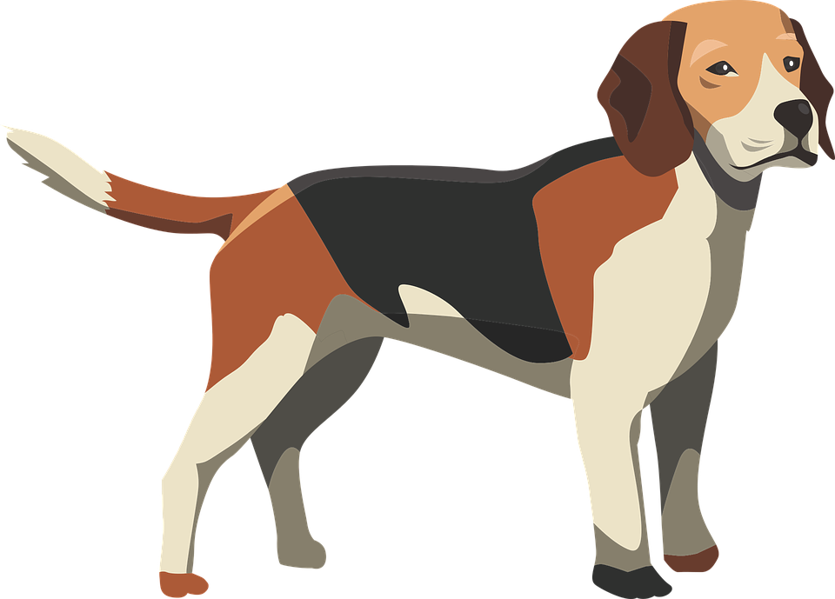
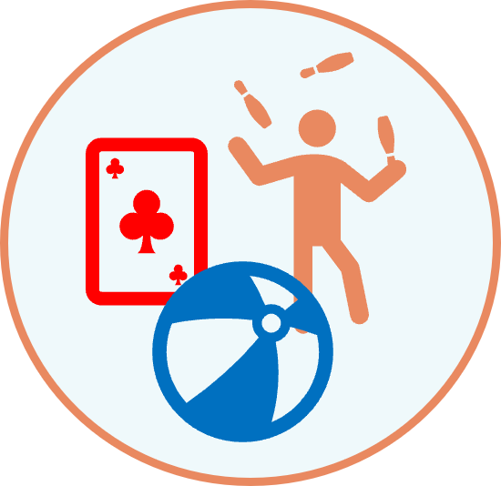
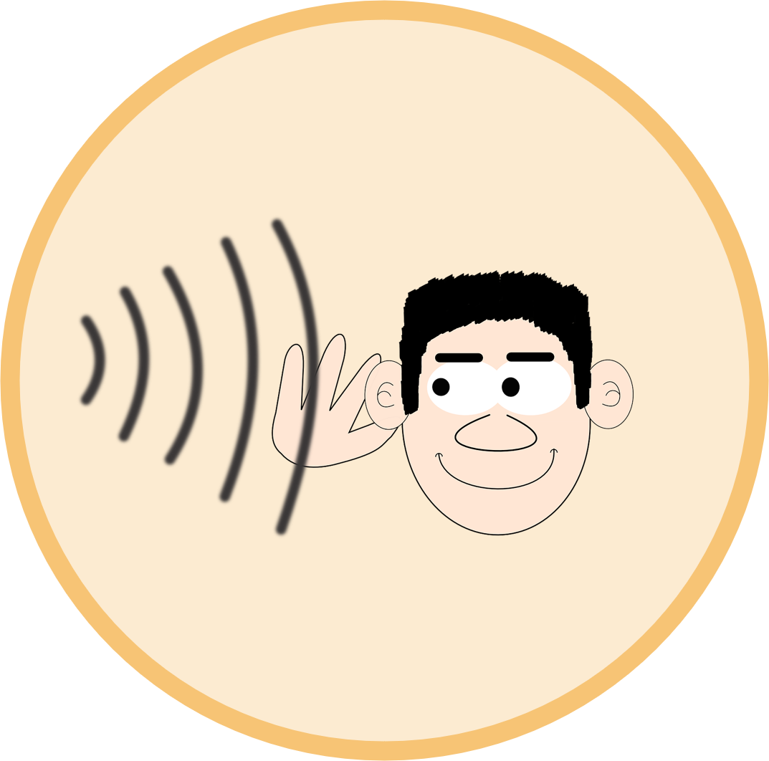
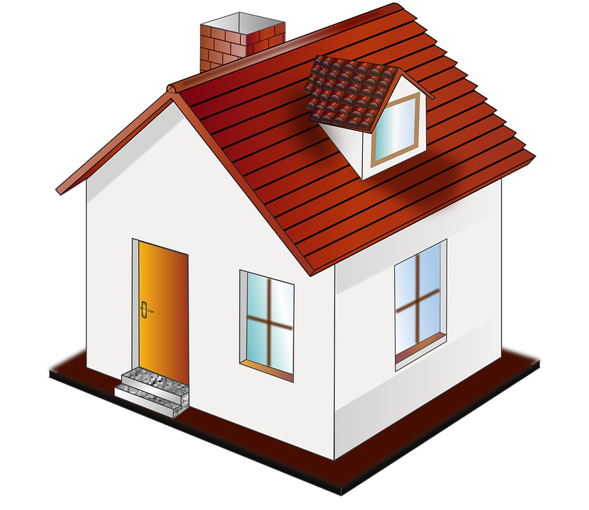
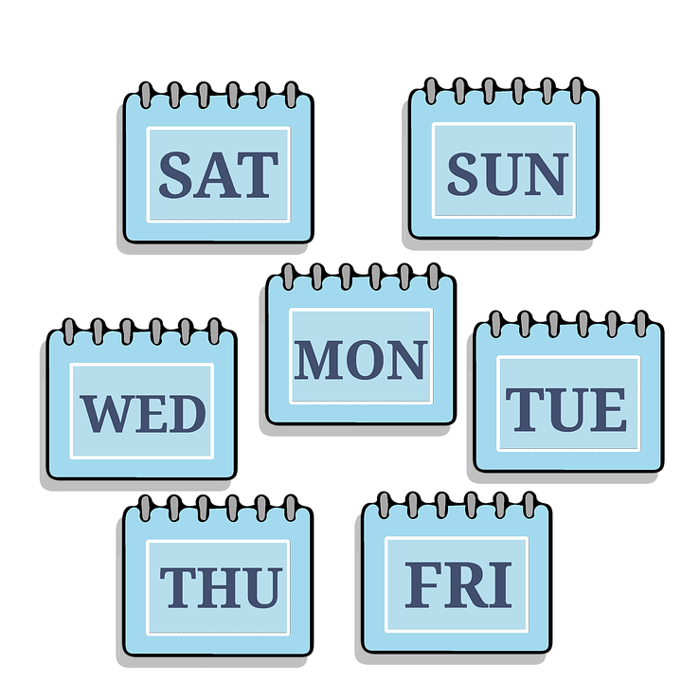
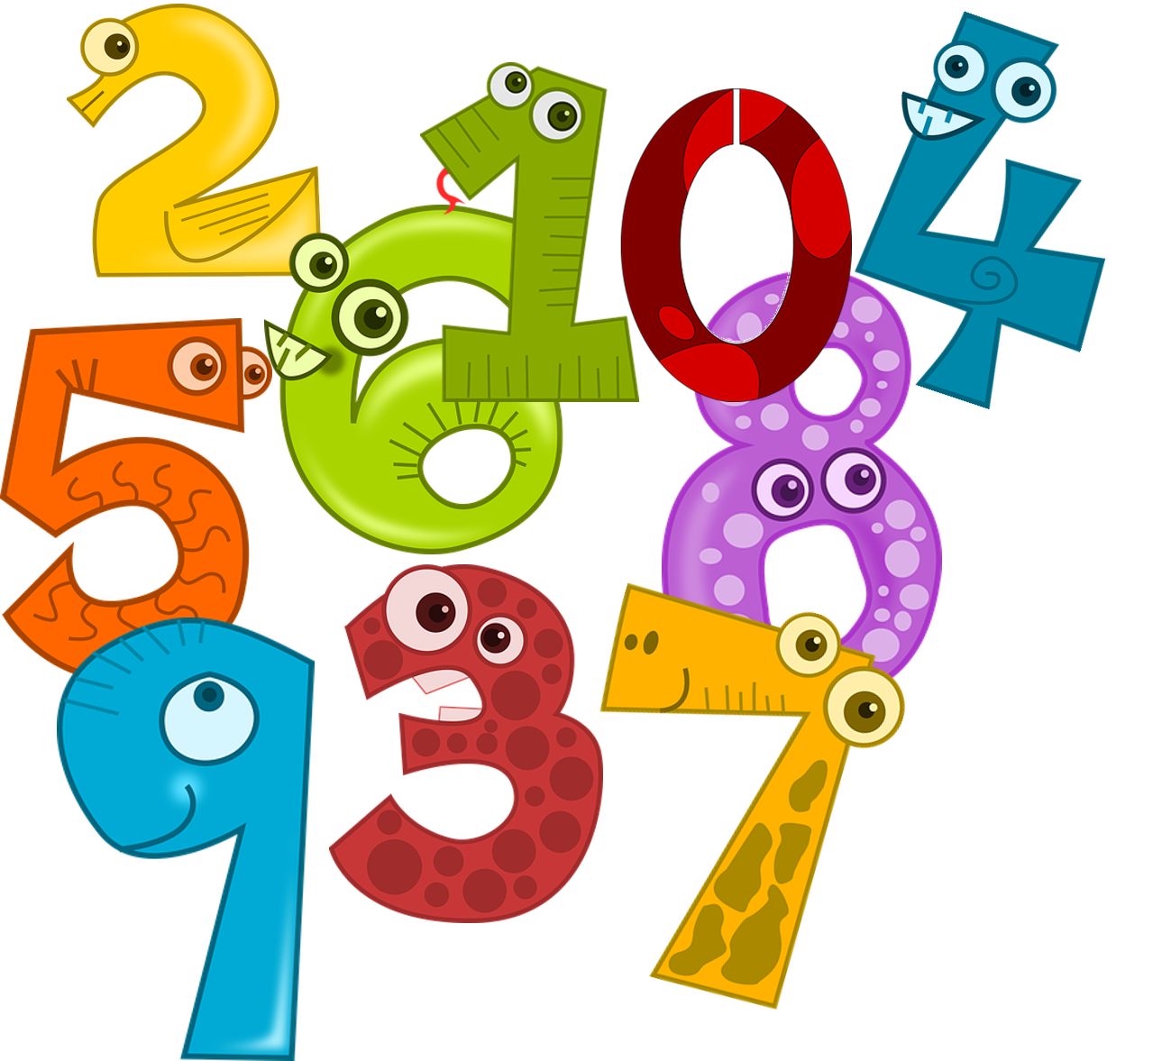
Verbs
Nouns
Notes:
Use these pictures for inspiration

Slide 11
Tschüss!
rot
Notes:
11

