Slide 1
Describing me and others
Freundschaft - friendship
gelb
Follow ups 1-5
Term 1 Week 10
Notes:
Artwork by Steve Clarke. Pronoun pictures from NCELP (www.ncelp.org). All additional pictures selected from Pixabay and are available under a Creative
Commons license, no attribution required.
Phonics:
[z] Zug [675] sitzen [231] Platz [326] Zimmer [665] zehn [333]
Vocabulary:
New words in bold: Aufgabe [256] Karte [1474] Liste [1792] Partner, Partnerin [1172] mein, meine [51] dein, deine [233]
Revisit 1: Idee [451] Preis [334] Problem [210] einfach [131] gut [76] schwer [257] Auf Wiedersehen [n/a] tschüss [3766]
Revisit 2: du [54] bist [4]
Jones, R.L & Tschirner, E. (2019). A frequency dictionary of German: Core vocabulary for learners. London: Routledge.
The frequency rankings for words that occur in this PowerPoint which have been previously introduced in these resources are given in the SOW and in the
resources that first introduced and formally re-visited those words.
For any other words that occur incidentally in this PowerPoint, frequency rankings will be provided in the notes field wherever possible.
Note that the first three lessons of the year teach language that can be continuously recycled as lesson routine every lesson in Y3/4.
The idea would be that the class teacher (whether or not s/he teaches the class German can re-use the language as part of the daily routine with the class.

Slide 2
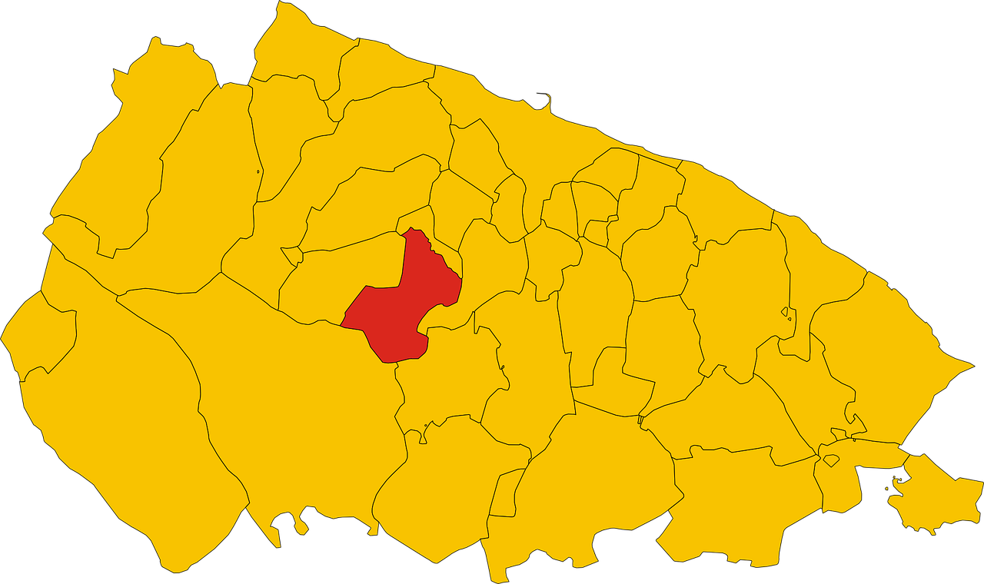
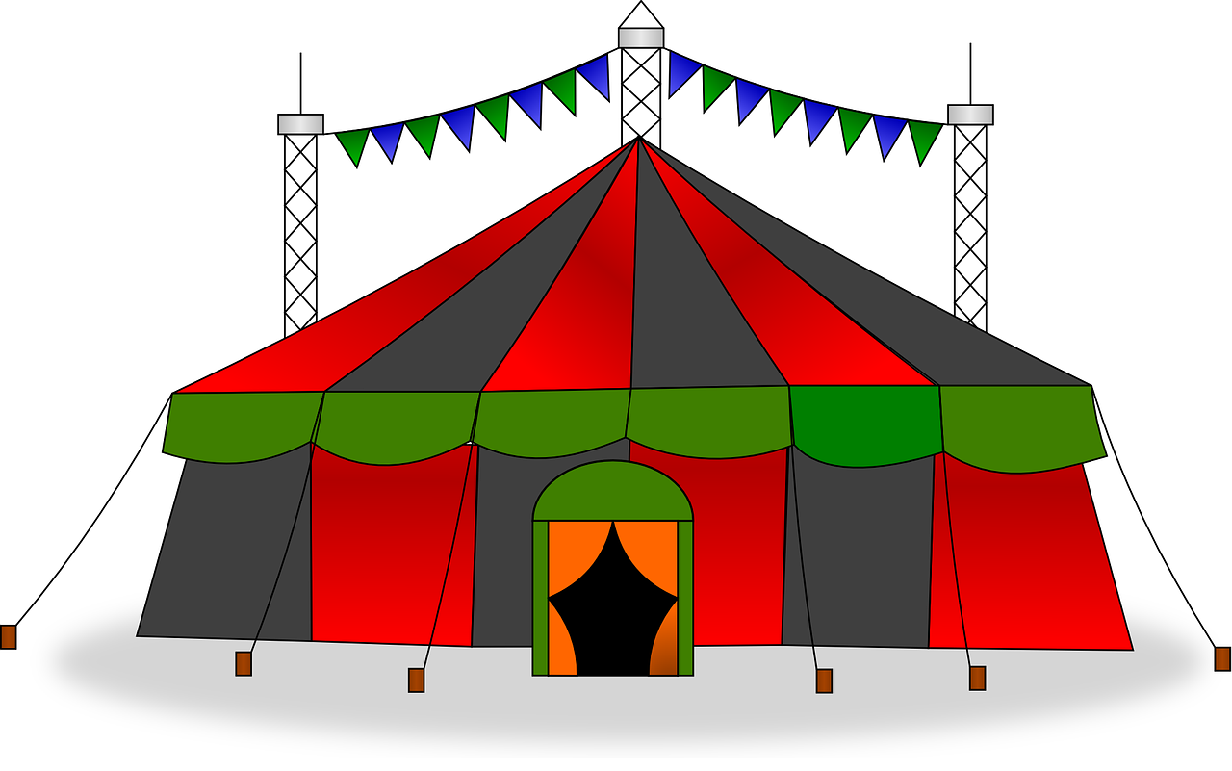
Follow up 1: Sag die Wörter.
‘C’ auf Englisch ist oft ‘Z’ auf Deutsch.
Secretly choose 5 of the words. Your partner will try to say them within 20 seconds. If s/he says [z] the English way, stop him/her for a 2-second penalty!
aussprechen
Medizin
Spezialist
Akzent
Ozean
20
Konzert
Prinz
Distanz
Provinz
S
0
Zirkus
Prozess
Dezember
Konferenz
START
Notes:
Timing: 3 minutes
Aim: to practise applying knowledge of [z] to unknown words that are cognates in which English ‘c’ becomes German ‘z’ in a read aloud task.
Procedure:
Pupil A secretly selects 5 words.
Pupil B has 20 seconds to ‘find’ them all by saying them.
If s/he pronounces inaccurately, his/her partner can impose a 2-second penalty.
When time elapses, swap roles.
Continue for several rounds of activity to build up familiarity and fluency in production.
Frequency of unknown words/cognates: Akzent [2740] Dezember [1527] Distanz [2671] Konferenz [3918] Konzert [2350] Medizin [1960] Ozean [4042] Prinz [3671] Provinz [3567] Prozess [595] Spezialist [4750] Zirkus [>5000]
Jones, R.L & Tschirner, E. (2019). A frequency dictionary of German: Core vocabulary for learners. London: Routledge.

Slide 3
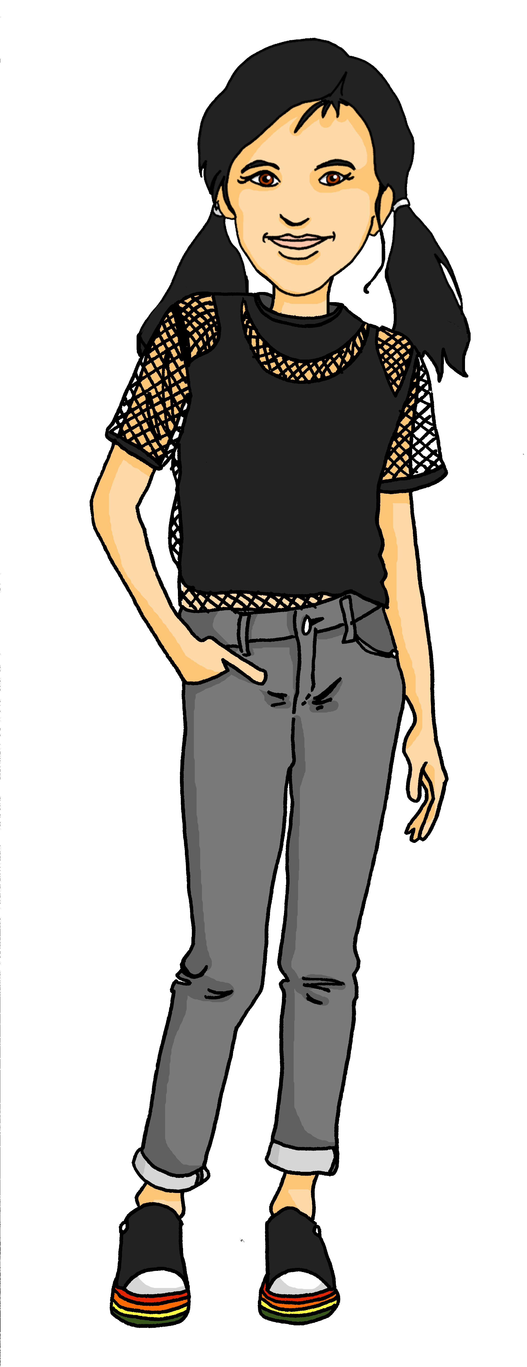
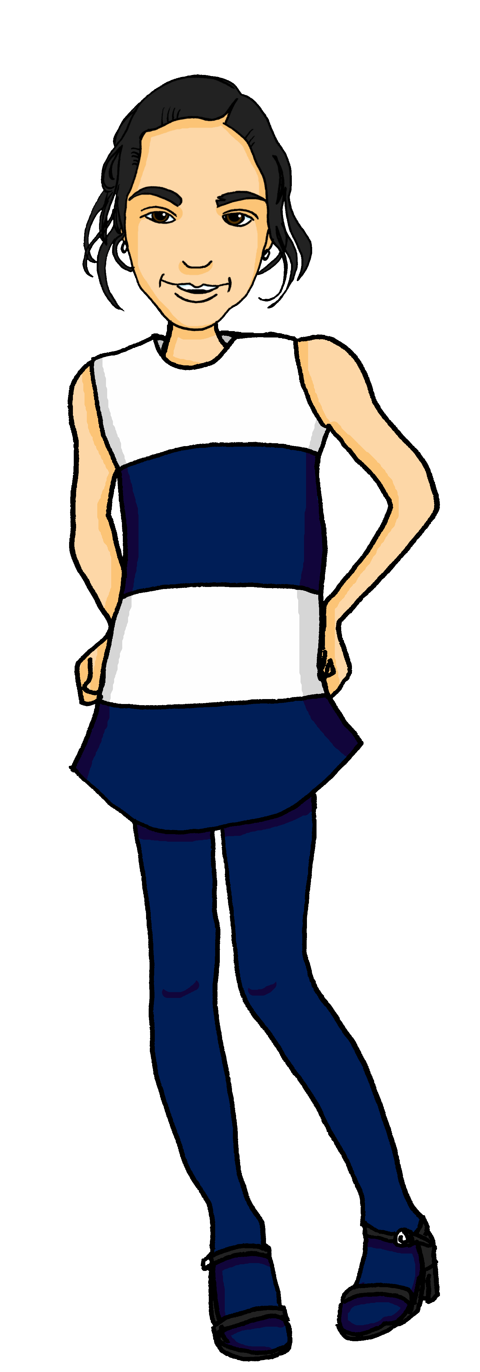
Follow up 2
Hör zu. Ist das Ronjas (mein) oder Mariems (dein)?
Ronja has gone to her friend Mariem’s house to work on the project. Their things are everywhere! Ronja works out what belongs to each of them.
hören
auf Englisch
1
That is my task.
2
That is my sheet.
3
But that is your card.
4
That is also your prize.
5
You are my partner.
6
That is your list.
Notes:
Timing: 5 minutes
Aim: to practise aural comprehension of this week’s vocabulary and to contrast mein(e) and dein(e).
Procedure:
Explain the task. Ronja is talking about her and Mariem’s things. If pupils hear mein(e), then Ronja is talking about her things. If they hear dein(e), then Ronja is talking about Mariem’s things.
Do [1] with the pupils. Click to listen. Pupils write either R for Ronja or M for Mariem.
Encourage pupils to also write the English translation. They can choose to either write the full sentence or just the noun.
Elicit answers and click to reveal them.
Continue with items 2-6.
Transcript:
Das ist meine Aufgabe. Das ist mein Blatt.
Aber das ist deine Karte. Das ist auch dein Preis. Du bist meine Partnerin. Das ist deine Liste.

Slide 4
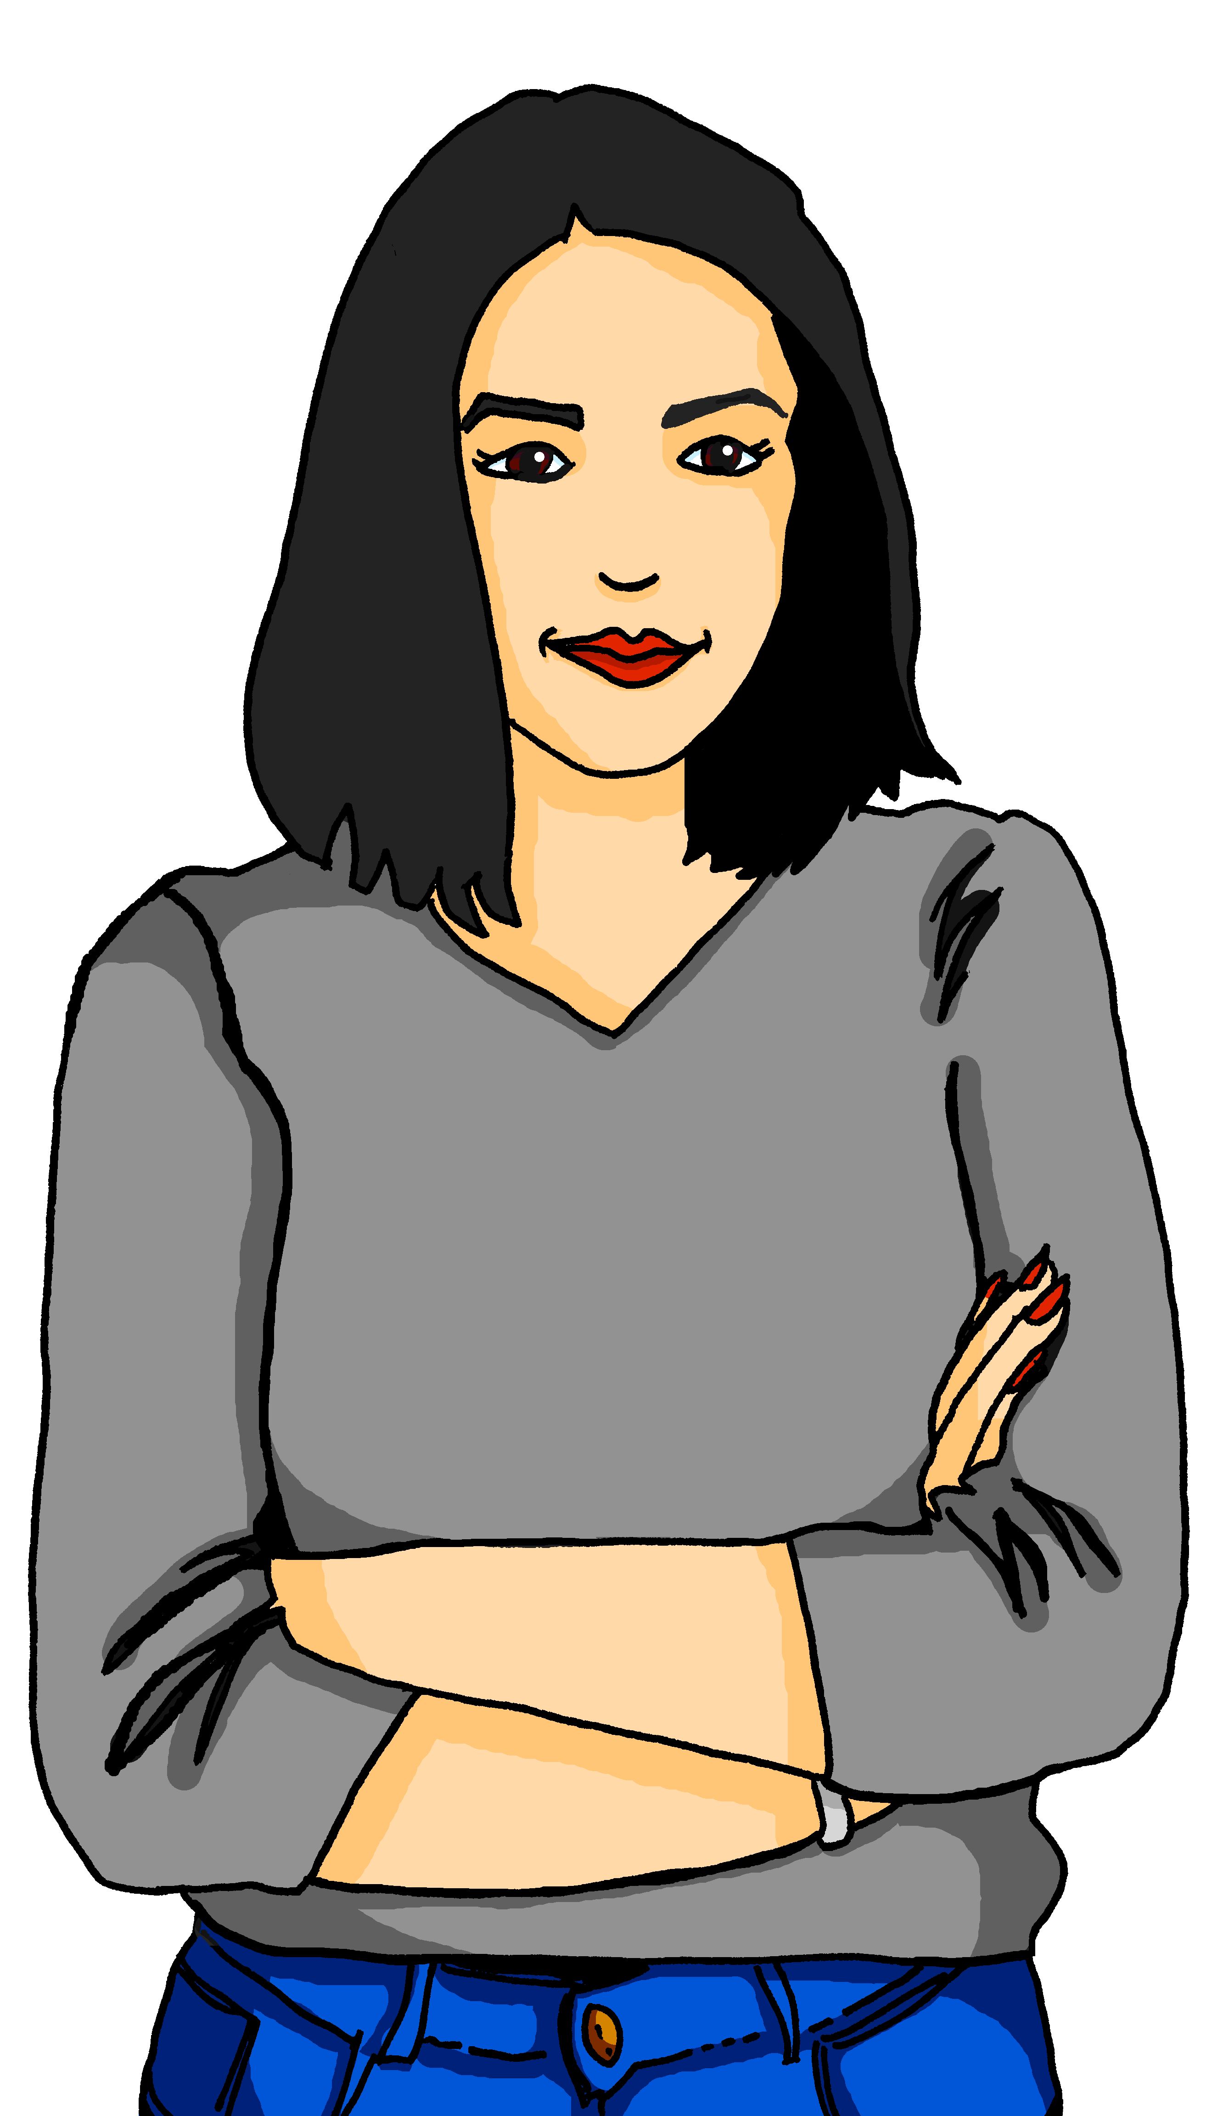
Follow up 3
Mariem ist Ronjas Partnerin
Ronja is texting her mum about the project.
lesen
1
4
Ist die Aufgabe schwer?
Und wie ist deine Karte?
1 | the | a | my | your | ?
2 | the | a | my | your | ?
3 | the | a | my | your | ?
4 | the | a | my | your | ?
5 | the | a | my | your | ?
6 | the | a | my | your | ?
task
problem
2
5
Ja, das ist ein Problem.
Meine Karte ist grün.
partner
card
3
6
card
Aber meine Partnerin ist gut.
Deine Idee ist wunderbar.
idea
Notes:
Timing: 5 minutes
Aim: to practise written comprehension of the four determiners taught so far.
Procedure:
Explain that pupils need to read item 1 carefully, selecting a) which of the four determiners is used, and b) what object is mentioned.
Elicit answers, then click for the answer to a). Then click again for the answer to b).
Click on the blue audio buttons to listen to a recording of sentence 1, if required.
Continue for items 2-6.

Slide 5
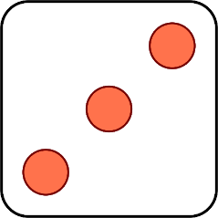
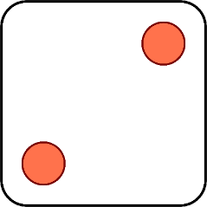
Follow up 4
Was ist das?
Das ist mein Problem.
sprechen
Das ist deine Karte.
Das ist deine Partnerin.
Das ist ein Preis.
Das ist die Aufgabe.
Das ist meine Liste.
1 | my
2 | your
3 | a/ an
4 | the
5 | your
6 | my
1 | task
2 | card
3 | list
4 | partner (female)
5 | prize
6 | problem
Das ist…
Notes:
Timing: 5 minutes
Aim: to practise oral production of mein(e), dein(e), ein(e), der, die das, and this week’s new and revisited nouns.
Procedure: 1. Click to ‘roll’ the dice.
2. Pupils translate the words whose numbers correspond to the respective dice to make a short sentence. They say the answer chorally.
3. Click to reveal the answer.
4. Repeat until all six combinations have been said.

Slide 6
Follow up 5:

Schreib auf Englisch.
Can you get at least 15 points?
Wörter
 | du bist | Auf Wiedersehen | das Problem
 | gut | schwer | tschüss
 | meine | die Idee | deine
 | dein | der Preis | einfach
 | die Aufgabe | der Partner | die Partnerin
 | die Karte | die Liste | mein
Vokabeln
you are
goodbye
(the) problem
x3
good, well
difficult
bye
my (f)
(the) idea
your (f)
x2
your (m, nt)
(the) prize
easy, easily
(the) task
(the) male partner
(the) female partner
x1
(the) card
(the) list
my (m, nt)
Notes:
Timing: 5 minutes
Aim: to practise written production of vocabulary from this and revisited weeks.
Procedure: 1. Give pupils a blank grid. They fill in the English meanings of any of the words they know, trying to reach 15 points in total. 2. Remind pupils that adjectives can refer to male or female persons and they should note this in their translations. E.g. pleased (f), short (m).
Note: The most recently learnt and practised words are pink, words from the previous week are green and those from week 1 are blue, thus more points are awarded for them, to recognise that memories fade and more effort (heavy lifting!) is needed to retrieve them.

Slide 7
Follow up 5:

Schreib auf Deutsch.
Can you get at least 15 points?
Wörter
 | goodbye | bye | you are
 | (the) problem | good, well | difficult
 | (the) task | easy | (the) idea
 | my (m, nt) | (the) card | (the) list
 | (the) male partner | my (f) | your (f)
 | your (m, nt) | (the) female partner | (the) prize
Vokabeln
Auf Wiedersehen
tschüss
du bist
x3
das Problem
gut
schwer
die Aufgabe
einfach
die Idee
x2
mein
die Karte
die Liste
der Partner
meine
deine
x1
dein
die Partnerin
der Preis
Notes:
Timing: 5 minutes
Aim: to practise written production of vocabulary from this and revisited weeks.
Procedure: 1. Give pupils a blank grid. They fill in the German meanings of any of the words they know, trying to reach 15 points in total. 2. Remind pupils that adjectives can refer to male or female persons and they should note this in their translations. E.g. pleased (f), short (m).
Note: The most recently learnt and practised words are pink, words from the previous week are green and those from week 1 are blue, thus more points are awarded for them, to recognise that memories fade and more effort (heavy lifting!) is needed to retrieve them.

Slide 8
Tschüss!
gelb
Notes:
8

Slide 9
Follow up 5:

Schreib auf Englisch.
Can you get at least 15 points?
Wörter
 | du bist | Auf Wiedersehen | das Problem
 | gut | schwer | tschüss
 | meine | die Idee | deine
 | dein | der Preis | einfach
 | die Aufgabe | der Partner | die Partnerin
 | die Karte | die Liste | mein
Vokabeln
x3
x2
x1
Notes:
HANDOUT

Slide 10
Follow up 5:

Schreib auf Deutsch.
Can you get at least 15 points?
Wörter
 | goodbye | bye | you are
 | (the) problem | good, well | difficult
 | (the) task | easy | (the) idea
 | my (m, nt) | (the) card | (the) list
 | (the) male partner | my (f) | your (f)
 | your (m, nt) | (the) female partner | (the) prize
Vokabeln
x3
x2
x1
Notes:
HANDOUT

