Slide 1
Describing me and others
Freundschaft - friendship
gelb
Possessive adjectives mein, meine, dein, deine
SSC [z]
Term 1 Week 10
Notes:
Artwork by Steve Clarke. Pronoun pictures from NCELP (www.ncelp.org). All additional pictures selected from Pixabay and are available under a Creative Commons
license, no attribution required.
Phonics:
[z] Zug [675] sitzen [231] Platz [326] Zimmer [665] zehn [333]
Vocabulary:
New words in bold: Aufgabe [256] Karte [1474] Liste [1792] Partner, Partnerin [1172] mein, meine [51] dein, deine [233]
Revisit 1: Idee [451] Preis [334] Problem [210] einfach [131] gut [76] schwer [257] Auf Wiedersehen [n/a] tschüss [3766]
Revisit 2: du [54] bist [4]
Jones, R.L & Tschirner, E. (2019). A frequency dictionary of German: Core vocabulary for learners. London: Routledge.
The frequency rankings for words that occur in this PowerPoint which have been previously introduced in these resources are given in the SOW and in the resources
that first introduced and formally re-visited those words.
For any other words that occur incidentally in this PowerPoint, frequency rankings will be provided in the notes field wherever possible.
Note that the first three lessons of the year teach language that can be continuously recycled as lesson routine every lesson in Y3/4.
The idea would be that the class teacher (whether or not s/he teaches the class German can re-use the language as part of the daily routine with the class.
1

Slide 2
aussprechen
[z]
…
This is a German high-speed train called ICE, which stands for Intercity Express.
Zug
Notice that alphabet letters sound different in German. ‘C’ sounds similar to ‘Z’!
ICE
Notes:
Timing: 1 minute
Aim: to introduce the SSC [z].
Procedure:
Introduce the SSC and present the source word ‘Zug’ (with gesture, if using).
Click to bring on the picture and get pupils to repeat the word ‘Zug’ (with gesture, if using).
Click again to bring up speech bubble to explain cultural reference re ICE train.
Click again to bring up an audio button to hear I-C-E pronounced. This is how these letters are pronounced in the German alphabet. We are not learning this here, but click to bring up a callout to raise awareness that the alphabet letters ‘C’ and ‘Z’ have the same starting sound.
Note:
a gesture for ‘Zug’ might be to roll your arms like wheels of a train and make a tche-tche-thche-tche sound like a train.
Vocabulary: Zug [675]
Jones, R.L & Tschirner, E. (2019). A frequency dictionary of German: Core vocabulary for learners. London: Routledge.
2

Slide 3
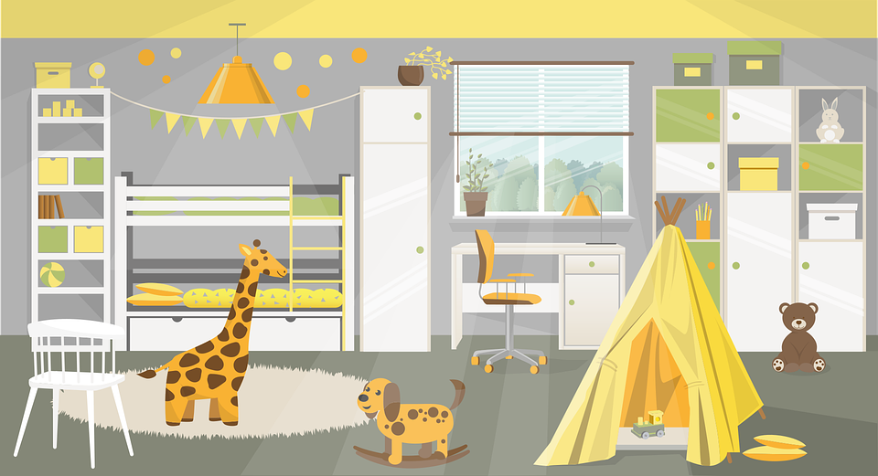
aussprechen
[z]
Which words are nouns? How do you know?
…
Zug
sitzen
Platz
zehn
Zimmer
Notes:
Timing: 1 minute
Aim: to consolidate the SSC [z].
Procedure:
Re-present the SSC and the source word ‘Zug’ (with gesture, if using).
Click to bring on the picture and get pupils to repeat the word ‘Zug’ (with gesture, if using).
Present the cluster words in the same way, bringing on the picture and getting pupils to pronounce the words.
Click to bring up call-out explaining the pronounciation of ‘z’.
Click to bring up the prompt to identify the nouns (the ones with capital letters). This is still very new knowledge for pupils, so it’s good to revisit this as often as we can. Plus, it gives an additional opportunity to pronounce the words.
Click to highlight the 3 x nouns.
Vocabulary:
sitzen [231] Platz [326] Zimmer [665] zehn [333]
Jones, R.L & Tschirner, E. (2019). A frequency dictionary of German: Core vocabulary for learners. London: Routledge.

Slide 4
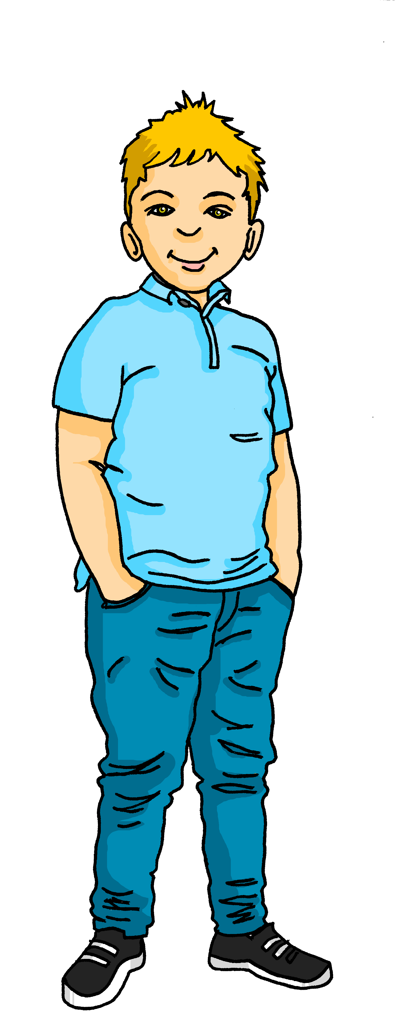
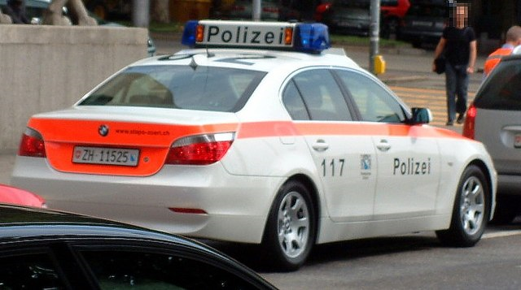
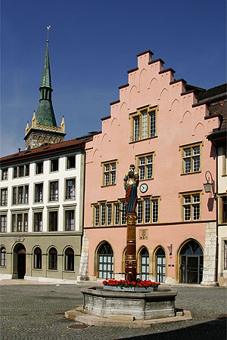
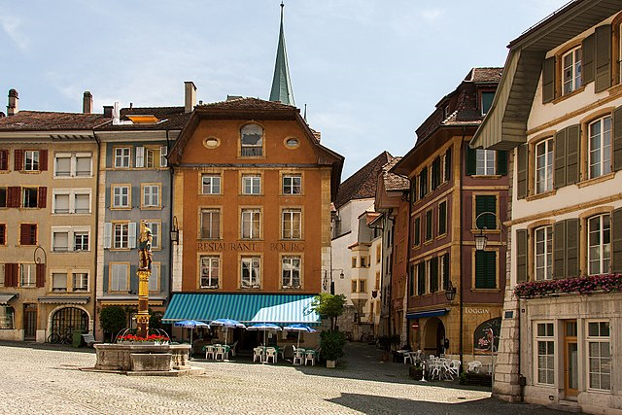
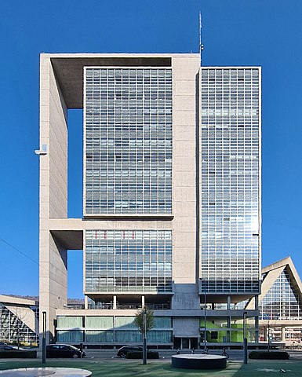
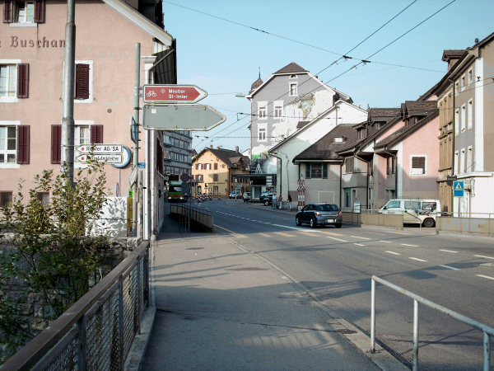
aussprechen
[z]
Lias and Gabriel are walking home from school. Where are they?
Arzt
Kreuzung
Polizei
Platz
Zentrum
Zentralstrasse
Bözingen
Notes:
Timing: 2 minutes
Aim: to consolidate the SSC [z] by reading out places in Biel.
Procedure:
1. Pupils work in pairs reading out the places.
2. Change roles.
3. Click to make Lias and Gabriel appear next to each of the places. Pupils chorally say where they are.
Image attribution:
Biel square: Von Roland Zumbühl (Picswiss), Arlesheim (Commons:Picswiss project) - http://www.picswiss.ch/09-BE/s-BE-90/sBE-98-20.html, CC BY-SA 3.0, https://commons.wikimedia.org/w/index.php?curid=2608634
Biel centre: Von Roland Zumbuehl - Eigenes Werk, CC BY-SA 4.0, https://commons.wikimedia.org/w/index.php?curid=60465448
Bözingen: Von Jürg Bolligerderivative work: MagentaGreen - Boezingen01.png, CC BY-SA 3.0, https://commons.wikimedia.org/w/index.php?curid=32397959
Kongresshaus: Von Tschubby - Eigenes Werk, CC BY-SA 3.0, https://commons.wikimedia.org/w/index.php?curid=116468892
Police: By Dontom, CC BY-SA 3.0, https://commons.wikimedia.org/w/index.php?curid=1045887
Frequency of unknown words/cognates: Arzt [622] Kreuzung [4990] Polizei [550] Platz [326] Zentrum [1145]
Jones, R.L & Tschirner, E. (2019). A frequency dictionary of German: Core vocabulary for learners. London: Routledge.

Slide 5
Freundschaft*
die Freundschaft - friendship
Learning languages is about making friends.
You show kindness when you learn even a few words in another language.
Let’s remember some of the friendship sentences we have learnt already!
Hallo!
Guten Morgen!
_ _ _ _ _!
_ _ _ _ _ _ _’_?
_ _ _ _ _ _ _ _ _ _ _ !
Wie geht’s?
Can you say other kind things?
Das ist gut!
Das ist wunderbar!
Du bist wunderbar!
That’s good!
That’s wonderful!
You are wonderful!
You are super!
Du bist super!
Thank you!
Danke!
Notes:
Timing: 3 minutes
Aim: to introduce the idea that learning other languages opens the door to new friendships, and that a few kind words go a long way; to revisit some previously-taught language from this term that fits our category of ‘friendship sentences’. This is an idea we will return to now and then during the course.
Procedure:
Click to present the information on the slide.
Elicit the German from pupils for the English greetings and friendly statements.
Allow pupils a few moments to turn to those around them and greet them and say something kind about their work or about them themselves.
Remind pupils that we all need to hear kind words every day, in whatever language!
5

Slide 6
Vokabeln
Wörter
wie?
how?
Wie
____ geht’s?
[How’s it going?]
Notes:
Timing: 2 minutes (two slides)
Aim: to recap ‘Wie geht’s’ and how to reply.
Procedure:
Click to bring up animations and elicit English and then German as appropriate to the sequence.
6

Slide 7
Vokabeln
Wörter
gut
Ja, es geht.
schlecht
Notes:
Procedure:
1. Click to bring up animations and elicit the German for each prompt.
2. Ensure meanings are clear.
3. Give pupils 30 seconds to turn to others around them and ask ‘how’s it going’ and reply.
7

Slide 8
Vokabeln
Vokabeln lernen
Wörter
task
partner (m)
partner (f)
die Aufgabe
der Partner
die Partnerin
card
list
die Karte
die Liste
Notes:
Timing: 5 minutes (3 slides)
Aim: to present and practise new vocabulary for this week.
Procedure:
1. Click for a German word. Elicit pronunciation from pupils.
2. Click for the English meaning and picture prompt. Elicit the German word again.
3. Present all six words like this, in order top left to bottom right.
4. Click for the next slide. Click for one English meaning to disappear in random order. Elicit the English meaning from pupils. Continue with the remaining items.
5. Click for the next slide. Click for the German word to disappear in random order. Elicit the German from pupils. Continue with the remaining items.
8

Slide 9
Vokabeln
Vokabeln lernen
Wörter
task
partner (m)
partner (f)
die Aufgabe
der Partner
die Partnerin
card
list
die Karte
die Liste
Notes:
[2/3]
9

Slide 10
Vokabeln
Vokabeln lernen
Wörter
task
partner (m)
partner (f)
die Aufgabe
der Partner
die Partnerin
card
list
die Karte
die Liste
Notes:
[3/3]
10

Slide 11
mein | dein (possessive adjectives)
To say ‘my’ use mein or meine:
masculine
feminine
neuter
mein Partner
meine Aufgabe
mein Problem
e
my partner
my task
my problem
The word ‘mein’ must agree with the gender of the noun that follows. The feminine form is ‘meine’.
To say ‘your’ use dein or deine:
dein Partner
deine Aufgabe
dein Problem
e
your partner
your task
your problem
Notes:
Timing: 2 minutes
Aim: to introduce the possessive adjectives ‘mein’ and ‘dein’.
Procedure:
Click through the animations to present the new information.
Elicit English translation for the German examples provided.
11

Slide 12
hören
Lias ist Gabriels Partner
Gabriel has come home with Lias to work on a school project.
Hör zu. Was ist das?
A | B
Preis | Farbe
Partner | Partnerin
Problem | Idee
Blatt | Aufgabe
Problem | Karte
Ding | Liste
Preis | Karte
Ex
1
2
3
4
5
6
Notes:
Timing: 6 minutes
Aim: to practise aural comprehension of ‘dein’ and ‘deine’ and relate them to the gender of previously taught nouns and nouns taught this lesson.
Procedure:
Explain the scenario.
Explain that pupils need to listen out for dein or deine and decide which thing Lias is talking about.
Complete the listening task. Teachers click to correct.
To hear full sentences, click on the answer ticks.
Transcript:
e.g. Das ist dein [Preis].
1. Ich bin dein [Partner].
2. Was ist deine [Idee]?
3. Das ist deine [Aufgabe].
4. Das ist dein [Problem].
5. Das ist deine [Liste].
6. Wie ist deine [Karte]?
12

Slide 13
lesen
Du bist mein Partner
Ist das mein, meine, dein, oder deine?
Wie ist deine Aufgabe, Gabriel?
__1__
Hier ist mein Blatt.
__2__
Und hier ist meine Karte.
__3__
Deine Karte ist wunderbar.
__4__
Ist das deine Jacke, Gabriel?
__5__
Ja, das ist meine Jacke.
__4__
Notes:
Timing: 8 minutes
Aim: to practise using mein, meine, dein and deine.
Note: A less challenging version of this activity can be found on the following slide.
Procedure:
Pupils read the dialogue between Lias and Gabriel. They decide whether the numbered gaps cover mein, meine, dein or deine.
Click to reveal answers.
13

Slide 14
lesen
Du bist mein Partner
Ist das mein, meine, dein, oder deine?
Wie ist meine|deine Aufgabe, Gabriel?
Hier ist mein|dein Blatt.
Und hier ist meine|deine Karte.
Meine|Deine Karte ist wunderbar.
Ist das meine|deine Jacke, Gabriel?
Ja, das ist meine|deine Jacke.
Notes:
Timing: 8 minutes
Aim: to practise using mein, meine, dein and deine.
Note: A more challenging version of this activity can be found on the following slide.
Procedure:
Pupils read the dialogue between Lias and Gabriel. They decide whether to use mein/e or dein/e for each option, based on meaning.
Click to reveal answers.
14

Slide 15
Tschüss!
gelb
Notes:
15

