Slide 1
Interacting
Wie ist dein Alltag*?
grün
Follow ups 1-5
der Alltag – everyday life, daily routine
Term 1 Week 10
Notes:
Artwork by Steve Clarke. Pronoun pictures from NCELP (www.ncelp.org). All additional pictures selected from Pixabay and are available under a Creative Commons license, no attribution required.
Phonics: [z] Zug [675] sitzen [231] Platz [326] Zimmer [665] zehn [333]
Vocabulary: helfen [338] mitnehmen [1459] nehmen [142] sehen [79] Bus [1562] Film [505] Freund [273] Geld [235] Hausaufgabe [n/a] Sachen [318] Zug [675] normalerweise [2062]
Revisit 1: Antwort [522] Baum [1013] Dorf [959] Fahrrad [2138] Farbe [1079] Form [307] Fußballspieler [n/a] Haus [147] Idee [451] Karte [1474] Land [134] Mädchen [602] Musiker [2577] Ort [341] Papier [1163] Partner [1172] Punkt [248] Satz [432] Schwimmbad, Schwimmbäder [n/a] Sportler [2565] keine² [46]
Revisit 2: sie sind [4] Antwort [522] Bruder [730] Buch [300] Computer [1252] Film [505] Geschichte [262] Gruppe [369] Handy [1693] Hund [825] Idee [451] Instrument [1572] Karte [1474] Konzert [2350] Land [134] Lehrer, Lehrerin [695] Lied [1733] Musik [509] Ort [341] Partner, Partnerin [1172] Satz [432] Schwester [974] Show [3367] Stadt [204] welcher, welche, welches [122] die² [1]
Jones, R.L & Tschirner, E. (2019). A frequency dictionary of German: Core vocabulary for learners. London: Routledge.
The frequency rankings for words that occur in this PowerPoint which have been previously introduced in these resources are given in the SOW and in the resources that first introduced and formally re-visited those words.
For any other words that occur incidentally in this PowerPoint, frequency rankings will be provided in the notes field wherever possible.
Remember that at the start of the course (first three lessons of Rot/Gelb) pupils learnt language (for greetings and register taking) that can still be part of the lesson routines in upper KS2 (Blau/Grün). They are not re-taught, as we anticipate that teachers have built these in from early in lower KS2.

Slide 2
Follow up 1:
Olivia singt ein Lied für Ronja.
Hör zu und sing mit!
Magst du Musik?
Magst du mein Lied?
Magst du Shows und Konzerte?
Du spielst vielleicht* ein Instrument.
Gitarre oder Geige*?
vielleicht – maybe
die Geige - violin
Notes:
Timing: 2 minutes
Aim: to practise some previously learnt vocabulary in a simple song (to the tune of ‘Pop Goes the Weasel’).
Procedure: 1. Explain that Olivia, Ronja’s friend from England, wants to know more about Ronja’s everyday life and as she loves music herself, has decided to send her a voice note singing her questions!
2. Click to play the audio of the song. Play again and ask pupils to sing along.

Slide 3
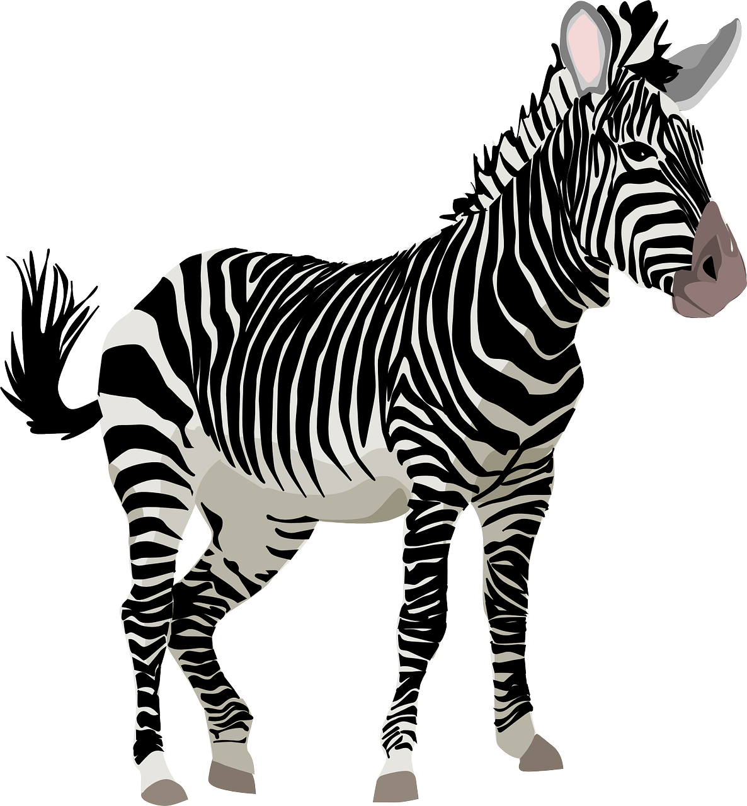
Follow up 1:
Sag die Zungenbrecher.
aussprechen
Sieht sie Zebras im Züricher Zoo?
60
Does she see/is she seeing zebras in Zürich zoo?
x 17
Siebzehn Zirkusclowns zaubern mit Zauberstäben
S
Seventeen circus clowns perform magic with magic wands
Zaras zwanzig Zertifikate
zeigt sie Zacher und Renate
0
Zara shows Zacher and Renate her twenty certificates
START
Notes:
Timing: 5 minutes
Aim: to practise the SSC [z] by reading out tongue twisters.
Procedure:
1. Read out the tongue twisters or play the recordings. Each one is recorded three times in increasing speed (clicking on the tortoise will play the slow version, the play button the medium version and the racing car the fast version. 2. Start the timer. Pupil A tries to read all three tongue twisters, within the 60 seconds allowed.
3. Pupil B listens. If Pupil A makes a mistake, Pupil B can direct him/her to start again from the beginning. 4. They swap roles and repeat the task.

Slide 4
Follow up 2:
das Geld
der Zug
mit-nehmen
Wörter
money
train
normaler-weise
Spiel Dominos
Vokabeln
friend (m)
der Bus
to see
normally
der Bus
to take with
der Freund
die Haus-aufgabe
to take with
train
to help
things
to take
mit-nehmen
der Freund
die Sachen
nehmen
sehen
home-work
normaler-weise
bus
to see
helfen
to help
das Geld
money
home-work
things
bus
normally
die Sachen
friend (m)
der Zug
nehmen
to take
sehen
helfen
die Haus-aufgabe
Notes:
Timing: 5 minutes
Aim: to practise written comprehension and spoken pronunciation of new and previously taught vocabulary.
Procedure:
Starting from the play button, pupils work in pairs or chorally, led by the teacher, to complete the domino orally.
Note: they only need to pronounce the German word each time.
If working as a whole class the teacher can click to provide the answers at each turn.
4. The activity can be repeated to speed up recall.

Slide 5
Follow up 3
Hör zu und schreib die Buchstaben.
hören
A I | E see | I often | K dog
B you | F take | J normalerweise | L bus
C he | G take with |  | M house
D they | H help |  | N at home
 |  |  | O swimming things
 |  |  | P Frau Ziegler
 |  |  | Q homework
 |  |  | R train
1
D
H
I
P
5
B
F
J
R
2
A
G
J
O
6
A
F
I
L
3
B
E
I
K
7
C
E
J
M
4
C
H
J
N
8
D
H
J
Q
Notes:
Timing: 5 minutes Aim: to practise aural comprehension of this week’s new language.
Procedure:
Click the numbered buttons to listen.
Pupils select 4 letters for each sentence.
Click to correct after each one, to give pupils instant feedback.
If time allows, elicit the German sentences from pupils chorally and click again for the audio, to listen and check.
Transcript:
Sie helfen oft Frau Ziegler.
Ich nehme normalerweise meine Schwimmsachen mit.
Du siehst oft den Hund.
Er hilft normlerweise zu Hause.
Du nimmst normlerweise den Zug.
Ich nehme oft den Bus.
Er sieht normalerweise das Haus.
Sie helfen normalerweise bei den Hausaufgaben.

Slide 6
Follow up 4
Rede mit deinem Partner/deiner Partnerin.
keine Antwort
B
sprechen
Beispiel:
A
 | I | she/he
1 | ein Konzert | keine Antwort
2
3
4
5
1. She gives...
Sie gibt…

Remember that for sehen and lesen, the e will change to ie.
E.g.
er sieht
sie liest
She gives no answer.
Notes:
Example slide.
Timing: 5 minutes (three slides)
Aim: to practise the difference between the verb forms and pronouns in first and third person singular in a combined listening and speaking task.
Procedure:
Click through the animations to explain the task. Person A says Sie gibt…
Person B chooses the correct sentence ending based on whether they hear the ‘ich’ or the ‘er/sie’ form of the verb.
Person A writes the whole sentence in English: She gives no answer.
Now give out the handouts. DO NOT DISPLAY THE NEXT SLIDE until ready for feedback. It has been animated to prevent accidental premature revealing of the answers.

Slide 7
Follow up 4a
Rede mit deinem Partner/deiner Partnerin.
…
Antworten [1]
B
A
…
sprechen
1. She helps…
2. I take…
3. He sees…
4. She gives…
5. I read…
Sie hilft…
 | I | she/he
1 | Frau Zimmermann | Frau Ziegler
2 | die Karte | das Papier
3 | keine Schwimmbäder | keinen Musiker
4 | oft Geld | normalerweise keine Bücher
5 | Geschichten | die Hausaufgabe
Ich nehme…
Er sieht…
Sie gibt…

Ich lese…
1. She helps Mrs Ziegler.
2. I take the ticket.
3. He sees no musician.
4. She normally doesn’t give books.
5. I read stories.
Notes:
ANSWER SLIDE ROUND 1 – DO NOT DISPLAY DURING THE TASK
Slide 1 of 2.
Procedure:
Elicit and click to reveal each pair of answers, making a full German sentence from A + B, and the English meaning.
Move to the next slide to swap roles, taking care NOT to click to reveal the prompts too early.

Slide 8
Follow up 4b
Rede mit deinem Partner/deiner Partnerin.
…
Antworten [2]
A
B
…
sprechen
1. I take…
2. She reads…
3. He sees…
4. She gives…
5. I help…
Ich nehme…
Sie liest…
 | I | she/he
1 | dieses Fahrrad | das Handy
2 | den Satz | ein Buch
3 | den Lehrer | die Gruppe
4 | das Geld | die Antwort
5 | zu Hause | in der Schule
Er sieht…
Sie gibt…

Ich helfe…
1. I take/am taking this bicycle.
2. She reads the sentence.
3. He sees the group.
4. She gives the answer.
5. I help at home.
Notes:
ANSWER SLIDE ROUND 2 – DO NOT DISPLAY DURING THE TASK
Slide 2 of 2.
Procedure:
Elicit and click to reveal each pair of answers, making a full German sentence from A + B, and the English meaning.
Move to the next slide to swap roles, taking care NOT to click to reveal the prompts too early.

Slide 9
Follow up 5:

Schreib auf Englisch.
Can you get at least 15 points?
Wörter
 | der Lehrer | welcher | die Stadt
 | der Computer | sie sind | welches
 | das Dorf | die Farbe | die Form
 | der Ort | der Punkt | das Schwimmbad
 | die Hausaufgabe | normalerweise | mitnehmen
 | der Freund | nehmen | der Film
 | die Sachen | helfen | das Geld
(the) teacher (m)
which (m)
(the) town
Vokabeln
x3
(the) computer
they are
which (n)
(the) village
(the) colour
(the) shape
x2
(the) place
(the) dot, point, full stop
(the) swimming pool
(the) homework
normally
to take/bring with
(the) friend (m)
to take
(the) film
x1
(the) things
to help
(the) money
Notes:
Timing: 5 minutes
Aim: to practise written production of vocabulary from this and revisited weeks.
Procedure: 1. Give pupils a blank grid. They fill in the English meanings of any of the words they know, trying to reach 15 points in total. 2. Remind pupils that adjectives can refer to male or female persons and they should note this in their translations. E.g. pleased (f), short (m).
Note: The most recently learnt and practised words are pink, words from the previous week are green and those from week 1 are blue, thus more points are awarded for them, to recognise that memories fade and more effort (heavy lifting!) is needed to retrieve them.

Slide 10
Follow up 5:

Schreib auf Deutsch.
Can you get at least 15 points?
Wörter
 | which (m) | they are | which (n)
 | (the) teacher (m) | (the) town | (the) computer
 | (the) colour | (the) swimming pool | (the) dot, point, full stop
 | (the) shape | (the) place | (the) village
 | (the) friend (m) | to take/bring with | (the) money
 | normally | (the) homework | (the) things
 | to take | (the) film | to help
welcher
sie sind
welches
Vokabeln
x3
der Lehrer
die Stadt
der Computer
die Farbe
das Schwimmbad
der Punkt
x2
die Form
der Ort
das Dorf
der Freund
mitnehmen
das Geld
normalerweise
die Hausaufgabe
die Sachen
x1
nehmen
der Film
helfen
Notes:
Timing: 5 minutes
Aim: to practise written production of vocabulary from this and revisited weeks.
Procedure: 1. Give pupils a blank grid. They fill in the German meanings of any of the words they know, trying to reach 15 points in total. 2. Remind pupils that adjectives can refer to male or female persons and they should note this in their translations. E.g. pleased (f), short (m).
Note: The most recently learnt and practised words are pink, words from the previous week are green and those from week 1 are blue, thus more points are awarded for them, to recognise that memories fade and more effort (heavy lifting!) is needed to retrieve them.

Slide 11
Tschüss!
grün
Notes:
11

Slide 12
Follow up 4a
Rede mit deinem Partner/deiner Partnerin.
A
…
Round 1
…
Round 2
sprechen
A
1. She helps…
2. I take…
3. He sees…
4. She gives…
5. I read…
 | I | she/he
1 | Frau Zimmermann | Frau Ziegler
2 | die Karte | das Papier
3 | keine Schwimmbäder | keinen Musiker
4 | oft Geld | normalerweise keine Bücher
5 | Geschichten | die Hausaufgabe

1
2
3
4
5
Notes:
Handout for Partner A

Slide 13
Follow up 4b
Rede mit deinem Partner/deiner Partnerin.
B
…
Round 2
B
Round 1
sprechen
…
1. I take…
2. She reads…
3. He sees…
4. She gives…
5. I help…
 | I | she/he
1 | dieses Fahrrad | das Handy
2 | den Satz | ein Buch
3 | den Lehrer | die Gruppe
4 | das Geld | die Antwort
5 | zu Hause | in der Schule

1
2
3
4
5
Notes:
Handout for Partner B

Slide 14
Follow up 5:

Wörter
 | der Lehrer | welcher | die Stadt
 | der Computer | sie sind | welches
 | das Dorf | die Farbe | die Form
 | der Ort | der Punkt | das Schwimmbad
 | die Hausaufgabe | normalerweise | mitnehmen
 | der Freund | nehmen | der Film
 | die Sachen | helfen | das Geld
Vokabeln
Notes:
Handout

Slide 15
Follow up 5:

Schreib auf Deutsch.
Can you get at least 15 points?
Wörter
 | which (m) | they are | which (n)
 | (the) teacher (m) | (the) town | (the) computer
 | (the) colour | (the) swimming pool | (the) dot, point, full stop
 | (the) shape | (the) place | (the0 village
 | (the) friend (m) | to take/bring with | (the) money
 | normally | (the) homework | (the) things
 | to take | (the) film | to help
Vokabeln
x3
x2
x1
Notes:
Handout

