Slide 1
Interacting
Wie ist dein Alltag?
grün
Present tense strong verbs (e→i, e→ ie)
SSC [z]
der Alltag – everyday life, daily routine
Term 1 Week 10
Notes:
Artwork by Steve Clarke. Pronoun pictures from NCELP (www.ncelp.org). All additional pictures selected from Pixabay and are available under a Creative Commons license, no
attribution required.
Phonics: [z] Zug [675] sitzen [231] Platz [326] Zimmer [665] zehn [333]
Vocabulary: helfen [338] mitnehmen [1459] nehmen [142] sehen [79] Bus [1562] Film [505] Freund [273] Geld [235] Hausaufgabe [n/a] Sachen [318] Zug [675] normalerweise [2062]
Revisit 1: Antwort [522] Baum [1013] Dorf [959] Fahrrad [2138] Farbe [1079] Form [307] Fußballspieler [n/a] Haus [147] Idee [451] Karte [1474] Land [134] Mädchen [602] Musiker [2577] Ort [341] Papier [1163] Partner [1172] Punkt [248] Satz [432] Schwimmbad, Schwimmbäder [n/a] Sportler [2565] keine² [46]
Revisit 2: sie sind [4] Antwort [522] Bruder [730] Buch [300] Computer [1252] Film [505] Geschichte [262] Gruppe [369] Handy [1693] Hund [825] Idee [451] Instrument [1572] Karte [1474] Konzert [2350] Land [134] Lehrer, Lehrerin [695] Lied [1733] Musik [509] Ort [341] Partner, Partnerin [1172] Satz [432] Schwester [974] Show [3367] Stadt [204] welcher, welche, welches [122] die² [1]
Jones, R.L & Tschirner, E. (2019). A frequency dictionary of German: Core vocabulary for learners. London: Routledge.
The frequency rankings for words that occur in this PowerPoint which have been previously introduced in these resources are given in the SOW and in the resources that first
introduced and formally re-visited those words.
For any other words that occur incidentally in this PowerPoint, frequency rankings will be provided in the notes field wherever possible.
Remember that at the start of the course (first three lessons of Rot/Gelb) pupils learnt language (for greetings and register taking) that can still be part of the lesson routines in upper KS2 (Blau/Grün). They are not re-taught, as we anticipate that teachers have built these in from early in lower KS2.
1

Slide 2
aussprechen
[z]
…
This is a German high-speed train called ICE, which stands for Intercity Express.
Zug
Notice that alphabet letters sound different in German. ‘C’ sounds similar to ‘Z’!
ICE
Notes:
Timing: 1 minute
Aim: to introduce the SSC [z].
Procedure:
Introduce the SSC and present the source word ‘Zug’ (with gesture, if using).
Click to bring on the picture and get pupils to repeat the word ‘Zug’ (with gesture, if using).
Click again to bring up speech bubble to explain cultural reference re ICE train.
Click again to bring up an audio button to hear I-C-E pronounced. This is how these letters are pronounced in the German alphabet. We are not learning this here, but click to bring up a callout to raise awareness that the alphabet letters ‘C’ and ‘Z’ have the same starting sound.
Note:
a gesture for ‘Zug’ might be to roll your arms like wheels of a train and make a tche-tche-thche-tche sound like a train.
Vocabulary: Zug [675]
Jones, R.L & Tschirner, E. (2019). A frequency dictionary of German: Core vocabulary for learners. London: Routledge.
2

Slide 3
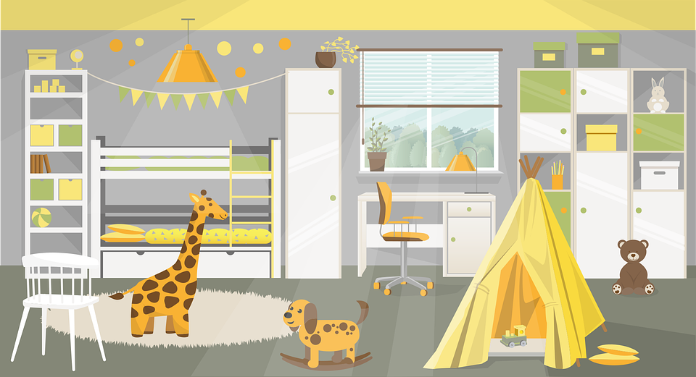
aussprechen
[z]
Which words are nouns? How do you know?
…
Zug
sitzen
Platz
zehn
Zimmer
Notes:
Timing: 1 minute
Aim: to consolidate the SSC [z].
Procedure:
Re-present the SSC and the source word ‘Zug’ (with gesture, if using).
Click to bring on the picture and get pupils to repeat the word ‘Zug’ (with gesture, if using).
Present the cluster words in the same way, bringing on the picture and getting pupils to pronounce the words.
Click to bring up call-out explaining the pronounciation of ‘z’.
Click to bring up the prompt to identify the nouns (the ones with capital letters). This is still very new knowledge for pupils, so it’s good to revisit this as often as we can. Plus, it gives an additional opportunity to pronounce the words.
Click to highlight the 3 x nouns.
Vocabulary:
sitzen [231] Platz [326] Zimmer [665] zehn [333]
Jones, R.L & Tschirner, E. (2019). A frequency dictionary of German: Core vocabulary for learners. London: Routledge.

Slide 4
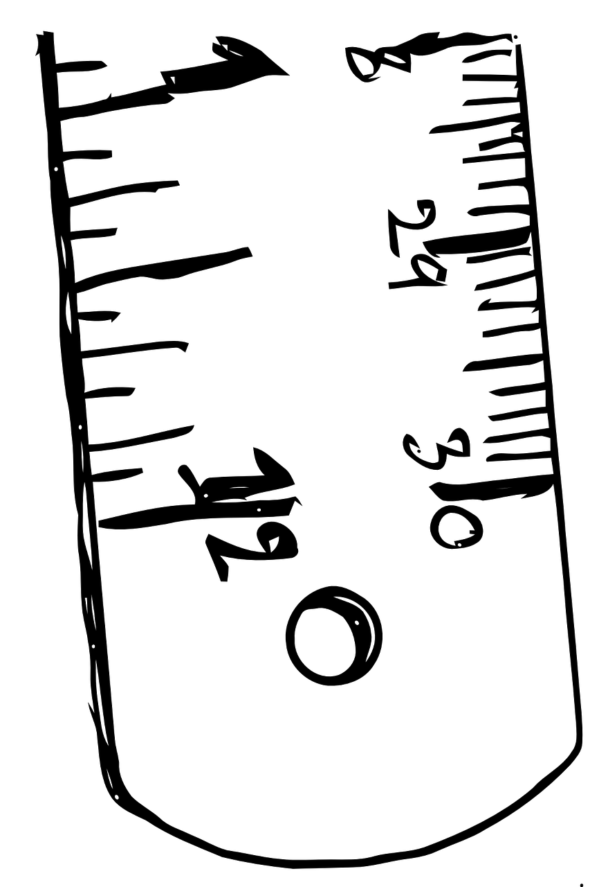
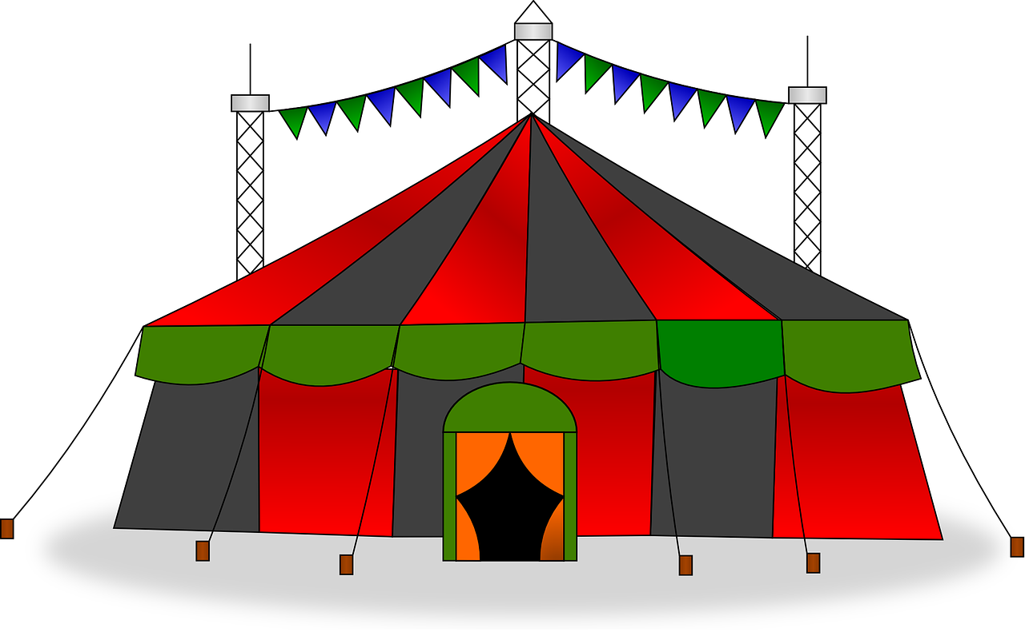
aussprechen
[z]
Sag die Wörter.
Zentimeter
Zirkus
Zebra
Zement
zentral
Zertifikat
Zoo
Zeremonie
Notes:
Timing: 2 minutes
Aim: to consolidate the SSC [z] by reading out unknown cognate words.
Procedure:
Click for the first image and word to appear.
Ask pupils to say the word how they think it should sound, focusing particularly on the [z] sound.
Click on the word to listen and check. NB that zentral, Zertifikat and Zeremonie have slightly different stress patterns to the equivalent English words
Continue for the rest of the images and words.
Frequency of unknown words and cognates:
Zentimeter [1338] Zirkus [>5009] Zebra [>5009] Zement [>5009] zentral [818] Zertifikat [>5009] Zoo [>5009] Zeremonie [>5009]
Jones, R.L & Tschirner, E. (2019). A frequency dictionary of German: Core vocabulary for learners. London: Routledge.

Slide 5
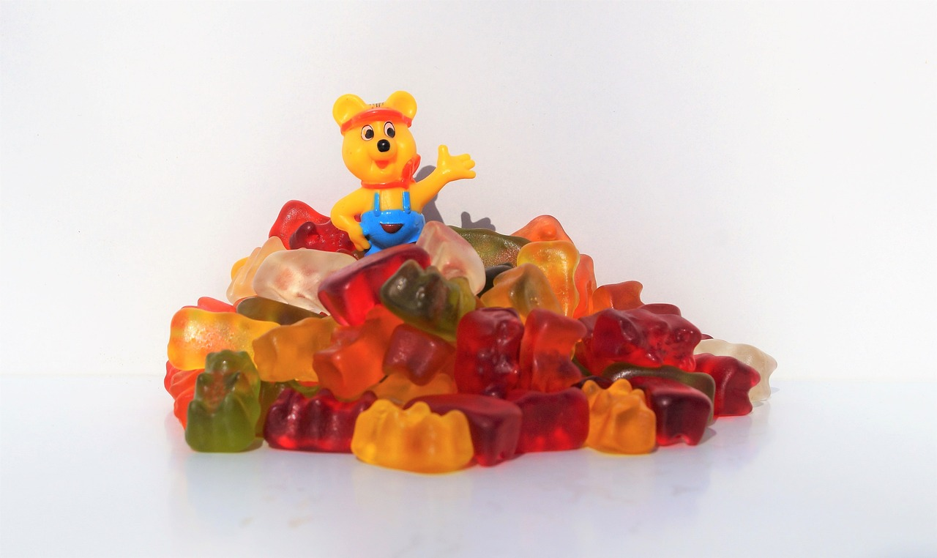
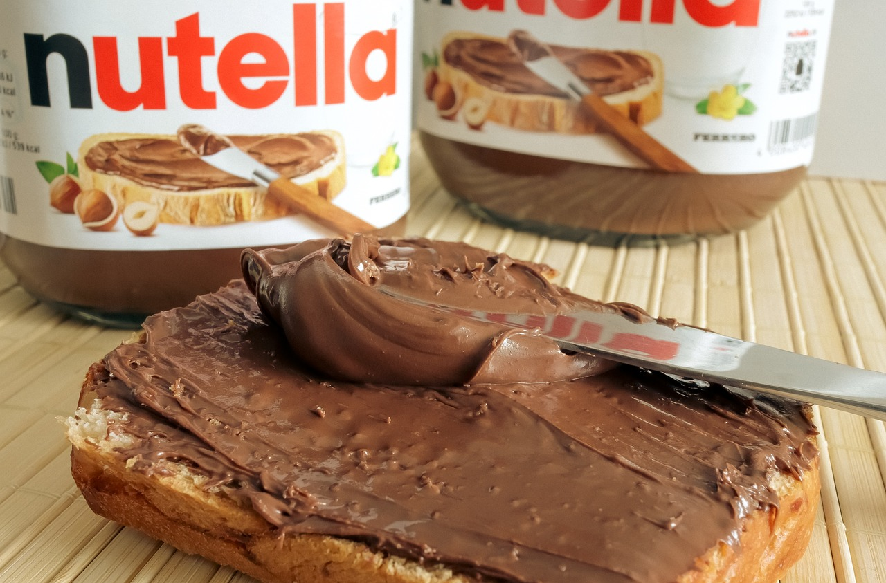
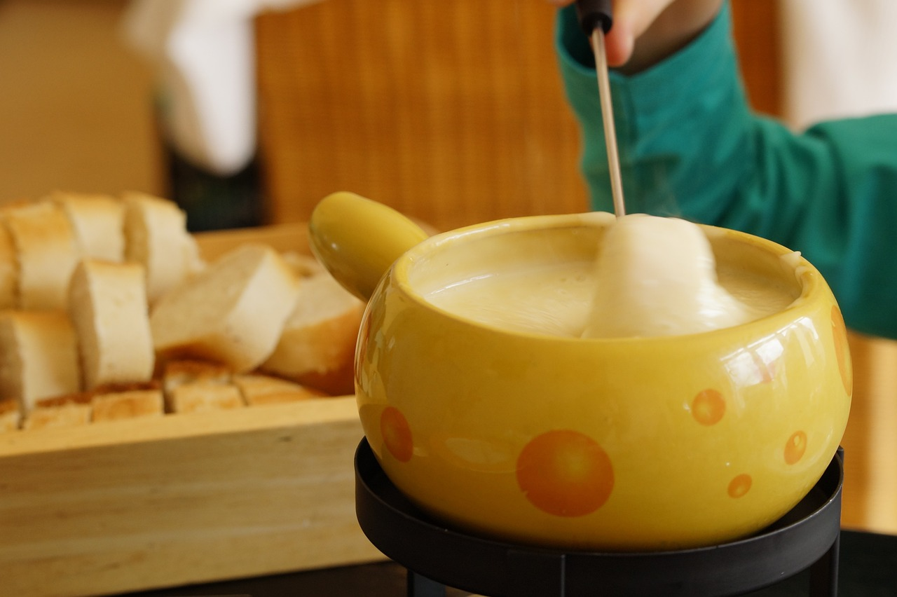
Vokabeln
Mmm, lecker*!
Aus welchem Land kommen* diese Sachen?
Aus Deutschland oder aus der Schweiz?
Emmentaler Käse
[Emmental cheese]
Ritter Sport Schokolade
Haribo Goldbären
[Haribo Gold Bears]
Nutella
Fondue
Lindt Schokolade
kommen aus – to come from; lecker – delicious, yummy
Notes:
Timing: 3 minutes
Aim: to introduce some well-known foods originating from Germany and Switzerland.
Procedure:
Click to present the first food item and click on the associated word to hear the German pronunciation.
Ask pupils to guess whether it comes from Germany or Switzerland. You could encourage pupils to give a full sentence as an answer: ‘Emmentaler Käse/Nutella… kommt aus Deutschland/der Schweiz.’ You could write ‘_______________ kommt aus Deutschland/der Schweiz’ on the board to help pupils with this.
(Optional) Ask pupils ‘Magst du Emmentaler Käse/Nutella…?’ (Do you like Emmental cheese/Nutella…?’) for some of the food items. Encourage them to answer either ‘ja’ or ‘nein’.
Frequency of unknown words and cognates: aus [37] kommen [62] lecker [>5009] Jones, R.L & Tschirner, E. (2019). A frequency dictionary of German: Core vocabulary for learners. London: Routledge.
5

Slide 6
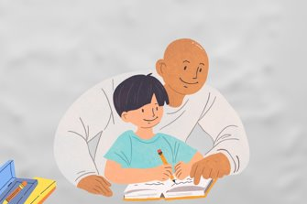
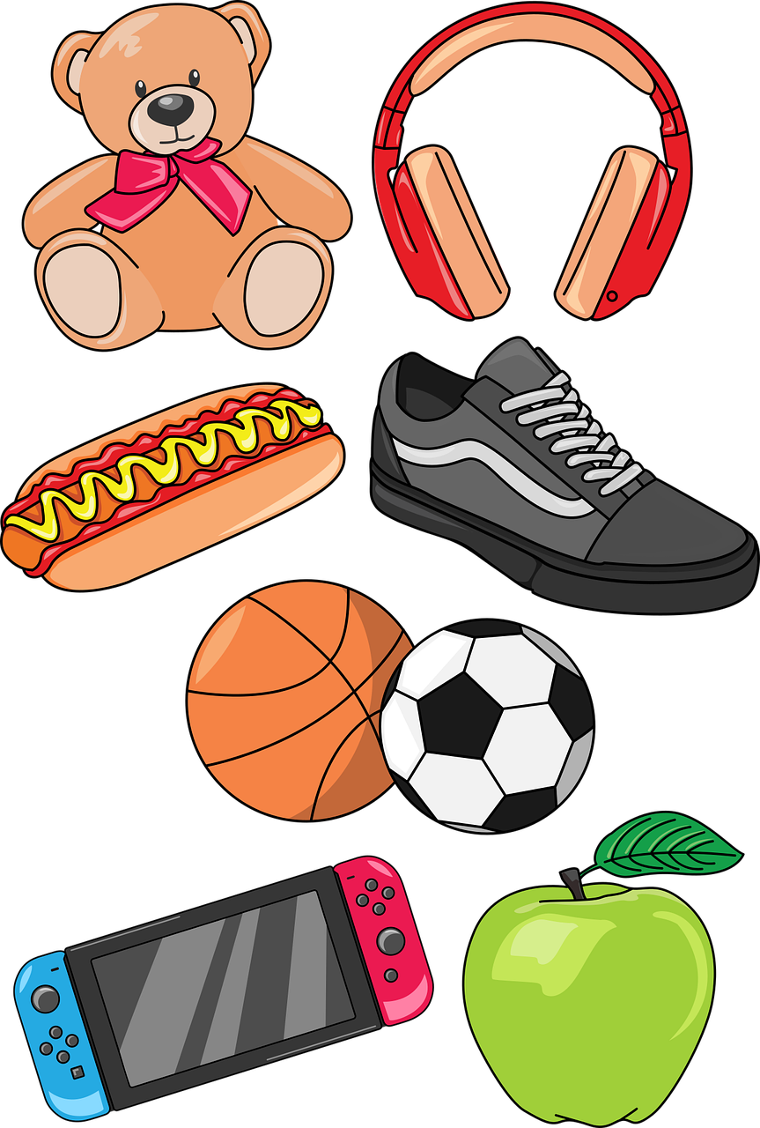
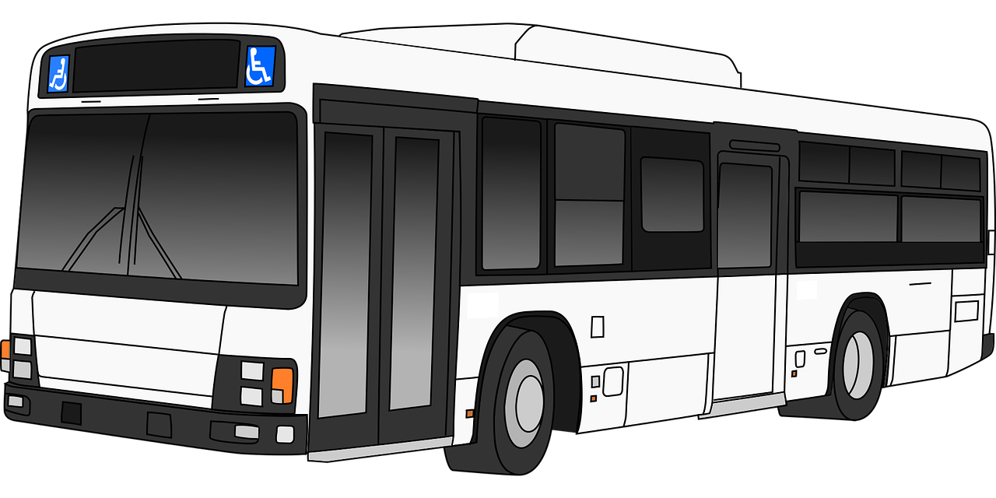
Vokabeln
Sag die Wörter auf Deutsch. Was ist das auf Englisch?
Wörter
You know German often joins two words together to make another word. E.g., Haus + Aufgabe → Hausaufgabe.
nehmen
die Hausaufgabe
[to take]
[homework]
mitnehmen
mitnehmen
…
[to take with, bring with]
die Sachen
[things]
This also happens with verbs. The mit then moves and matches English word order: Ich nehme mein Handy mit. I take my phone with me. And you don’t need the ‘me’ in German!
sehen
[to see]
der Bus
[bus]
der Freund
normally
normalerweise
[friend (m)]
[normally]
Notes:
[1/3]
Timing: 3 minutes
Aim: to introduce new vocabulary for this week.
Procedure 1. Pupils either work by themselves or in pairs, reading out the words and reading their English meanings (1 minute).
2. Ask pupils if they noticed anything similar about nehmen and mitnehmen. Does anyone remember what ‘mit’ means (with)? Display the two explanations about this separable verb. 2. Then, on the next slide, students try to recall the English orally (chorally), looking at the German (1 minute). 3. Then, on the following slide, they to recall the German meanings orally (again, chorally), looking at the English (1 minute).
Notes:
Note that images/words won’t disappear and appear in this activity as in previous resources.
6

Slide 7
Vokabeln
Sag die Wörter auf Deutsch. Was ist das auf Englisch?
…
Wörter
to take
nehmen
homework
die Hausaufgabe
to take with, bring with
mitnehmen
things
die Sachen
to see
sehen
bus
der Bus
friend (m)
der Freund
normally
normalerweise
Notes:
[2/3]
Procedure: 1. Students try to recall the English orally (chorally), looking at the German (1 minute). 2. Elicit answers and click to reveal
3. Then, in the following slide, they to recall the German meanings orally (again, chorally), looking at the English (1 minute).
7

Slide 8
Vokabeln
Sag die Wörter auf Deutsch. Was ist das auf Englisch?
Wörter
to take
nehmen
homework
die Hausaufgabe
to take with, bring with
mitnehmen
things
die Sachen
…
to see
sehen
bus
der Bus
friend (m)
der Freund
normally
normalerweise
Notes:
[3/3]
Procedure: 1. Students recall the German meanings orally (again, chorally), looking at the English (1 minute).
2. Click to reveal the answers.
8

Slide 9
Present tense: strong verbs e→ i, e→ ie
Some German verbs change the vowel in the er/sie/es form.
The ‘e’ in the stem changes to ‘i’:
We call these strong verbs.
Nehmen and mitnehmen have another change, too. What is it?
Ich nehme das Papier.
Er nimmt das Papier.
Ich helfe.
I help/am helping.
Sie hilft.
She helps/is helping.
In other verbs, the ‘e’ in the stem changes to ‘ie’:
Ich sehe.
I see/am seeing.
Er sieht.
He sees/is seeing.
The verb endings are the same for all verbs in the present tense.
Notes:
Timing: 2 minutes
Aim: to present the 1st and 3rd persons singular of strong verbs with e→i and e→ie change.
Procedure:
Click through the animations to present the new information.
Elicit English translation for the German examples provided.
Remind pupils of the verbs ‘geben’ (to give) and lesen (to read). These also follow these rules. Ask learners to put these in the third person (er/sie/es gibt, er/sie/es liest). So geben follows the e -> i rule and lesen follows the e -> ie rule.
The answer to the question in the final speech bubble is that the h in nehmen turns into an m, so it’s not ‘er nihmt’, it’s ‘er nimmt’. The same happens with mitnehmen e.g. Ich nehme das Papier mit -> Er nimmt das Papier mit.
9

Slide 10
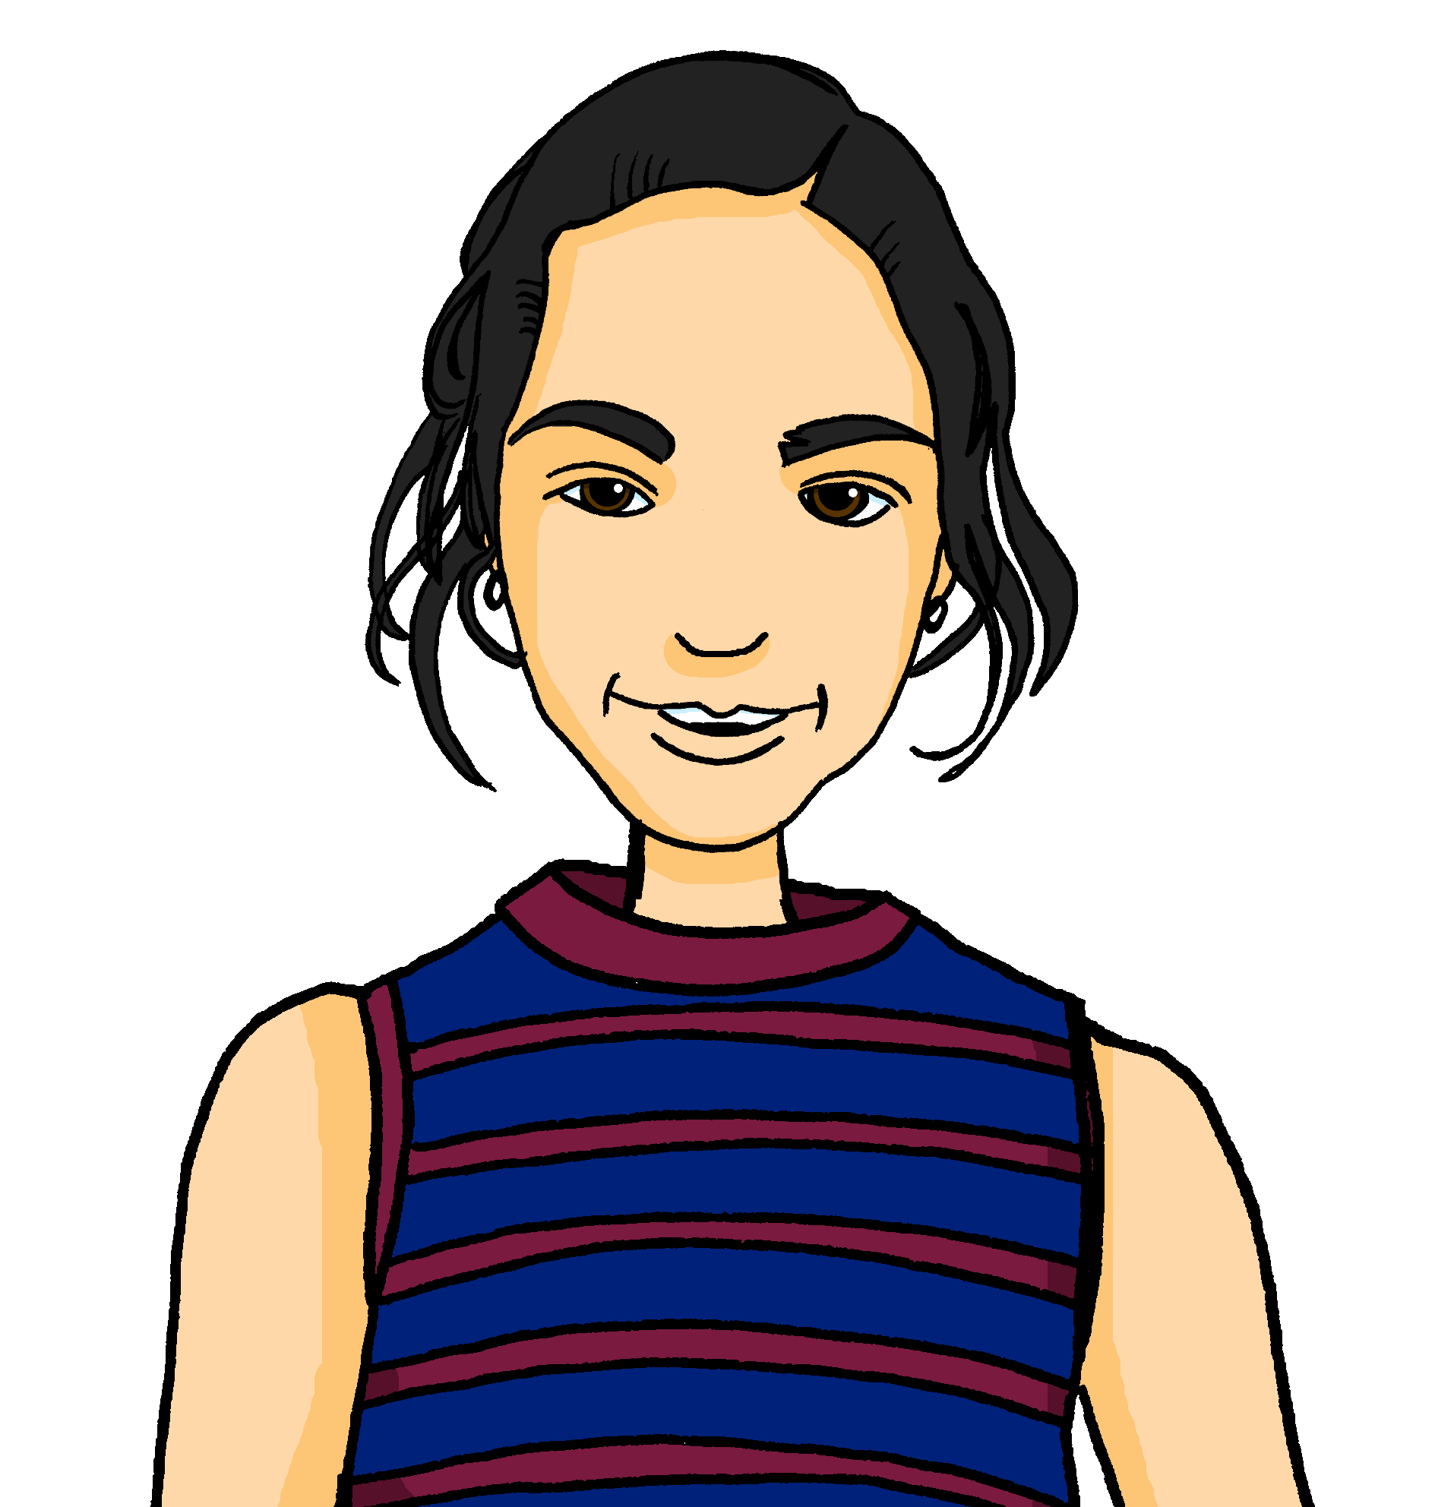
hören
Olivia
Olivia ist eine Freundin von Ronja. Sie kommt aus England. Ronja spricht mit Mariem.
Hör zu. Wer macht das? Ronja (ich) oder Olivia (sie)?
She often takes the bus.
I normally take the train.
I normally read books.
She often helps at school concerts.
She often sees a film.
She takes an instrument to school.
I help at home every day.
ich (I)
sie (she)
Was? Schreib auf Englisch.
B.
1
2
3
4
5
6
bei – with/at
Notes:
Timing: 8 minutes
Aim: to practise aural comprehension of strong verbs in 1st and 3rd persons singular as well as vocabulary for this week.
Procedure:
Ensure that the scenario is clear. Ronja is telling her friend Mariem about her friend Olivia from England and how their everyday routines are different.
Explain the pupils need to listen out for the verb to decide if Ronja is talking about herself (I) or Olivia (she).
Explain that they will listen again and write the action/activity in English.
Complete the example. Click to give feedback.
Repeat steps 1-4 for items 1 – 6.
Click to correct.
Note: there are two clues in the verbs here, the verb ending and the vowel, so we are not just isolating the vowel change for practice. This first task develops familiarity with the verb forms and the new vocabulary. In the follow up activities we will contrast the ihr (you all) form e.g., helft with the er/sie form hilft, to focus pupils solely on the vowel change. In addition, the reading activity that follows obscures the endings as well as the pronouns, so the pupils are compelled to focus all their attention on the spelling of the verb stem.
Transcript:
Beispiel: [sie] nimmt oft den Bus.
[ich] nehme normalerweise den Zug.
[ich] lese normalerweise Bücher.
[sie] hilft oft bei Schulkonzerten.
[sie] sieht oft einen Film.
[sie] nimmt ein Instrument in die Schule mit.
[ich] helfe jeden Tag zu Hause.
10

Slide 11
lesen
Ronja textet mit Mariem.
Olivia ist meine Freundin aus England und…
Wer macht was? Schreib 1 – 6, ich oder sie, und die Sätze auf Englisch.
1. Sie liest oft Bücher.
4. Sie nimmt viele Sachen in die Schule* mit.
1. nnn liesn oft Bücher.
4.
nnn nimmn viele Sachen in die Schule mit.
2. Sie hilft Lias – er hat manchmal Probleme mit Englisch.
nnn hilfn Lias –
er hat manchmal Probleme mit Englisch.
2.
5.
nnn siehn samstags ihre Schwester.
5. Sie sieht samstags ihre Schwester.
nnn helfn auch in der Englischklasse.
3.
3. Ich helfe auch in der Englischklasse.
nnn sehn Lias nicht sehr oft im Moment!
6. Ich sehe Lias nicht sehr oft im Moment!
6.
Notes:
Timing: 5 minutes
Aim: to practise recognising stem changes between ich and sie and connecting these with meaning.
Procedure:
Pupils write down 1 to 6 .
Pupils read Ronja’s messages, and for each message say whether it applies to ich (Ronja) or sie (Olivia), based upon whether or not there is a stem change.
Note: teachers tell pupils that they will only be able to decide I or she if the verbs are strong verbs. For weak (regular) verbs that don’t change their stems you need the verb ending and pronoun.
3. Elicit full phrase answers from pupils in German – click to reveal written messages. 4. Elicit English meanings, and check using the answers below.
Answers:
She often reads books.
She helps Lias – he sometimes has problems with English in school.
I also help in English class.
She takes a lot of things with her to school.
She sees her sister on Saturdays.
I don’t see Lias very often at the moment!
11

Slide 12
Tschüss!
grün
Notes:
12

