Slide 1
Interacting
Klassenfahrt
grün
Follow ups 1-5
Term 1 Week 2
Notes:
Artwork by Steve Clarke. Pronoun pictures from NCELP (www.ncelp.org). All additional pictures selected from Pixabay and are available under a Creative Commons license, no
attribution required.
Phonics:
long [u] du [54] gut [76] super [1772]
short [u] Punkt [248] Nummer [806] dunkel [706]
Vocabulary: sie sind [4] Antwort [522] Bruder [730] Buch [300] Computer [1252] Film [505] Geschichte [262] Gruppe [369] Handy [1693] Hund [825] Idee [451] Instrument [1572] Karte [1474] Konzert [2350]
Land [134] Lehrer, Lehrerin [695] Lied [1733] Musik [509] Ort [341] Partner, Partnerin [1172] Satz [432] Schwester [974] Show [3367] Stadt [204] welcher, welche, welches [122] die² [1]
Jones, R.L & Tschirner, E. (2019). A frequency dictionary of German: Core vocabulary for learners. London: Routledge.
The frequency rankings for words that occur in this PowerPoint which have been previously introduced in these resources are given in the SOW and in the resources that first
introduced and formally re-visited those words.
For any other words that occur incidentally in this PowerPoint, frequency rankings will be provided in the notes field wherever possible.
Remember that at the start of the course (first three lessons of Rot/Gelb) pupils learnt language (for greetings and register taking) that can still be part of the lesson routines in upper KS2 (Blau/Grün). They are not re-taught, as we anticipate that teachers have built these in from early in lower KS2.
1

Slide 2
aussprechen
long [u]
…
gut
du
super
[good]
[you]
Ruth
Lukas
Notes:
Timing: 2 minutes
Aim: to consolidate the SSC long [u].
Procedure:
Re-present the SSC and the source word ‘du’ (with gesture, if using).
Click to bring on the picture and get pupils to repeat the word ‘du’ (with gesture, if using).
Present the cluster words in the same way, bringing on the picture and getting pupils to pronounce the words.
Note:
a gesture for ‘du’ might be to point at someone else.
2

Slide 3
aussprechen
short [u]
…
Nummer
Punkt
dunkel
[number]
[dot, full stop]
[dark]
Notes:
Timing: 2 minutes
Aim: to consolidate the SSC short [u].
Procedure:
Re-present the SSC and the source word ‘Punkt’ (with gesture, if using).
Click to bring on the picture and get pupils to repeat the word ‘Punkt’ (with gesture, if using).
Present the cluster words in the same way, bringing on the picture and getting pupils to pronounce the words.

Slide 4
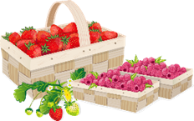
Follow up 1
Long [u] or short [u]? Which word is the odd one out?
Hör zu.
hören
hören
 | A | B | C
 | Schule | null | Mutter
 | Juni | Juli | August
 | Minute | Stunde | Uhr
 | ruhig | wunderbar | gut
 | jung | du | besuchen
 | Butterbrot | Gruppe | Computer
1
2
3
4
5
6
Notes:
Timing: 8 minutes
Aim: to practise long and short [u] in the listening modality.
Procedure:
Click to play the first recording. Pupils decide which of the three words they hear is the odd one out based on a long or short [u].
Differentiation: pupils write all the words down for a higher challenge and then select the odd one out, or just 1.B etc.
Click to reveal answer tick.
Click to reveal written version of the words.
Continue for items 2-6.
Transcript:
Schule | null | Mutter
Juni | Juli | August
ruhig | wunderbar | gut
Minute | Stunde | Uhr
jung | du | besuchen
Computer | Butterbrot | Gruppe

Slide 5
Follow up 2
Word snake!
Put capitals on the nouns, then sort into singular and plural.
Wörter
Now read the words aloud with a partner!
Vokabeln
60
S
Singular
Plural
Land
Schwestern
Land
Antwort
Computer
Geschichten
Schwestern
Filme
Konzert
Hunde
Computer
Idee
Antwort
Filme
Konzert
Handy
0
Idee
Gruppen
Geschichten
Gruppen
Handy
Karten
Hunde
Karten
START
Notes:
Timing: 5 minutes
Aim: to consolidate this week’s new nouns.
Procedure: 1. Pupils put capitals on the nouns.
2. Click to bring up the individual words. 3. Pupils sort nouns into plural and singular 4. Pupils work with a partner to say the nouns out loud.

Slide 6
Follow up 3
Hör zu. Ist das welcher, welche oder welches? Welches Wort ist das?
hören
 | Show | Konzert
 | Lehrer | Person
 | Show | Film
 | Bruder | Partnerin
 | Ort | Land
 | Lied | Geschichte
1
2
3
4
5
6
Notes:
Timing: 8 minutes
Aim: to practise the different forms of welch- in the listening modality.
Procedure:
Click to play the first recording of a bleeped sentence. Pupils decide which of the two nouns is the correct one, based on the gender of welch-
Click to blank out incorrect choice and hear audio to listen and check the full sentence.
Continue for items 2-6.
Transcript:
Welches [Konzert] ist das? Dua Lipa!
Welcher [Lehrer] ist das? Herr Suhr!
Welche [Show] ist das? Les Miserables! Welcher [Bruder] ist das? Alex.
Welches [Land] ist das? Deutschland Welche [Geschichte] ist das? Hänsel und Gretel.

Slide 7
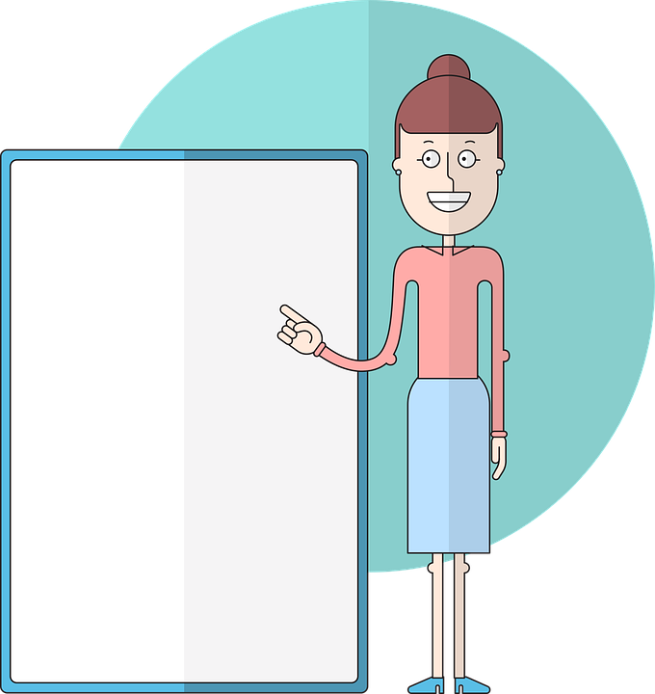
Follow up 4:
Schreib das Verb auf Deutsch.

Ist es ‘is’ oder ‘are’? Dann beschreib das Ding.
Zum Beispiel:
schreiben
Das sind die Geschichten. Sie sind wunderbar!
_____
_____
_____
_________!
sein
1
Das ist die Karte. Sie ist blau!
____
____
____
____ !
2
Das ist das Land. Es ist schön!
____
____
____
______ !
3
Das sind die Hunde. Sie sind toll!
____
____
____
____ !
4
Das sind die Antworten. Sie sind gut!
____
____
____
____ !
Das ist das Konzert. Es ist super!
5
___
____
____
____________ !
Notes:
More challenging version
Note: There are two versions of this slide, this is the more challenging version which has no suggestions for adjectives. The next slide is the same task, but includes a list of suggestions for adjectives which pupils can choose.
Timing: 8 minutes.
Aim: to practise the third person singular and plural of sein in the written modality.
Procedure:
For each pair of sentences: Ask pupils to say / write down the correct verb (is – ist or are – sind) for part 1 and then complete part 2 using the correct subject pronoun and verb. Pupils can choose their own adjectives for each sentence.
Click to reveal answers in turn. The adjective at the end can vary as pupils will have chosen their own.

Slide 8
Follow up 4:
Schreib das Verb auf Deutsch.

Ist es ‘is’ oder ‘are’? Dann beschreib das Ding.
Zum Beispiel:
schreiben
Das sind die Geschichten. Sie sind wunderbar!
_____
_____
_____
_________!
sein
1
Das ist die Karte. Sie ist blau!
____
____
____
____ !
2
Das ist das Land. Es ist schön!
____
____
____
______ !
3
Das sind die Hunde. Sie sind toll!
____
____
____
____ !
blau - falsch – freundlich – groß - gut – klar – klein – kurz – lang – nett – richtig – rot – super - toll – wunderbar
4
Das sind die Antworten. Sie sind gut!
____
____
____
____ !
Das ist das Konzert. Es ist super!
5
___
____
____
____________ !
Notes:
Less challenging version
Note: There are two versions of this slide, this is the less challenging version which has suggestions for adjectives which pupils can choose from.
Timing: 8 minutes.
Aim: to practise the third person singular and plural of sein in the written modality.
Procedure:
For each pair of sentences: Ask pupils to say / write down the correct verb (is – ist or are – sind) for part 1 and then complete part 2 using the correct subject pronoun and verb. Pupils can choose their own adjectives for each sentence.
Click to reveal answers in turn. The adjective at the end can vary as pupils will have chosen their own.

Slide 9
Follow up 5:
Ist das der, die oder das?
Bruder
Musik
Karte
Show
Partner
Film
Land
Computer
Partnerin
der
das
die
Notes:
Timing: 3 minutes Aim: To revisit the knowledge that there are lots of words that look similar or exactly the same in German and English but it is important to know their gender and how to pronounce them.
Procedure:
1. Pupils sort the cognates into the three gender ‘pacpeople’: der, die , and das.
2. Pupils pronounce the words together with their articles.
3. Click to move each word to the correct ‘pacperson’ (der, die, das).
9

Slide 10
Extra:

Schreib auf Englisch.
Can you get at least 15 points?
Vokabeln
 | ich möchte | möcht- | das Handy
 | du möchtest | das Instrument | der Satz
 | der Ort | die Karte | der Hund
 | das Lied | die Geschichte | der/die Lehrer/in
 | welche | sie sind | die Show
 | das Konzert | das Land | welcher
 | die | welches | sie
I would like
would like
(the) mobile phone
x3
you would like
(the) instrument
(the) sentence
(the place)
(the) card, ticket
(the) dog
x2
(the) song
(the) story
(the) teacher
which (f, pl)
they are
(the) show
(the concert)
(the) country
which (m)
x1
the (f), the (pl)
which (nt)
she/it
Notes:
Timing: 5 minutes
Aim: to practise written production of vocabulary from this and revisited weeks.
Procedure: 1. Give pupils a blank grid. They fill in the English meanings of any of the words they know, trying to reach 15 points in total. 2. Click to reveal the answers (which will appear one by one from the bottom row upwards).
Note: The most recently learnt and practised words are pink, words from the previous week are green and those from week 1 are blue, thus more points are awarded for them, to recognise that memories fade and more effort (heavy lifting!) is needed to retrieve them.

Slide 11
Extra:

Schreib auf Deutsch.
Can you get at least 15 points?
Vokabeln
 | (the) instrument | you would like | (the) sentence
 | would like | I would like | (the) mobile phone
 | (the) story | (the) place | (the) song
 | (the) teacher | (the) dog | (the) card, ticket
 | which (nt) | (the) show | she/it
 | the (f), the (pl) | which (m) | which (f, pl)
 | they are | (the) concert | (the) country
das Instrument
du möchtest
der Satz
x3
möcht-
das Handy
ich möchte
die Geschichte
der Ort
das Lied
x2
der/die Lehrer/in
der Hund
die Karte
welches
die Show
sie
die
welcher
welche
x1
sie sind
das Konzert
das Land
Notes:
Timing: 5 minutes
Aim: to practise written production of vocabulary from this and revisited weeks.
Procedure: 1. Give pupils a blank grid. They fill in the German meanings of any of the words they know, trying to reach 15 points in total. 2. Click to reveal the answers (which will appear one by one from the bottom row upwards). Click on each German word to hear audio.
Note: The most recently learnt and practised words are pink, words from the previous week are green and those from week 1 are blue, thus more points are awarded for them, to recognise that memories fade and more effort (heavy lifting!) is needed to retrieve them.

Slide 12
Tschüss!
grün
Notes:
12

