Slide 1
Interacting
Klassenfahrt
grün
sein (to be, being) – wir sind, ihr seid
Subject pronouns 'it' and 'they' - er/sie/es, sie
SSC long and short [u]
Term 1 Week 2
Notes:
Artwork by Steve Clarke. Pronoun pictures from NCELP (www.ncelp.org). All additional pictures selected from Pixabay and are available under a Creative Commons license, no
attribution required.
Phonics:
long [u] du [54] gut [76] super [1772]
short [u] Punkt [248] Nummer [806] dunkel [706]
Vocabulary: sie sind [4] Antwort [522] Bruder [730] Buch [300] Computer [1252] Film [505] Geschichte [262] Gruppe [369] Handy [1693] Hund [825] Idee [451] Instrument [1572] Karte [1474] Konzert [2350]
Land [134] Lehrer, Lehrerin [695] Lied [1733] Musik [509] Ort [341] Partner, Partnerin [1172] Satz [432] Schwester [974] Show [3367] Stadt [204] welcher, welche, welches [122] die² [1]
Jones, R.L & Tschirner, E. (2019). A frequency dictionary of German: Core vocabulary for learners. London: Routledge.
The frequency rankings for words that occur in this PowerPoint which have been previously introduced in these resources are given in the SOW and in the resources that first
introduced and formally re-visited those words.
For any other words that occur incidentally in this PowerPoint, frequency rankings will be provided in the notes field wherever possible.
Remember that at the start of the course (first three lessons of Rot/Gelb) pupils learnt language (for greetings and register taking) that can still be part of the lesson routines in upper KS2 (Blau/Grün). They are not re-taught, as we anticipate that teachers have built these in from early in lower KS2.
1

Slide 2
aussprechen
long[u]
…
gut
du
super
[good]
[you]
Ruth
Lukas
Notes:
Timing: 2 minutes
Aim: to consolidate the SSC long [u].
Procedure:
Re-present the SSC and the source word ‘du’ (with gesture, if using).
Click to bring on the picture and get pupils to repeat the word ‘du’ (with gesture, if using).
Present the cluster words in the same way, bringing on the picture and getting pupils to pronounce the words.
Note:
a gesture for ‘du’ might be to point at someone else.
2

Slide 3
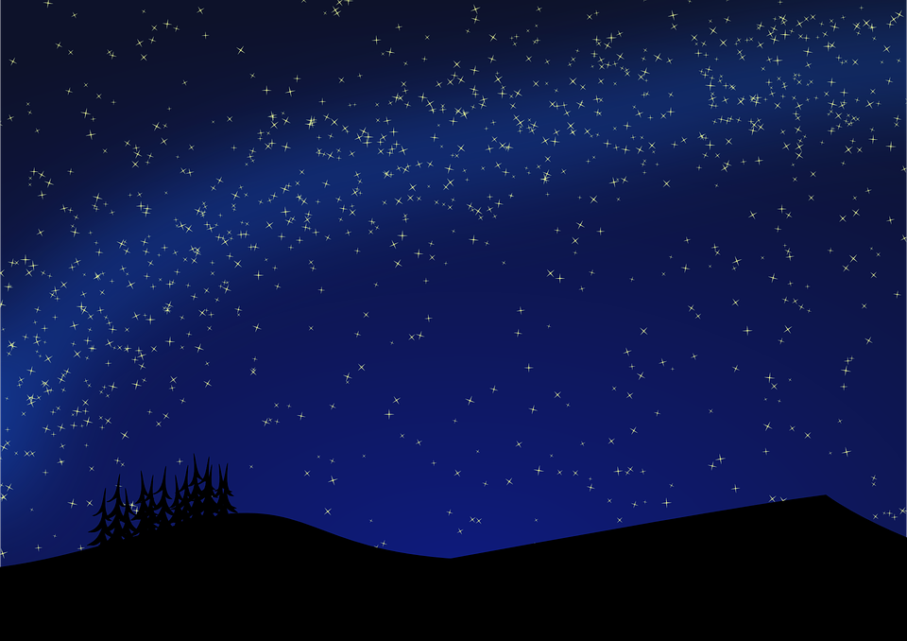
aussprechen
short [u]
…
Nummer
Punkt
dunkel
[number]
[dot, full stop]
[dark]
Notes:
Timing: 2 minutes
Aim: to consolidate the SSC short [u].
Procedure:
Re-present the SSC and the source word ‘Punkt’ (with gesture, if using).
Click to bring on the picture and get pupils to repeat the word ‘Punkt’ (with gesture, if using).
Present the cluster words in the same way, bringing on the picture and getting pupils to pronounce the words.

Slide 4
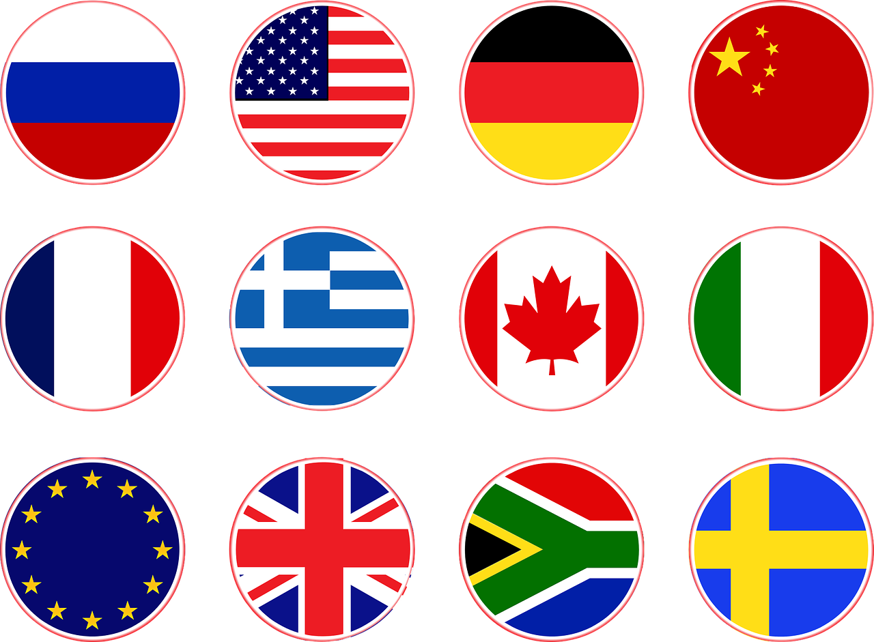
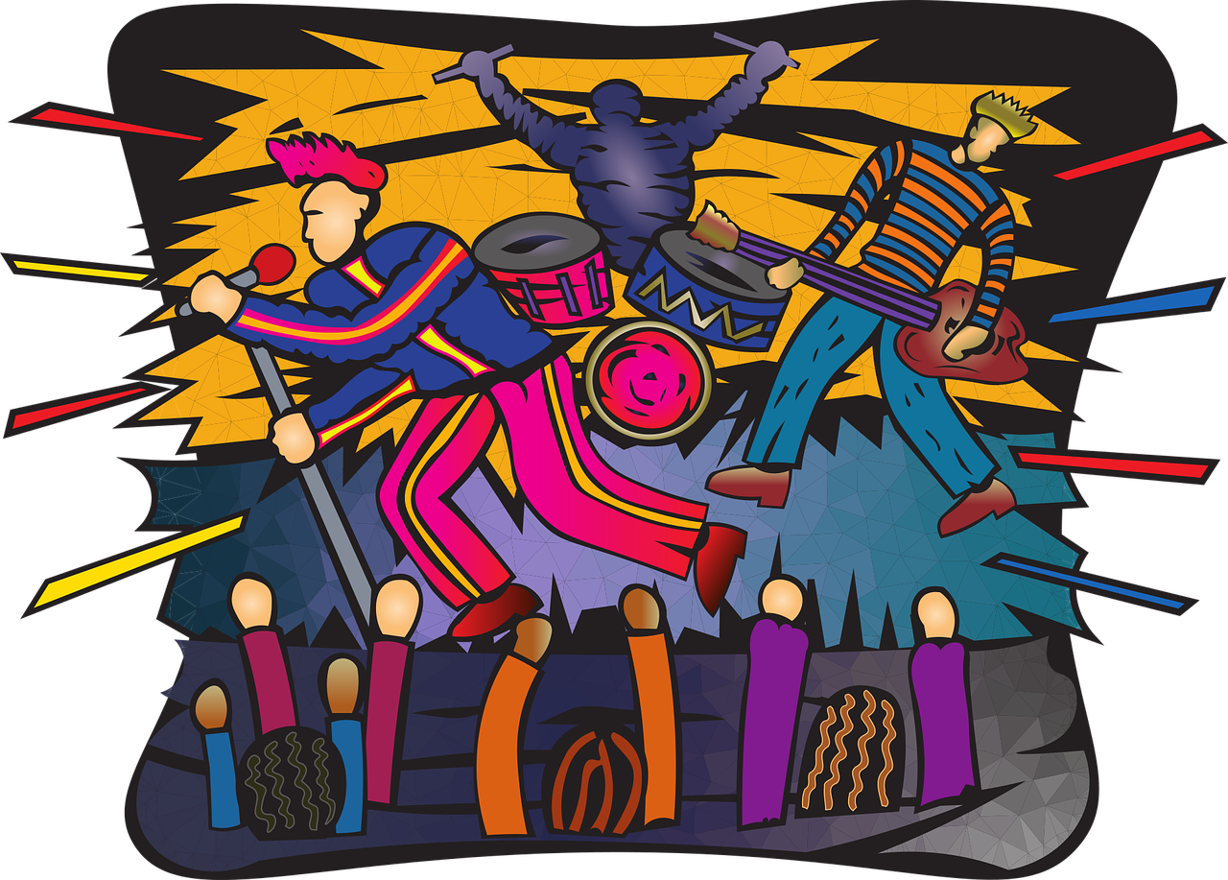
Vokabeln
Was ist das auf Deutsch?
Wörter
die Karte means ticket as well as card!
(the) country
(the) concert
(the) song
(the) answer
the (f/pl)
(the) place
(the) show
(the) card, ticket
(the) mobile phone
(the) story
which?
(the) teacher
die Karte
welche(r/s)?
der Ort
das Handy
die Antwort
die
die Geschichte
das Lied
der/die Lehrer(in)
das Land
das Konzert
die Show
Notes:
Timing: 3 minutes
Aim: to elicit oral production of revisited nouns and two new nouns
Procedure:
1. Click for an English word.
2. Elicit the German word from all pupils, chorally.
3. Click to provide the written answer and hear the word pronounced.
4. Depending on level of class, use slide with German words on as a read aloud/ translation activity: pupils read in pairs / one says German word one says English word, swap roles.
4

Slide 5
die (the, plural)
You know three words for the in German:
der Ort
die Show
das Konzert
To say ‘the’ for all plural nouns, use ‘die’.
die Orte
die Shows
die Konzerte
You know this plural pattern:
m/nt → + e
Some cognate plurals have –s just like in English!
Notes:
Timing: 3 minutes Aim: To introduce the plural ‘die’ of direct articles der, die das and remind pupils of the two plural patterns they have been introduced to already.
Procedure: Click through the animations to present the information.
5

Slide 6
welcher?/welche?/welches? (which?)
To ask ‘which?’ in German, use welch- with these endings:
der Ort
die Show
das Konzert
Welcher Ort?
Welche Show?
Welches Konzert?
Welche? is which? for all plural nouns:
Welche Orte?
Welche Shows?
Welche Konzerte?
Notes:
Timing: 3 minutes Aim: To introduce the question word welcher/welche/welches? (which?)
Procedure: 1. Click through the animations to present the information.
2. For the plural forms, try to elicit the responses from pupils.
6

Slide 7
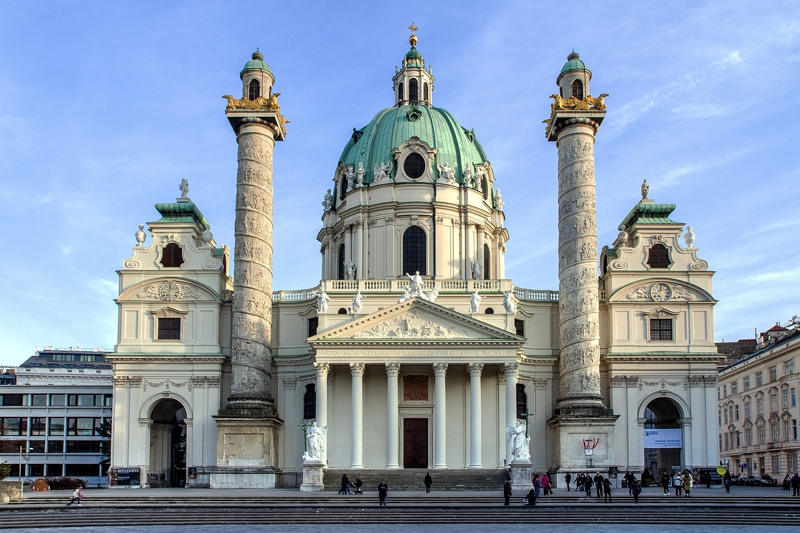
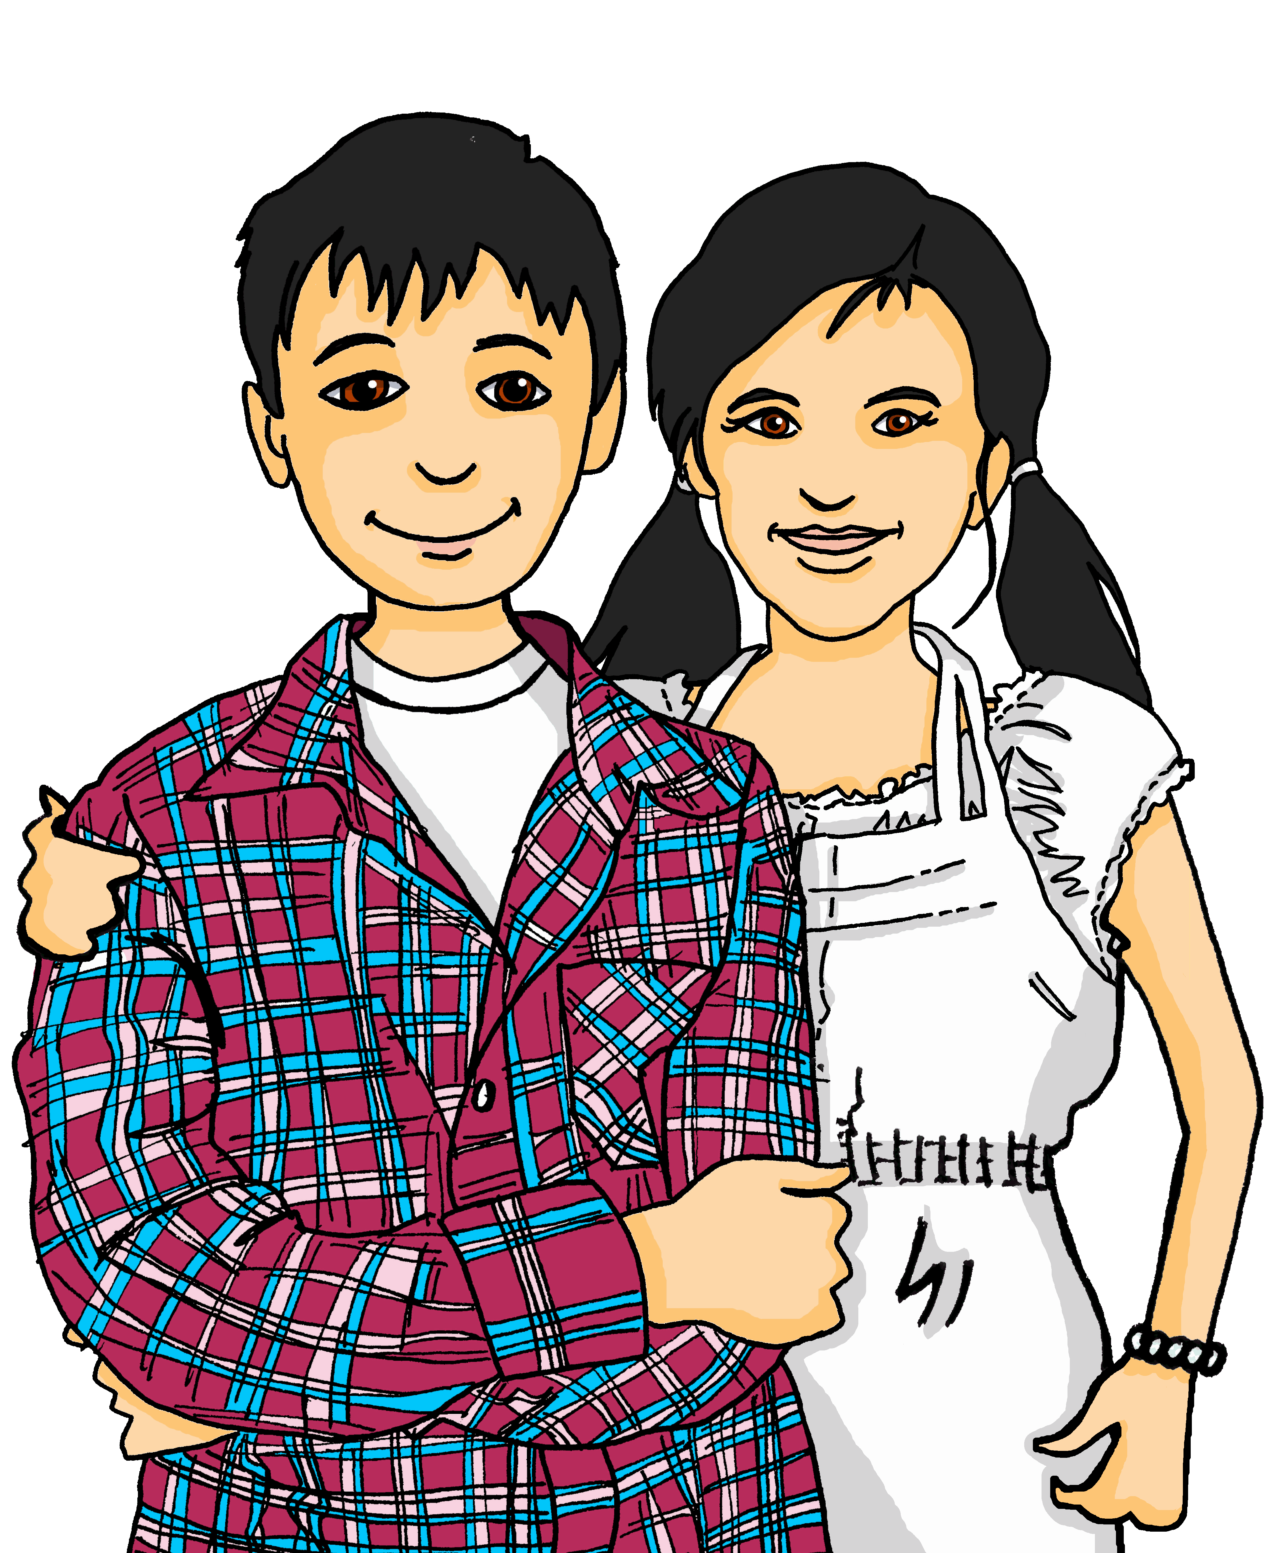
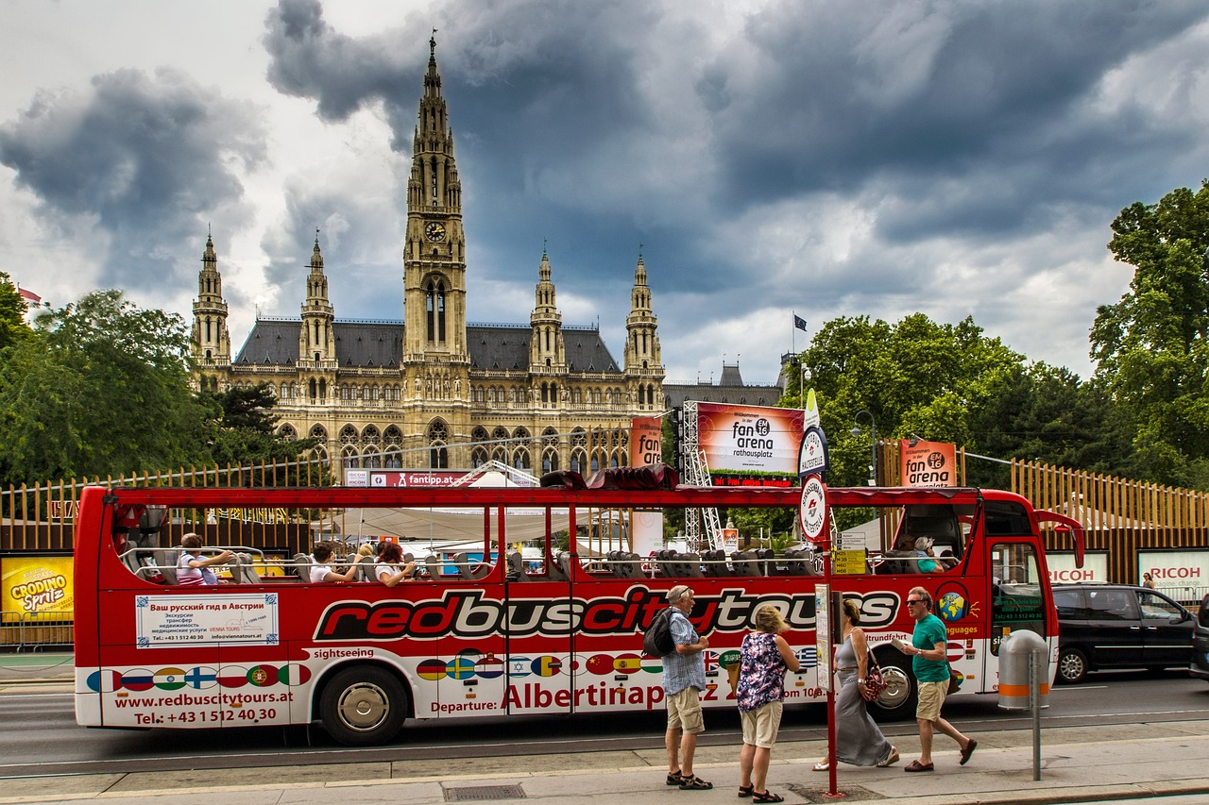
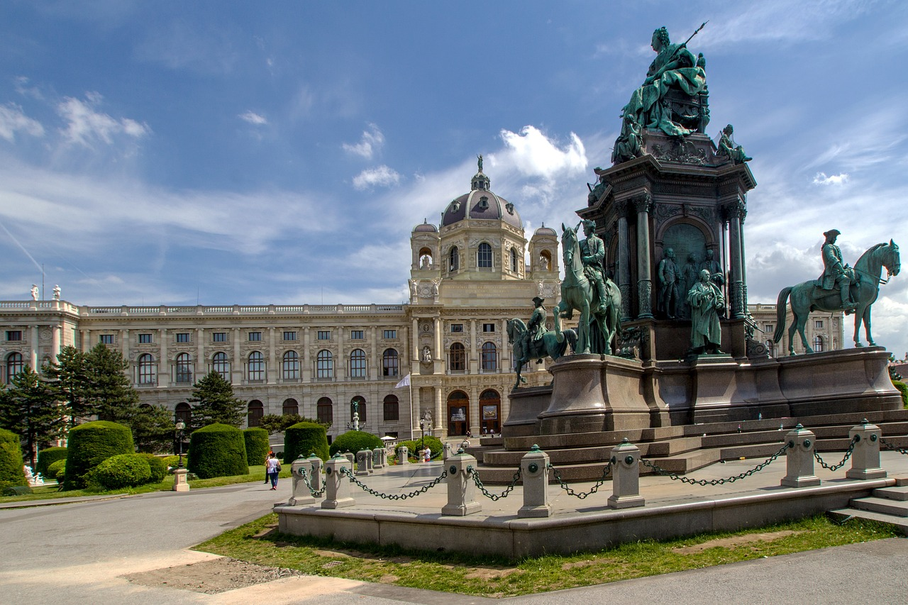
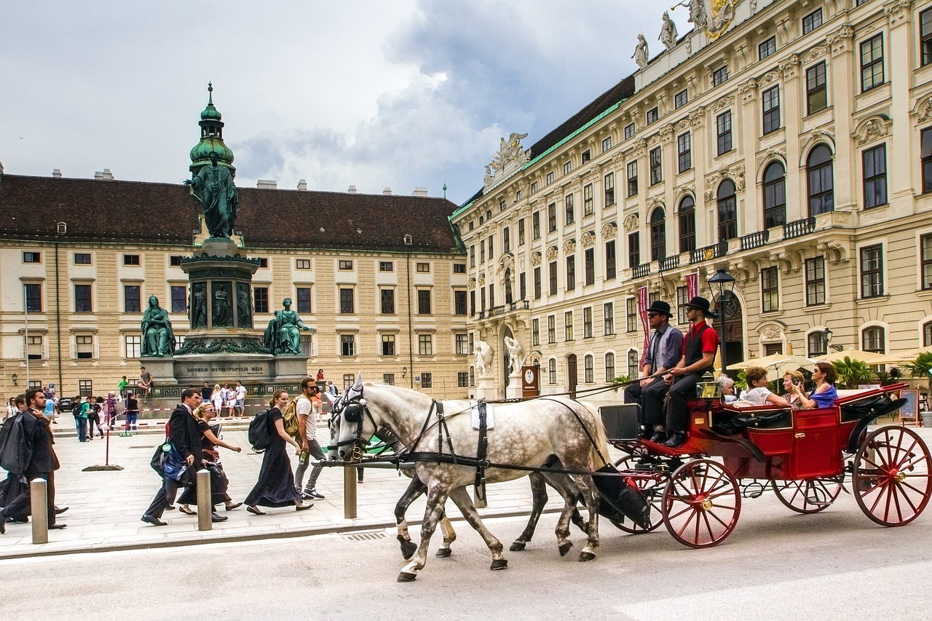
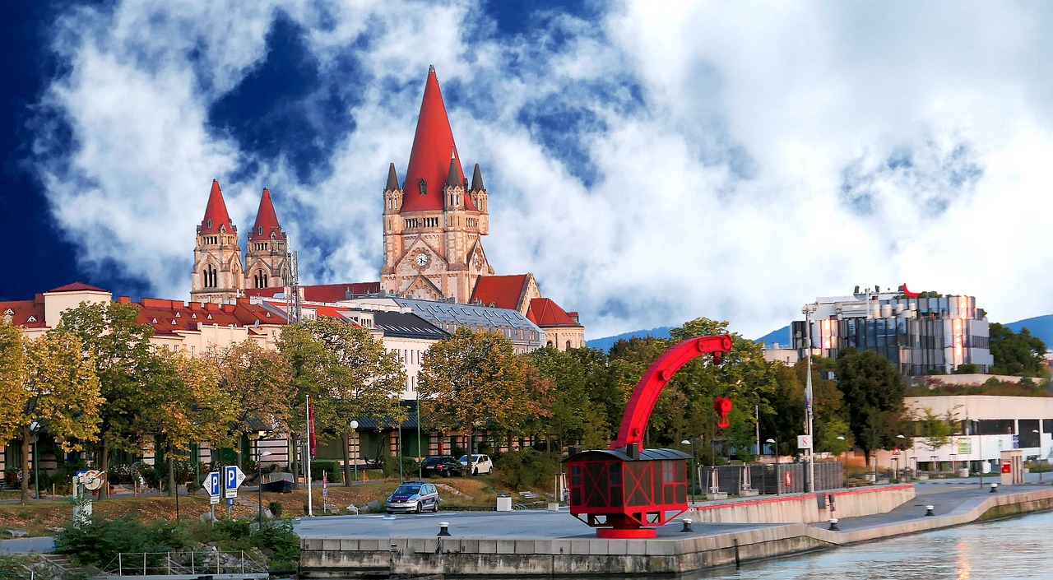
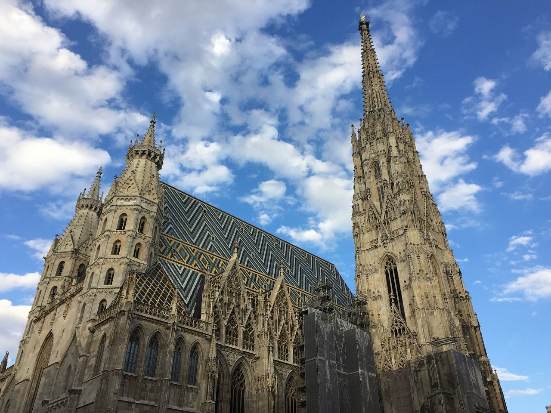
Stadtrundfahrt*
Lias und Ronjas Klasse macht eine Stadtrundfahrt* in Wien, in Österreich.
Remember that in German we can join two or more nouns together to make a new noun:→
Stadt = town,city
rund = round
Fahrt = trip
→ Stadtrundfahrt = city round trip (= tour!)
Wir machen viele Fotos!
Wir fahren mit dem Bus!
Notes:
Timing: 30 seconds Aim: to remind pupils of the scenario of Lias’ and Ronja’s class trip to Vienna and introduce the context for this week – their bus tour of the city. Procedure: 1. Display the slide and read the description with pupils.
2. Click to bring up the callout about Stadt-rund-fahrt and explain the word.
7

Slide 8
lesen
Lias und Ronja texten* mit Freunden in der Klasse.
Welches Wort ist das?
texten –
text, are texting
1. Welche
Musik|Sport
ist das?
3. Welches Show|Lied
ist das?
5. Welcher
Handy| Computer ist das?
4. Edelweiß!
Welcher
Ort|Stadt
ist das?
6. Ronjas! Welches
Konzert|Person
ist das?
2. Ein Instrument!
Welche
Lehrerin|Computer
ist das?
Frau Muhr!
Wien!
Mozart!
Notes:
Timing: 8 minutes
Aim: to practise the gender endings of welch- depending on the gender of the noun.
Procedure:
Explain the scenario: the two classes are texting each other.
Pupils identify the correct from of welch- based on the gender of the noun in the text message. Explain that there can only be a grammatical choice based on the ending of welch- as the meaning would work with either noun.
Click to block out the incorrect choice and only the correct choice will be visible.
Elicit oral translations of each message.
Vocabulary: texten [>5009]
Jones, R.L & Tschirner, E. (2019). A frequency dictionary of German: Core vocabulary for learners. London: Routledge.
8

Slide 9
die (the, plural)
You now know four words for the in German!
der Ort
die Show
das Konzert
die Orte
die Shows
die Konzerte
We use pronouns ‘it’ and ‘they’ to refer to nouns we have already mentioned. In German we need four words to do this:
So, er means he and it, sie means she and it.
Das ist der Ort. Er ist gut.
That is the place. It is good.
Das ist die Show. Sie ist super.
That is the show. It is super.
They are (sie sind) is the same verb as we are (wir sind).
Das ist das Konzert. Es ist toll.
That is the concert. It is great.
Das sind die Konzerte. Sie sind toll.
Those are the concerts. They are great.
sie = they for all German nouns.
Notes:
Timing: 3 minutes Aim: To introduce the plural ‘die’ of direct articles der, die das and the singular and plural subject pronouns (er, sie, es – it, sie – they).
Procedure: 1. Click through the animations to present the new information.
2. Elicit the English for each of the German examples.
9

Slide 10
lesen
Die Klasse schreibt im Chat. Der Chat ist kaputt!
Was ist das? Welches Wort ist richtig?
Chatbox
To: everyone
Das ist der Film | die Geschichte. Er ist lang!
1
Chatbox
To: everyone
Das ist die Show| das Buch. Sie ist super!
2
kaputt – broken
.
.
Chatbox
To: everyone
Das ist der Ort | das Lied. Es ist schön!
Chatbox
To: everyone
Das ist der Partner | die Partnerin. Er ist müde.
3
4
.
Chatbox
To: everyone
Das ist der Satz | die Antwort.
Sie ist schwer.
5
Chatbox
To: everyone
Das ist das Land |die Musik. Es ist schön!
6
.
Notes:
Timing: 8 minutes
Aim: to practise identifying masculine, feminine, and neuter subject pronouns.
Procedure:
Explain the scenario.
Pupils identify the correct choice of noun for item one, based on the pronoun in the next sentence.
Click to block out the incorrect choice. Only the correct choice will be visible.
Elicit oral translations of each message.
Unknown vocabulary and cognates:
kaputt [295]
Jones, R.L & Tschirner, E. (2019). A frequency dictionary of German: Core vocabulary for learners. London: Routledge.
10

Slide 11
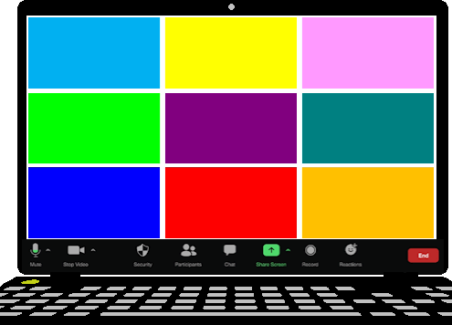
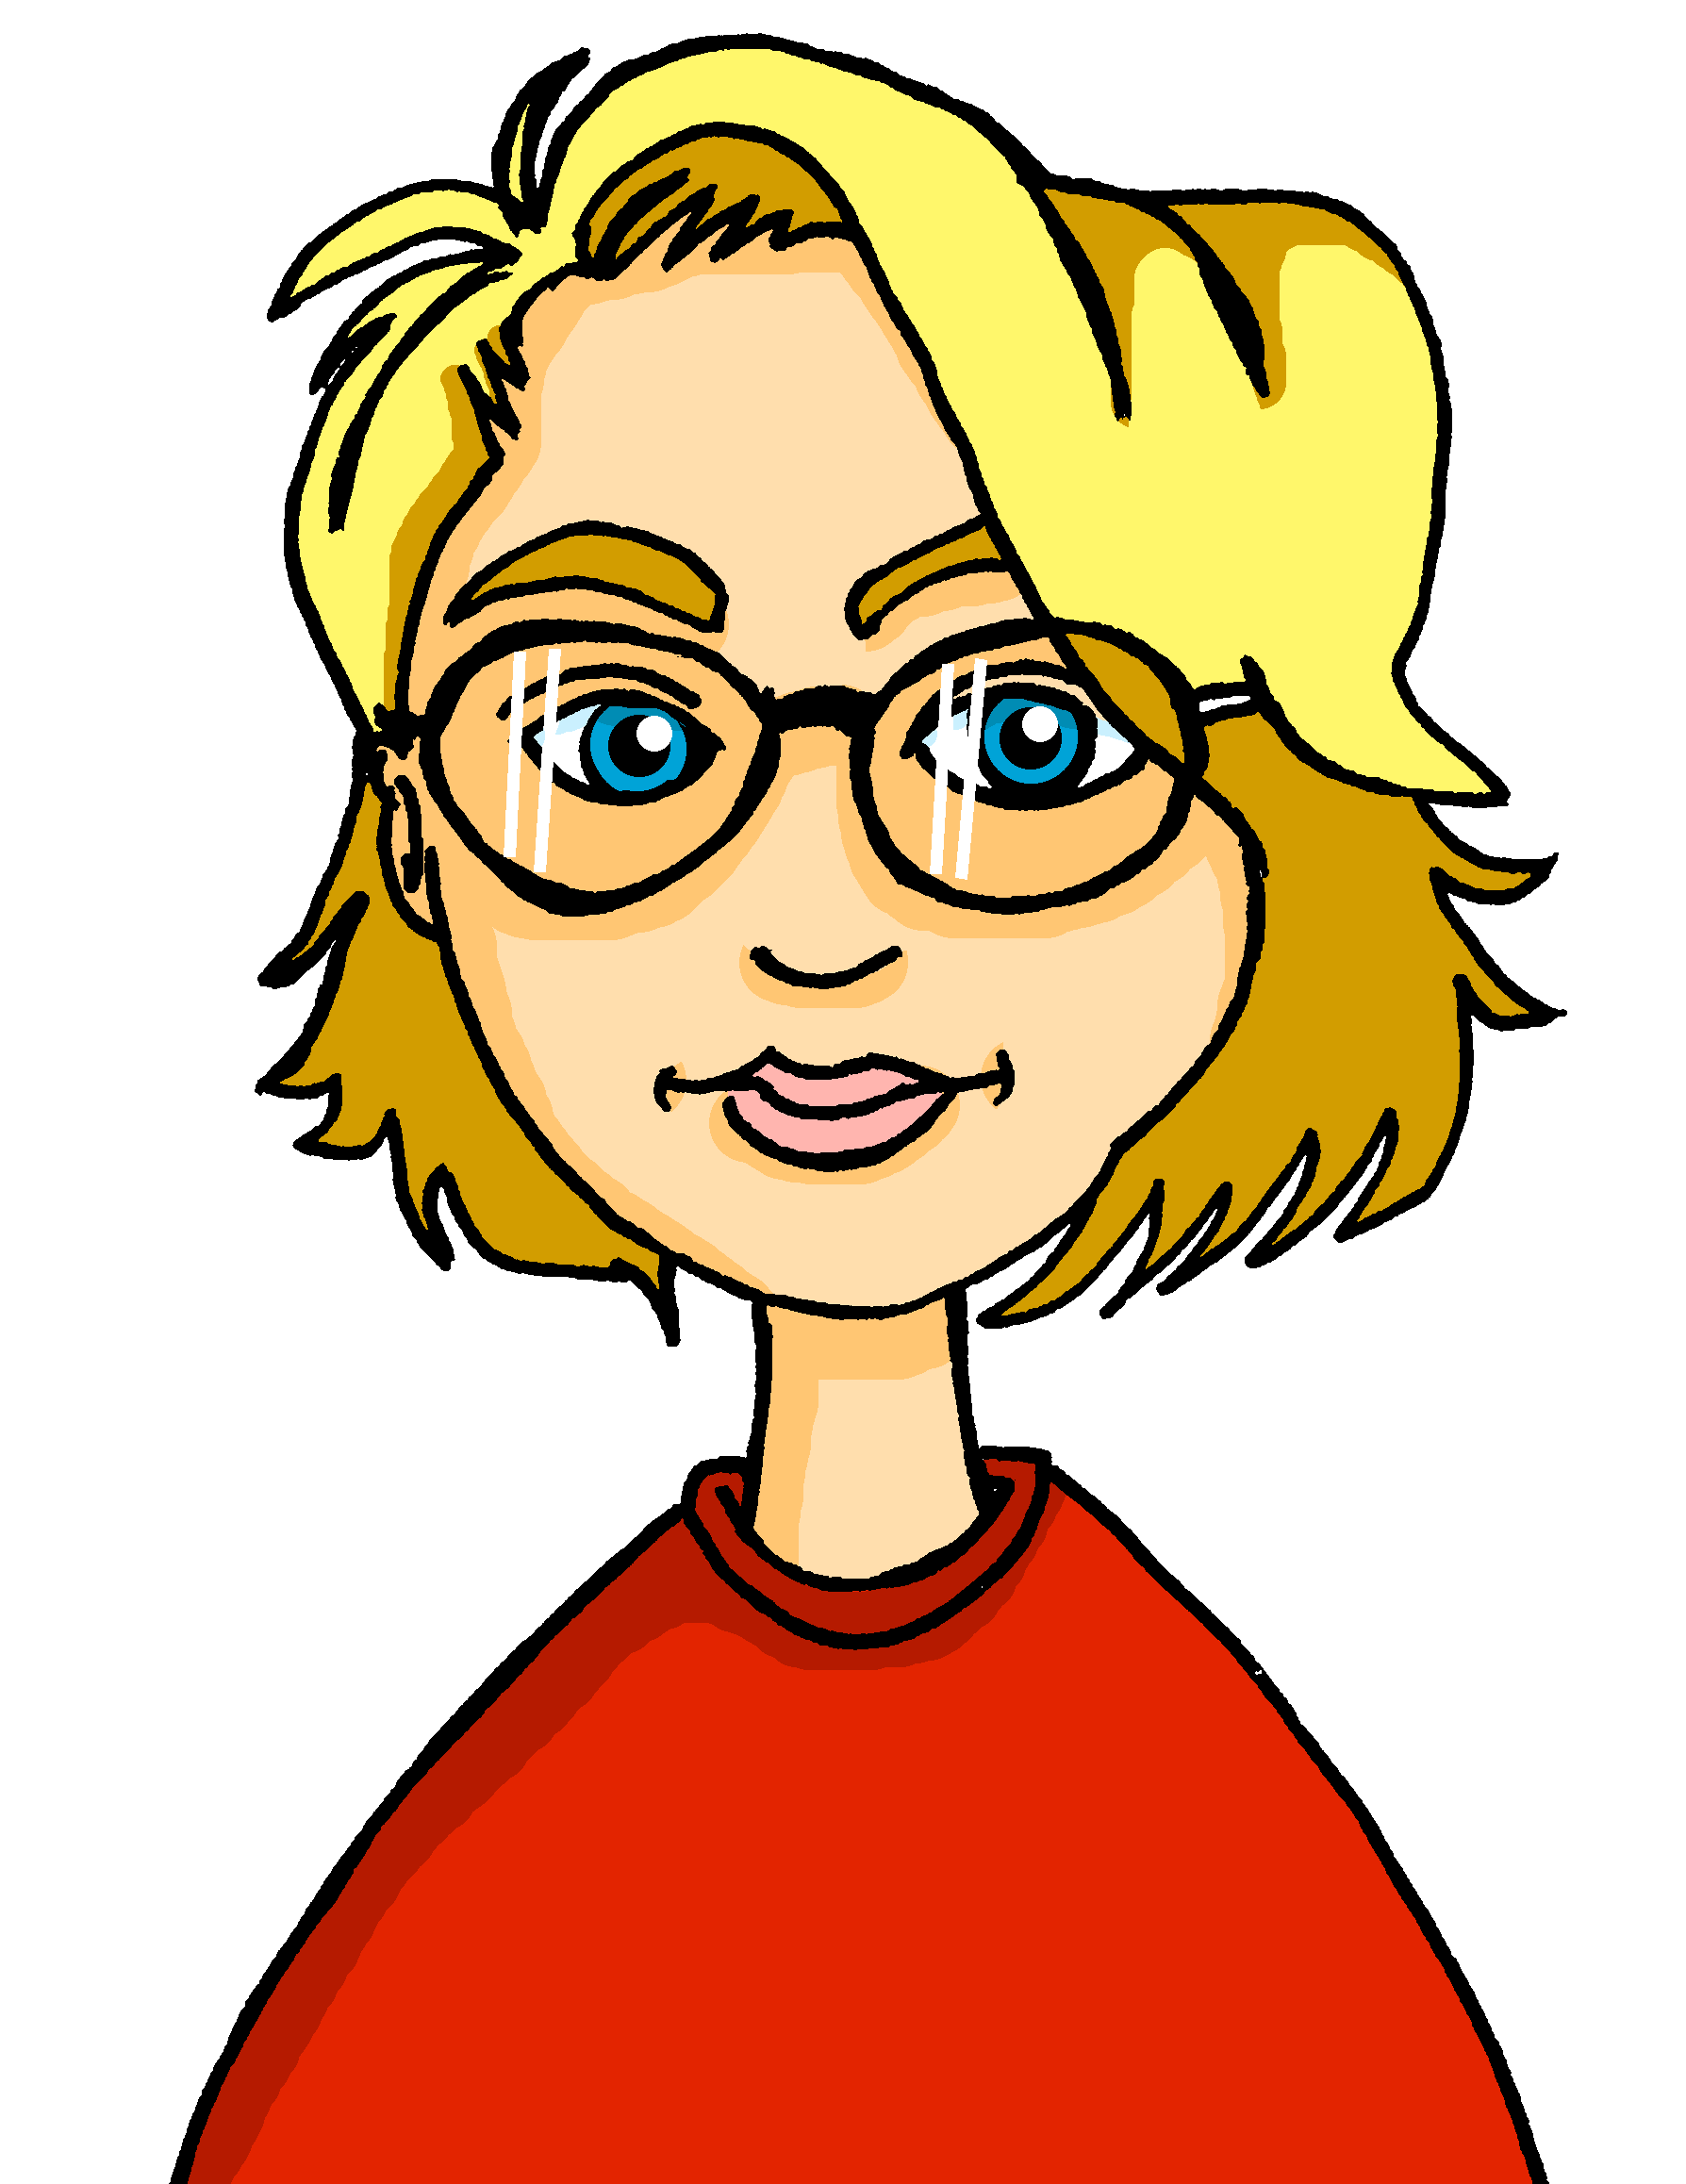
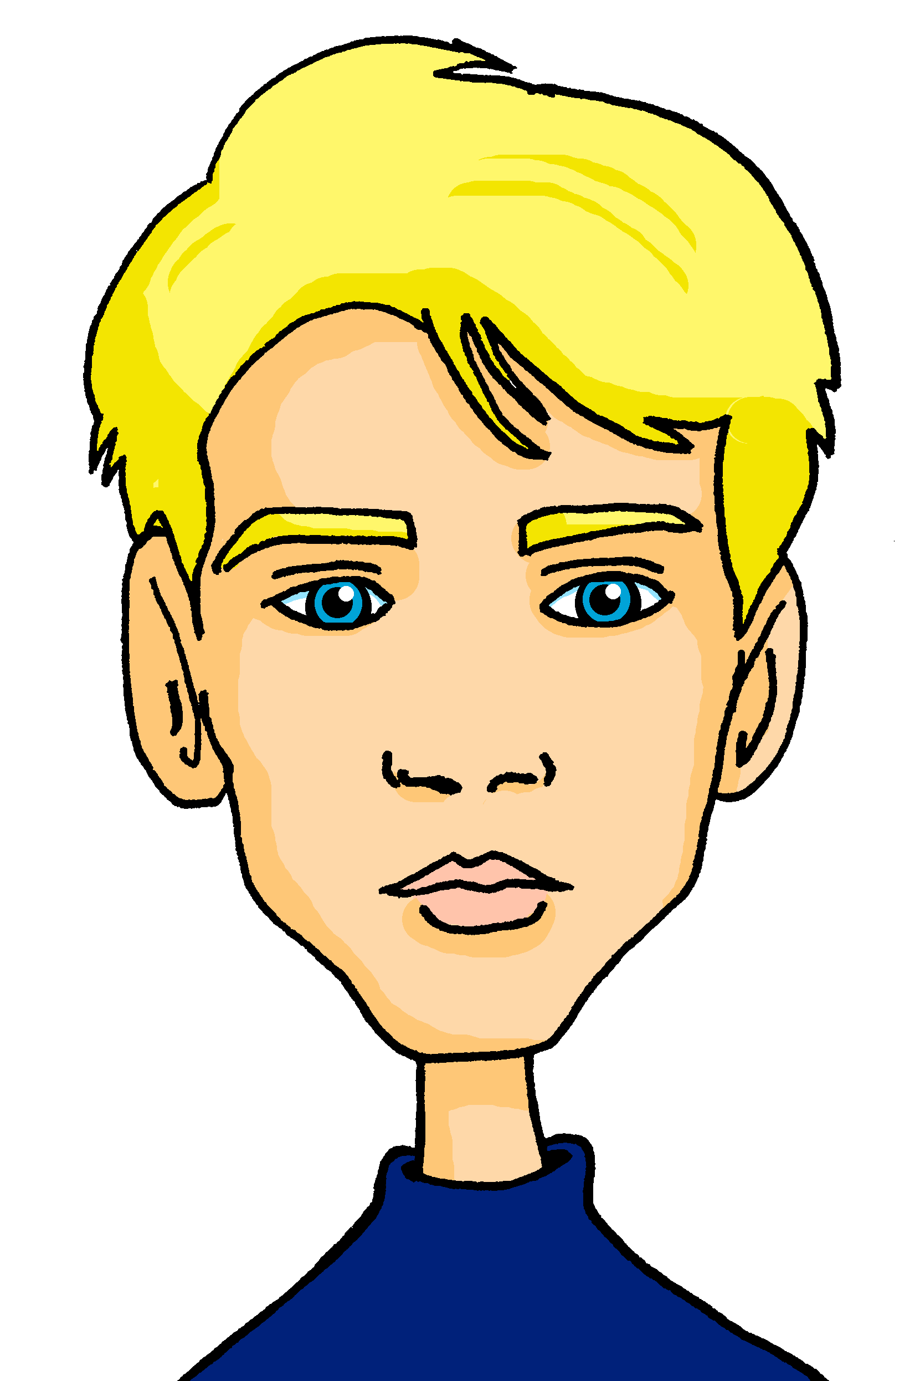
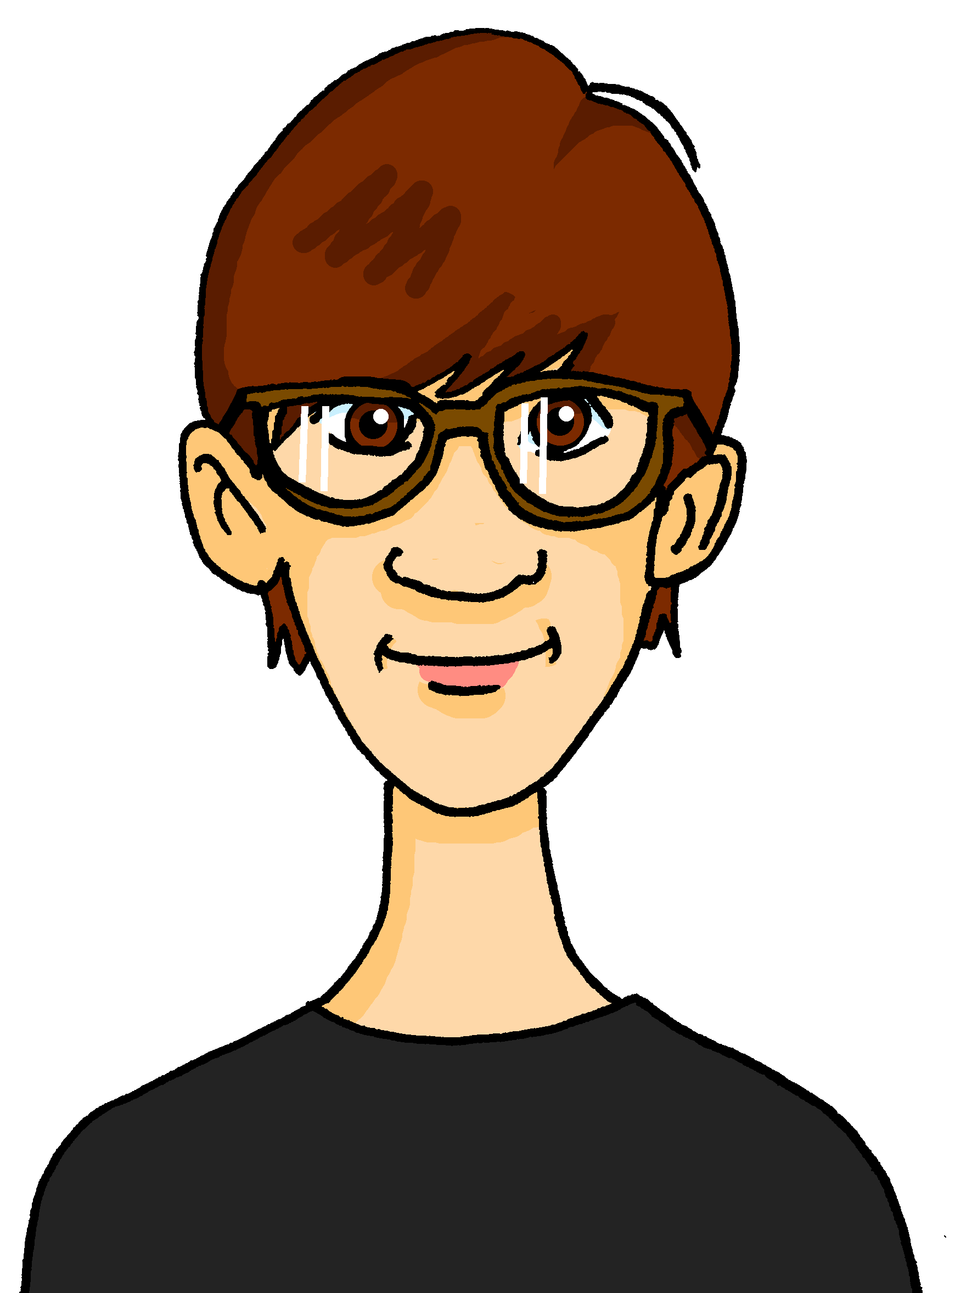
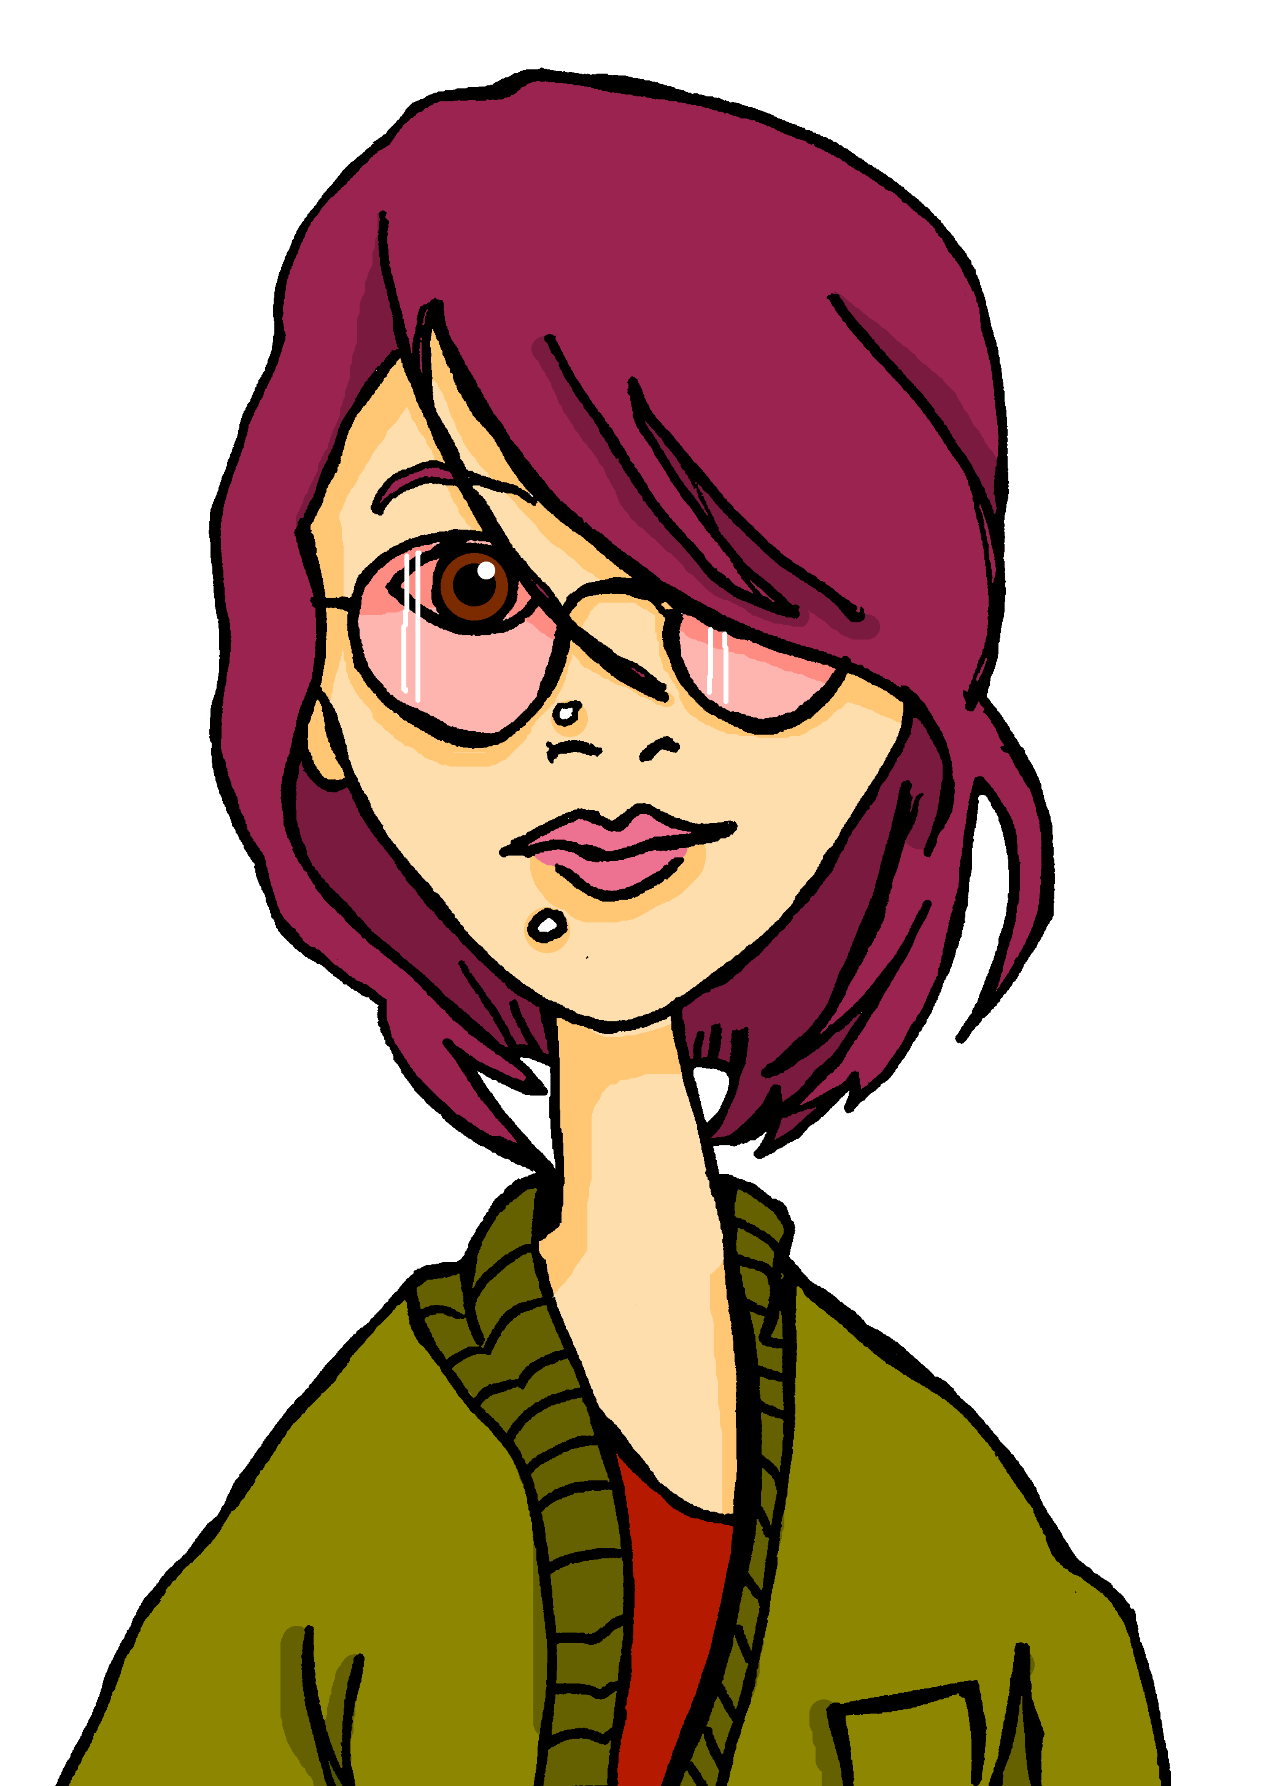
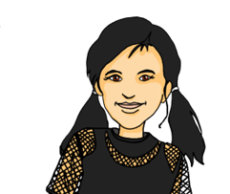
hören
Hör zu.
Es gibt ein Problem mit dem Mikro*. Was sagt Ronja?
1
die Antworten | die Antwort.
die Karten | die Karte.
die Shows | die Show.
die Gruppe | die Gruppen.
die Schwester | die Schwestern.
die Idee | die Ideen.
2
Gabriel
Mariem
Barbara
3
Lias
Matteo
Emil
4
5
Jana
Clara
Ronja
6
Remember!
die = the (f) and die = the (pl).
Listen out for the verb and look at the noun. Is it singular or plural?
das Mikro (informal) - microphone
Notes:
Note: if time is tight, complete this task as one of the follow up activities.
Timing: 5 minutes
Aim: to practise identifying singular/plural nouns based on the verb.
Procedure:
Explain the task. Pupils need to select the correct noun from the singular/plural options. (All nouns chosen are feminine so that the only way to choose is by focusing on the singular/plural verb ist/sind, and choosing the corresponding singular/plural form of the noun.
Click to block out the incorrect choice and leave only the correct choice visible.
Unknown and cognate vocabulary:
Mikro [>5009]
Jones, R.L & Tschirner, E. (2019). A frequency dictionary of German: Core vocabulary for learners. London: Routledge.
Transcript:
1. Das sind [die Antworten]. 2. Das ist [die Karte]. 3. Das ist [die Show].
4. Das sind [die Gruppen].
5. Das sind [die Schwestern.]
6. Das ist [die Idee!]
11

Slide 12
Tschüss!
grün
Notes:
12

