Slide 1



Interacting
Konzerte und Shows
grün
Numbers 13 - 31
Revisit months
Dates
SSC [ei]
Term 1 Week 4
Notes:
Artwork by Steve Clarke. Pronoun pictures from NCELP (www.ncelp.org). All additional pictures selected from Pixabay and are available under a Creative Commons license, no
attribution required.
Phonics:
[ei]
frei [318] ein [5] klein [114] sein [3] allein [258]
Vocabulary: dreizehn [4772] vierzehn [3950] fünfzehn [2858] sechzehn [4924] siebzehn [n/a] achtzehn [3741] neunzehn [n/a] zwanzig [1359] zweiundzwanzig [n/a] dreißig [2046] einunddreißig [n/a] an [19]
Jones, R.L & Tschirner, E. (2019). A frequency dictionary of German: Core vocabulary for learners. London: Routledge.
The frequency rankings for words that occur in this PowerPoint which have been previously introduced in these resources are given in the SOW and in the resources that first
introduced and formally re-visited those words.
For any other words that occur incidentally in this PowerPoint, frequency rankings will be provided in the notes field wherever possible.
Remember that at the start of the course (first three lessons of Rot/Gelb) pupils learnt language (for greetings and register taking) that can still be part of the lesson routines in upper KS2 (Blau/Grün). They are not re-taught, as we anticipate that teachers have built these in from early in lower KS2.
1

Slide 2

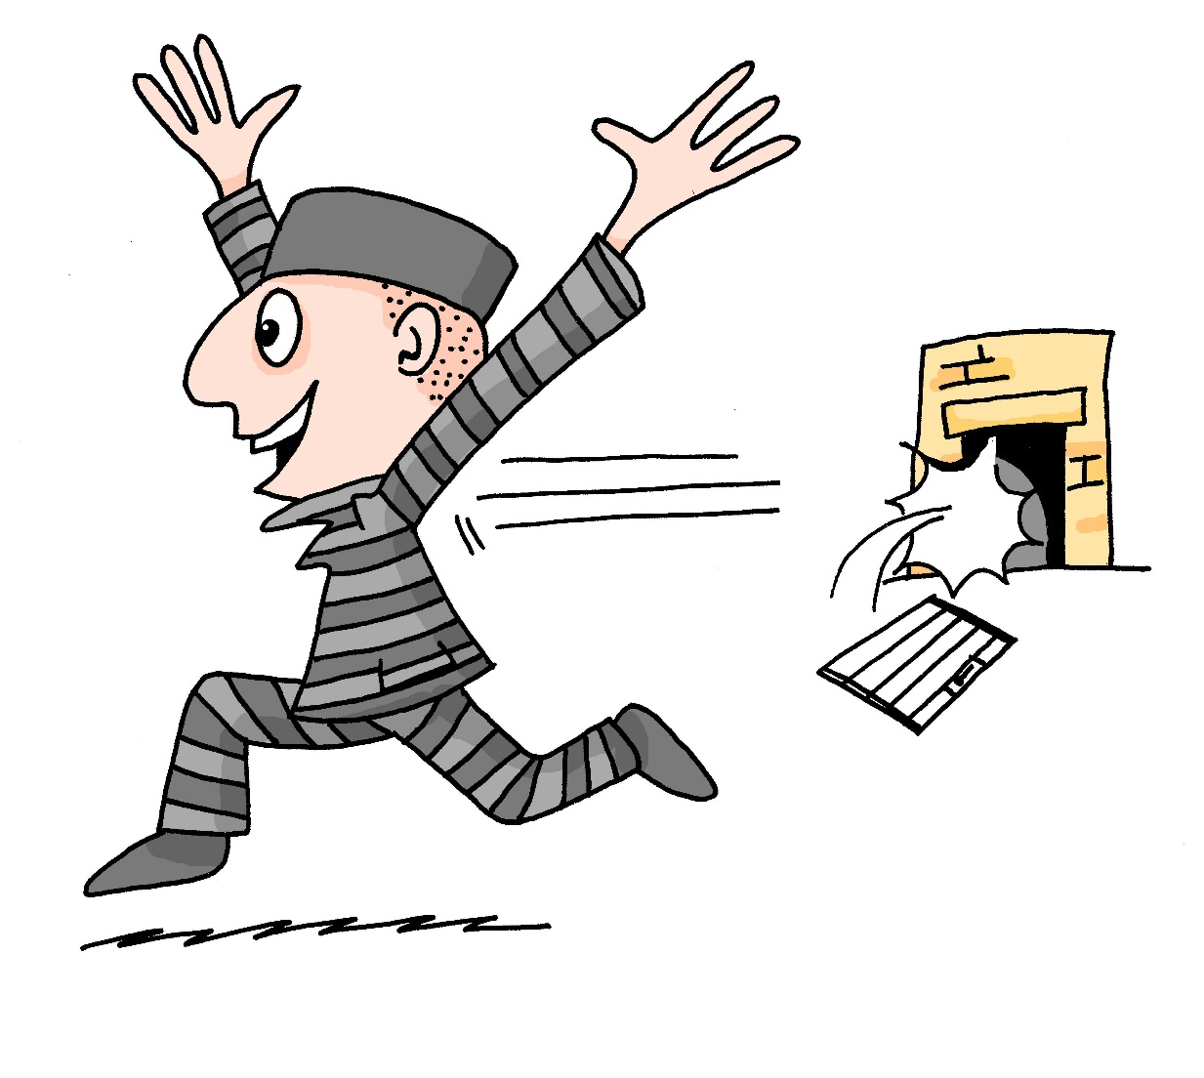
aussprechen
[ei]
…
free
frei
Notes:
Timing: 1 minute
Aim: to introduce the SSC [ei].
Procedure:
Introduce the SSC and present the source word ‘frei’ (with gesture, if using).
Click to bring on the picture and get pupils to repeat the word ‘frei’ (with gesture, if using).
Note:
a gesture for frei’ might be to throw you hands up in the air and pretend to run away.
Vocabulary: frei [318
Jones, R.L & Tschirner, E. (2019). A frequency dictionary of German: Core vocabulary for learners. London: Routledge.
2

Slide 3



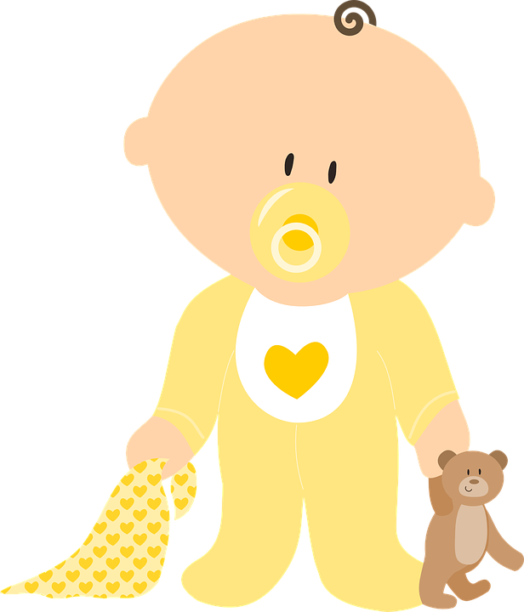

aussprechen
[ei]
…
frei
/a
sein
ein
alone
klein
allein
Notes:
Timing: 1 minute
Aim: to consolidate the SSC [ei].
Procedure:
Re-present the SSC and the source word ‘frei’ (with gesture, if using).
Click to bring on the picture and get pupils to repeat the word ‘frei’ (with gesture, if using).
Present the cluster words in the same way, bringing on the picture and getting pupils to pronounce the words.
Vocabulary: frei [318] ein [5] klein [114] sein [3] allein [258]

Slide 4















sprechen
Sag die Nummern 1 - 12.
…
lesen
60
S
- - - - - - - - - - - - - - - - - - - - - - - - - - - - - - -
eins
zwei
drei
vier
fünf
sechs
sieben
elf
zwölf
0
acht
neun
zehn
START
Notes:
Timing: 3 minutes
Aim: to revisit numbers 1-12 in oral production.
Procedure:
Teacher reads the instruction in German (or click to play audio).
Pupils work in pairs to say the numbers in order (1-12). They have one minute.
Click to trigger the timer.
To bring up the answers, each number disappears on a mouse click and the correct answer appears.
4

Slide 5










die Nummern 13 – 20 und 30
16 and 17 lose a letter or two!
German numbers 13 - 19 are simple sums:
drei [3] (+) zehn [10] = dreizehn [13]
dreizehn
vierzehn
fünfzehn
sechzehn
siebzehn
‘zig’ is like ‘ty’
in English:
forty = vierzig
achtzehn
neunzehn
zwanzig
dreißig
Notes:
Timing: 4 minutes
Procedure:
Click through the animations to present the new information.
Elicit pronunciation of the German examples provided.
5

Slide 6











hören
Welche Nummer ist das?
. Écoute les noms des animaux. C’est [ien] ou [(a)in]?
Hör zu und schreib die Nummer und das Wort.
zB
19
neunzehn
5
14
vierzehn
1
11
elf
6
16
sechzehn
2
15
fünfzehn
7
17
siebzehn
3
10
zehn
8
13
dreizehn
4
12
zwölf
9
18
achtzehn
Notes:
Time: 8 minutes
Aim: to practise understanding and transcribing cardinal numbers (10 -19)
Procedure:
1. Do the example with pupils. Click zB to listen. Pupils write the number in digits and letters. Click to check the answer.
2. Complete items 1-9, then click to check.
3. In feedback, teachers can ask for the number in German. This has been included in the answers to provide pupils with support when giving the number.
Transcript:
Ex. neunzehn
1. elf
2. fünfzehn
3. zehn
4. zwölf
5. vierzehn
6. sechzehn
7. siebzehn
8. dreizehn
9. achtzehn
6

Slide 7




die Nummern 21 - 31
Practise saying the words for 20 and 30:
zwanzig
dreißig
When you hear a number between 21 and 99, write it down from right to left as you will always hear the second number first:
Numbers 21+ are always written as one word, joined with und:
vierundzwanzig
siebenundzwanzig
2
4
einunddreißig
Notes:
Timing: 3 minutes
Procedure:
Click through the animations to present the new information.
Elicit pronunciation of the German examples provided.
7

Slide 8











aussprechen
. Écoute les noms des animaux. C’est [ien] ou [(a)in]?
Welche Nummer ist das?
A: Sag die Nummer.
B: Sag die Nummer.
A: Hör zu und schreib die Nummer.
hören
B: Hör zu und schreib die Nummer.
1
2
3
4
5
6
7
8
9
10
fünfundzwanzig
25
zweiundzwanzig
22
neunundzwanzig
29
vierundzwanzig
24
einunddreißig
31
dreißig
30
dreiundzwanzig
23
achtundzwanzig
28
27
siebenundzwanzig
sechsundzwanzig
26
Notes:
Time: 5 minutes
Aim: to practise reading aloud, understanding and transcribing cardinal numbers (22 -31).
Procedure:
1. Explain the task to pupils, using the German instructions.
2. Pupil B turns away from the board with a pen and something to write on. They will just write the digits this time.
3. Click to bring up the first set of numbers. Pupil A reads the numbers slowly and carefully, one by one, repeating as necessary.
4. Pupil B writes down the 5 numbers (in digits only – we are not practising spelling at this stage), then turns back to face the board.
5. Teacher elicits numbers in German from pupils chorally for additional read aloud practice and clicks to reveal the number answers. Press play button to hear audio.
6. Pupils swap roles.
7. Repeat steps 2 – 5 with the 2nd set of numbers.
8. If required, teachers can click the number buttons to hear the numbers said by a native speaker.
Transcript:
1. fünfundzwanzig
2. neunundzwanzig
3. einunddreißig
4. dreiundzwanzig
5. siebenundzwanzig
6. zweiundzwanzig
7. vierundzwanzig
8. dreißig
9. achtundzwanzig
10. sechsundzwanzig

Slide 9


Wann ist das?
Use ‘der’ because it’s ‘der Tag’.
As in English, use ordinal numbers to say dates in German:
Don’t use ‘of’ in German.
Add -te to the numbers 1-19:
Heute ist der neunte Juli.
Today is the ninth of July.
Add -ste to the numbers 20+:
Heute ist der zwanzigste August.
Today is the twentieth of August.
Exceptions:
der erste - 1st
To say ‘on the’ use an + dem → am:
der dritte - 3rd
Note:
After ‘am’ also add -n to the number.
Ich sehe am vierten September eine Show!
der siebte - 7th
Ich sehe am zwanzigsten Mai ein Konzert!
Notes:
Timing: 3 minutes
Aim: To introduce the way to form ordinal numbers in German, and how to use them to say which day it is (R1-nominative) and when an event is taking place (an+R3-dative).
Procedure:
Click through the animations to present the new information.
Elicit English for the German examples provided.
Note: pupils already learnt the months, der Geburtstag and wann during Y3/4 and revised all of this vocabulary in week 1 of this year (three weeks ago).
9

Slide 10




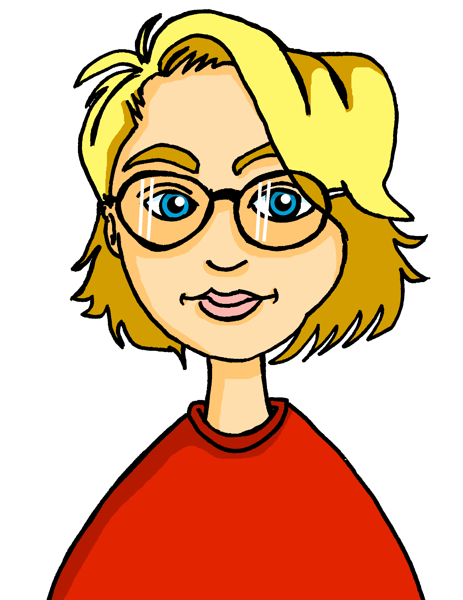








hören
Hör zu. Schreib das Datum auf.
Ronja fragt die Schulklasse…
nimaux. C’est [ien] ou [(a)in]?
Remember compound nouns? Schul(e)+Klasse = Schulkasse!
Gabriel
Mariem
Barbara
__
am 22. Oktober
am 17. April
am 12. März
__
__
Wann siehst du eine Show oder ein Konzert?
Lias
Matteo
Emil
am 27. November
am 31. Juni
__
__
am 24. Februar
__
Hallo, ich bin’s, Ronja!
Jana
Clara
Ronja
am 13. Juli
am 16. Januar
am 20. Mai
__
__
__
Notes:
Note: This final activity makes this lesson 33 minutes. If this is not possible, then use this activity as one of the follow ups during the week. ☺
Time: 6 minutes
Aim: to practise understanding ordinal numbers in dates.
Procedure:
Explain the scenario: Ronja is asking her class (online) when they are next seeing a show or a concert. Click to bring up reminder callout to explain the compound ‘Schulkasse’ and click again to disappear it again.
1. Click on the name of each person to hear the audio.
2. Pupils listen to the date given for each person’s date for a show or a concert, and write down the number.
3. They also write S if the person is seeing a show, and K if they are seeing a concert.
4. Click to reveal answers in turn, from top left to bottom right.
3. In feedback, teachers can ask: ‘Wer sieht am 13. Juli ein Konzert?’ to elicit the names from pupils, and allow them another opportunity to hear and understand the dates one more time.
Transcript:
[Gabriel] Ich sehe am zweiundzwanzigsten Oktober eine Show.
[Mariem] Ich sehe am siebzehnten April ein Konzert.
[Barbara] Ich sehe am zwölften März eine Show.
[Lias] Ich sehe am einunddreißigsten Juni ein Konzert.
[Matteo] Ich sehe am siebenundzwanzigsten November ein Konzert.
[Emil]. Ich sehe am vierundzwanzigsten Februar eine Show.
[Jana] Ich sehe am dreizehnten Juli ein Konzert.
[Clara] Ich sehe am sechzehnten Januar eine Show.
[Ronja] Ich sehe am zwanzigsten Mai ein Konzert.
10

Slide 11
Tschüss!
grün
Notes:
11

