Slide 1
Interacting
Das Bücherfest
grün
Follow ups 1-5
Term 1 Week 6
Notes:
Artwork by Steve Clarke. Pronoun pictures from NCELP (www.ncelp.org). All additional pictures selected from Pixabay and are available under a Creative Commons license, no
attribution required.
Phonics:
long [i] Familie [329] Linie [926] ihn [92]
short [i] bitte [471] mit [13] Hilfe [481]
Vocabulary: holen [547] sitzen [231] stehen [85] Dorf, Dörfer [959] fertig [n/a] durch [55] (plus language from week 5)
Revisit 1: mögen, ich mag, du magst, er/sie/es mag [168] Fahrräder [2138] Feier [n/a] Häuser [147] Länder [134] Mädchen [602] Musiker [2577] Sportler [2565]
Revisit 2: --
Jones, R.L & Tschirner, E. (2019). A frequency dictionary of German: Core vocabulary for learners. London: Routledge.
The frequency rankings for words that occur in this PowerPoint which have been previously introduced in these resources are given in the SOW and in the resources that first
introduced and formally re-visited those words.
For any other words that occur incidentally in this PowerPoint, frequency rankings will be provided in the notes field wherever possible.
Remember that at the start of the course (first three lessons of Rot/Gelb) pupils learnt language (for greetings and register taking) that can still be part of the lesson
routines in upper KS2 (Blau/Grün). They are not re-taught, as we anticipate that teachers have built these in from early in lower KS2.

Slide 2
aussprechen
long [i]
…
The 2nd ‘i’ is short.
Here’s the ‘e’ that sounds like the ‘a’ in ‘ago’, again!
Familie
Notes:
Timing: 1 minute
Aim: to introduce the SSC long [i].
Procedure:
Introduce the SSC and present the source word ‘Familie’ (with gesture, if using).
Click to bring on the picture and get pupils to repeat the word ‘Familie’ (with gesture, if using).
Note:
A gesture for ‘Familie’ might be to mime a roof overhead followed by a ‘heart’ shape with both hands.
Familie [49]
2

Slide 3
aussprechen
long [i]
…
Familie
Linie
ihn
Notes:
Timing: 1 minute
Aim: to introduce the SSC long [i].
Procedure:
Re-present the SSC and the source word ‘Familie’ (with gesture, if using).
Click to bring on the picture and get pupils to repeat the word ‘Familie’ (with gesture, if using).
Present the cluster words in the same way, bringing on the picture and getting pupils to pronounce the words.
ihn [52] Linie [451]
3

Slide 4
aussprechen
short [i]
…
🙏
bitte
Notes:
Timing: 1 minute
Aim: to consolidate the SSC short [i].
Procedure:
Procedure:
Introduce the SSC and present the source word ‘bitte’ (with gesture, if using).
Click to bring on the picture and get pupils to repeat the word ‘bitte’ (with gesture, if using).
Note: a gesture for ‘bitte’ might be to put your hands together as though asking for something.
bitte [471]
Image attribution: please emoji from https://emojipedia.org/folded-hands/

Slide 5
aussprechen
short [i]
…
bitte
with
🙏
Hilfe!
mit
Notes:
Timing: 1 minute
Aim: to consolidate the SSC short [i].
Procedure:
Re-present the SSC and the source word ‘bitte’ (with gesture, if using).
Click to bring on the picture and get pupils to repeat the word ‘bitte’ (with gesture, if using).
Present the cluster words in the same way, bringing on the picture and getting pupils to pronounce the words.
Note: a gesture for ‘bitte’ might be to put your hands together as though asking for something.
Hilfe [481] mit [13]

Slide 6
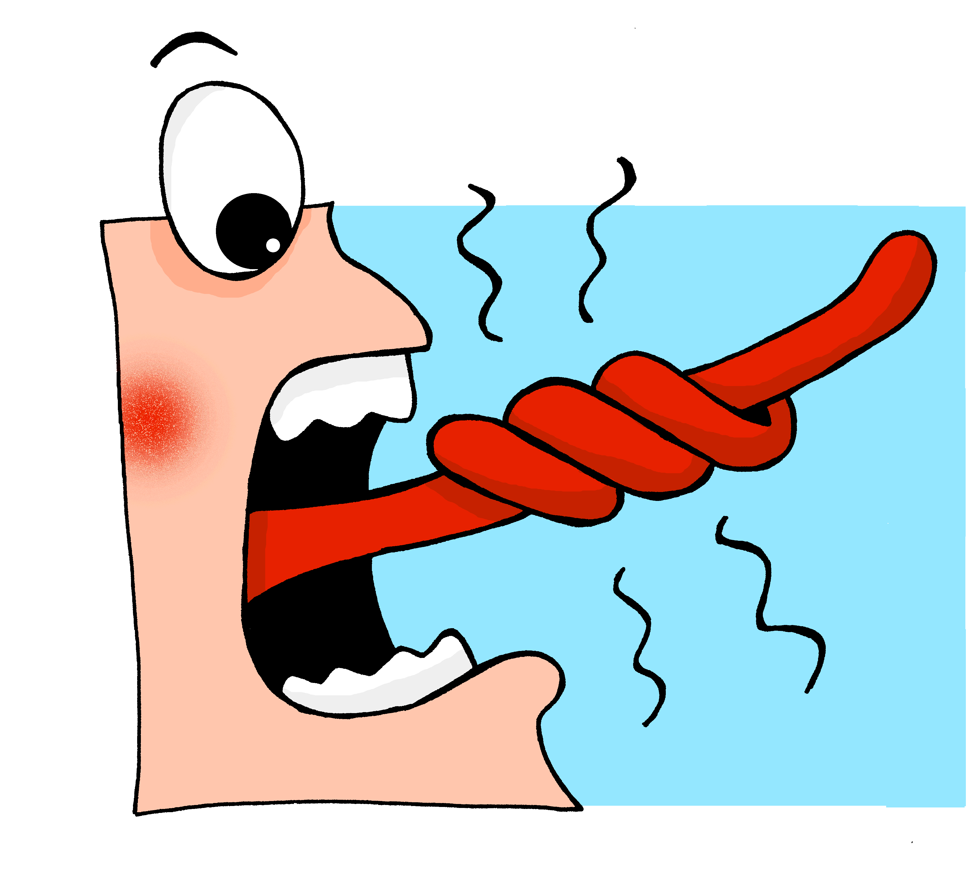
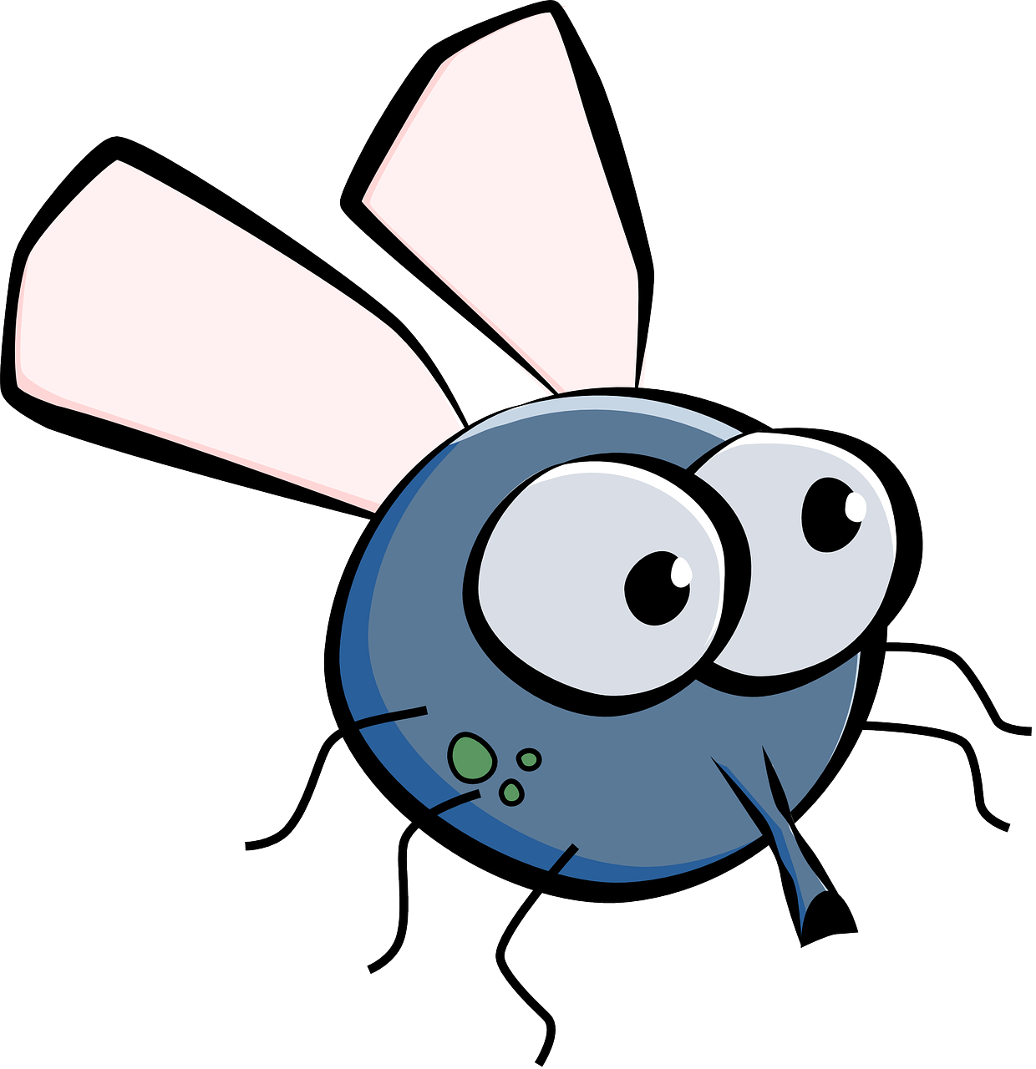
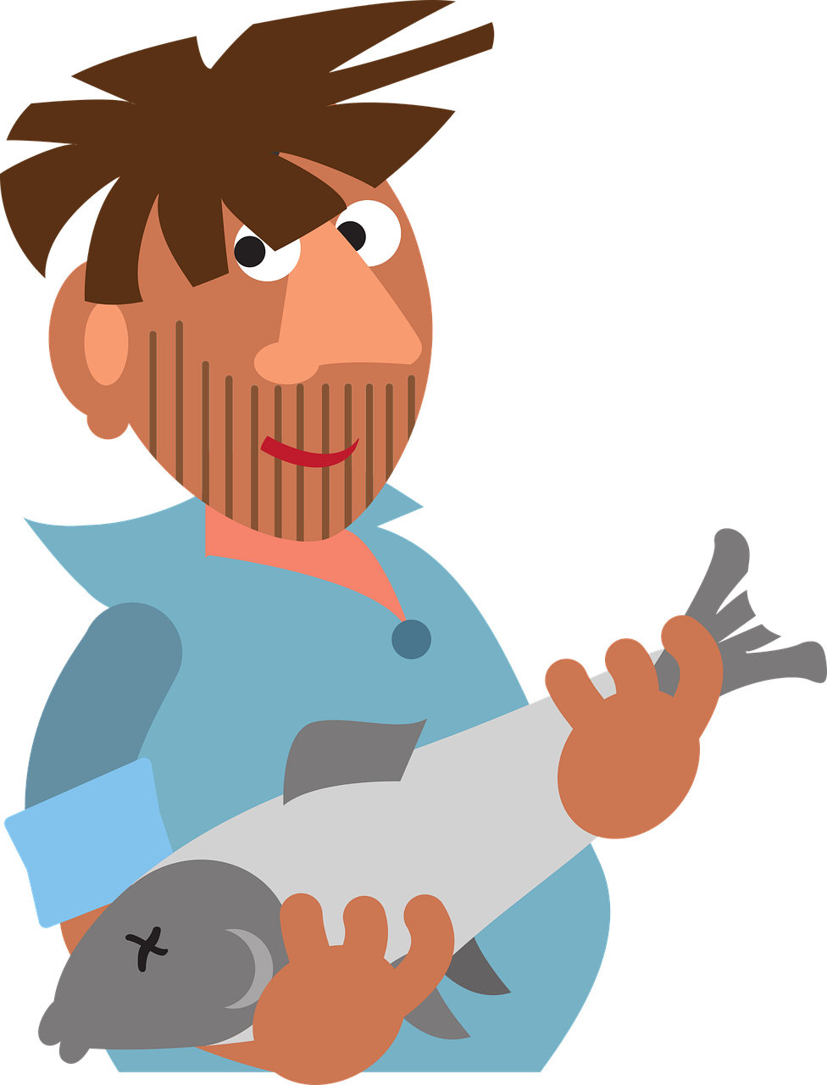
Follow up 1:
Sag die Zungenbrecher! Dann hör zu.
aussprechen
1
Die lange Linie liegt links laut Lisa Liske
20
The long line is on the left according to Lisa Liske
Wenn Fliegen hinter Fliegen fliegen, fliegen Fliegen hinter Fliegen her
2
When flies fly after flies, flies fly after flies
3
Fischers Fritz fischt frische Fische, frische Fische fischt Fischers Fritz
0
Fisherman’s Fritz fishes fresh fish, fresh fish fishes Fisherman’s Fritz
START
Notes:
Timing: 5 minutes
Aim: to practise oral production of the long and short [i] sounds in tongue-twister style sentences.
Procedure:
Pupils practise first in pairs, trying to pronounce the tongue-twisters, focusing on long and short [i].
Discuss meanings of tongue-twisters (using picture prompts to help) and show English translations. Pupils are unlikely to know all the words – just ask them to pick out the ones that they do know and guess some others through the pictures and the sounds.
Click to listen to the tongue twisters said by a native speaker at three different speeds: slow, medium, fast.
Give pupils more time practise saying them at whatever speed they can manage! Important to maintain clear pronunciation.
Note: the second two tongue twisters are real German tongue twisters that even those who speak German as their first language can struggle with, especially the Fischers Fritz one. Tell your pupils they’re supposed to be challenging and praise them for attempting them, even if slow.

Slide 7
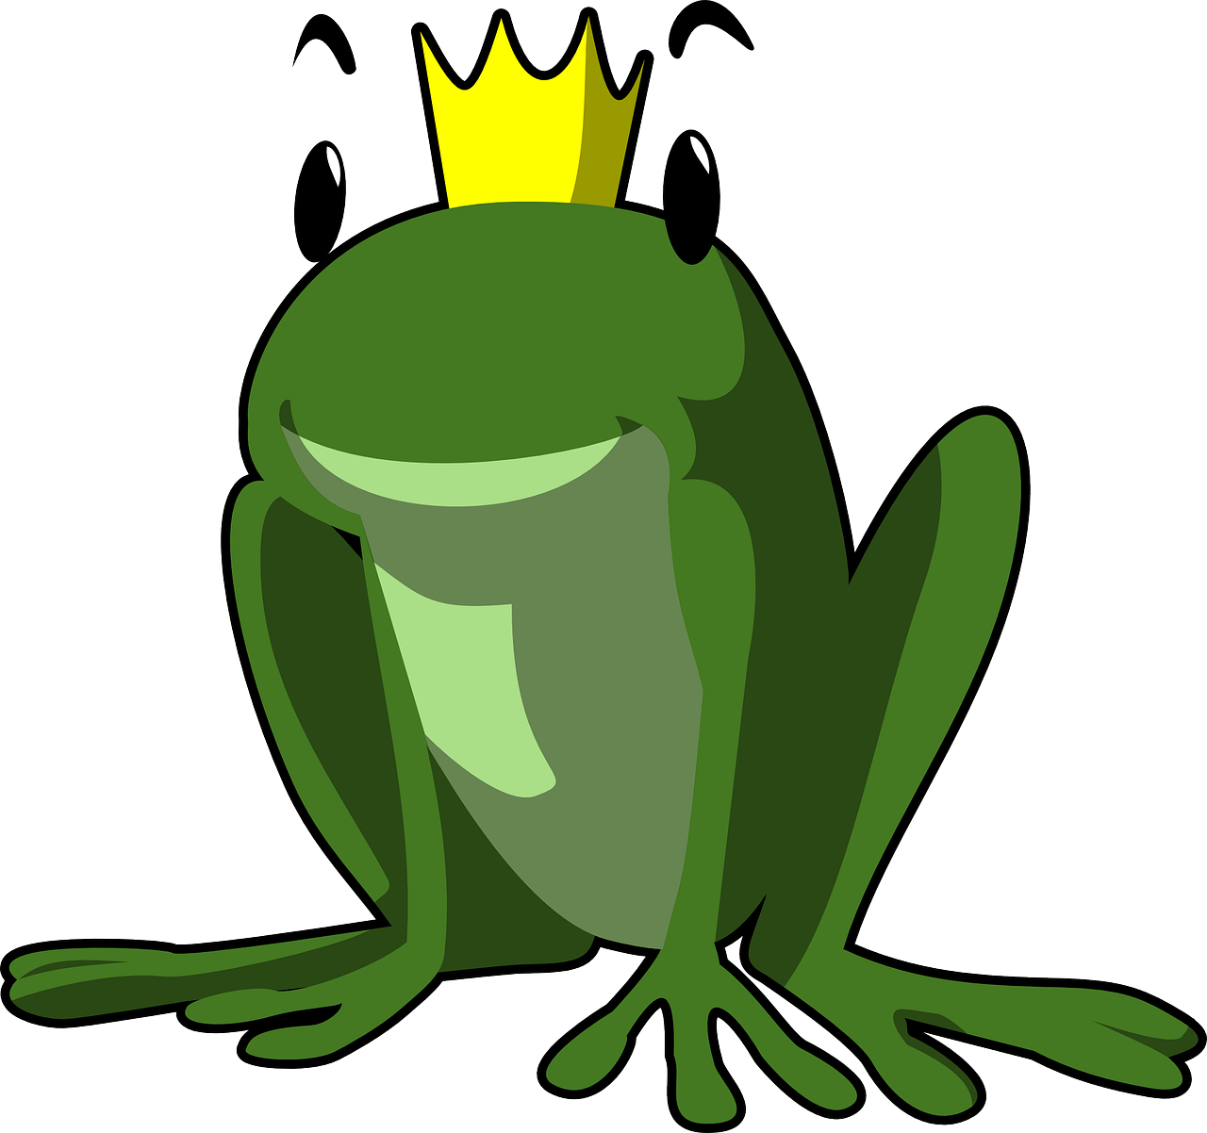
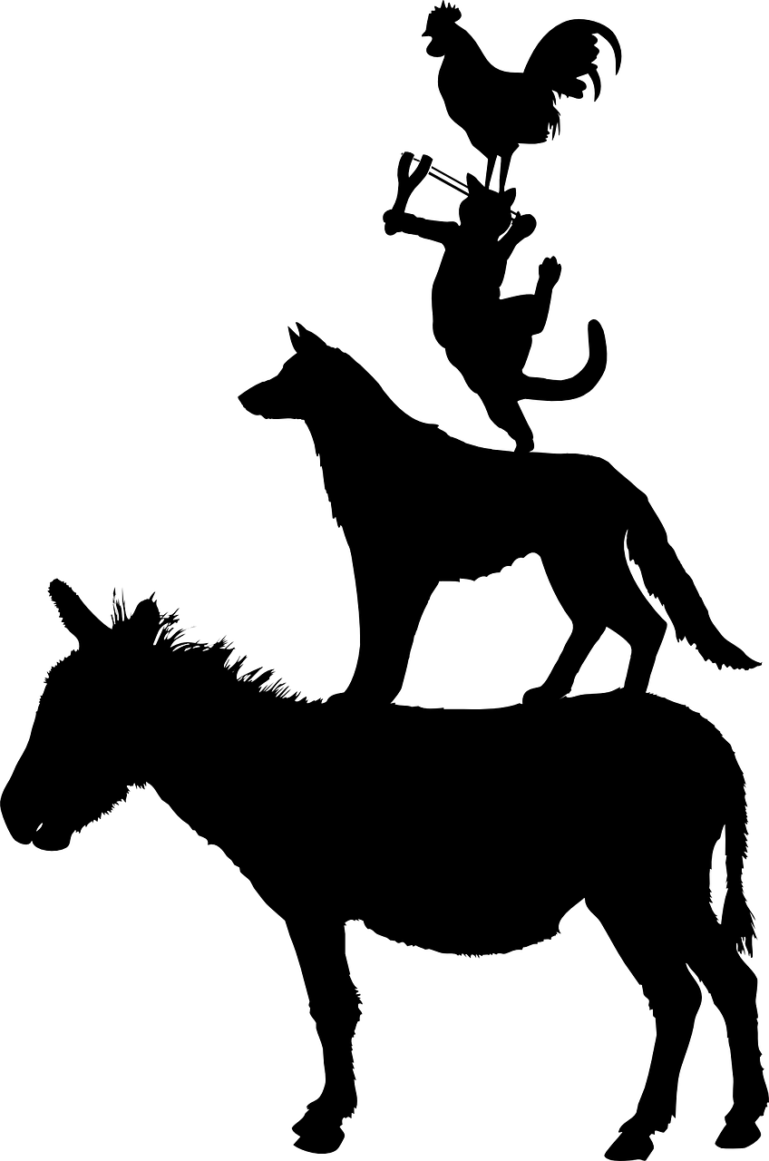
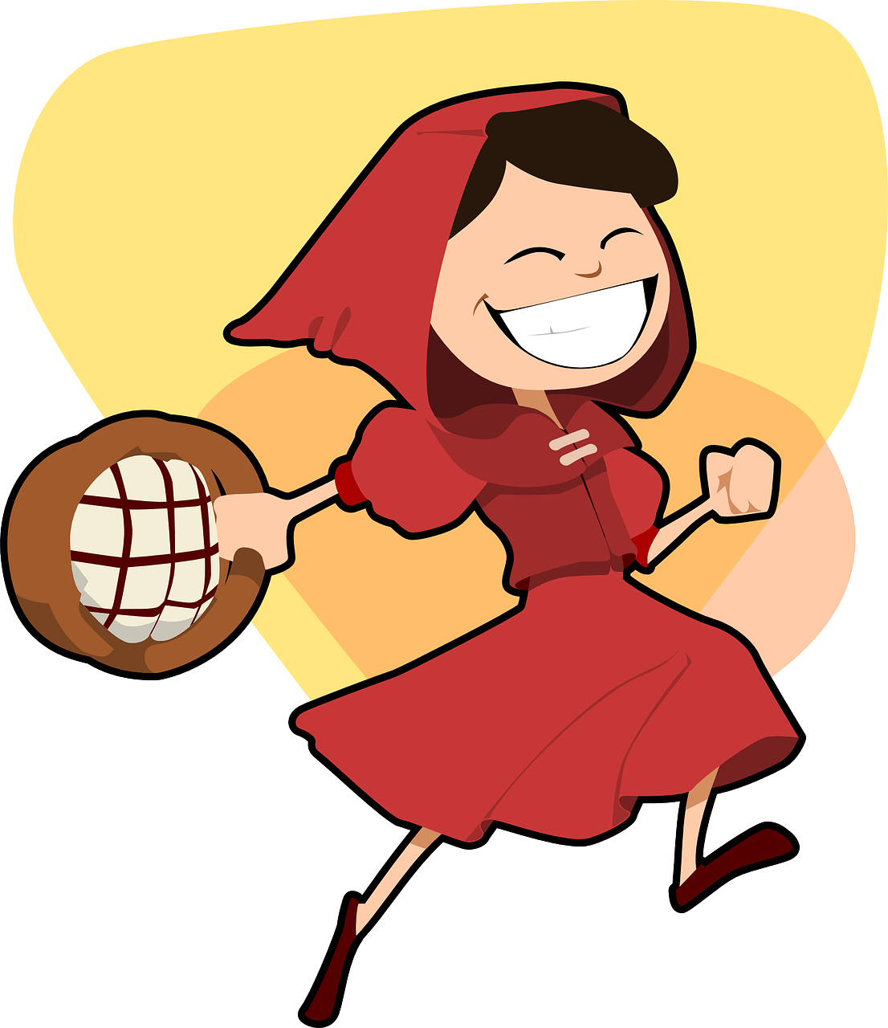
Follow up 2
Wie heißt die Geschichte auf Englisch?
Do you know any of these fairy tales by the Grimm brothers?
Deutsch | Englisch
1. Rotkäppchen | a. The Frog King
2. Hänsel und Gretel | b. The Bremen Town Musicians
3. Der Froschkönig | c. Hansel and Gretel
4. Die zwölf Brüder | d. Little Red Riding Hood
5. Die Bremer Stadtmusikanten | e. The Twelve Brothers
1
2
3
You know that ‘rot’ means ’red’. Did you know that if you see ‘chen’ at the end of a noun, it means ‘little’?
What is the plural of ‘Bruder’ and how does it sound different?
4
How do you pronounce Hansel and Gretel in German? Hint: it’s not the same as the English pronunciation!
We came across ‘König’ (king) when we were practising the ö sound. Can you remember how it sounds?
We learnt a different word for musician. Can you remember what it was? Hint: M_s_k_r
5
Notes:
Timing: 5 minutes
Aim: to be introduced to traditional German fairy tales written/collected by the Grimm brothers, many of which they will already know in English. To work out the meaning and pronunciation of unknown words by using the language they know to help them.
Procedure:
Ask pupils if they can think of any fairy tales. Say that the Grimm brothers collected and wrote over 200 fairy tales, many of which are very well known today. Ask if they knew the fairy tales on the right-hand side of the table were originally written in German?
Say, you’re going to try match up the English title of the story with German title and that you’ll give them a few clues to help. Click three times to bring up three words they already know.
Pupils match up the titles. As you go through the answers, extra boxes will come up with additional information.

Slide 8
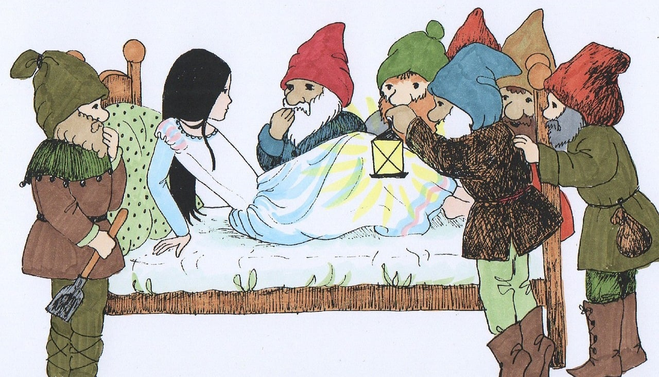
Follow up 3
Wie sagt man das…?
…
Wer warnt Schneewittchen*?
sprechen
Remember that regular (weak) verbs in the present tense follow this pattern:
60
Wie sagt man:
Wir warnen Schneewittchen!
warnen | to warn
ich warne | I warn
du warnst | you warn
er, sie, es warnt | he, she, it warns
wir warnen | we warn
ihr warnt | you (all) warn
sie warnen | they warn
I warn?
we warn?
ich warne
___ _____
___ ______
S
wir warnen
you warn?
___/___/__ ______
she warns?
du warnst
___ _______
sie warnt
you all warn?
___ _______
___ _______
they warn?
ihr warnt
0
sie warnen
START
Schneewittchen – Snow White
Notes:
Timing: 5 minutes
Aim: to practise all known verb endings with an unknown regular verb.
Procedure:
Remind pupils that regular (weak) verbs all follow a certain pattern in the present tense. Can they remember the pattern? Say that one verb you often see in stories like fairy tales is to warn – warnen. Characters are often warned about something before it happens! Ask pupils if they can translate ‘Wer warnt Schneewittchen?’ (Who warns/is warning Snow White?). Mention that Snow White is also a Grimm fairy tale. You might ask ask if pupils can guess the meaning of ‘schnee’ (snow).
Click to show them and hear the ‘ich’ form, then elicit the different forms from the class and click to reveal and listen.
Give pupils 60 seconds to try and pronounce all verb forms in pairs, then run through them again as a class.
Click to reveal English verb forms one at a time in a random order and ask: Wie sagt man ‘we warn’ auf Deutsch? Wie sagt man ‘she warns’ auf Deutsch?
After the final pair, the seven dwaves are shown saying ‘Wir warnen Schneewittchen!’. (The dwarves warn Snow White not to open the door to anyone while they’re out working).
Additional task suggestion: Pupils could practise this pattern with any other regular (weak) verbs they know. Each pair could choose a verb e.g. spielen; trinken; planen; gewinnen; bleiben; singen and write it out in full on mini whiteboards, then practise saying the different verb forms aloud.

Slide 9
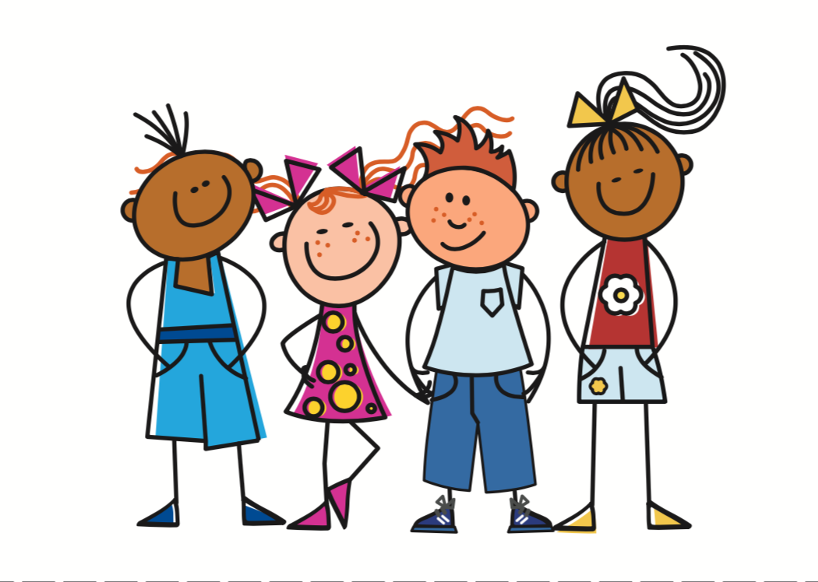
Follow up 4:
Partnerarbeit: wir sprechen!
…
Person A spricht.
sprechen
Person B findet das richtige Bild. Ist das eine Frage oder ein Satz?
Person A
Are you (all) warning Snow White?
Person B
1) _____________________
[A] [B] ?
Warnt ihr Schneewittchen?
Are you all warning Snow White?
B
A
Notes:
Timing: 5-10 minutes
Aim: to practise receptive and productive knowledge of first and second person plural (wir/ihr) regular verbs and yes/no questions in present tense.
Procedure: 1. Use this slide to model the task.
2. Pupil A produces the statement or question in German. Discuss with the class how a statement and question will be different (word order).
3. Pupil B identifies the correct picture – (we or you (all)?), writes the English down, and identifies whether or not it is a question. Ensure that pupils are clear which image is ‘wir’ and which ‘ihr’.
4. Complete items 1-5 for partner A.
5. Then pupils swap roles and repeat the task. 6. See next slides for answers. Handouts are at the end of the presentation.
Note: pupils have learnt that the German present tense translates into present simple and present continuous in English. Here, as there are no adverbs many of the sentences/questions could be either present simple or continuous, so if pupils have given a different formulation in their answer, they can be reassured about this.

Slide 10
Round 1
…
Person A
1) We are standing next to Herr Weber.
……………………………….
2) Are you (all) singing the song?.
……………………………….
3) You (all) sell snacks.
……………………………….
4) Are we using the library?
……………………………….
5) Are we finished?
………………………………..
Person B
sprechen
[A] [B] ?
We stand/are standing next to Herr Weber.
Wir stehen neben Herrn Weber.
Are you (all) singing the song?
Singt ihr das Lied?
You (all) sell/are selling snacks.
Ihr verkauft Snacks.
Are we using the library?
Benutzen wir die Bibliothek?
Are we ready/finished?
Sind wir fertig?
Notes:
ANSWERS ROUND 1
Note: In question 1, pupils are unlikely to know that they should add an ‘n’ to Herr for the dative case. Accept the answer even without the n.

Slide 11
Round 2
…
Person B
1) We are playing music .
……………………………….
2) Do we need songs?
……………………………….
3) You (all) know this story.
……………………………….
4) Do you (all) love books?
……………………………….
5) We drive home.
………………………………..
Person A
sprechen
[A] [B] ?
Wir spielen Musik.
We play/are playing music.
Brauchen wir Lieder?
Do we need songs?
Ihr kennt diese Geschichte.
You (all) know this story.
Liebt ihr Bücher?
Do you (all) love books?
Wir fahren nach Hause.
We drive home.
Notes:
ANSWERS ROUND 2

Slide 12
Follow up 5:

Schreib auf Englisch.
Can you get at least 15 points?
Wörter
 | besuchen | bleiben | die Gitarre
 | die Oma | tanzen | arbeiten
 | du magst | die Fahrräder | die Feier
 | die Häuser | das Mädchen | ich mag
 | fertig | holen | die Dörfer
 | durch | stehen | sitzen
to visit
to remain, stay
(the) guitar
Vokabeln
x3
(the) grandma
to dance
to work
you like
(the) bicycles
celebration
x2
(the) houses
(the) girl
I like
ready, finished
to fetch
(the) villages
x1
through
to stand
to sit
Notes:
Timing: 5 minutes
Aim: to practise written comprehension of vocabulary from this and revisited weeks.
Procedure: 1. Give pupils a blank grid (included at the end of this presentation). They fill in the English meanings of any of the words they know, trying to reach 15 points in total. 2. Remind pupils that adjectives can refer to male or female persons and they should note this in their translations. E.g. pleased (f), short (m).
Note: The most recently learnt and practised words are pink, words from the previous week are green and those from week 1 are blue, thus more points are awarded for them, to recognise that memories fade and more effort (heavy lifting!) is needed to retrieve them.

Slide 13
Follow up 5:

Schreib auf Deutsch.
Can you get at least 15 points?
Wörter
 | (the) guitar | (the) grandma | to work
 | to stay | to visit | to dance
 | (the) celebration | (the) girl | (the) houses
 | (the) bicycles | you like | I like
 | (the) villages | to sit | to stand
 | ready, finished | to fetch | through
die Gitarre
die Oma
arbeiten
Vokabeln
x3
bleiben
besuchen
tanzen
die Feier
das Mädchen
die Häuser
x2
die Fahrräder
du magst
ich mag
die Dörfer
sitzen
stehen
x1
fertig
holen
durch
Notes:
Timing: 5 minutes
Aim: to practise written production of vocabulary from this and revisited weeks.
Procedure: 1. Give pupils a blank grid (included at the end of this presentation). They fill in the German meanings of any of the words they know, trying to reach 15 points in total. 2. Remind pupils that adjectives can refer to male or female persons and they should note this in their translations. E.g. pleased (f), short (m).
Note: The most recently learnt and practised words are pink, words from the previous week are green and those from week 1 are blue, thus more points are awarded for them, to recognise that memories fade and more effort (heavy lifting!) is needed to retrieve them.

Slide 14
Tschüss!
grün
Notes:
14

Slide 15
Person A
…
sprechen
Person A
We are standing next to Herr Weber.
……………………………….
2) Are you (all) singing the song?
……………………………….
3) You (all) sell snacks.
……………………………….
4) Are we using the library?
……………………………….
5) Are we finished?
………………………………..
Person A
[A] [B] ?
Notes:
HANDOUT Person A

Slide 16
Person B
…
Round 1
Round 2
Person B
sprechen
Person B
1) We are playing music.
……………………………….
2) Do we need songs?
……………………………….
3) You (all) know this story.
……………………………….
4) Do you (all) love books?
……………………………….
5) We drive home.
………………………………..
[A] [B] ?
Notes:
Handout Person B

Slide 17
Follow up 5:

Schreib auf Englisch.
Can you get at least 15 points?
Wörter
 | besuchen | bleiben | die Gitarre
 | Oma | tanzen | arbeiten
 | du magst | Fahrräder | die Feier
 | Häuser | das Mädchen | ich mag
 | fertig | holen | Dörfer
 | durch | stehen | sitzen
Vokabeln
x3
x2
x1
Notes:
HANDOUT

Slide 18
Follow up 5:

Schreib auf Deutsch.
Can you get at least 15 points?
Wörter
 | guitar | grandma | to work
 | to stay | to visit | to dance
 | celebration | girl | houses
 | bicycles | you like | I like
 | villages | to sit | to stand
 | ready, finished | to fetch | through
Vokabeln
x3
x2
x1
Notes:
HANDOUT

