Slide 1
Interacting
Das Bücherfest
grün
Present tense
yes/no and wh-word questions
SSC long & short [i]
Term 1 Week 6
Notes:
Artwork by Steve Clarke. Pronoun pictures from NCELP (www.ncelp.org). All additional pictures selected from Pixabay and are available under a Creative Commons license, no
attribution required.
Phonics:
long [i] Familie [329] Linie [926] ihn [92]
short [i] bitte [471] mit [13] Hilfe [481]
Vocabulary: holen [547] sitzen [231] stehen [85] Dorf, Dörfer [959] fertig [n/a] durch [55] (plus language from week 5)
Revisit 1: mögen, ich mag, du magst, er/sie/es mag [168] Fahrräder [2138] Feier [n/a] Häuser [147] Länder [134] Mädchen [602] Musiker [2577] Sportler [2565]
Revisit 2: --
Jones, R.L & Tschirner, E. (2019). A frequency dictionary of German: Core vocabulary for learners. London: Routledge.
The frequency rankings for words that occur in this PowerPoint which have been previously introduced in these resources are given in the SOW and in the resources that first
introduced and formally re-visited those words.
For any other words that occur incidentally in this PowerPoint, frequency rankings will be provided in the notes field wherever possible.
Remember that at the start of the course (first three lessons of Rot/Gelb) pupils learnt language (for greetings and register taking) that can still be part of the lesson routines
in upper KS2 (Blau/Grün). They are not re-taught, as we anticipate that teachers have built these in from early in lower KS2.
1

Slide 2
aussprechen
long [i]
…
The 2nd ‘i’ is short.
Here’s the ‘e’ that sounds like the ‘a’ in ‘ago’, again!
Familie
Notes:
Timing: 1 minute
Aim: to introduce the SSC long [i].
Procedure:
Introduce the SSC and present the source word ‘Familie’ (with gesture, if using).
Click to bring on the picture and get pupils to repeat the word ‘Familie’ (with gesture, if using).
Note:
A gesture for ‘Familie’ might be to mime a roof overhead followed by a ‘heart’ shape with both hands.
Familie [49]
2

Slide 3
aussprechen
long [i]
…
Familie
Linie
ihn
Notes:
Timing: 1 minute
Aim: to introduce the SSC long [i].
Procedure:
Re-present the SSC and the source word ‘Familie’ (with gesture, if using).
Click to bring on the picture and get pupils to repeat the word ‘Familie’ (with gesture, if using).
Present the cluster words in the same way, bringing on the picture and getting pupils to pronounce the words.
ihn [52] Linie [451]
3

Slide 4
aussprechen
short [i]
…
🙏
bitte
Notes:
Timing: 1 minute
Aim: to consolidate the SSC short [i].
Procedure:
Procedure:
Introduce the SSC and present the source word ‘bitte’ (with gesture, if using).
Click to bring on the picture and get pupils to repeat the word ‘bitte’ (with gesture, if using).
Note: a gesture for ‘bitte’ might be to put your hands together as though asking for something.
bitte [471]
Image attribution: please emoji from https://emojipedia.org/folded-hands/

Slide 5
aussprechen
short [i]
…
bitte
with
🙏
Hilfe!
mit
Notes:
Timing: 1 minute
Aim: to consolidate the SSC short [i].
Procedure:
Re-present the SSC and the source word ‘bitte’ (with gesture, if using).
Click to bring on the picture and get pupils to repeat the word ‘bitte’ (with gesture, if using).
Present the cluster words in the same way, bringing on the picture and getting pupils to pronounce the words.
Note: a gesture for ‘bitte’ might be to put your hands together as though asking for something.
Hilfe [481] mit [13]

Slide 6
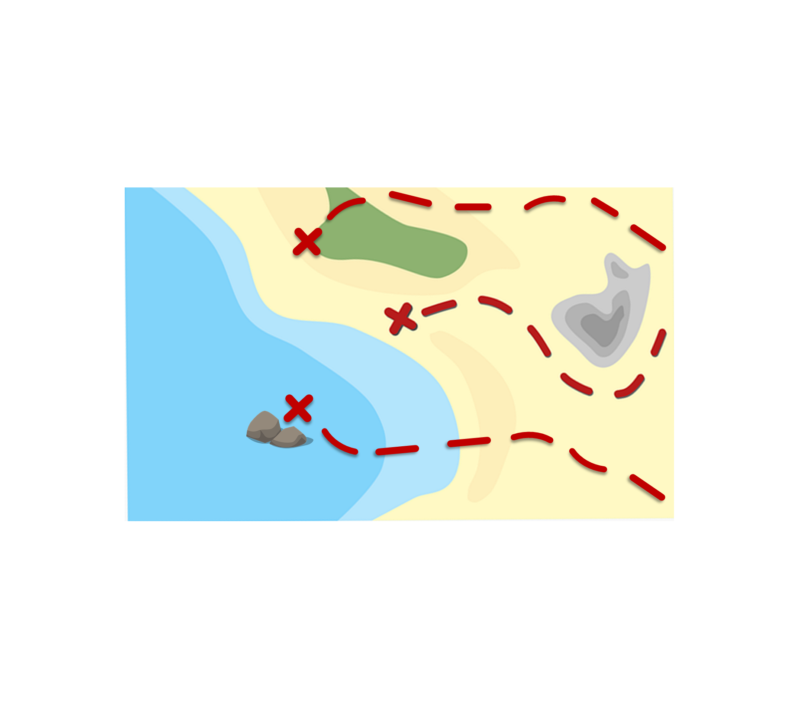
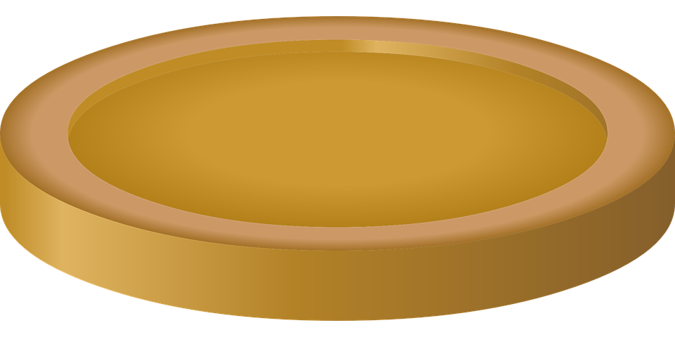
prononcer
*sammeln-to collect
Sag die Wörter und sammle* das Gold.
Remember: [ie] is the same sound as long [i].
aussprechen
aussprechen
Musik
Geschichte
60
Film
April
Tourist
lieben
S
Idee
Familie
ideal
singen
Hilfe
Musiker
Zimmer
Juli
0
sitzen
schwimmen
bitte
Start
Notes:
Timing: 2 minutes [2 rounds]
Aim: To practise the pronunciation of words with long or short [i].
Procedure:
Pupils work in pairs to practise pronunciation.
Pupil A starts from either ‘Tourist’, ‘Idee’ or ‘bitte’, and follows the path to pronounce the words and collect the corresponding coins in 60 seconds. Pupil B listens and notes down the number of coins for his/her partner.
Repeat with pupils switching roles. Who has the most gold?
Click on each word to hear it pronounced, as required.
Note the difference in pronunciation between Musik (long [i]) and Musiker (short [i])
6

Slide 7
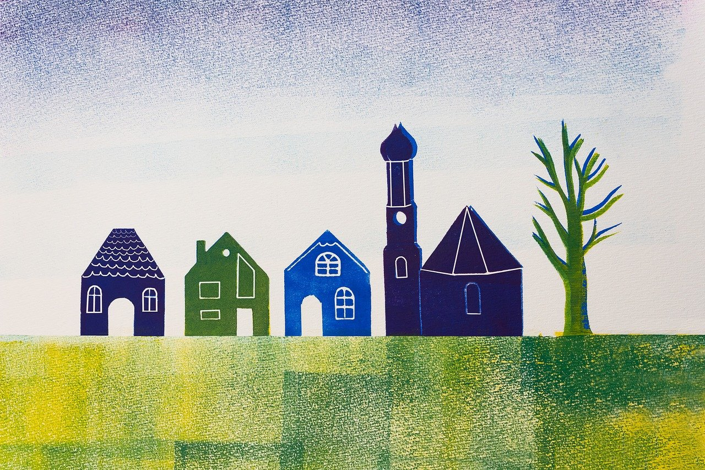
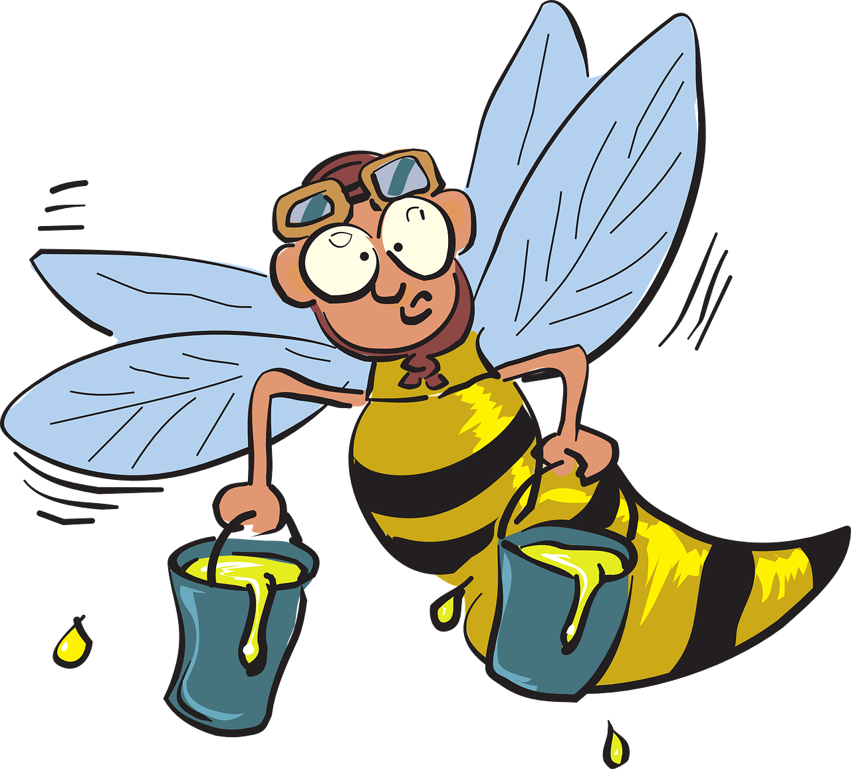
Vokabeln
Sag die Wörter. Wie heißt das auf Englisch?
Wörter
holen
sitzen
stehen
das Dorf
[to fetch, fetching]
[to sit, sitting]
[to stand, standing]
[village]
fertig
Dörfer
durch
[ready, finished]
[villages]
[through]
Notes:
Timing: 2 minutes
Aim: to present and practise new vocabulary for this week.
Procedure:
Click to present the German word and pupils repeat the word.
Click to present the English meaning and image. Pupils repeat the German meaning.
Click to remove the English meaning and image. Pupils recall the English meaning.
Click to remove the German meaning. Pupils recall the German meaning.
7

Slide 8
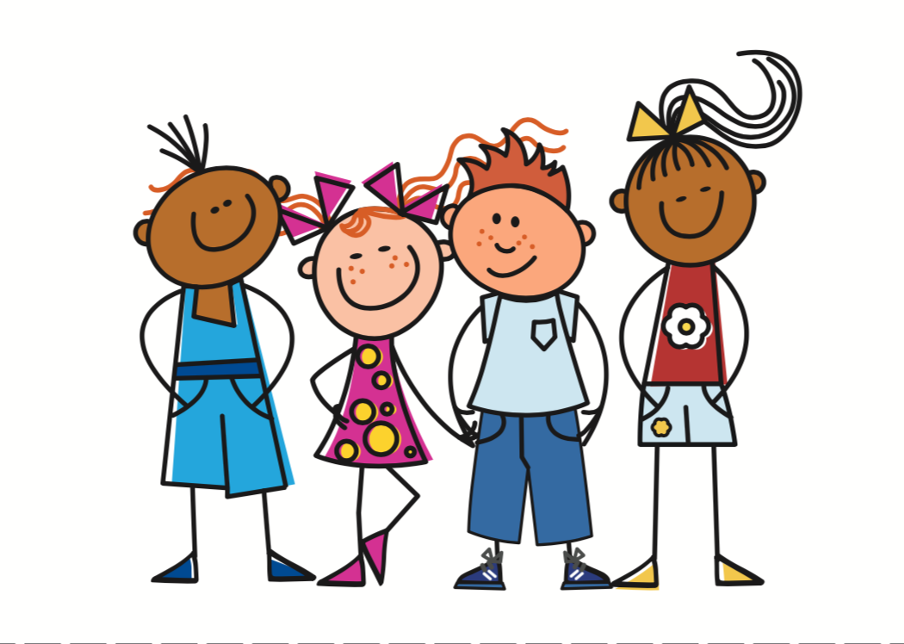
Present tense: ihr (you all)
You have practised the endings for plural subjects ‘we’ and ‘they’:
Wir sitzen im Garten.
We sit/are sitting in the garden.
Sie sitzen im Garten.
They sit/are sitting in the garden.
Both these plural forms are the same as the infinitive.
To say ihr (you all) + regular verb:
Ihr sitzt im Garten.
You (all) sit/are sitting in the
garden.
This is ‘you’ for talking to more than one person you know well or who is the same age as you.
Notes:
Timing: 2 minutes
Aim: to present the 2nd person plural form (‘you all’) of regular present tense.
Procedure:
Click through the animations to present the new information.
Elicit English translation for the German examples provided.
8

Slide 9
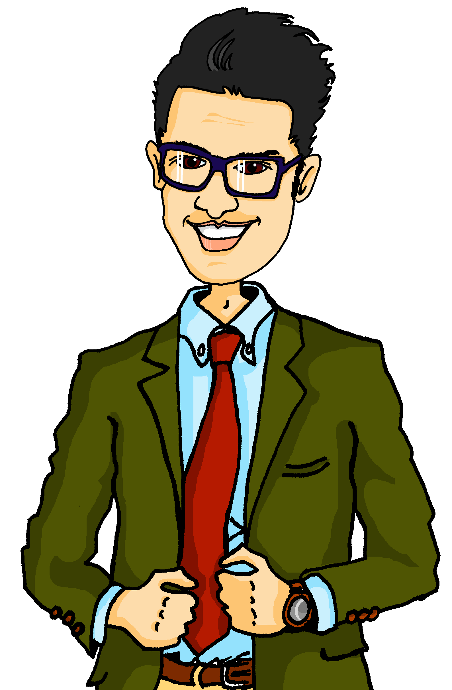
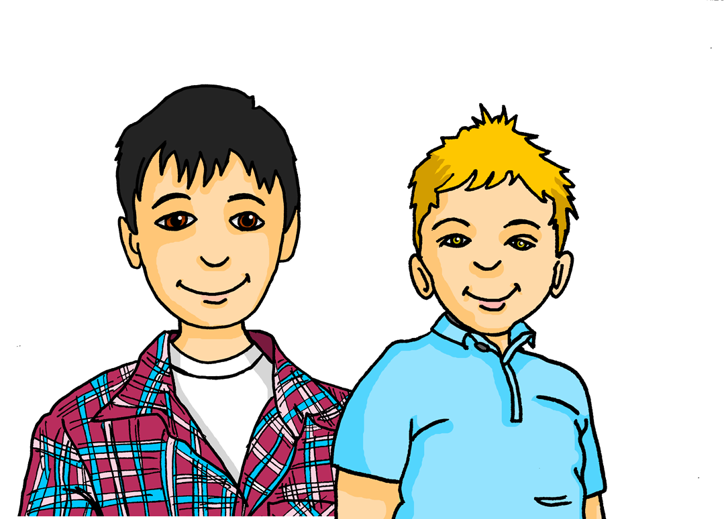
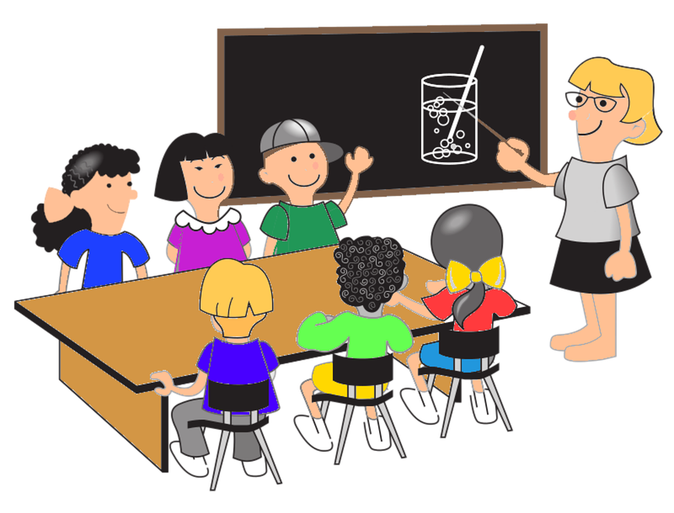
hören
Das Bücherfest
Herr Weber und die Schüler sind noch nicht fertig!
Was sagt Herr Weber? Was machen Herr Weber und die Schüler (wir) und Lias und Gabriel (ihr)?
 | wir (we) | ihr (you all) | activity?
1
fetch the tables
1
2
2
drive/go into town to buy snacks
3
3
find lovely/beautiful music for the book festival
4
4
write a song about a story
5
5
learn the song
6
6
write the prices in the books
Notes:
Timing: 8 minutes
Aim: to practise aural comprehension of 1st and 2nd person plural (we and you (all)) verb forms in the present tense.
Procedure:
1. Click to play number 1 as an example. Pupils note down whether the activity is being done by ‘we’ or ‘you all’ by listening carefully to the verb ending ‘en’ or ‘t’. They also note down in English what the activity is.
2. Repeat for numbers 2-6.
3. Click to reveal answers.
4. Extra: Can pupils accurately recreate the German sentences when giving answers?
Transcript:
1. Also, [ihr] holt die Tische.
2. [Wir] fahren in die Stadt und kaufen Snacks.
3. [Wir] finden schöne Musik für das Bücherfest.
4. [Ihr] schreibt ein Lied über eine Geschichte. 5. [Ihr] lernt das Lied. 6. Und [ihr] schreibt die Preise in die Bücher.
9

Slide 10
Fragen
To ask yes/no questions in German, you know to swap the verb and subject:
Wir spielen Musik.
We play/are playing music.
Spielen wir Musik?
Do we play music? Are we playing music?
And remember! To ask a wh-question, just add a question word in front.
Wo spielen wir Musik?
Where do we play music? Where are we playing music?
Wann spielen wir Musik?
When do we play music? When are we playing music?
Notes:
Timing: 2 minutes
Aim: to remind pupils about subject-verb inversion questions and wh-questions in German.
Procedure:
Click through the animations to present the new information.
Elicit English translation for the German examples provided.
10

Slide 11
lesen
Gabriel textet mit Lias. Wie geht’s auf dem Bücherfest?
Wer macht was? Schreib ‘wir’ (we) oder ‘ihr’ (you all)’.
1. Was macht ihr im Moment?
__
4. Wo seid ihr? Es ist dreizehn Uhr!
8. Durch das Dorf und die Stadt?! Seid ihr Sportler oder was?
__
__
2. Wir stehen in der Bibliothek. Wir singen bald* das Lied.
__
5. Wir sind noch* im Dorf. Das Auto ist kaputt*.
ohne mich - without me
noch – still
kaputt – broken
__
9. Und…wir tragen alle Harry Potter Kostüme!!!
__
__
6. Was? Wie fahrt ihr zur Schule?
3. Oh nein! Wir kommen zu spät! Ihr singt ohne mich*
__
__
7. Wir fahren mit dem Fahrrad.
__
__
Notes:
Timing: 6 minutes
Aim: to practise written comprehension of 1st and 2nd person plural (we and you (all)) verb forms in the present tense.
Procedure:
Explain the scenario: It’s the day of the book festival and Gabriel and his parents are running late. Gabriel is chatting to Lias over text to see what’s happening.
Pupils identify the correct subject (wir-we) or (ihr-you all) from the verb form used. Click to reveal the answers for each gap.
Pupils make notes on what Lias and his classmates are doing and what Gabriel and his parents are doing.
Elicit oral translations of each message.
Note: In no. 9 elicit from pupils what they think Kostüme means (costumes).
Vocabulary: texten [>5009]
Jones, R.L & Tschirner, E. (2019). A frequency dictionary of German: Core vocabulary for learners. London: Routledge.
11

Slide 12
schreiben
Gabriel und Lias sprechen über das Bücherfest.
Was ist die Frage? Was ist die Antwort? Schreib die richtige Verbform.
 | Frage | Antwort
1 | Holt ihr die Snacks? | Ja! Wir holen die Snacks.
2 | Singt ihr das Lied? | Nein. Wir singen nicht mehr*. Wir sind fertig.
3 | Wo steht ihr? | Wir stehen in der Bibliothek.
4 | Verkauft ihr Bücher? | Ja, wir verkaufen Bücher.
5 | Wann braucht ihr Hilfe? | Wir brauchen Hilfe jetzt!
6 | Wann seid ihr fertig? | Wir sind in einer Stunde fertig.
nicht mehr – not any more
Notes:
Timing: 6 minutes
Aim: to practise written production of the ‘wir’ and ‘ihr’ forms of the verb in the context of asking and answering questions.
Procedure:
Explain to pupils that Gabriel has now arrived at the book festival and is asking Lias about what is happening and how he can help.
Pupils must complete the answers (numbers 1-3) using the ‘wir’ form of the verb and the questions (numbers 4-6) using the ‘ihr’ form of the verb.
Note: For numbers 3 & 6, pupils are also expected to write the pronoun.
Elicit translations of each question & answer pair.
If time allows, pupils could practise the questions and answers in pairs, changing details if they can. E.g. Holt ihr Snacks? Nein! Wir holen Tische!
Note: no. 6 needs pupils to use (the irregular) verb sein. Pupils can translate ’fertig’ as ‘finished’ or ‘ready’
12

Slide 13
Tschüss!
grün
Notes:
13

