Slide 1
Interacting
Concerts and Shows
Kann ich helfen?
grün
Follow ups 1-5
Term 1 Week 7
Notes:
Artwork by Steve Clarke. Pronoun pictures from NCELP (www.ncelp.org). All additional pictures selected from Pixabay and are available under a Creative Commons license, no
attribution required.
Phonics:
[ei]
frei [318] ein [5] klein [114] sein [3] allein [258]
Vocabulary: Antwort [522] Baum [1013] Dorf [959] Fahrrad [2138] Farbe [1079] Form [307] Fußballspieler [n/a] Haus [147] Idee [451] Karte [1474] Land [134] Mädchen [602] Musiker [2577] Ort [341] Papier [1163] Partner [1172] Punkt [248] Satz [432] Schwimmbad, Schwimmbäder [n/a] Sportler [2565] keine² [46]
Revisit 1: dreizehn [4772] vierzehn [3950] fünfzehn [2858] sechzehn [4924] siebzehn [n/a] achtzehn [3741] neunzehn [n/a] zwanzig [1359] zweiundzwanzig [n/a] dreißig [2046] einunddreißig [n/a] an [19]
Jones, R.L & Tschirner, E. (2019). A frequency dictionary of German: Core vocabulary for learners. London: Routledge.
The frequency rankings for words that occur in this PowerPoint which have been previously introduced in these resources are given in the SOW and in the resources that first
introduced and formally re-visited those words.
For any other words that occur incidentally in this PowerPoint, frequency rankings will be provided in the notes field wherever possible.

Slide 2
Follow up 1:
Sag nur die Wörter mit der SSC [ie] oder langem [i].
Remember! Long [i] sounds the same as [ie]!
aussprechen
30
nein
Auf Wiedersehen
Papier
ihr
viel
Spieler
Haustier
wie geht’s?
Brief
S
die
lieb
Österreich
Lied
diese
lieben
Feier
spielen
sein
0
keine
Spielerin
START
Notes:
Timing: 5 minutes
Aim: to practise applying knowledge of [ie] to previously taught words.
Procedure: 1. Start the timer. Pupil A tries to read aloud all of the words with the SSC [ie], within the 30 seconds allowed.
2. Pupil B listens. If Pupil A says one of the other words by mistake, Pupil B can direct him/her to start again from the beginning. 3. They swap roles and repeat the task.

Slide 3
Follow up 2:

Schreib auf Englisch.
Can you get at least 15 points?
Wörter
 | an | sechzehn | einunddreißig
 | dreizehn | achtzehn | zweiundzwanzig
 | das Fahrrad | der Satz | die Form
 | die Farbe | das Papier | der Fußballspieler
 | das Schwimmbad | die Idee | die Schwimmbäder
 | keine | der Baum | die Karte
 | das Mädchen | der Ort | der Musiker
on
16
31
Vokabeln
x3
13
18
22
(the) bicycle, bike
(the) sentence
(the) shape
x2
(the) colour
(the) paper
(the) footballer
(the) swimming pool
(the) idea
(the) swimming pools
not (any) /no (pl)
(the) tree
(the) map
x1
(the) girl
(the) place
(the) musician
Notes:
Timing: 5 minutes
Aim: to practise written production of vocabulary from this and revisited weeks.
Procedure: 1. Give pupils a blank grid. They fill in the English meanings of any of the words they know, trying to reach 15 points in total. 2. Remind pupils that adjectives can refer to male or female persons and they should note this in their translations. E.g. pleased (f), short (m).
Note: The most recently learnt and practised words are pink, words from the previous week are green and those from week 1 are blue, thus more points are awarded for them, to recognise that memories fade and more effort (heavy lifting!) is needed to retrieve them.

Slide 4
Follow up 2:

Schreib auf Deutsch.
Can you get at least 15 points?
Wörter
 | 16 | 22 | 18
 | 31 | on | 13
 | (the) footballer | (the) paper | (the) colour
 | (the) shape | (the) sentence | (the) bicycle, bike
 | (the) musician | (the) tree | (the) map
 | (the) place | (the) idea | (the) swimming pools
 | (the) map | not (any) /no (pl) | (the) swimming pool
sechzehn
zweiundzwanzig
achtzehn
Vokabeln
x3
einunddreißig
an
dreizehn
der Fußballspieler
das Papier
die Farbe
x2
die Form
der Satz
das Fahrrad
der Musiker
der Baum
die Karte
die
Schwimmbäder
der Ort
die Idee
x1
die Karte
keine
das Schwimmbad
Notes:
Timing: 5 minutes
Aim: to practise written production of vocabulary from this and revisited weeks.
Procedure: 1. Give pupils a blank grid. They fill in the German meanings of any of the words they know, trying to reach 15 points in total. 2. Remind pupils that adjectives can refer to male or female persons and they should note this in their translations. E.g. pleased (f), short (m).
Note: The most recently learnt and practised words are pink, words from the previous week are green and those from week 1 are blue, thus more points are awarded for them, to recognise that memories fade and more effort (heavy lifting!) is needed to retrieve them.

Slide 5
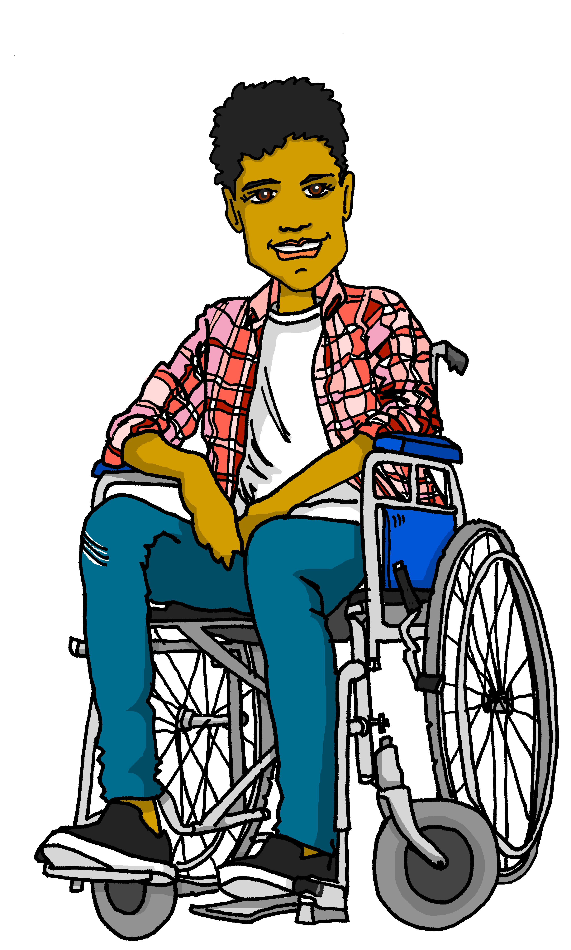
Follow up 3
Ravi schreibt auf Deutsch (und auf Englisch!)
Lies den Text und schreib die englischen Wörter auf Deutsch.
lesen
Hallo in der Schweiz! Ich [am called] Ravi. Ich [live] in Plymouth. Ich
[am learning] Deutsch, [but] ich [think], Deutsch
[is not] einfach!
Ich mag [swimming pools] und [football] . Mein Lieblingsfußballspieler ist Marcus Rashford. Ich [like] auch [colours] und [art]*. Ich kann meine Beine nicht benutzen und ich habe einen Rollstuhl* – er ist schnell*. Ich [like] meinen Rollstuhl*!
[Thank you] für die Deutschhilfe, bis bald,Ravi ☺
heiße
wohne
schreiben
lerne
aber
denke,
ist nicht
What is it called when German sticks two or more nouns together?
Schwimmbäder
Fußball
mag
Farben
Kunst*.
mag
Can you work out what it means? Are the two words cognates?
Danke
die Kunst – art |schnell – fast | der Stuhl - chair
Notes:
Timing: 8 minutes
Aim: to practise written production of previously taught vocabulary and verbs (1st person singular) and understanding of a longer text; to revisit previously taught vocabulary in a new longer written context.
Procedure:
Pupils write 1-13 and the correct German word for each English item.
Click on the image of Ravi to listen to the whole message and check answers. Click to reveal written answers, too.
Teacher uses questioning to ensure pupils’ understanding of the text. E.g. Tell me two things you know about Ravi now etc.
Vocabulary
Stuhl [1661]

Slide 6
Follow up 4

Schreib auf Englisch. [1/5]
hören
1
The partners are here.
Schreib!
Die Partner sind hier.
Notes:
Timing: 5 minutes (5 slides)
Aim: to practise aural comprehension of previously-taught words in short sentences.
Procedure:
Complete this first slide with pupils to model the activity.
Tell students this is a translation activity. They will hear a sentence twice and then need to write its meaning in English.
Click the audio button to hear the audio.
Click for the instruction ‘Schreib’ and pupils need to write the whole sentence.
Click to reveal the English meaning and again to reveal the original German sentence they heard. Note: teachers may prompt pupils to produce the German sentence from the English prompt for additional practice.
Repeat steps 3-6 with the remaining 4 slides.
Transcript: Die Partner sind hier.

Slide 7
Follow up 4

Schreib auf Englisch. [2/5]
hören
2
We have ten ideas.
Schreib!
Wir haben zehn Ideen.
Notes:
[2/5]
Procedure:
Click the audio button to hear the audio.
Click for the instruction ‘Schreib’ and pupils need to write the whole sentence.
Click to reveal the English meaning and again to reveal the original German sentence they heard. Note: teachers may first prompt pupils to produce the German sentence from the English prompt for additional practice.
Repeat steps 1-3 with the remaining 3 slides.
Transcript: Wir haben zehn Ideen.

Slide 8
Follow up 4

Schreib auf Englisch. [3/5]
hören
3
There are 18 colours in the classroom.
Schreib!
Es gibt achtzehn Farben im Klassenzimmer.
This compound is also a cognate, because it’s very similar to English ‘classroom’.
Notes:
[3/5]
Procedure:
Click the audio button to hear the audio.
Click for the instruction ‘Schreib’ and pupils need to write the whole sentence.
Click to reveal the English meaning and again to reveal the original German sentence they heard. Note: teachers may first prompt pupils to produce the German sentence from the English prompt for additional practice.
Repeat steps 1-3 with the remaining 2 slides.
Transcript: Es gibt achtzehn Farben im Klassenzimmer.

Slide 9
Follow up 4

Schreib auf Englisch. [4/5]
English often just puts two nouns next to each other.
hören
4
I like German. The German answers are easy.
Schreib!
Ich mag Deutsch. Die Deutschantworten sind einfach!
German usually joins the words together as one compound noun.
Notes:
[4/5]
Procedure:
Click the audio button to hear the audio.
Click for the instruction ‘Schreib’ and pupils need to write the whole sentence.
Click to reveal the English meaning and again to reveal the original German sentence they heard. Note: teachers may first prompt pupils to produce the German sentence from the English prompt for additional practice.
Repeat steps 1-3 with the remaining slide.
Transcript: Ich mag Deutsch. Die Deutschantworten sind einfach!

Slide 10
Follow up 4

Schreib auf Englisch. [5/5]
hören
5
I learn/am learning sentences and I can read stories.
Schreib!
Ich lerne Sätze und ich kann Geschichten lesen.
Notes:
[5/5]
Procedure:
Click the audio button to hear the audio.
Click for the instruction ‘Schreib’ and pupils need to write the whole sentence.
Click to reveal the English meaning and again to reveal the original German sentence they heard. Note: teachers may first prompt pupils to produce the German sentence from the English prompt for additional practice.
Transcript: Ich lerne Sätze und ich kann Geschichten lesen.

Slide 11
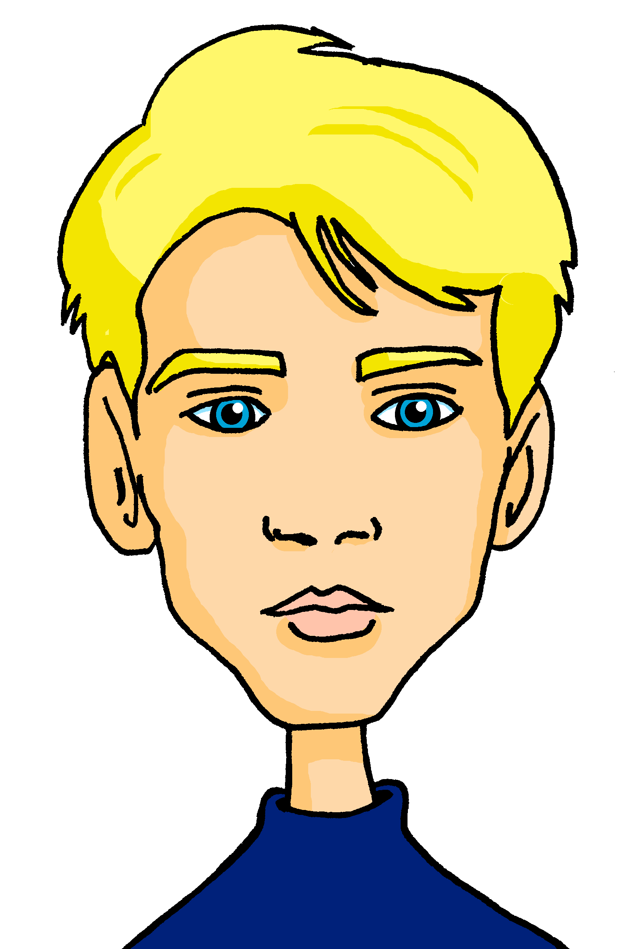
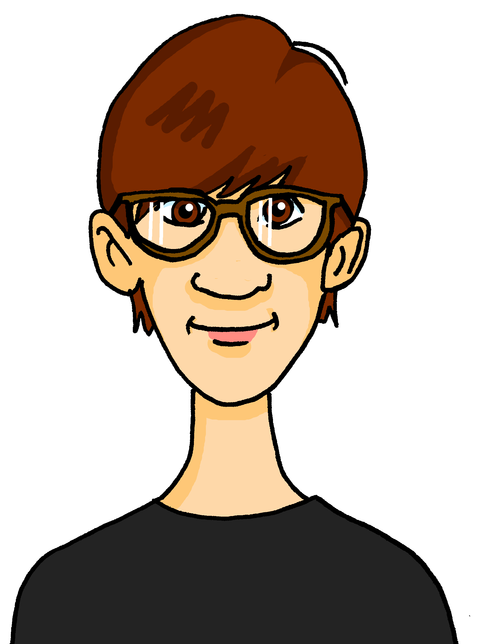
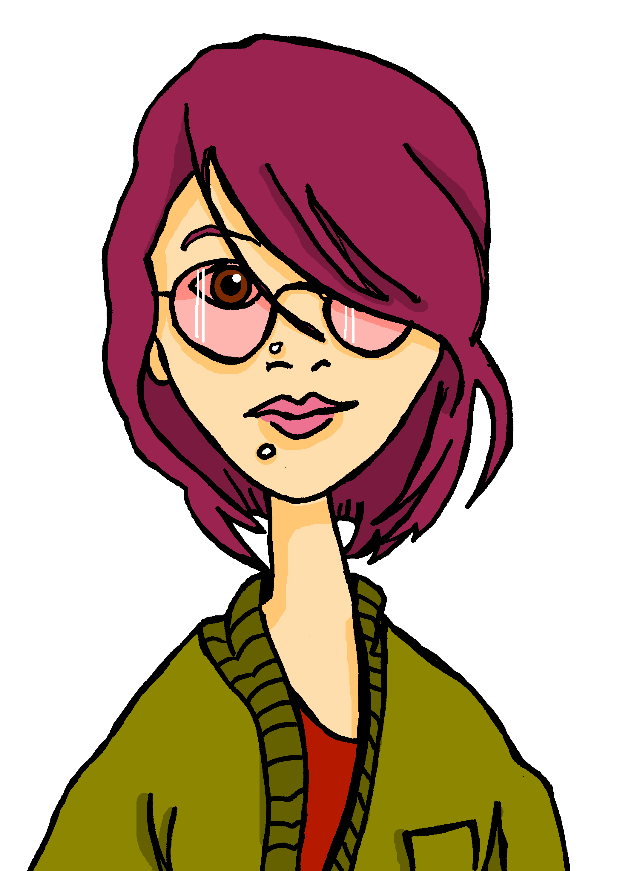
Follow up 5a
Rede mit deinem Partner/deiner Partnerin.
sprechen
13
30
3
Beispiel:
Person A: Hast du drei Farben? Person B: Ja. Person A: Bist du Matteo? Person B: Nein!
Person A: Hast du drei Karten? Person B: Nein, ich habe keine Karten.
Person A: Ah, du bist Lias!
30
13
Gabriel
Mariem
Barbara
3
3
3
3
Lias
Matteo
Emil
13
3
13
30
13
Jana
Clara
Ronja
Notes:
[1/2]
Timing: 5 minutes (two slides)
Aim: to practise spoken production of vocabulary and structures from this week and previous learning; in particular, the use of ‘keine’ with plural nouns.
Procedure:
Person B chooses a person to be.
Person A asks yes/no questions about the two items (Karten and Farben) to work out who B is. Perhaps remind pupils that they know multiple meanings of ‘Karte’ and elicit them.
Pupils can answer yes/ no but if they have ‘none’ of an item, they need to say so (i.e., Nein, ich habe keine…)
They want their partner to guess so that they can do more rounds of the game. They can spend 2 minutes on this slide and then move to the next slide for different items and no prompts on slide.

Slide 12
Follow up 5b
Rede mit deinem Partner/deiner Partnerin.
sprechen
3
30
3
30
13
Gabriel
Mariem
Barbara
3
3
3
3
Lias
Matteo
Emil
13
3
13
30
13
Jana
Clara
Ronja
Notes:
[2/2]
This slide has no clues.
Pupils are asking about ‘Ideen’ and ‘Fahrräder’ this time.

Slide 13
Tschüss!
grün
Notes:
13

Slide 14
Follow up 2:

Schreib auf Englisch.
Can you get at least 15 points?
Wörter
 | an | sechzehn | einunddreißig
 | dreizehn | achtzehn | zweiundzwanzig
 | das Fahrrad | der Satz | die Form
 | die Farbe | das Papier | der Fußballspieler
 | das Schwimmbad | die Idee | die Schwimmbäder
 | keine | der Baum | die Karte
 | das Mädchen | der Ort | der Musiker
Vokabeln
x3
x2
x1
Notes:
TEMPLATE

Slide 15
Follow up 2:

Schreib auf Deutsch.
Can you get at least 15 points?
Wörter
 | 16 | 22 | 18
 | 31 | on | 13
 | (the) footballer | (the) paper | (the) colour
 | (the) shape | (the) sentence | (the) bicycle, bike
 | (the) musician | (the) tree | (the) map
 | (the) place | (the) idea | (the) swimming pools
 | (the) map | not (any) /no (pl) | (the) swimming pool
Vokabeln
x3
x2
x1
Notes:
TEMPLATE

