Slide 1
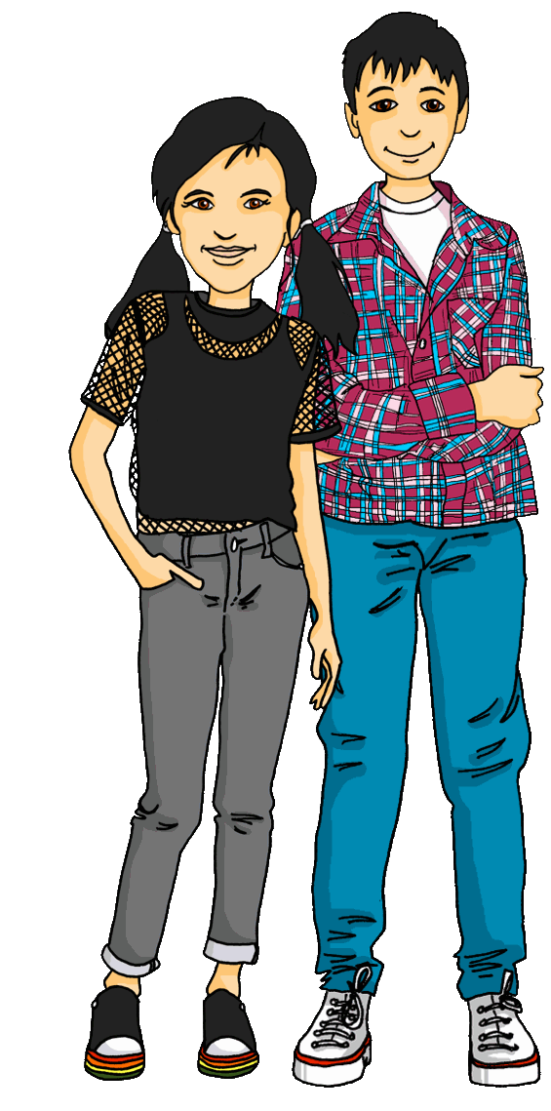
Interacting
Projekt*: die Schweiz
grün
Follow ups 1-5
Term 1 Week 8
Notes:
Artwork by Steve Clarke. Pronoun pictures from NCELP (www.ncelp.org). All additional pictures selected from Pixabay and are available under a Creative Commons license, no
attribution required.
Phonics:
revisit [ei] - frei [318] ein [5] klein [114] sein [3] allein [258]
revisit [ie] - Brief [838] Liebe [844] sie [7]
Vocabulary: alles [36] alle [36] viele [56] Baum [1013] Blume [2463] Buch [300] Essen1 [323] Fußballspieler [n/a] Haus [147] Käse [4094] Kultur [594] Land2 [134] Satz [432] Schule [359] See [1317] Seen [1317] Song [3373] Sport [945]
Revisit 1: bekommen [212] benutzen [1119] brauchen [179] erklären [238] kennen [216] lernen [288] lieben [701] schreiben [184] schwimmen [1863] singen [1063] spielen [205] Geld [235] dieser, diese, dieses [24]
Jones, R.L & Tschirner, E. (2019). A frequency dictionary of German: Core vocabulary for learners. London: Routledge.
The frequency rankings for words that occur in this PowerPoint which have been previously introduced in these resources are given in the SOW and in the resources that first
introduced and formally re-visited those words.
For any other words that occur incidentally in this PowerPoint, frequency rankings will be provided in the notes field wherever possible.
Remember that at the start of the course (first three lessons of Rot/Gelb) pupils learnt language (for greetings and register taking) that can still be part of the lesson routines in upper KS2 (Blau/Grün). They are not re-taught, as we anticipate that teachers have built these in from early in lower KS2.

Slide 2
Follow up 1a
Word snake!
Put capitals on the nouns, then sort into [ei] and [ie].
Wörter
Vokabeln
[ei]
[ie]
dreizehn
Auf Wiedersehen
schreiben
Brief
Auf Wiedersehen
weiß
arbeiten
viele
Schweiz
dreizehn
heißt
sieben
arbeiten
schreiben
viele
heißt
Brief
eins
eins
weiß
sieben
Feier
Schweiz
Feier
Notes:
Slide 1 of 2
Timing: 5 minutes
Aim: to differentiate between [ei] and [ie]
Procedure: 1. Pairwork. One pupil turns away from board to listen, the other pupil reads out the words.
2. Pupil who listens says for each word whether they hear [ei] or [ie].
3. More challenging version: Pupil who listens transcribes the full word.
4. Click through solutions with all pupils facing the front again – first reveal the words, then the [ei] /[ie] sorting.
5. On next slide, pupils swap roles.
Note: if desired, teachers can click on the darker green text boxes to hear each word pronounced.

Slide 3
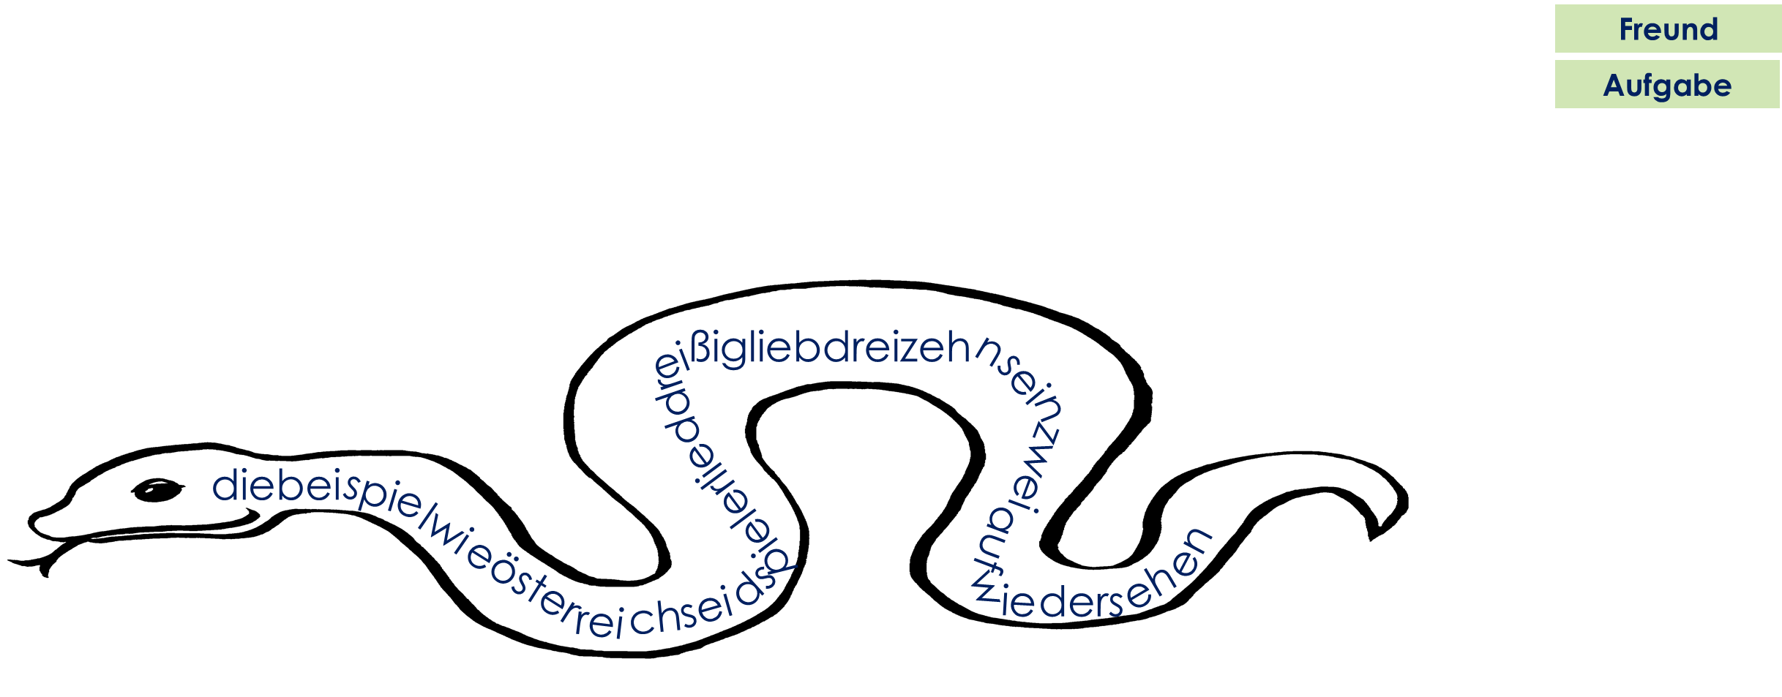
Follow up 1b
Word snake!
Put capitals on the nouns, then sort into [ei] and [ie].
Wörter
Vokabeln
[ei]
[ie]
Beispiel
die
Österreich
Beispiel
die
Lied
seid
wie
Beispiel
dreißig
dreißig
Spieler
wie
lieb
dreizehn
Lied
Östereich
dreizehn
sein
lieb
seid
sein
Auf Wiedersehen!
zwei
Auf Wiedersehen
Spieler
zwei
Notes:
2/2
Pupils swap roles
Note: if desired, teachers can click on the darker green text boxes to hear each word pronounced.

Slide 4
Words for ‘a’ (ein, eine, ein)
After haben and most other verbs, the words for ‘a’ are:
masculine
feminine
neuter
Wir haben
einen Baum
eine Blume
ein Haus
We have
a tree
a flower
a house
Ihr liebt
einen Fußball spieler
eine Farbe
ein Schwimmbad
You love
a colour
a swimming pool
a football player
Sie schreiben
einen Song
eine Antwort
ein Buch
They write
a song
an answer
a book
Notes:
Timing: 2 minutes
Aim: to revise the indefinite singular articles after ‘haben’ (and most other verbs)
Procedure:
Click through the animations to present the new information.
Elicit English translation for the German examples provided.
4

Slide 5
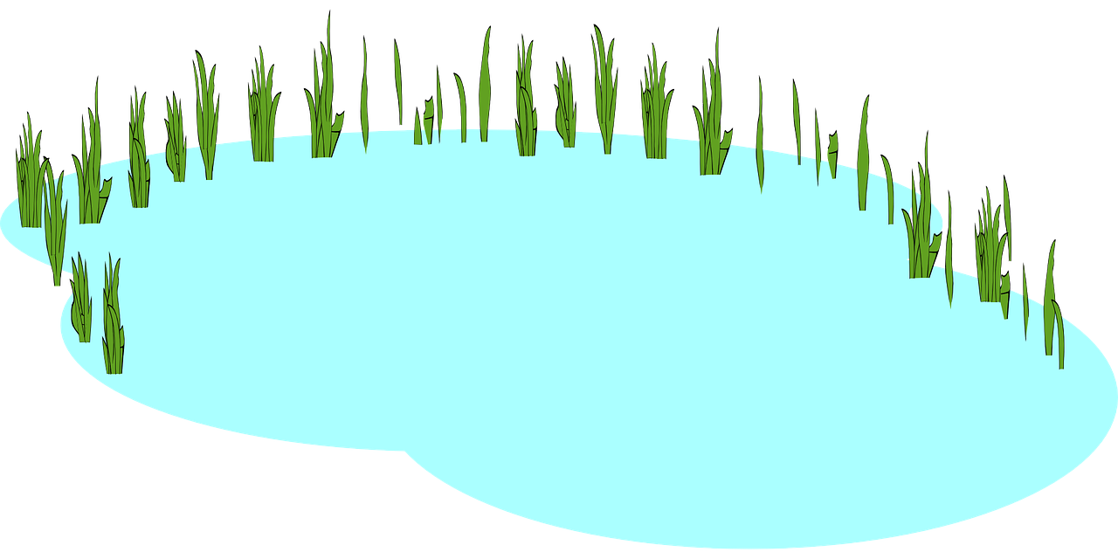
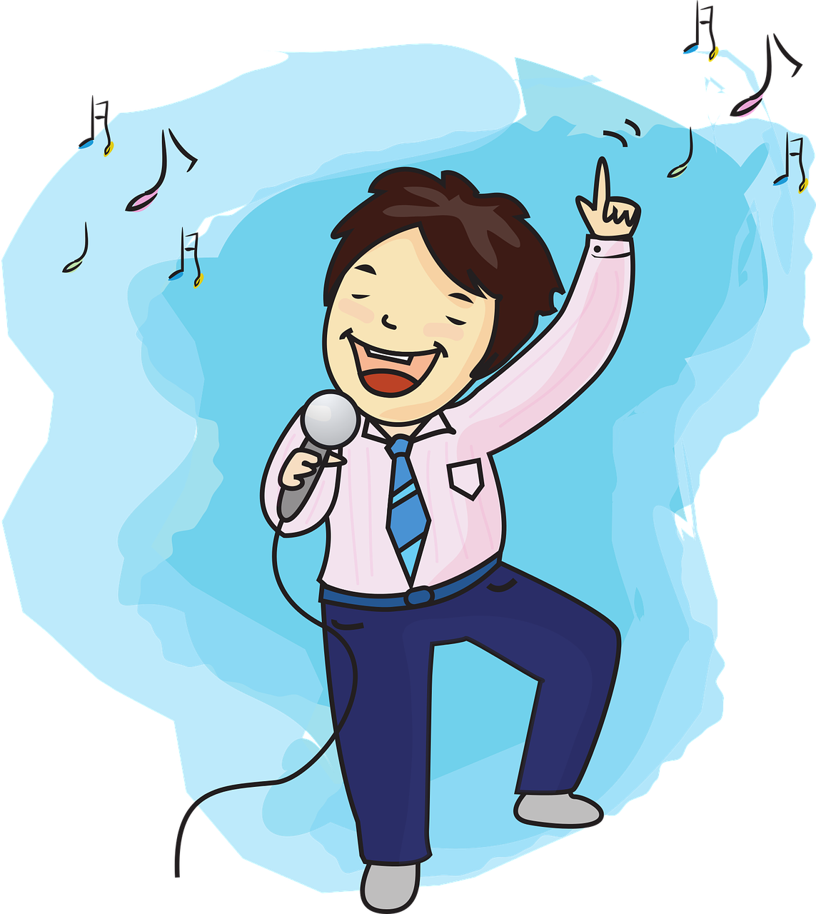
Follow up 2
Hör zu.
B Welches Bild ist richtig? Schreib A/B oder das Wort.
A Welches Wort ist das? Und auf Englisch?
A B
B.
Land | Länder
lots of countries
Baum
1 Ich habe einen…
hören
1
Blume | Blumen
lots of flowers
Buch.
2 Ich habe ein…
lesen
2
See | Seen
one lake
Schule
3 Ich habe eine…
3
Buch | Bücher
one book
See.
4 Ich habe einen…
4
Song | Songs
lots of songs
Song.
5 Ich habe einen…
5
Haus | Häuser
lots of houses
schreiben
Notes:
Timing: 5 minutes
Aim: to practise aural comprehension of the difference between one and many, to identify correct written indefinite article forms depending on gender of the noun.
Procedure:
Listening: Click on loudspeaker icon to listen.
Pupils circle the correct word (singular or plural) (if they have the sheet printed). If not, they can use numbers 1 and 2.
Click for answer.
Elicit English translation, click to bring up translation.
Reading:
5. Click for instructions.
6. Click for first item. Pupils decide based on gender of the noun which picture is the correct one. Elicit the answer.
7. Click for answer tick. Elicit the word – for a more challenging version, pupils can write down the correct word.
8. Click to bring up the written version of the correct word.
9. Continue for items 2-5.
Transcript: Beispiel: Wir haben viele [Länder].
Wir lieben viele [Blumen].
Wir kennen einen [See].
Wir schreiben ein [Buch].
Wir singen viele [Songs].
Wir brauchen viele [Häuser].

Slide 6
Follow up 3

Schreib die Wörter auf Deutsch und auf Englisch.
wir machen
Hello,
schreiben
_______ we are doing __ ____________ we are learning all about Switzerland!
Switzerland has _ __ __ _______.
All the people know ______ ____________.
There is a lot of countryside and ___ ___ _____.
___ ___ food is very good – there is a lot of cheese!
Hallo, __ _________ eine Präsentation: wir lernen ______ über die Schweiz!
Die Schweiz _____ ____ Kultur.
_____ Menschen kennen viele Sprachen.
Es gibt ____ _____ und viele Seen.
Alles ______ ist sehr gut – es gibt ____ ______
a
alles
presentation:
hat viel
a lot of culture
Alle
many
languages
viel Land
lots of lakes
Essen
All the
viel
Käse!
Notes:
Timing: 5-10 minutes
Aim: to practise written production of the plural forms of haben, viel, viele, alle and alles.
This is a jigsaw translation task.
Procedure:
Students write the missing words in both German and English to complete the sentences.
Teacher clicks to provide the written answers and/or clicks the audio buttons to hear the full German sentences.
Differentiation: 1. For a different challenge (i.e. to practise spelling rather than full written recall of the missing German words), the task could be completed as a transcription task initially, by listening to the full sentences and writing the words.
2. Then pupils could complete the English part of the jigsaw.

Slide 7
Follow up 4
Rede mit deinem Partner/deiner Partnerin.
sprechen
Beispiel:
B
Seen
A
1 | Seen | Baum
2
3
4
5
Wir haben viele…

We have lots of lakes.
Notes:
Example slide.
Timing: 5 minutes (two slides)
Aim: to practise viel/ viele with countable and uncountable plural nouns, and the plural forms of haben.
Procedure:
Click through the animations to explain the task. Person A says Wir haben viele…
Person B chooses the correct word out of two (Seen).
3. Person A write the whole sentence in English: We have lots of lakes.

Slide 8
Follow up 4a
Rede mit deinem Partner/deiner Partnerin.
A
…
sprechen
1. Wir haben viel…
2. Ihr habt viele…
3. Sie haben viele…
4. Wir haben viel…
5. Sie haben viele…
…
B
1 | Kultur | Songs
2 | Dörfer | Wasser
3 | Baum | Fußball-spieler
4 | Kuchen | Songs
5 | Papier | Farben

1. We have lots of culture.
2. You (all) have lots of villages.
3. They have lots of footballers.
4. We have lots of cake.
5. They have lots of colours.
Notes:
Round 1
Procedure:
Partner As turn away.
Click to bring up partner B’s prompts, which they copy down.
Partner Bs turn away.
Click to bring up Partner A’s prompts. Partner As say each of the 5 sentences.
Partner Bs listen out for viel or viele and provide the ending to Partner A’s sentences, depending on whether is it a countable/uncountable noun.
Partner As listen and write the full sentence that the they have jointly created, in English.
Partner Bs turn back to the board.
Click to reveal answers.
Move to the next slide to swap roles.
Note: the procedure is designed to avoid using paper/printing. However, if it is too time-consuming then pupils can be given their prompts on a paper handout. See the end of the presentation.

Slide 9
Follow up 4b
Rede mit deinem Partner/deiner Partnerin.
B
…
sprechen
1. Ihr habt viele…
2. Wir haben viel…
3. Sie haben viele…
4. Wir haben viele…
5. Ihr habt viel…
A
…
1 | Schwimmbäder | Musik
2 | Land | Fahrräder
3 | Häuser | Feier
4 | Essen | Musiker
5 | Sportler | Käse

1. You (all) have lots of swimming pools.
2. We have lots of countryside.
3. They have lots of houses.
4. We have lots of musicians.
5. You (all) have lots of cheese.
Notes:
Slide 2 of 2. Pupils swap roles.

Slide 10
Follow up 5:

Schreib auf Englisch.
Can you get at least 12 points?
Wörter
 | dieser | diese | dieses
 | schwimmen | singen | spielen
 | bekommen | benutzen | erklären
 | alles | alle | viele
 | der Käse | das Essen | die Kultur
 | das Land | der See | die Seen
this, that (f), these, those
x2
this, that (m)
this, that (nt)
Vokabeln
to swim, swimming
to sing, singing
to play, playing
to receive, receiving
to use, using
to explain, explaining
everything
all (of the)
many, lots of
(the) cheese
(the) food, meal
(the) culture
x1
(the) country, countryside
(the) lake
(the) lakes
Notes:
Timing: 5 minutes
Aim: to practise written production of vocabulary from this and revisited weeks.
Procedure: 1. Give pupils a blank grid. They fill in the English meanings of any of the words they know, trying to reach 15 points in total. 2. Remind pupils that adjectives can refer to male or female persons and they should note this in their translations. E.g. pleased (f), short (m).
Note: The most recently learnt and practised words are pink, words from the previous week are green and those from week 1 are blue, thus more points are awarded for them, to recognise that memories fade and more effort (heavy lifting!) is needed to retrieve them.

Slide 11
Follow up 5:

Schreib auf Deutsch.
Can you get at least 12 points?
Wörter
 | to use, using | to explain, explaining | to sing, singing
 | this, that (m) | to receive, receiving | this, that (f), these, those
 | this, that (nt) | to swim, swimming | to play, playing
 | (the) food,meal | the lakes | the lake
 | many, lots of | everything | (the) country, countryside
 | all (of the) | (the) culture | (the) cheese
benutzen
erklären
singen
Vokabeln
dieser
bekommen
diese
x2
dieses
schwimmen
spielen
das Essen
die Seen
der See
viele
alles
das Land
x1
alle
die Kultur
der Käse
Notes:
Timing: 5 minutes
Aim: to practise written production of vocabulary from this and revisited weeks.
Procedure: 1. Give pupils a blank grid. They fill in the English meanings of any of the words they know, trying to reach 15 points in total. 2. Remind pupils that adjectives can refer to male or female persons and they should note this in their translations. E.g. pleased (f), short (m).
Note: The most recently learnt and practised words are pink, words from the previous week are green and those from week 1 are blue, thus more points are awarded for them, to recognise that memories fade and more effort (heavy lifting!) is needed to retrieve them.

Slide 12
Tschüss!
grün
Notes:
12

Slide 13
Follow up 5:

Schreib auf Englisch.
Can you get at least 12 points?
Wörter
 | dieser | diese | dieses
 | schwimmen | singen | spielen
 | bekommen | benutzen | erklären
 | alles | alle | viele
 | der Käse | das Essen | die Kultur
 | das Land | der See | die Seen
x2
Vokabeln
x1
Notes:
Handout

Slide 14
Follow up 5:

Schreib auf Deutsch.
Can you get at least 12 points?
Wörter
 | to use, using | to explain, explaining | to sing, singing
 | this, that (m) | to receive, receiving | this, that (f), these, those
 | this, that (nt) | to swim, swimming | to play, playing
 | (the) food, meal | the lakes | the lake
 | many, lots of | everything | (the) country, countryside
 | all (of the) | (the) culture | (the) cheese
Vokabeln
x2
x1
Notes:
Handout

