Slide 1
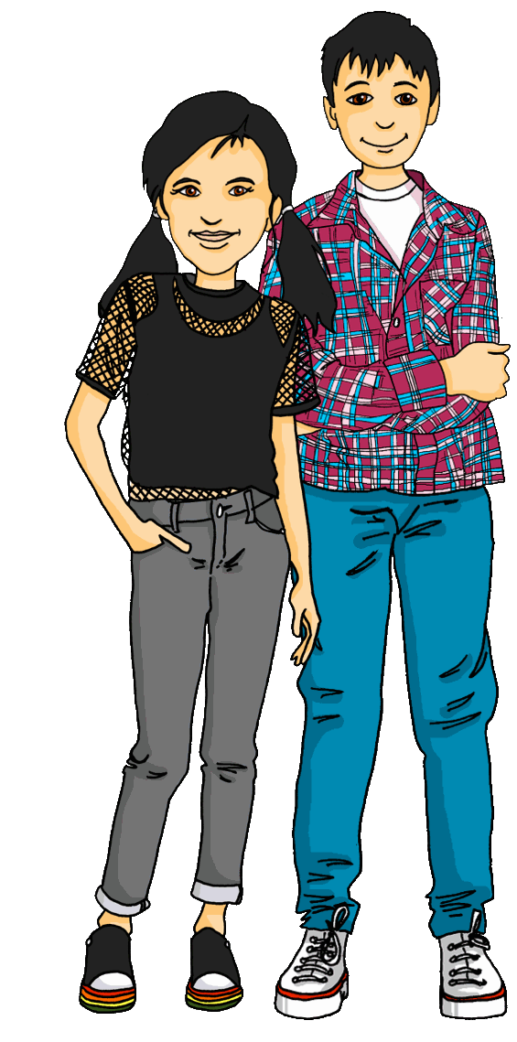
Interacting
Projekt*: die Schweiz
grün
HABEN – wir, ihr, sie
viel, viele, alle
SSC [ei] [ie]
das Projekt – project
Term 1 Week 8
Notes:
Artwork by Steve Clarke. Pronoun pictures from NCELP (www.ncelp.org). All additional pictures selected from Pixabay and are available under a Creative Commons license, no
attribution required.
Phonics:
revisit [ei] - frei [318] ein [5] klein [114] sein [3] allein [258]
revisit [ie] - Brief [838] Liebe [844] sie [7]
Vocabulary: alles [36] alle [36] viele [56] Baum [1013] Blume [2463] Buch [300] Essen1 [323] Fußballspieler [n/a] Haus [147] Käse [4094] Kultur [594] Land2 [134] Satz [432] Schule [359] See [1317] Seen [1317] Song [3373] Sport [945]
Revisit 1: bekommen [212] benutzen [1119] brauchen [179] erklären [238] kennen [216] lernen [288] lieben [701] schreiben [184] schwimmen [1863] singen [1063] spielen [205] Geld [235] dieser, diese, dieses [24]
Jones, R.L & Tschirner, E. (2019). A frequency dictionary of German: Core vocabulary for learners. London: Routledge.
The frequency rankings for words that occur in this PowerPoint which have been previously introduced in these resources are given in the SOW and in the resources that first
introduced and formally re-visited those words.
For any other words that occur incidentally in this PowerPoint, frequency rankings will be provided in the notes field wherever possible.
Remember that at the start of the course (first three lessons of Rot/Gelb) pupils learnt language (for greetings and register taking) that can still be part of the lesson routines in upper KS2 (Blau/Grün). They are not re-taught, as we anticipate that teachers have built these in from early in lower KS2.
1

Slide 2
aussprechen
[ei]
…
free
frei
Notes:
Timing: 1 minute
Aim: to revisit the SSC [ei].
Procedure:
Re-present the SSC [ei] and present the source word ‘frei’ (with gesture, if using).
Click to bring on the picture and get pupils to repeat the word ‘frei’ (with gesture, if using).
Note:
a gesture for frei’ might be to throw you hands up in the air and pretend to run away.
Vocabulary: frei [318
Jones, R.L & Tschirner, E. (2019). A frequency dictionary of German: Core vocabulary for learners. London: Routledge.
2

Slide 3
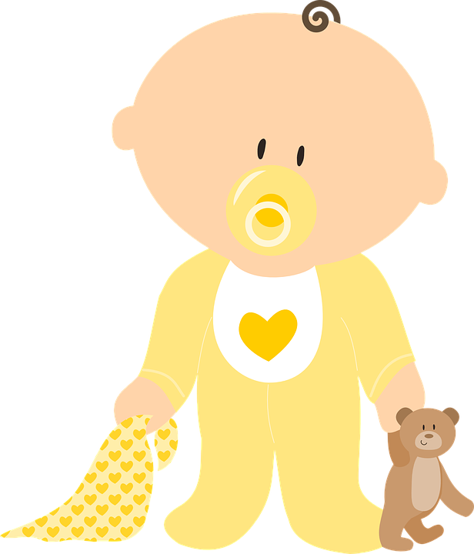
aussprechen
[ei]
…
frei
/a
sein
ein
alone
klein
allein
Notes:
Timing: 1 minute
Aim: to revisit the SSC [ei].
Procedure:
Re-present the SSC and the source word ‘frei’ (with gesture, if using).
Click to bring on the picture and get pupils to repeat the word ‘frei’ (with gesture, if using).
Present the cluster words in the same way, bringing on the picture and getting pupils to pronounce the words.
Vocabulary: frei [318] ein [5] klein [114] sein [3] allein [258]
Jones, R.L & Tschirner, E. (2019). A frequency dictionary of German: Core vocabulary for learners. London: Routledge.

Slide 4
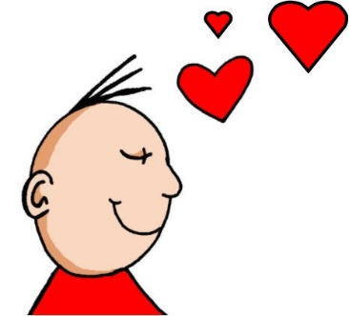
aussprechen
[ie]
…
Liebe
Notes:
Timing: 1 minute
Aim: to revisit the SSC [ie].
Procedure:
Re-present the SSC [ie] and present the source word ‘Liebe’ (with gesture, if using).
Click to bring on the picture and get pupils to repeat the word ‘Liebe’ (with gesture, if using).
Note:
A gesture for ‘Liebe’ might be to make a ‘heart’ shape with both hands approximately where your heart is in your body.
Liebe [844]
Jones, R.L & Tschirner, E. (2019). A frequency dictionary of German: Core vocabulary for learners. London: Routledge.
4

Slide 5
aussprechen
[ie]
…
sie
Liebe
Brief
Notes:
Timing: 1 minute
Aim: to revisit the SSC [ie].
Procedure:
Re-present the SSC and present the source word ‘Liebe’ (with gesture, if using).
Click to bring on the picture and get pupils to repeat the word ‘Liebe’ (with gesture, if using).
Present the cluster words in the same way, bringing on the picture and getting pupils to pronounce the words.
sie [7] Brief [838]
Jones, R.L & Tschirner, E. (2019). A frequency dictionary of German: Core vocabulary for learners. London: Routledge.
5

Slide 6
Vokabeln
Sag die Wörter auf Deutsch.
Wörter
das Haus
das Essen
der See
der Baum
die Seen
das Land
all
(of the)
(the) food/meal
(the) culture
(the) cheese
(the) school
(the) countryside
(the) house
(the) book
(the)
flower
(the) lakes
everything
(the) tree
(the) lake
many
das Buch
die Blume
die Schule
die Kultur
alle
der Käse
viele
alles
Notes:
Timing: 5 minutes
Aim: to present and practise new vocabulary for this week
Procedure:
Click to bring up the English clue for item 1 in the yellow star in the middle.
Click again for corresponding German word to change colour.
Say the word as it appears or play the recording.
Pupils repeat.
Continue for all items (14).
Order of words:
das Buch das Haus das Land der See der Käse die Seen die Kultur das Essen die Blume viele
alle der Baum die Schule alles
6

Slide 7
viel | viele (lots of)
Uncountable means you can’t put a number in front of it to make it plural e.g., money, luck.
Viel and viele both mean ‘lots of’.
Use viel with uncountable nouns.
E.g., two books, three prizes, four tables.
Remember! alles = everything and is not followed by a noun.
Use viele with countable nouns.
Ich habe viel Wasser.
I have lots of water.
Du hast viele Flaschen!
You have lots of bottles!
Ich?!? Du hast alle Flaschen!
Me?!? You have all (of) the bottles!
Notes:
Timing: 3 minutes
Aim: to introduce viel and viele.
Procedure:
Click through the animations to present the new information.
Elicit English translation for the German examples provided.
7

Slide 8
Grammatik
Ronja macht ein Projekt über* die Schweiz
Why would Ronja use apples in her Switzerland project?! Have a guess – we will come back to this later!
Was hat Ronja für das Projekt ? Viel oder viele?
viel (uncountable) | viele (countable)
To check whether a noun is countable or uncountable, try putting a number in front of the English word.
Musik
Äpfel
Musik
Äpfel
Wasser
Ideen
Wasser
Essen
Häuser
Ideen
Papier
Blätter
Häuser
Papier
Essen
Blätter
über – (here): about
Notes:
Timing: 5 minutes
Aim: to practise recognition of countable and uncountable nouns and their connection to viel | viele.
Procedure:
NB: ‘Essen’ is here used meaning ‘food’ (uncountable) not ‘meal’ (countable). ‘Blätter’ is used meaning ‘sheets’ (of paper).
Click through the animations to present the new information.
Elicit English translation for the German examples provided.
After Äpfel, click for callout foreshadowing the William Tell legend in the Kultur slide at the end of the lesson.
8

Slide 9
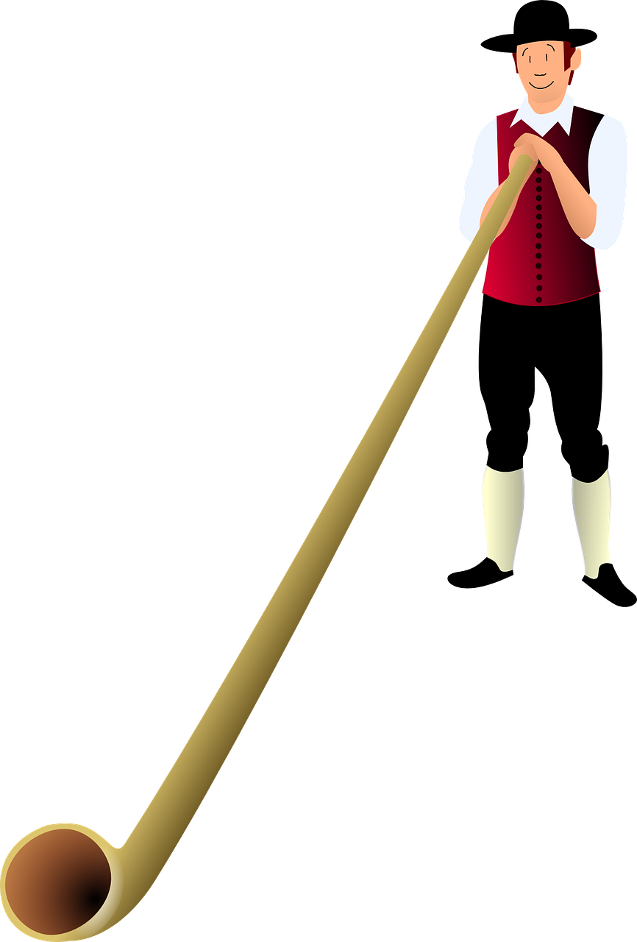
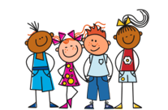
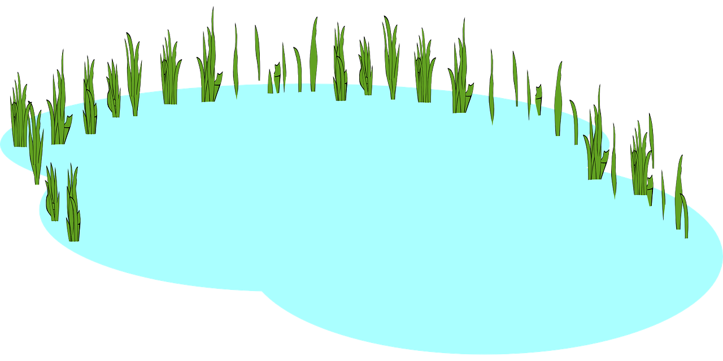
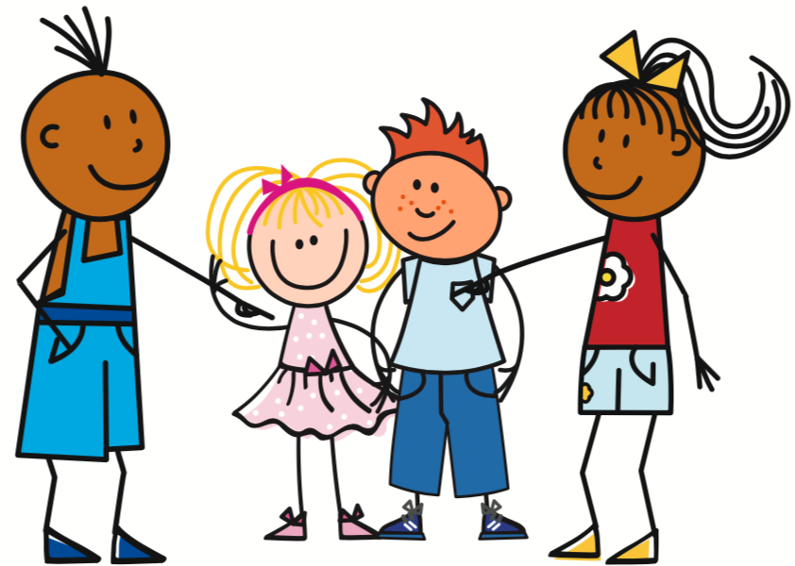
haben – wir, ihr, sie
In plural forms, haben (to have) works like other weak verbs you know.
we have
Wir haben…
viel Kultur.
We have lots of culture.
you (all) have
Ihr habt…
alle Seen.
You (all) have all the lakes.
they have
Sie haben…
viele Bücher.
They have lots of books.
Notes:
Timing: 2 minutes
Aim: to introduce the plural forms of the verb haben.
Procedure:
Click through the animations to present the new information.
Elicit German and English translations, as appropriate.
9

Slide 10
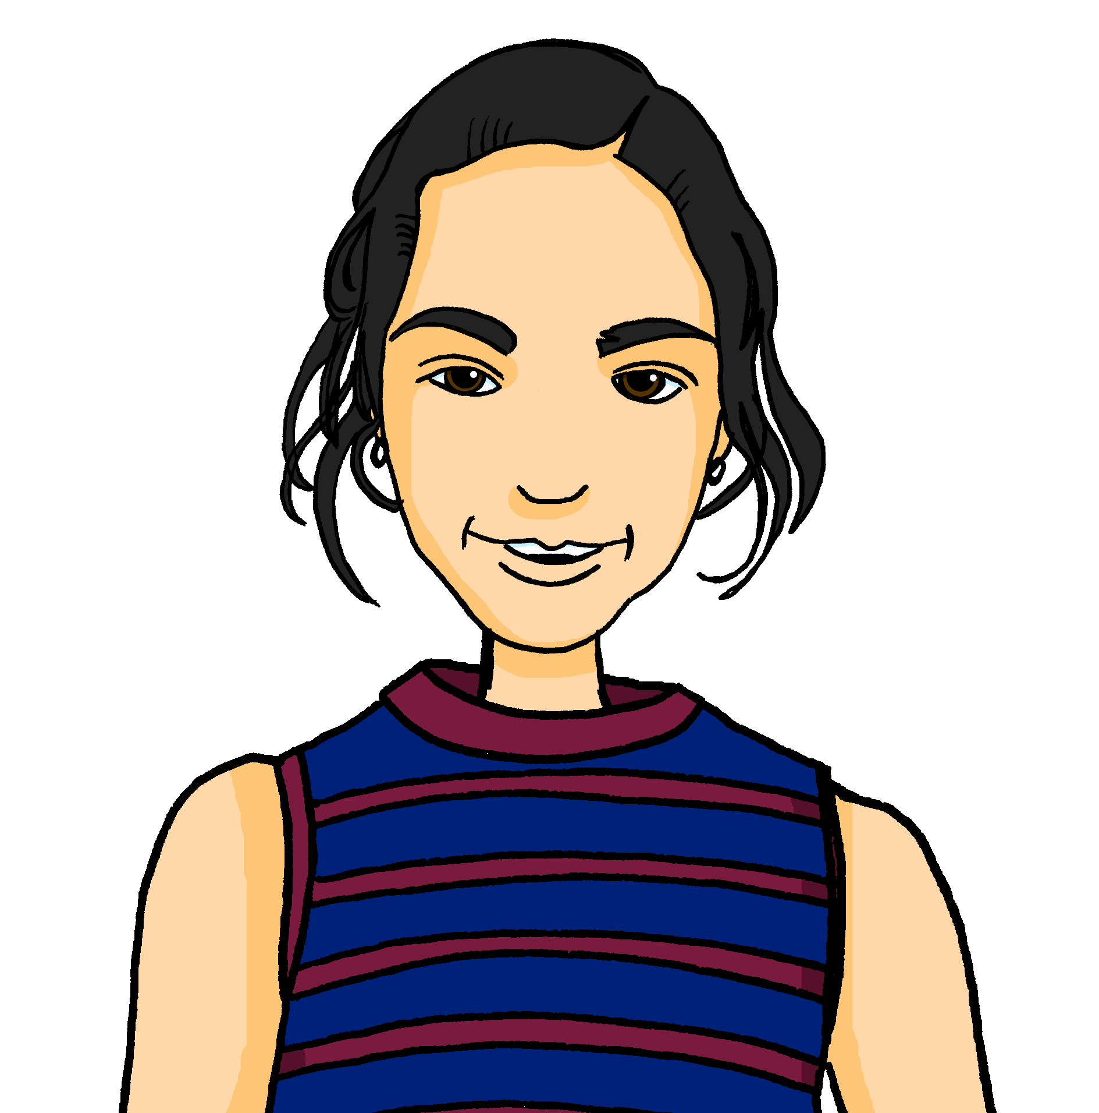
lesen
Gabriel und Mariem helfen Lias und Ronja. Habt ihr alles?
Wer hat was? Mach eine Liste 1-6 mit Objekt.
1
4
Wir haben viele
Fußballspieler | Käse
Wir haben viele See| Songs.
ihr (you all)
.
lots of culture
lots of lakes
2
5
lots of food
Ihr habt viel Blumen| Kultur.
Ihr habt viele Sport | Seen.
wir (we)
3
lots of footballers
6
Wir haben viel Bäume| Land.
Ihr habt viel Essen | Sätze.
lots of countryside
.
lots of songs
Notes:
Timing: 5 minutes
Aim: to practise written comprehension of ihr habt and wir haben and nouns new and previously taught.
Procedure:
Pupils write 1-6 and the correct English noun from the two options, under their two headings ‘ihr’ and ‘wir’.
Click to reveal answers.
In audio version, click on the numbered buttons to hear the full sentences, if desired.
10

Slide 11
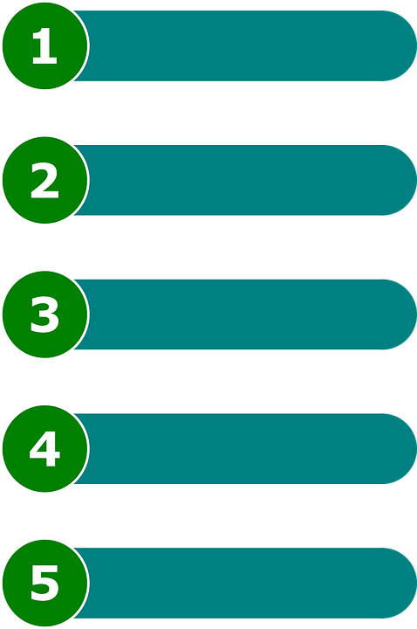
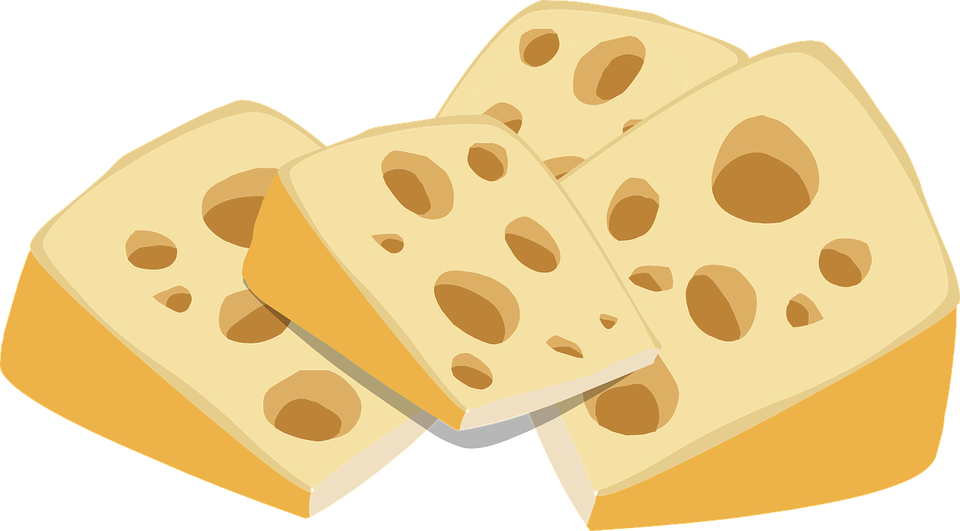
hören
Lias und Ronja machen eine Präsentation.
Hör zu. Welches Wort ist richtig? A oder B?
A | B
alles | alle
viele | viel
viele | viel
viele | viel
alle | alles
viele | viel
alles | alle
1
2
3
4
5
6
7
Präsentation – presentation
Notes:
Timing: 6 minutes
Aim: to practise aural comprehension of viel, viele, alle and their connection with countable and uncountable nouns and alles.
Procedure:
1. Explain that Lias and Ronja are giving a presentation about their country, Switzerland, to the class.
2. Explain that the audio keeps cutting in and out and that they need to decide which word out of the choices is in each bleeped gap.
3. Do the first one as an example. Click to bring up answer tick. NB the correct audio is attached to the answer tick! So make sure you click on the audio button first before clicking anywhere else, otherwise the answer tick and answer audio comes up before the task item.
4. Continue with items 2-7, elicit responses and click for the answer.
5. Elicit meanings orally in English.
Transcript:
1. Hallo! Wir machen eine Präsentation über die Schweiz. Wir sagen [alle] Sätze auf Deutsch.
2. Die Schweiz hat [viel] Musik. Wir mögen Rap, HipHop und Popsongs.
3. Wir haben auch [viel] Käse hier. Das Essen hier ist toll!
4. Es gibt auch [viele] Seen in der Schweiz. Das Land ist toll!
5. Die Schweiz hat [alles]! Hier ist es super!
6. Habt ihr [viele] Fragen?
7. Gibt es Probleme? Ja? Ok, wir erklären [alle] Sätze!
Vocabulary:
Präsentation [4335]
Jones, R.L & Tschirner, E. (2019). A frequency dictionary of German: Core vocabulary for learners. London: Routledge.
11

Slide 12
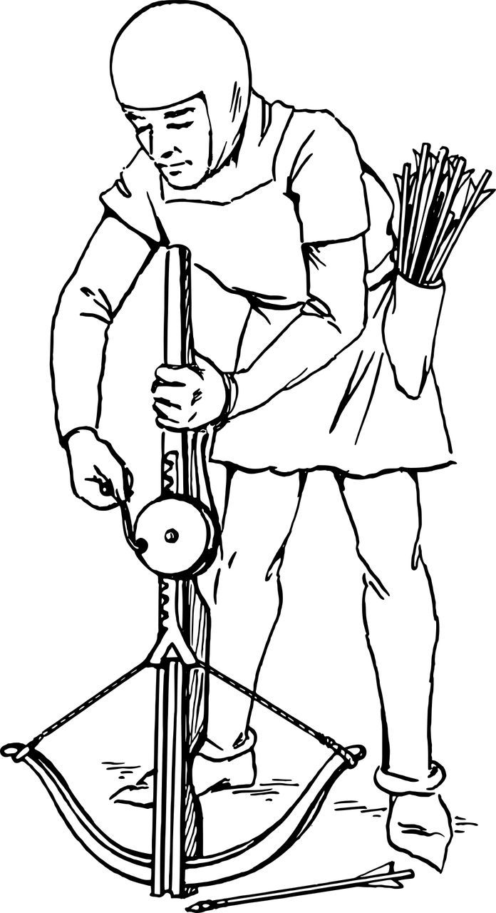
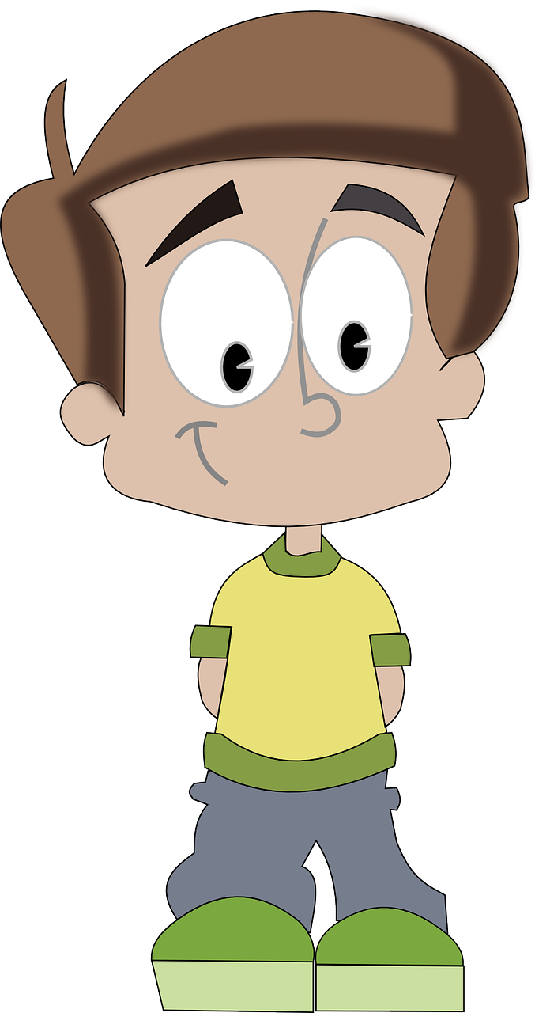
Kultur
Lies die Texte: In der Schweiz
das Volksheld – folk hero
der Sohn – son
schießen – to shoot
Wilhelm Tell
Wer ist Wilhem Tell? Er ist ein Volksheld* in der Schweiz. Er kann viel gut – er kann auch gut schießen*! Wilhelm hat einen Sohn*. Er heißt Walter. Walter hat einen Apfel auf dem Kopf. Wilhelm schießt den Apfel! Hurrah!
Do you remember Ronja used apples for the presentation about Switzerland? Now you are going to find out why!
Walter
In der Schweiz gibt es viele Sprachen*. Die Menschen kennen alle Sprachen gut:
Schweizer Deutsch , Französisch , Italienisch ,
und mehr. Welche Sprachen kennst du?
die Sprache – language
mehr – more.
Notes:
Timing: 5 minutes
Aim: to present cultural information on Switzerland , expanding on the previous slide.
Procedure:
Read the callout reminding pupils of Ronja using an apple for her presentation about Switzerland. Ask pupils why they think she may have used an apple.
Click again to bring up the two texts. Read the texts or play the recording.
Ensure pupils understand the general meaning.
Compare and contrast with countries pupils have experience of – UK and others. What folk heroes do you know? When are they supposed to have lived (Wilhelm Tell: 14th Century). What languages do people speak in countries you know?
Vocabulary:
auf [16] Französisch [816] Held [2447] Italienisch [593] mehr [52] schießen [1363] Schweizer [1247] Sohn [596] Sprache [421] Volk [1032]
Jones, R.L & Tschirner, E. (2019). A frequency dictionary of German: Core vocabulary for learners. London: Routledge.
12

Slide 13
Tschüss!
grün
Notes:
13

